Slide 1
Analyst Case Study
Rhodes Kirkpatrick

Slide 2
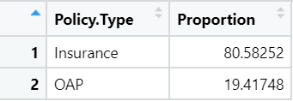
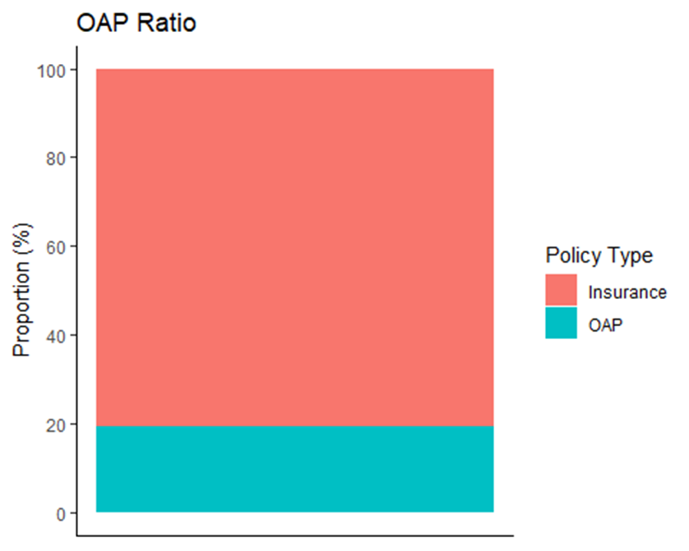
Splitting the Data and OAP Ratio
1st step - Splitting Data into 2 frames:
(OAP and Insurance)
OAP Ratio: 19% or ≈ 1:4

Slide 3
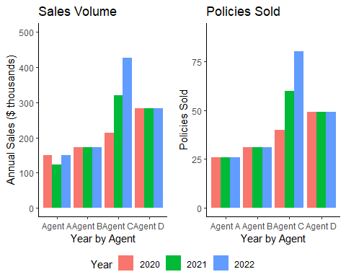
Agent Insurance Sales
Key Questions:
Why the Volume Dip for Agent A?
Why the Increase in Volume for Agent C?

Slide 4
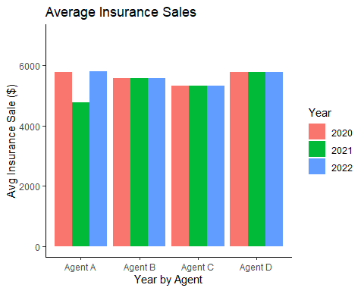
Average Sale Per Policy Per Agent
For Agent C: increase in sales 100% proportional to increase in volume
For Agent A: same # of policies sold, Average Sale 100% proportional to volume decrease

Slide 5
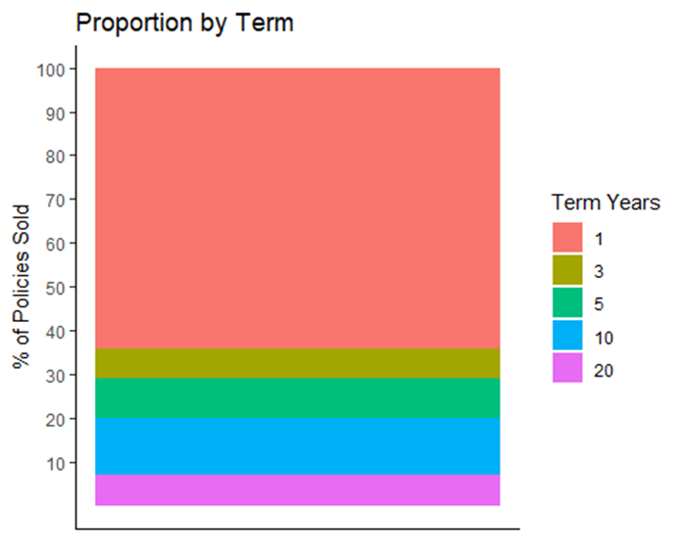
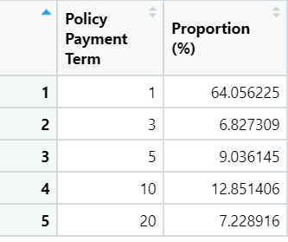
Proportion of 1 Year Payment Terms
1 Pay Mix of Business: ≈ 64%
Everything Else ≈ 36%

Slide 6
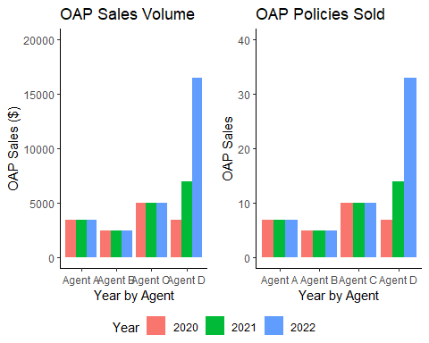
OAP Sales Volume and OAPs Sold by Agent by Year

Slide 7
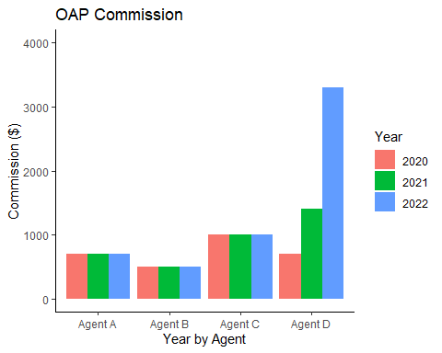
OAP Commission
Key Question: What is influencing this change?
- Fixed Earning so 100% proportional to Sales Volume.
- OAP is Fixed price so Sales is solely function of policies sold.
- Therefore, Commission is fully explained by policies sold.

Slide 8
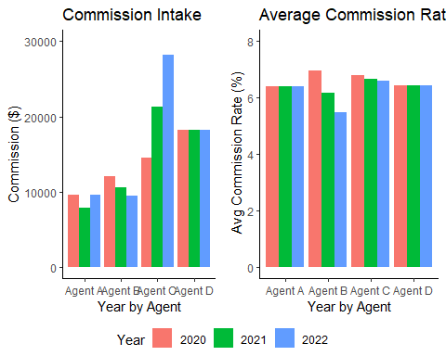

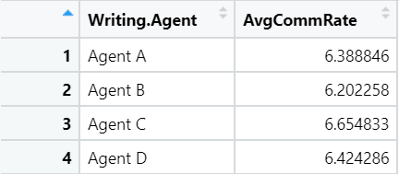

Commission Per Agent Per Year
e

Slide 9
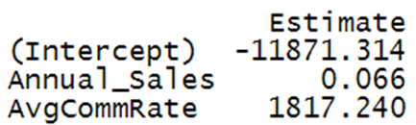
Commission Per Agent Per Year
e
Key Observations:
- Commission variation explained by Commission Rate and Sales Volume
- For Agent A, Earnings Dip in 21’ purely from Volume
- For Agent B, Sales Volume consistent, dips purely bc of Rate
- For Agent C, Rates decrease but overcome by huge Sales increase.

