Slide 1
PYTHON

Slide 2
Variables
Numbers
a = 10
b = 20
c = a + b
a += 5
Strings
a = “Hello”
b = “World”
c = a + b

Slide 3
Numbers and Strings
Numbers
a = 10 + 10
print a
20
Strings
b = “10” + “10”
print b
1010

Slide 4
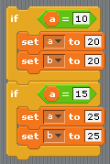
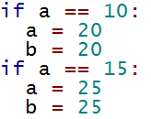
IF
Scratch
Python

Slide 5


WHILE
Scratch
Python

Slide 6
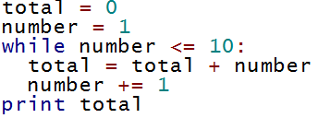

EXAMPLE 1
Print the sum of the numbers 1 to 10
Using range

