Slide 1
PROGRAM CONTROL

Slide 2
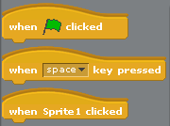
Simple control

Slide 3
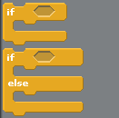



Other simple tests
Lots of different “operators”
Can be “nested”

Slide 4
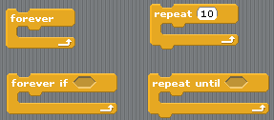
Repeating stuff
Lots of different ways of doing the same thing

