Slide 1
#Checklist
A title slide
A list of your visualizations and your role in their creation for the "Stock Profile" team
A visualization of the distribution of the stock prices for Netflix in 2017
A visualization and a summary of Netflix stock and revenue for the past four quarters and a summary
A visualization and a brief summary of their earned versus actual dividends
A visualization of Netflix stock against the Dow Jones stock (to get a sense of the market) in 2017

Slide 2
Netflix Stock Performance
Codeacademy Pro Capstone Project:
Data Visualization with Python
by Rhodri Williams
Notes:
A title slide

Slide 3
List of Visualizations
Stock Price Distribution
Quarterly Revenue & Earnings
Quarterly Dividends
Performance versus Market
The following analysis and graphics were created using Python 3 in Jupyter Notebook, using the matplotlib, pandas and seaborn modules.
The data used in this analysis was provided by CodeAcademy in the following files: DJI.csv, NFLX.csv, NFLX_daily_by_quarter.csv, as a sample of data taken from Yahoo Finance.
The data is comprised of monthly values from 2017.
Notes:
A list of your visualizations and your role in their creation for the "Stock Profile" team

Slide 4
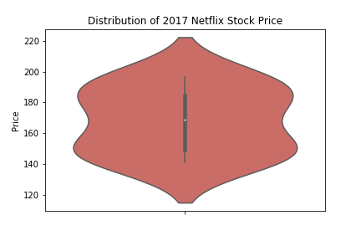
Stock Price Distribution
This violin plot describes the distribution of Netflix stock prices for 2017, including the high/low and median values.
For 2017, Netflix stock prices ranged from a low of $120 to a high of $220.
The median stock prices were around $170.
The majority of prices cleared between $140 and $180.
(Source: Codeacademy, Yahoo Finance).
Notes:
A visualization of the distribution of the stock prices for Netflix in 2017

Slide 5
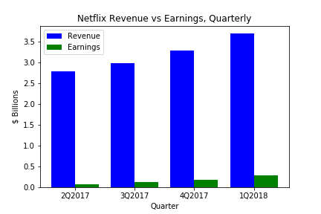
2. Quarterly Revenue & Earnings
This bar chart describes Netflix revenue (blue) versus earnings (green) for each quarter of 2017, in $ billions.
Revenue and earnings both increase each quarter, at a similar magnitude.
Earnings are around 2% to 7% of earnings through all quarters.
(Source: Codeacademy, Yahoo Finance).
Notes:
A visualization and a summary of Netflix stock and revenue for the past four quarters and a summary

Slide 6
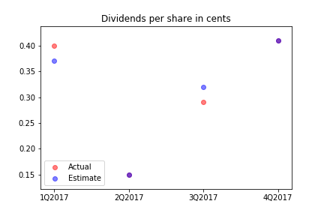
3. Quarterly Dividends
This graph describes actual dividends versus analyst estimates.
In 2Q2017 and 4Q2017 actual dividends were the same as estimated dividends (0.15/share)
Therefore the red (estimated) and blue (actual) plots overlap, creating a purple dot.
(Source: Codeacademy, Yahoo Finance).
Notes:
A visualization and a brief summary of their earned versus actual dividends

Slide 7
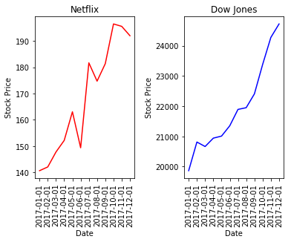
4. Performance versus Market
These subplots describe Netflix stock price (left, in red) versus the Dow Jones Industrial Average (right, in blue).
Overall, Netflix stock increased in value in line with the Dow Jones Industrial Average (DJIA).
Netflix was more volatile compared with the DJIA, with downward price movement in July and September 2017.
Netflix outperformed the DJIA, increasing 36.42% during 2017, compared to the DJIA increasing 24.44%.
(Source: Codeacademy, Yahoo Finance).
Notes:
A visualization of Netflix stock against the Dow Jones stock (to get a sense of the market) in 2017

