Slide 1
First model training has finished:
Model architecture of GN2.
Training on 30m jet training set.
Completed on LightGPU in about 22h.
Tested & plotted with puma.

Slide 2
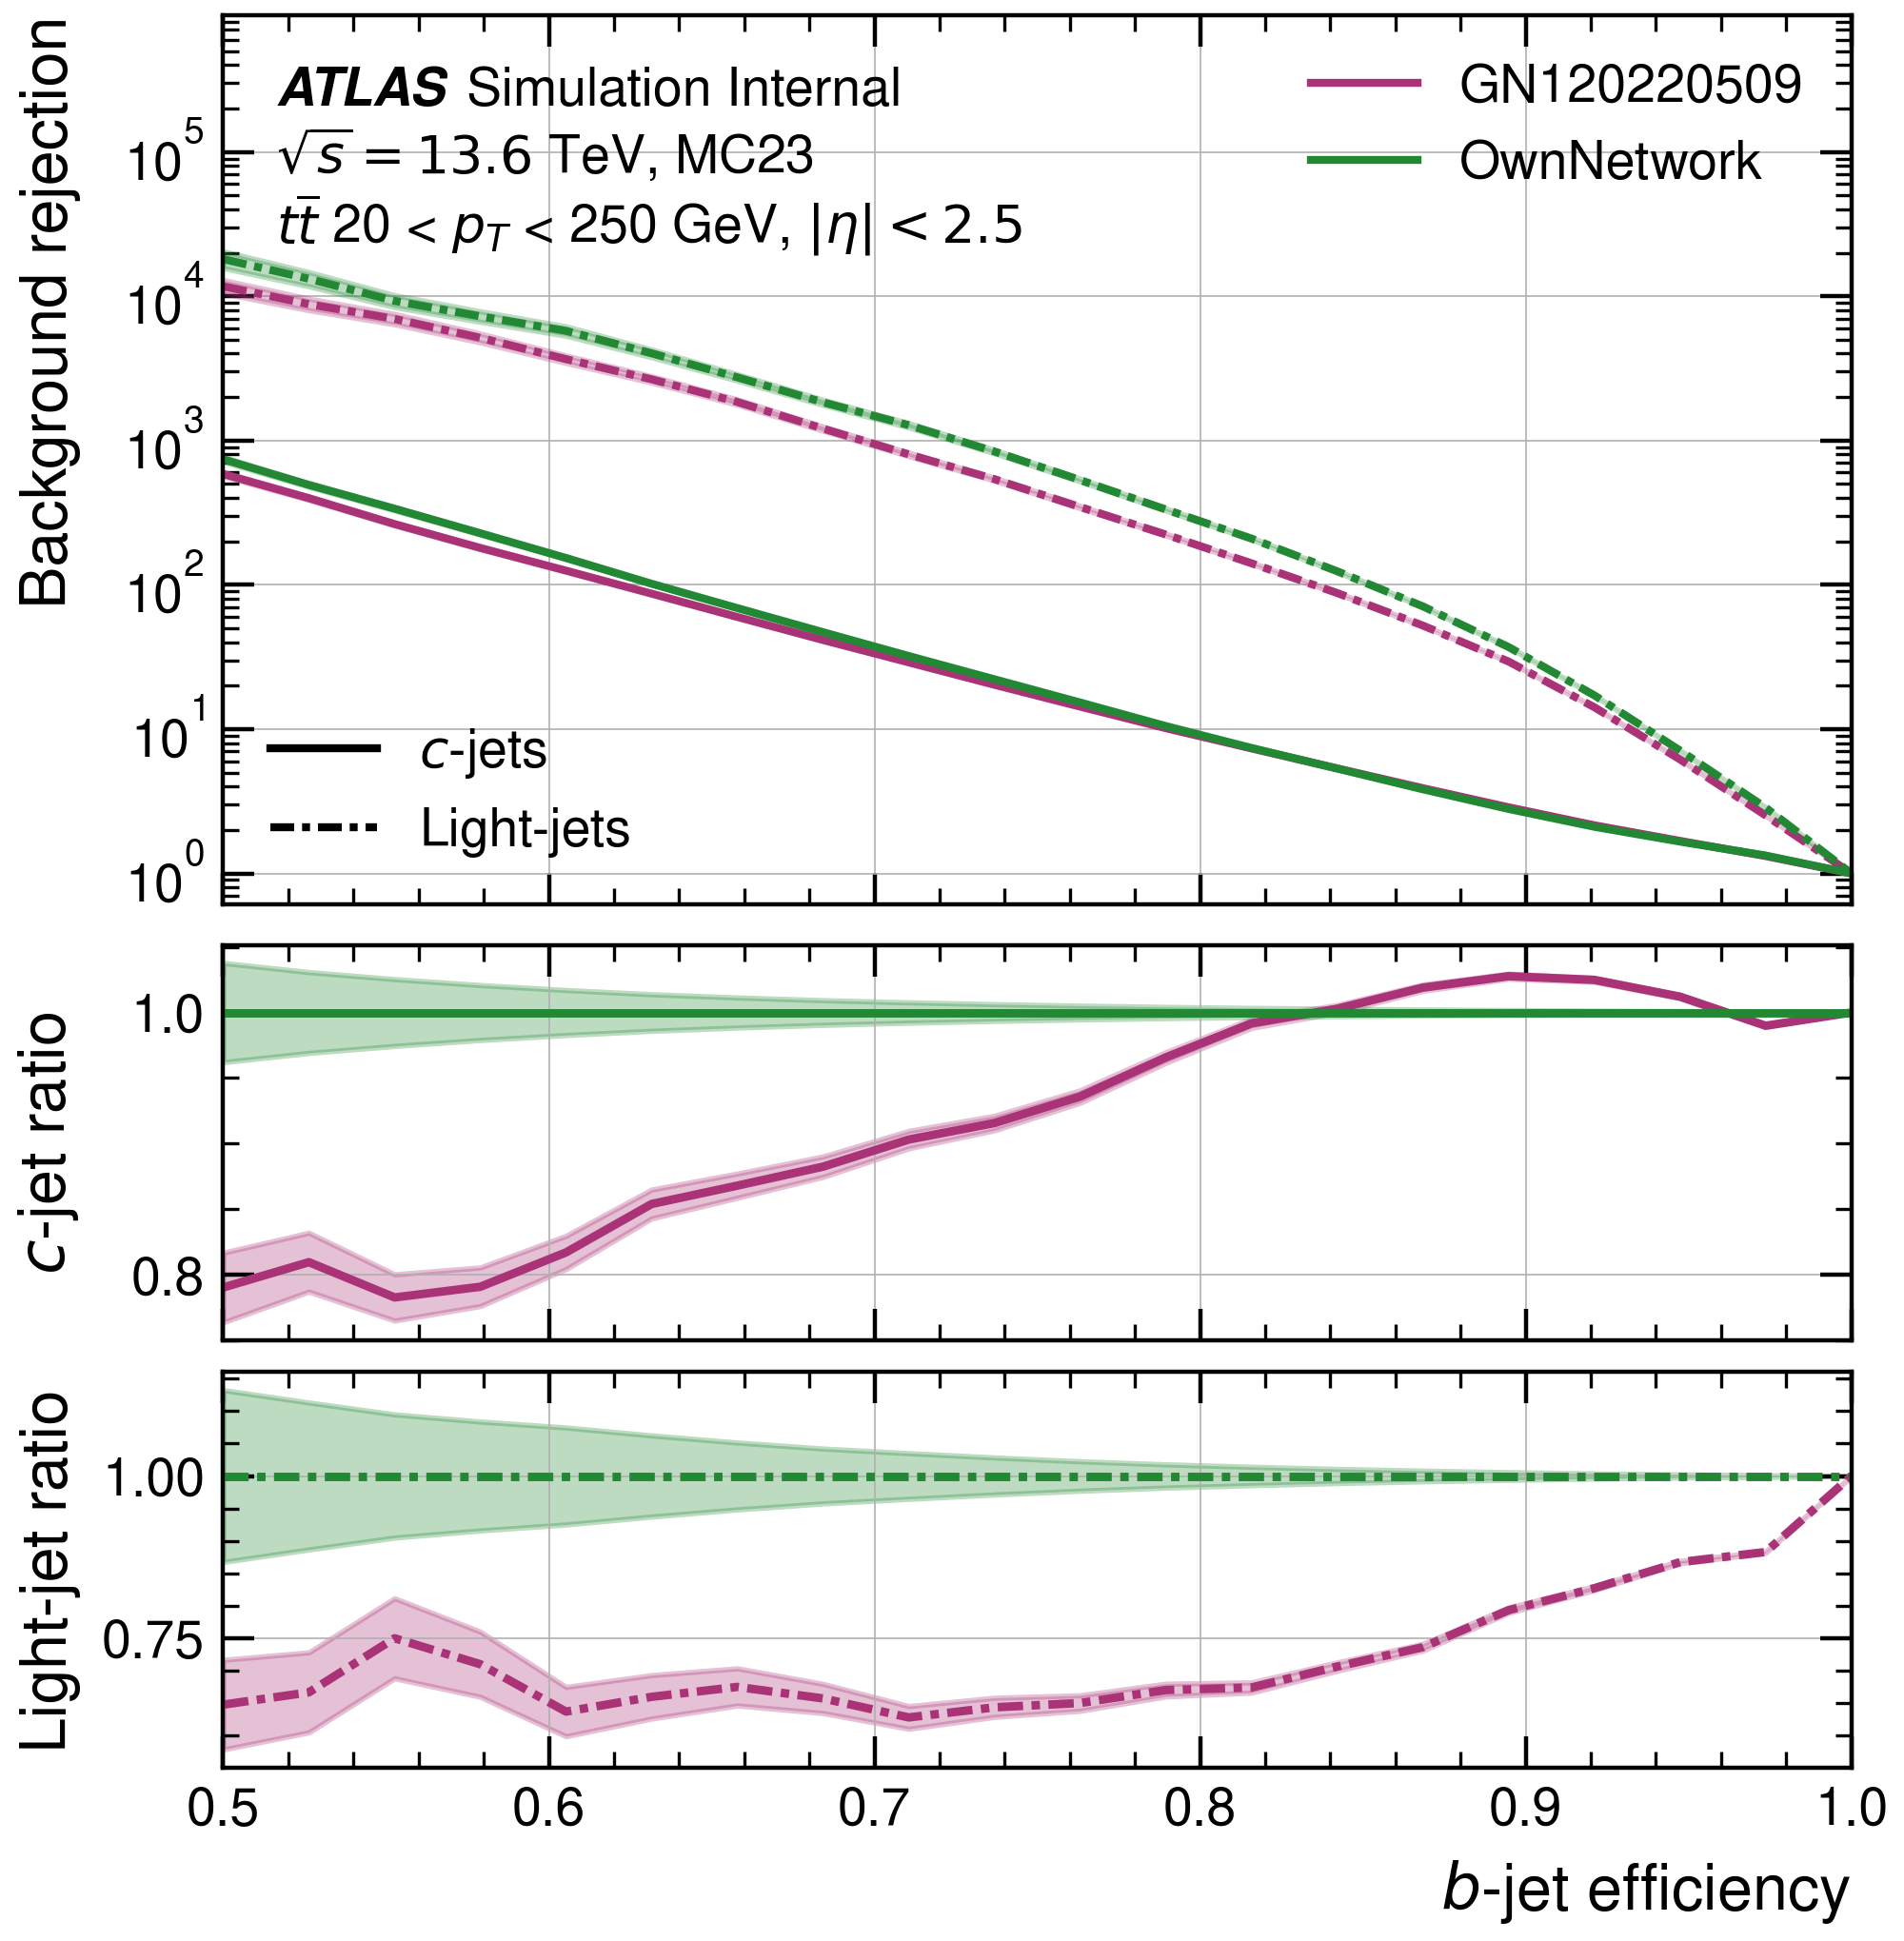

$t\overline{t}$-sample ROC Plot

Slide 3
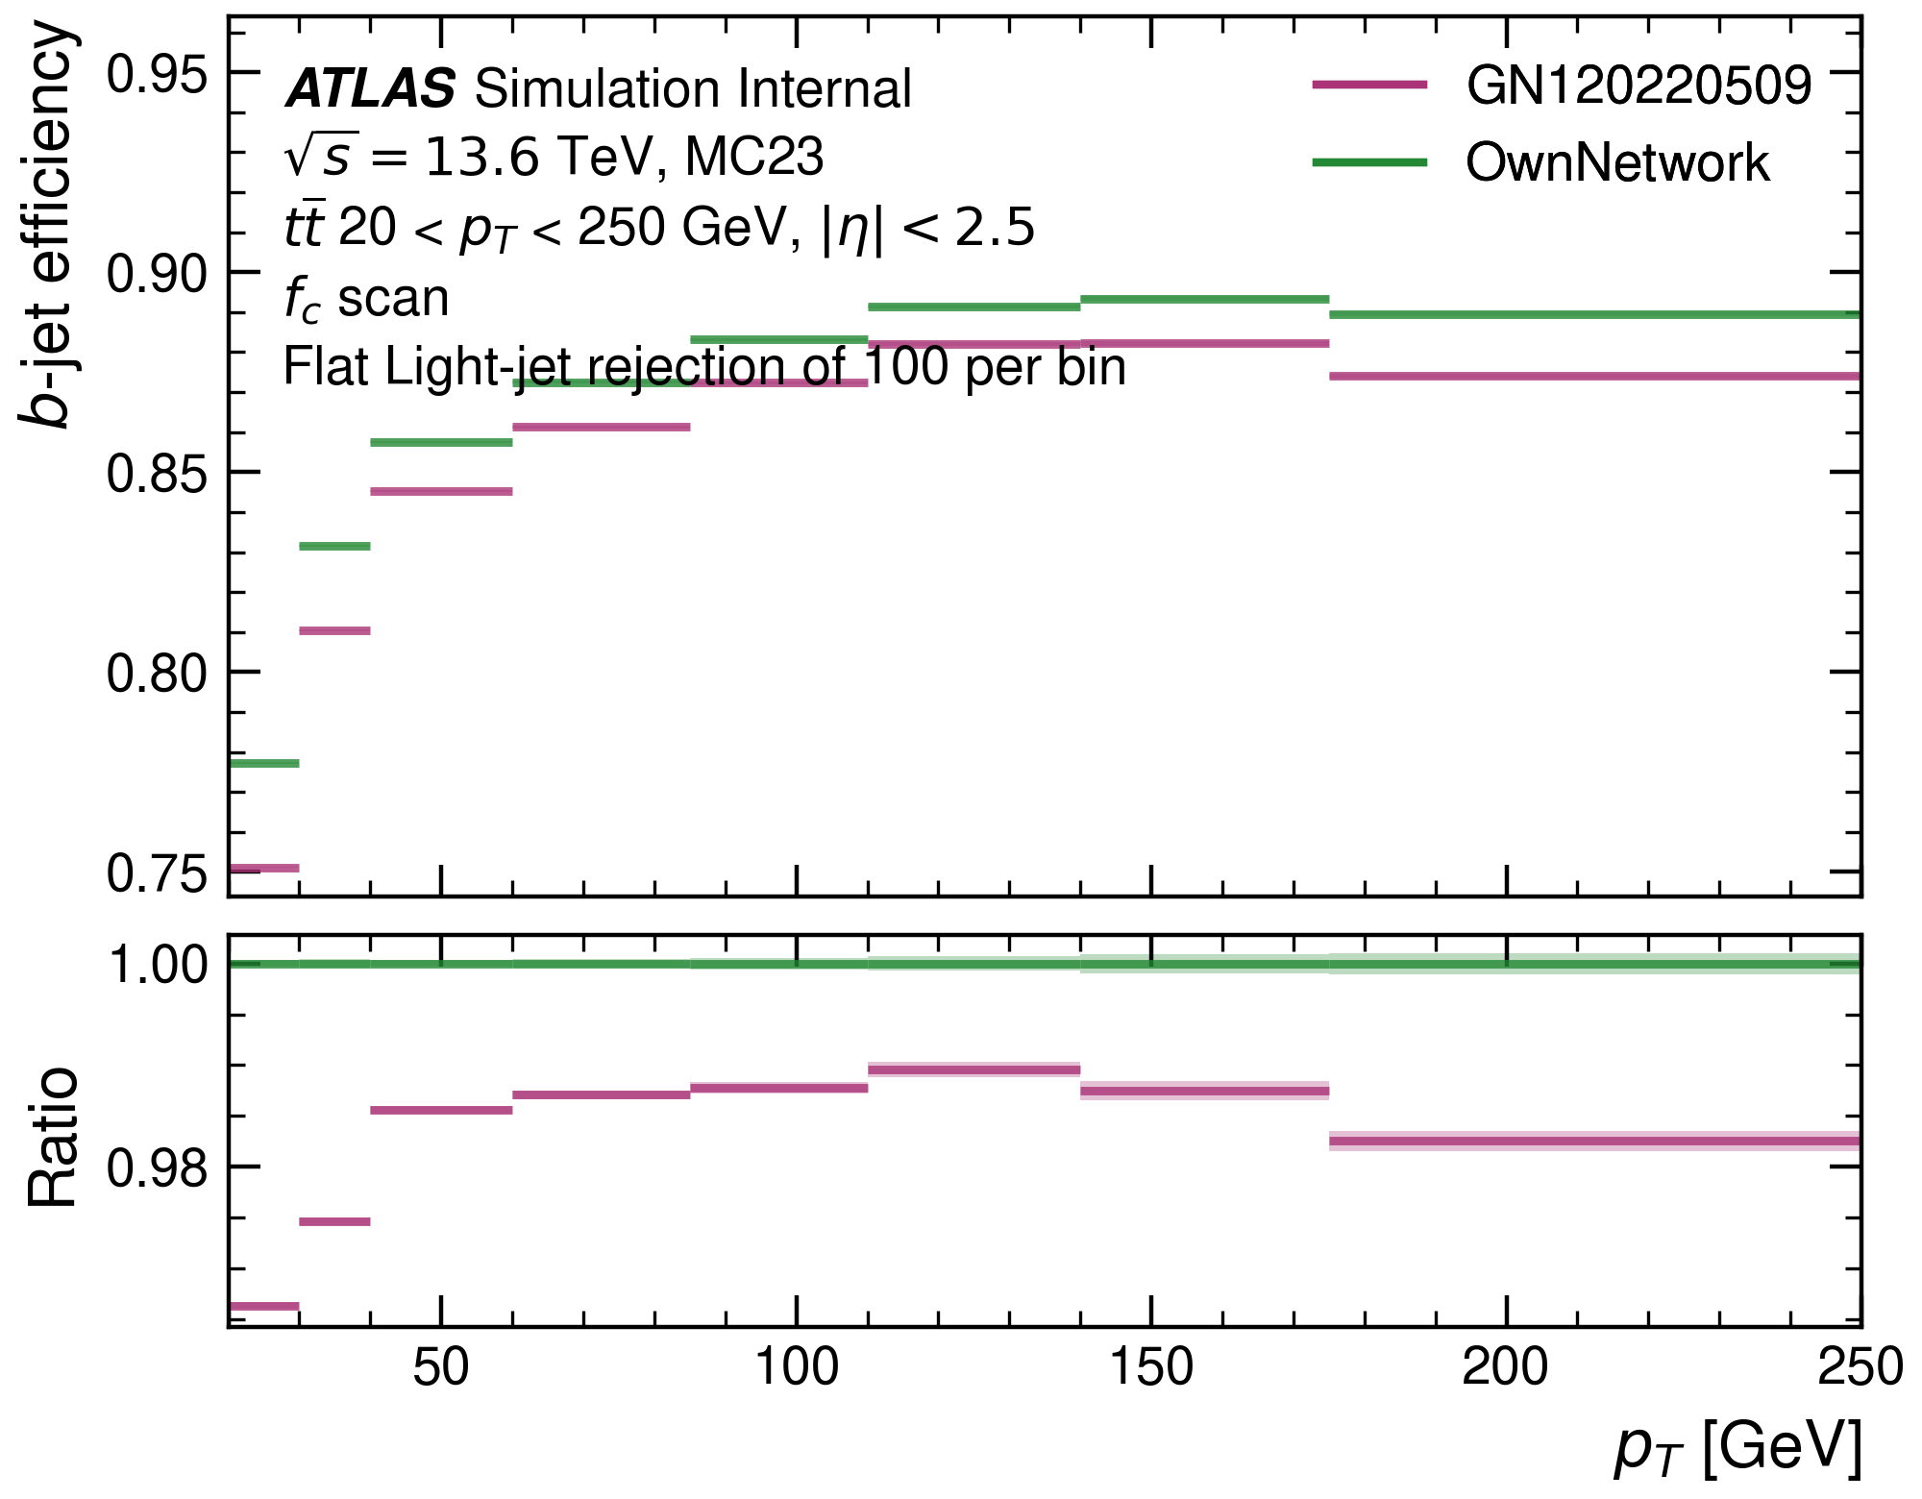
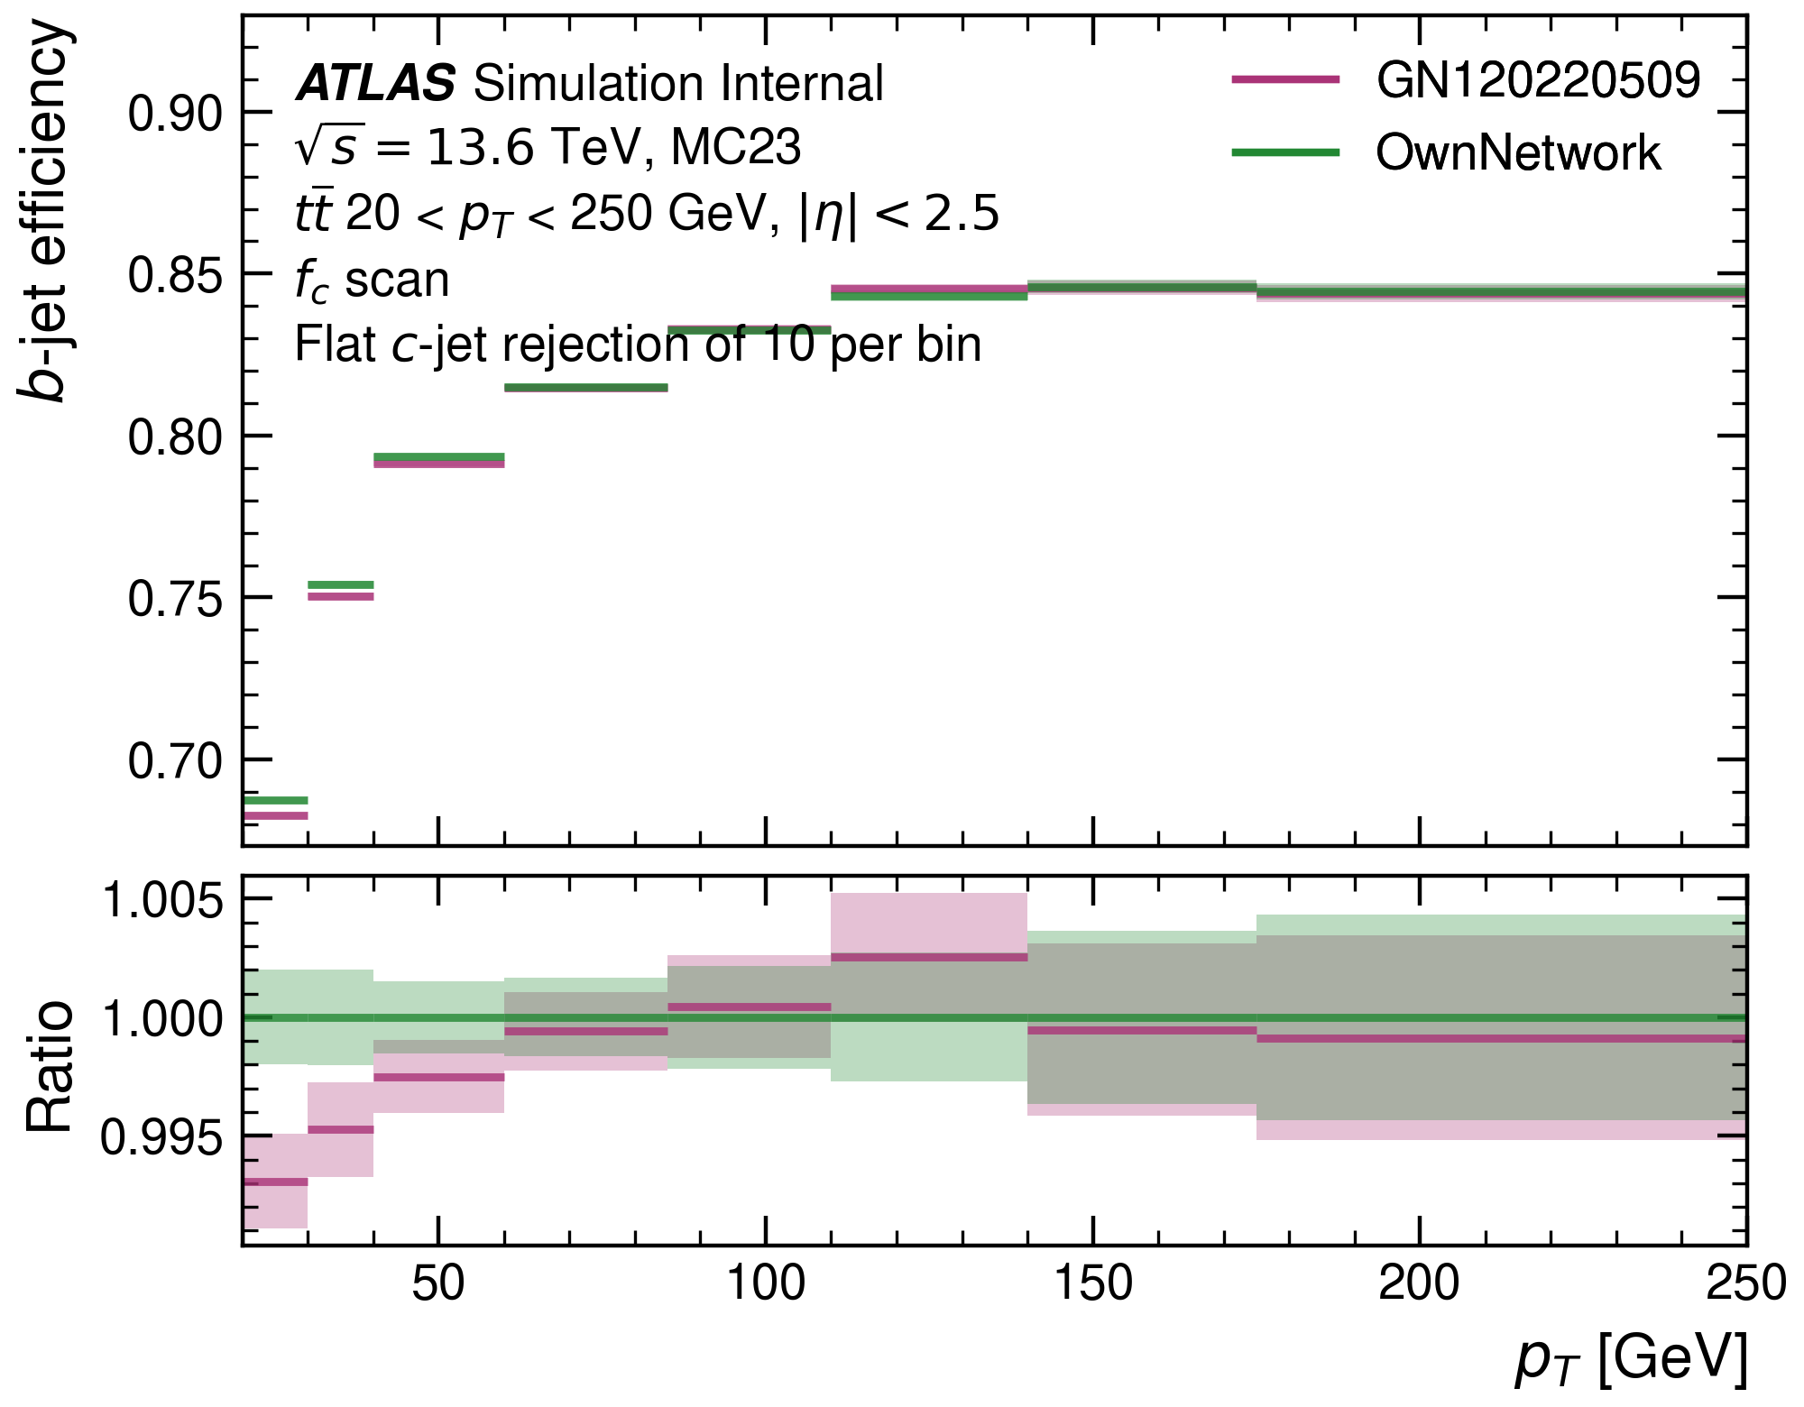
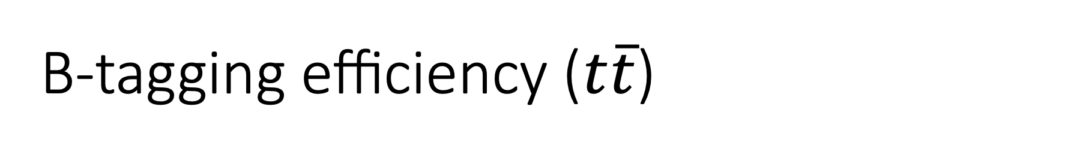
B-tagging efficiency ($t\overline{t}$)

Slide 4
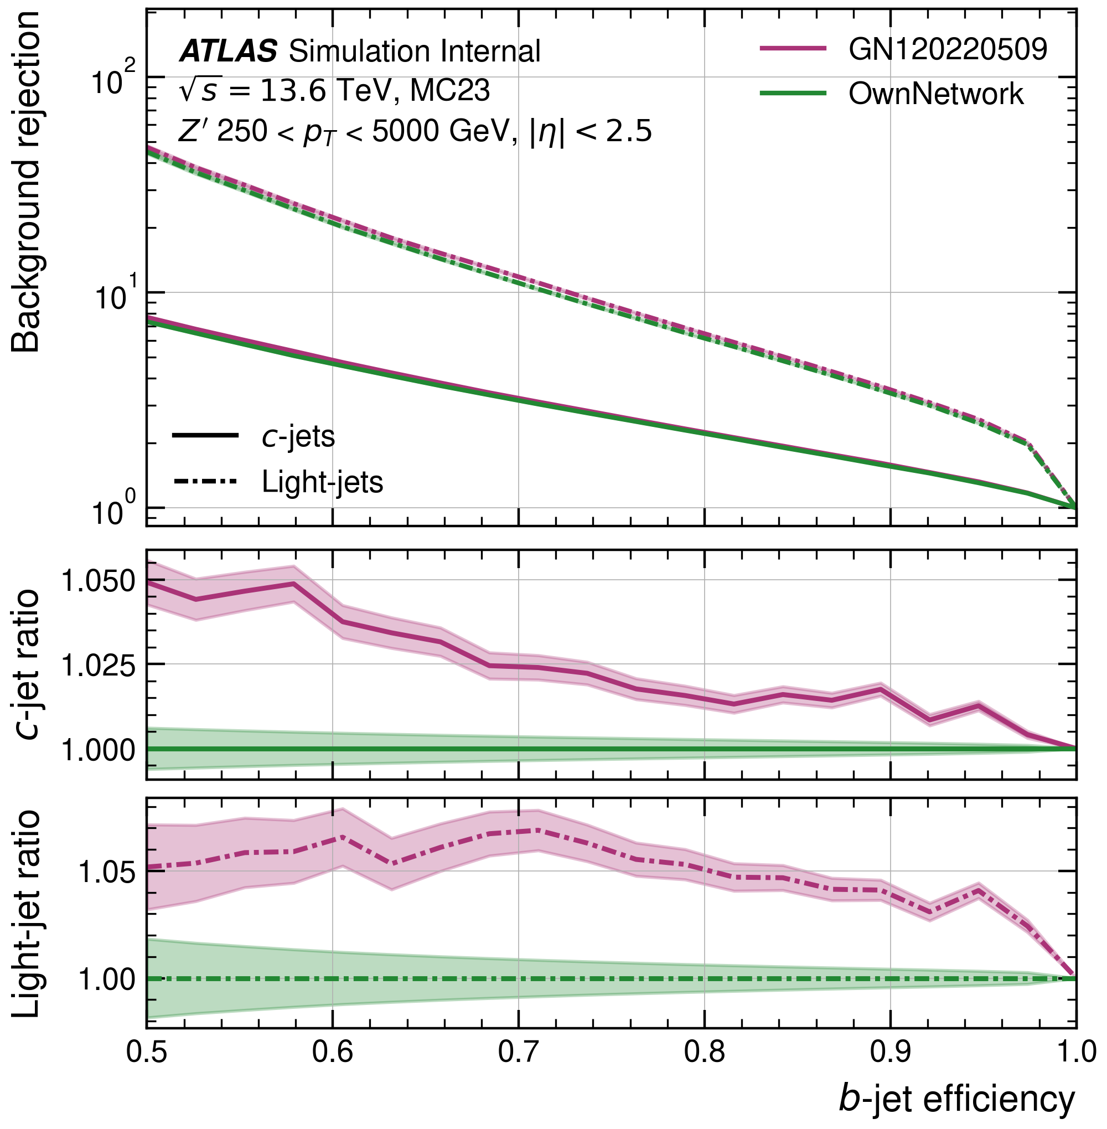

$Z′$-sample ROC Plot

Slide 5
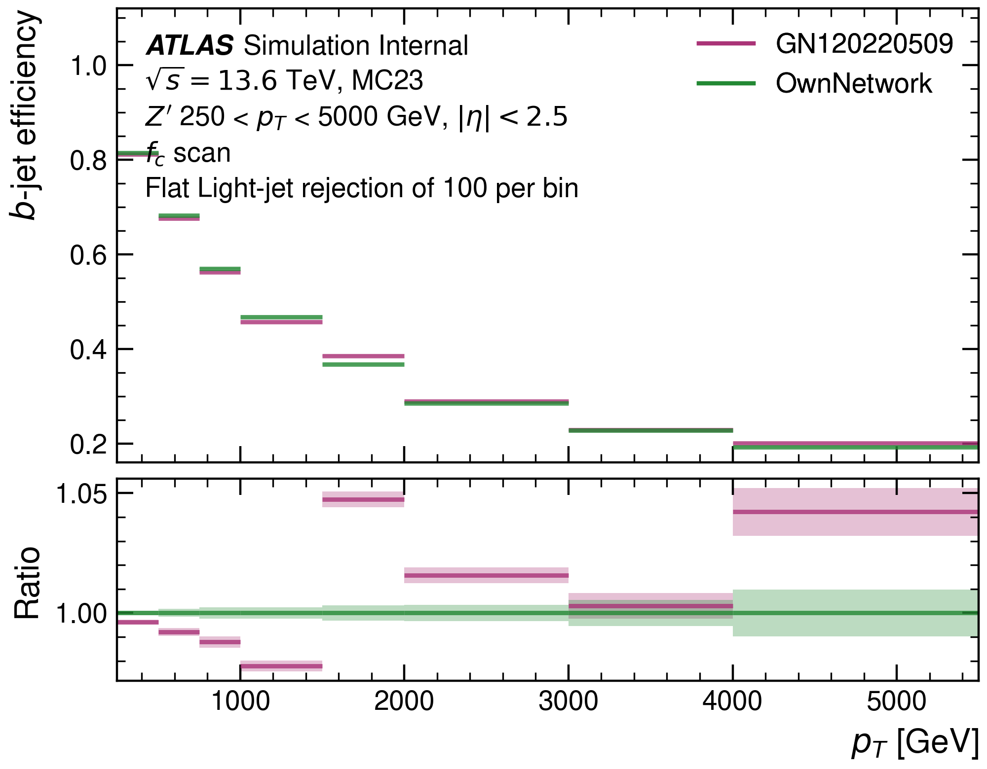
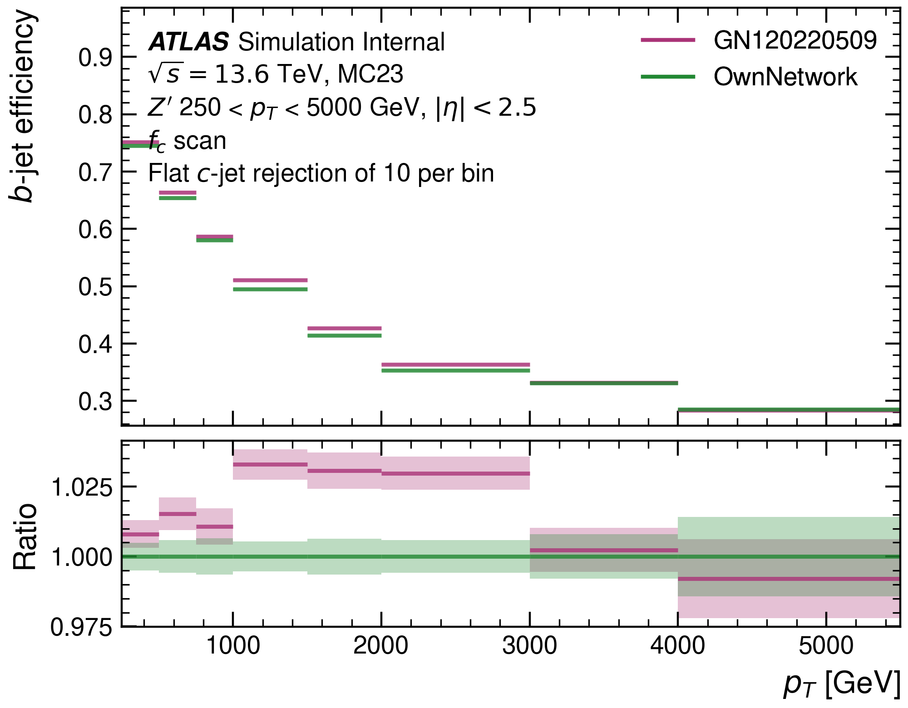
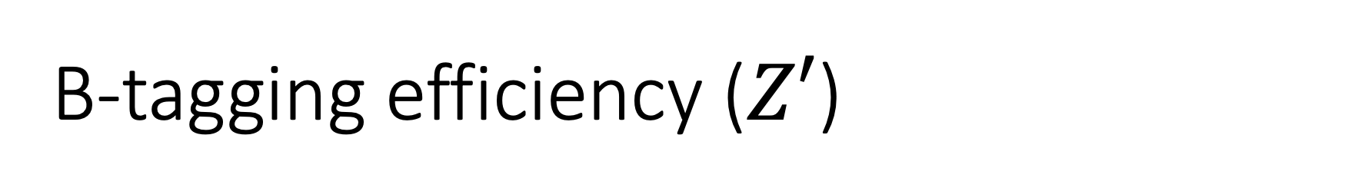
B-tagging efficiency ($Z′$)

Slide 6
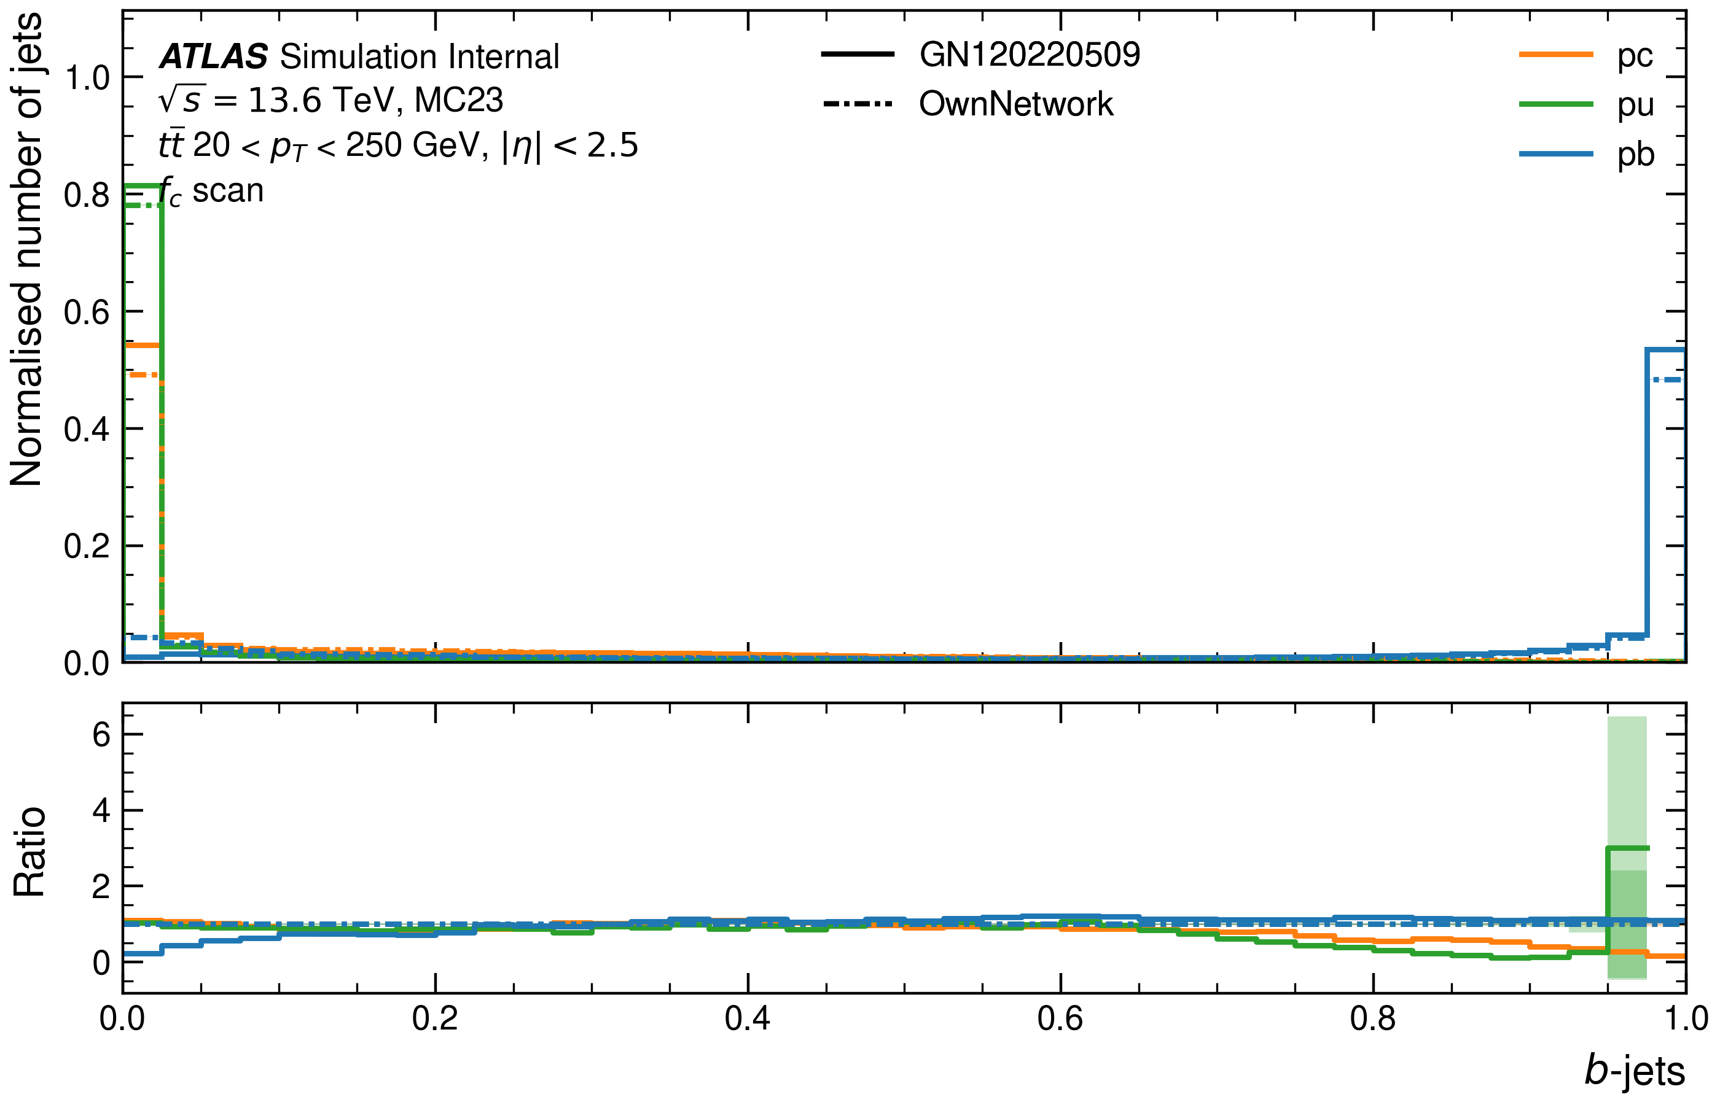
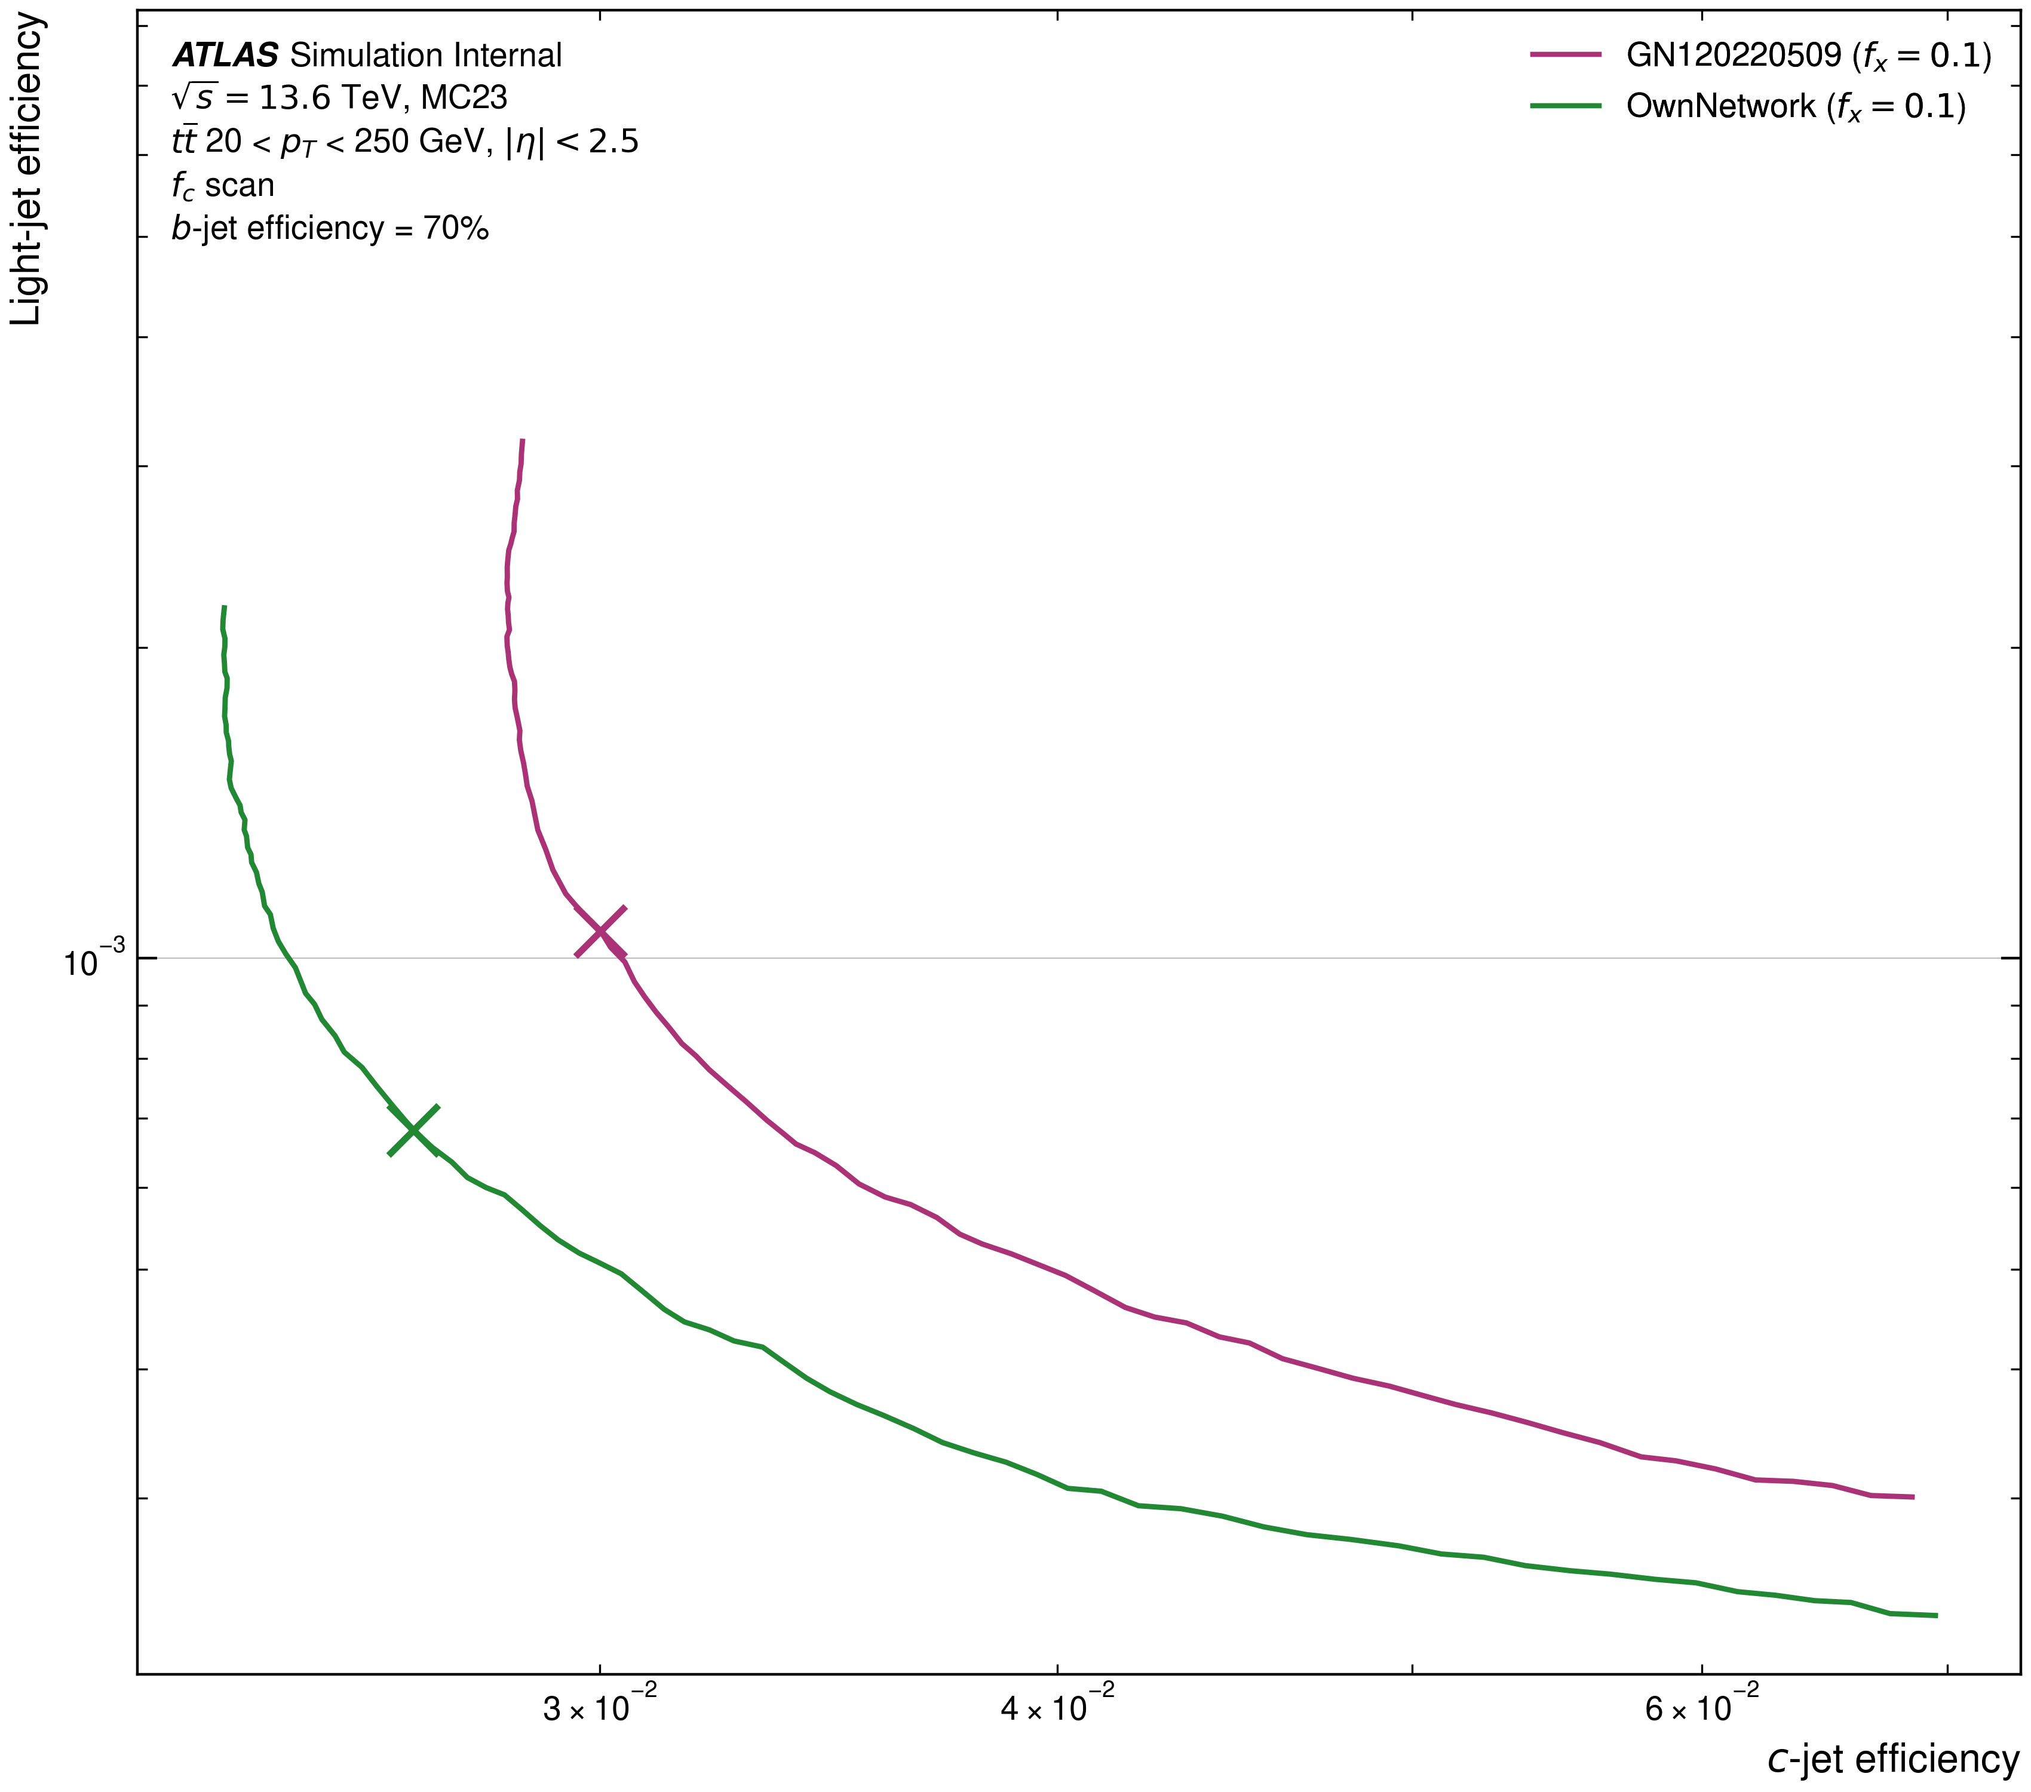
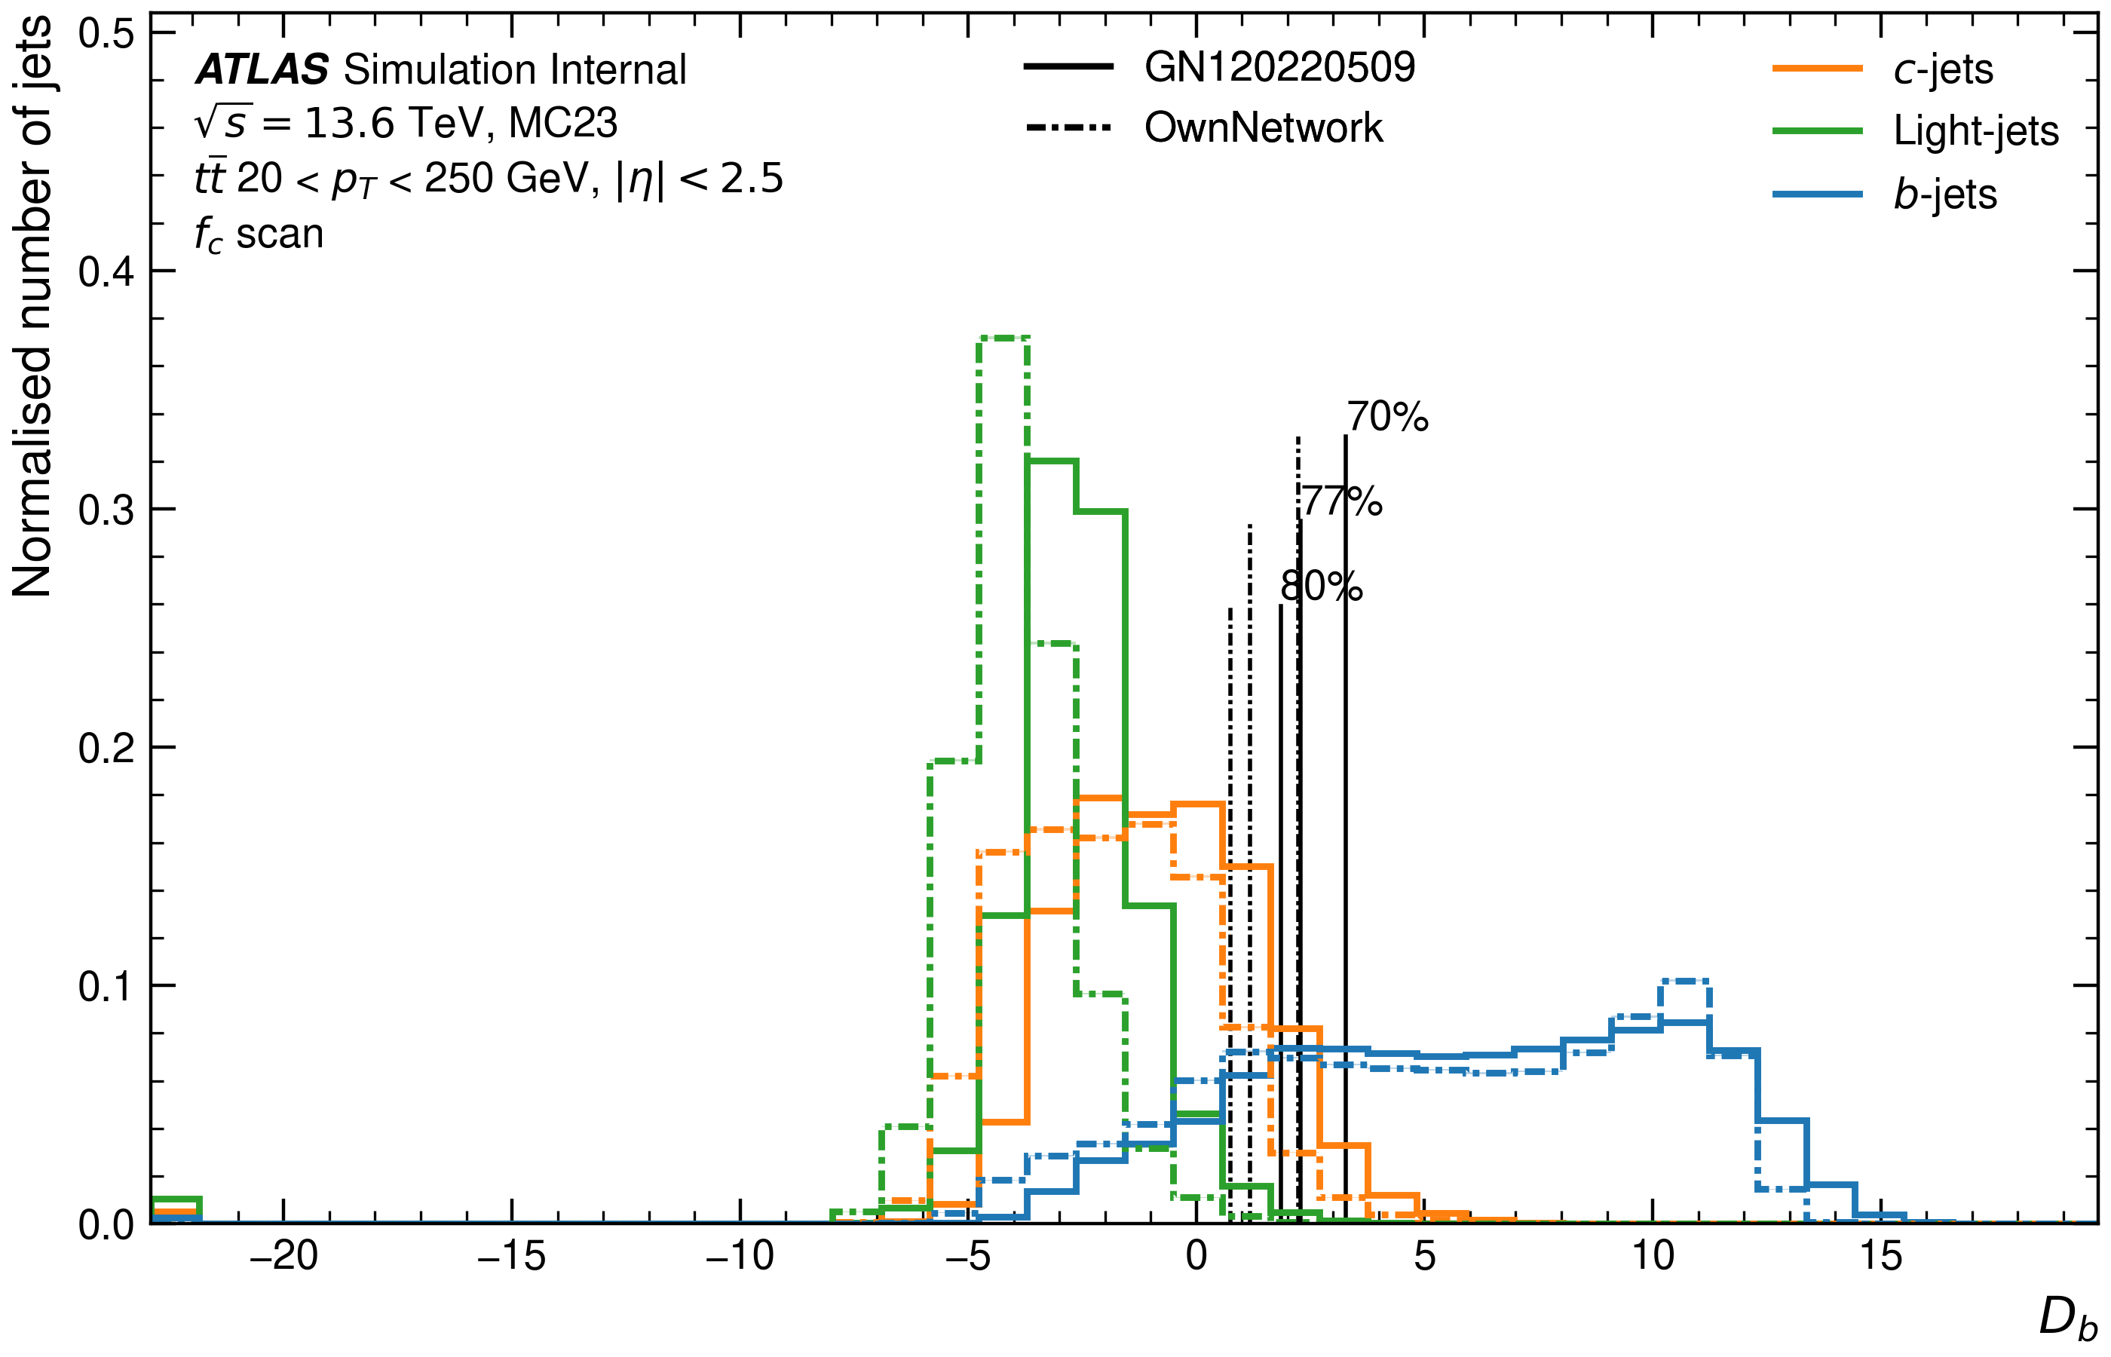
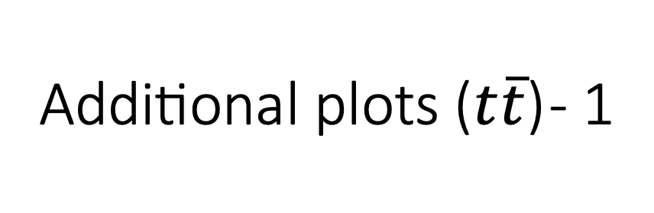
Additional plots ($t\overline{t}$) - 1

Slide 7
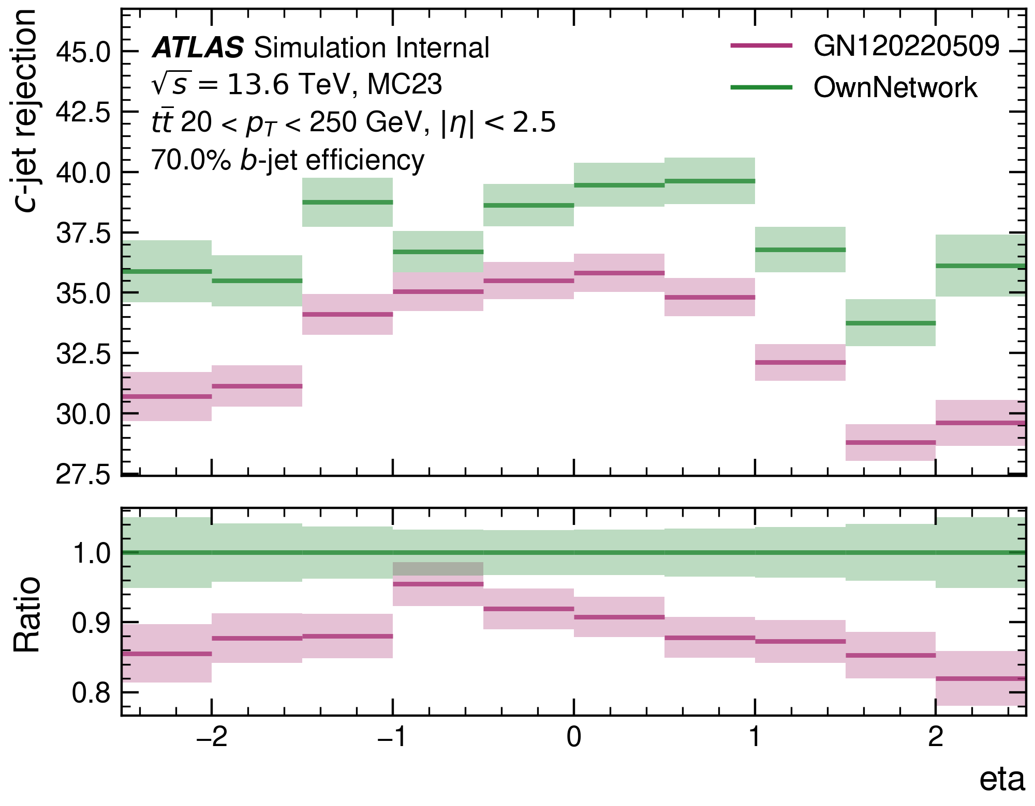
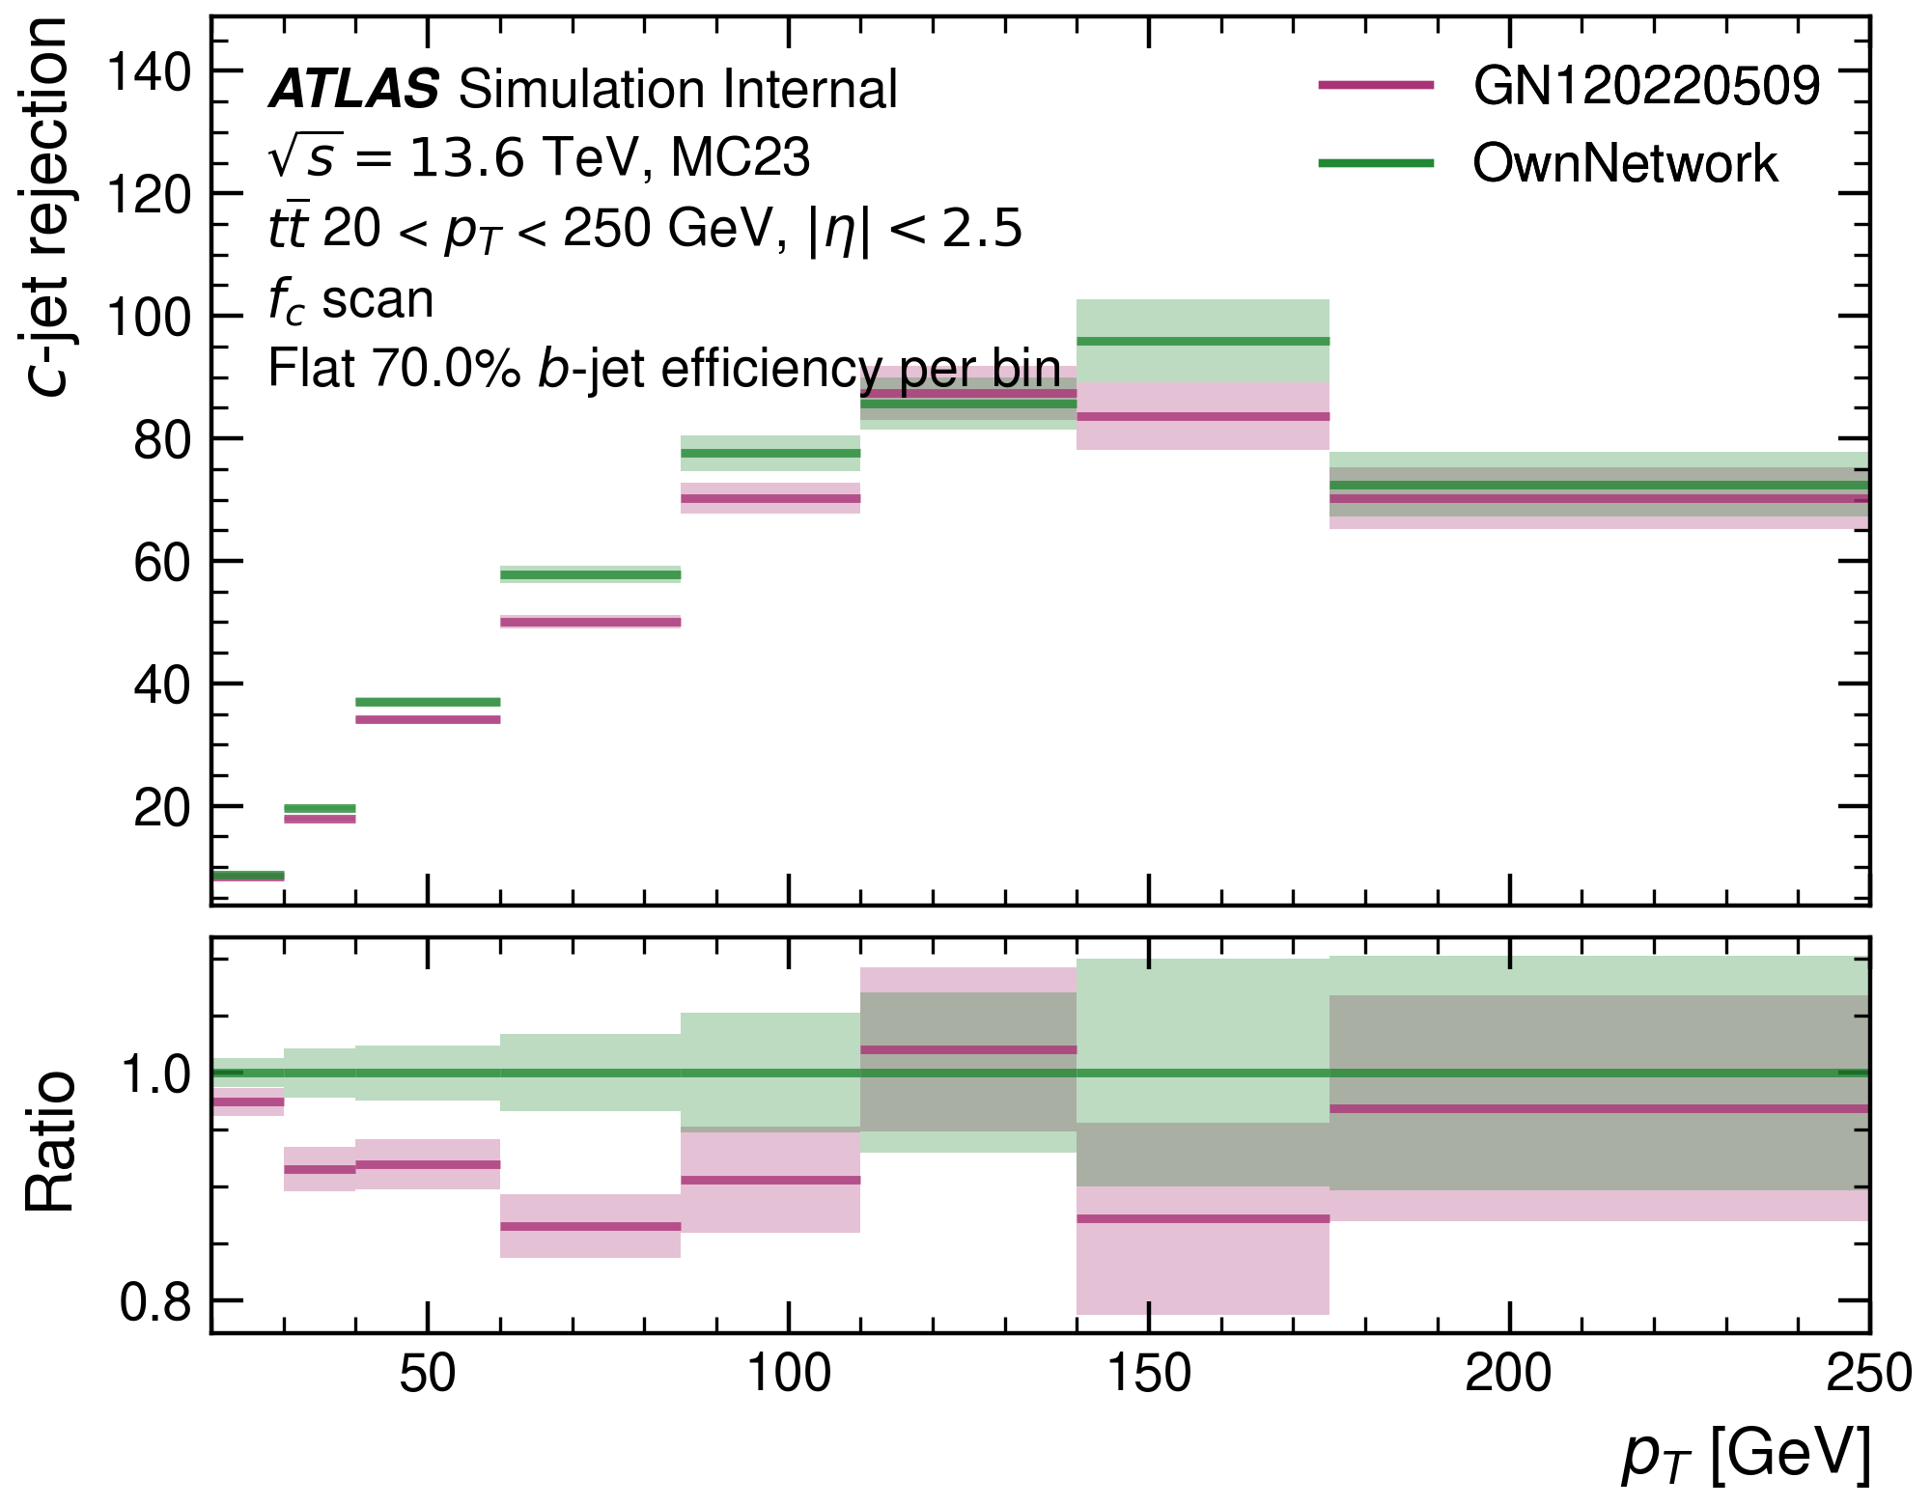
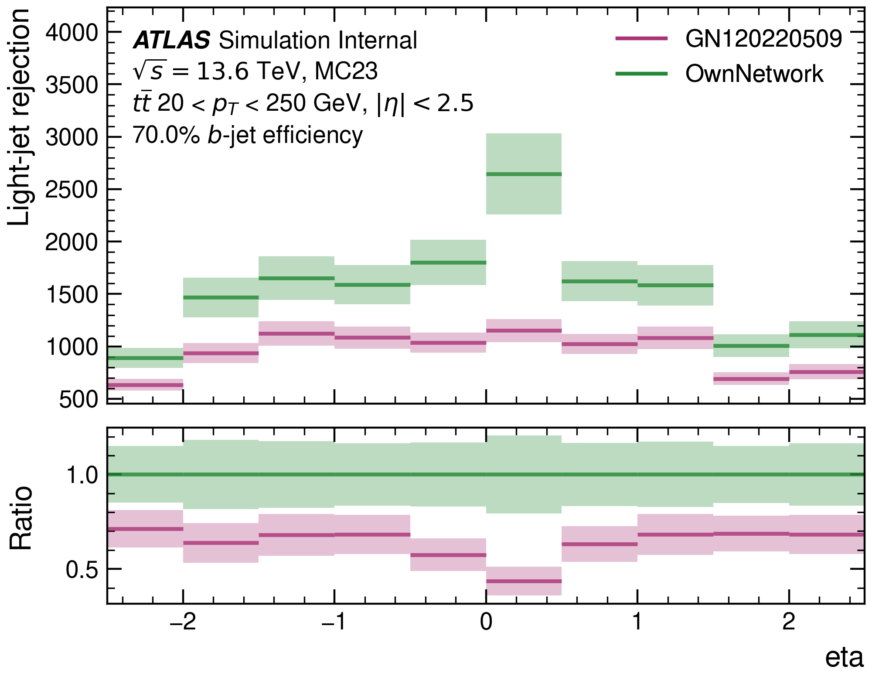
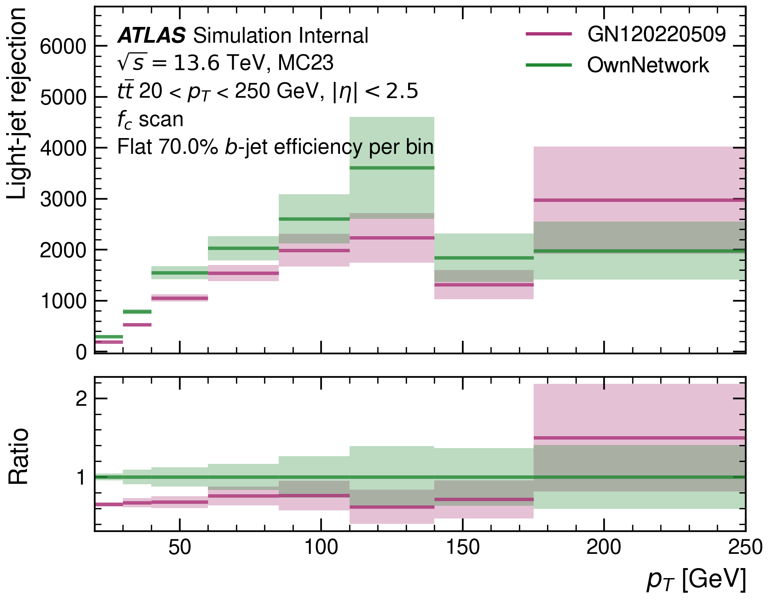
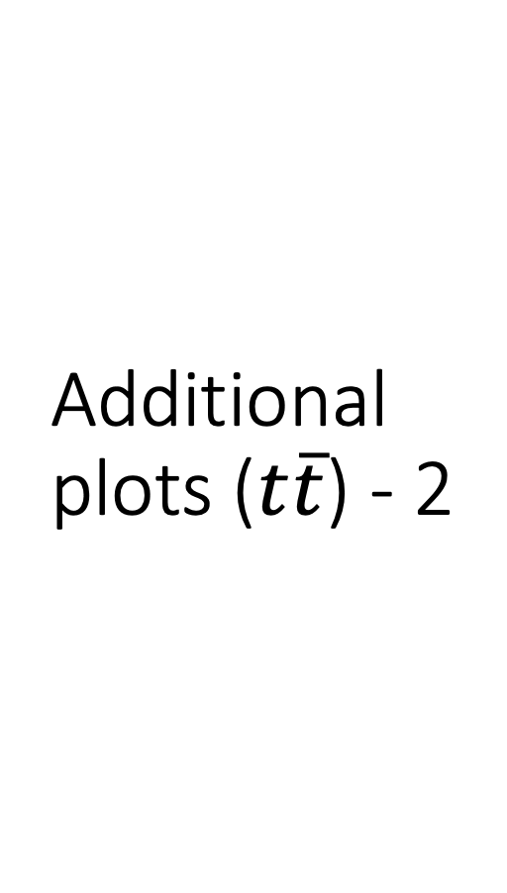
Additional plots ($t\overline{t}$) - 2

Slide 8
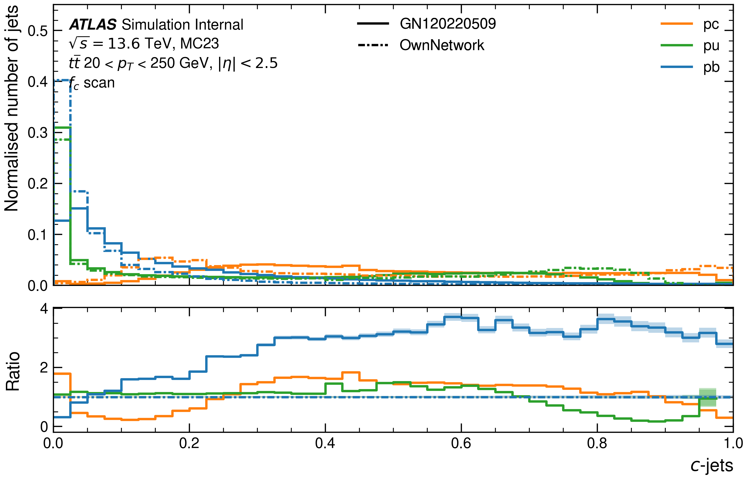
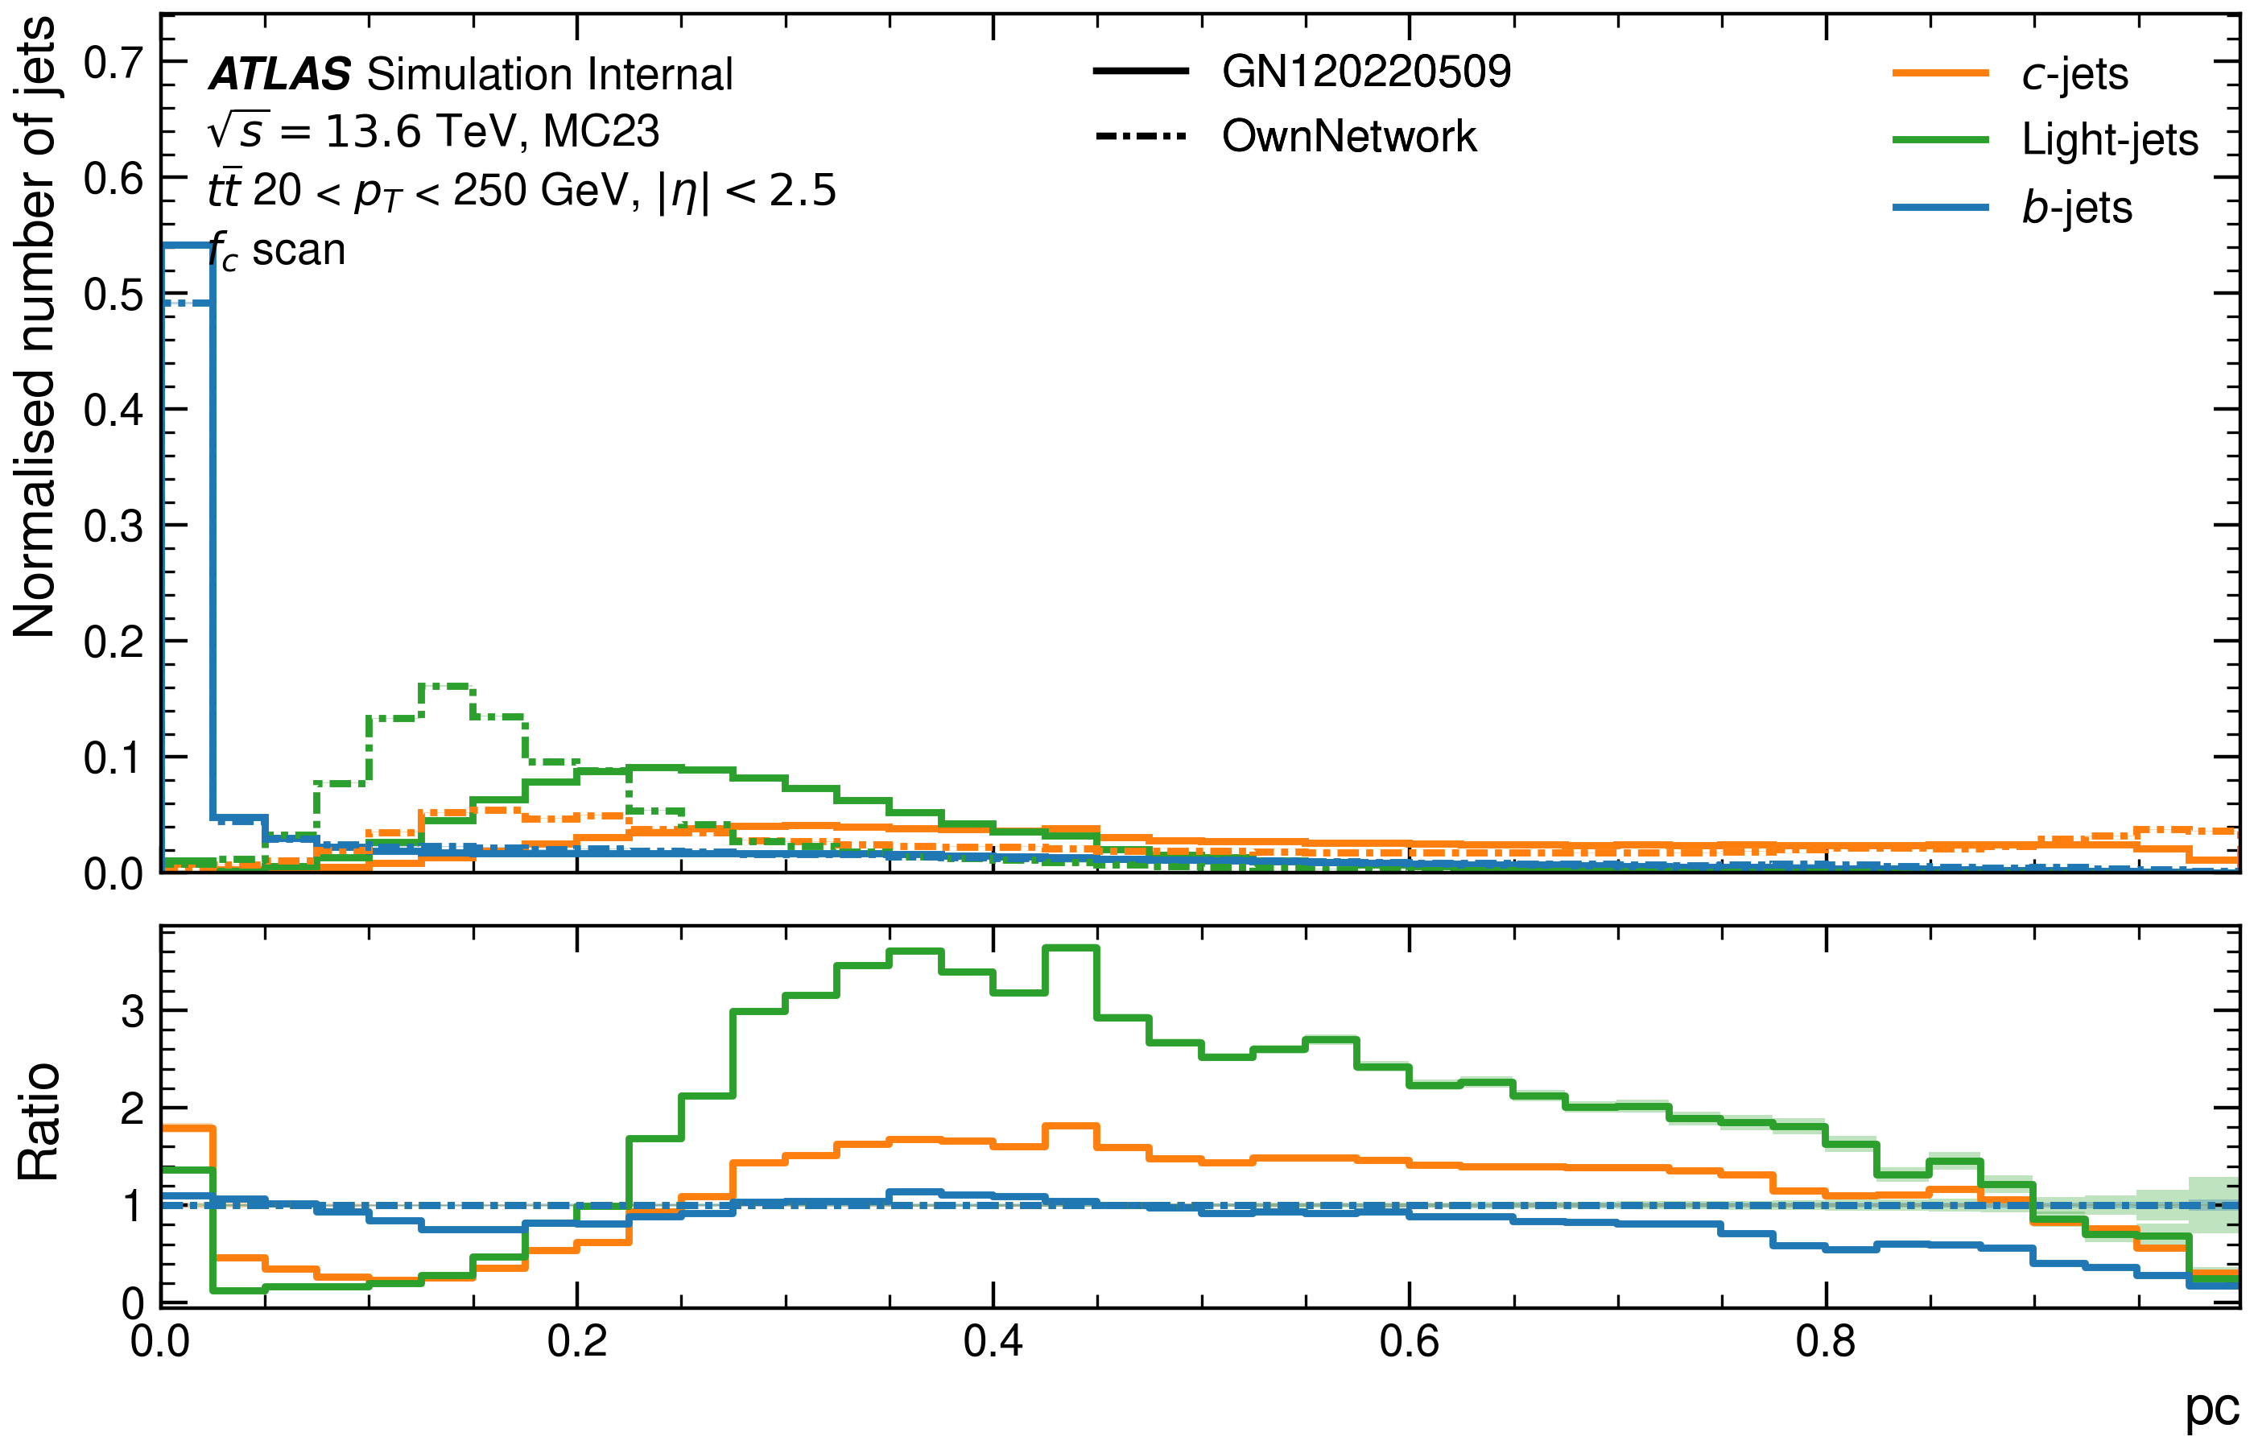
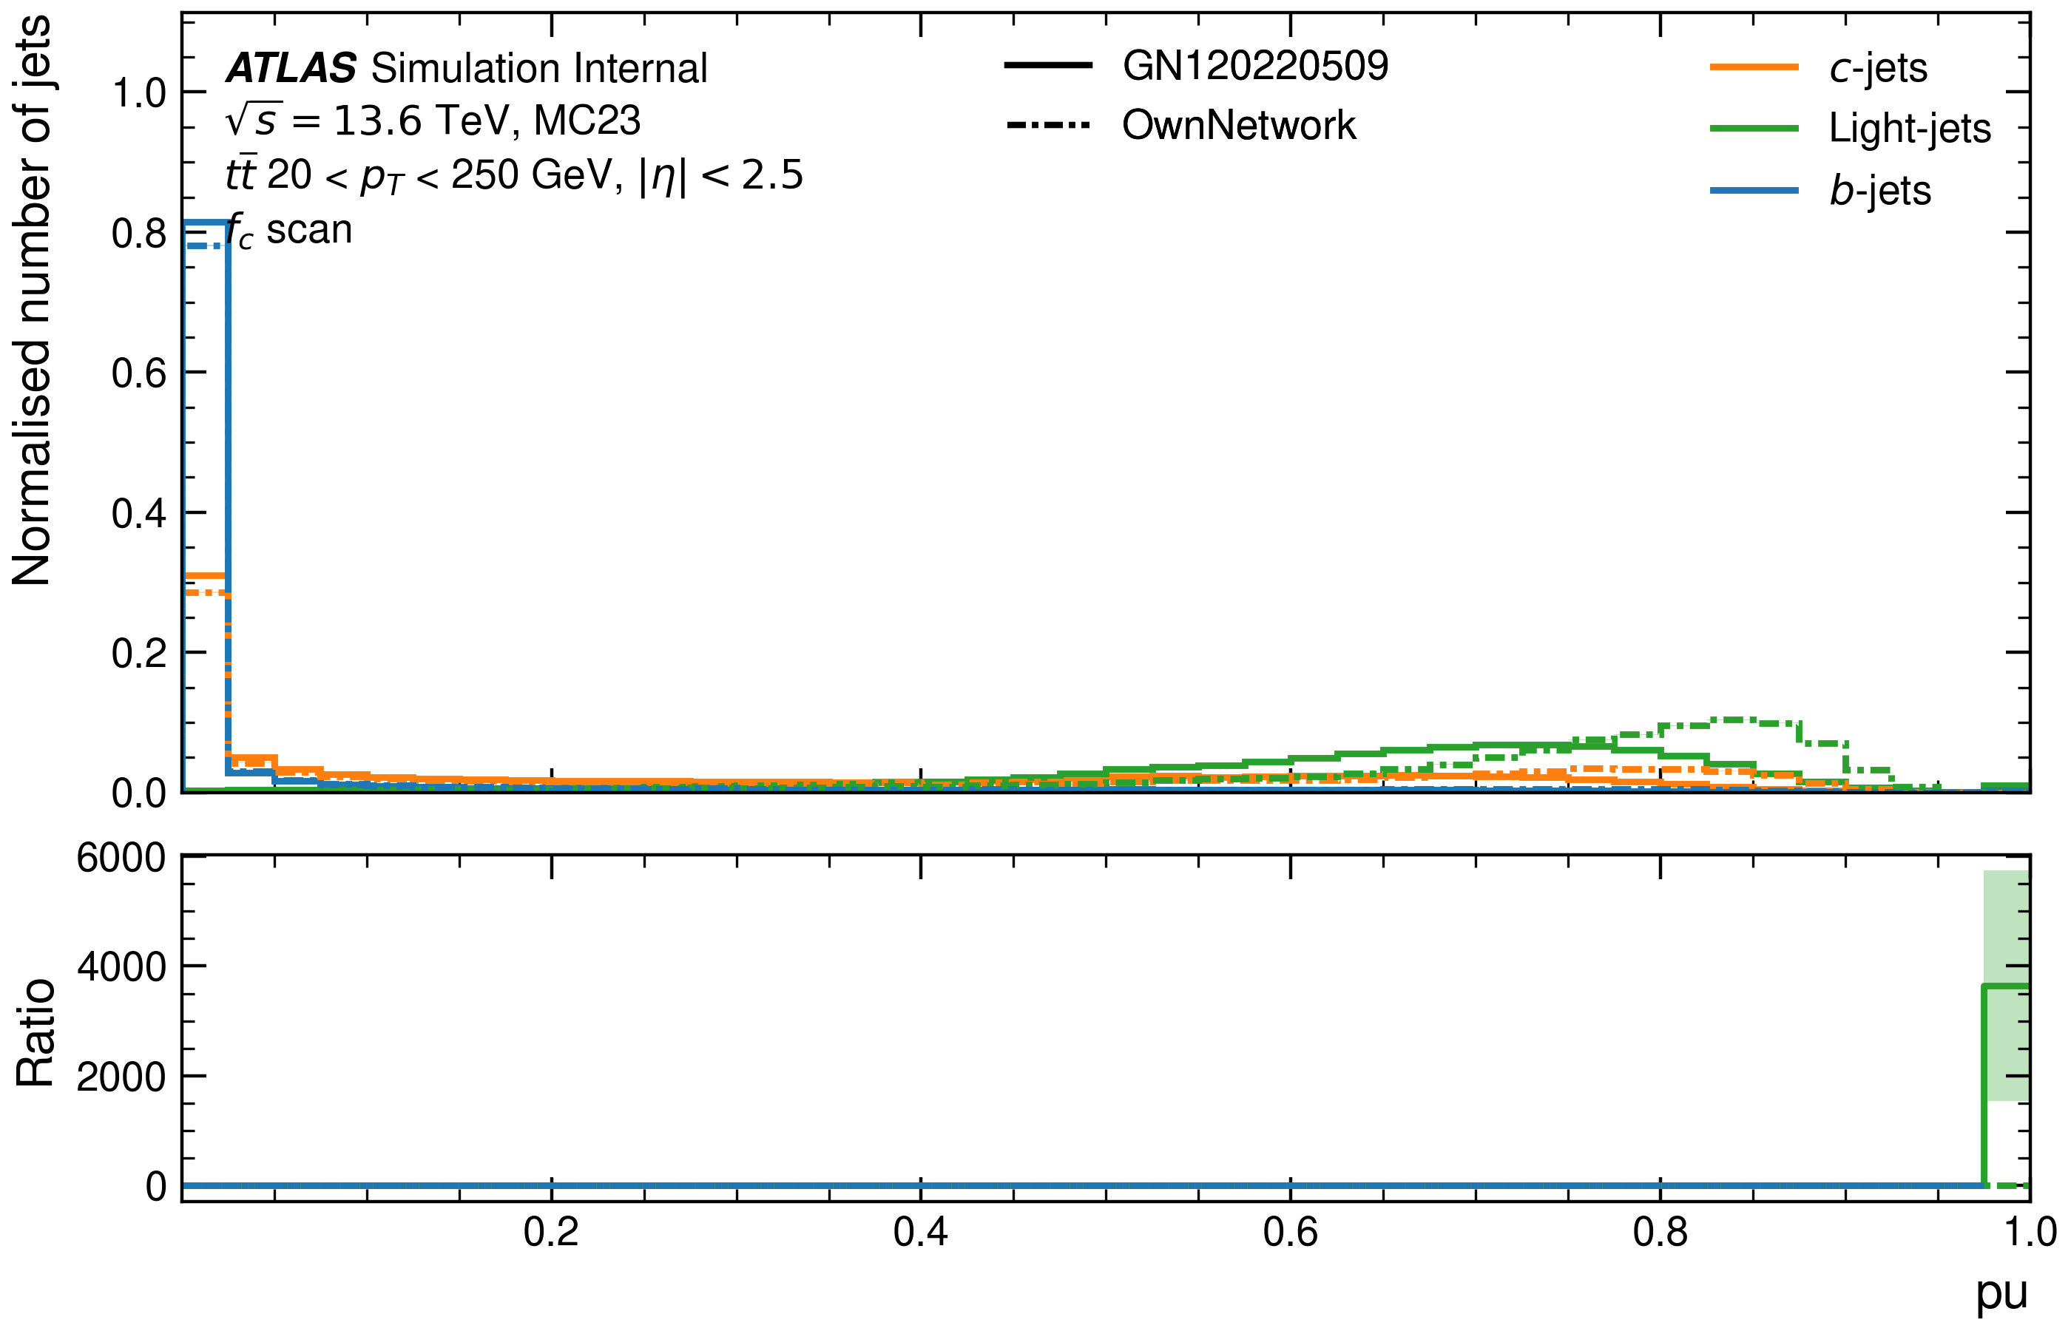
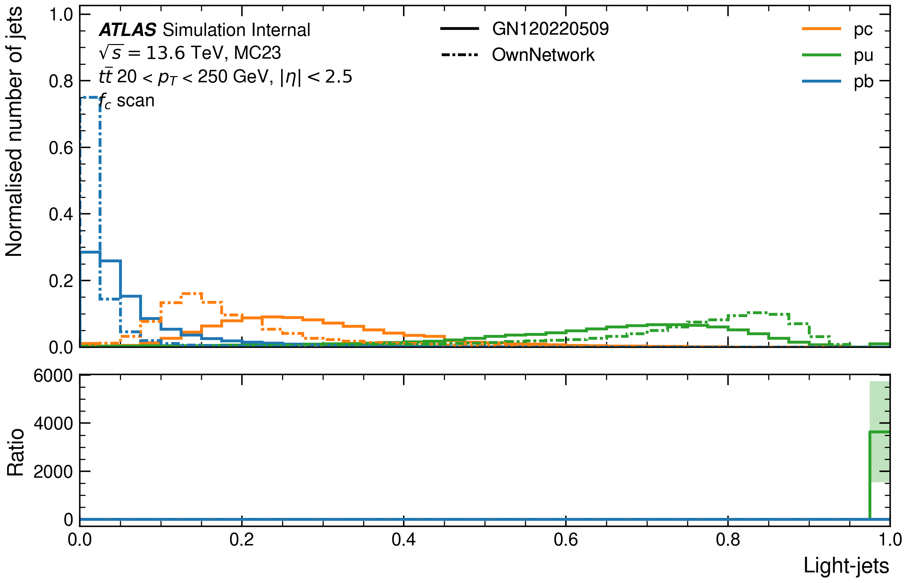
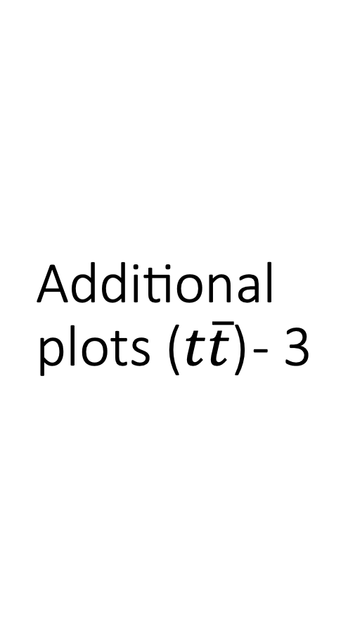
Additional plots ($t\overline{t}$) - 3

Slide 9
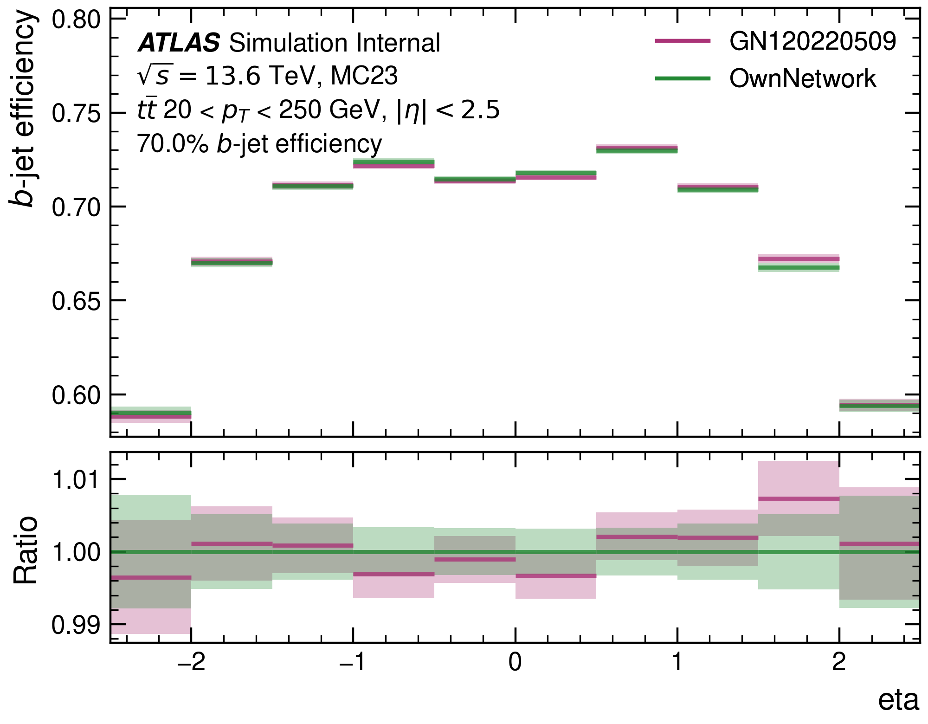

Additional plots ($t\overline{t}$) - 4

Slide 10
Issues
Accessing the LightGPU-queue on the cluster
Edd ran a fix.
Setting up the Conda environment for the salt-repo
Our gcc-version is incompatible with the newer versions of jsonnet, hence an older version must be installed instead.
Had to break the installation down into separate .sh files to work.
Plotting model with Puma
The output .h5 test-file does not just include the model anymore, so the model name has to be specified in config-files.

Slide 11
Next Steps
Comparison with different ATLAS taggers to understand measures of performance
Compare with current tagger
Re-train on the larger (300m jets) dataset with the ATLAS hyper-parameters and network architecture to reproduce the official ATLAS performance.

