Slide 1
Comparison Plots: Re-training of GN2 with updated training set
24/11/23 | Ruben Hoenscheid | Supervisor: Prof Tim Scanlon
First network presented on 17/11/23 was trained on a dataset with mislabelled track vertices, which most likely impacted training performance.
Training set was debugged (23/11/23) and the network subsequently re-trained.
Training finished after approx. 24h
The following plots compare the performance between GN2 trained on 30m jets on the mislabelled dataset vs the debugged dataset.

Slide 2
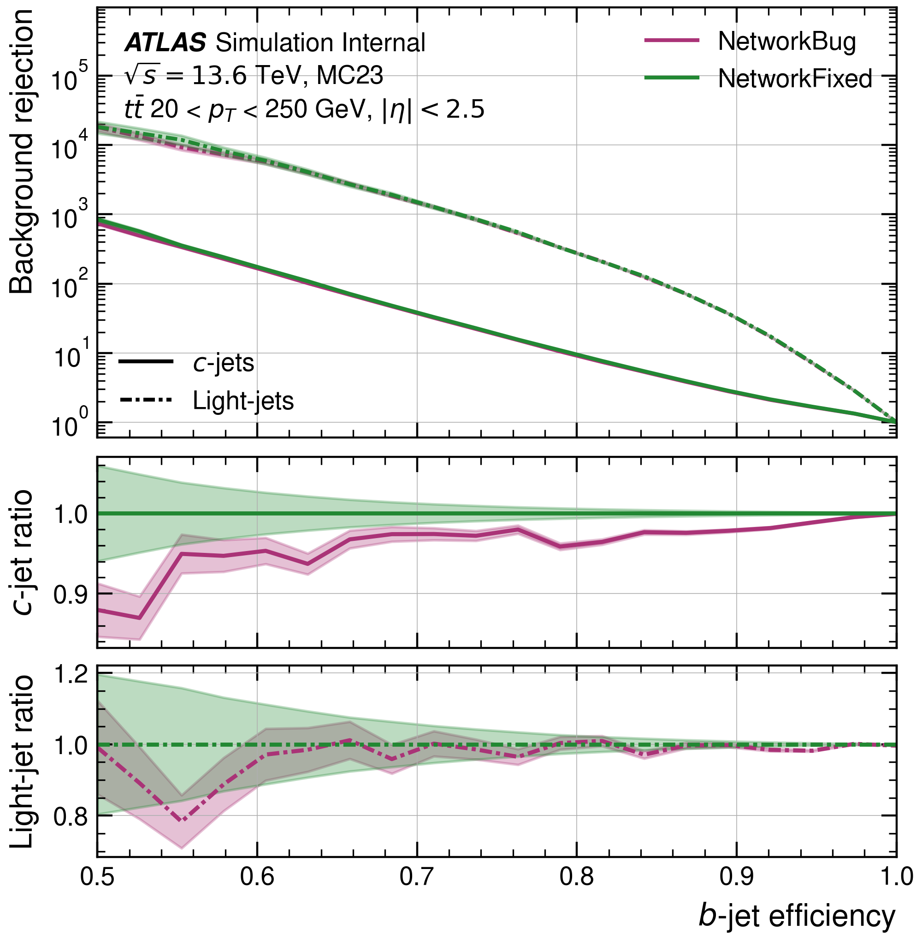
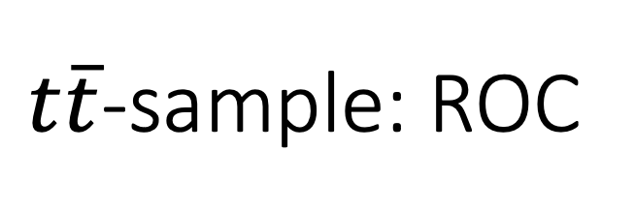
$t\overline{t}$-sample: ROC
Generally improved c-jet rejection by up to 10%.
Light-jet rejection within uncertainties.

Slide 3
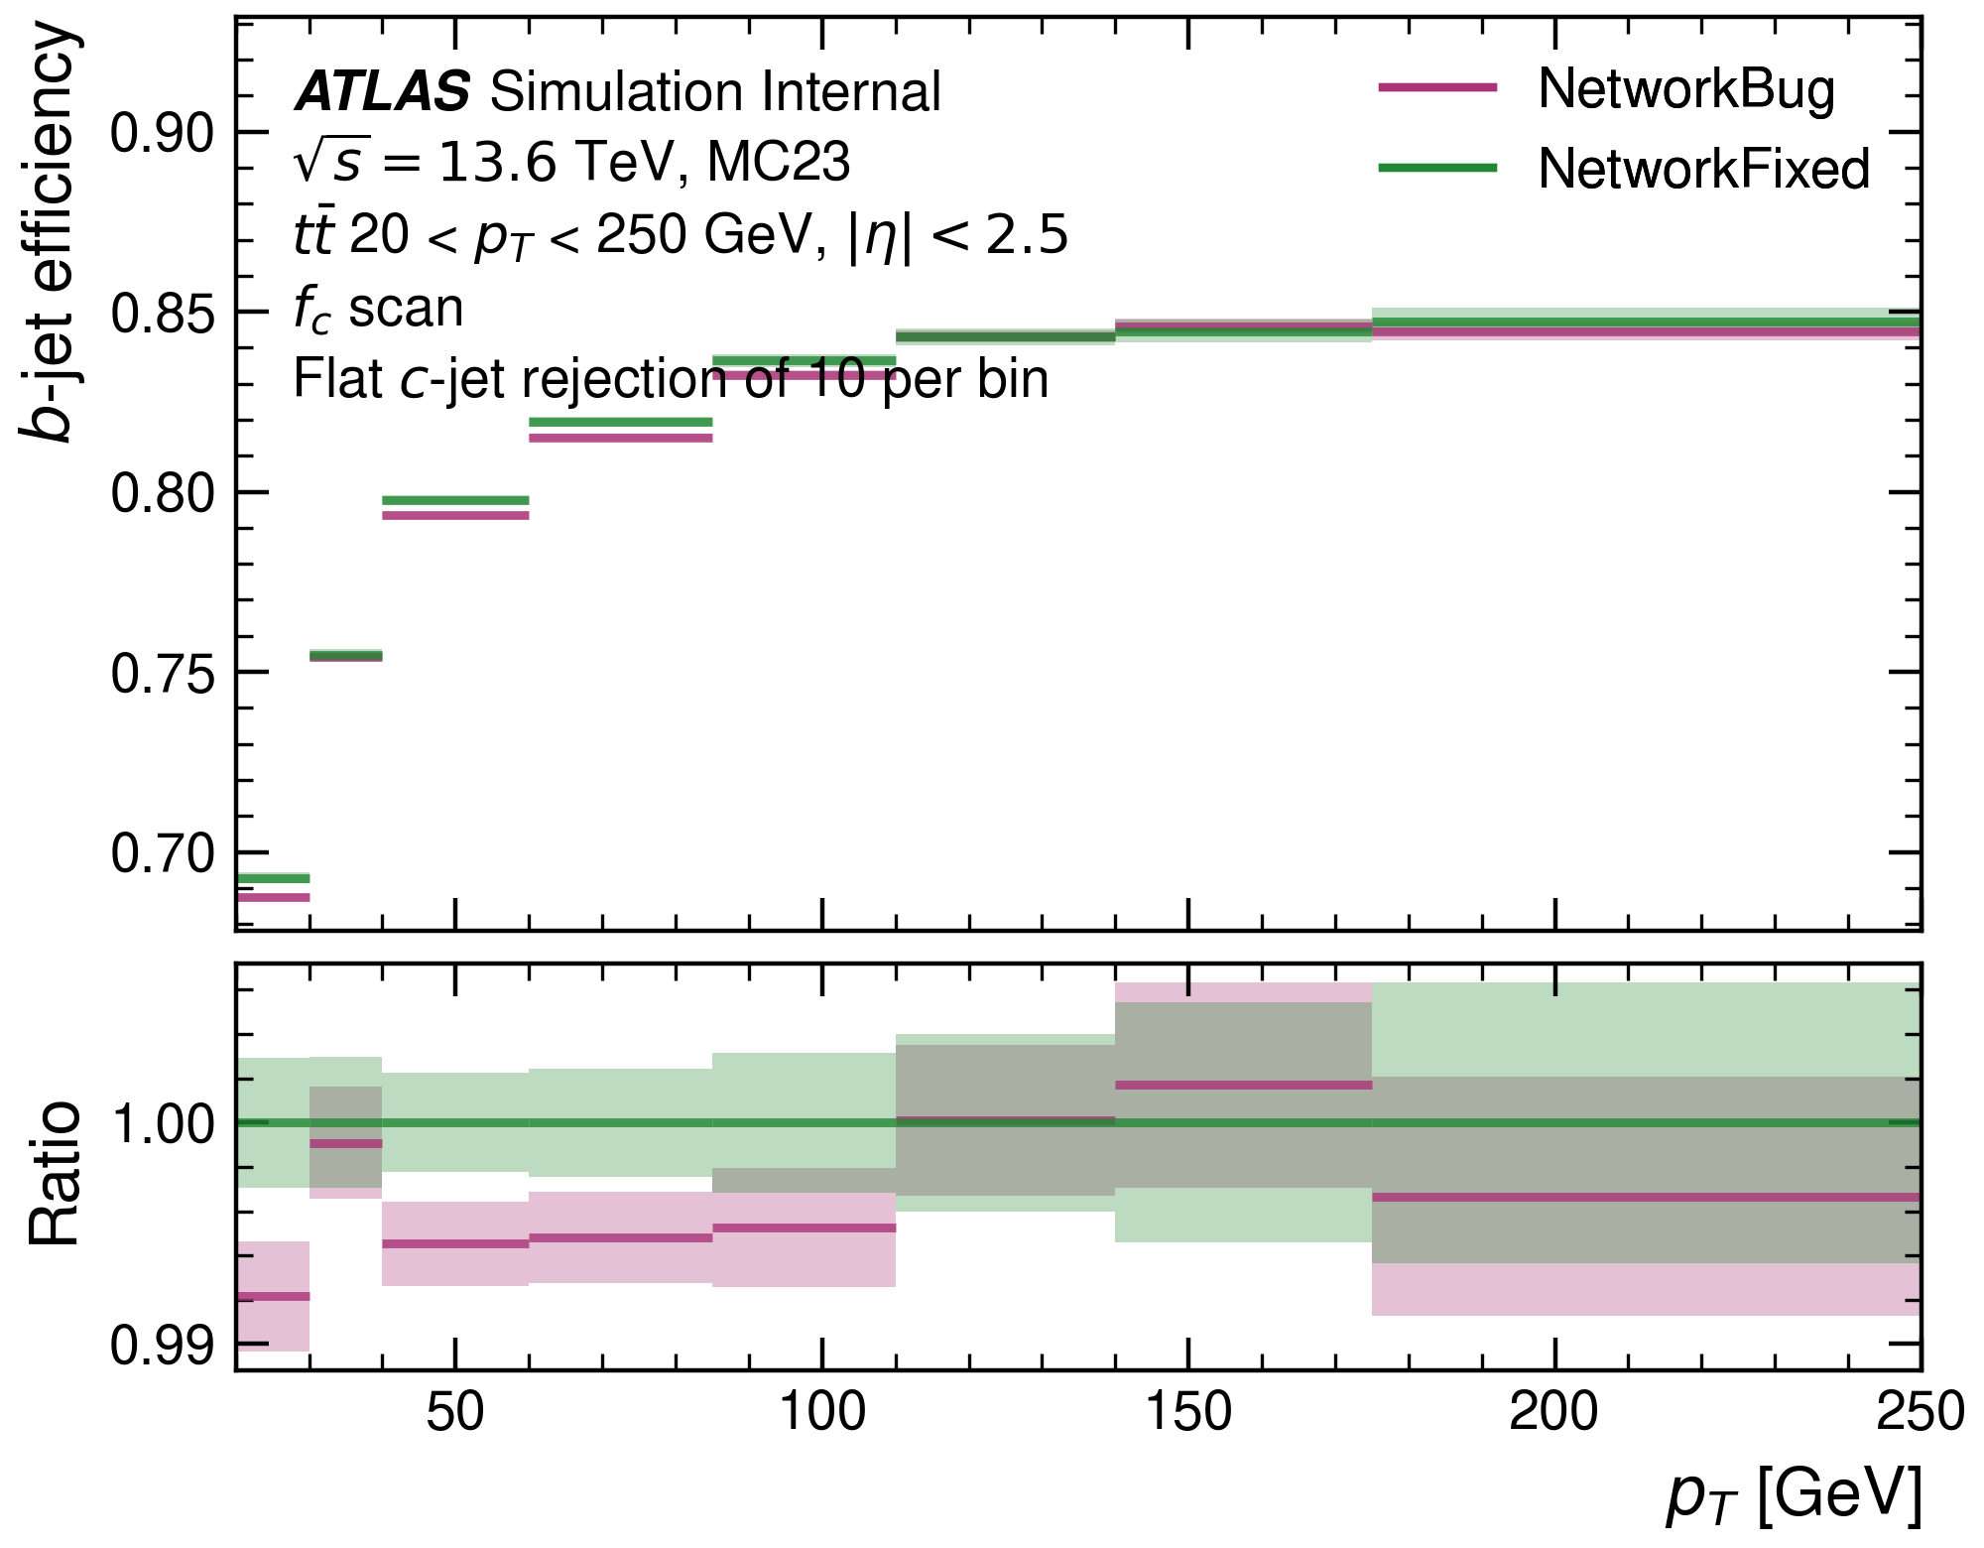
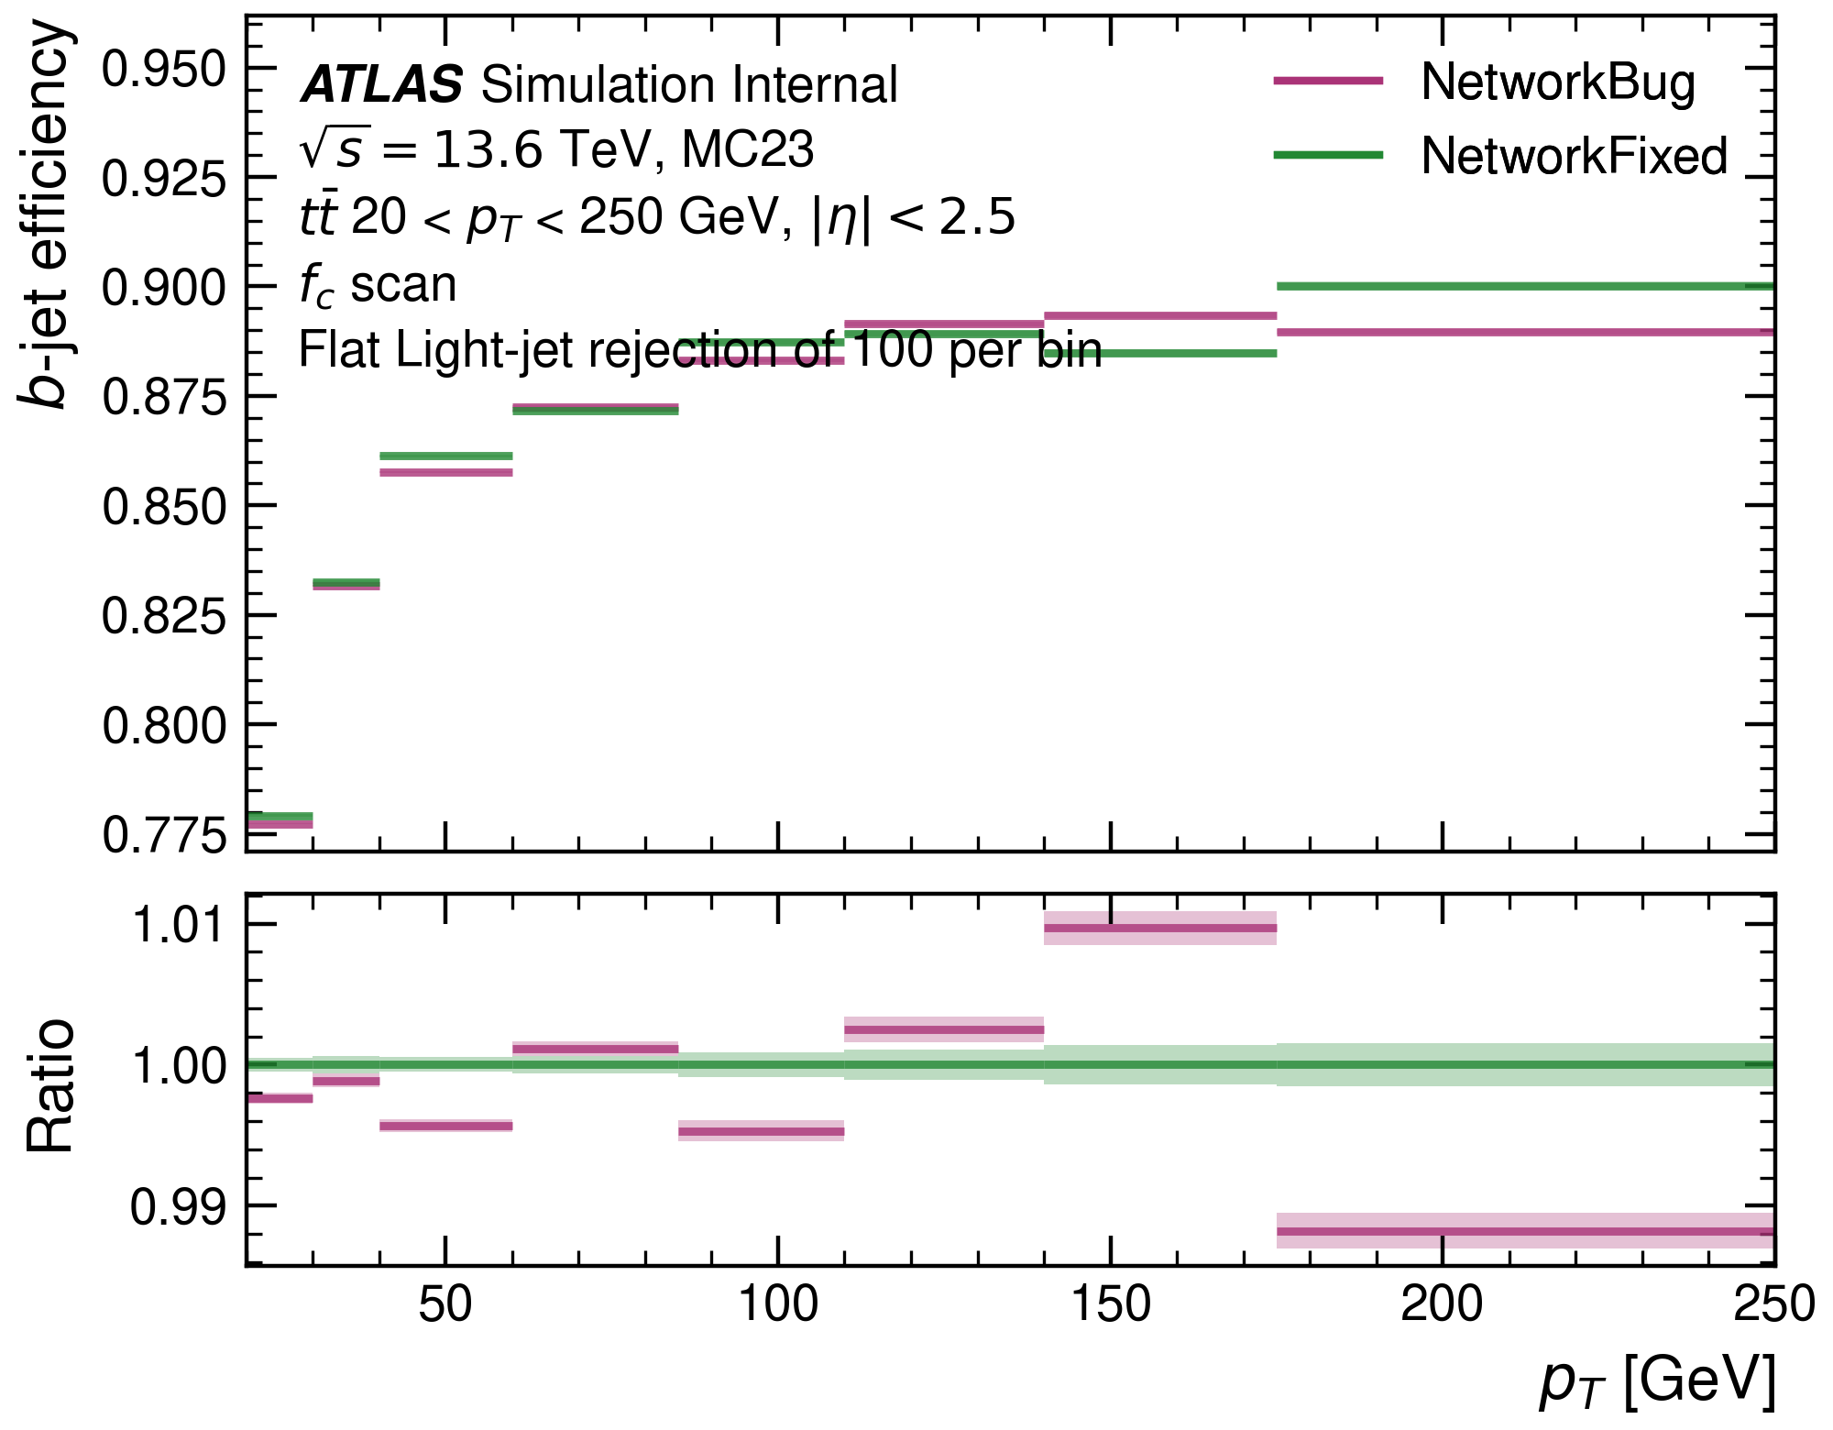
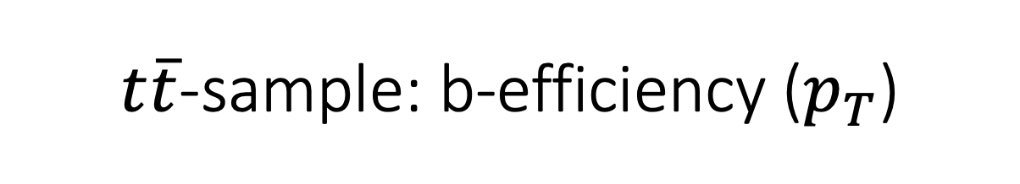
$t\overline{t}$-sample: b-efficiency ($p_{T}$)
Slight improvements in the very low-$p_{T}$ region, otherwise no notable changes.

Slide 4
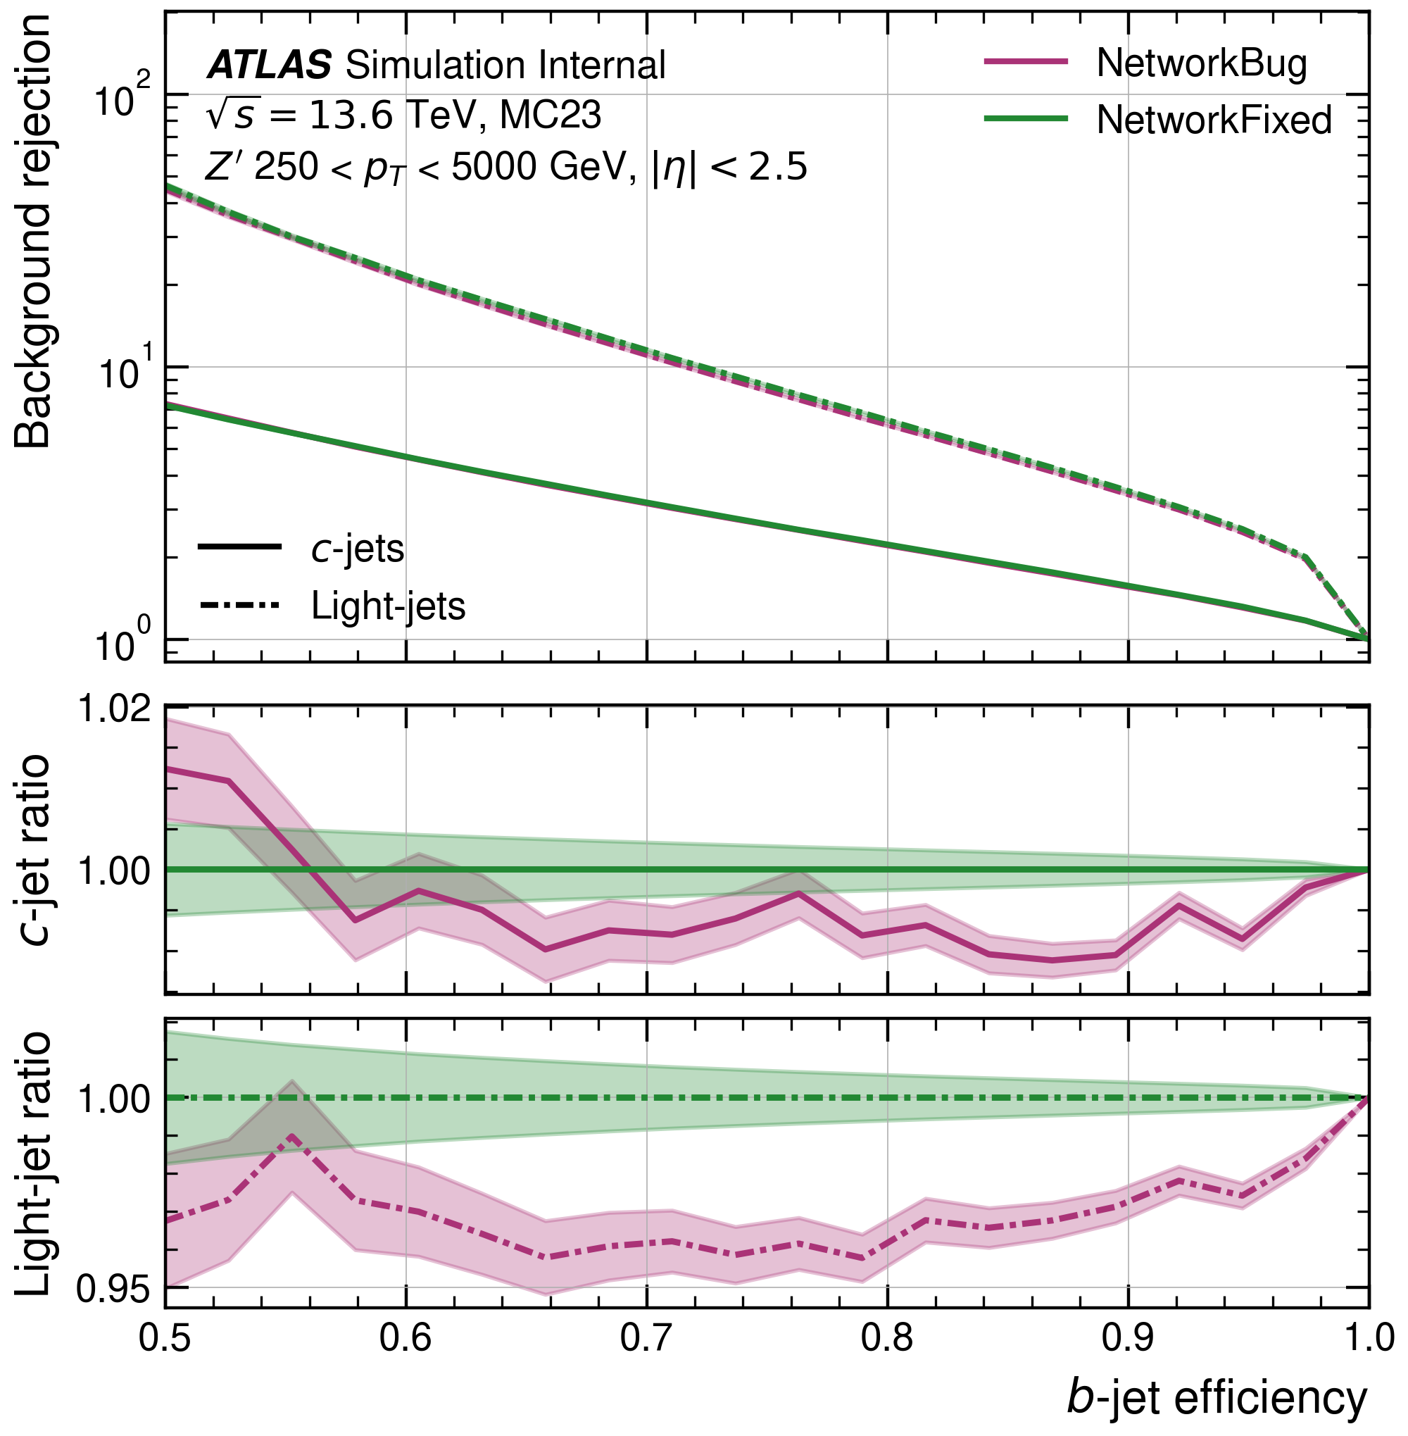
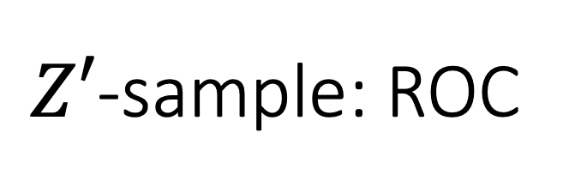
$Z′$-sample: ROC
Clear improvements in background rejection to the mislabelled training set
Particular improvements of light-jet rejection

Slide 5
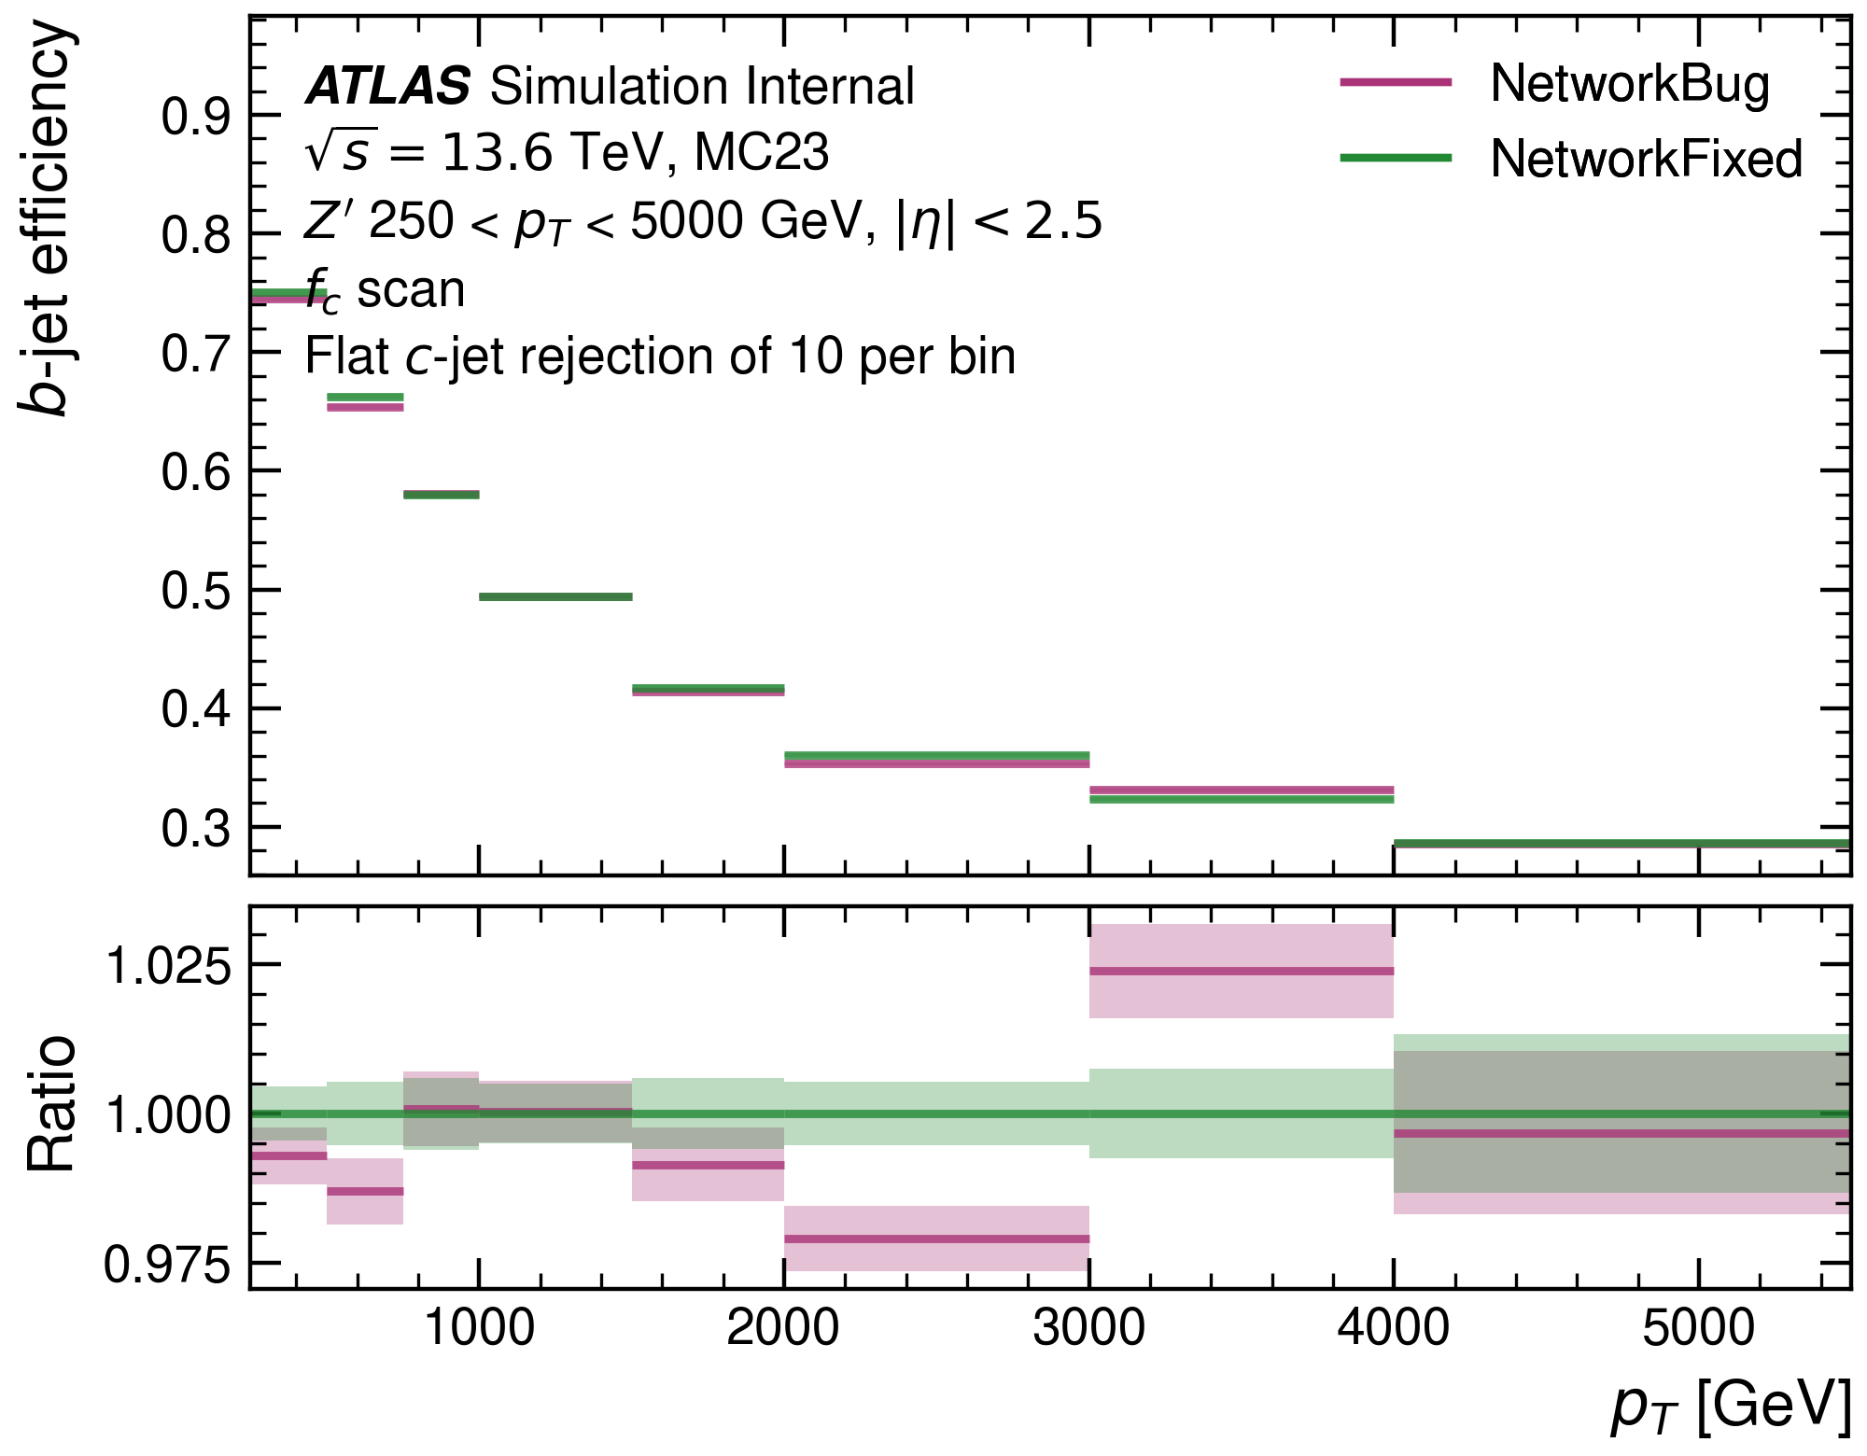
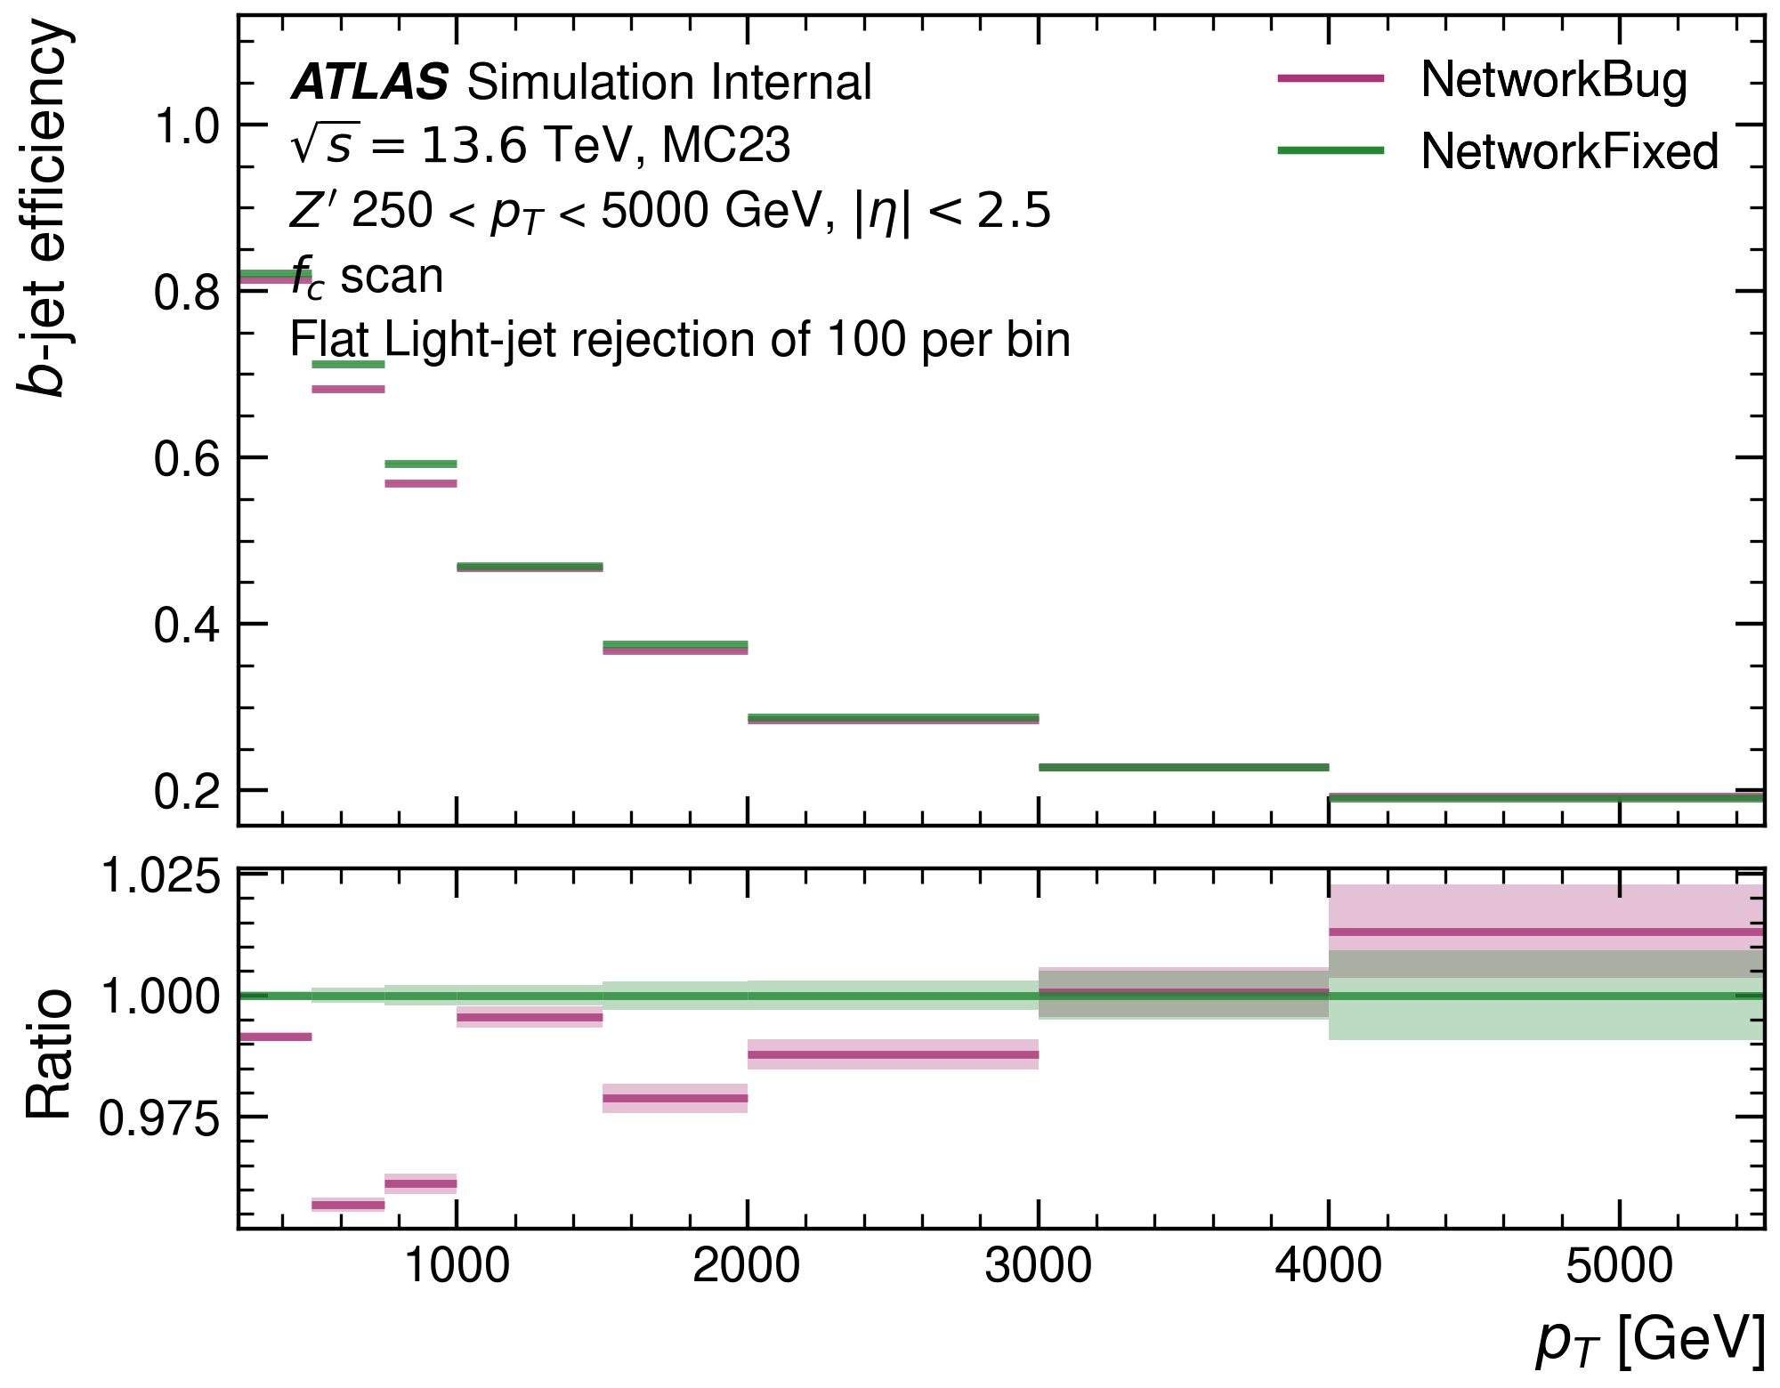
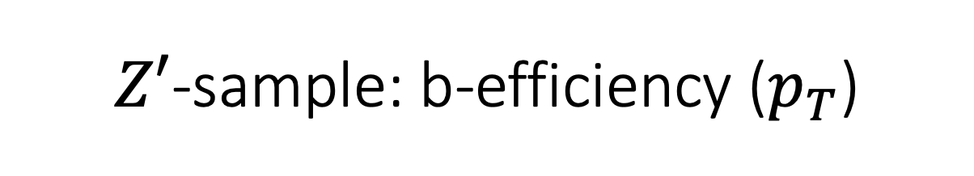
$Z′$-sample: b-efficiency ($p_{T}$)
Clear improvements in the $250 GeV<p_{T}<3000 GeV$ region.

Slide 6
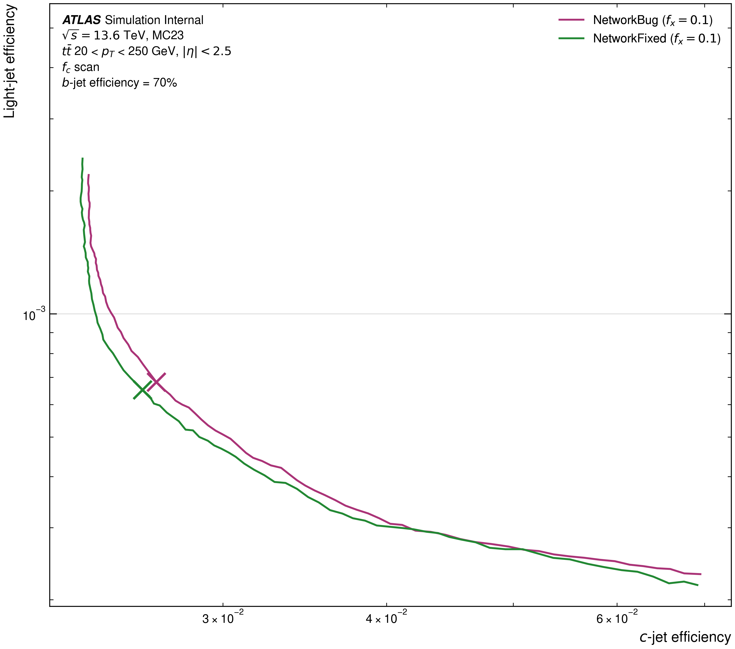
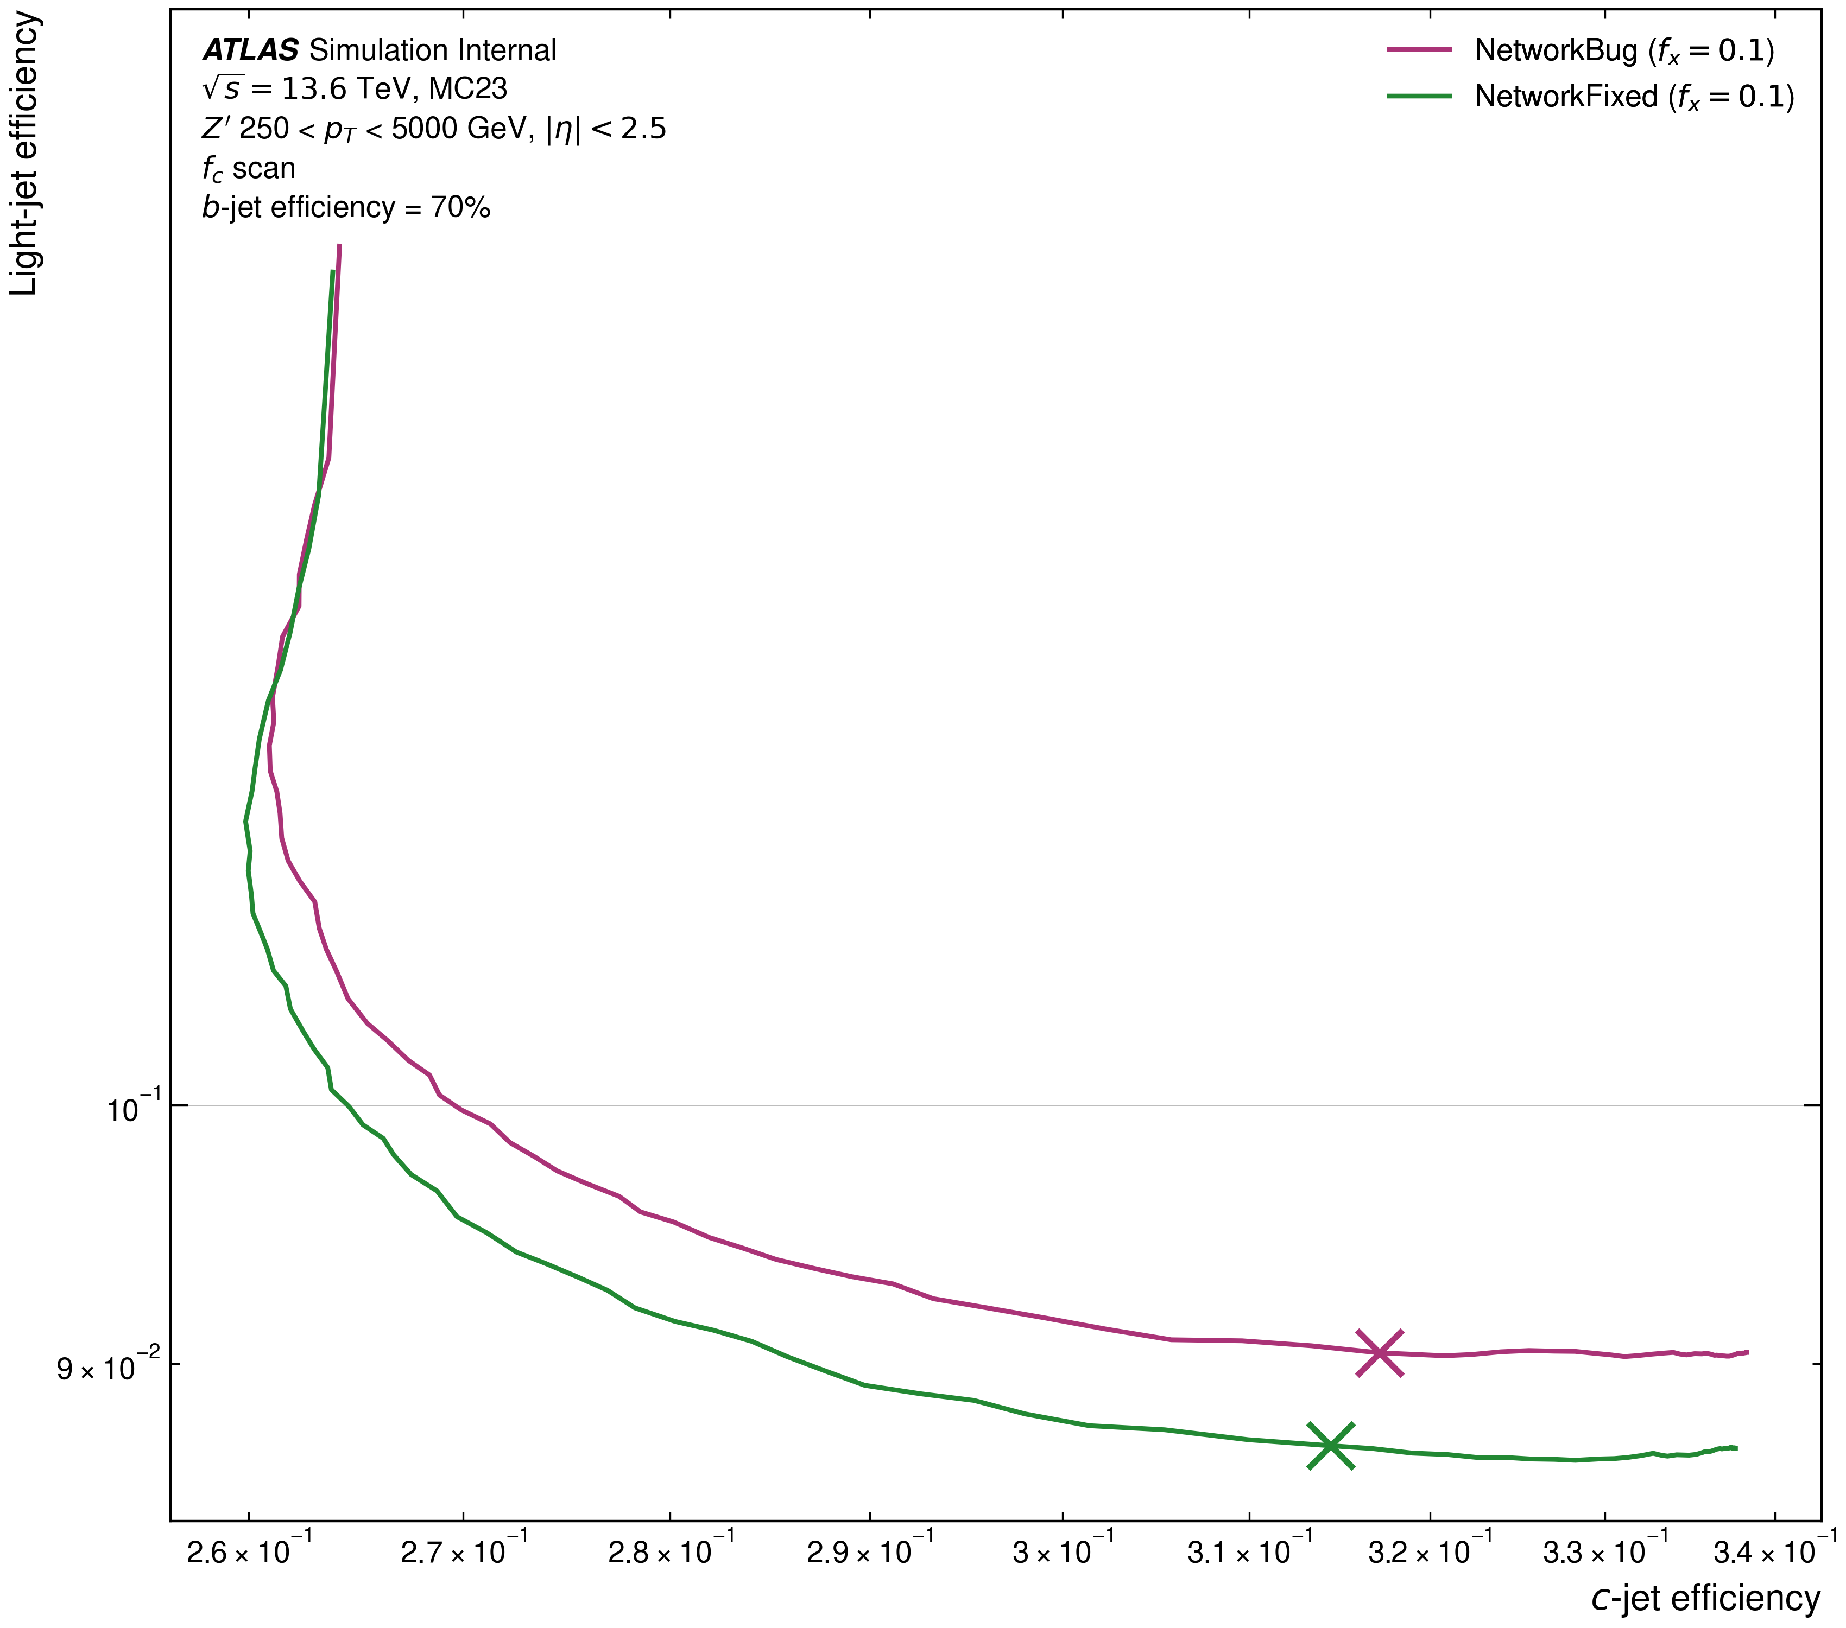
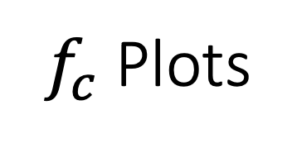
$f_{c}$ Plots

Slide 7
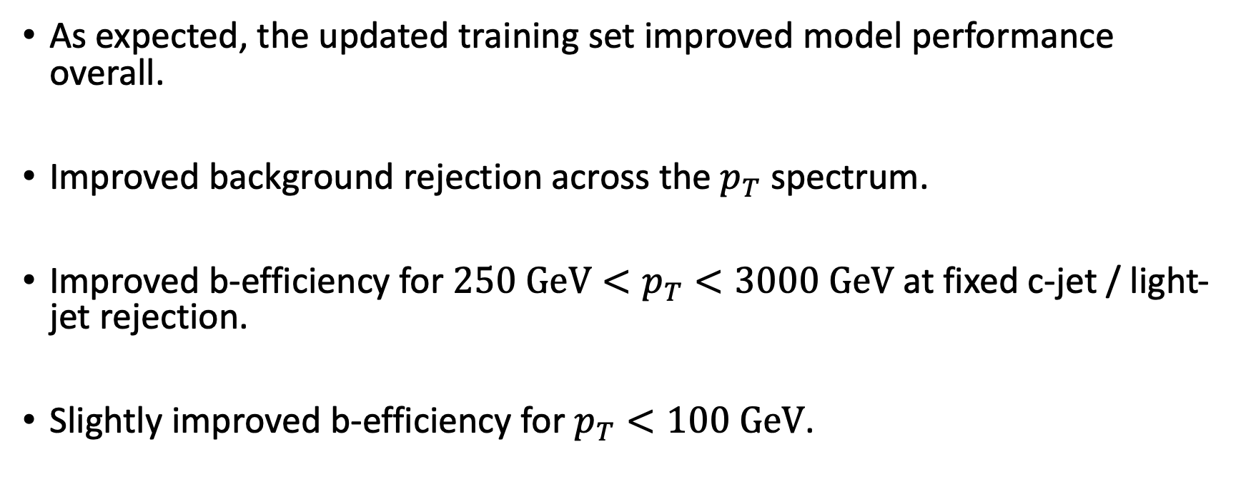
Summary
As expected, the updated training set improved model performance overall.
Improved background rejection across the $p_{T}$ spectrum.
Improved b-efficiency for $250 GeV<p_{T}<3000 GeV$ at fixed c-jet / light-jet rejection.
Slightly improved b-efficiency for $p_{T}<100 GeV$.

