Slide 1

MSc Project Weekly Update (8th Dec)
Ruben Hönscheid | Supervisor: Prof. Tim Scanlon
Contents:
Investigation into jet variables over $p_{T}$
Model performance against jet variables in different $p_{T}$ bins

Slide 2
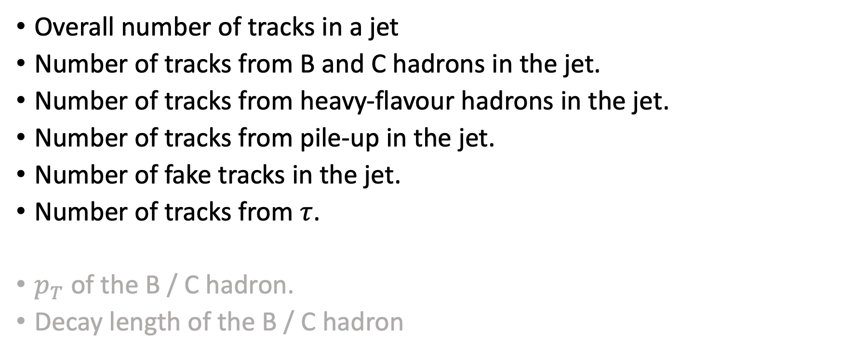
Jet variables under investigation
Overall number of tracks in a jet
Number of tracks from B and C hadrons in the jet.
Number of tracks from heavy-flavour hadrons in the jet.
Number of tracks from pile-up in the jet.
Number of fake tracks in the jet.
Number of tracks from $τ$.
$p_{T}$ of the B / C hadron.
Decay length of the B / C hadron

Slide 3
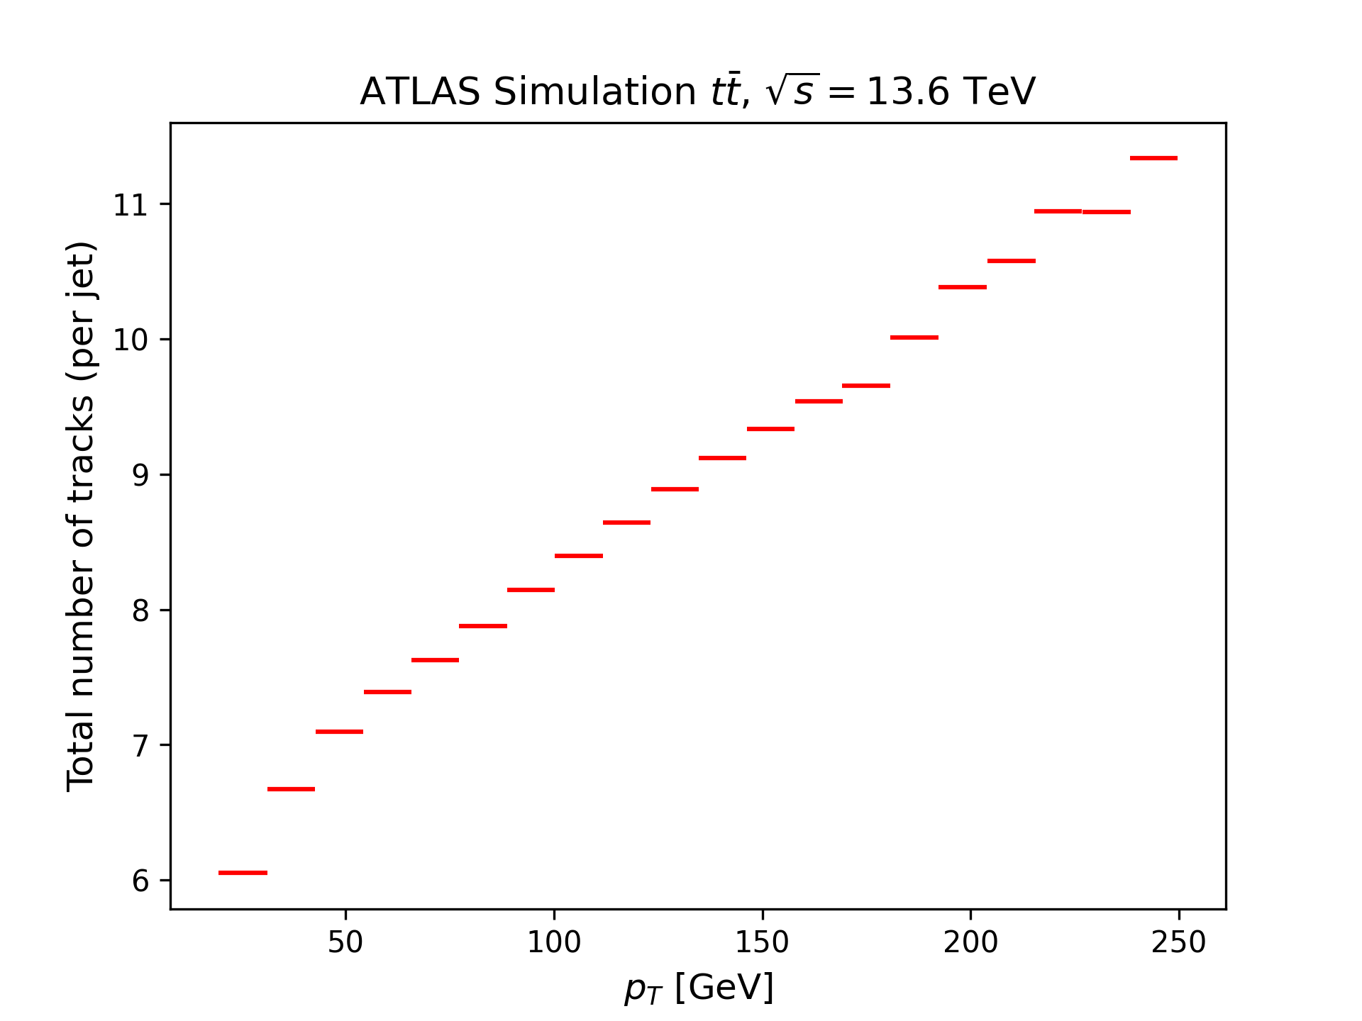
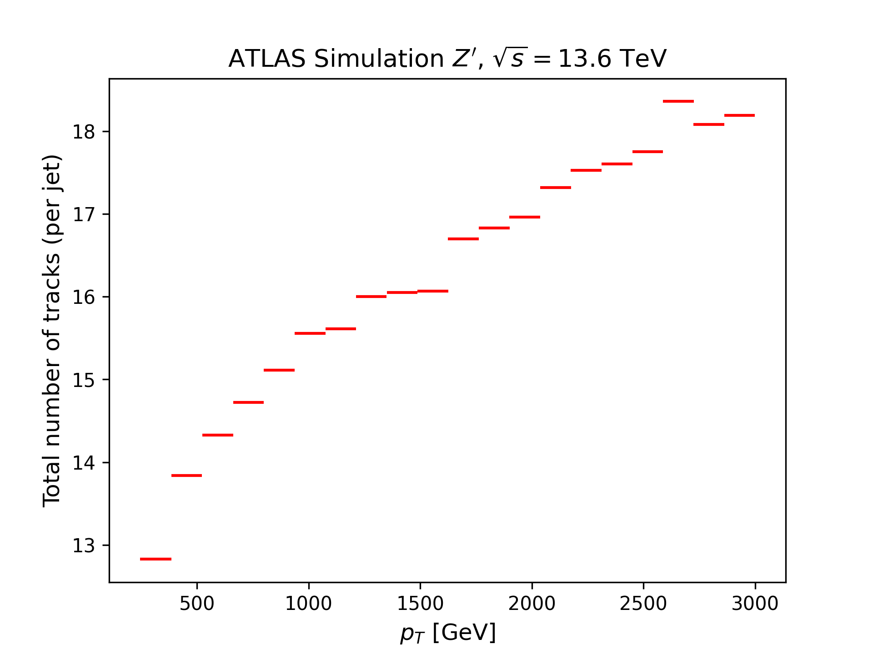
Number of tracks in the jet: $p_{T}$-dependence
Unsurprisingly, higher jet-$p_{T}$ gives an overall larger number of tracks per jet.

Slide 4
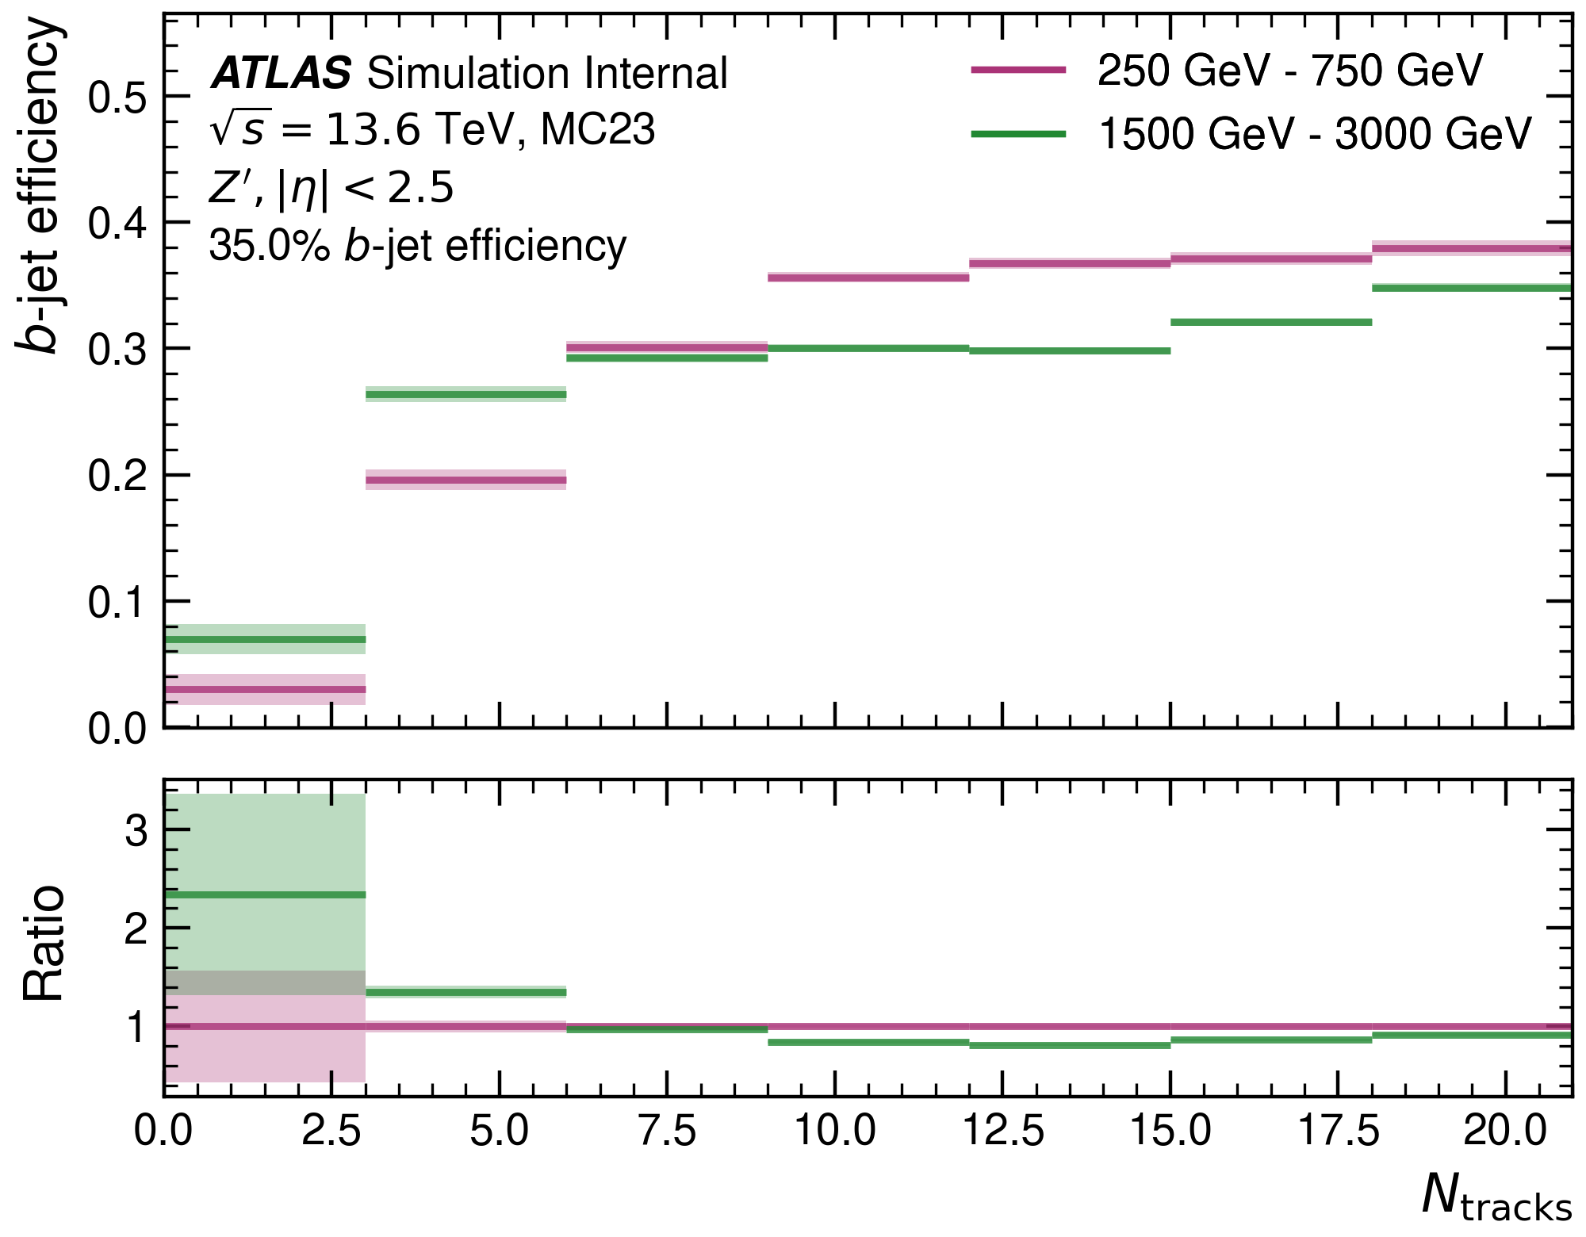
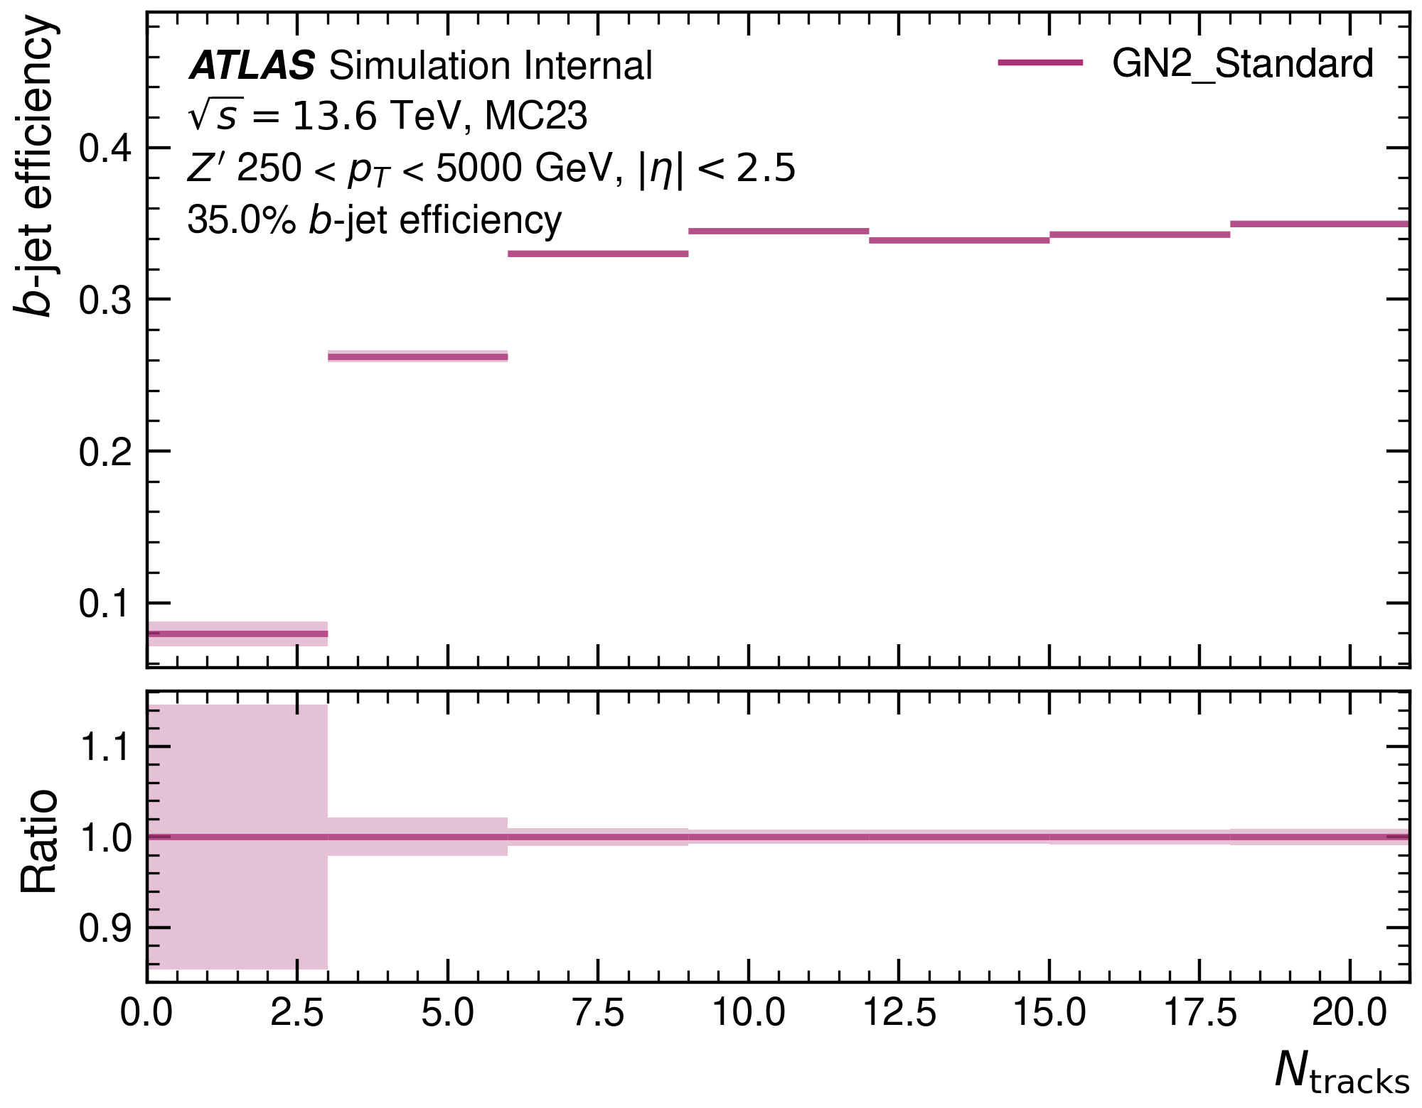
Number of tracks in the jet: $b$-efficiency
Jet classification benefits from large numbers of tracks in the jet.

Slide 5
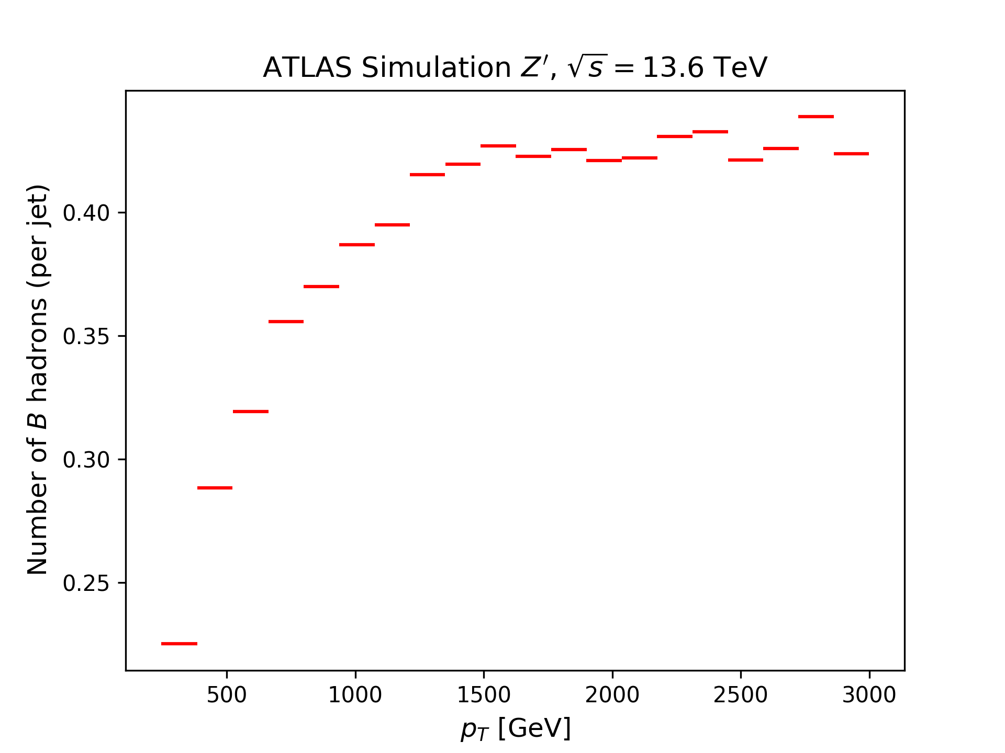
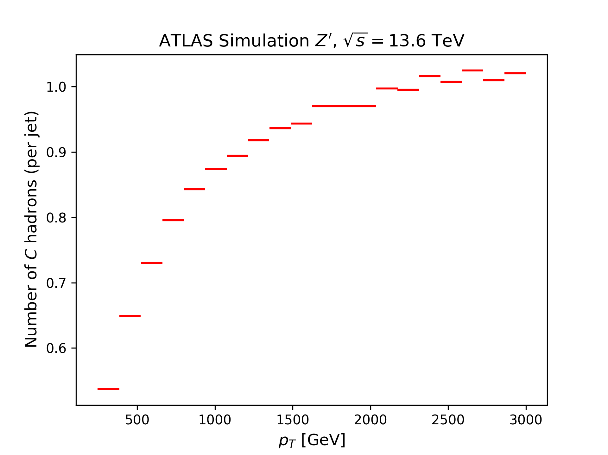
Number of tracks from $B$, $C$: $p_{T}$-dependence
At high $p_{T}$, every jet contains a $C$-hadron on average, while every second jet contains a $B$-hadron.

Slide 6
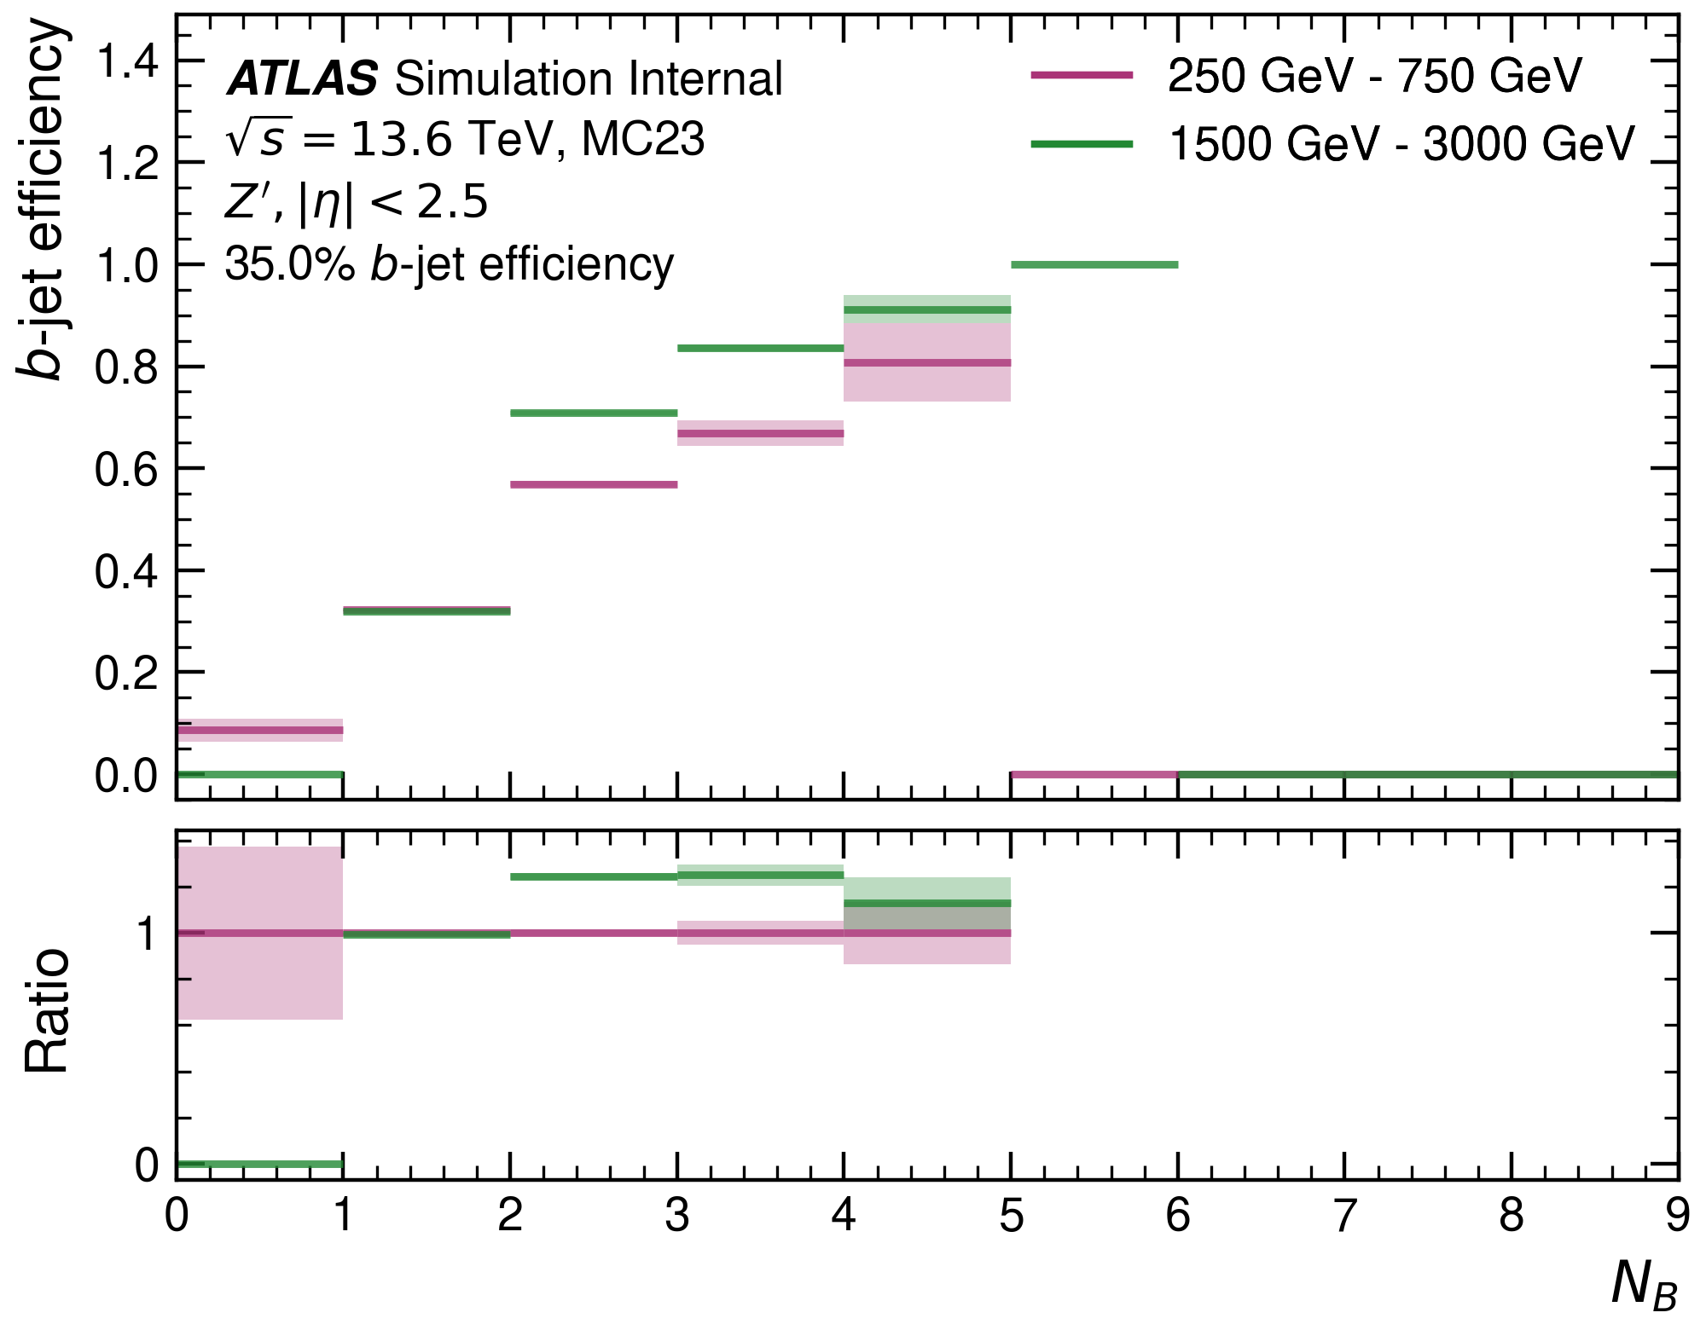
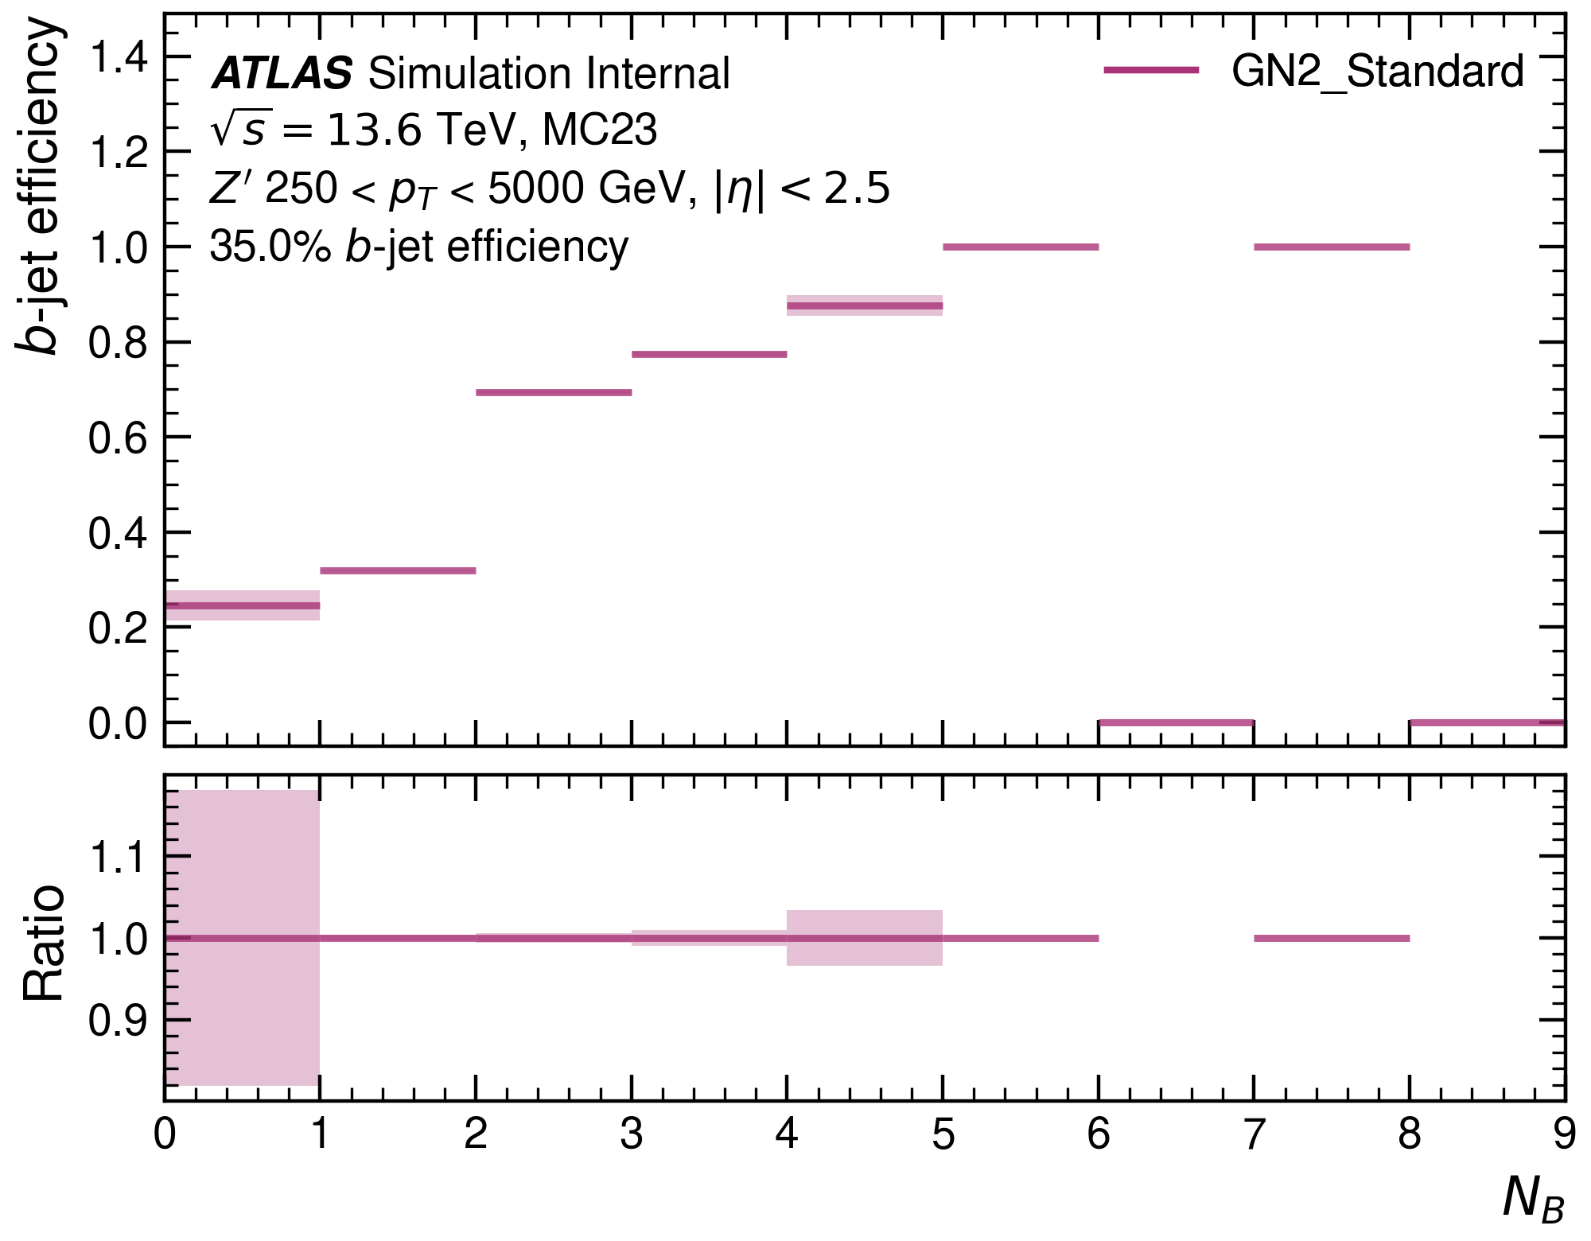
Number of tracks from $B$: $b$-efficiency
For jets with larger numbers of $B$-hadrons, the $b$-efficiency increases.

Slide 7
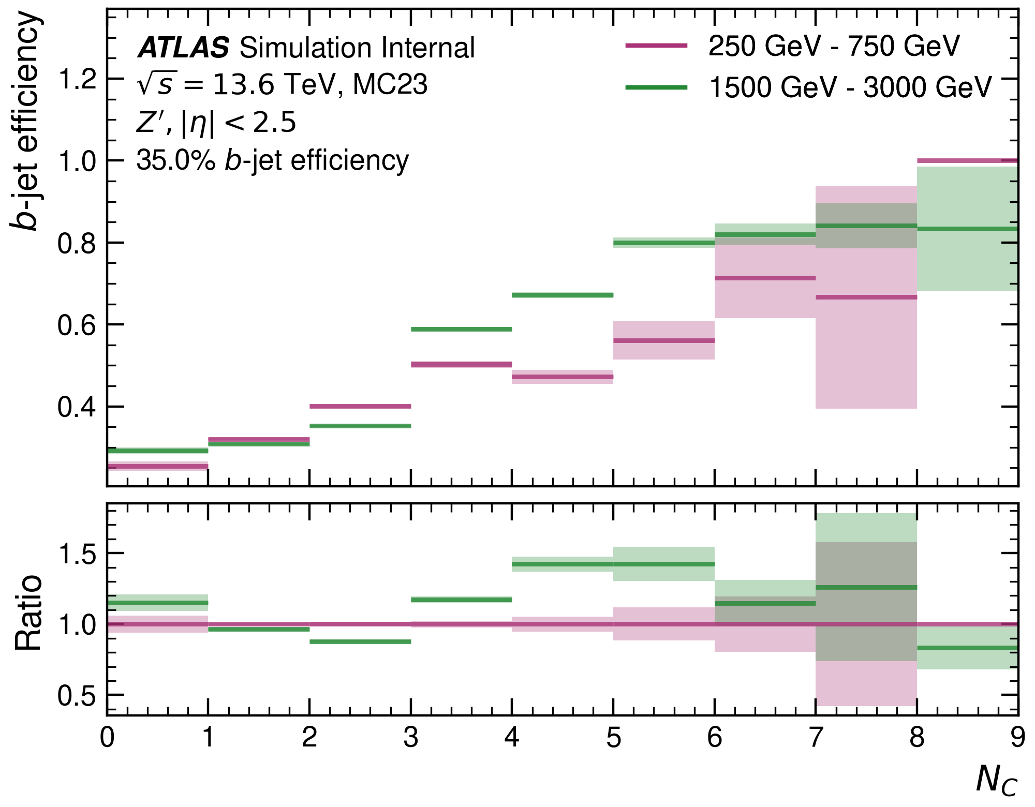
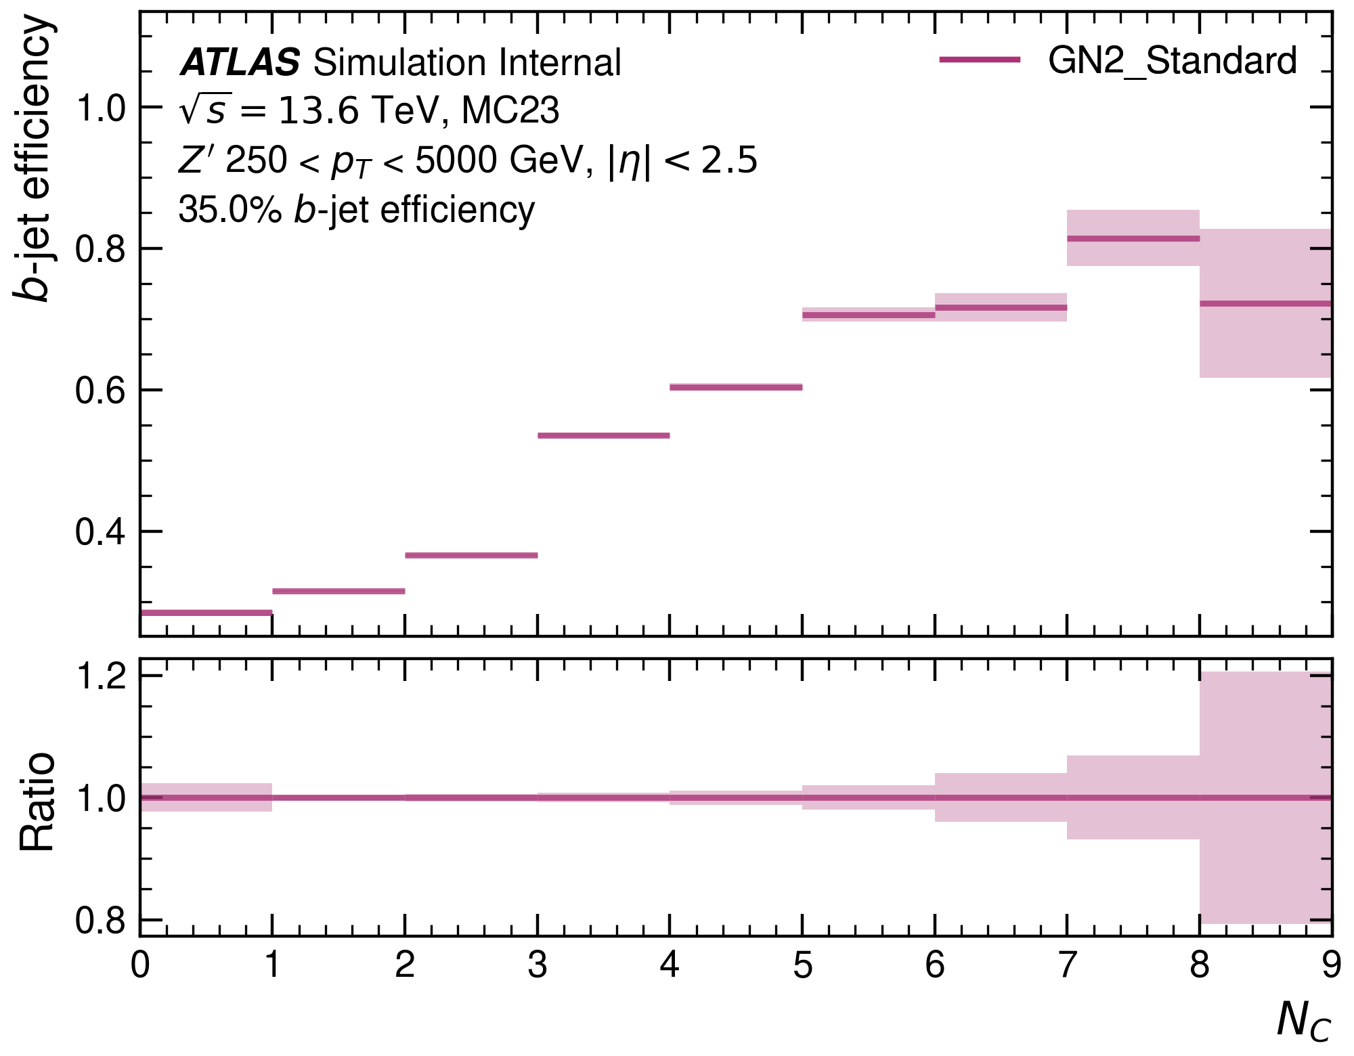
Number of tracks from $C$: $b$-efficiency
For jets with larger numbers of $C$-hadrons, the $b$-efficiency increases.

Slide 8
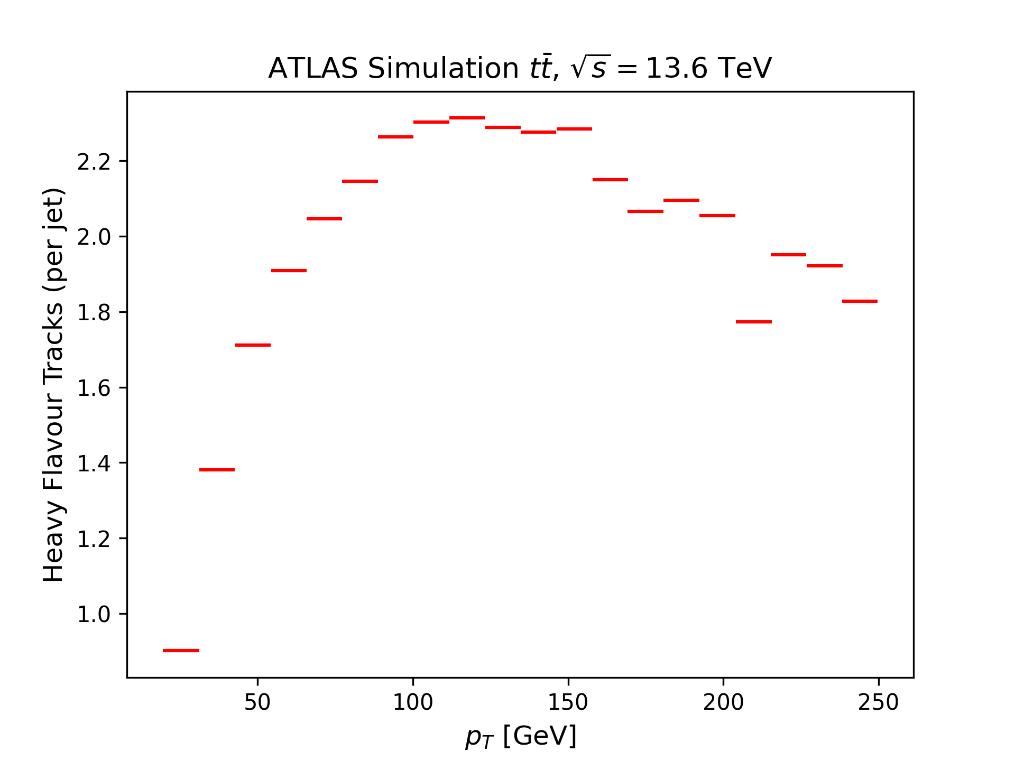
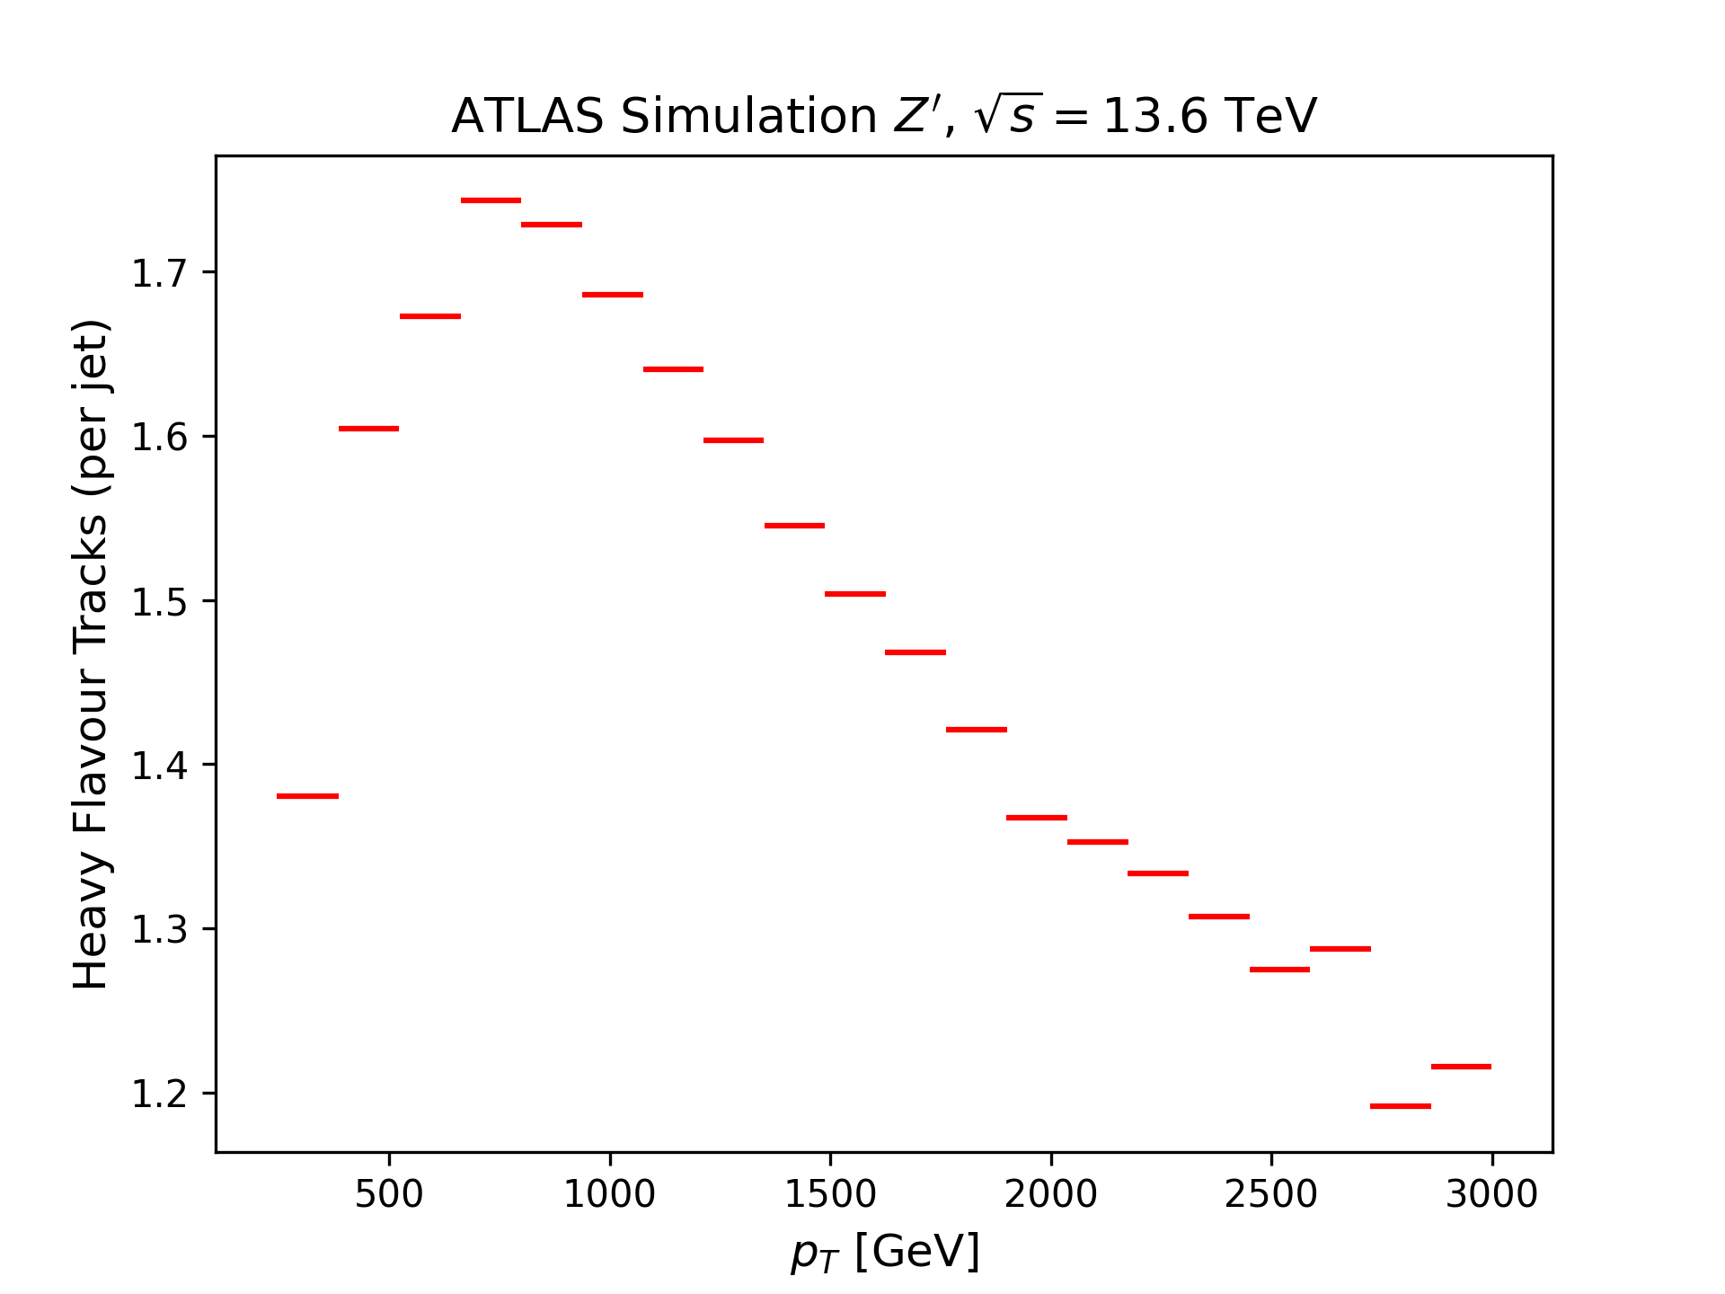
Total number of tracks from HF: $p_{T}$-dependence
Smaller numbers of HF tracks in high-$p_{T}$ region
Most HF tracks in $100<p_{T}<1500 GeV$

Slide 9
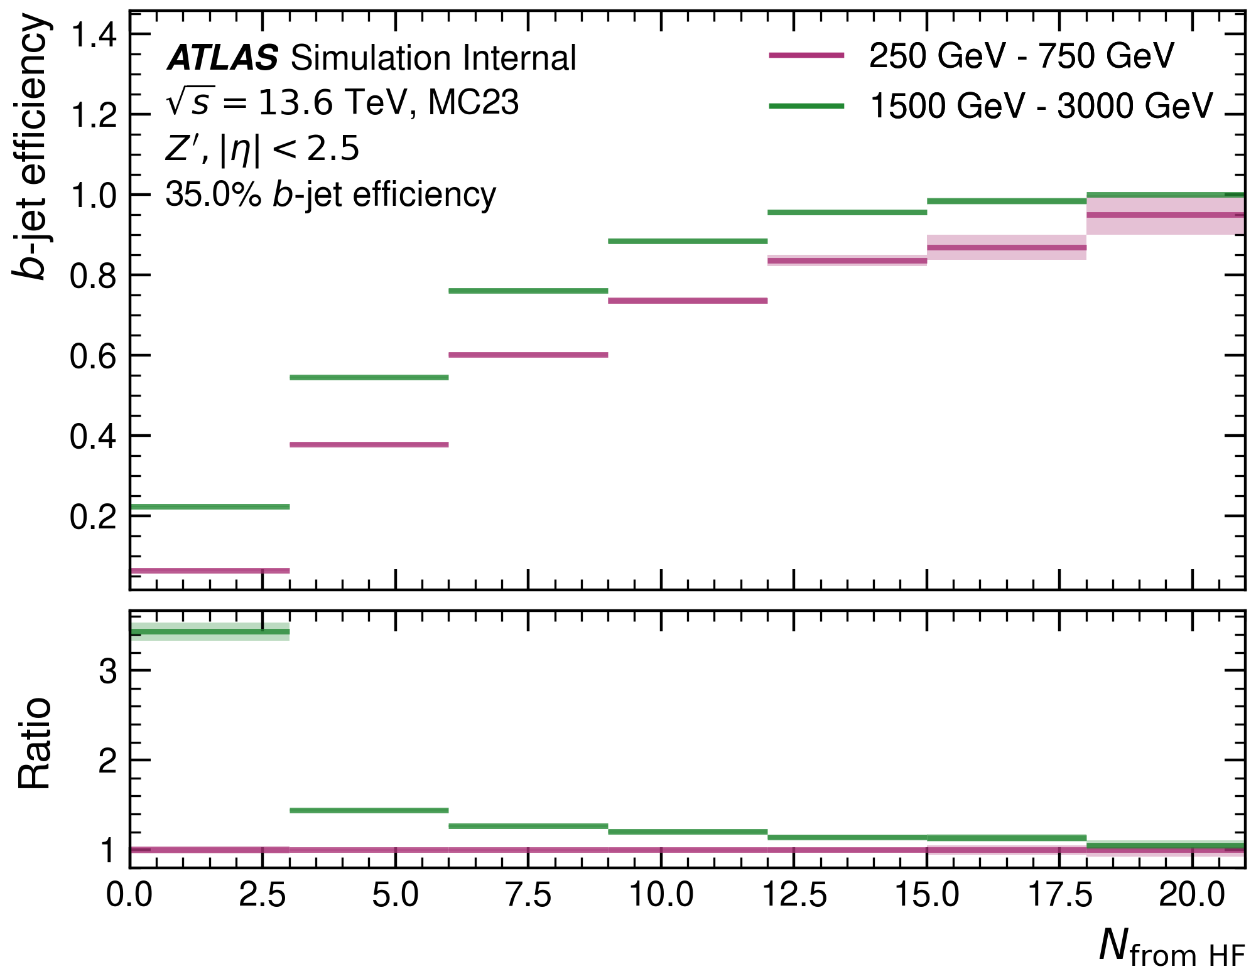
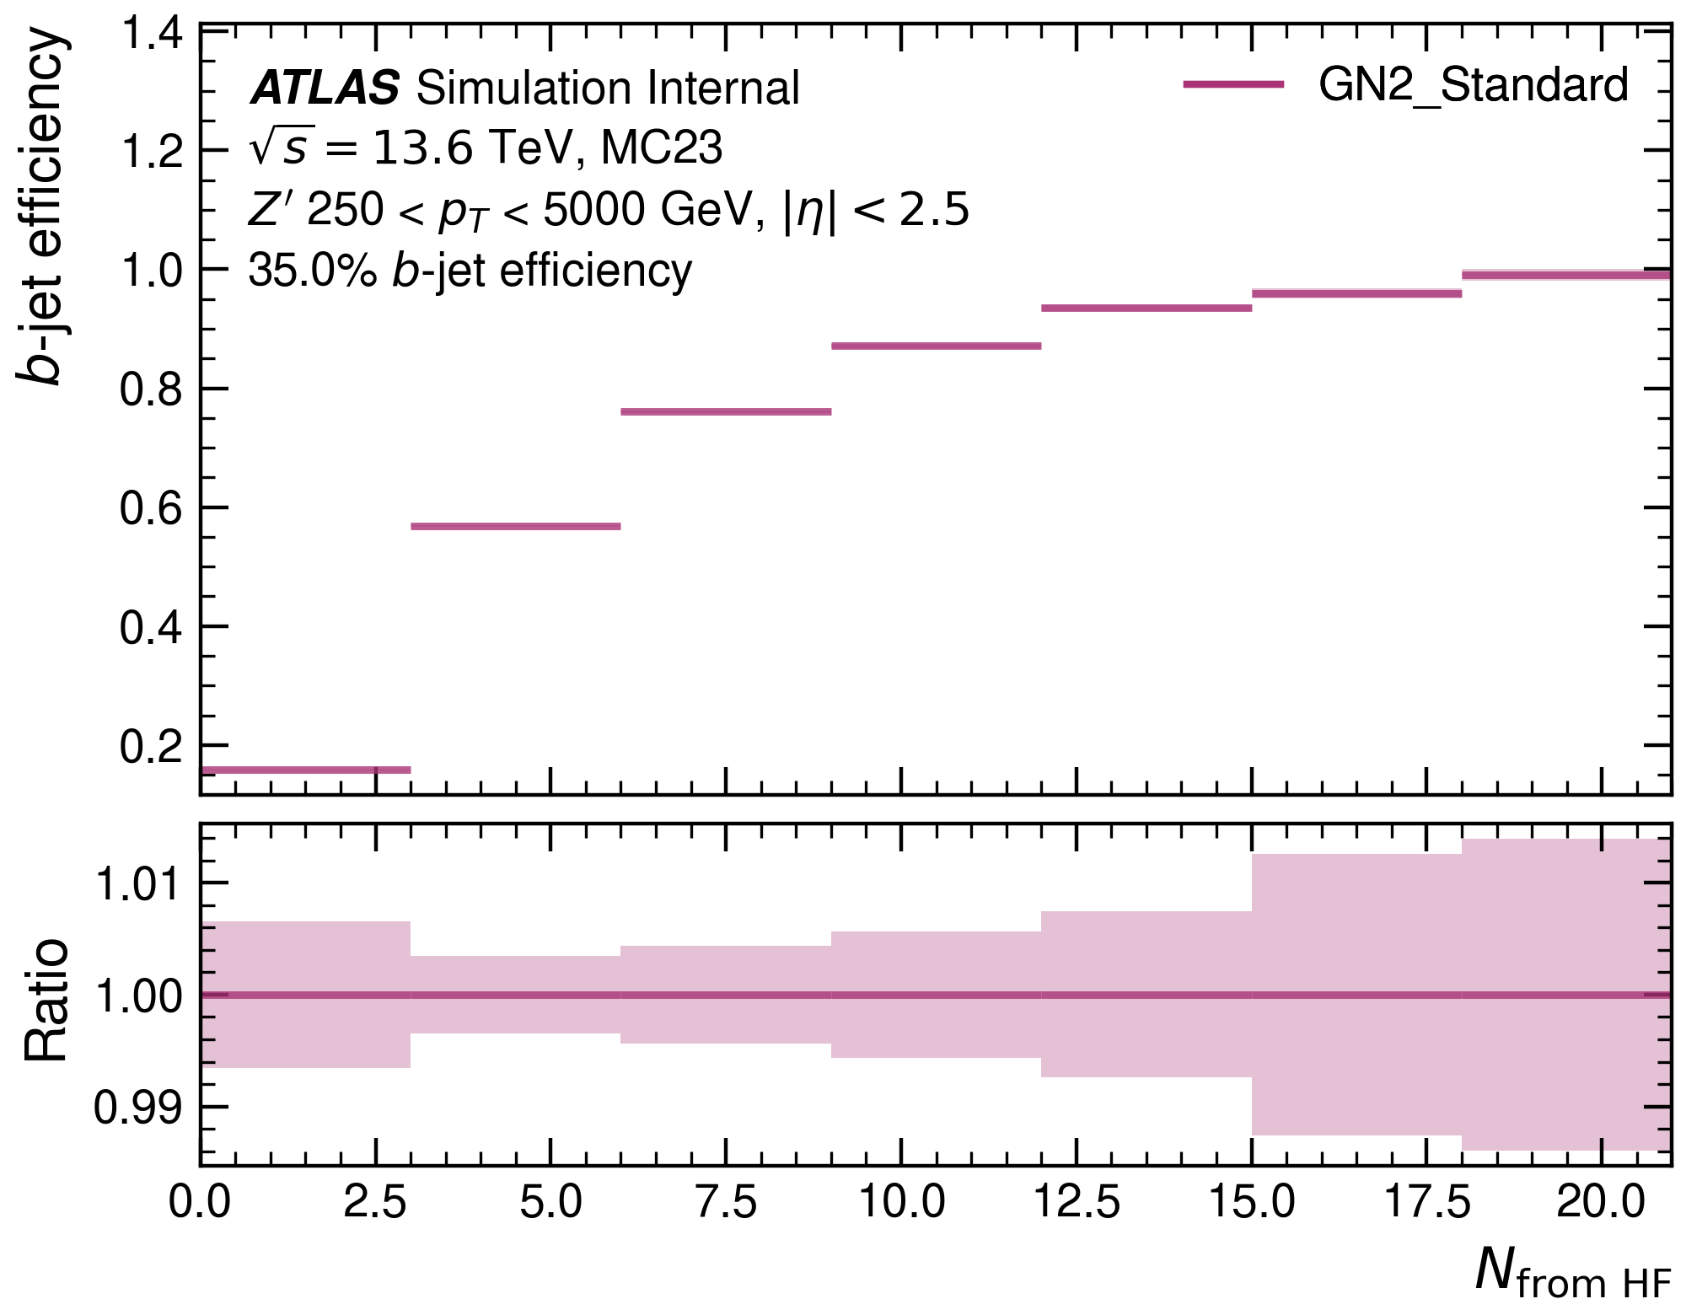

Total number of tracks from HF: $b$-efficiency
Overall, the model greatly benefits form heavy-flavour tracks.
Partly explains good model performance in $100<p_{T}<1000 GeV$.
Partly explains model failure at very high and very low $p_{T}$.

Slide 10
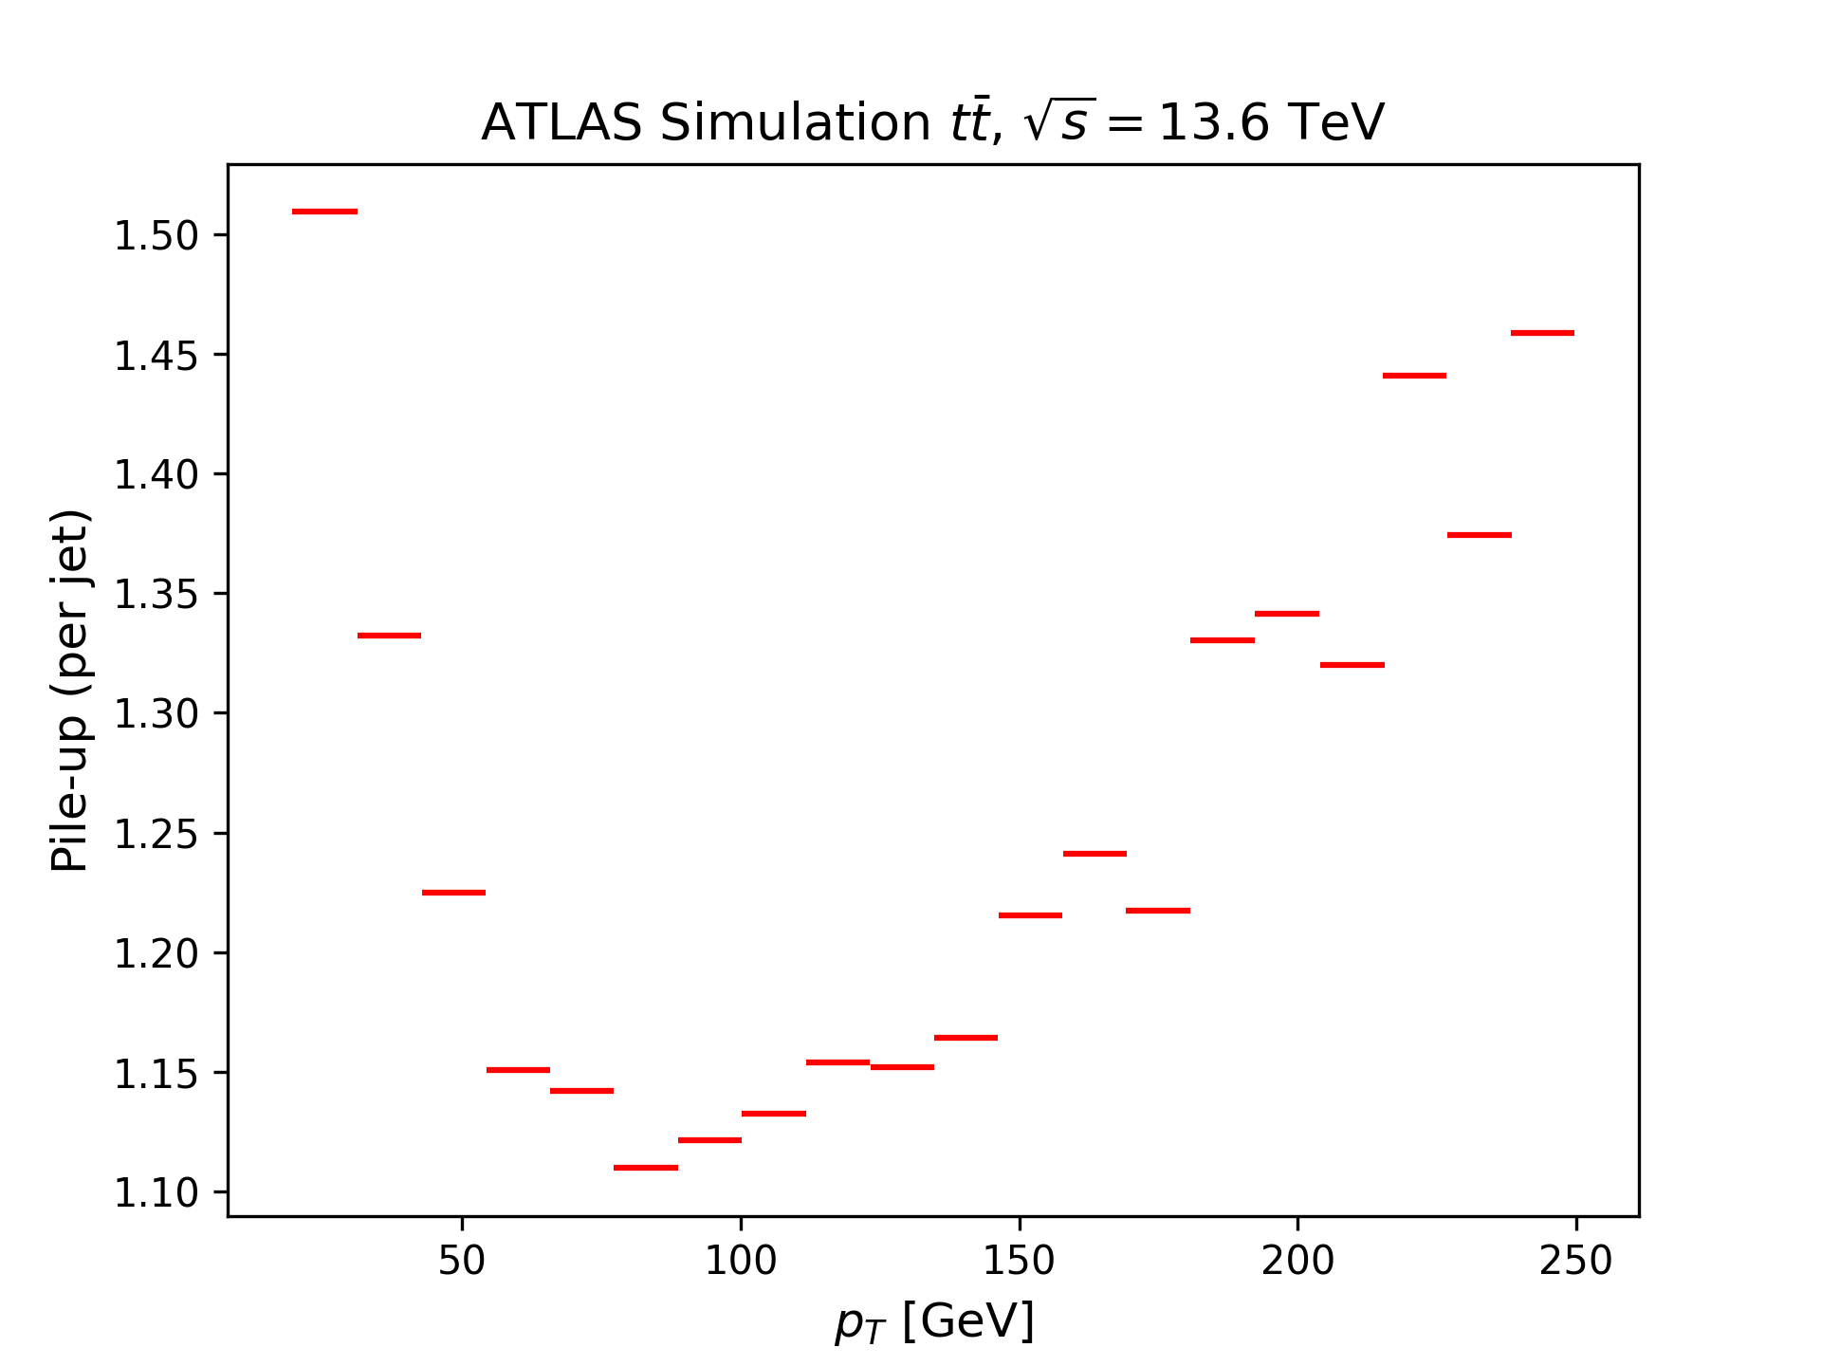
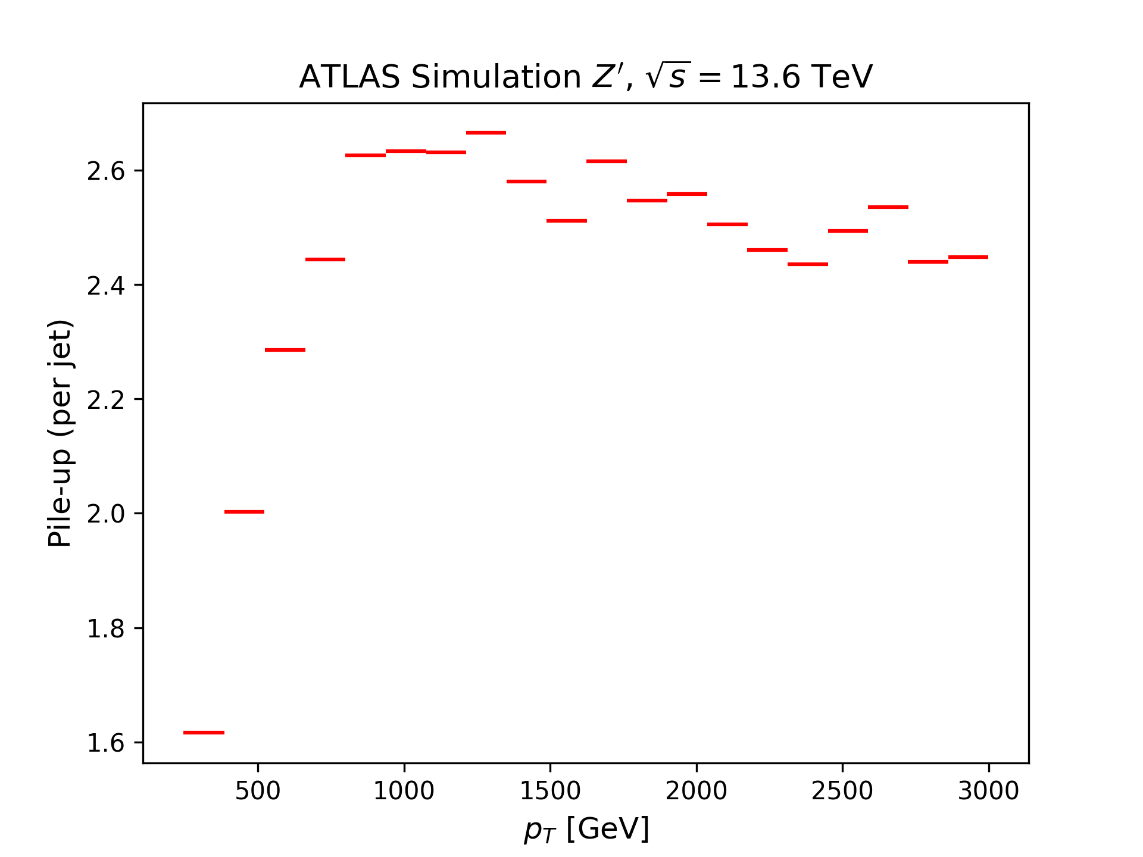
Number of tracks from pile-up: $p_{T}$-dependence
On average, all jets contain tracks from pile-up. At high $p_{T}$, pile-up contamination is about twice as high.

Slide 11
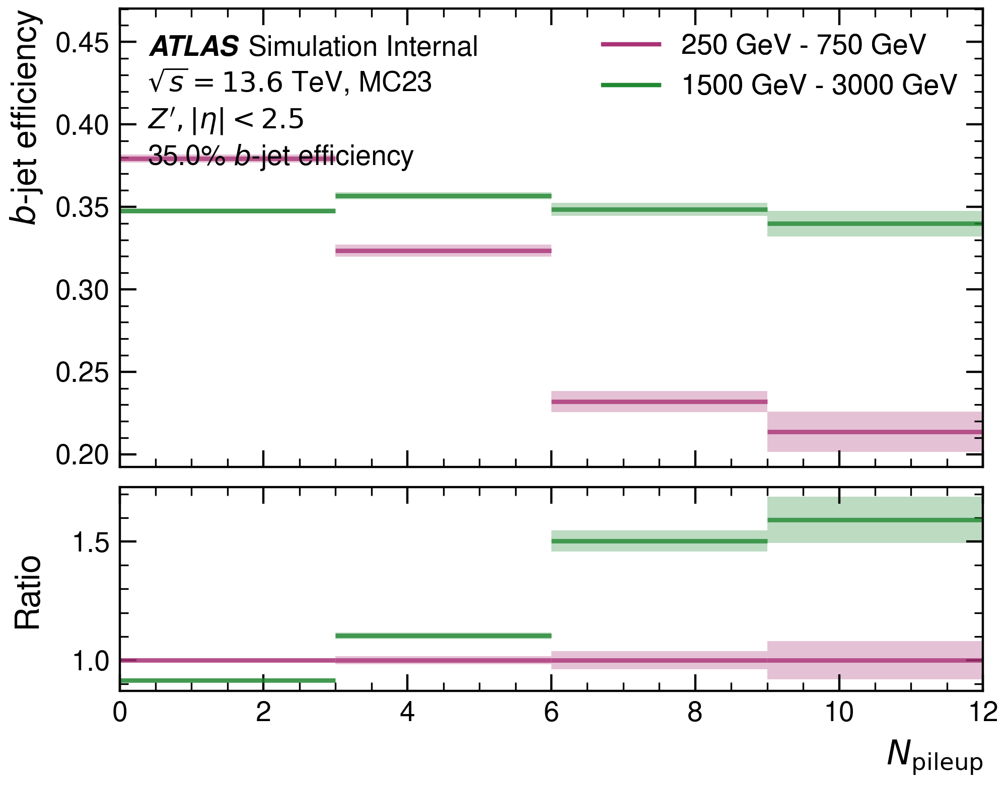
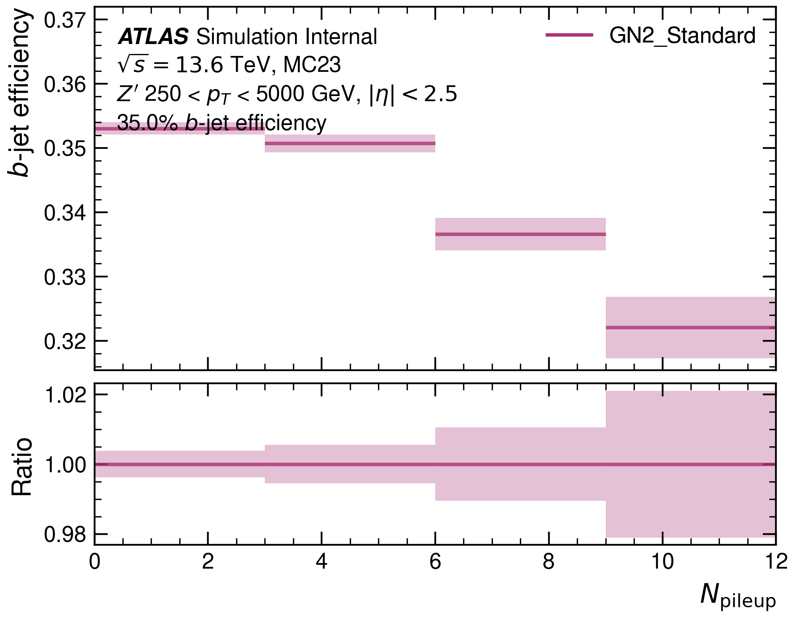
Number of tracks from pile-up: $b$-efficiency
Pile-up degrades the model performance. At small $p_{T}$ the negative effects of large pile-up are smaller than at large $p_{T}$.

Slide 12
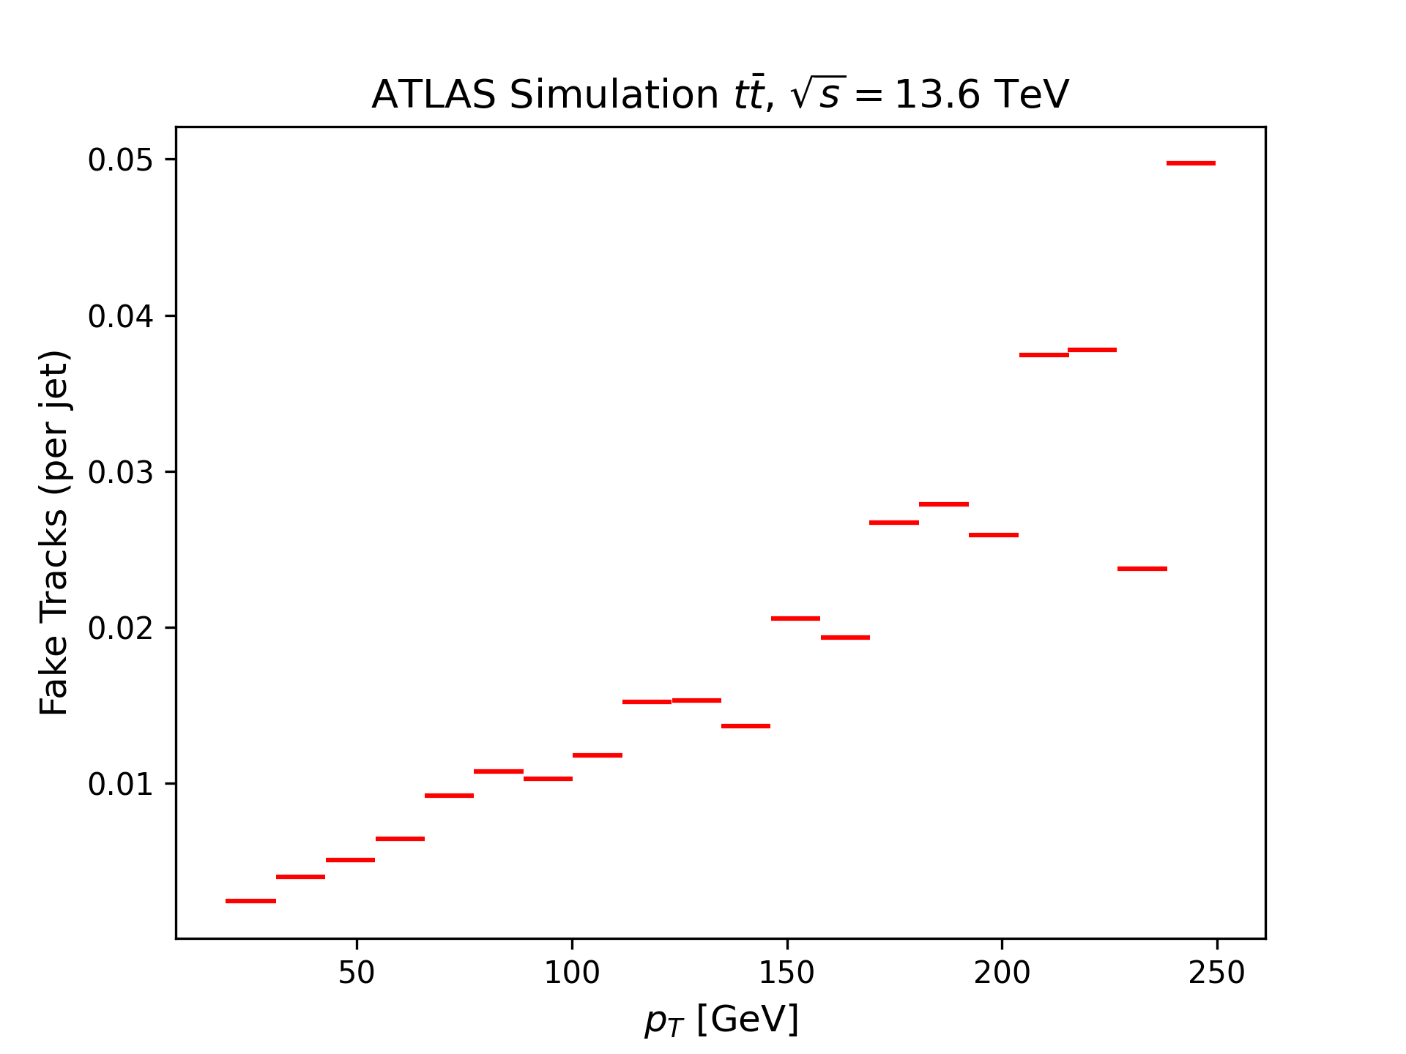
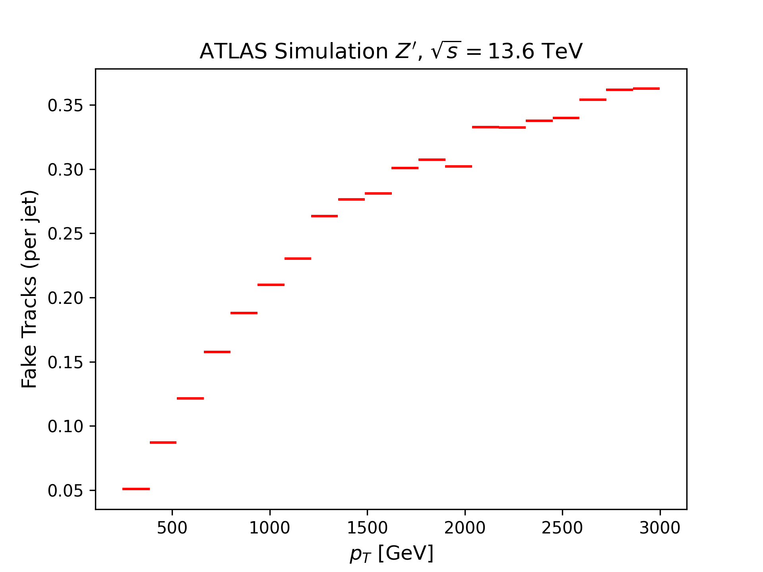
Number of fake tracks: $p_{T}$-dependence
The presence of fake tracks grows substantially at high $p_{T}$.

Slide 13
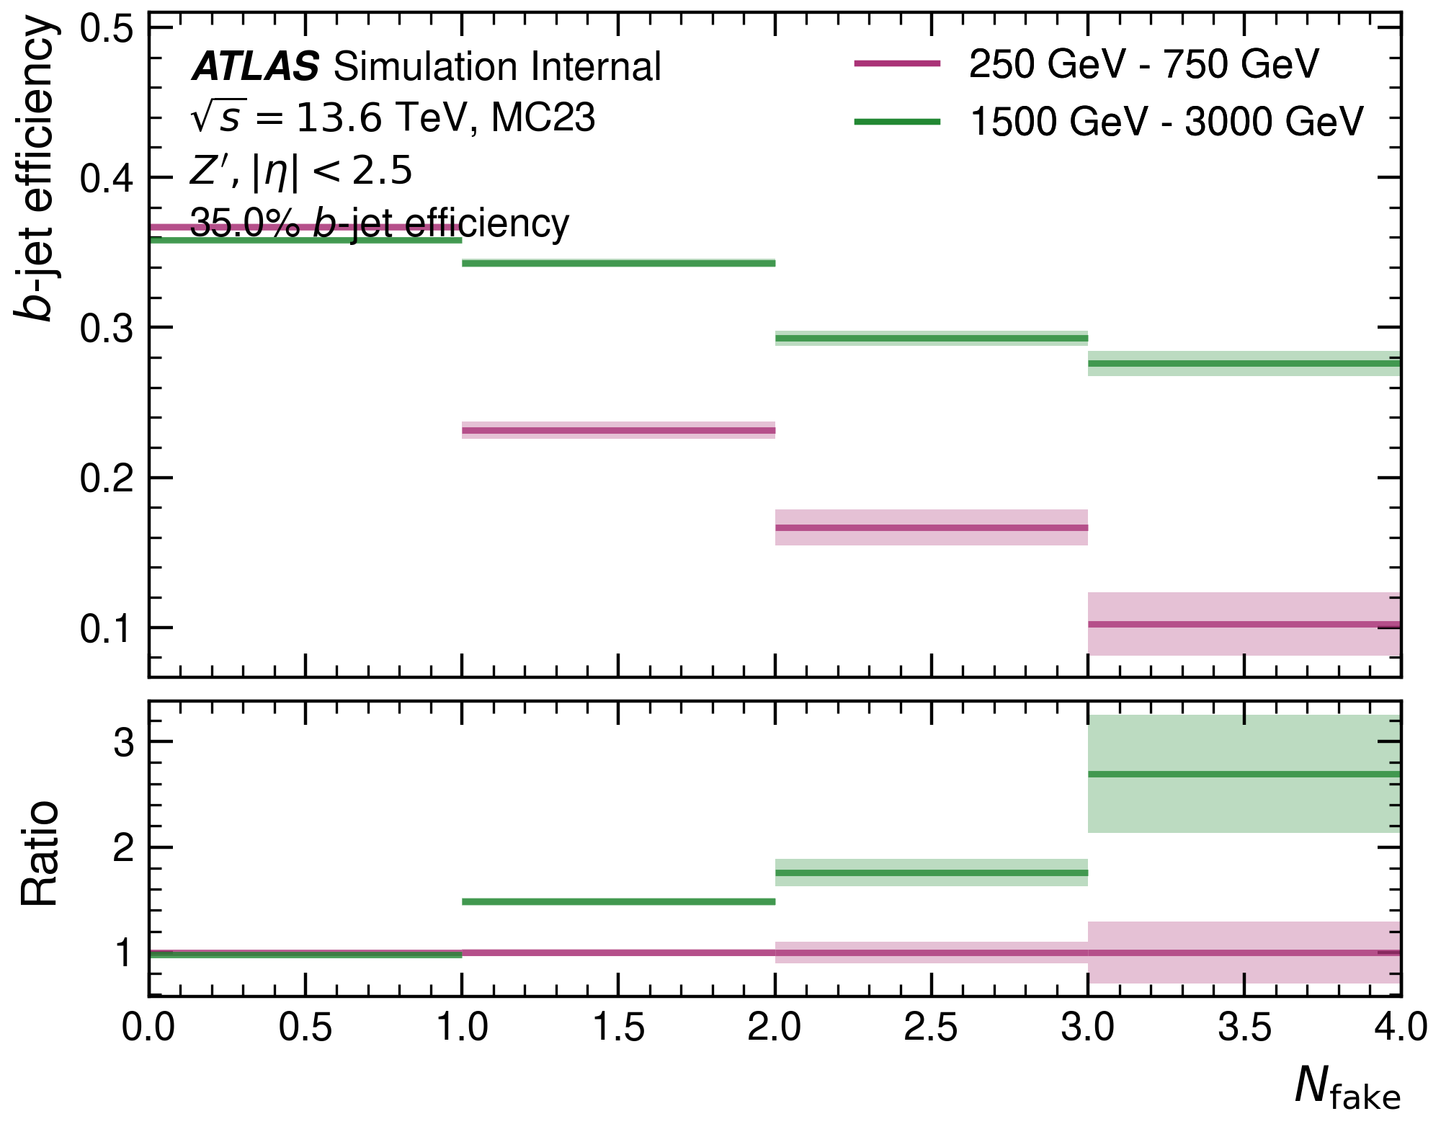
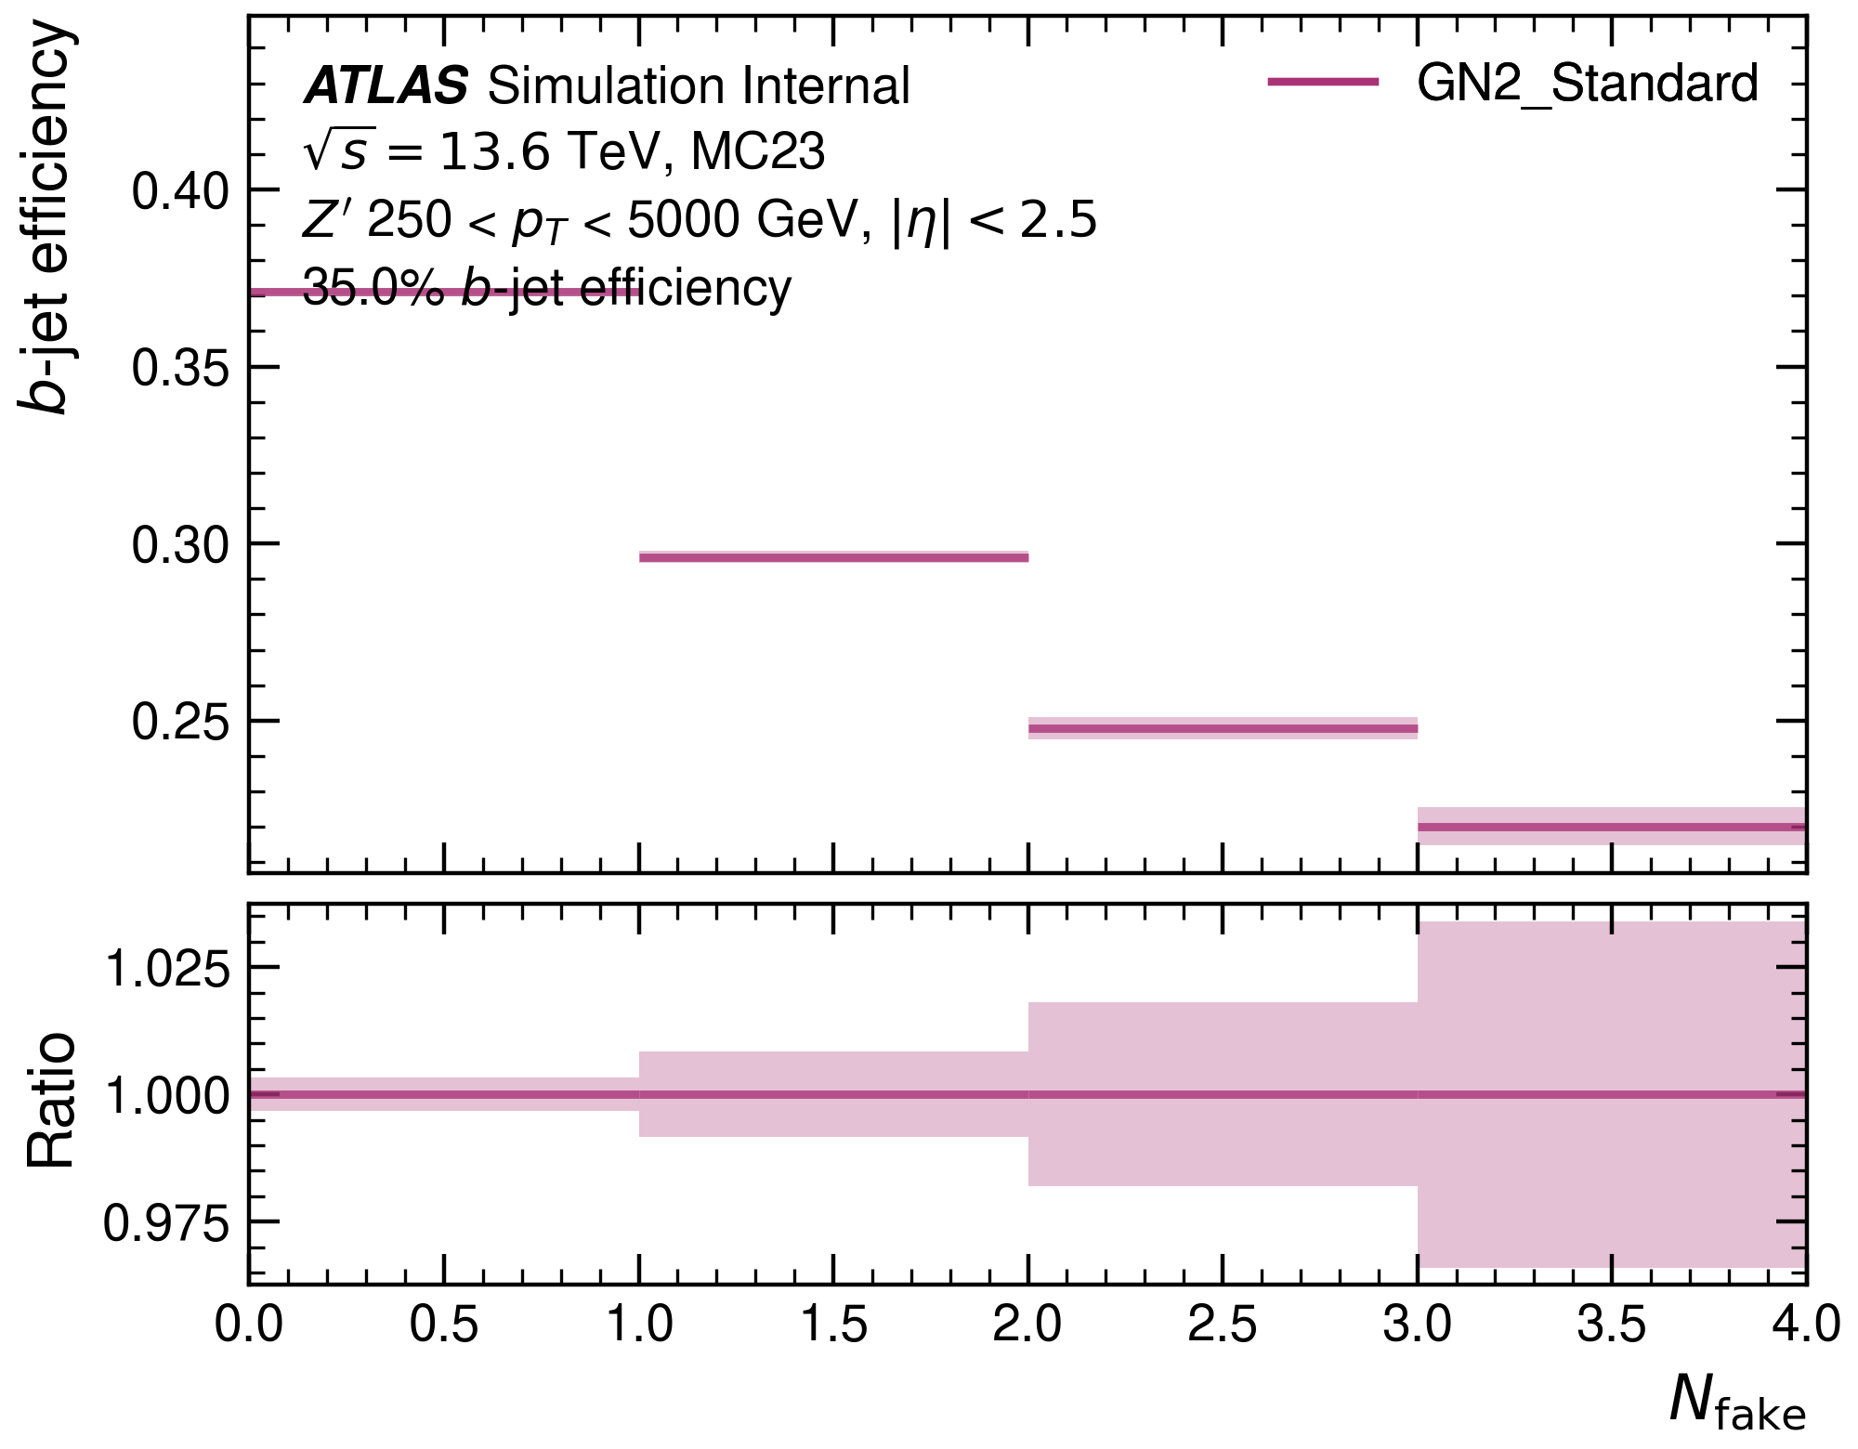
Number of fake tracks: $b$-efficiency
Large number of fake tracks in a jet are a big problem for the network.
Partly explains the poor performance at high $p_{T}$.

Slide 14
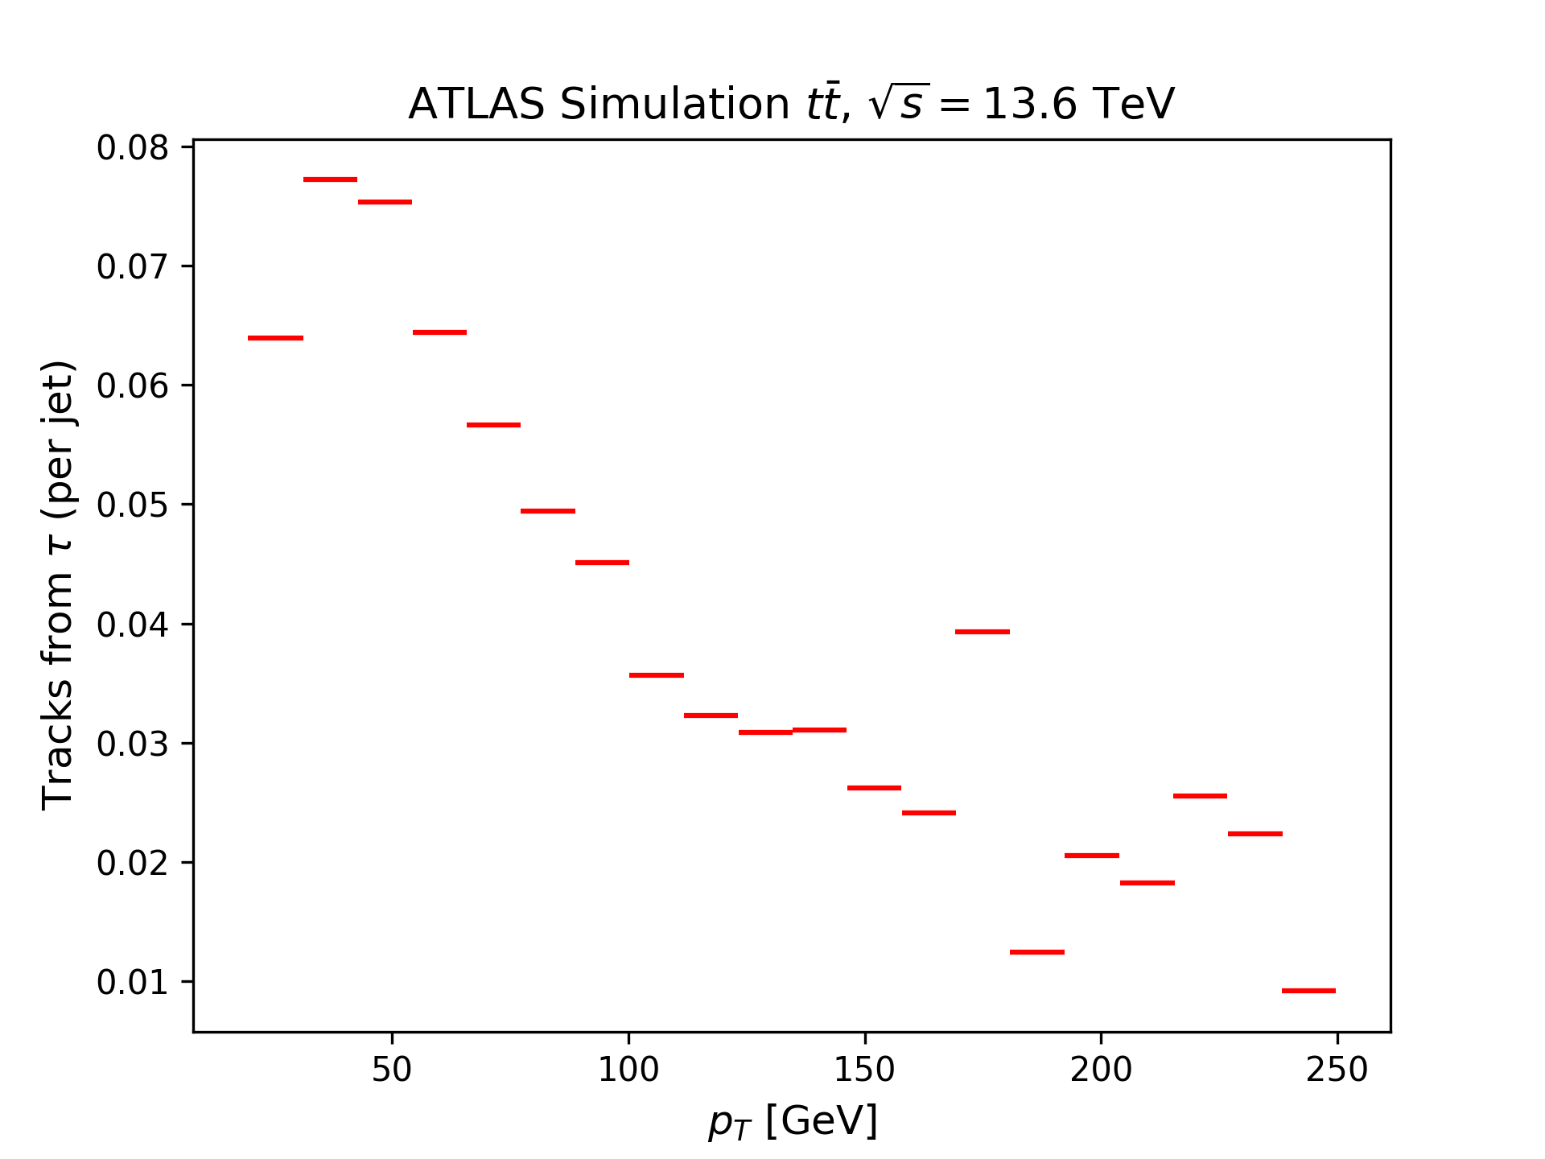
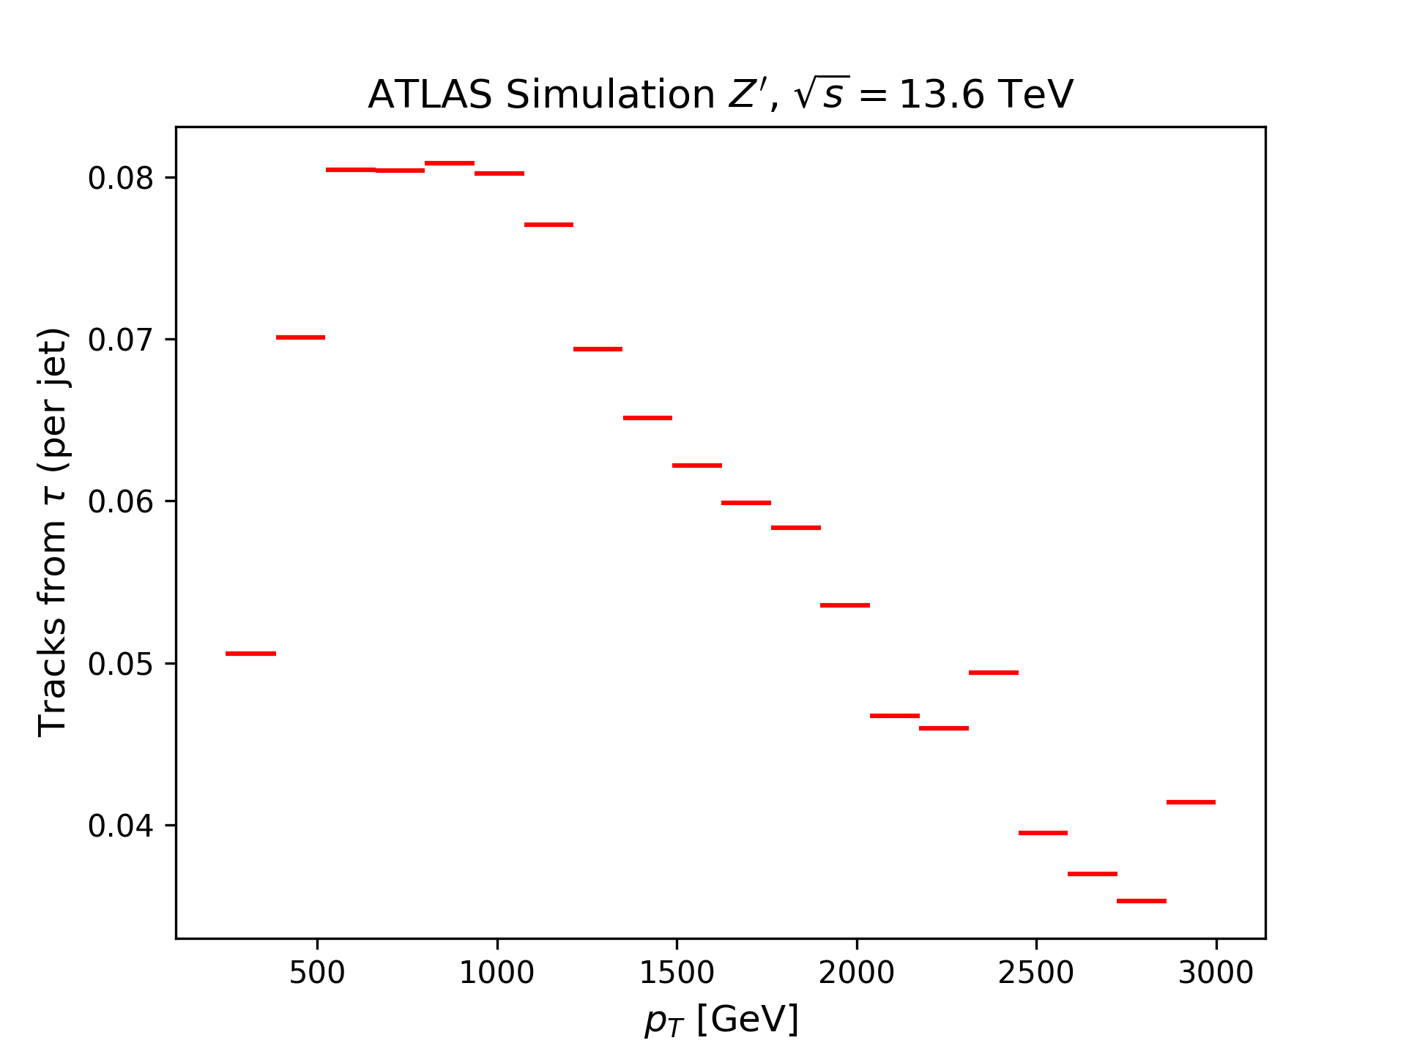
Number of tracks from $τ$: $p_{T}$-dependence
$τ$ tracks are generally very rare. Highest at low $p_{T}$ and around 1000 GeV.

Slide 15
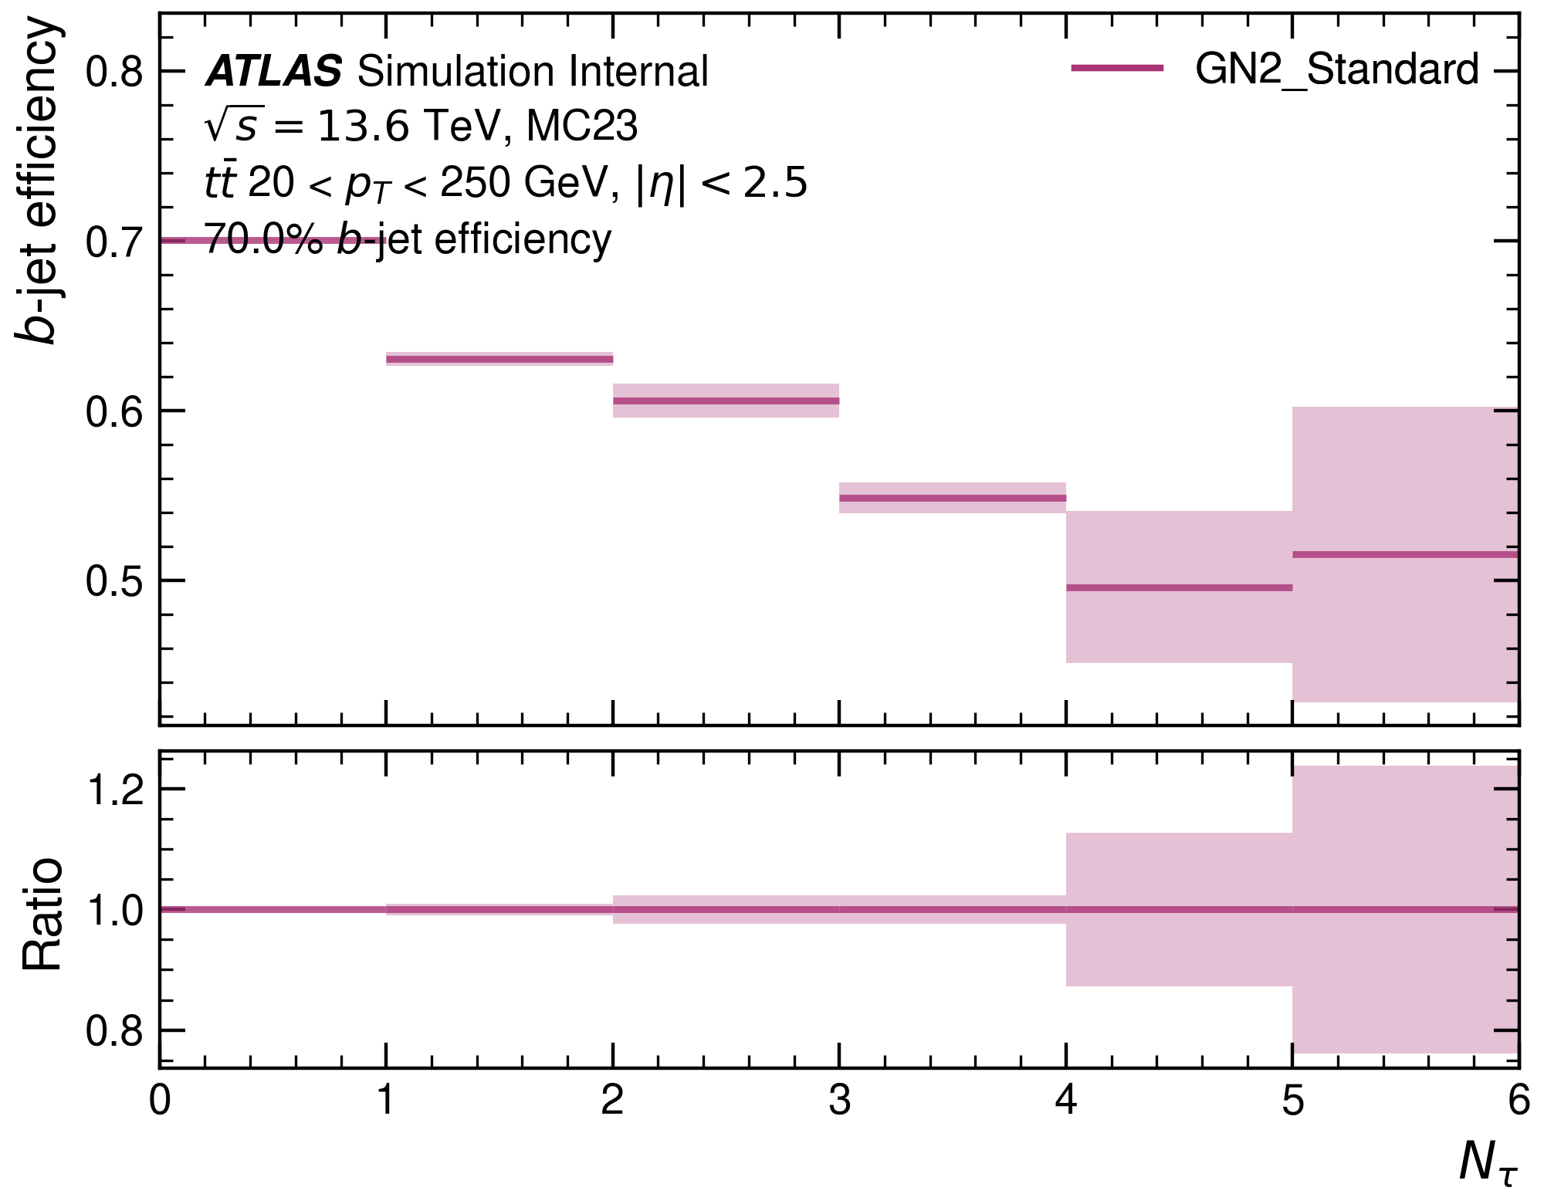
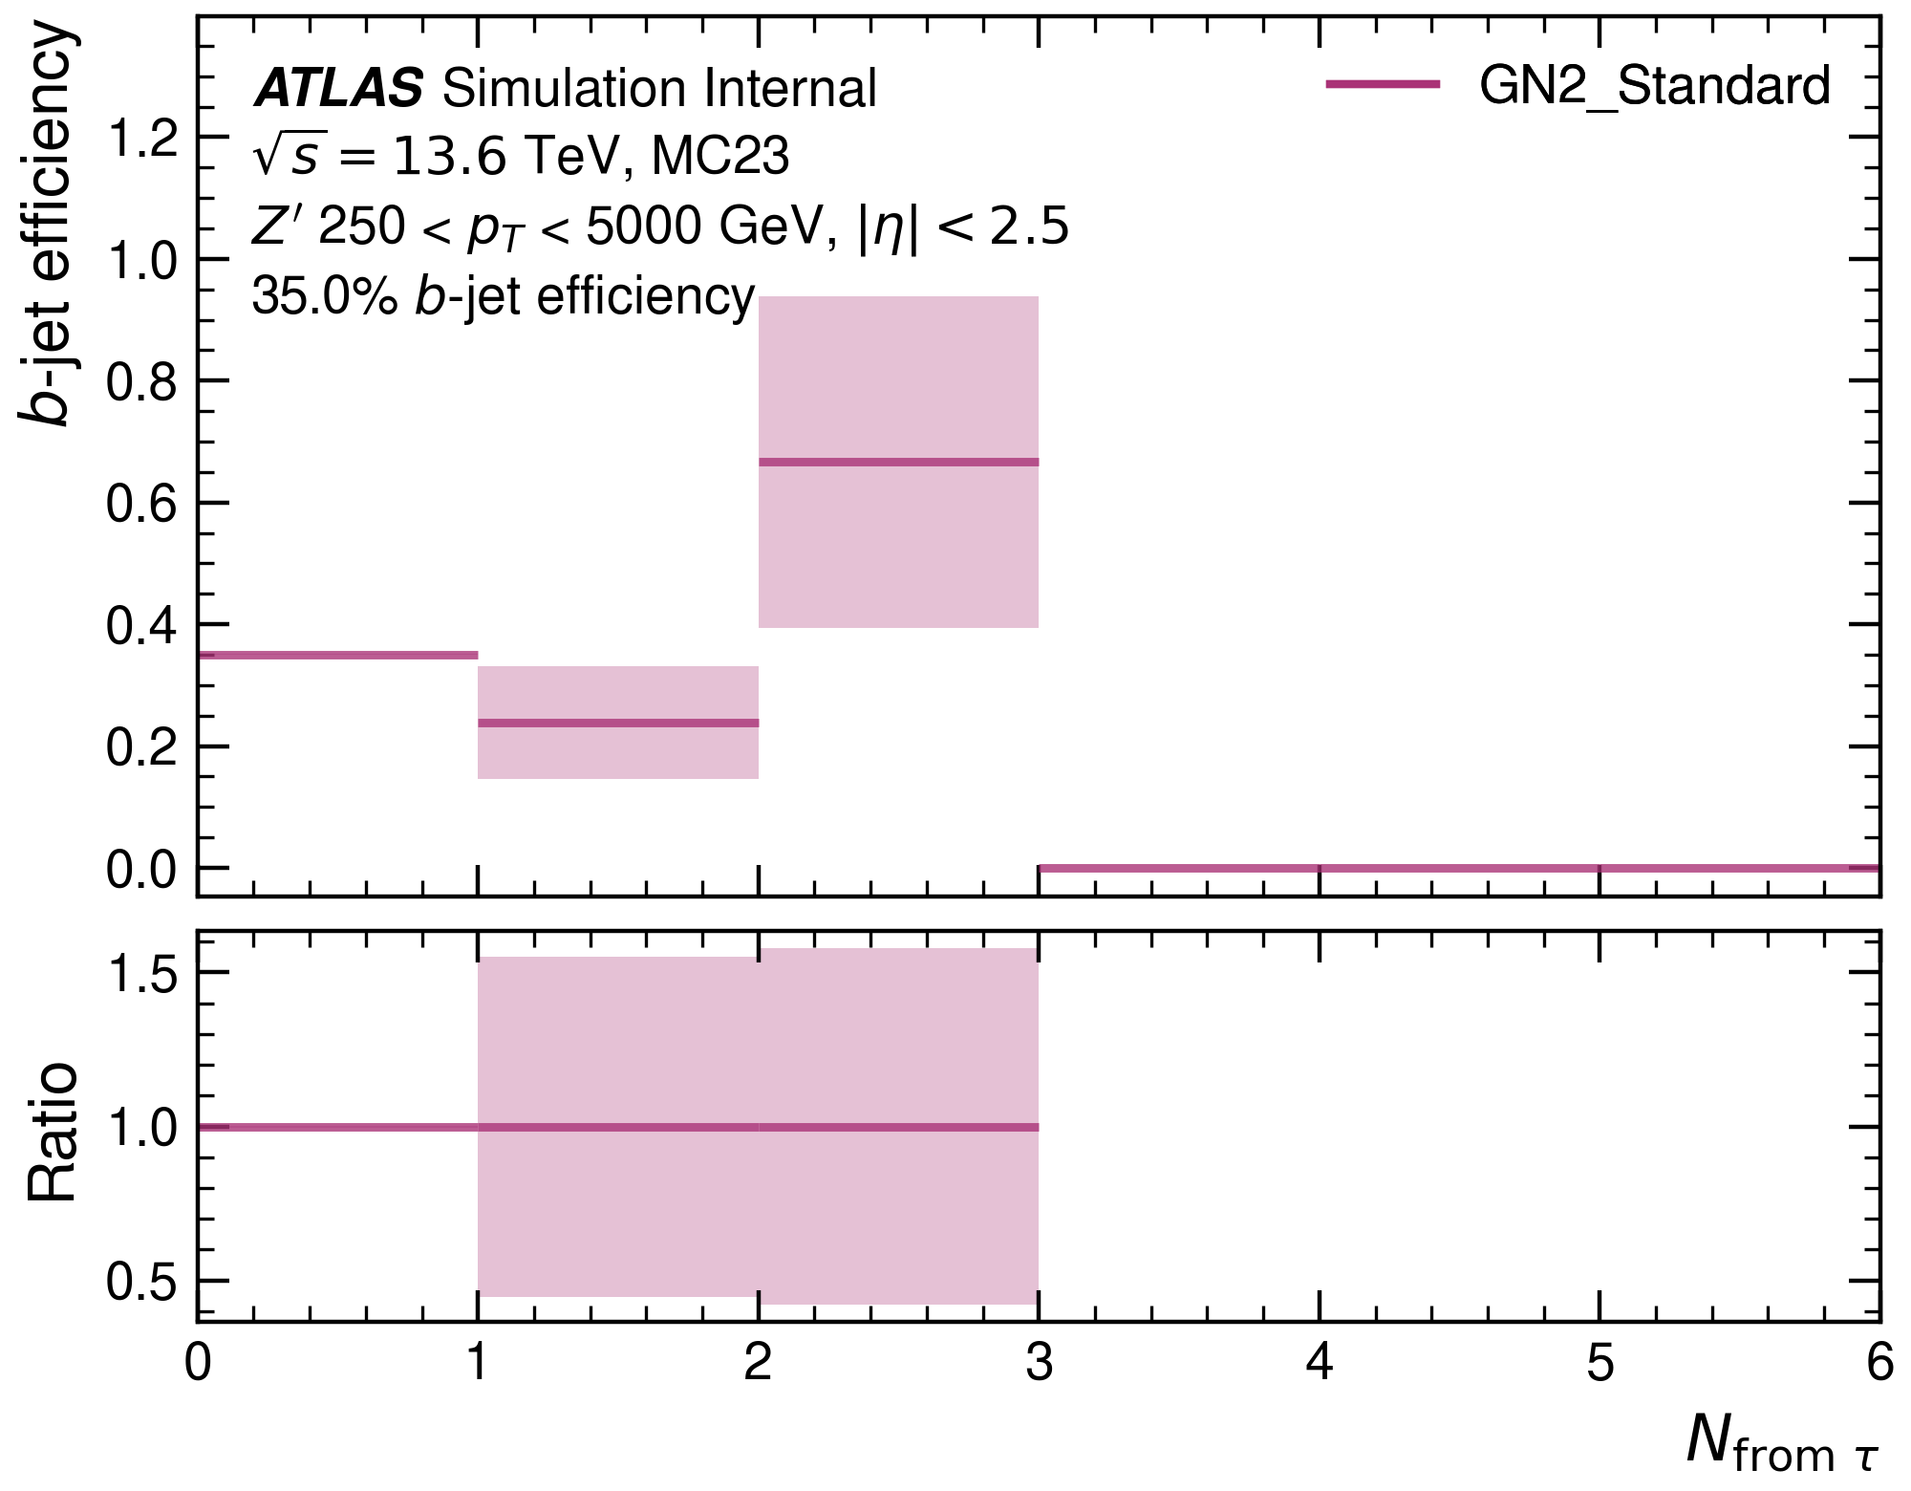
Number of tracks from $τ$: $b$-efficiency
Number of $τ$-tracks deteriorate the model.
However, they are so rare that this is most likely not a pressing issue.

Slide 16
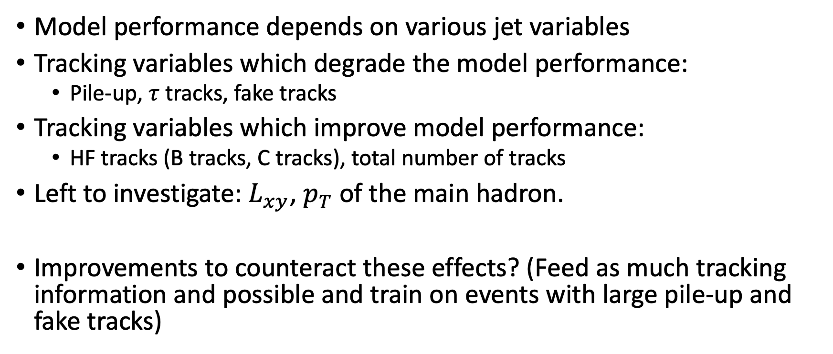
Summary & Outlook
Model performance depends on various jet variables
Tracking variables which degrade the model performance:
Pile-up, $τ$ tracks, fake tracks
Tracking variables which improve model performance:
HF tracks (B tracks, C tracks), total number of tracks
Left to investigate: $L_{xy}$, $p_{T}$ of the main hadron.
Improvements to counteract these effects? (Feed as much tracking information and possible and train on events with large pile-up and fake tracks)

