Slide 1
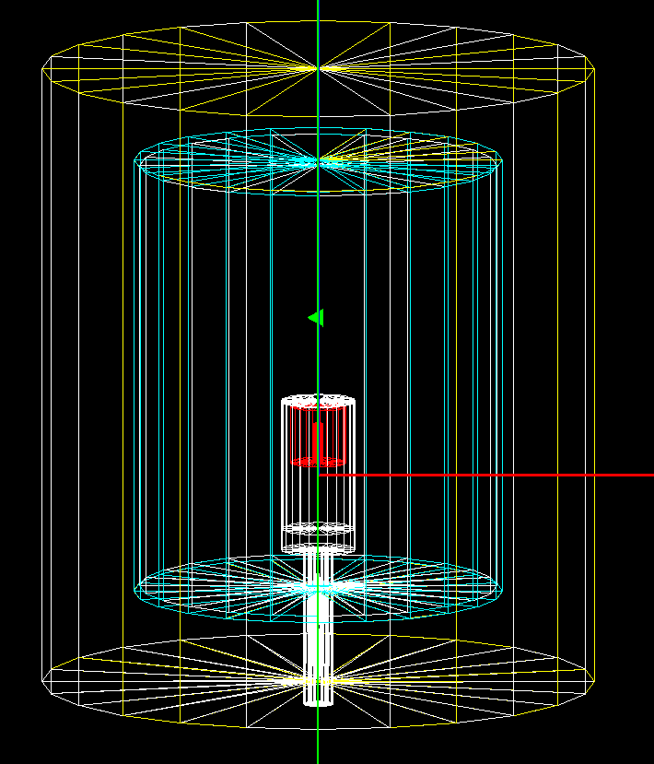
Detector Geometry
Geometry written into GDML files for use in g4simple.
Germanium crystal surrounded by Aluminium cryostat.
Shielding: outer lead layer (10 cm), followed by Copper (6 mm).
Connection to the nitrogen tank modelled by Copper rod, surrounded by air and stainless steel.

Slide 2
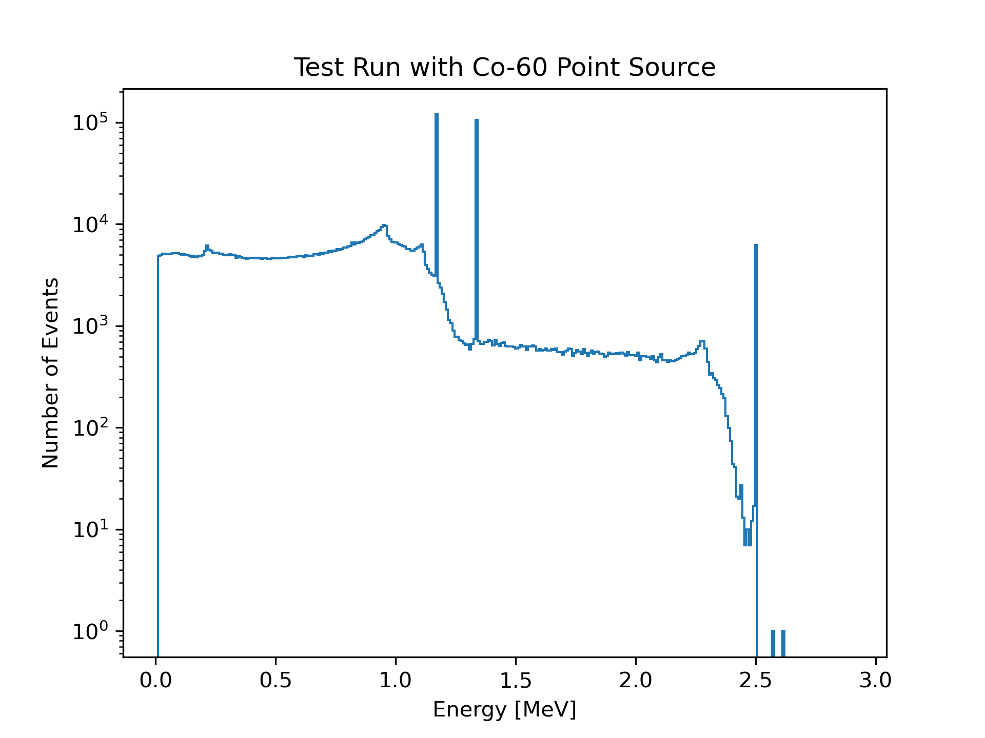
Simulated Spectrum of ⁶⁰Co Point Source
Running g4simple via the LEGEND software singularity
.root output files analysed using uproot in Python
⁶⁰Co source 1.5 mm above the cryostat
3 million simulated decays

Slide 3
1173 keV
1332 keV
1173 keV + 1332 keV
= 2505 keV
Backscatter Peak
~ 209 keV - 215 keV
CE
CE
CE
Q-Value
2822 keV

Slide 4
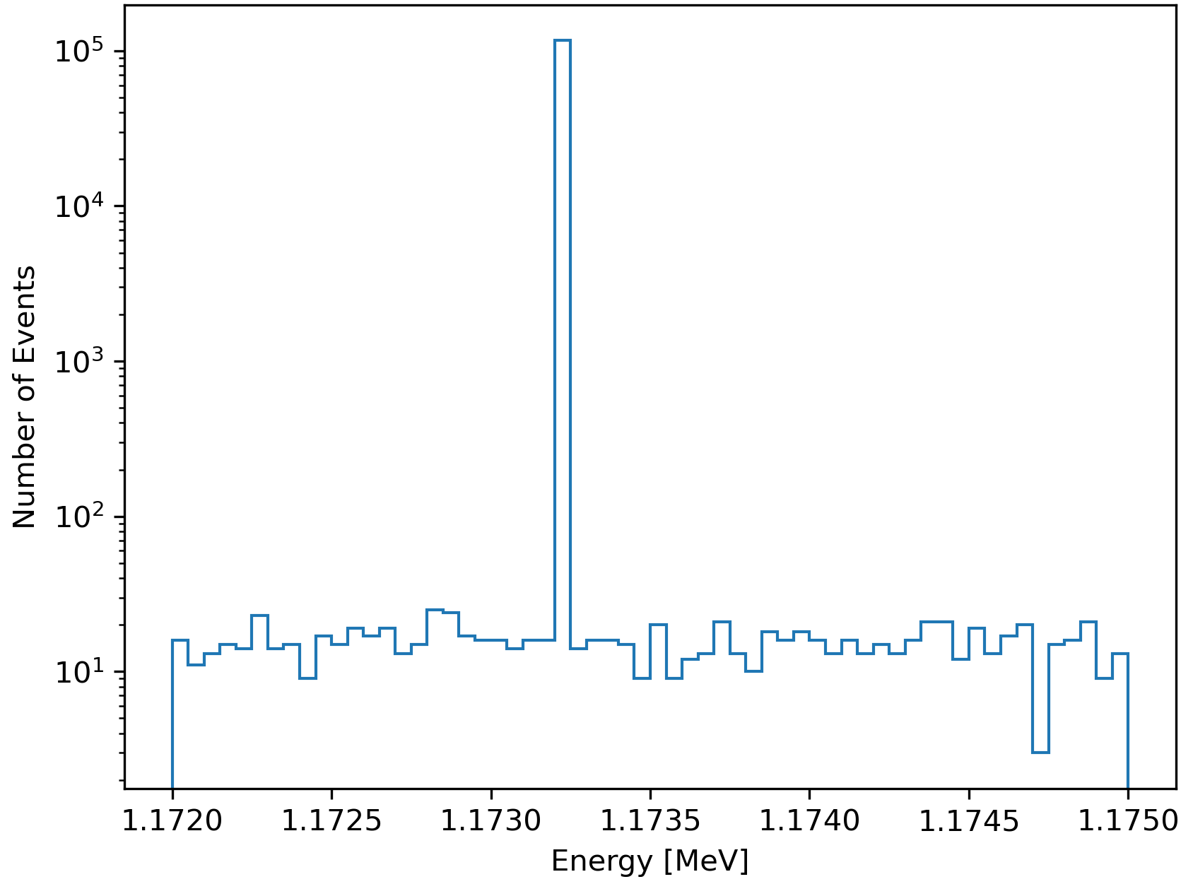
Peaks behave like δ-functions, as opposed to Gaussian distributions, which are observed in experiment.

Slide 5
Comparison with Experiment
Place a ⁶⁰Co sample at various points in the detector.
Compare obtained spectrum with simulations at the same point in space
Validate my geometry work
Estimate detection efficiency
Requires a structure which allows us to place the sample at a point of our choosing

Slide 6
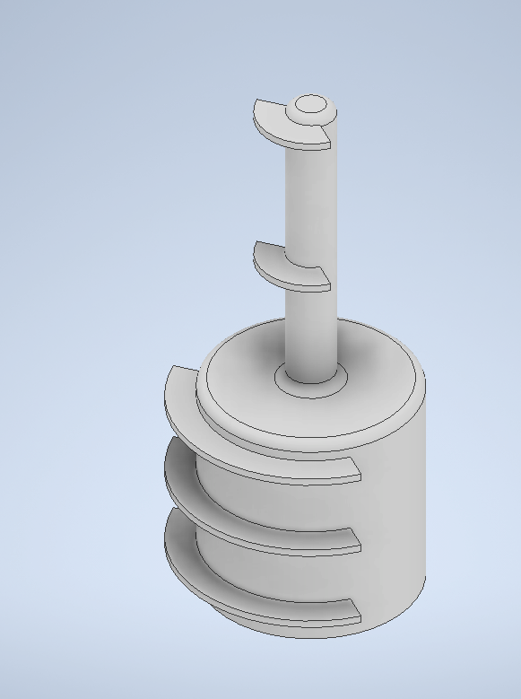
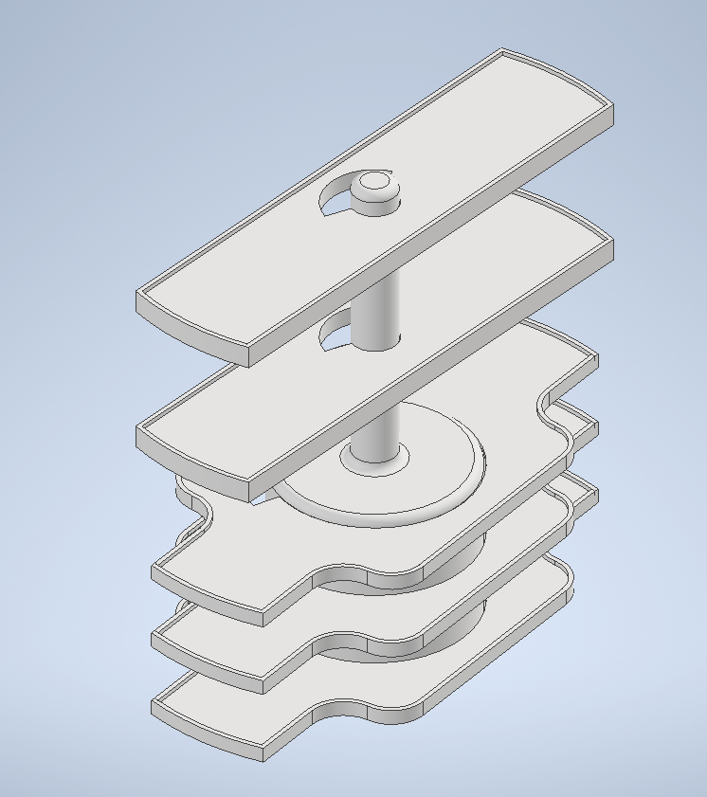
Suggested Holder Design

Slide 7
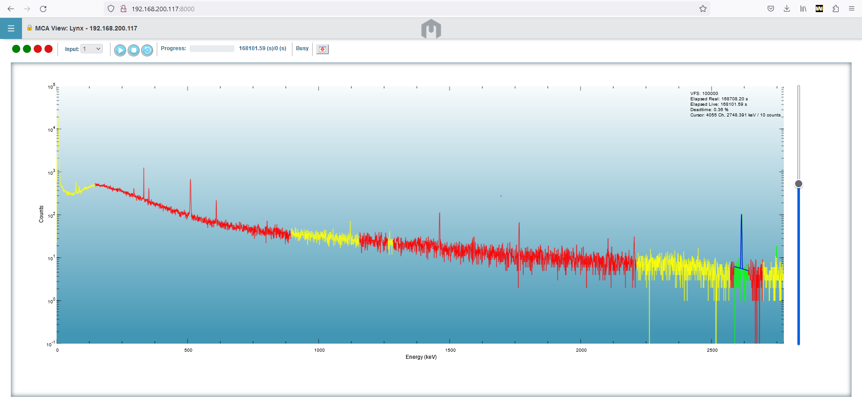
Data Acquisition with Lynx via SSH Tunnel

