Slide 1
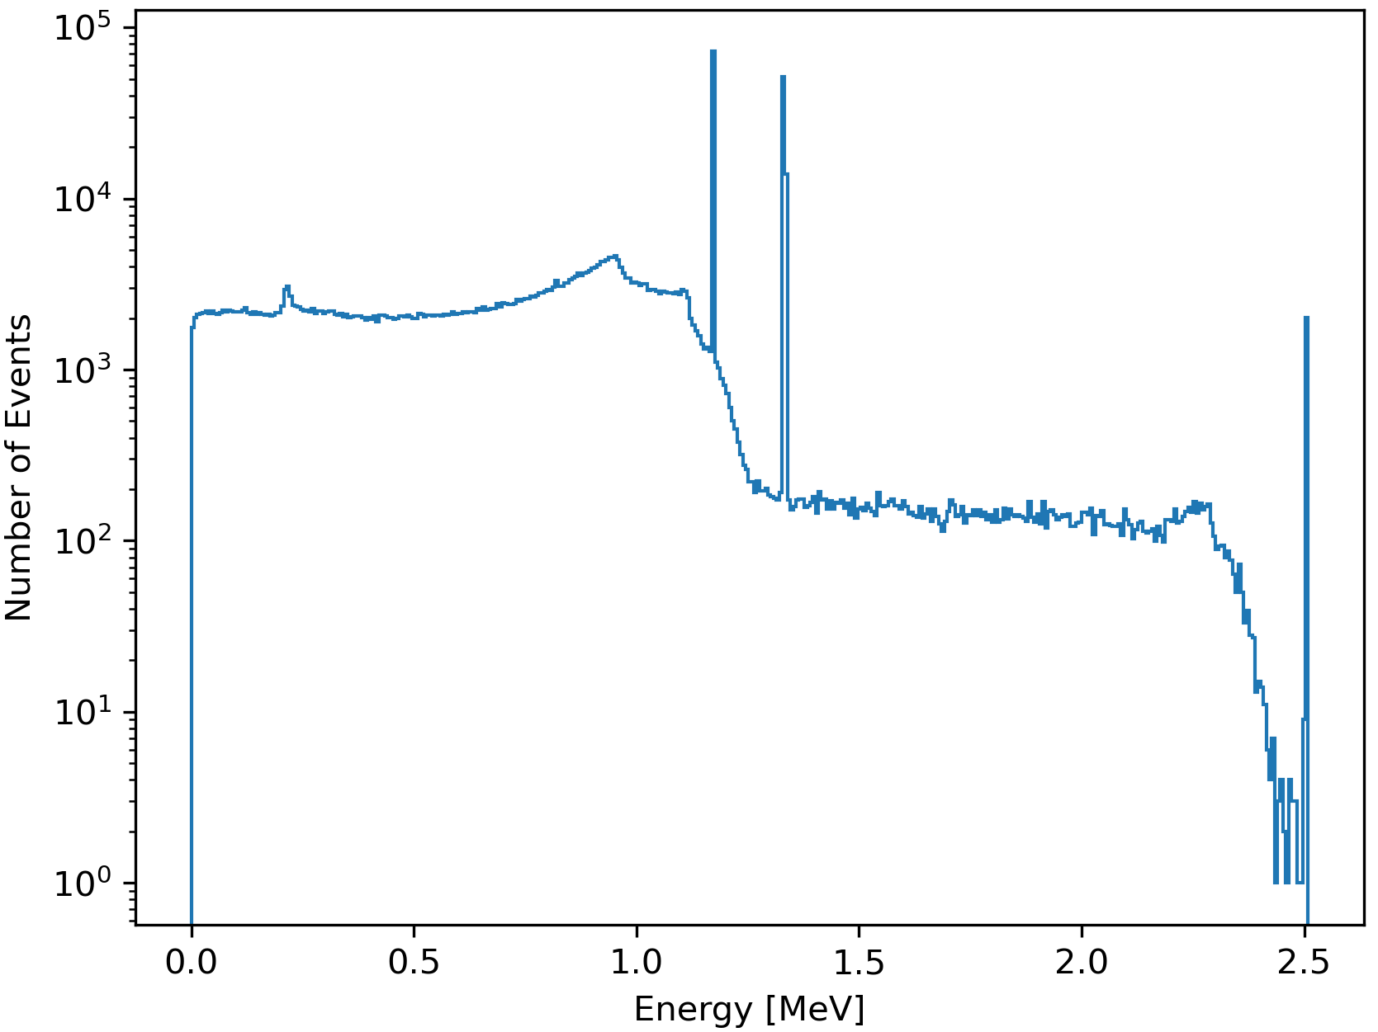
Added resolution function in line with FWHM specs
Simulated different isotopes
Computed full peak detection efficiency
Comparison with Experimental Data

Slide 2
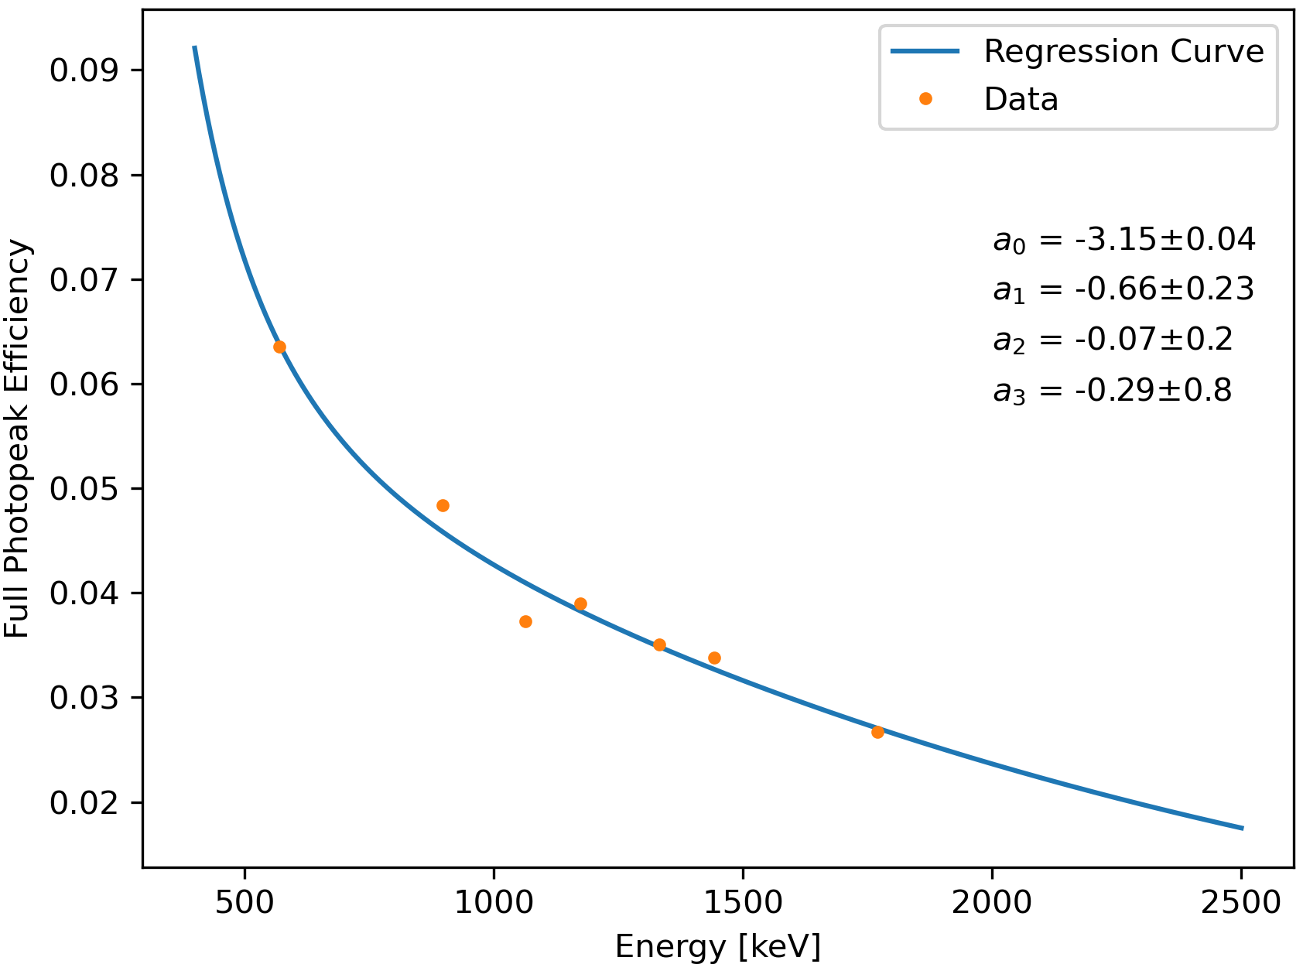
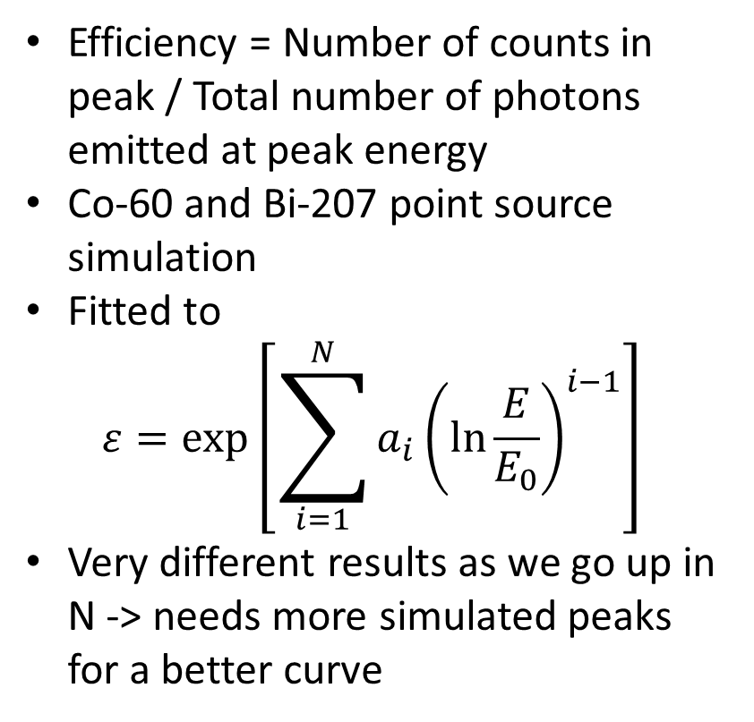
Steps towards detection efficiency
Efficiency = Number of counts in peak / Total number of photons emitted at peak energy
Co-60 and Bi-207 point source simulation
Fitted to
$$ε=\exp\left[\sum_{i=1}^{N}{a_{i}{\left(\ln{\frac{E}{E_{0}}}\right)}^{i−1}}\right]$$
Very different results as we go up in N -> needs more simulated peaks for a better curve

Slide 3
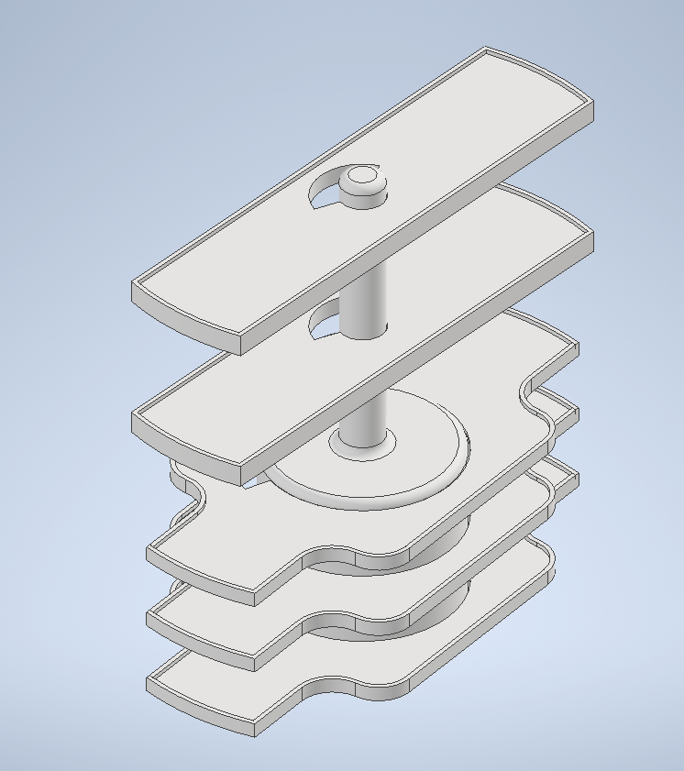
Holder & shelves have been printed
Recorded data for two shelves.
Compare with simulated data at the same location to validate the geometry work.
The ratio of the counts in the 2505 keV Co-60 summation peak to the counts in the 1173 keV peak is expected to be heavily geometry dependent.
-> used this as an indicator to judge the accuracy of the simulation

Slide 4
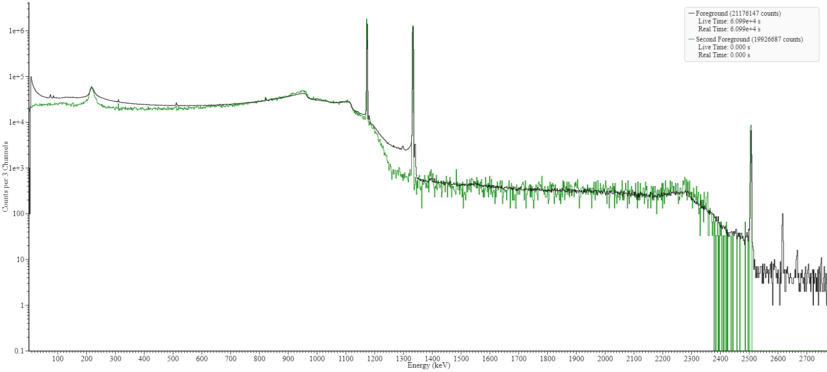
Green: Simulation
Black: Measurement

Slide 5
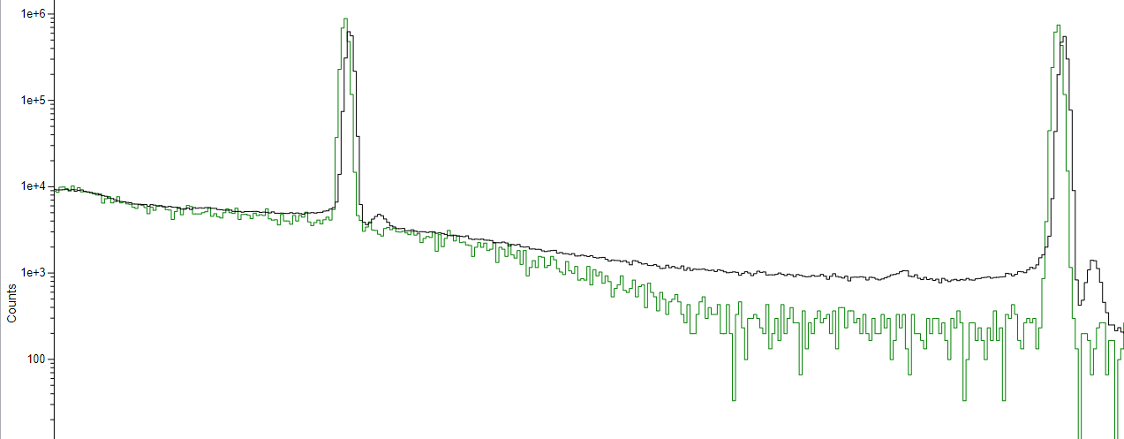
Close-up of 1173 keV and 2505 keV peaks

Slide 6
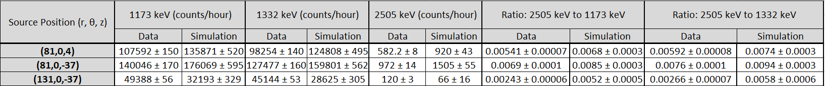
Validation of Simulation Geometry
Absolute number of counts does not agree
Ratio of counts in 2505 keV to counts in 1773 keV and counts 1332 keV does not agree
Simulation of (131,0,-37) position needs more statistics

Slide 7
To-Do
Resolve descrepancies between simulation and measurement
Determine detection efficiency curve
Generalise detection efficiency of point sources to general source volumes

