Slide 1
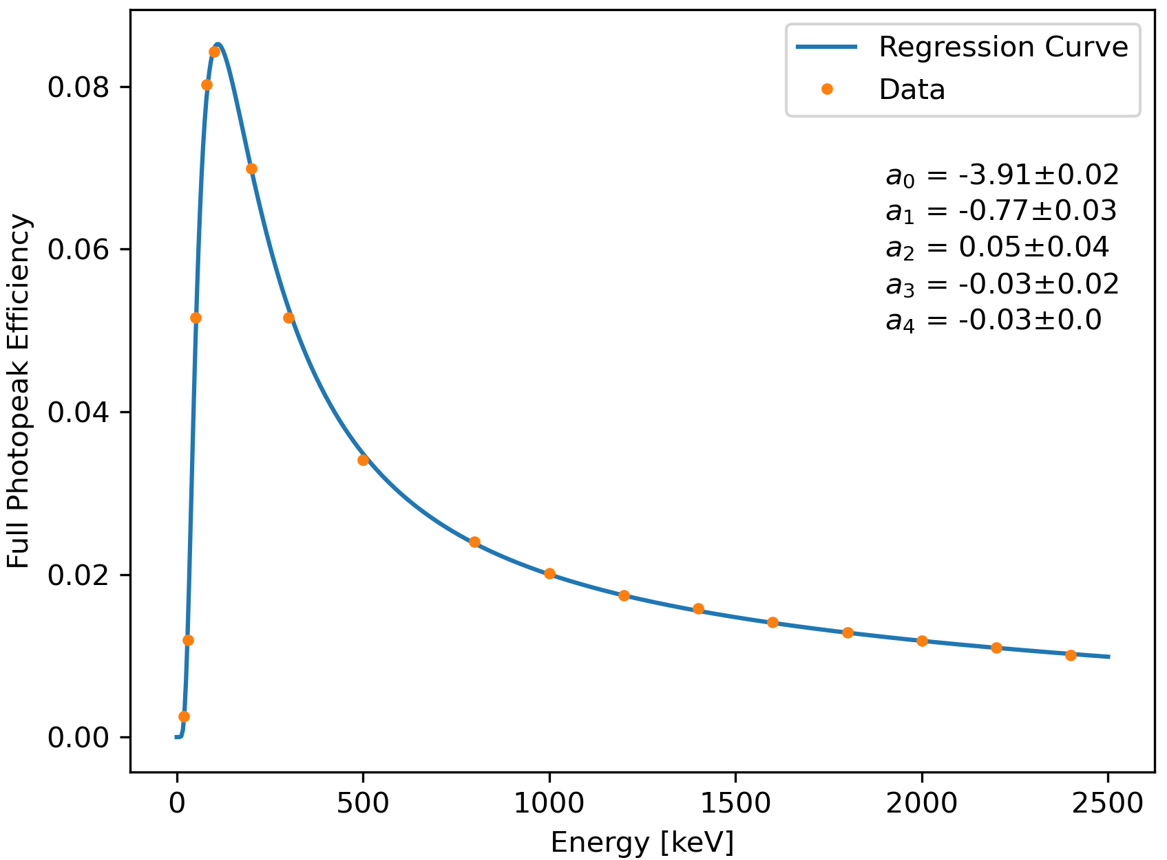
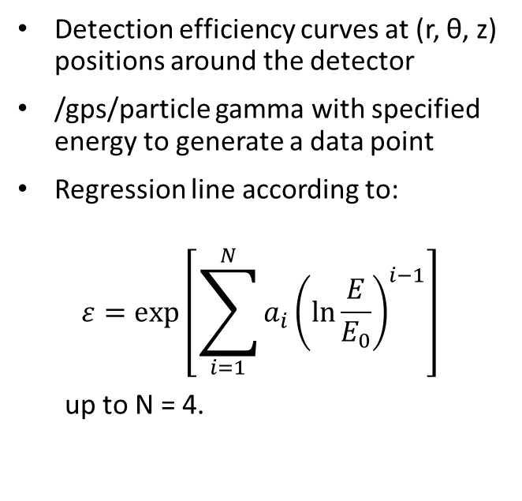
Detection Efficiency
(r, θ, z) = (42 mm, 0, -74.5 mm)
Detection efficiency curves at (r, θ, z) positions around the detector
/gps/particle gamma with specified energy to generate a data point
Regression line according to:
$$ε=\exp\left[\sum_{i=1}^{N}{a_{i}{\left(\ln{\frac{E}{E_{0}}}\right)}^{i−1}}\right]$$
up to N = 4.

Slide 2
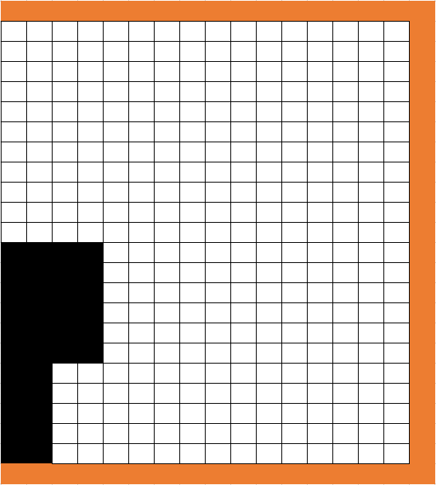
Find point source efficiency curve for every square in the grid.
Use r-z coordinates, assuming axial symmetry.
X denotes the origin (r = 0, z = 0)
Currently simulating 3cm x 3cm squares around the cryostat. Finished 29 / 42.
For now the user has to interpolate between squares for extended source volumes.
Perhaps in the future: regression model depending on (r, θ, z, E), giving the efficiency per unit volume. This could be integrated over source volumes.

Slide 3
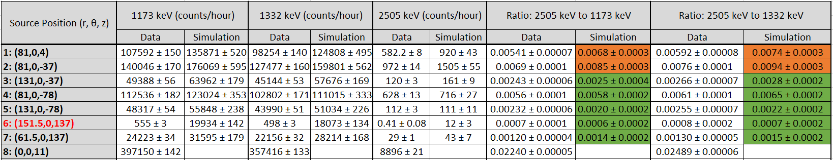
Comparison with Measurement
Using the ratios to assess how the simulation geometry agrees with the real detector geometry:
Row 1 & 2 disagree with data, these are closest to the top of the crystal in absolute distance
Absolute counts per hour are consistently ~ 20 % higher in the simulation
Row 6 disagrees substantially in terms of absolute counts (likely a mistake in my simulation)

Slide 4
Wrapping up
Adding my code to GitHub with some README documentation.
Efficiency curve generation & Co-60 simulations
First version of the efficiency grid for use on extended source volumes.

