Slide 1

COVID19 Vaccine Twitter Posts: Data Labeling and Text Classification
Rhoeun Park
dsir-fx-222
Notes:
Hi, everyone, today I am going to be sharing my work on Labeling Twitter open-source text data about covid19 vaccine and modeling binary classification on the labeled data. The premise is that I am part of a data science team in a pharmaceutical company and we are to come up with a method to analyze social network data for business applications.

Slide 2
Problem Statement
SNS data serve as great resources for public opinions on different topics, don't have necessary y-labels to predict on.
The goal of this project is to find out an optimal labeling method for twitter posts regarding COVID19 vaccines to classify them into "pro-vaccination" vs "anti-vaccination".
Notes:
Social networks services(SNS) such as Facebook, Twitter, and Instagram serve as great resources for public opinions on different topics. Same applies to COVID19 and its vaccine industries, as COVID virus continues to live through in our communities. However, such open-text data are hard to be used as it is in machine learning or deep learning process as they usually don't have necessary y-labels to predict on. The goal of this project is to **find out an optimal labeling method for twitter posts regarding COVID19 vaccines** to classify them into "pro-vaccination" vs "anti-vaccination". With the proper labeling method established, it can have various future use cases such as predicting future vaccine outlook or user-specific advertising based on their view on the vaccines.

Slide 3
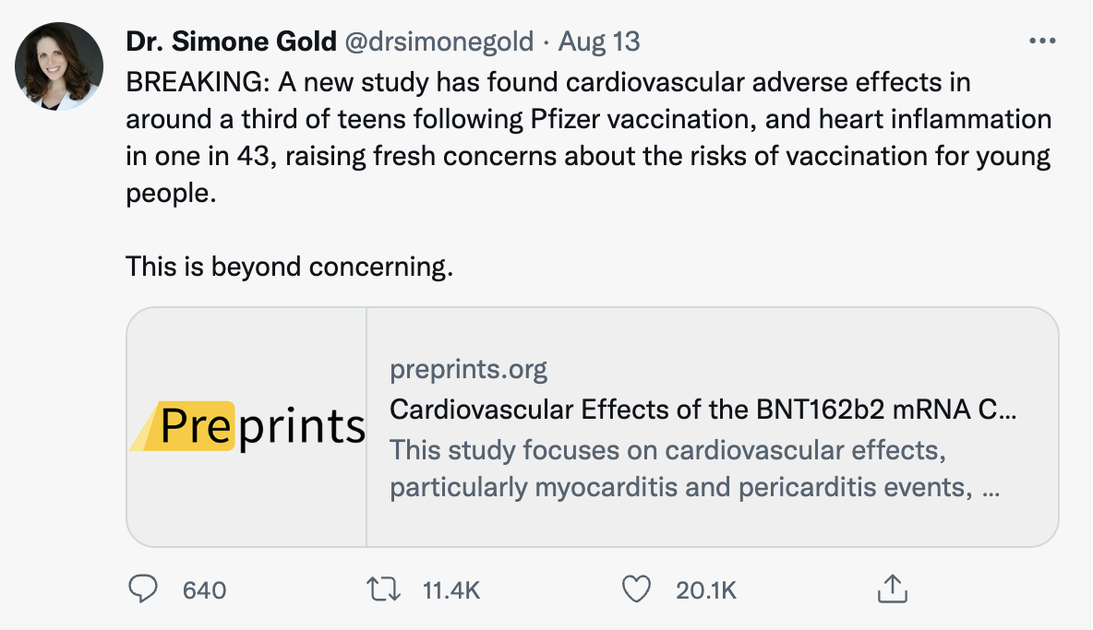
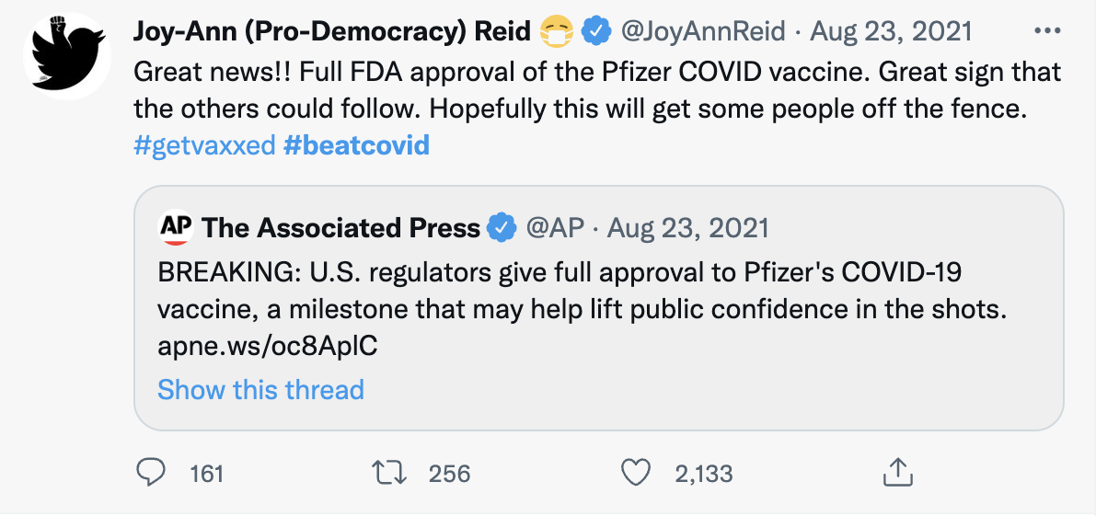
Anti-vax vs Pro-vax
Notes:
To share some backgrounds on the kind of classification that I will be doing,
we all know that COVID19 pandemic marks an unusual case in the modern world; because its unexpected rise and out of norm, public opinion has been fluctuating over how to deal with the pandemic. One of the biggest arguments regarding the topic is whether or not to require or mandate the vaccines, and the United States public has been divided over whether or not to obtain COVID-19 vaccines.
Here are some example tweets. There are many reasons that each side argues on.
Antivax group relate vaccines to many side effects, diseases, its efficacy being low, and etc.
Pro vax would argue for vaccine lowering symptoms, often thanking the fact they they got vaccine and etc.

Slide 4
Labeling Methods
Hashtag –
crowdsourcing
Snorkel-
Data Labeling Platform
Notes:
For this particular project, I am comparing across two labeling methods, although I’m sure there are more out there.
First is an easy way through, labeling using Hashtags. In this case, hashtags can serve as a method of crowdsource labeling, that is given by individuals who upload the posts. In order to obtain such "crowdsource" labeled data via hashtag, I would simply have to scrape sns data based on specified hashtaged parameters. In order to do this, I did a simply google search on popular anti and pro vax hashtags.
Second method that I used is Snorkel, a platform that contains data labeling tool.

Slide 5
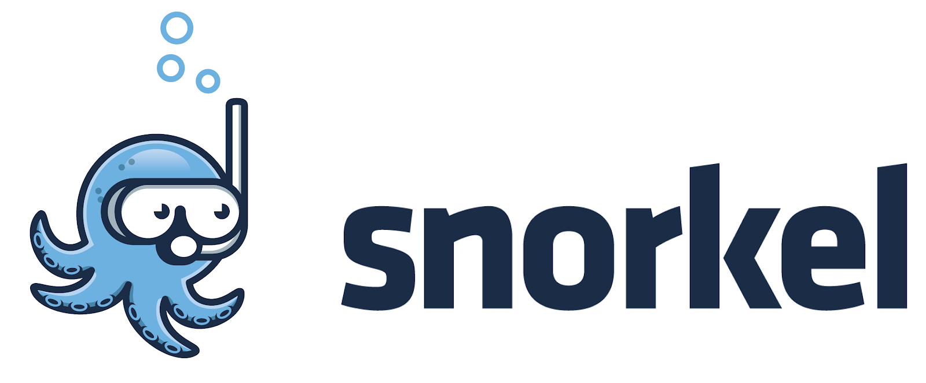
Snorkel.ai
Labeling tool for unlabeled data
Sets of rough rules that help classify between the texts
Take a vote on the majority!
Takes weight into consideration
Notes:
To briefly explain what snorkel is and how it works,
it is a system that facilitates the process of building and managing training datasets without manual labelling. Because manually labeling millions of rows isn’t just possible.
The steps you would take for this is
first, component of a Snorkel pipeline includes labelling functions, which are designed to be weak heuristic functions that predict a label given unlabeled data. For example, it is as simple as just saying If the text contains the word booster, label it pro-vax. It doesn’t have to be too accurate, and in fact, they recommend that the functions are simple. After you make many of these functions, you compile them by taking a majority vote.
Some functions may have higher weights.

Slide 6
Datasets
SNScrape API
2 main datasets
Unlabeled ( data scraped just with general covid19 vaccine topic)
Hashtag labeled (data scraped based on parameters
Notes:
So Here are the datasets that I used for this projects. I scraped them using SNScrape API that allows me to specify a search field and request the most recent posts of specified number of posts.
I did 2 separate scraping for hashtag labeled and unlabeled data. To get the hashtag labeled data, I simply specified the list of hashtags depending on the label that I want to get – pro or anti vax.
unlabeled data, I just made general specification on covid19 vaccine across different dates.

Slide 7
Hashtag Labeled Data – Other Hashtags
Pro_Vax | n
Unite2FightCorona | 1000
StaySafe | 679
GetVaccinated | 473
Vaccinated | 417
LargestVaccinationDrive | 381
healthcare | 360
COVIDisAirborne | 337
COVIDAppropriateBehaviour | 332
Anti_Vax | n
NoVaccineMandates | 1060
InformedConsent | 748
MyBodyChoice | 545
NoVaccinePassports | 528
VaccineSideEffects | 513
MedicalFreedom | 503
IDoNotConsent | 484
VaccineInjury | 419
Notes:
So I first went on to explore some of the features in the hashtag labeled data to see what features may be helpful and possibly apply to the labeling function. I first examined whether there were any hashtags other than the ones used for labeled data scraping that were prevalent in each class of text. These were some top hashtags found from each dataset, and n is the number of times mentioned.

Slide 8
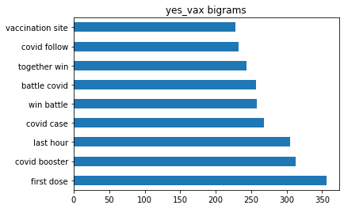
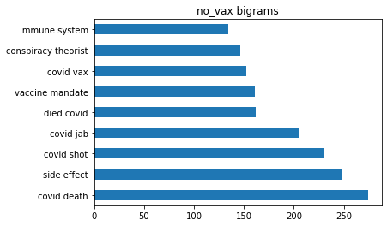
Hashtag Labeled - Bigrams

Slide 9
Snorkel labeling function
Keywords
Sentiment
subjectivity
Hashtags
Profanity words

Slide 10
Snorkel Results
development set accuracy =
59.2%
hashtag subset accuracy =
61.5%
Coverage:
75,644 out of 111,959 rows
label distribution:
pro-vax (0.86), anti-vax (0.14)

Slide 11
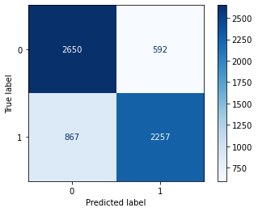
Model results – Hashtag Labeled
precision | recall | f1-score
0 | 0.75 | 0.82 | 0.78
1 | 0.79 | 0.72 | 0.76
accuracy |  |  | 0.77

Slide 12
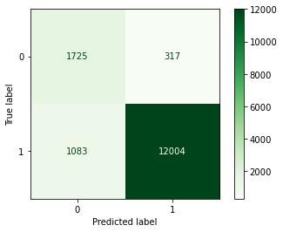
Model results – Snorkel Labeled
precision | recall | f1-score
0 | 0.61 | 0.84 | 0.78
1 | 0.97 | 0.92 | 0.94
accuracy |  |  | 0.91

Slide 13
Conclusion & next steps
Snorkel Labeled data is better in terms of accuracy, recall, and precision
Snorkel model integrity could be questionable
Hashtag labeling is easier, but limited
Next step:
compare across the two models
Label against each other’s model

