Slide 1
Vermont 2-1-1:
Mobile App
Greg Grillone
RHOK 2012: Burlington, VT
Github page: https://github.com/rhokburlington/vermont-2-1-1

Slide 2
About Vermont 2-1-1
A phone service in Vermont area
Call specialists assist callers by aiding them with their issues
They provide references to services to help with their issue(s) such as:
Child care
Employment services
Mentoring

Slide 3
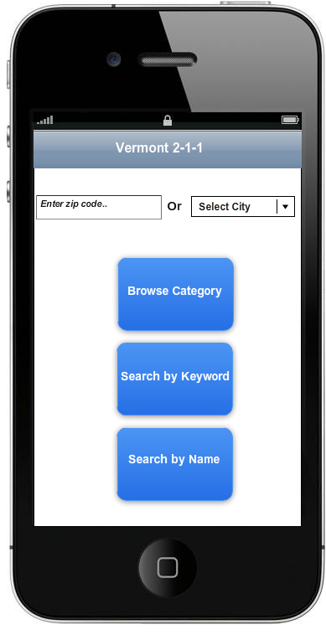
Problem
How do we make an effective mobile application for Vermont 2-1-1?
http://www.refersoftware.com/vermont211/

Slide 4
Goals & Needs
Build an effective mobile application for Vermont 2-1-1
Provide personalized services to meet needs of the user group
Use the app to assist vulnerable populations (i.e. non-English speakers, low income populations, families in crisis)
Make services/resources more accessible, appealing, and convenient for community members
Track usage

Slide 5
Solution :)
Build mobile app using jQuery mobile
Connect to existing database of services
Simple interface
Google maps APIs to get directions, mark services on map, and track usage
Google map maker and Google places
Offer phone number for non-English speakers
Possible alternative: i18n (internationalization and localization)

