Slide 1



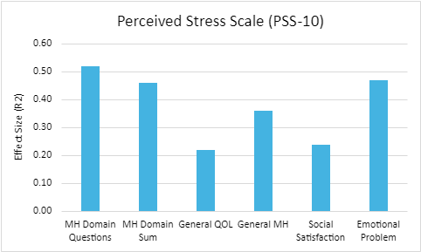
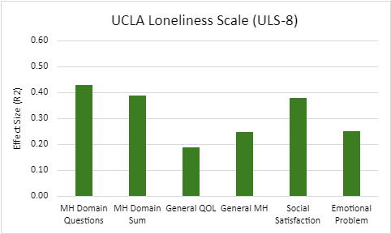
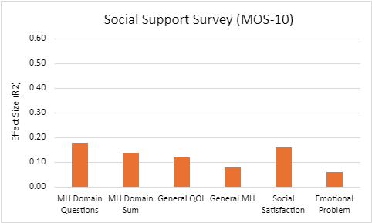
New Approaches to Quality of Life Assessment in Mental Health
Richard O’Keefe, Ryan J. Zamora, Alyse Finch, Alessandro S. De Nadai
Background
Methods and Results
Conclusions
Researchers, regulatory bodies, and third-party payers need a common metric to compare the impact of mental health (MH) and physical health (PH) conditions and treatments on equal footing.
Without such a metric, progress in clinical investigation and policy development is impeded, such as through the limitation of meaningful comparisons (e.g., depression vs. schizophrenia or diabetes) and the slowing of clinical and policy decisions.
Quality of Life (QOL) measures are a promising candidate for such a metric, but current QOL measures and tools have many flaws.
– Current QOL tools are poorly suited to MH symptoms, reducing sensitivity and accuracy.
– Existing QOL measures lack comparability, often being too disorder-specific to work across MH and PH conditions.
– Current methods to convert existing QOL measures into more generalized metrics introduce bias, weakening the reliability of QOL as a universal metric.
Traditionally, researchers have aimed to create single total QOL scores to reflect all domains in QOL.
– This project challenges the notion that we should aim for a single total QOL score, testing whether QOL is better measured as separate domains rather than a single combined score.
Using QOL data from the All of Us large behavioral study (N=64,160), we assessed whether items from the Patient-Reported Outcomes Measurement Information System Global Health (PROMIS-GH) Scale better predicted clinical and behavioral outcomes of interest as individual items versus combined total scores.
Outcomes included a variety of constructs, such as blood pressure, heart rate, perceived stress, social support, and loneliness.
We compared the amount of variance explained in these outcomes first by correlating PROMIS-GH scores with each respective outcome.
– This reflected the traditional approach of creating single QOL total scores and relating them to measures of interest.
To compare the performance of individual items, we compared two methods to each other and to the traditional single total score method.
– First, we computed bivariate correlations between each PROMIS-GH item and the aforementioned clinical and behavioral outcomes.
– Second, we predicted these same outcomes using multivariable regression with all of the PROMIS- GH items included as a predictor.
– Results found the regression method to have the best performance (ΔR2 ranged from 1%-7% relative to the traditional method of bivariate relations between PROMIS-GH total scores and outcomes).
Overall, this work demonstrates a simple and improved method for providing a common and accurate foundation for outcome-focused quality measurement.
Specifically, we find that using multivariable regression with key life domains as separate predictors is a more accurate way to measure QOL than the traditional single total score method.
This method also:
Creates a stronger, unbiased foundation for evaluating mental health care
Enables progress in multiple MH domains
Moves us closer to a national standard for outcome-focused measurement of MH care
This work is supported by NIMH grant R01MH137075 to PI De Nadai
Focus on using latent variable modeling and unsupervised machine learning to further improve upon these methods
Figures and Demonstration Models
Figure 1: A comparison of how well different sets of MH variables predicted PSS-10 values
Figure 2: A comparison of how well different sets of MH variables predicted ULS-8 values
Figure 3: A comparison of how well different sets of MH variables predicted MOS-10 values

