Slide 1
JavaScript Arrays
Working with Ordered Collections
https://javascript.info/array

Slide 2

Need Ordered Collection?
Array Data Structure stores and manage ordered collections
Way to create arrays
Prefered syntax:
Objects store keyed collections of values
Unable to insert between
No way to manage order
( ) Dangerous.
Use [ ] syntax

Slide 3
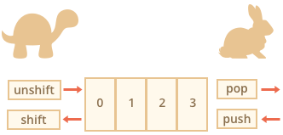
Arrays are Objects?
[ ] Bracket used to access
Position is the key (e.g. element position 2 = key [1])
Special Object for ordered data
Stored contiguously
Optimized for speed
Stay within the length

Slide 4
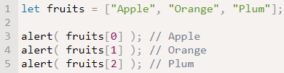
Array Elements Order/Access
Elements defined in brackets [ ] with comma separated list
Accessed and replace by their number key [9]
Numbering starts at Zero (0)
Element count = length
Use alert to display item or list

Slide 5
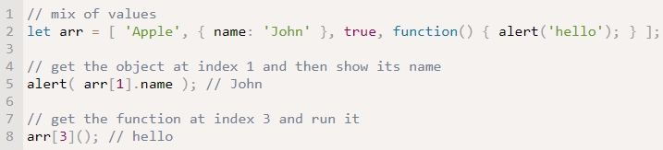
ANY Type of Array Elements
Elements are not limited to text strings
May include: text, numbers, Boolean values, function results, arrays, images

Slide 6

Queue – Most Common Use of Array
Two Array Operations
push adds an element at “end”
shift takes element from “beginning”
Advances queue
2nd element becomes 1st
1.Beginning 2. End

Slide 7
Queue – FIFO
First-In-First-Out (FIFO)
Beginning → End
1st In is 1st Out

Slide 8

Queue Data Structure Stack
New elements added and taken away at “end”
push adds an element to the end
pop takes an element to the end
JavaScript can work as queue and stack
Add/remove to and from beginning or end
Always from top end

Slide 9
Stack – LIFO - Like a Deck of Card
Last one stacked (push) is first one served (pop)
Last-In-First-Out (LIFO)
Last care placed on deck is
1st card served

Slide 10
Array Methods
END of Array:
Pop: Extracts and returns last element
Push: Appends/Adds element at end (multiples allowed)
BEGINNING of Array:
Shift: Extracts and returns 1st element
Unshift: Adds element at beginning (multiples allowed)

Slide 11
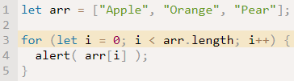
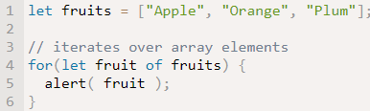
Loop through Array
Option 1: access to length Option 2: access to value not length
Do not use For..in for arrays as a general rule –BAD IDEA

