Slide 1
Feeling Swamped?
Find a way to swim

Slide 2
The secret to Skilled
Combine topics learned
Be creative
Show the skill learned in a real-world application
Clearly articulate what you accomplished
Make it easy for the professor
Provide a link to your work
Give instructions if necessary
Don’t make the professor guess
Don’t make the professor hunt and peck

Slide 3
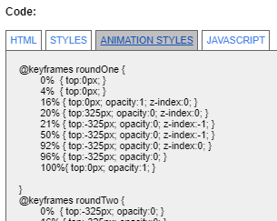
Share how you changed out your code
Create tabs & box
Define css tab classes
Default 1st tab to gray color class
Convert HTML, css, and js code using: https://defuse.ca/html-sanitize.htm
Copy converted file into appropriate div content for display
Create function to swap code
On click execute swap code
Set tab colors
Set display to appropriate div
Set document.getElement(xxs).
style.display = “block”
http://www.msummers.com/cit261/topic13.html

Slide 4
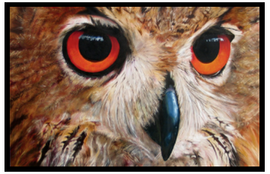
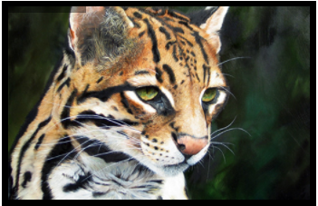
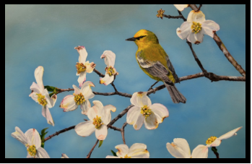
Share- Picture sliders
Defining Picture Slider
<div id="myContentSlider"> <div id="mySlider"> <div id="myMask"> <ul> <li id="first" class="firstanimation"> <a href="#"> <img src="images/slider_img_01.jpg"/> </a> <div class="myInfoTab" id="infoTab1"> <h1>Mountain Bluebird</h1> </div> </li> <li id="second" class="secondanimation"> <a href="#"> <img src="images/slider_img_02.jpg"/> </a> <div class="myInfoTab" id="infoTab2"> <h1>Owl</h1> </div> </li>
5 Images to rotate

Slide 5
Share- Picture sliders
Setting Base Styles w/ CSS
#myContentSlider { width:100%; height:360px; } #mySlider { background:#000000; border:10px solid #000000; height:320px; width:500px; margin:40px auto 0; } #myMask { overflow:hidden; height:320px; }
Black Boarder

Slide 6
Share- Picture sliders
Setting Base Styles cont.
#mySlider ul { margin:0; padding:0; position:relative; } #mySlider li { width:500px; height:320px; position:absolute; top:-325px; list-style:none; }
Height / Width
&
Position

Slide 7
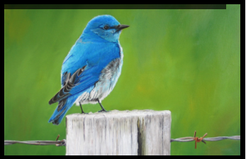
Share- Picture sliders
Styling animation w/ CSS
#mySlider li.firstanimation { animation:roundOne 25s linear infinite; } #mySlider li.secondanimation { animation:roundTwo 25s linear infinite; } #mySlider li.thirdanimation { animation:roundThree 25s linear infinite; } #mySlider li.fourthanimation { animation:roundFour 25s linear infinite; } #mySlider li.fifthanimation { animation:roundFive 25s linear infinite; }
Sets slideshow duration to 25s

Slide 8
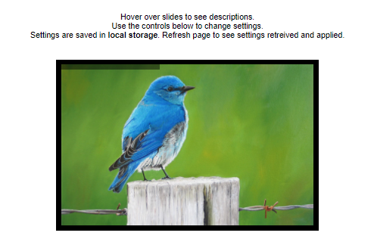

Share- Picture sliders
On hover text from .myInfoTab
Styling slider w/ CSS
#mySlider .myInfoTab { background:rgba(0,0,0,0.7); width:300px; height:60px; position:relative; bottom:75px; left:-320px; transition:all 0.3s ease-in-out; } #mySlider .myInfoTab h1 { color:#ffffff; font-size:24px; font-weight:300; line-height:60px; padding:0 0 0 20px; }
0.3s to fly in or out
Display at bottom
Left justify
ease-in-out

Slide 9
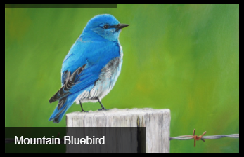
Share- Picture sliders
Controlling actions w/ CSS
#mySlider li#first:hover .myInfoTab, #mySlider li#second:hover .myInfoTab, #mySlider li#third:hover .myInfoTab, #mySlider li#fourth:hover .myInfoTab, #mySlider li#fifth:hover .myInfoTab { left:0px; } #mySlider:hover li, #mySlider:hover .loadingBar { animation-play-state:paused; }
On hover the .myInfoTab content is displayed

Slide 10
Share- Picture sliders
Controlling animation
w/ CSS
#loadingBar { position:relative; top:-320px; width:680px; height:10px; background-color:#000000; animation:fullexpand 25s ease-out infinite; }
Progress bar across top

Slide 11
Share- making image scroll
New picture pushes old picture down
after 5 seconds
How to make pictures scroll out
Use linear on animation
Example:
animation:roundFive 25s linear infinite;
How to make status bar display every 5 seconds
Slideshow is set at 25s
So 5 pictures have 5 seconds each

Slide 12
Two Content Layout with SmartArt
Remember attention to details:
Simple interface
Visually pleasing
Easy to navigate
Keeps interest of user
Works every time
Visually
Pleasing
Easy to Navigate
Works Consistently

Slide 13
Take a deep breath & dive right in!
Don’t be afraid to get wet...☺

Slide 14
Thank you and
Good Luck!

