Slide 1

Estimation and Confidence Intervals
Chapter 9

Slide 2
GOALS
Define a point estimate.
Define level of confidence.
Construct a confidence interval for the population mean when the population standard deviation is known.
Construct a confidence interval for a population mean when the population standard deviation is unknown.
Construct a confidence interval for a population proportion.
Determine the sample size for attribute and variable sampling.

Slide 3
Point Estimates
A point estimate is the statistic, computed from sample information, which is used to estimate the population parameter.
How close to the population parameter is this Point Estimate? We will use Confidence Intervals to answer this question

Slide 4
Confidence Intervals
A confidence interval estimate is a range of values constructed from sample data so that the population parameter (like the mean) is likely to occur within that range at a specified probability.
The specified probability is called the level of confidence.

Slide 5
Factors Affecting Confidence Interval Estimates
The factors that determine the width of a confidence interval are:
1.The sample size, n.
2.The variability in the population, usually σ estimated by s.
3.The desired level of confidence.

Slide 6
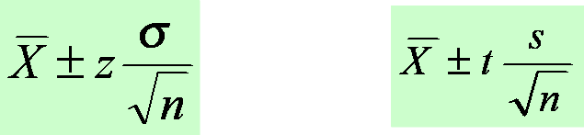
Confidence Interval Estimates for the Mean
Use Z-distribution
If the population standard deviation is known or the sample is greater than 30.
Use t-distribution
If the population standard deviation is unknown and the sample is less than 30.

Slide 7
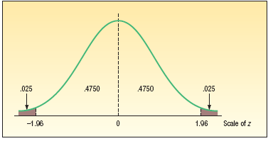
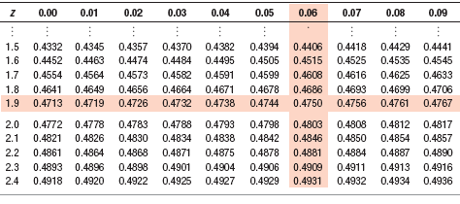
How to Obtain z value for a Given Confidence Level
LO3
The 95 percent confidence refers to the middle 95 percent of the observations. Therefore, the remaining 5 percent are equally divided between the two tails.
Following is a portion of Appendix B.1.
9-7

Slide 8
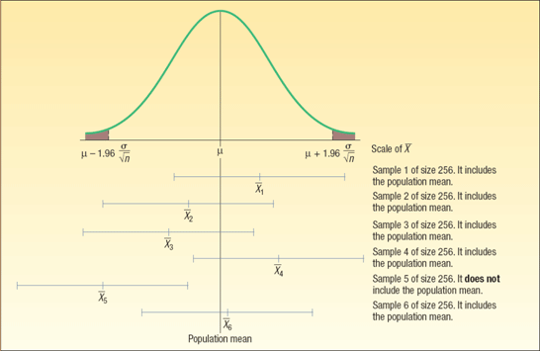
Interval Estimates - Interpretation
For a 95% confidence interval about 95% of the similarly constructed intervals will contain the parameter being estimated. Also 95% of the sample means for a specified sample size will lie within 1.96 standard deviations of the hypothesized population. The standard deviations here are also called “standard error of the mean”.

Slide 9
Example: Confidence Interval for a Mean – σ Known
LO3
The American Management Association wishes to have information on the mean income of middle managers in the retail industry. A random sample of 256 managers reveals a sample mean of $45,420. The standard deviation of this population is $2,050. The association would like answers to the following questions:
1. What is the population mean?
2. What is a reasonable range of values for the population mean?
3. What do these results mean?
9-9

Slide 10
Example: Confidence Interval for a Mean – σ Known
LO3
The American Management Association wishes to have information on the mean income of middle managers in the retail industry. A random sample of 256 managers reveals a sample mean of $45,420. The standard deviation of this population is $2,050. The association would like answers to the following questions:
What is the population mean?
In this case, we do not know. We do know the sample mean is $45,420. Hence, our best estimate of the unknown population value (parameter) is the corresponding sample statistic.
The sample mean of $45,420 is a point estimate of the unknown population mean.
9-10

Slide 11
Example: Confidence Interval for a Mean – σ Known
LO3
The American Management Association wishes to have information on the mean income of middle managers in the retail industry. A random sample of 256 managers reveals a sample mean of $45,420. The standard deviation of this population is $2,050. The association would like answers to the following questions:
What is a reasonable range of values for the population mean?
Suppose the association decides to use the 95 percent level of confidence:
The confidence limit are $45,169 and $45,671
The ±$251 is referred to as the margin of error
9-11

Slide 12
Confidence Interval Estimates for the Mean
Use Z-distribution
If the population standard deviation is known or the sample is greater than 30.
Use t-distribution
If the population standard deviation is unknown AND the sample is less than 30.

Slide 13
Characteristics of the t-distribution
1. It is, like the z distribution, a continuous distribution.
2. It is, like the z distribution, bell-shaped and symmetrical.
3. There is not one t distribution, but rather a family of t distributions. All t distributions have a mean of 0, but their standard deviations differ according to the sample size, n.
4. The t distribution is more spread out and flatter at the center than the standard normal distribution As the sample size increases, however, the t distribution approaches the standard normal distribution,

Slide 14
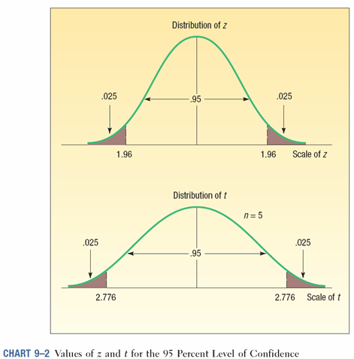
Comparing the z and t Distributions when n is small

Slide 15
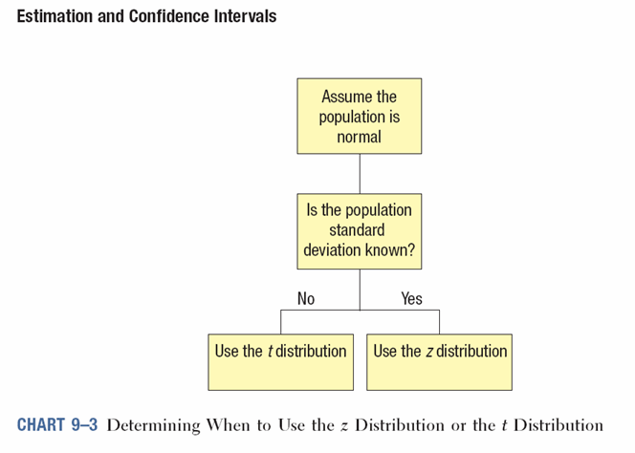
When to Use the z or t Distribution for Confidence Interval Computation

Slide 16
Population Standard Deviation (σ) Unknown
In most sampling situations the population standard deviation (σ) is not known. Below are some examples where it is unlikely the population standard deviations would be known.
1. The Dean of the Business College wants to estimate the mean number of hours full-time students work at paying jobs each week. He selects a sample of 30 students, contacts each student and asks them how many hours they worked last week.
2. The Dean of Students wants to estimate the distance the typical commuter student travels to class. She selects a sample of 40 commuter students, contacts each, and determines the one-way distance from each student’s home to the center of campus.
3. The Director of Student Loans wants to know the mean amount owed on student loans at the time of his/her graduation. The director selects a sample of 20 graduating students and contacts each to find the information.
9-16

Slide 17
Confidence Interval for the Mean – Example using the t-distribution
A tire manufacturer wishes to investigate the tread life of its tires. A sample of 10 tires driven 50,000 miles revealed a sample mean of 0.32 inch of tread remaining with a standard deviation of 0.09 inch. Construct a 95 percent confidence interval for the population mean. Would it be reasonable for the manufacturer to conclude that after 50,000 miles the population mean amount of tread remaining is 0.30 inches?
This is a Sample s!
N<30 Therefore use t instead of z

Slide 18
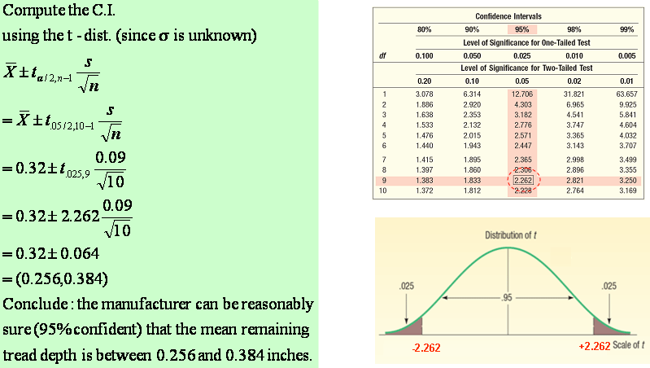
Student’s t-distribution Table

Slide 19
Confidence Interval for a Population Proportion
The confidence interval for a population proportion is estimated by:
Where p is the sample proportion; p = x/n

Slide 20
Confidence Interval for a Population Proportion- Example
The union representing the Bottle Blowers of America (BBA) is considering a proposal to merge with the Teamsters Union. According to BBA union bylaws, at least three-fourths of the union membership must approve any merger. A random sample of 2,000 current BBA members reveals 1,600 plan to vote for the merger proposal. What is the estimate of the population proportion?
Develop a 95 percent confidence interval for the population proportion. Basing your decision on this sample information, can you conclude that the necessary proportion of BBA members favor the merger? Why?

Slide 21
Selecting a Sample Size
There are 3 factors that determine the size of a sample, none of which has any direct relationship to the size of the population. They are:
The degree of confidence selected.
The maximum allowable error.
The variation in the population.

Slide 22
Sample Size Determination for a Variable
To find the sample size for a variable:

Slide 23
Sample Size Determination for a Variable-Example
A student in public administration wants to determine the mean amount members of city councils in large cities earn per month as remuneration for being a council member. The error in estimating the mean is to be less than $100 with a 95 percent level of confidence. The student found a report by the Department of Labor that estimated the standard deviation to be $1,000. What is the required sample size?
Given in the problem:
E, the maximum allowable error, is $100
The value of z for a 95 percent level of confidence is 1.96,
The estimate of the standard deviation is $1,000.

Slide 24
Sample Size Determination for a Variable- Another Example
A consumer group would like to estimate the mean monthly electricity charge for a single family house in July within $5 using a 99 percent level of confidence. How large a sample is required? Based on similar studies the standard deviation is estimated to be $20.00.

Slide 25
Sample Size for Proportions
The formula for determining the sample size in the case of a proportion is:

Slide 26

A Sample Size Example
The American Kennel Club wanted to estimate the proportion of children that have a dog as a pet. If the club wanted the estimate to be within 3% of the population proportion, how many children would they need to contact? Assume a 95% level of confidence and that the club estimated that 30% of the children have a dog as a pet.

Slide 27
Another Sample Size Example
A study needs to estimate the proportion of cities that have private refuse collectors. The investigator wants the margin of error to be within .10 of the population proportion, the desired level of confidence is 90 percent, and no estimate is available for the population proportion. Therefore we use .50. What is the required sample size?

Slide 28


Confidence Interval Estimates for the Mean – Using Minitab
The manager of the Inlet Square Mall, near Ft. Myers, Florida, wants to estimate the mean amount spent per shopping visit by customers. A sample of 20 (n) customers reveals the following amounts spent. Is it reasonable that the population mean could be $50.00; how about $60.00?

Slide 29
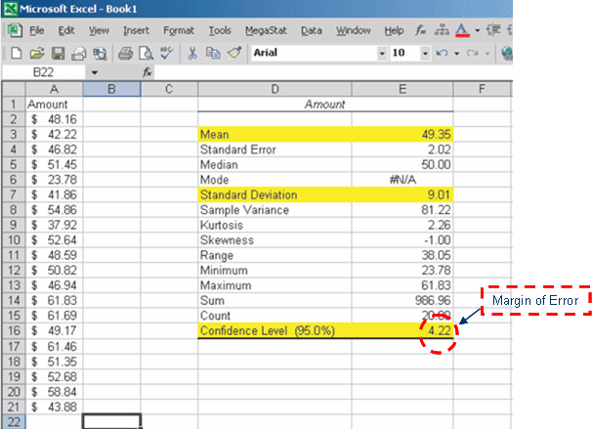
Confidence Interval Estimates for the Mean – Using Excel (see Inlet Square Mall file in BB)
Using the Descriptive Statistics function in Excel

Slide 30
Confidence Interval Estimates for the Mean – By Formula

Slide 31
End of Chapter 9

Slide 32
Using the Normal Distribution to Approximate the Binomial Distribution
To develop a confidence interval for a proportion, we need to meet the following assumptions. (Remember this!)
1. The binomial conditions, discussed in Chapter 6, have been met. Briefly, these conditions are:
a. The sample data is the result of counts.
b. There are only two possible outcomes.
c. The probability of a success remains the same from one trial to the next.
d. The trials are independent. This means the outcome on one trial does not affect the outcome on another.
2. The values n π and n(1-π) should both be greater than or equal to 5. This condition allows us to invoke the central limit theorem and employ the standard normal distribution, that is, z, to complete a confidence interval.

Slide 33
Finite-Population Correction Factor
A population that has a fixed upper bound is said to be finite.
For a finite population, where the total number of objects is N and the size of the sample is n, the following adjustment is made to the standard errors of the sample means and the proportion:
However, if n/N < .05, the finite-population correction factor may be ignored.

Slide 34
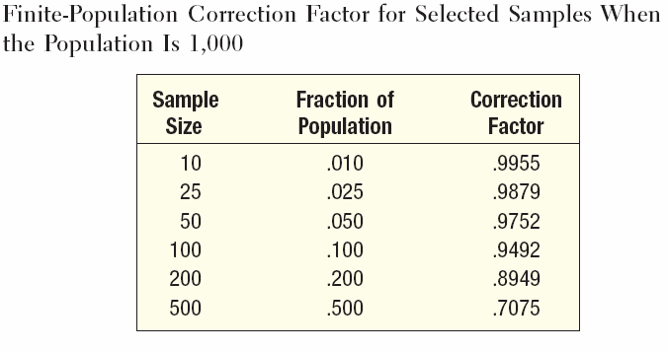
Effects on FPC (Finite-Population Correction) when n/N Changes
Observe that FPC approaches 1 when n/N becomes smaller

Slide 35
Confidence Interval (CI) Formulas for Estimating Means and Proportions with Finite Population Correction
C.I. for the Mean (μ)
C.I. for the Mean (μ)
C.I. for the Proportion (π)

Slide 36
CI For Mean with FPC - Example
There are 250 families in Scandia, Pennsylvania. A random sample of 40 of these families revealed the mean annual church contribution was $450 and the standard deviation of this was $75.
Develop a 90 percent confidence interval for the population mean.
Interpret the confidence interval.
Given in Problem:
N – 250
n – 40
s - $75
Since n/N = 40/250 = 0.16, the finite population correction factor must be used.
The population standard deviation is not known therefore we must use the t-distribution
Use the formula below to compute the confidence interval:

Slide 37
CI For Mean with FPC - Example

