Slide 1

What are RESTful API’s?
Rhonda Rivas
WEB-420

Slide 2
RESTful API’s
What are RESTful API’s?
RESTful API is an application program interface (API) that uses HTTP requests to GET, PUT, POST and DELETE data (among some other options)
REST technology is generally preferred over the more robust Simple Object Access Protocol (SOAP) technology because REST uses less internet bandwidth, making it more suitable for efficient internet usage.
Unlike Web API’s, RESTful API’s do not have human-readable documentation explaining how to construct URL’s for different resources. Think of that like an English prose describing how to find a specific files on an FTP server. That’s tedious.
REST does not use embed tags <a> and <form> but rather tells you what URL’s to use or type in.
Website re-design is solely housed within the self-descriptive HTML documents served by a website.
Do not depend on customer API clients
﻿A RESTful system is made up of independent components: servers, clients, caches, proxies, caching proxies
RESTful API’s is code that allows two software programs to communicate with each other

Slide 3
Using RESTful API’s
Since RESTful API’s uses code to connect two software programs to communicate with each other, we can further explain how it allows websites to work.
REST Uses the independent components: servers, clients, caches, proxies, caching proxies.
A RESTful API breaks down a transaction to create a series of small modules. Those modules address a underlying part of the transaction. This provides developers with a lot of flexibility, but it can be a challenge for the design of REST API from scratch
A RESTful API uses existing HTTP methodologies defined by the ‘RFC 2616 protocol’. They use GET to retrieve a resource; PUT to change the state of or update a resource, which can be an object, file or block; POST to create that resource; and DELETE to remove it.
Calls are stateless and are useful in cloud-based applications and can be freely re-deployed if a failure occurs and are scaleable to accommodate the situation of the load changes.

Slide 4
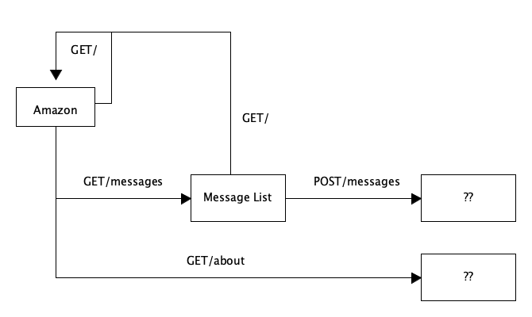
Website Communication

Slide 5
Advantages of RESTful API’s
Automation: with API’s, computers rather than people can manage the work. Through API’s, agencies can update workflows to make them quicker and more productive.
Application: because API’s can access the applications components, the delivery of services and information is more flexible.
More scope: with an API an application layer can be created which can be used to distribute information and services to new audiences which can be personalized to create custom user experiences.
New data available: an API allows all of the information generated at the government level to be available to every citizen, not just a select few.

Slide 6
Advantages of RESTful API’s?
Efficiency: when access is provided to an API, the content generated can be published automatically and is available for every channel. It allows the data to be shared and distributed more easily.
Integration: API’s allow content to be embedded from any site or application more easily. This guarantees more fluid information delivery and an integrated user experience.
Personalization: through APIs any user or company can customize the content and services that they use the most.
Adaptation: needs change over time and APIs help to anticipate changes. When working with this technology, data migration is supported better, and the information is reviewed more closely. Basically, API’s make service provision more flexible.

Slide 7
Drawbacks of RESTful API’s
Low Rest – (this means just using GET & POST)
REST- programming languages are not resource oriented so the handling code that maps URIs can be messy
This is NOT HTTP specific
But some Microsoft implementation in conjunction with Joe Gregorio URI mapping resolves most of that.
it is relatively hard to make the REST API hyper-text driven (Which is a constraints of REST)
REST is not the answer to everything –
REST is a good tool for your toolset, but keep in mind it’s not the only one.
The majority of REST implementations do not support ”sub/pub”
Misusers – there seems to be some misunderstanding it’s assumed that REST if better than HTTP and some think HTTP is REST.
This includes building an implementation that is GETsful (it does everything with http GET) or doing plain RPC where the URI is the command, doing CRUD with HTTP verbs and other things.
Some people think is NOT simple and suggest that it is complex.
All it takes is some adjustments in your thinking

Slide 8
The Difference Between a URI and a URL

Slide 9
A URI is an identifier of a specific resource. Like a page, or book, or a document. This can be an ISBN number for books. A URL is special type of identifier that also tells you how to access it, such as HTTPs, FTP, etc. - For example: https://www.netflix.com. If the protocol (https, ftp, etc.) is either present or implied for a domain, you should call it a URL- even though it’s also a URI.

Slide 10
References
Richardson, Leonard. RESTful Web APIs: Services for a Changing World . O'Reilly Media. Kindle Edition.
Tech Target : https://searchapparchitecture.techtarget.com/definition/RESTful-API
BBVA – API_Market - https://searchapparchitecture.techtarget.com/definition/RESTful-API
DZone – Integration Zone - https://searchapparchitecture.techtarget.com/definition/RESTful-API

