Slide 1

Microservices
Rhonda Rivas
WEB-420

Slide 2
What are Microservices?
Microservices – (also known as the microservice architecture) - is an architectural style that structures an application as a collection of services that are
Highly maintainable and testable
Loosely coupled
Independently deployable
Organized around business capabilities
Owned by a small team
The microservice architecture enables the rapid, frequent and reliable delivery of large, complex applications. It also enables an organization to evolve its technology stack.

Slide 3
Microservices …
We use the pattern language as a guide
The microservice architecture is not a smoking gun, and it has several drawbacks.
When using this architecture there are numerous issues that you must address.
The microservice architecture pattern language is a collection of patterns for applying the microservice architecture. It has two goals:
The pattern language enables you to decide whether microservices are a good fit for your application.
The pattern language enables you to use the microservice architecture successfully.
A good starting point is the Monolithic Architecture pattern. This is the “traditional” architectural style that is still a good choice for many applications.
It does, however, have numerous limitations and issues and so a better choice for large/complex applications is the Microservice architecture pattern.
Promotes a modular application design – flexibility for organizations.

Slide 4
Disadvantages of microservices
Communication between services is complex: Since everything is now an independent service, you have to carefully handle requests traveling between your modules. In one such scenario, developers may be forced to write extra code to avoid disruption. Over time, complications will arise when remote calls experience latency.
More services equals more resources: Multiple databases and transaction management can be painful.
Global testing is difficult: Testing a microservices-based application can be cumbersome. In a monolithic approach, we would just need to launch our WAR on an application server and ensure its connectivity with the underlying database. With microservices, each dependent service needs to be confirmed before testing can occur.
Debugging problems can be harder: Each service has its own set of logs to go through. Log, logs, and more logs.
Deployment challengers: The product may need coordination among multiple services, which may not be as straightforward as deploying a WAR in a container.
Large vs small product companies: Microservices are great for large companies but can be slower to implement and too complicated for small companies who need to create and iterate quickly, and don’t want to get bogged down in complex orchestration.

Slide 5
Advantages of microservices
Improved fault isolation: Larger applications can remain mostly unaffected by the failure of a single module.
Eliminate vendor or technology lock-in: Microservices provide the flexibility to try out a new technology stack on an individual service as needed. There won’t be as many dependency concerns and rolling back changes becomes much easier. With less code in play, there is more flexibility.
Ease of understanding: With added simplicity, developers can better understand the functionality of a service.
Smaller and faster deployments: Smaller codebases and scope = quicker deployments, which also allow you to start to explore the benefits of Continuous Deployment.
Scalability: Since your services are separate, you can more easily scale the most needed ones at the appropriate times, as opposed to the whole application. When done correctly, this can impact cost savings.
The advantages of microservices are used by some heavy enterprise players such as Amazon, Netflix, and eBay to adopt the methodology.

Slide 6
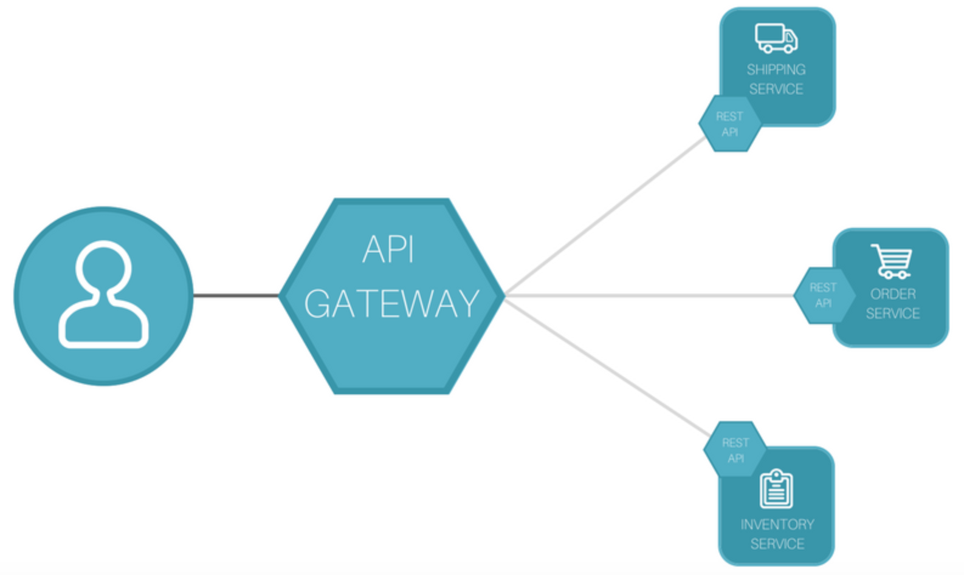
API Gateway
An API gateway is an API management tool that sits between a client and a collection of “backend” services.
The API gateway acts as a reverse proxy so it can accept all the needed application programming interface (API). It calls, aggregate the various services required to fulfill them, and return the appropriate result.
API gateway is considered a “middleware”.
It uses protocols through RESTful API’s.
This makes things easier to develop, secure, manage and scale endpoints.
Moves most of the required logic from the client, into the gateway.

Slide 7
Deploying Microservices
While there is no prescriptive or universal action plan to deploy microservices in a production environment, there are some principles that should and are followed by the big companies (Amazon, Google, etc…
Use cloud services for production infrastructure
This captures an infrastructure resource or enterprise app(s) as on-demand services.
enable microservice
make it more cost-effective and convenient to disaggregate and run application functions as separate components
Design for failure
Microservices are decoupled and distributed – the individual components have lots of dependencies.
The microservices infrastructure cannot be critically dependent on a single server
must design and deploy microservices to accommodate for failure
Must treat servers (or container nodes) as stateless entities that can independently stop, restart, auto-scale and patch.
Decentralize data management
consolidate databases and storage volumes onto a few systems to improve operational efficiency
cuts licensing costs
simplify application, policy and security management.

Slide 8
Deploying Microservices, contd.
Distribute governance
Microservices should upend this structure.
Replace IT silos with cross-functional microservices teams with a DevOps culture and agile development practices
Create a culture with very little processes balanced responsibility to find and fix problems as they come up
Automate infrastructure deployment, embrace CI/CD processes
Keep coding at similar levels
create a new microservice when an enterprise needs to add features or fix bugs in an existing one
use separate ”builds” for each microservice
Share files – libraries, code functions - to build from the storage class memory
Monitor, log and troubleshoot from the beginning

Slide 9
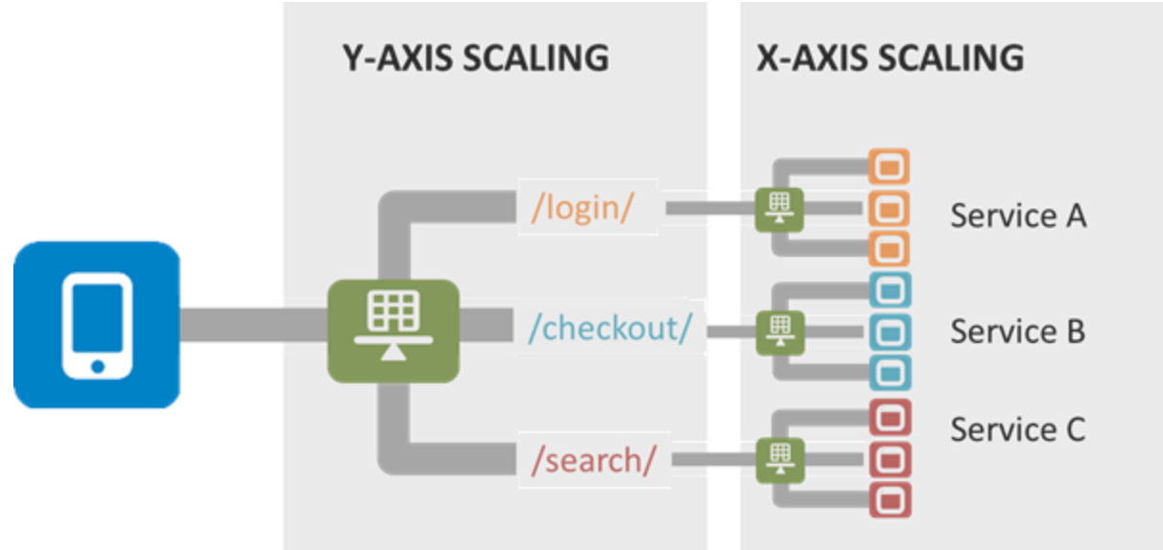
How do you scale Microservices?
The traditional method of scaling by running multiple copies of an application load-balanced across servers is the X-axis. The general approach of microservices falls along the Y-axis. Y-axis scaling breaks the application into its components and services.
The Scalability “Cube”
The "Scale Cube" is composed of an X-axis, Y-axis, and Z-axis. The traditional method of scaling by running multiple copies of an application load-balanced across servers is the X-axis

Slide 10
References
Microservices: https://content.bellevue.edu/cst/WEB/WEB420/Week%208/Microservices.pdf
Advantages and Disadvantages of Mircoservices Architecture: https://cloudacademy.com/blog/microservices-architecture-challenge-advantage-drawback/
Building Microservices: Using an API Gateway: https://www.nginx.com/blog/building-microservices-using-an-api-gateway/
What is an API Gateway?: https://www.express-gateway.io/eg-vs-amazon-aws-api-gateway/
Follow these 6 steps to deploy microservices in production: https://searchitoperations.techtarget.com/tip/Follow-these-6-steps-to-deploy-microservices-in-production
The Art of Scale: Microservices, The Scale Cube and Load Balancing: https://devcentral.f5.com/s/articles/the-art-of-scale-microservices-the-scale-cube-and-load-balancing
The challenges of scaling microservices: https://techbeacon.com/app-dev-testing/challenges-scaling-microservices
What are microservices?: https://microservices.io/

