Slide 1

Hypermedia
Design
Rhonda Rivas
WEB-420

Slide 2
HYPERMEDIA DESIGN
Business case use
Hypermedia Design is basically an extension of hypertext that allows images, movies, and Flash animations to be linked to other content. The most common type of hypermedia is an image link. Photos or graphics on the Web are often linked to other pages
The WWW is a classic example of hypermedia. It is a non-interactive cinema presentation is an example of standard multimedia due to the absence of hyperlinks. Audio hypermedia is emerging with voice command devices and voice browsing.
Hypermedia is the approach to building information systems made up of nodes of various media (such as text, audio data, video data, etc.) connected together by a collection of associative links. A subset of this discipline known as hypertext concentrates on the construction of loosely connected textual systems
Hypermedia API's are systems which want a consuming API (the programmed client) to do that as well. Hypermedia API's accomplish this by responding to requests with both the requested data AND other resources available or actions to take.

Slide 3
The Business Case Use
The API will provide potential clients to request photography information, book sessions and see availability
The API will use GET and POST to gather and provide potential clients information to book sessions
Once you select a session type calendar events, and open session times and package options will appear
The API provides details on sessions, themes, pricing and packages.
Potential clients can view policies, procedures and any minimums associated with the packages
Potential clients can view customer reviews and previous work/photography work

Slide 4
Return of Investment. (ROI)
The return of investment, shows itself by interacting with the potential clients, while showing them examples of past work, achievements and customer reviews.
If you showcase your work with previous clients, show achievements or awards and review you can draw in potential clients.
Reviews help grow the business and word-of-mouth advertising the API will generate.
A well designed and pleasing aesthetic API encourages past, present and future clients to return as clients for their photographic needs.

Slide 5
7 Step Design Procedure
Step 1: Items the client may want to get out of the API’s using hierarchy order
  Semantics
  Booking Sessions
    Type of Sessions
      Family, marriage, pet etc…
    Number of People
      Single
      Couple
      Group
    Appointment Time
    Session Theme (Optional)
      Based off type of session
    Destination (optional)
    Package/Bundle Details

Slide 6
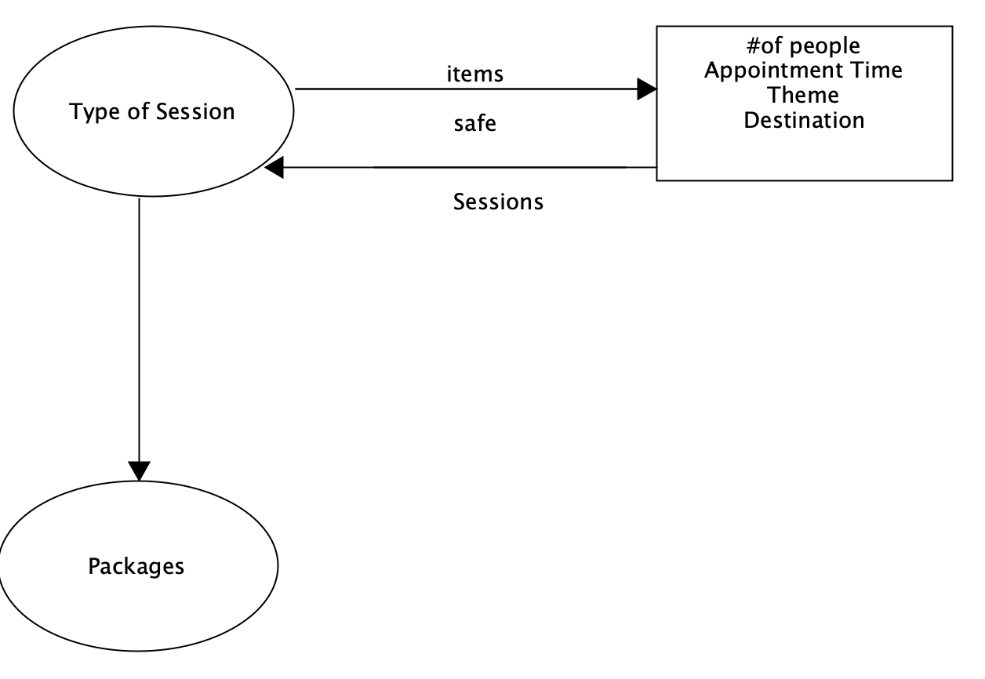
Step 2: State Diagram
Draw a state diagram for your API.
  Each box represents one kind of
  representation
You use your previous list in step 1 to
group together
You use arrows to connect the connections
You feel the client will find appealing
The arrows are your state transitions
The state transitions are then triggered by
HTTP requests

Slide 7
Step 3: Reconcile Names
This step could be skipped since a computer does not comprehend what a “name” is
Though you could skip, you should still complete this step
Names matter quite a lot to humans
Make up your own names for things you choose
It is not a good idea to “autogenerate” the names of the semantic descriptors from the fields in the database or scheme models
Do not duplicate link relations so it does not affect the functionality of IANA–registered link relations. This clutters things and makes more work

Slide 8
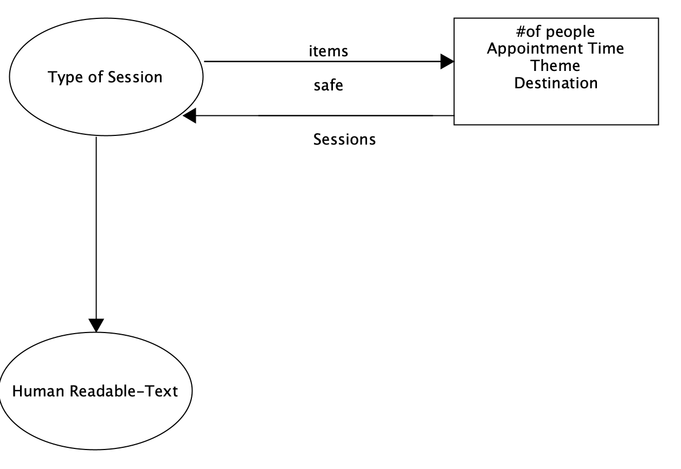
IANA Updates

Slide 9
Step 4: Choose a Media Type
Choose a Hypermedia format
One can be created but you may not need to do so
You can use a pre-existing media type
Depending on your semantics you can choose one to use
There are a number of different media types to choose
You can use: Collections+JSON, AtomPub, Odata,
A generic hypermedia language such as HTML, HAL, Siren are also possible
For this API, it will use Collection+JSON

Slide 10
Step 5: Write a Profile
Writing the API profile: When the server sends some sort of representation of it, it will include content, headers and basically tells the client how to parse the provided representation
Also, we would include a link to at least one or possibly more profiles to explain the semantics provided
This profile can be an ALPS document, a JSON-LD context, a webpage that utilizes XMDP microformat, either way it should be a machine-readable document. If there are issues it can be a human-readable profile
FYI Machine Readable is something only computers can read and decipher
FYI Human Readable is a “traditional” API document

Slide 11
Step 6: Implementation
This is the coding step. It triggers the state transmission to get the specific representation for the response
This is the most time-consuming part of the steps. You set up, test and get it ready to go
Write the code
Choose the framework
Use the state diagram using it as a basis and make adjustments as needed
You create the HTTP server to implement the state diagram
Use the media type you chose in the Step 4 and the link you chose in Step 5

Slide 12
Step 7: Publication
Publish your URL that the clients andusers will use to use the API
Documents can be used to provide training for the client on how to use the API
We create the human readable profile

Slide 13
References
Richard, Leonard. RESTful Web APIs: Services for a Changing World. O’Reilly Media
Choosing a hypermedia : https://sookocheff.com/post/api/on-choosing-a-hypermedia-format/
7 Steps for building successful API’s | Nordic APIs: https://nordicapis.com/7-steps-for-building-successful-api-products/

