Slide 1
COVID19 CT Image Classification
Runyu Hong
2020.04.20

Slide 2
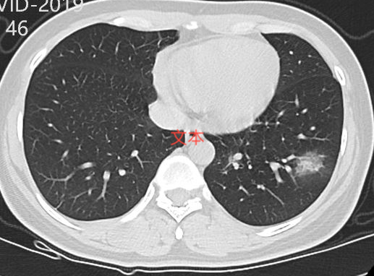
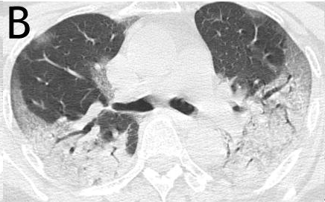
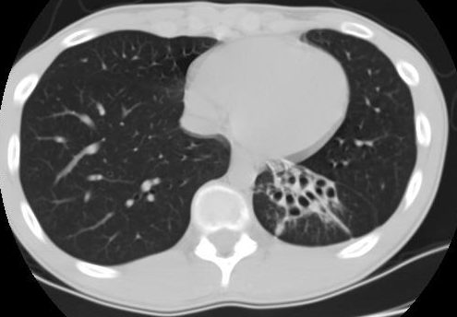
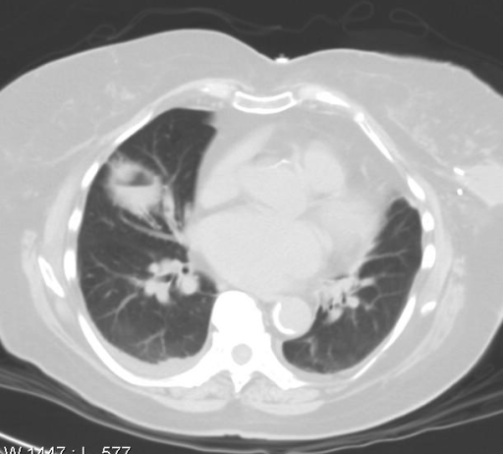
Data
https://arxiv.org/pdf/2003.13865.pdf
https://github.com/UCSD-AI4H/COVID-CT
349 COVID19 CT images from 216 patients; 397 non-COVID19 CT images from 171 patients
Random split train/validation/test 70/15/15% at per patient level
COVID19 examples
Non-COVID19 examples

Slide 3
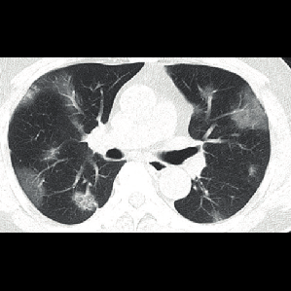
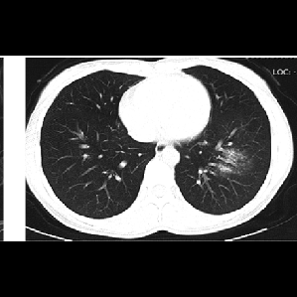
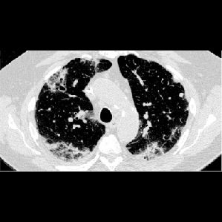
Preprocessing
Padding and reshape to 299x299
Normalization
Augmentation for training set (random color jitter: brightness, contrast, saturation, hue)

Slide 4
Workflow
Pytorch
34 CNN architectures; 31 of them have pretrained model on torchvision
Trained from scratch and transfer learning from pretrained models.
Save the best model with lowest validation loss
Early stop if validation loss does not decrease after 100 epochs

Slide 5
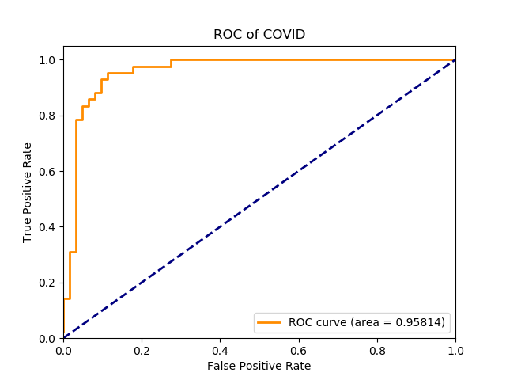
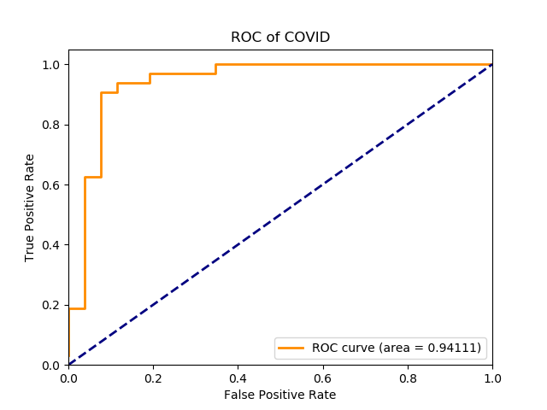
Results
Pretrained models performs better than training from scratch
Best AUROC per-image: 0.958; per-patient: 0.941 (pretrained GoogleNet)
Best AUPRC per-image: 0.92; per-patient: 0.935 (pretrained Resnet152)
Best accuracy per-image: 0.885 (pretrained GoogleNet); per-patient: 0.897 (pretrained mobilenet)
Best F1 score per-image: 0.87 (pretrained GoogleNet); per-patient: 0.909 (pretrained mobilenet)

Slide 6
Results
model | state | best epoch | test loss | TP_image | TN_image | FN_image | FP_image | precision_image | recall_image | F1_image | accuracy_image | AUROC_image | AUPRC_image | TP_patient | TN_patient | FN_patient | FP_patient | precision_patient | recall_patient | F1_patient | accuracy_patient | AUROC_patient | AUPRC_patient
googlenet | pretrained | 14 | 0.0314 | 40 | 52 | 2 | 10 | 0.8000 | 0.9524 | 0.8696 | 0.8846 | 0.9581 | 0.9140 | 30 | 21 | 2 | 5 | 0.8571 | 0.9375 | 0.8955 | 0.8793 | 0.9411 | 0.9320
resnet152 | pretrained | 18 | 0.0367 | 40 | 48 | 2 | 14 | 0.7407 | 0.9524 | 0.8333 | 0.8462 | 0.9432 | 0.9201 | 30 | 21 | 2 | 5 | 0.8571 | 0.9375 | 0.8955 | 0.8793 | 0.9291 | 0.9349
densenet121 | pretrained | 6 | 0.0306 | 37 | 49 | 5 | 13 | 0.7400 | 0.8810 | 0.8043 | 0.8269 | 0.9140 | 0.8428 | 27 | 22 | 5 | 4 | 0.8710 | 0.8438 | 0.8571 | 0.8448 | 0.9267 | 0.9342
vgg16bn | pretrained | 3 | 0.0306 | 35 | 53 | 7 | 9 | 0.7955 | 0.8333 | 0.8140 | 0.8462 | 0.9336 | 0.8932 | 26 | 23 | 6 | 3 | 0.8966 | 0.8125 | 0.8525 | 0.8448 | 0.9183 | 0.9186
densenet169 | pretrained | 5 | 0.0459 | 42 | 35 | 0 | 27 | 0.6087 | 1.0000 | 0.7568 | 0.7404 | 0.9247 | 0.8900 | 32 | 14 | 0 | 12 | 0.7273 | 1.0000 | 0.8421 | 0.7931 | 0.9099 | 0.9182
mobilenet | pretrained | 16 | 0.0453 | 40 | 47 | 2 | 15 | 0.7273 | 0.9524 | 0.8247 | 0.8365 | 0.8763 | 0.7552 | 30 | 22 | 2 | 4 | 0.8824 | 0.9375 | 0.9091 | 0.8966 | 0.9099 | 0.8960
resnext50_32x4d | pretrained | 9 | 0.0378 | 40 | 47 | 2 | 15 | 0.7273 | 0.9524 | 0.8247 | 0.8365 | 0.9005 | 0.8674 | 30 | 21 | 2 | 5 | 0.8571 | 0.9375 | 0.8955 | 0.8793 | 0.9075 | 0.9169
resnet34 | pretrained | 7 | 0.0342 | 41 | 46 | 1 | 16 | 0.7193 | 0.9762 | 0.8283 | 0.8365 | 0.9128 | 0.8567 | 31 | 18 | 1 | 8 | 0.7949 | 0.9688 | 0.8732 | 0.8448 | 0.9063 | 0.9012
resnet50 | pretrained | 10 | 0.0459 | 40 | 41 | 2 | 21 | 0.6557 | 0.9524 | 0.7767 | 0.7788 | 0.8383 | 0.7487 | 30 | 21 | 2 | 5 | 0.8571 | 0.9375 | 0.8955 | 0.8793 | 0.9063 | 0.9291
squeezenet10 | pretrained | 8 | 0.0364 | 38 | 42 | 4 | 20 | 0.6552 | 0.9048 | 0.7600 | 0.7692 | 0.9078 | 0.8785 | 29 | 19 | 3 | 7 | 0.8056 | 0.9063 | 0.8529 | 0.8276 | 0.8990 | 0.9143
wide_resnet50_2 | pretrained | 36 | 0.0461 | 34 | 44 | 8 | 18 | 0.6538 | 0.8095 | 0.7234 | 0.7500 | 0.8721 | 0.8302 | 26 | 21 | 6 | 5 | 0.8387 | 0.8125 | 0.8254 | 0.8103 | 0.8942 | 0.9215
vgg11 | pretrained | 35 | 0.0632 | 36 | 45 | 6 | 17 | 0.6792 | 0.8571 | 0.7579 | 0.7788 | 0.8886 | 0.8163 | 28 | 21 | 4 | 5 | 0.8485 | 0.8750 | 0.8615 | 0.8448 | 0.8918 | 0.8739
wide_resnet101_2 | pretrained | 27 | 0.0475 | 42 | 29 | 0 | 33 | 0.5600 | 1.0000 | 0.7179 | 0.6827 | 0.8437 | 0.7775 | 32 | 13 | 0 | 13 | 0.7111 | 1.0000 | 0.8312 | 0.7759 | 0.8918 | 0.8845
vgg13 | pretrained | 17 | 0.0506 | 39 | 46 | 3 | 16 | 0.7091 | 0.9286 | 0.8041 | 0.8173 | 0.9071 | 0.8492 | 29 | 21 | 3 | 5 | 0.8529 | 0.9063 | 0.8788 | 0.8621 | 0.8906 | 0.8773
alexnet | pretrained | 3 | 0.0347 | 38 | 45 | 4 | 17 | 0.6909 | 0.9048 | 0.7835 | 0.7981 | 0.9044 | 0.7941 | 28 | 17 | 4 | 9 | 0.7568 | 0.8750 | 0.8116 | 0.7759 | 0.8906 | 0.8501
densenet201 | pretrained | 10 | 0.0434 | 35 | 48 | 7 | 14 | 0.7143 | 0.8333 | 0.7692 | 0.7981 | 0.8763 | 0.8239 | 25 | 22 | 7 | 4 | 0.8621 | 0.7813 | 0.8197 | 0.8103 | 0.8906 | 0.9064
resnet101 | pretrained | 9 | 0.0475 | 41 | 41 | 1 | 21 | 0.6613 | 0.9762 | 0.7885 | 0.7885 | 0.9063 | 0.8549 | 31 | 18 | 1 | 8 | 0.7949 | 0.9688 | 0.8732 | 0.8448 | 0.8894 | 0.8939

Slide 7
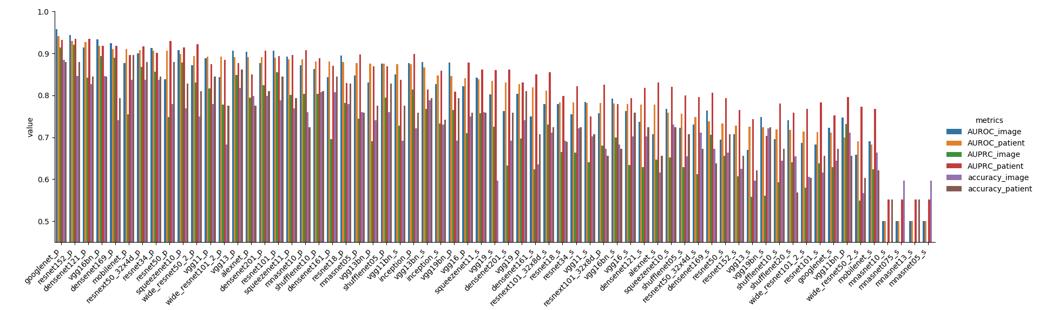
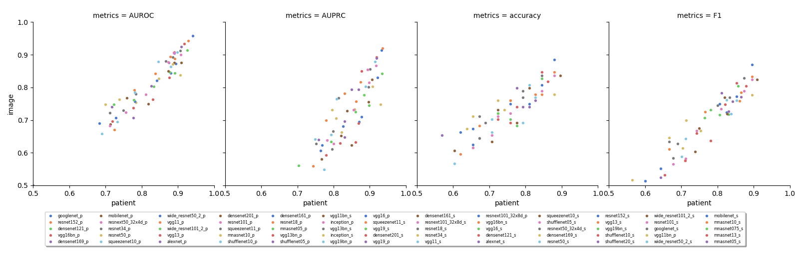

Slide 8
What’s next?
NYU data?
IRB?
Grant?
A manuscript?

