Slide 1
OpenCV-Python
Runyu Hong
10.23.2017

Slide 2
Introduction
OpenCV was started at Intel in 1999 and the first release came out in 2000.
Currently OpenCV supports a wide variety of programming languages like C++, Python, Java etc and is available on different platforms including Windows, Linux, OS X, Android, iOS etc.
OpenCV-Python is the Python API of OpenCV. It combines the best qualities of OpenCV C++ API and Python language.
OpenCV requires Python 2.7, Numpy, and optionally Matplotlib.
Easy to be downloaded and imported. (>>> import cv2)

Slide 3
Features
GUI Features (eg. Show Image, Drawing, Paint Brush)
Core Operations (eg. Image addition, Pixel Modification)
Image Processing
Feature Detection and Description
Video Analysis
Camera Calibration and 3D Reconstruction
Machine Learning
Computational Photography
Object Detection
+
=
Learn more about OpenCV-Python features at:
http://opencv-python-tutroals.readthedocs.io/en/latest/py_tutorials/py_tutorials.html

Slide 4
Basic Functions
cv2.imread() Read image
cv2.imshow() Display image
cv2.imwrite() Save image
cv2.VideoCapture() Capture video
cv2.VideoWriter() Save video
cv2.line() Draw line
cv2.circle() Draw circle
cv2.rectangle() Draw rectangle
cv2.ellipse() Draw ellipse
cv2.putText() Add text
Set Image ROI
>>> ball = img[280:340, 330:390]
>>> img[273:333, 100:160] = ball
cv2.setMouseCallback() Set mouse functions
cv2.getTrackbarPos() Set trackbars
cv2.createTrackbar()

Slide 5
Some Useful Image Processing Functions
Changing Color-space (eg. RGB<-->HSV<-->Gray)
cv2.cvtColor(input_image, flag) # flag determines the type of conversion
Image Thresholding (eg. Create binary masks)
cv2.threshold()
cv2.adaptiveThreshold() # calculate the threshold for small regions of the image.
Rotation
cv2.getRotationMatrix2D()
Image Blurring (Image Smoothing)
cv2.blur() or cv2.boxfilter() or cv2.GaussianBlur()
Canny Edge Detection
cv2.Canny()

Slide 6
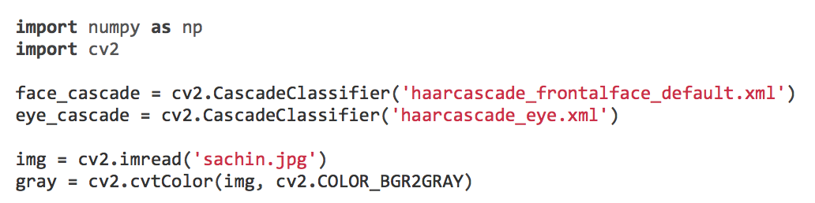
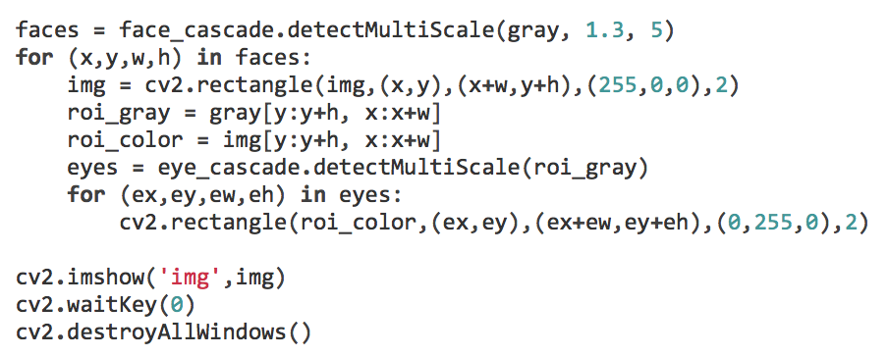
Object Detection
Face Detection using Haar Cascades

Slide 7
Demo

