Slide 1
What are the American people eating?
And why should we be interested?

Slide 2
Working hypothesis:
If consumers i.e. the American people, are becoming increasingly food-conscious, then they are also buying more food-conscious and we can see that in the form of buying less meat.
Reasoning:
Meat prices have increased while produce prices have decreased based on the Dept. of Labor’s dataset
Meat takes a lot of space and energy to produce
Alternative protein sources have emerged
Cardiovascular health has waned in the last century, with direct correlations to overconsumption of meat

Slide 3
Where’s the data from?
Consumer Expenditure Reports from 2010-2014
Diary Data vs. Interview Data
Diary data is collected over 2 consecutive weeks, 4 times a year
Interview data is collected over 1 consecutive week, once a year
Diary data is meant to collect info on smaller purchases (why I used it)

Slide 4
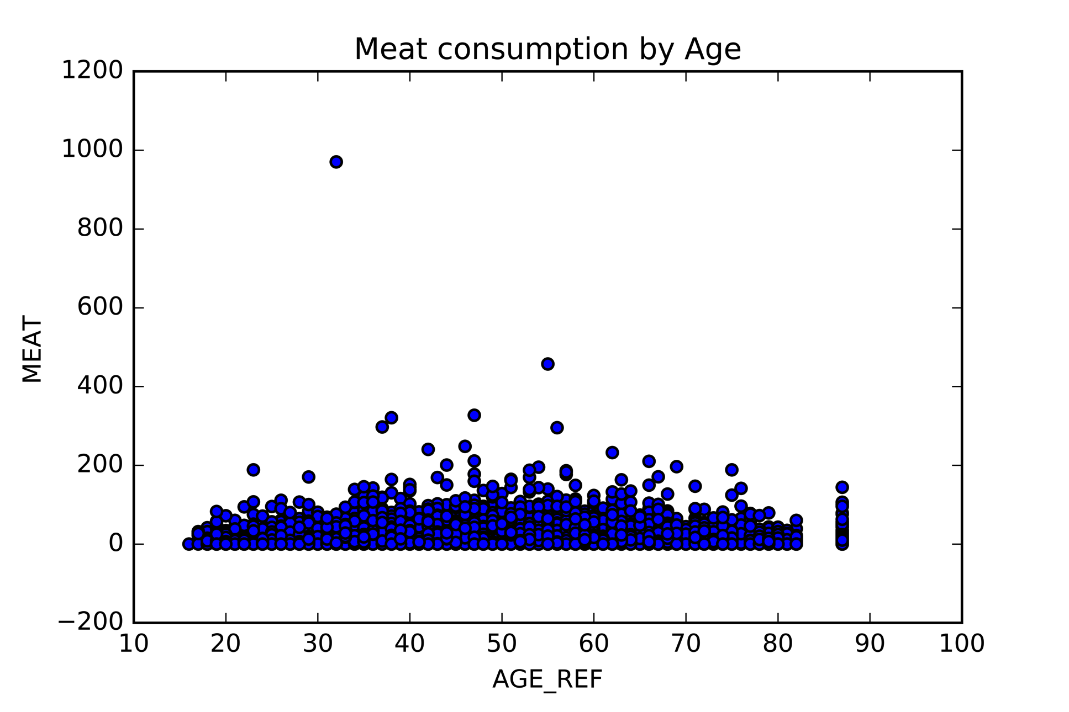
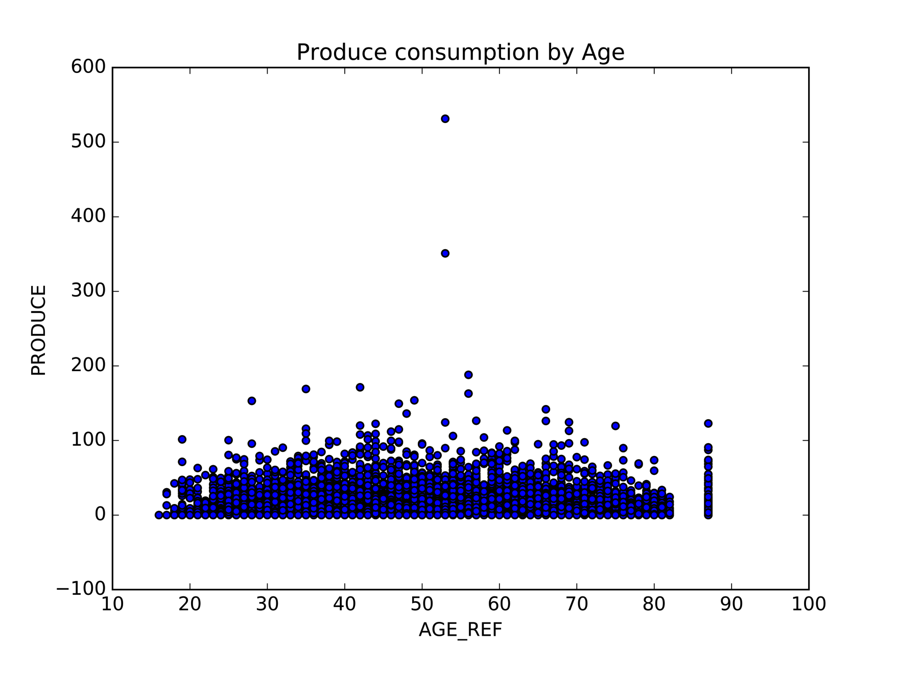
Meat and Produce Consumption by Age
The meat category consists of: beef, pork, poultry, seafood, and “othmeat”
The produce category consists of: fresh fruit, fresh vegetables, processed fruits, and processed vegetables

Slide 5
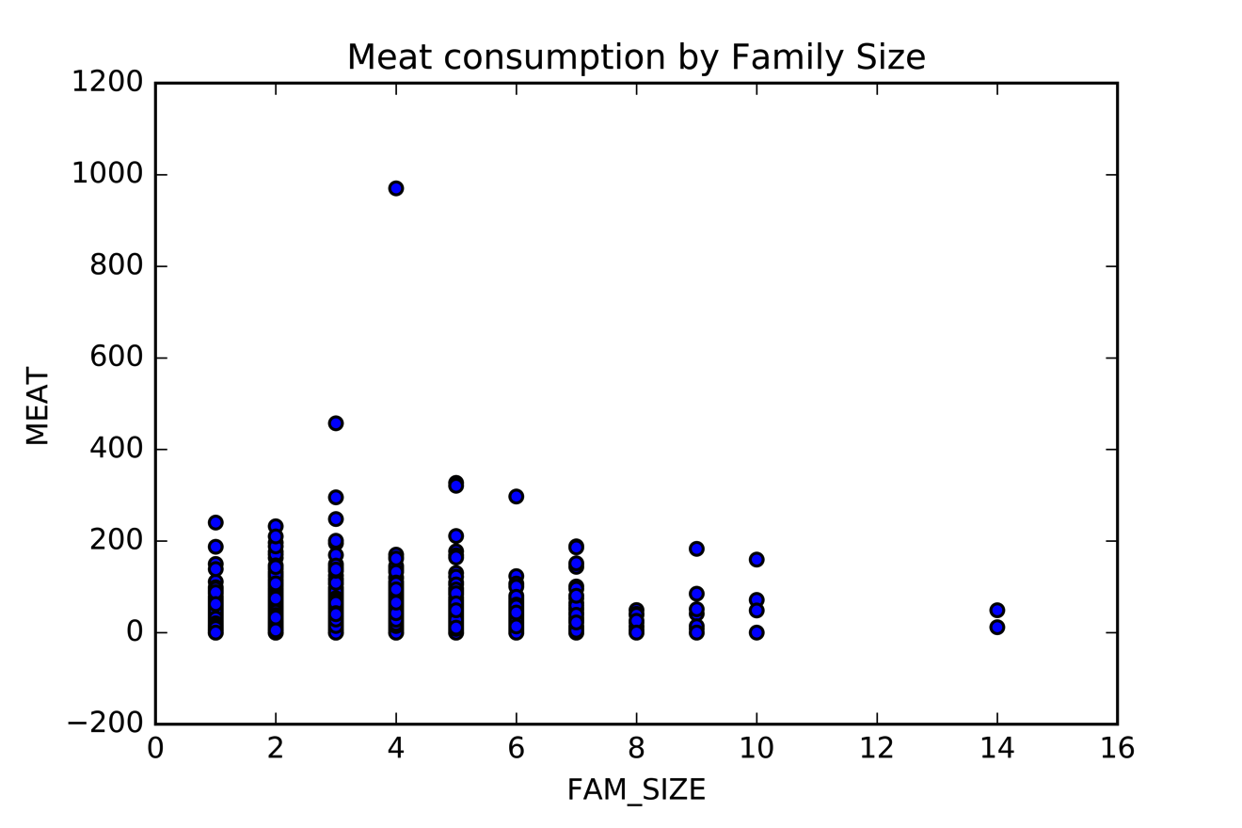
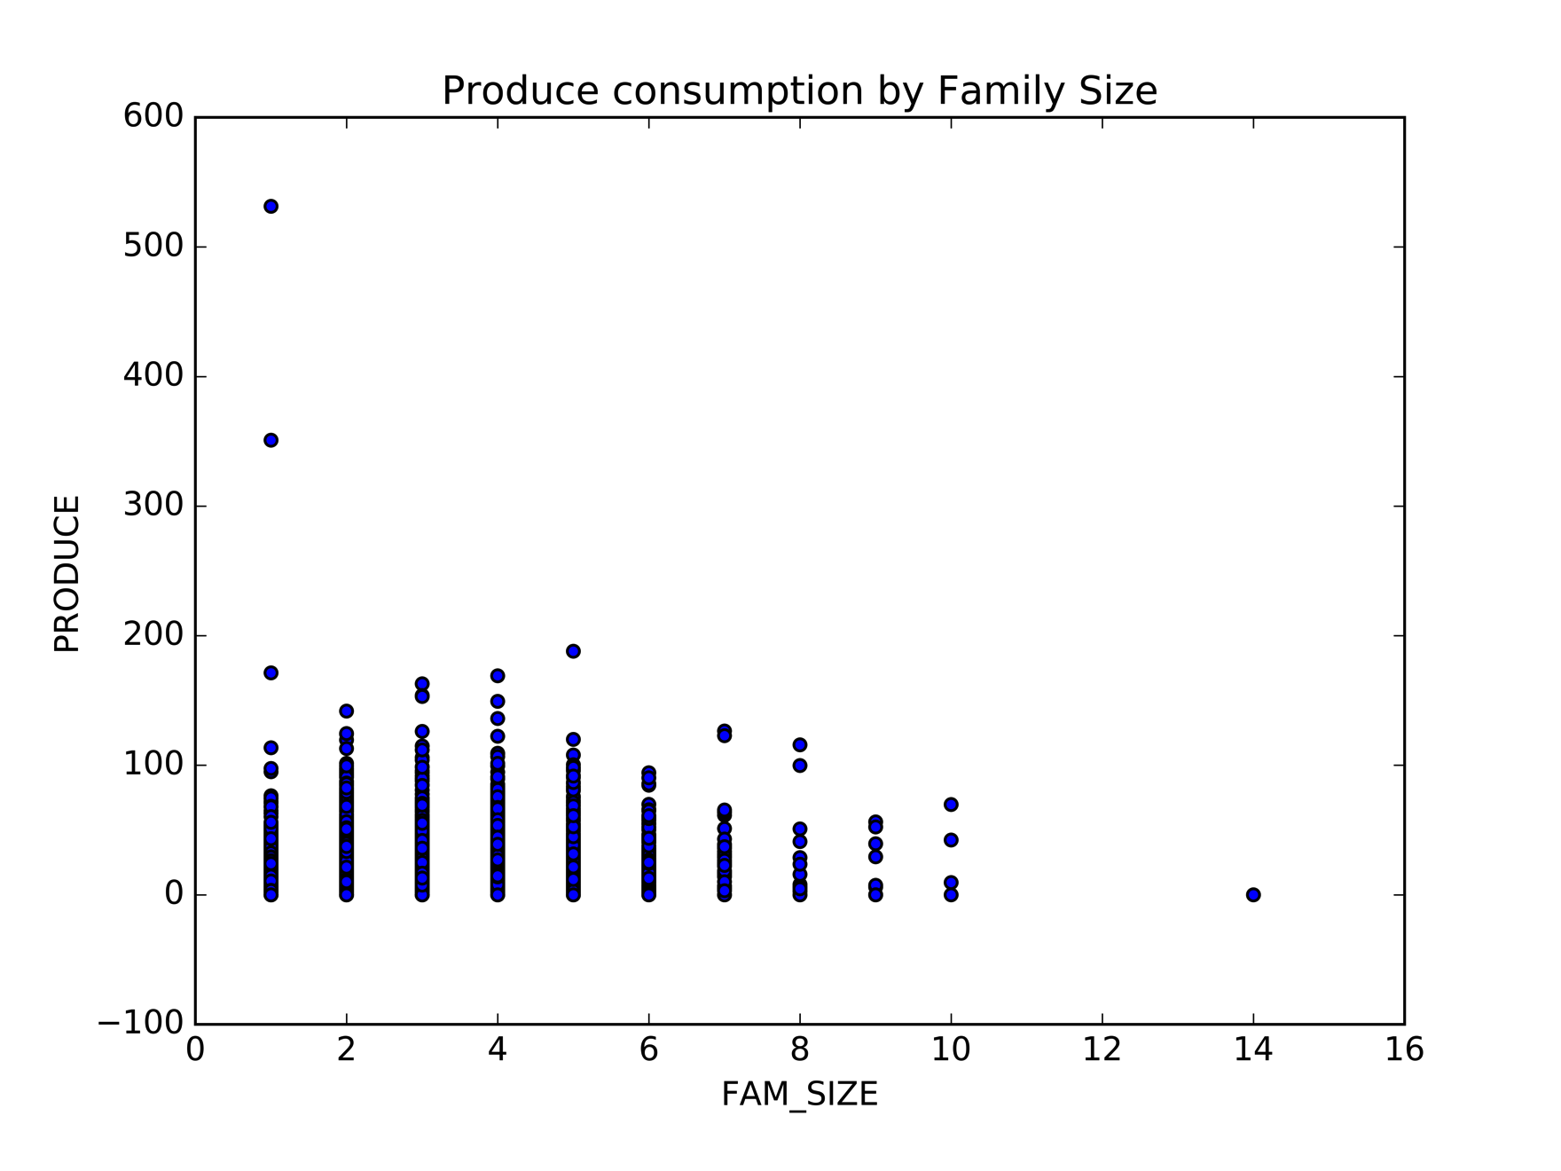
Meat and Produce Consumption by Family Size

Slide 6
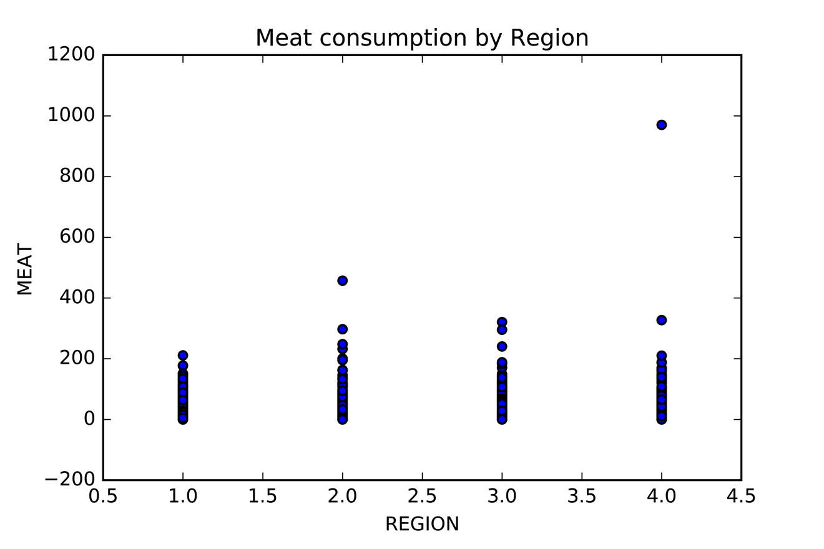
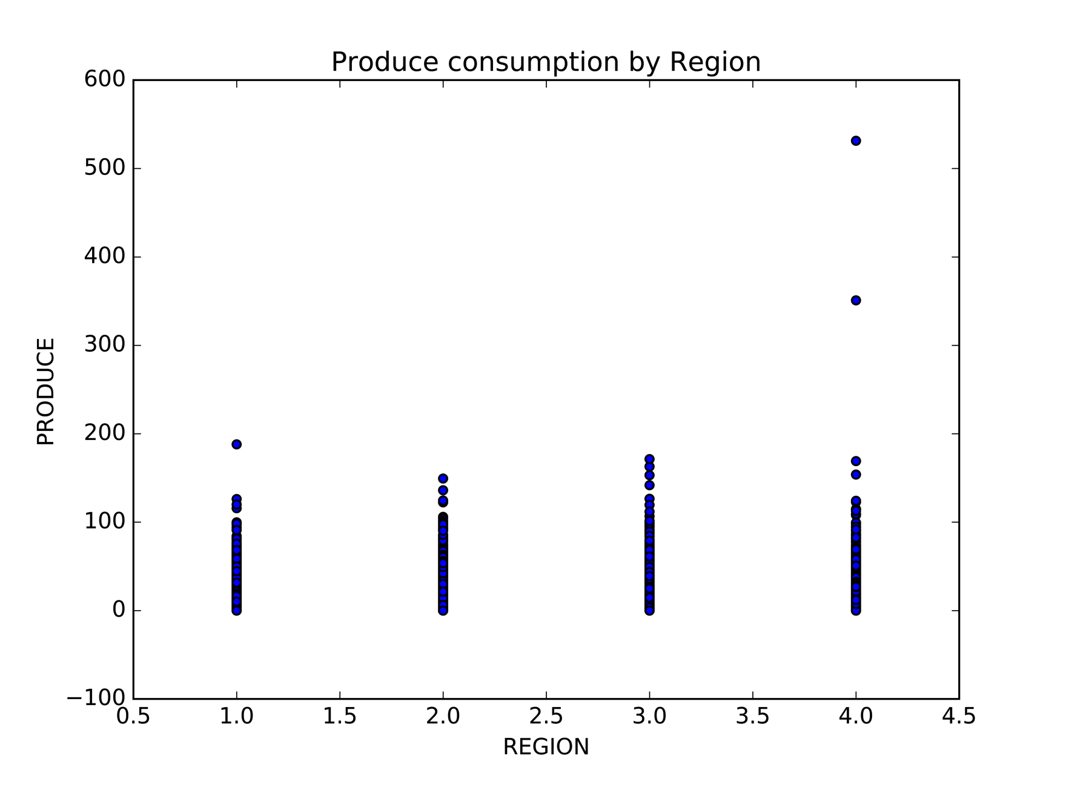
Meat and Produce Consumption by Region

Slide 7
Initial data hiccups
Realized that the price of meat greatly exceeds the price of produce
Solution: convert expenditures into units, based on US Dept. of Labor’s annual price report http://www.bls.gov/regions/mid-atlantic/data/AverageRetailFoodAndEnergyPrices_USandMidwest_Table.htm

Slide 8
Interesting points within data
 | 2010 | 2011 | 2012 | 2013 | 2014
Meat units* | 1,645.05 | 1610.15 | 1605.38 | 6.77 | 6.72
Produce units* | 2000.24 | 1732.67 | 1741.28 | 10.02 | 9.05
Family Size | 1.8 | 1.76 | 1.77 | 2.44 | 2.45
*Measured average lbs/household purchased per year

Slide 9
A few possible reasons to explore:
The code is wrong on either the lower or higher years
The code is fine and need more data to explain
Or…

Slide 10
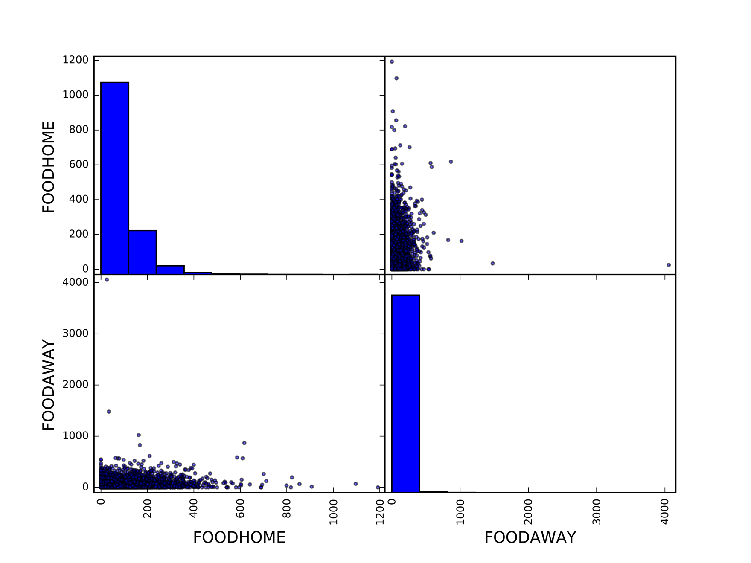
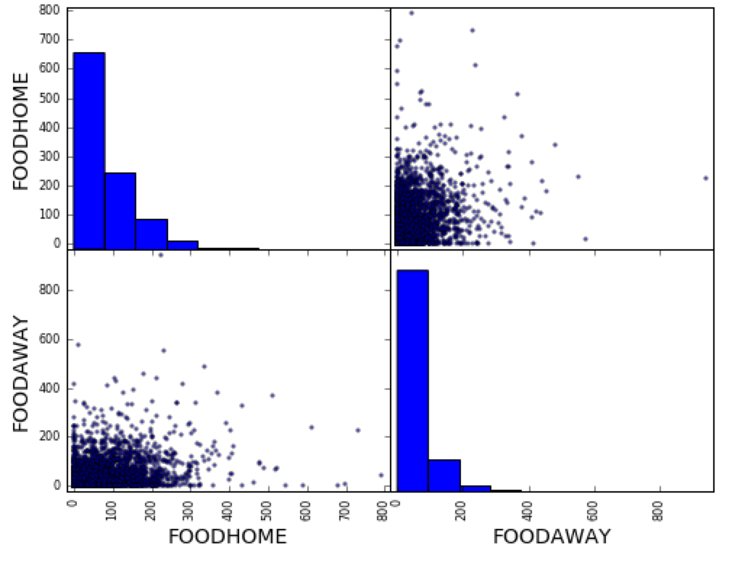
Well, what about the fact that not everyone eats out?
2014
2013

Slide 11
Based on what evidence?
In 2012, Mintel Menu Insights* reported a 66% increase in vegetarian menu options, with a reported 61% positive consumer reviews
In 2013, the National Restaurant Association* surveyed 1,300 professional chefs for top food trends in restaurants, almost 60% said vegetarian dishes would be a new trend
In 2015, OSU introduced its new kelp strain that tastes like bacon and the World Health Organization released research that real bacon can be as much a cancer-causing agent as cigarettes
*Datasets are private and couldn’t verify data

Slide 12
And on the home front:
Just Mayo™, a start-up funded by Hampton Creek boasted celebrity investors Bill Gates, Vinod Khosla, and Peter Thiel
Cheaper, cholesterol-free, and chicken free egg alternative
Heidi Ho, the plant-based cheese brand was featured on Shark Tank in 2014, winning Lori Greiner (Shark) as a partner
OSU’s new dulse strain that was originally grown to stabilize the abalone market, is now being tested to make nonmeat, commercial products
Nonmeat butcher spaces, such as the The Herbivorous Butcher in Minneapolis, are gaining funding through Kickstarter campaigns (spaces up 200% since 2014)
Google tried to purchase Impossible Food’s meatless burger, a plant-based burger that “bleeds” like meat

Slide 13
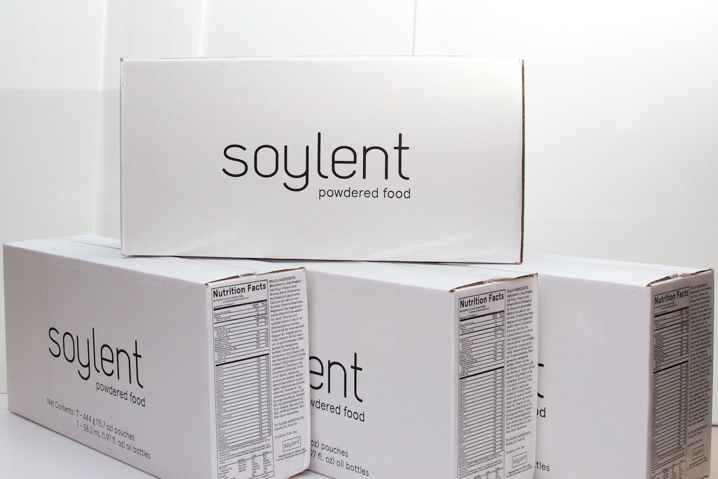
There will be 9 billion people on the planet by 2050…
Concerns include:
Feeding everyone short term and long term
Feeding everyone at a global level
Not feeding them Soylent…
Health (reducing cardiovascular, cancerous, and pulmonary diseases)
Reducing carbon footprint

Slide 14
Sources
http://fortune.com/2014/04/18/vegan-cuisine-aims-for-the-mainstream/
http://latestvegannews.com/report-vegetarian-menus-see-66-percent-growth-since-2012/#
http://blogs.wsj.com/economics/2014/07/22/vegans-rejoice-meat-prices-rising-more-than-fresh-fruits-and-vegetables/
http://www.economist.com/blogs/economist-explains/2015/06/economist-explains-13
http://www.npr.org/sections/thesalt/2015/10/26/451211964/bad-day-for-bacon-processed-red-meats-cause-cancer-says-who
http://www.forbes.com/sites/ryanmac/2013/11/23/bill-gates-food-fetish-hampton-creek-foods-looks-to-crack-the-egg-industry/
http://www.dailymail.co.uk/sciencetech/article-3177026/Google-wants-world-meat-free-Search-giant-tried-buy-veggie-burger-start-300-MILLION.html
http://oregonstate.edu/ua/ncs/archives/2015/jul/osu-researchers-discover-unicorn-–-seaweed-tastes-bacon
http://heavy.com/entertainment/2015/04/heidi-ho-vegan-cheese-shark-tank-products-season-6-episodes-lori-deals/
http://modernfarmer.com/2014/12/buy-meat-free-meat-americas-new-vegan-butchers/

