Slide 1
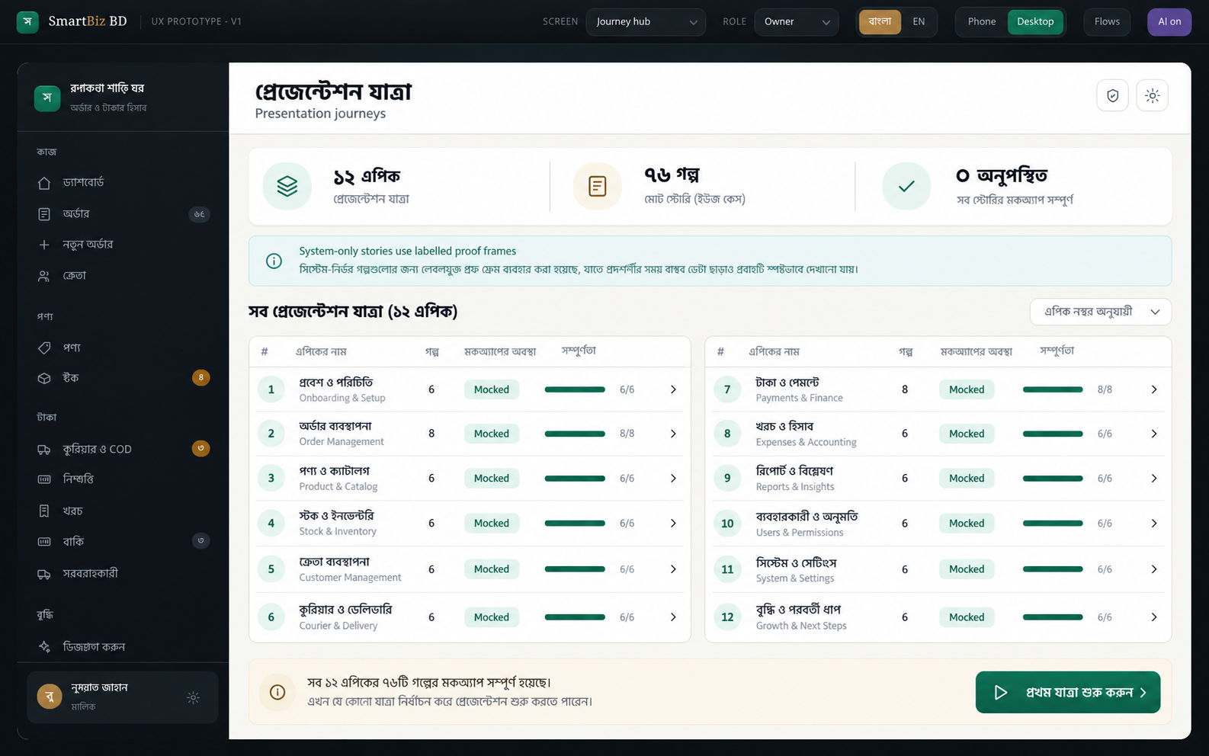
SmartBiz BD
Complete story-to-screen journey
12 epics · 76 stories · 76 presentation screens
Bangla-first order-to-cash clarity for small online sellers in Bangladesh
01
Notes:
Sources: approved SmartBiz BD product brief, epics.md, and the authoritative 76-story mockup catalog. Presentation data is synthetic.

Slide 2
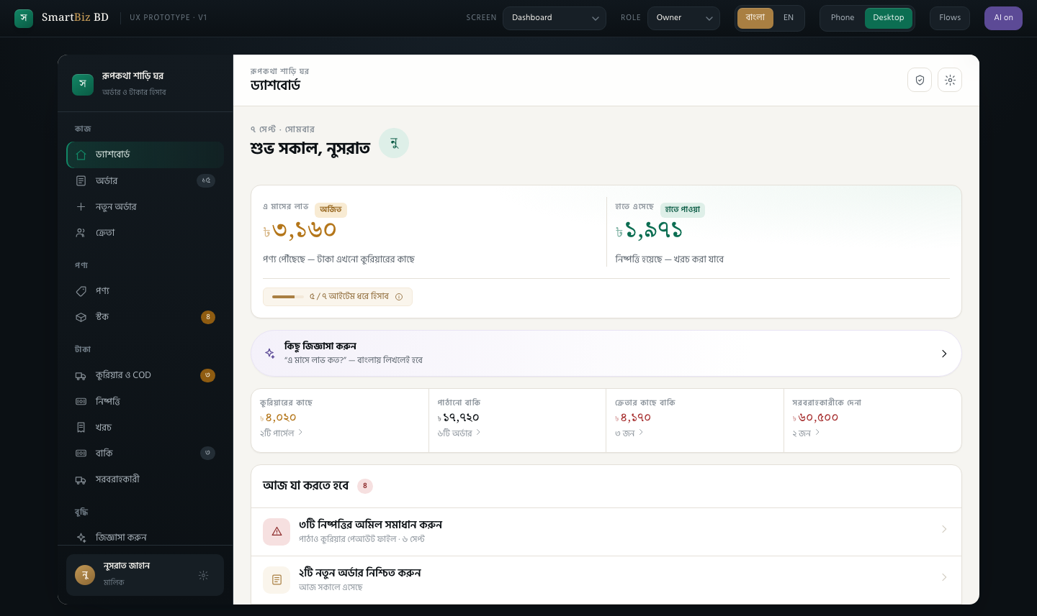
SmartBiz BD in brief
The problem
Small Facebook and WhatsApp sellers can see sales, but returns, delivery charges, purchase cost, and COD deductions make real profit hard to know.
The product
One order-to-cash ledger follows each order from message capture through stock, delivery, collection, settlement, and realized profit.
The distinction
Every profit figure states its recognition basis and completeness. Missing cost stays visible instead of becoming false precision.
Primary audience: owner-led social-commerce businesses handling 10 to 50 orders a day.
02
Notes:
Source: _bmad-output/planning-artifacts/briefs/brief-SmartBiz-2026-09-06/brief.md.

Slide 3
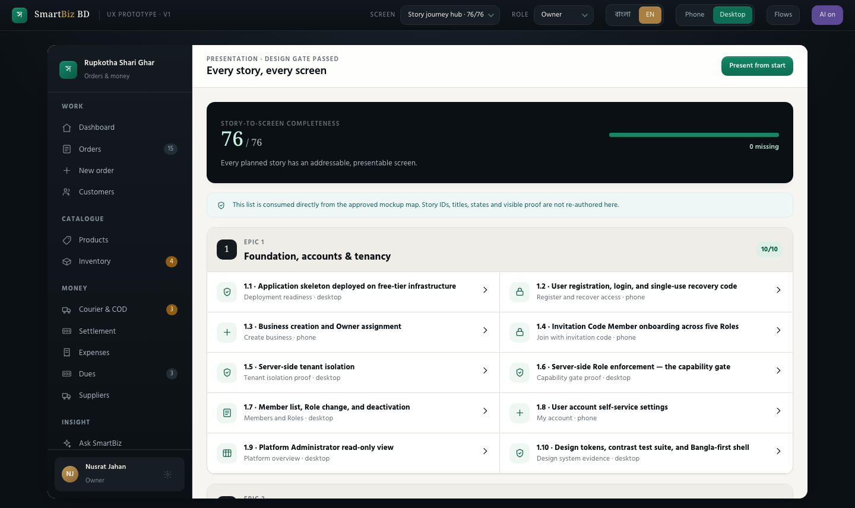
Journey coverage
76 / 76
Every story in epics.md has a directly addressable static prototype screen.
Sequence
Foundation first, then catalog, inventory, order lifecycle, settlement, reporting, audit, and safe insights.
03
Notes:
The journey hub consumes the approved mockup map directly. Story IDs and titles therefore stay aligned with epics.md.

Slide 4
How to read the journey
12 epics 76 stories 76 screens
Story order
Each screen
System stories
Slides follow the exact epic and story sequence.
A designed state, one primary action, and the evidence the audience should notice.
Tenant isolation, permissions, rendering, and AI safeguards appear as explicit proof surfaces.
The deck shows synthetic presentation data. It demonstrates UX coverage rather than production readiness.
04
Notes:
Use the story number at the top of each slide to correlate the screen with epics.md.

Slide 5
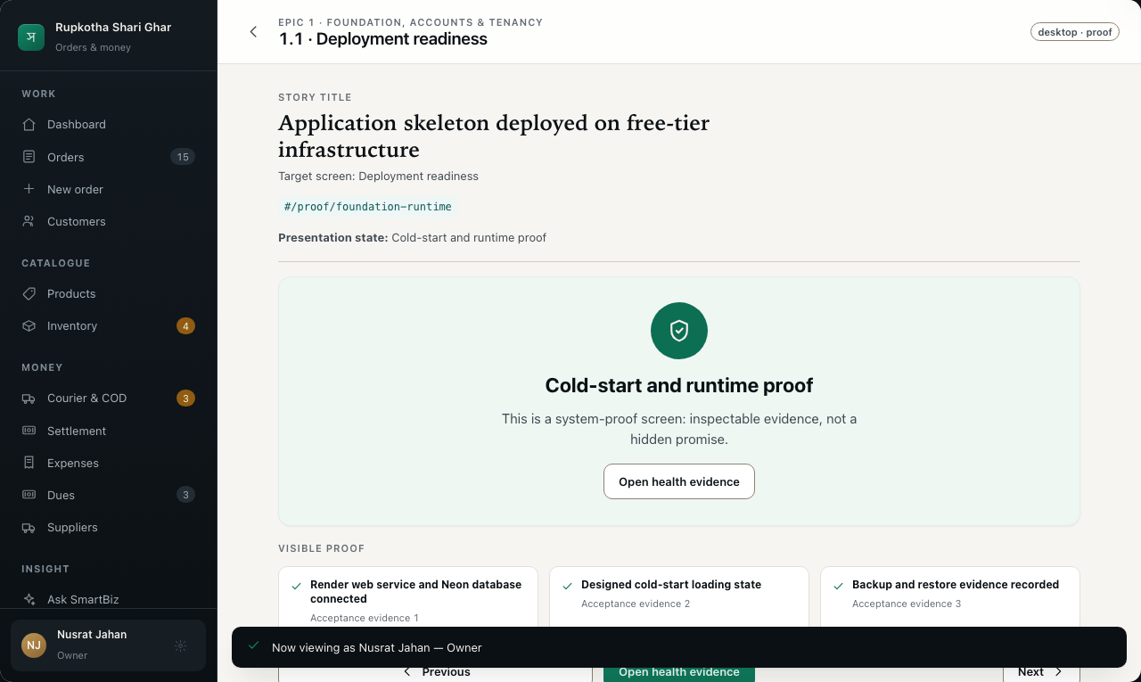
EPIC 1 · STORY 1.1
Foundation, accounts & tenancy
Application skeleton deployed on free-tier infrastructure
Deployment readiness
State: Cold-start and runtime proof
Visible proof
✓
Render web service and Neon database connected
✓
Designed cold-start loading state
✓
Backup and restore evidence recorded
Primary action: Open health evidence
05
Notes:
Source: epics.md Story 1.1, Application skeleton deployed on free-tier infrastructure. Prototype target: #/proof/foundation-runtime. Presentation data is synthetic.

Slide 6
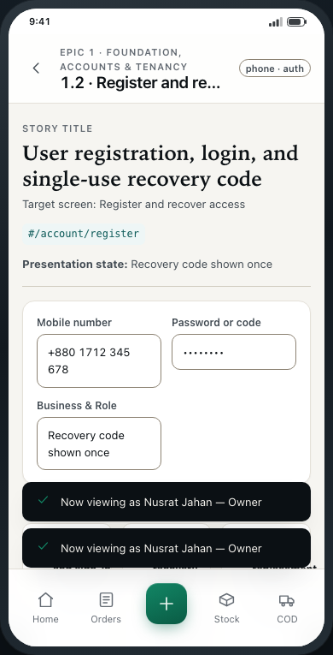
EPIC 1 · STORY 1.2
Foundation, accounts & tenancy
User registration, login, and single-use recovery code
Register and recover access
State: Recovery code shown once
Visible proof
✓
Password registration and sign-in
✓
Single-use recovery code reveal
✓
Reset issues a replacement code
Primary action: Save recovery code
06
Notes:
Source: epics.md Story 1.2, User registration, login, and single-use recovery code. Prototype target: #/account/register. Presentation data is synthetic.

Slide 7
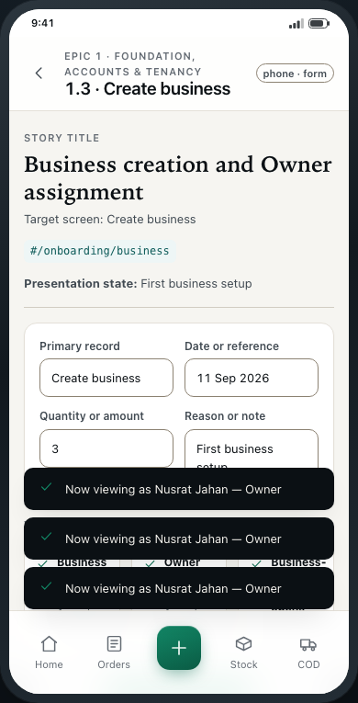
EPIC 1 · STORY 1.3
Foundation, accounts & tenancy
Business creation and Owner assignment
Create business
State: First business setup
Visible proof
✓
Business name and type
✓
Owner assignment confirmed
✓
Business-scoped workspace opens
Primary action: Create my business
07
Notes:
Source: epics.md Story 1.3, Business creation and Owner assignment. Prototype target: #/onboarding/business. Presentation data is synthetic.

Slide 8
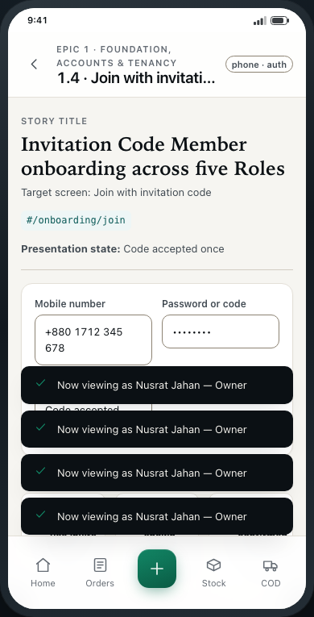
EPIC 1 · STORY 1.4
Foundation, accounts & tenancy
Invitation Code Member onboarding across five Roles
Join with invitation code
State: Code accepted once
Visible proof
✓
Enter single-use invite code
✓
Five Role choices shown
✓
Business and Role confirmed
Primary action: Join business
08
Notes:
Source: epics.md Story 1.4, Invitation Code Member onboarding across five Roles. Prototype target: #/onboarding/join. Presentation data is synthetic.

Slide 9
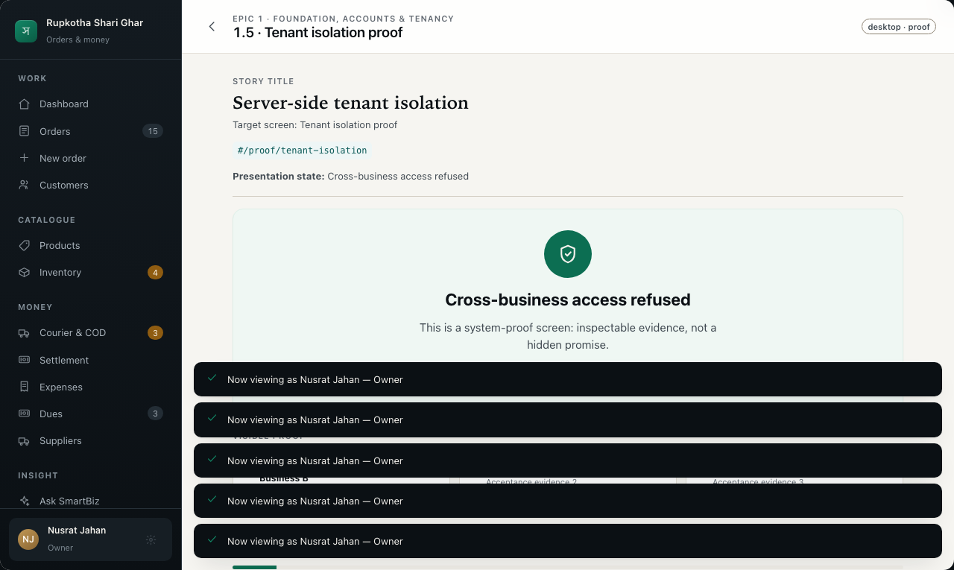
EPIC 1 · STORY 1.5
Foundation, accounts & tenancy
Server-side tenant isolation
Tenant isolation proof
State: Cross-business access refused
Visible proof
✓
Business A query cannot return Business B
✓
Default data manager applies scope
✓
Named administrator exception only
Primary action: Inspect isolation checks
09
Notes:
Source: epics.md Story 1.5, Server-side tenant isolation. Prototype target: #/proof/tenant-isolation. Presentation data is synthetic.

Slide 10
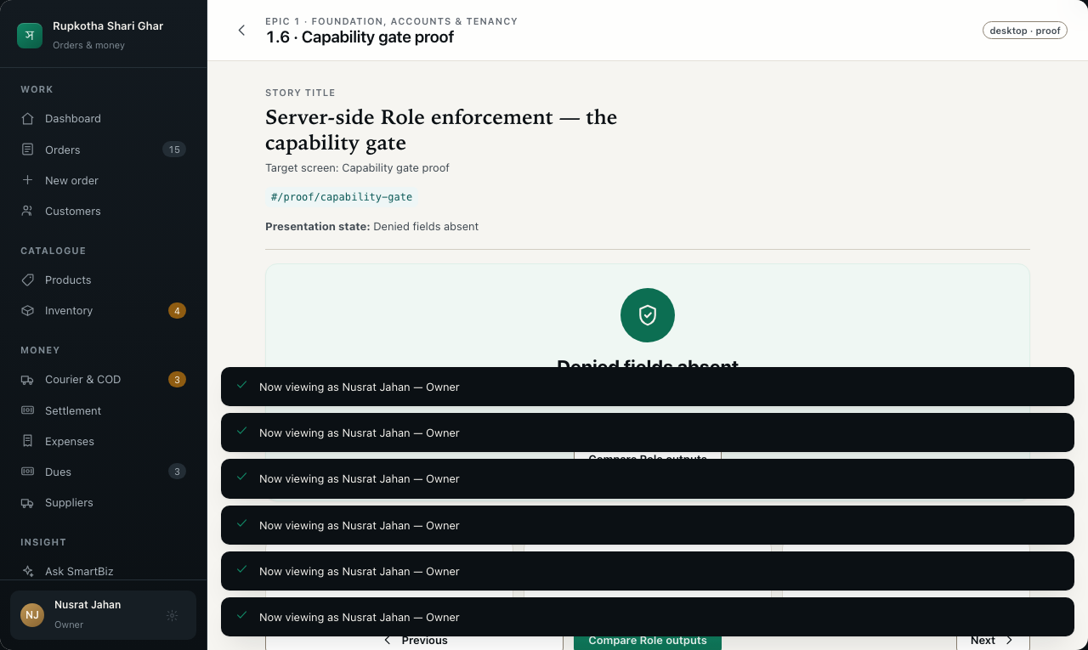
EPIC 1 · STORY 1.6
Foundation, accounts & tenancy
Server-side Role enforcement — the capability gate
Capability gate proof
State: Denied fields absent
Visible proof
✓
One per-cell capability lookup
✓
Pages, exports and answers filtered
✓
Direct action request refused
Primary action: Compare Role outputs
10
Notes:
Source: epics.md Story 1.6, Server-side Role enforcement — the capability gate. Prototype target: #/proof/capability-gate. Presentation data is synthetic.

Slide 11
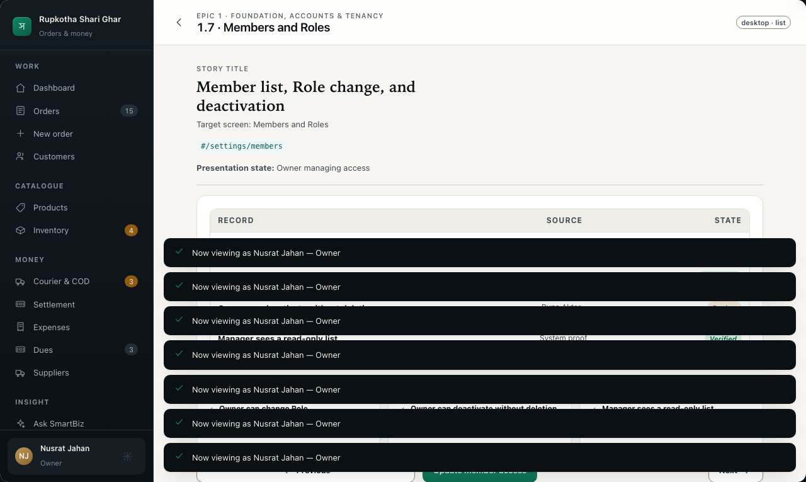
EPIC 1 · STORY 1.7
Foundation, accounts & tenancy
Member list, Role change, and deactivation
Members and Roles
State: Owner managing access
Visible proof
✓
Owner can change Role
✓
Owner can deactivate without deletion
✓
Manager sees a read-only list
Primary action: Update member access
11
Notes:
Source: epics.md Story 1.7, Member list, Role change, and deactivation. Prototype target: #/settings/members. Presentation data is synthetic.

Slide 12
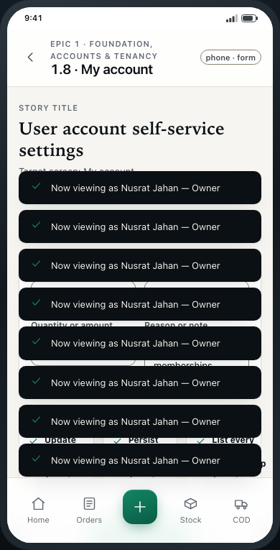
EPIC 1 · STORY 1.8
Foundation, accounts & tenancy
User account self-service settings
My account
State: Profile and memberships
Visible proof
✓
Update personal details
✓
Persist language preference
✓
List every Business membership
Primary action: Save my settings
12
Notes:
Source: epics.md Story 1.8, User account self-service settings. Prototype target: #/settings/account. Presentation data is synthetic.

Slide 13
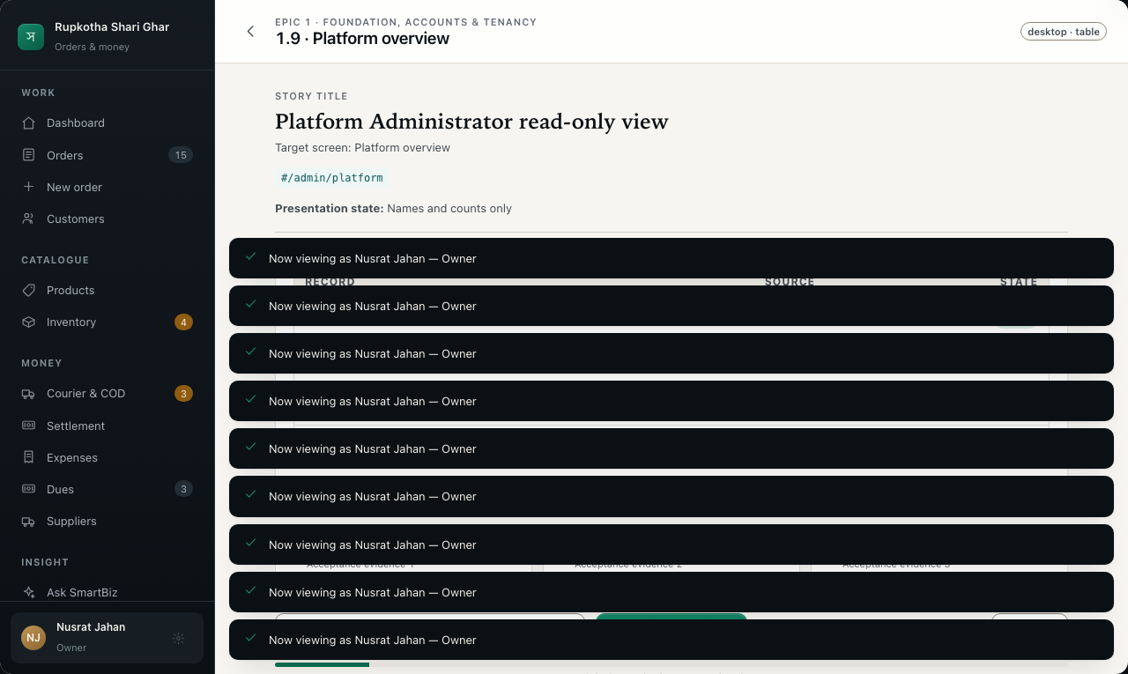
EPIC 1 · STORY 1.9
Foundation, accounts & tenancy
Platform Administrator read-only view
Platform overview
State: Names and counts only
Visible proof
✓
Business names and member counts
✓
User names and access counts
✓
No orders, customers or money
Primary action: Return to platform list
13
Notes:
Source: epics.md Story 1.9, Platform Administrator read-only view. Prototype target: #/admin/platform. Presentation data is synthetic.

Slide 14
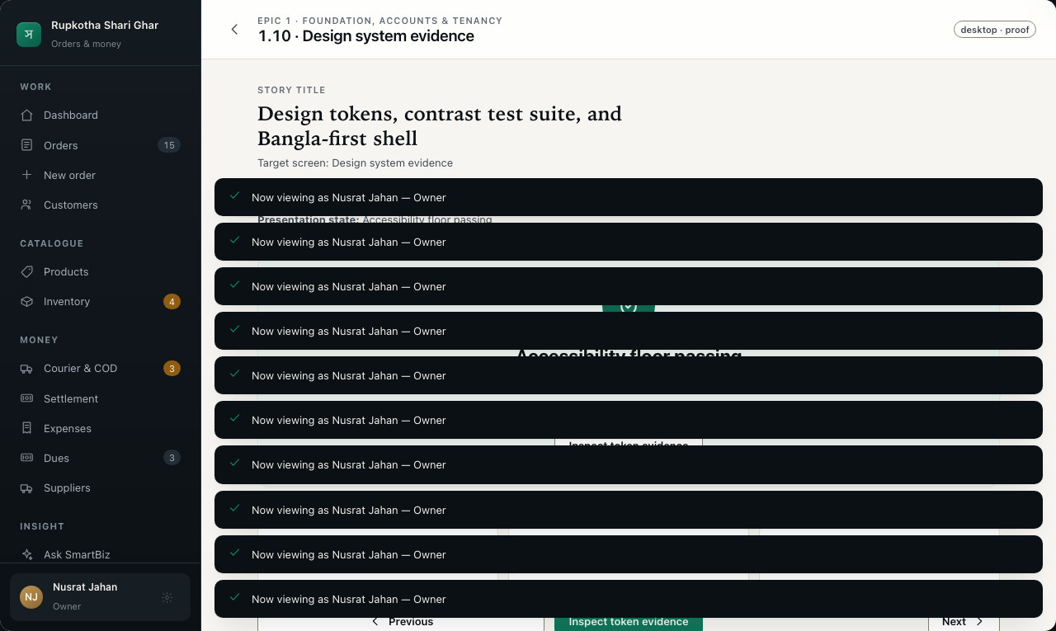
EPIC 1 · STORY 1.10
Foundation, accounts & tenancy
Design tokens, contrast test suite, and Bangla-first shell
Design system evidence
State: Accessibility floor passing
Visible proof
✓
DESIGN.md token parity
✓
AA contrast and control boundaries
✓
Bangla default with localized numerals
Primary action: Inspect token evidence
14
Notes:
Source: epics.md Story 1.10, Design tokens, contrast test suite, and Bangla-first shell. Prototype target: #/proof/design-system. Presentation data is synthetic.

Slide 15
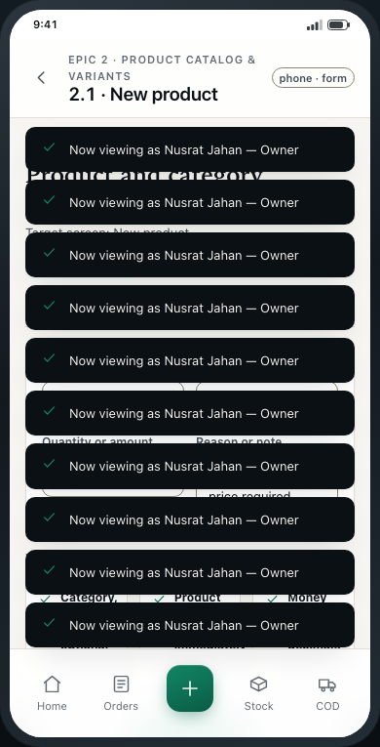
EPIC 2 · STORY 2.1
Product catalog & variants
Product and category definition
New product
State: Name and selling price required
Visible proof
✓
Category, SKU and Supplier optional
✓
Product appears in capture immediately
✓
Money fields use two decimals
Primary action: Save product
15
Notes:
Source: epics.md Story 2.1, Product and category definition. Prototype target: #/products/new. Presentation data is synthetic.

Slide 16
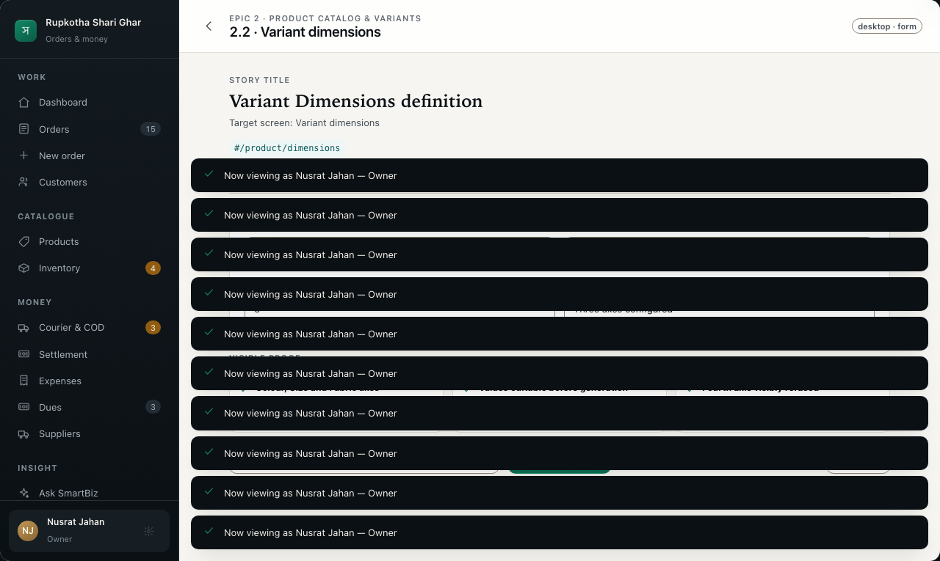
EPIC 2 · STORY 2.2
Product catalog & variants
Variant Dimensions definition
Variant dimensions
State: Three axes configured
Visible proof
✓
Colour, Size and Fabric axes
✓
Values editable before generation
✓
Fourth axis visibly refused
Primary action: Save dimensions
16
Notes:
Source: epics.md Story 2.2, Variant Dimensions definition. Prototype target: #/product/dimensions. Presentation data is synthetic.

Slide 17
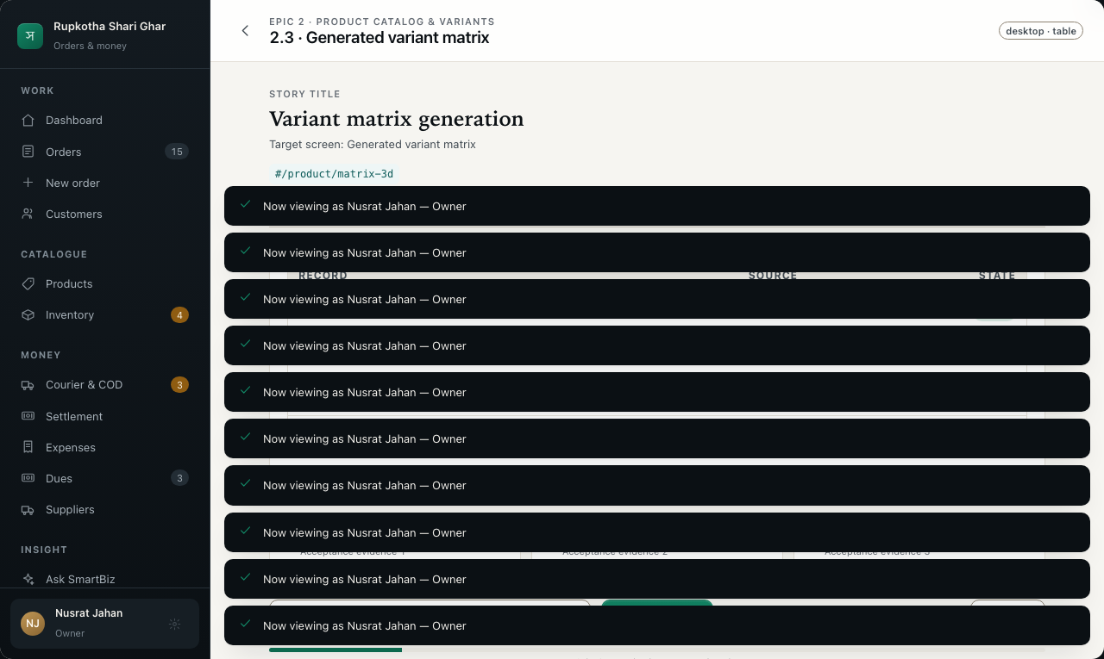
EPIC 2 · STORY 2.3
Product catalog & variants
Variant matrix generation
Generated variant matrix
State: All combinations ready
Visible proof
✓
Every three-axis combination
✓
SKU, zero stock and missing cost
✓
Parent balance migration explained
Primary action: Create variants
17
Notes:
Source: epics.md Story 2.3, Variant matrix generation. Prototype target: #/product/matrix-3d. Presentation data is synthetic.

Slide 18
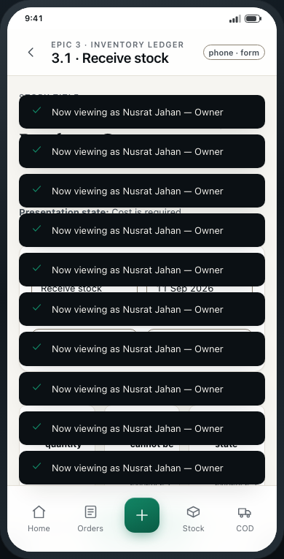
EPIC 3 · STORY 3.1
Inventory ledger
Stock-In with mandatory Purchase Cost
Receive stock
State: Cost is required
Visible proof
✓
Variant and quantity
✓
Purchase Cost cannot be blank
✓
Paid or unpaid state captured
Primary action: Record stock-in
18
Notes:
Source: epics.md Story 3.1, Stock-In with mandatory Purchase Cost. Prototype target: #/inventory/stock-in. Presentation data is synthetic.

Slide 19
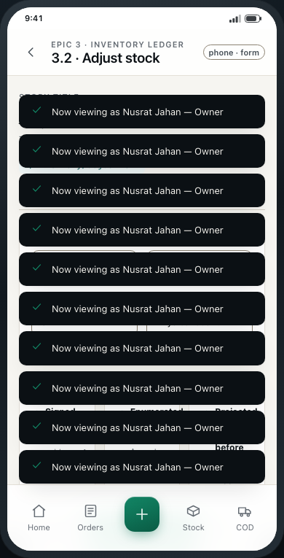
EPIC 3 · STORY 3.2
Inventory ledger
Adjustment with reason
Adjust stock
State: Physical count correction
Visible proof
✓
Signed quantity
✓
Enumerated reason required
✓
Projected stock shown before commit
Primary action: Record adjustment
19
Notes:
Source: epics.md Story 3.2, Adjustment with reason. Prototype target: #/inventory/adjustment. Presentation data is synthetic.

Slide 20
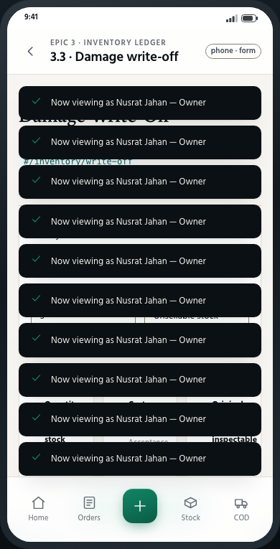
EPIC 3 · STORY 3.3
Inventory ledger
Damage Write-Off
Damage write-off
State: Unsellable stock selected
Visible proof
✓
Quantity cannot exceed stock
✓
Cost consequence visible
✓
Original movement remains inspectable
Primary action: Write off damaged units
20
Notes:
Source: epics.md Story 3.3, Damage Write-Off. Prototype target: #/inventory/write-off. Presentation data is synthetic.

Slide 21
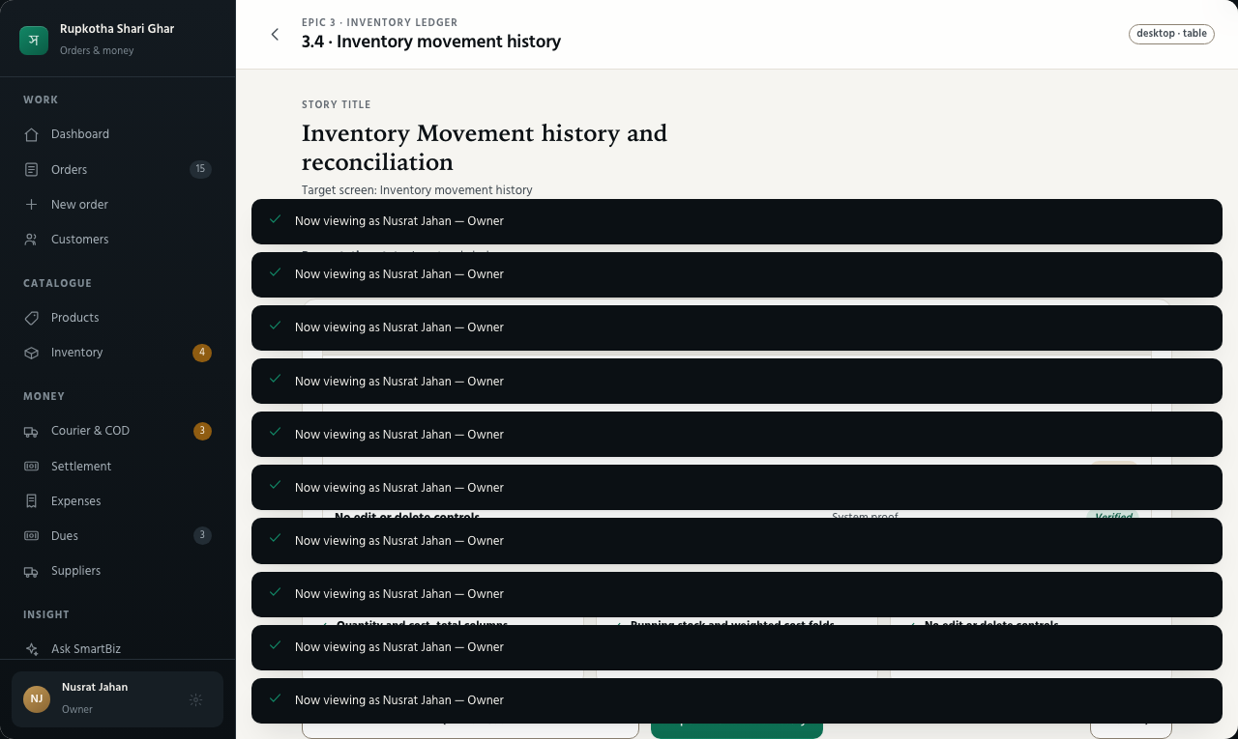
EPIC 3 · STORY 3.4
Inventory ledger
Inventory Movement history and reconciliation
Inventory movement history
State: Insert-only ledger
Visible proof
✓
Quantity and cost_total columns
✓
Running stock and weighted cost folds
✓
No edit or delete controls
Primary action: Export movement history
21
Notes:
Source: epics.md Story 3.4, Inventory Movement history and reconciliation. Prototype target: #/inventory/movements. Presentation data is synthetic.

Slide 22
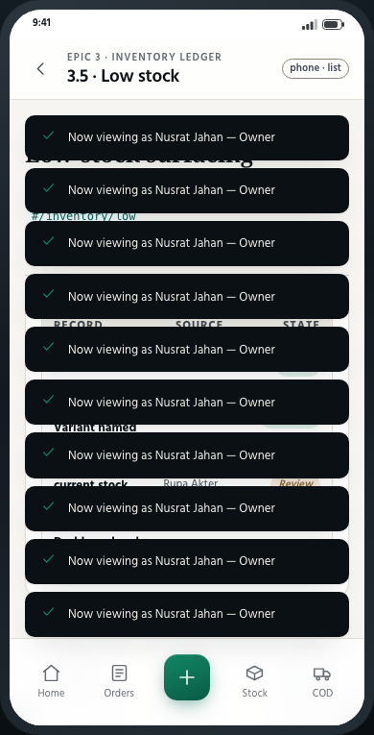
EPIC 3 · STORY 3.5
Inventory ledger
Low-stock surfacing
Low stock
State: Variants at or below threshold
Visible proof
✓
Specific Variant named
✓
Threshold and current stock shown
✓
Dashboard and inventory agree
Primary action: Start stock-in
22
Notes:
Source: epics.md Story 3.5, Low-stock surfacing. Prototype target: #/inventory/low. Presentation data is synthetic.

Slide 23
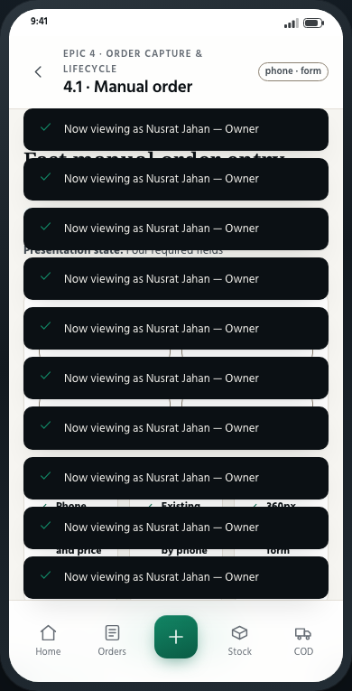
EPIC 4 · STORY 4.1
Order capture & lifecycle
Fast manual order entry
Manual order
State: Four required fields
Visible proof
✓
Phone, Product, quantity and price
✓
Existing Customer matched by phone
✓
360px single-column form
Primary action: Save new order
23
Notes:
Source: epics.md Story 4.1, Fast manual order entry. Prototype target: #/capture/manual. Presentation data is synthetic.

Slide 24
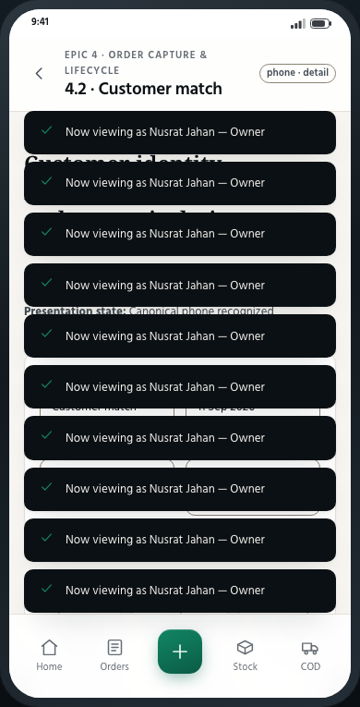
EPIC 4 · STORY 4.2
Order capture & lifecycle
Customer identity hardening — normalization and tenant isolation
Customer match
State: Canonical phone recognized
Visible proof
✓
Different phone formats normalize
✓
Match stays inside this Business
✓
Duplicate identity warning
Primary action: Use this Customer
24
Notes:
Source: epics.md Story 4.2, Customer identity hardening — normalization and tenant isolation. Prototype target: #/capture/customer-match. Presentation data is synthetic.

Slide 25
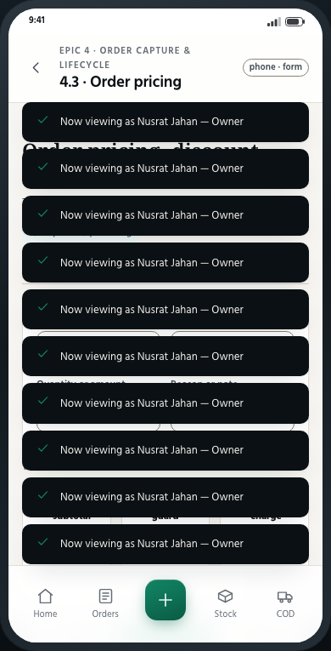
EPIC 4 · STORY 4.3
Order capture & lifecycle
Order pricing, discount, and delivery charge
Order pricing
State: COD total calculated
Visible proof
✓
Line subtotal
✓
Discount guard
✓
Delivery charge and advance applied
Primary action: Accept total
25
Notes:
Source: epics.md Story 4.3, Order pricing, discount, and delivery charge. Prototype target: #/capture/pricing. Presentation data is synthetic.

Slide 26
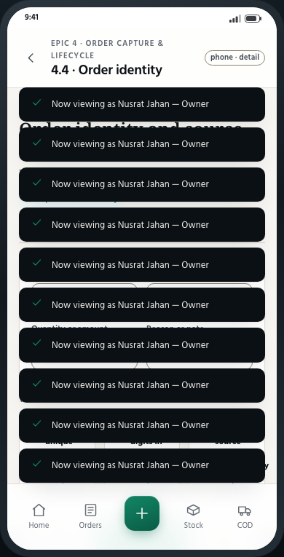
EPIC 4 · STORY 4.4
Order capture & lifecycle
Order identity and source tracking
Order identity
State: Identifier reserved
Visible proof
✓
Business-unique sequential ID
✓
Latin digits in every locale
✓
Capture source assigned automatically
Primary action: Continue order
26
Notes:
Source: epics.md Story 4.4, Order identity and source tracking. Prototype target: #/capture/identity. Presentation data is synthetic.

Slide 27
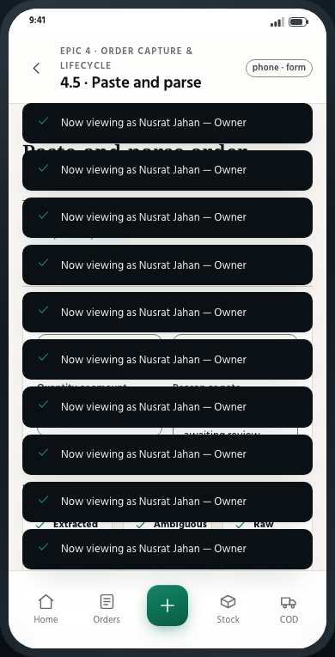
EPIC 4 · STORY 4.5
Order capture & lifecycle
Paste-and-parse order capture
Paste and parse
State: Extracted fields awaiting review
Visible proof
✓
Extracted versus missing labels
✓
Ambiguous Product candidates offered
✓
Raw message remains beside form
Primary action: Review order
27
Notes:
Source: epics.md Story 4.5, Paste-and-parse order capture. Prototype target: #/capture/paste. Presentation data is synthetic.

Slide 28
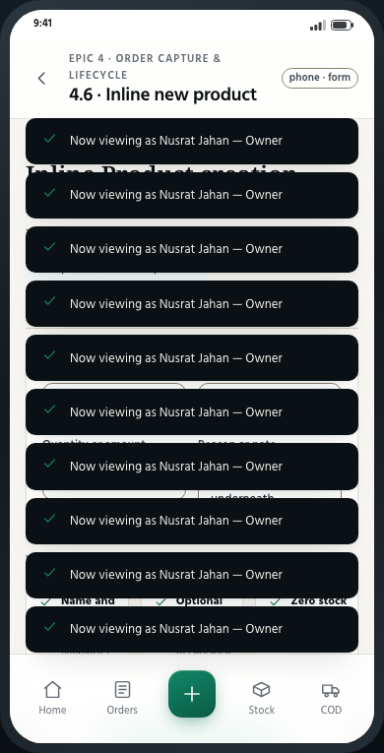
EPIC 4 · STORY 4.6
Order capture & lifecycle
Inline Product creation from the order screen
Inline new product
State: Order preserved underneath
Visible proof
✓
Name and price only
✓
Optional single Variant
✓
Zero stock and incomplete cost
Primary action: Create and select product
28
Notes:
Source: epics.md Story 4.6, Inline Product creation from the order screen. Prototype target: #/capture/inline-product. Presentation data is synthetic.

Slide 29
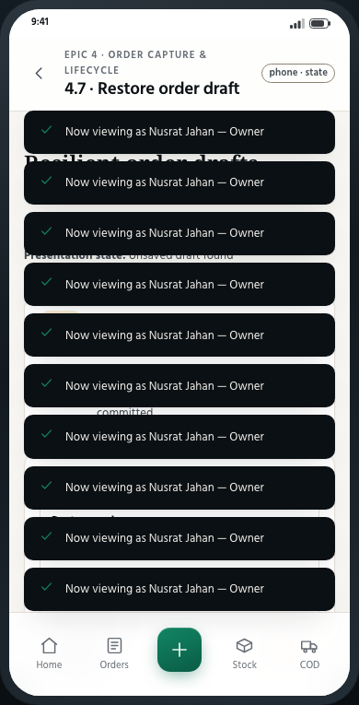
EPIC 4 · STORY 4.7
Order capture & lifecycle
Resilient order drafts
Restore order draft
State: Unsaved draft found
Visible proof
✓
Saved within two seconds
✓
Raw message and lines retained
✓
Discard and save clear the draft
Primary action: Restore every field
29
Notes:
Source: epics.md Story 4.7, Resilient order drafts. Prototype target: #/capture/draft-restore. Presentation data is synthetic.

Slide 30
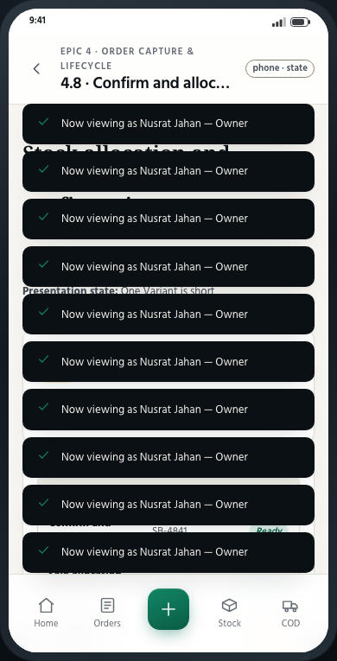
EPIC 4 · STORY 4.8
Order capture & lifecycle
Stock allocation and Purchase Cost snapshot on confirmation
Confirm and allocate
State: One Variant is short
Visible proof
✓
Sale allocation preview
✓
Purchase Cost snapshot
✓
Idempotent confirmation and shortfall
Primary action: Acknowledge and confirm
30
Notes:
Source: epics.md Story 4.8, Stock allocation and Purchase Cost snapshot on confirmation. Prototype target: #/order/confirm-stock. Presentation data is synthetic.

Slide 31
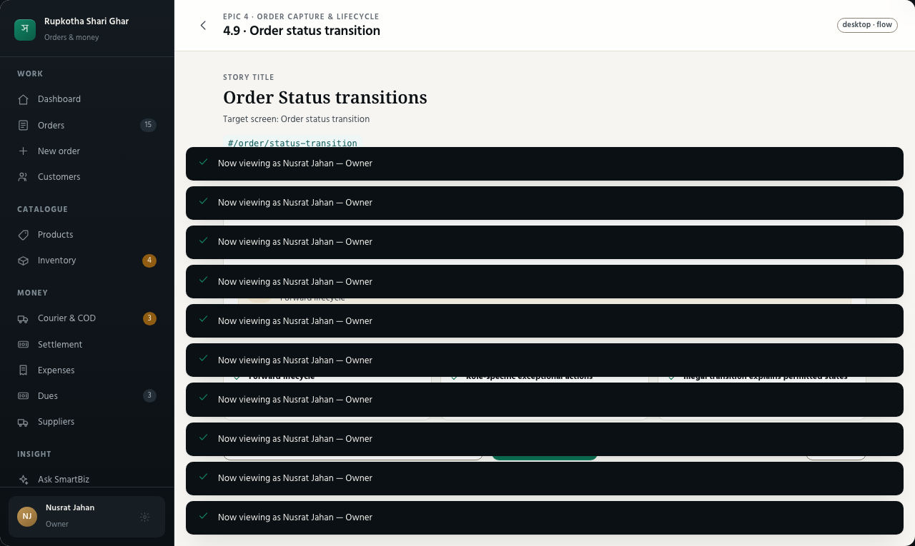
EPIC 4 · STORY 4.9
Order capture & lifecycle
Order Status transitions
Order status transition
State: Only legal next states enabled
Visible proof
✓
Forward lifecycle
✓
Role-specific exceptional actions
✓
Illegal transition explains permitted states
Primary action: Move to next status
31
Notes:
Source: epics.md Story 4.9, Order Status transitions. Prototype target: #/order/status-transition. Presentation data is synthetic.

Slide 32
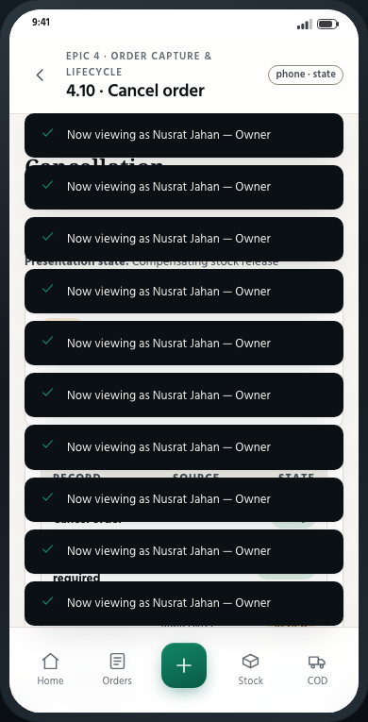
EPIC 4 · STORY 4.10
Order capture & lifecycle
Cancellation
Cancel order
State: Compensating stock release
Visible proof
✓
Reason required
✓
Allocation reversal preview
✓
Excluded from sales and profit
Primary action: Cancel and restore stock
32
Notes:
Source: epics.md Story 4.10, Cancellation. Prototype target: #/order/cancel. Presentation data is synthetic.

Slide 33
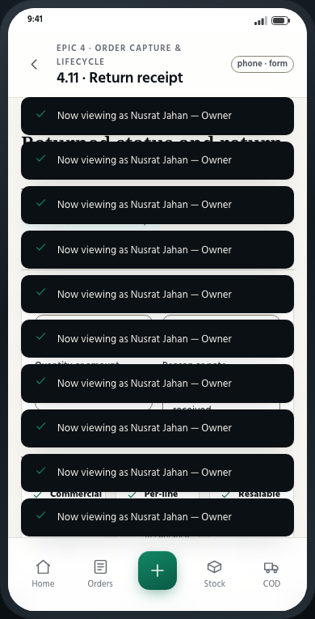
EPIC 4 · STORY 4.11
Order capture & lifecycle
Returned status and return-to-stock receipt
Return receipt
State: Goods physically received
Visible proof
✓
Commercial return separate from receipt
✓
Per-line partial quantity
✓
Resalable or damaged condition
Primary action: Record receipt
33
Notes:
Source: epics.md Story 4.11, Returned status and return-to-stock receipt. Prototype target: #/order/return-receipt. Presentation data is synthetic.

Slide 34
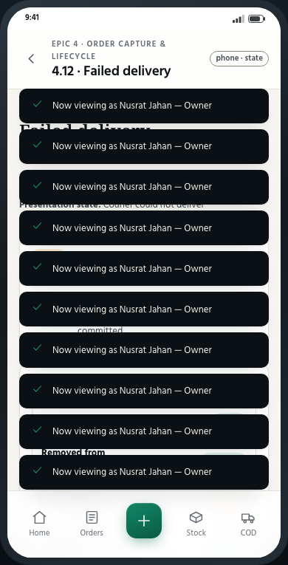
EPIC 4 · STORY 4.12
Order capture & lifecycle
Failed delivery
Failed delivery
State: Courier could not deliver
Visible proof
✓
Removed from courier custody
✓
Retry shipment or receive return
✓
Courier charge remains
Primary action: Record failed delivery
34
Notes:
Source: epics.md Story 4.12, Failed delivery. Prototype target: #/order/failed-delivery. Presentation data is synthetic.

Slide 35
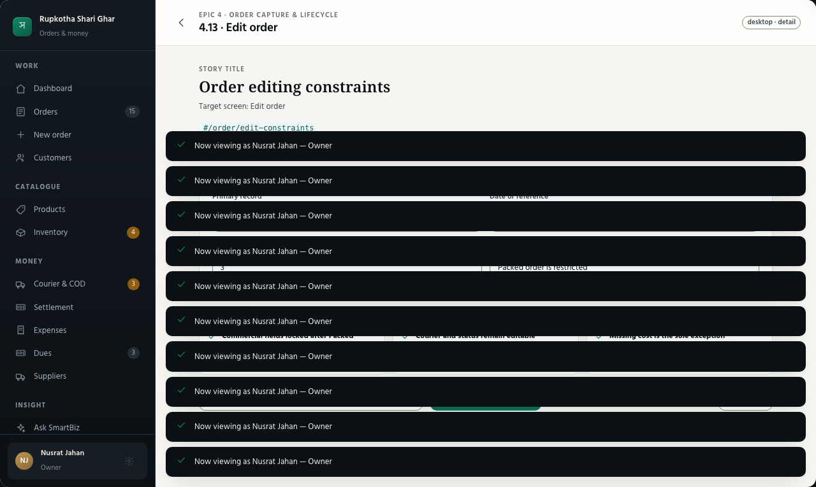
EPIC 4 · STORY 4.13
Order capture & lifecycle
Order editing constraints
Edit order
State: Packed order is restricted
Visible proof
✓
Commercial fields locked after Packed
✓
Courier and status remain editable
✓
Missing cost is the sole exception
Primary action: Review allowed changes
35
Notes:
Source: epics.md Story 4.13, Order editing constraints. Prototype target: #/order/edit-constraints. Presentation data is synthetic.

Slide 36
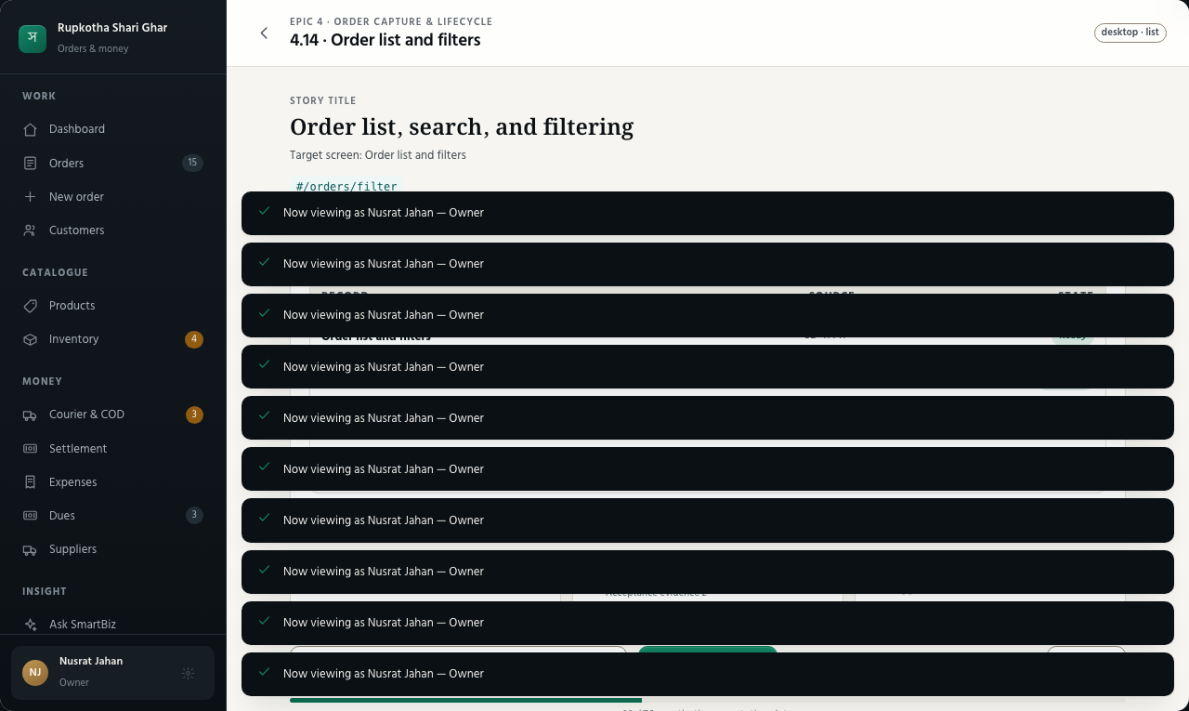
EPIC 4 · STORY 4.14
Order capture & lifecycle
Order list, search, and filtering
Order list and filters
State: Attention filters applied
Visible proof
✓
Status, date, courier, custody, collection, source
✓
Search ID, phone or name
✓
Returns, shortfalls and unsettled orders flagged
Primary action: Open selected order
36
Notes:
Source: epics.md Story 4.14, Order list, search, and filtering. Prototype target: #/orders/filter. Presentation data is synthetic.

Slide 37
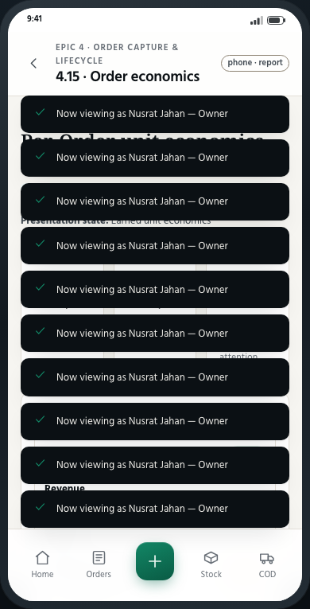
EPIC 4 · STORY 4.15
Order capture & lifecycle
Per-Order unit economics
Order economics
State: Earned unit economics
Visible proof
✓
Revenue, historical cost and courier charge
✓
Resulting margin
✓
Capability-gated cost visibility
Primary action: Explain this margin
37
Notes:
Source: epics.md Story 4.15, Per-Order unit economics. Prototype target: #/order/economics. Presentation data is synthetic.

Slide 38
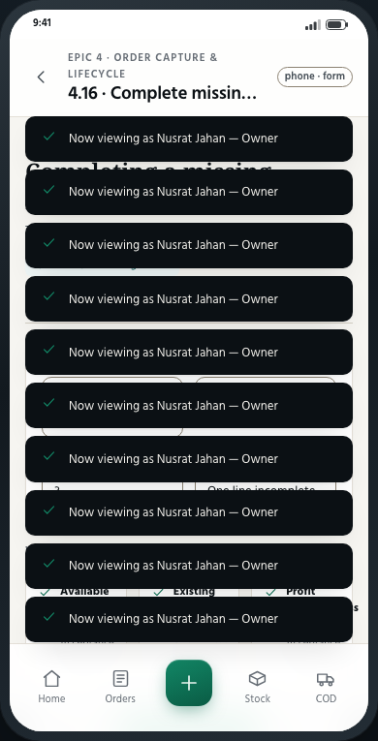
EPIC 4 · STORY 4.16
Order capture & lifecycle
Completing a missing Purchase Cost
Complete missing Purchase Cost
State: One line incomplete
Visible proof
✓
Available at every status
✓
Existing cost cannot be overwritten
✓
Profit completeness recomputes
Primary action: Save Purchase Cost
38
Notes:
Source: epics.md Story 4.16, Completing a missing Purchase Cost. Prototype target: #/order/missing-cost. Presentation data is synthetic.

Slide 39
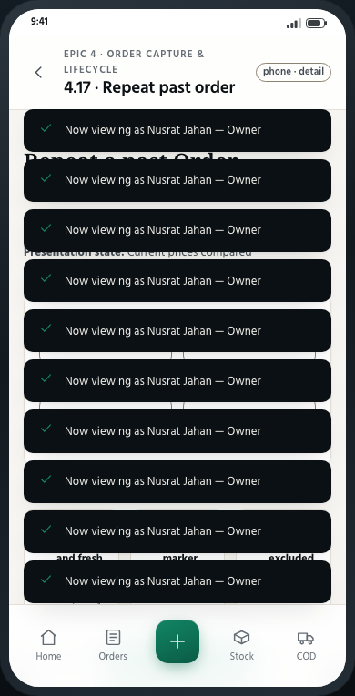
EPIC 4 · STORY 4.17
Order capture & lifecycle
Repeat a past Order
Repeat past order
State: Current prices compared
Visible proof
✓
New status and fresh identity
✓
Changed-price marker
✓
Inactive Variant excluded
Primary action: Create repeated order
39
Notes:
Source: epics.md Story 4.17, Repeat a past Order. Prototype target: #/capture/repeat. Presentation data is synthetic.

Slide 40
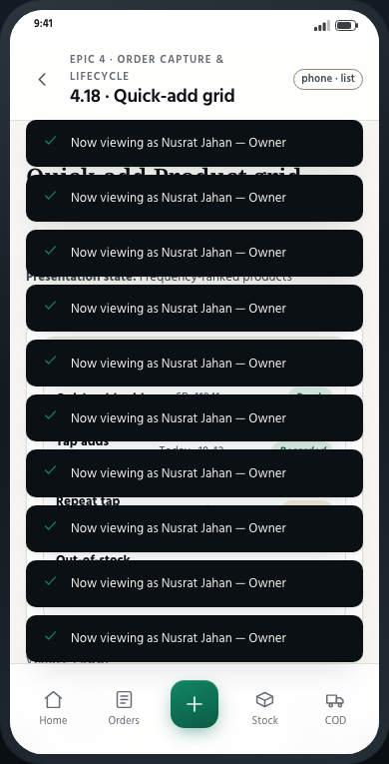
EPIC 4 · STORY 4.18
Order capture & lifecycle
Quick-add Product grid
Quick-add grid
State: Frequency-ranked products
Visible proof
✓
Tap adds quantity one
✓
Repeat tap increments
✓
Out-of-stock stays tappable and marked
Primary action: Continue with selected items
40
Notes:
Source: epics.md Story 4.18, Quick-add Product grid. Prototype target: #/capture/quick. Presentation data is synthetic.

Slide 41
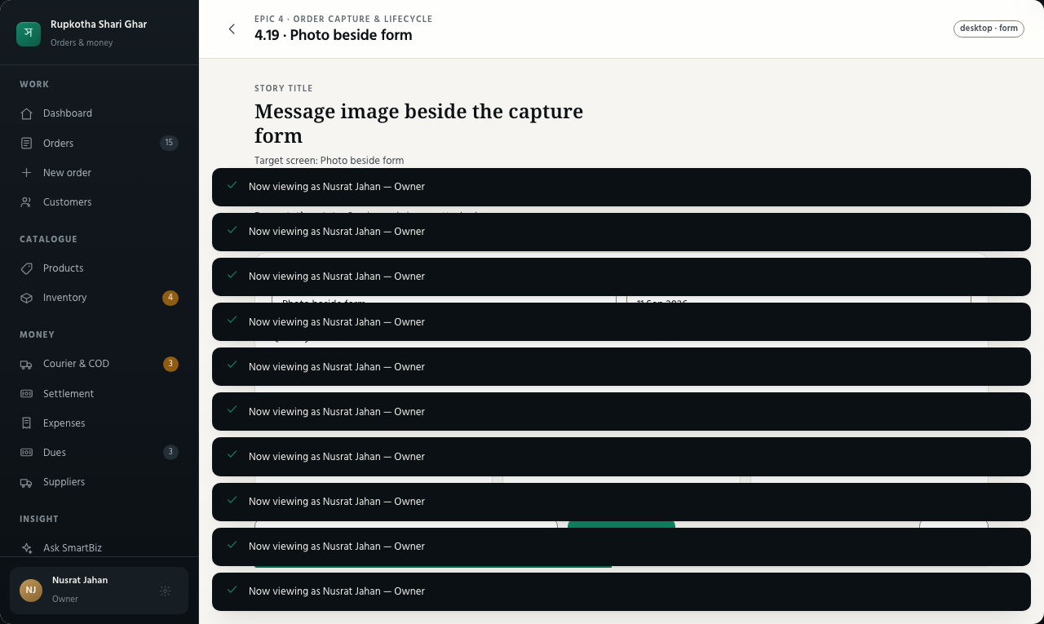
EPIC 4 · STORY 4.19
Order capture & lifecycle
Message image beside the capture form
Photo beside form
State: Session-only image attached
Visible proof
✓
Image and form remain side-by-side
✓
Downscaled before display
✓
No OCR promise when unavailable
Primary action: Save typed order
41
Notes:
Source: epics.md Story 4.19, Message image beside the capture form. Prototype target: #/capture/photo. Presentation data is synthetic.

Slide 42
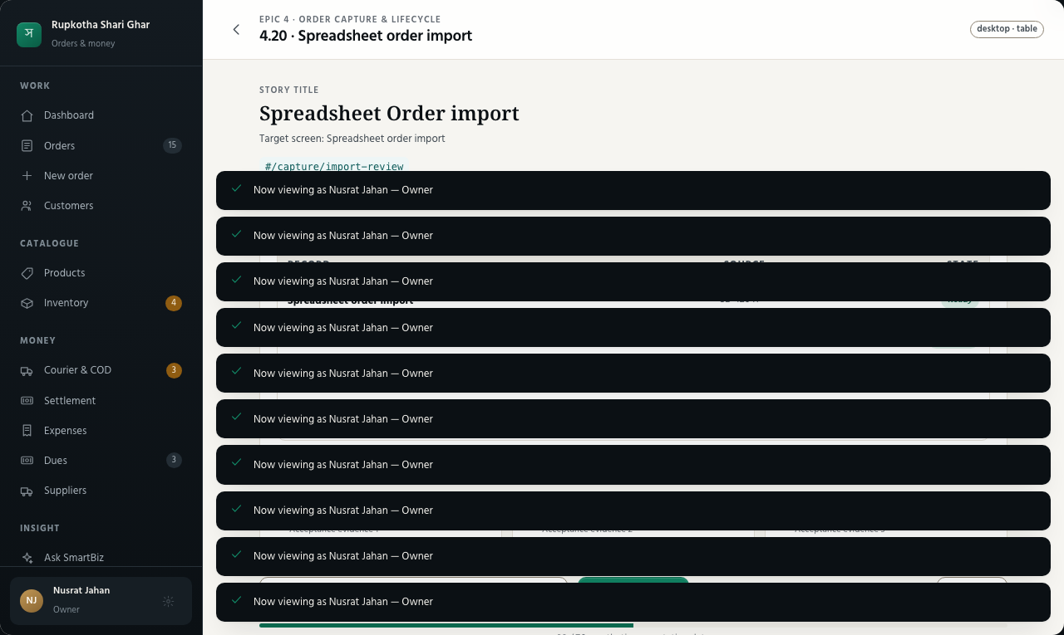
EPIC 4 · STORY 4.20
Order capture & lifecycle
Spreadsheet Order import
Spreadsheet order import
State: Three valid, two need attention
Visible proof
✓
Saved Business column mapping
✓
Row-specific validation
✓
Bad rows do not block valid rows
Primary action: Import valid rows
42
Notes:
Source: epics.md Story 4.20, Spreadsheet Order import. Prototype target: #/capture/import-review. Presentation data is synthetic.

Slide 43
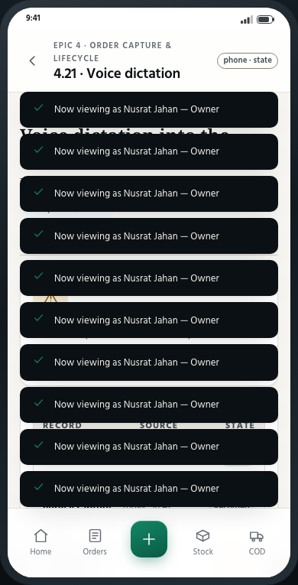
EPIC 4 · STORY 4.21
Order capture & lifecycle
Voice dictation into the capture field
Voice dictation
State: Transcript ready to parse
Visible proof
✓
Speech fills the normal capture field
✓
Same parser as pasted text
✓
Control absent when unsupported
Primary action: Parse transcript
43
Notes:
Source: epics.md Story 4.21, Voice dictation into the capture field. Prototype target: #/capture/voice. Presentation data is synthetic.

Slide 44
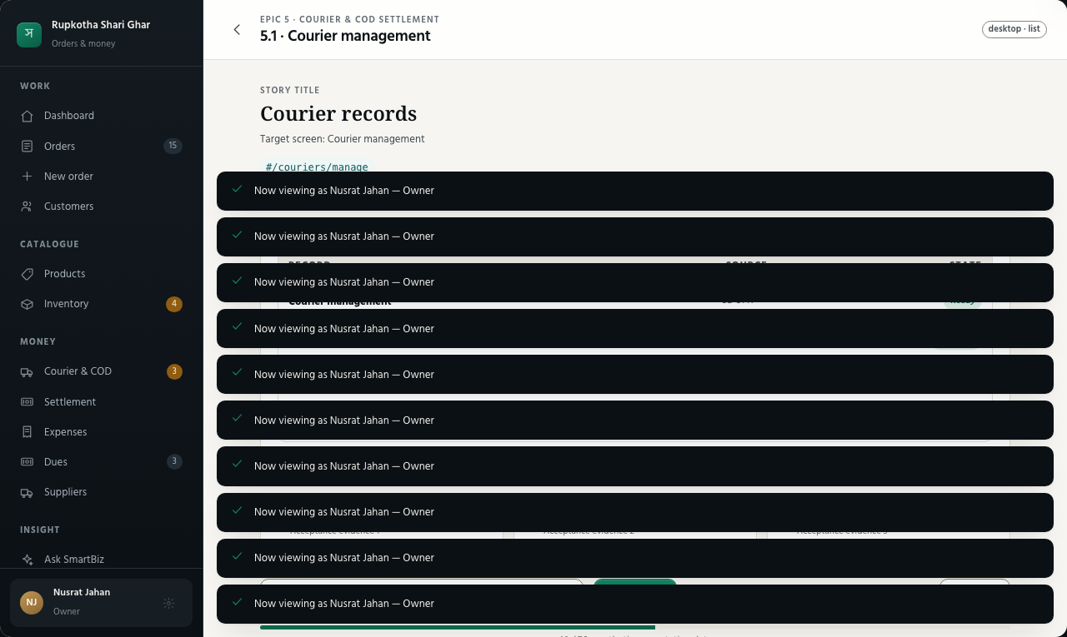
EPIC 5 · STORY 5.1
Courier & COD settlement
Courier records
Courier management
State: Four Couriers available
Visible proof
✓
Name and status
✓
Own column mapping
✓
Available during assignment
Primary action: Add courier
44
Notes:
Source: epics.md Story 5.1, Courier records. Prototype target: #/couriers/manage. Presentation data is synthetic.

Slide 45
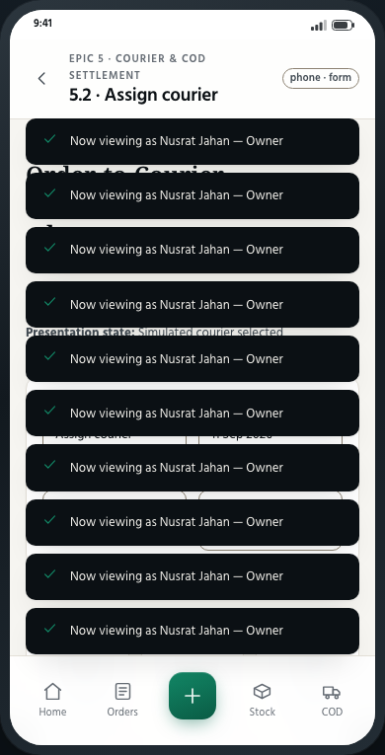
EPIC 5 · STORY 5.2
Courier & COD settlement
Order-to-Courier assignment and simulated adapter
Assign courier
State: Simulated courier selected
Visible proof
✓
Courier and tracking reference
✓
Simulator labelled at point of use
✓
Same surface for a real adapter
Primary action: Assign and create tracking
45
Notes:
Source: epics.md Story 5.2, Order-to-Courier assignment and simulated adapter. Prototype target: #/order/courier-assign. Presentation data is synthetic.

Slide 46
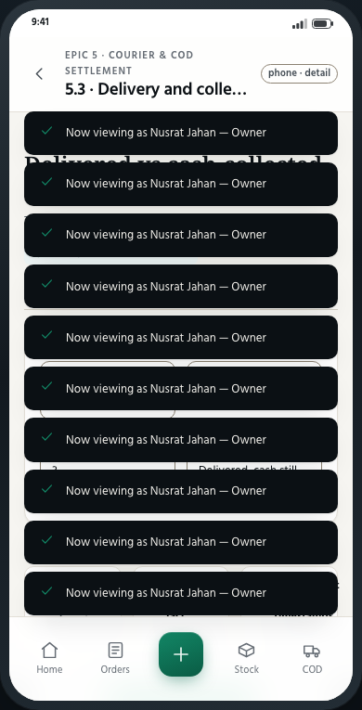
EPIC 5 · STORY 5.3
Courier & COD settlement
Delivered vs cash-collected as two distinct facts
Delivery and collection facts
State: Delivered, cash still pending
Visible proof
✓
Delivery fact
✓
Cash-collected fact
✓
Independent editable timestamps
Primary action: Update collection fact
46
Notes:
Source: epics.md Story 5.3, Delivered vs cash-collected as two distinct facts. Prototype target: #/order/collection-state. Presentation data is synthetic.

Slide 47
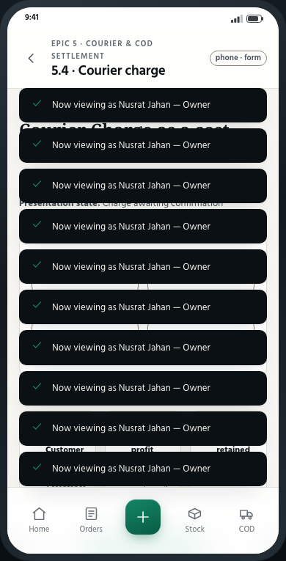
EPIC 5 · STORY 5.4
Courier & COD settlement
Courier Charge as a cost
Courier charge
State: Charge awaiting confirmation
Visible proof
✓
Separate from Customer delivery charge
✓
Applied to both profit bases
✓
Source and date retained
Primary action: Record courier charge
47
Notes:
Source: epics.md Story 5.4, Courier Charge as a cost. Prototype target: #/order/courier-charge. Presentation data is synthetic.

Slide 48
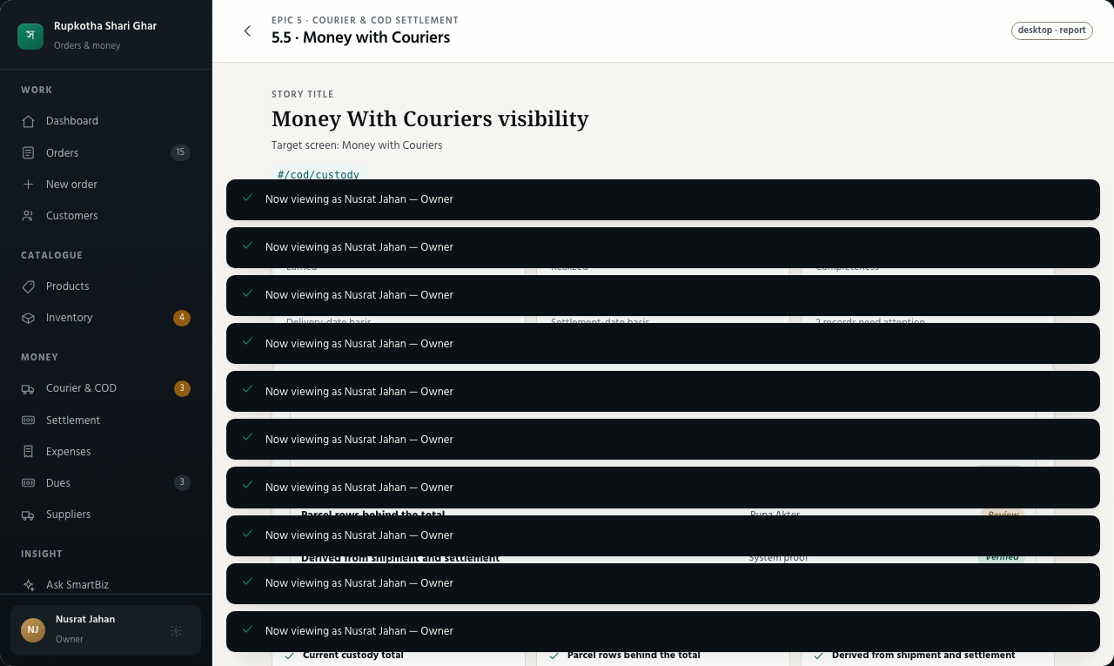
EPIC 5 · STORY 5.5
Courier & COD settlement
Money With Couriers visibility
Money with Couriers
State: Live custody position
Visible proof
✓
Current custody total
✓
Parcel rows behind the total
✓
Derived from shipment and settlement
Primary action: Inspect courier parcels
48
Notes:
Source: epics.md Story 5.5, Money With Couriers visibility. Prototype target: #/cod/custody. Presentation data is synthetic.

Slide 49
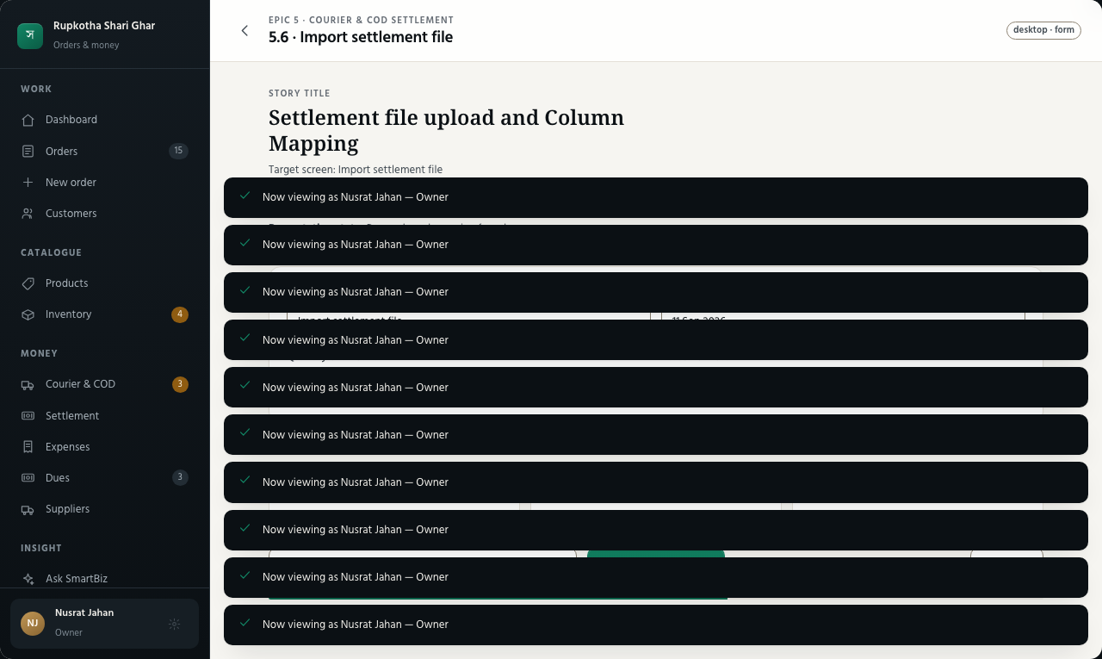
EPIC 5 · STORY 5.6
Courier & COD settlement
Settlement file upload and Column Mapping
Import settlement file
State: Remembered mapping found
Visible proof
✓
Courier-scoped mapping
✓
Synthetic sample available
✓
Rows staged for review
Primary action: Preview mapped rows
49
Notes:
Source: epics.md Story 5.6, Settlement file upload and Column Mapping. Prototype target: #/settlement/import-map. Presentation data is synthetic.

Slide 50
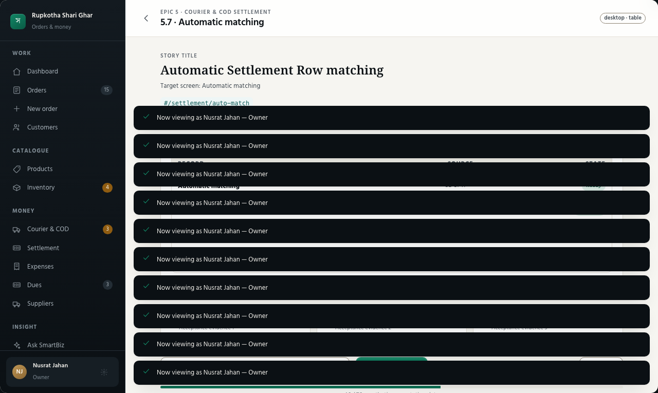
EPIC 5 · STORY 5.7
Courier & COD settlement
Automatic Settlement Row matching
Automatic matching
State: Two matched, three exceptions
Visible proof
✓
Consignment identity match
✓
One Order can match once
✓
Duplicate already-settled row surfaced
Primary action: Review exceptions
50
Notes:
Source: epics.md Story 5.7, Automatic Settlement Row matching. Prototype target: #/settlement/auto-match. Presentation data is synthetic.

Slide 51
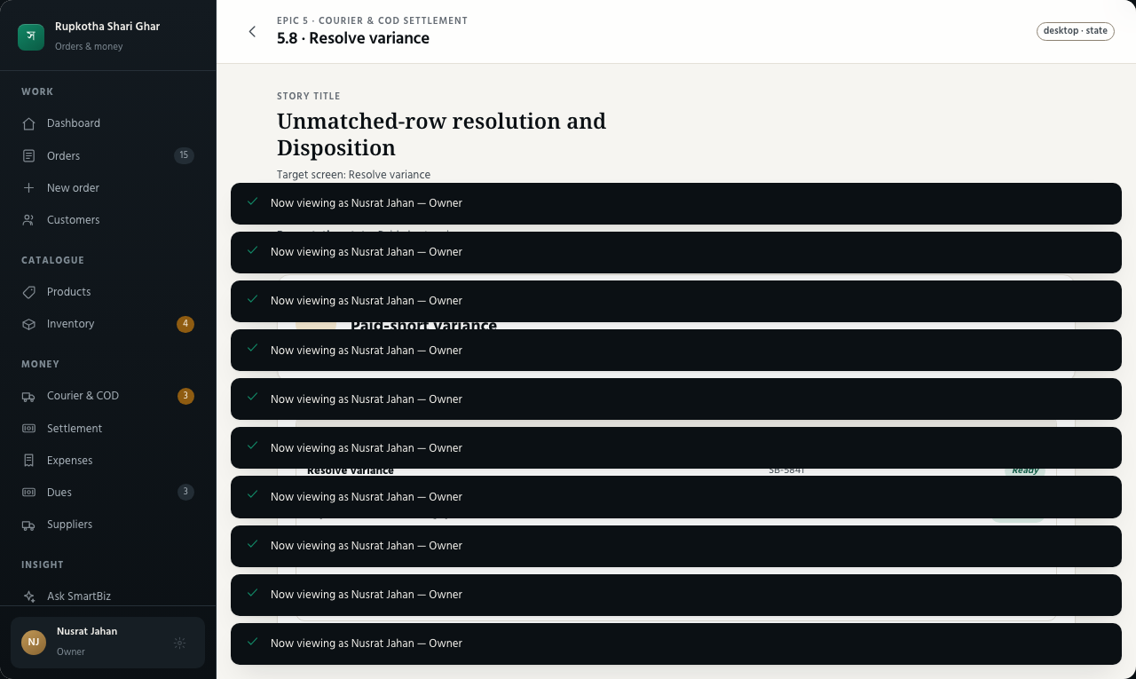
EPIC 5 · STORY 5.8
Courier & COD settlement
Unmatched-row resolution and Disposition
Resolve variance
State: Paid-short variance
Visible proof
✓
Expected, received and gap
✓
Every option states its effect
✓
No unresolved row can disappear
Primary action: Record disposition
51
Notes:
Source: epics.md Story 5.8, Unmatched-row resolution and Disposition. Prototype target: #/settlement/disposition. Presentation data is synthetic.

Slide 52

EPIC 5 · STORY 5.9
Courier & COD settlement
Settlement Match realizes cash
Settlement match result
State: Money moved to realized once
Visible proof
✓
Pending decreases
✓
Realized increases
✓
A second match is unavailable
Primary action: View matched Order
52
Notes:
Source: epics.md Story 5.9, Settlement Match realizes cash. Prototype target: #/settlement/realize. Presentation data is synthetic.

Slide 53

EPIC 5 · STORY 5.10
Courier & COD settlement
Batch review and close
Close settlement batch
State: Close blocked by one variance
Visible proof
✓
Whole-batch totals
✓
Open variance named
✓
Close unlocks only at zero
Primary action: Resolve remaining variance
53
Notes:
Source: epics.md Story 5.10, Batch review and close. Prototype target: #/settlement/close. Presentation data is synthetic.

Slide 54

EPIC 5 · STORY 5.11
Courier & COD settlement
Past Batches remain inspectable
Settlement history
State: Closed batch read-only
Visible proof
✓
Rows, matches and dispositions
✓
Closed timestamp and actor
✓
No edit controls after close
Primary action: Open selected batch
54
Notes:
Source: epics.md Story 5.11, Past Batches remain inspectable. Prototype target: #/settlement/history. Presentation data is synthetic.

Slide 55

EPIC 5 · STORY 5.12
Courier & COD settlement
Partial and grouped settlement handling
Grouped payout resolution
State: Group decomposed to clean outcomes
Visible proof
✓
One-to-one matches only
✓
Shortfall becomes variance
✓
Duplicate file hash recognized
Primary action: Confirm one-to-one outcomes
55
Notes:
Source: epics.md Story 5.12, Partial and grouped settlement handling. Prototype target: #/settlement/grouped. Presentation data is synthetic.

Slide 56

EPIC 6 · STORY 6.1
Decision-first dashboard
Dashboard money panel
Dashboard money panel
State: Earned and realized position
Visible proof
✓
Money With Couriers
✓
Pending versus realized cash
✓
Live profit derivation
Primary action: Open money detail
56
Notes:
Source: epics.md Story 6.1, Dashboard money panel. Prototype target: #/home/money. Presentation data is synthetic.

Slide 57

EPIC 6 · STORY 6.2
Decision-first dashboard
Dashboard operational counts
Dashboard attention
State: Four decisions need attention
Visible proof
✓
Low stock
✓
Unreceived returns and shortfalls
✓
Unsettled delivered Orders
Primary action: Start first decision
57
Notes:
Source: epics.md Story 6.2, Dashboard operational counts. Prototype target: #/home/attention. Presentation data is synthetic.

Slide 58

EPIC 6 · STORY 6.3
Decision-first dashboard
Recognition Basis on every profit figure
Recognition Basis coverage
State: All profit surfaces labelled
Visible proof
✓
Earned buckets by delivery date
✓
Realized buckets by settlement date
✓
No bare Profit label
Primary action: Inspect surface audit
58
Notes:
Source: epics.md Story 6.3, Recognition Basis on every profit figure. Prototype target: #/proof/recognition. Presentation data is synthetic.

Slide 59

EPIC 6 · STORY 6.4
Decision-first dashboard
Completeness Indicator on every profit figure
Completeness coverage
State: Exact gap explained
Visible proof
✓
Based on N of M
✓
Missing-cost Orders named
✓
Expenses completeness disclosed
Primary action: Inspect missing records
59
Notes:
Source: epics.md Story 6.4, Completeness Indicator on every profit figure. Prototype target: #/proof/completeness. Presentation data is synthetic.

Slide 60

EPIC 6 · STORY 6.5
Decision-first dashboard
Role-composed dashboard
Role-composed dashboard
State: Sales Staff view
Visible proof
✓
Denied money items absent
✓
Shared components, filtered payload
✓
Labels reinforce amber and brass
Primary action: Compare with Owner
60
Notes:
Source: epics.md Story 6.5, Role-composed dashboard. Prototype target: #/home/role. Presentation data is synthetic.

Slide 61

EPIC 7 · STORY 7.1
Customers & dues
Customer profile and full history
Customer profile
State: Complete relationship history
Visible proof
✓
Profile and contact details
✓
Orders, payments and dues
✓
Return and cancellation history
Primary action: Repeat a previous order
61
Notes:
Source: epics.md Story 7.1, Customer profile and full history. Prototype target: #/customer/history. Presentation data is synthetic.

Slide 62

EPIC 7 · STORY 7.2
Customers & dues
Customer Risk Ratio
Customer Risk Ratio
State: High risk, formula visible
Visible proof
✓
Returned ÷ completed Orders
✓
Small-sample caveat
✓
No predictive model language
Primary action: Explain this ratio
62
Notes:
Source: epics.md Story 7.2, Customer Risk Ratio. Prototype target: #/customer/risk. Presentation data is synthetic.

Slide 63

EPIC 7 · STORY 7.3
Customers & dues
Customer Due and Customer Payment
Record Customer payment
State: Part payment entered
Visible proof
✓
Remaining Due preview
✓
Ageing bucket updates
✓
Payment remains its own event
Primary action: Record payment
63
Notes:
Source: epics.md Story 7.3, Customer Due and Customer Payment. Prototype target: #/dues/payment. Presentation data is synthetic.

Slide 64

EPIC 8 · STORY 8.1
Suppliers & purchases
Supplier profile and purchase history
Supplier profile
State: Trading relationship overview
Visible proof
✓
Contact and associated Products
✓
Stock-In purchase history
✓
Computed outstanding balance
Primary action: Open purchase record
64
Notes:
Source: epics.md Story 8.1, Supplier profile and purchase history. Prototype target: #/supplier/history. Presentation data is synthetic.

Slide 65

EPIC 8 · STORY 8.2
Suppliers & purchases
Stock-In payment state and Supplier Payment
Supplier payment
State: Unpaid Stock-In selected
Visible proof
✓
Paid or Unpaid per Stock-In
✓
Ad-hoc payment event
✓
Outstanding balance recomputes
Primary action: Record supplier payment
65
Notes:
Source: epics.md Story 8.2, Stock-In payment state and Supplier Payment. Prototype target: #/supplier/payment. Presentation data is synthetic.

Slide 66

EPIC 9 · STORY 9.1
Expenses
Expense entry
Add expense
State: Required fields complete
Visible proof
✓
Eight categories or custom
✓
Date, amount and note
✓
Filterable expense history
Primary action: Save expense
66
Notes:
Source: epics.md Story 9.1, Expense entry. Prototype target: #/expenses/new. Presentation data is synthetic.

Slide 67

EPIC 9 · STORY 9.2
Expenses
Expenses reduce profit on both bases
Expense effect on profit
State: Before-and-after comparison
Visible proof
✓
Same period expense total
✓
Earned profit reduced
✓
Realized profit reduced
Primary action: Open source expense
67
Notes:
Source: epics.md Story 9.2, Expenses reduce profit on both bases. Prototype target: #/reports/profit-expenses. Presentation data is synthetic.

Slide 68

EPIC 10 · STORY 10.1
Reports & exports
Shared Bangla rendering pipeline
Bangla document pipeline
State: PDF and image compared
Visible proof
✓
One HTML/CSS template set
✓
WeasyPrint then rasterization
✓
Bangla conjunct fixture passes
Primary action: Inspect rendering fixture
68
Notes:
Source: epics.md Story 10.1, Shared Bangla rendering pipeline. Prototype target: #/proof/rendering. Presentation data is synthetic.

Slide 69

EPIC 10 · STORY 10.2
Reports & exports
Nine reports with date filtering
All reports
State: Nine report destinations
Visible proof
✓
All nine reports named
✓
Custom date range
✓
Role-gated columns
Primary action: Run selected report
69
Notes:
Source: epics.md Story 10.2, Nine reports with date filtering. Prototype target: #/reports/all. Presentation data is synthetic.

Slide 70

EPIC 10 · STORY 10.3
Reports & exports
CSV export for all nine reports
CSV export
State: Export contents previewed
Visible proof
✓
Same columns as screen
✓
Current date range
✓
Capability-gated fields omitted
Primary action: Download CSV
70
Notes:
Source: epics.md Story 10.3, CSV export for all nine reports. Prototype target: #/reports/export-csv. Presentation data is synthetic.

Slide 71

EPIC 10 · STORY 10.4
Reports & exports
Bangla PDF export for three reports
Bangla PDF preview
State: Profit Summary ready
Visible proof
✓
Sales, Profit and COD Settlement
✓
Shared rendering pipeline
✓
Basis and completeness retained
Primary action: Download Bangla PDF
71
Notes:
Source: epics.md Story 10.4, Bangla PDF export for three reports. Prototype target: #/reports/export-pdf. Presentation data is synthetic.

Slide 72

EPIC 10 · STORY 10.5
Reports & exports
Daily Summary digest
Daily Summary digest
State: Text and image ready
Visible proof
✓
Copyable Bangla text
✓
Saveable rendered image
✓
Orders, COD, basis and completeness
Primary action: Share daily summary
72
Notes:
Source: epics.md Story 10.5, Daily Summary digest. Prototype target: #/home/summary. Presentation data is synthetic.

Slide 73

EPIC 11 · STORY 11.1
Audit & reversals
Audit Entry on every financial and inventory change
Audit entry
State: Before and after values
Visible proof
✓
Exactly one entry per service call
✓
Actor and timestamp
✓
Before and after money or stock
Primary action: Open affected record
73
Notes:
Source: epics.md Story 11.1, Audit Entry on every financial and inventory change. Prototype target: #/audit/change. Presentation data is synthetic.

Slide 74

EPIC 11 · STORY 11.2
Audit & reversals
Audit trail view and filtering
Audit trail filters
State: Member and operation applied
Visible proof
✓
Date range
✓
Member and entity type
✓
Operation with Role access
Primary action: Inspect selected entry
74
Notes:
Source: epics.md Story 11.2, Audit trail view and filtering. Prototype target: #/audit/filters. Presentation data is synthetic.

Slide 75

EPIC 11 · STORY 11.3
Audit & reversals
Reversal via Compensating Entry for the seven operations
Compensating reversal
State: Eligible entry selected
Visible proof
✓
Exactly seven operation types
✓
Original stays visible
✓
Already-reversed and ineligible states blocked
Primary action: Write compensating entry
75
Notes:
Source: epics.md Story 11.3, Reversal via Compensating Entry for the seven operations. Prototype target: #/audit/reverse. Presentation data is synthetic.

Slide 76

EPIC 12 · STORY 12.1
Safe insight assistant
Insight Provider configuration and degradation
Insight Provider states
State: Absent, failing and exhausted
Visible proof
✓
Three states remain distinct
✓
Numbered query fallback
✓
Key remains server-side
Primary action: Compare provider outcomes
76
Notes:
Source: epics.md Story 12.1, Insight Provider configuration and degradation. Prototype target: #/ai/provider-states. Presentation data is synthetic.

Slide 77

EPIC 12 · STORY 12.2
Safe insight assistant
Question Routing to ten Insight Queries
Question routing
State: Routed, withheld or unroutable
Visible proof
✓
Bangla, Banglish and English
✓
Exactly ten query destinations
✓
Three outcome vocabulary
Primary action: Ask the question
77
Notes:
Source: epics.md Story 12.2, Question Routing to ten Insight Queries. Prototype target: #/ai/routing. Presentation data is synthetic.

Slide 78

EPIC 12 · STORY 12.3
Safe insight assistant
Insight Query answers from Business data
Computed insight answer
State: Business-scoped answer
Visible proof
✓
Same domain calculations
✓
Role-filtered result
✓
Allow-listed outbound payload
Primary action: Inspect source figures
78
Notes:
Source: epics.md Story 12.3, Insight Query answers from Business data. Prototype target: #/ai/answer. Presentation data is synthetic.

Slide 79

EPIC 12 · STORY 12.4
Safe insight assistant
No-invented-number answer composition
Answer validation
State: Altered numeral rejected
Visible proof
✓
Computed figure set shown
✓
Model draft comparison
✓
Template fallback selected
Primary action: Use safe template
79
Notes:
Source: epics.md Story 12.4, No-invented-number answer composition. Prototype target: #/ai/validated-composition. Presentation data is synthetic.

Slide 80

EPIC 12 · STORY 12.5
Safe insight assistant
Profit change decomposition
Profit change decomposition
State: Arithmetic drivers add exactly
Visible proof
✓
Revenue and cost movement
✓
Expenses, courier charges and variances
✓
Signed components equal total change
Primary action: Open underlying report
80
Notes:
Source: epics.md Story 12.5, Profit change decomposition. Prototype target: #/ai/decomposition. Presentation data is synthetic.

