Slide 1
Automated Test Suite Generation
Rye Howard-Stone
CSE 5095: AI for Software Engineering
https://github.com/rhowardstone/atsr
Feel free to follow along (this PPTX included in GitHub)
For testScout, please see: https://github.com/rhowardstone/testScout
Notes:
Welcome, everyone. This is Automatic Generation of Automated Test Suites. My name is Rye Howard Stone. Feel free to follow along on our GitHub. The link is listed right there, I’ll give you a minute to copy it down if you like. This PowerPoint is actually included in the GitHub along with all of the other code for my project so far.

Slide 2
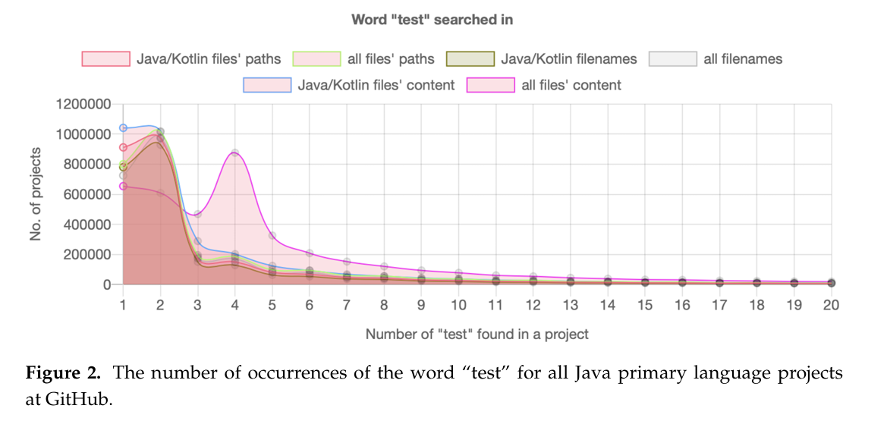
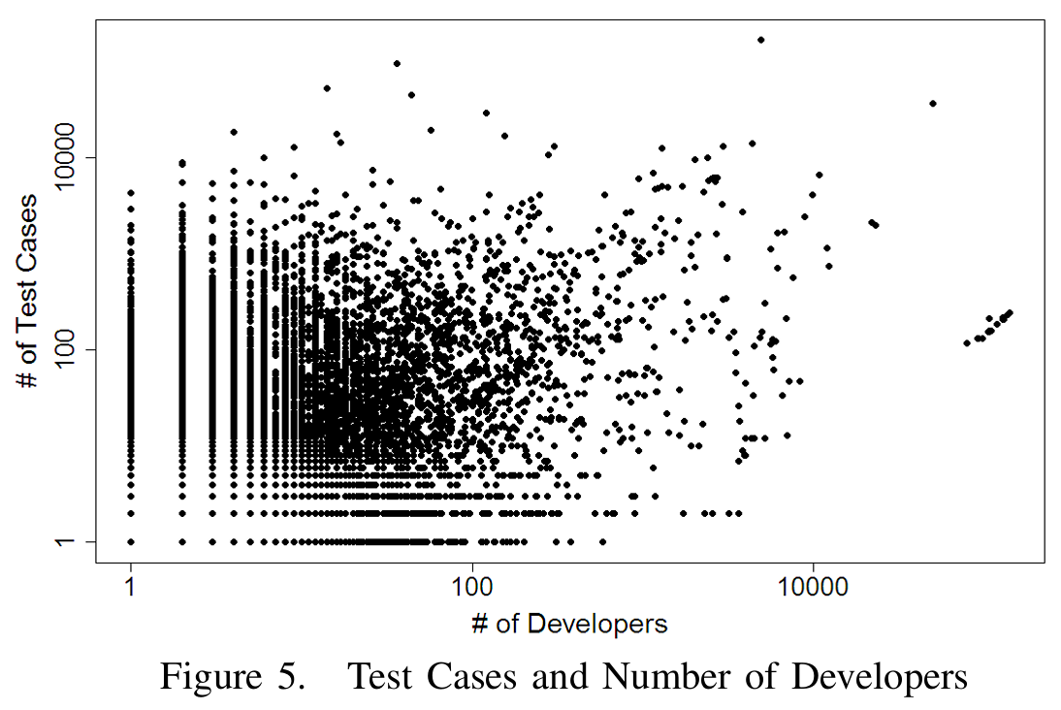
Problem: Test Suites are Incomplete
Empirical Study of Test Case and Test Framework Presence in Public Projects on GitHub
Adoption of Software Testing in Open Source Projects--A Preliminary Study on 50,000 Projects
Only 52% of 6.3M public GitHub projects contain at least one test case.
56.81% of 50K open source GitHub projects that do have test cases have only 1-9 tests.
Notes:
So the problem? Test suites are incomplete for the most part. On the left you can see a figure 2 from this empirical study where they were searching the word test in all of the Java files in a project and they're able to find that the number of test occurrences drops radically after maybe 3 or 4 and that about half of GitHub repositories have no test cases. On the right you can see a scatter plot from a different publication where it shows the number of developers on a log scale on the x-axis and on the y-axis it's log scale of the number of test cases. And you can see there's not a whole lot of correlation between the number of developers that you have and the number of test cases that you end up with. They also found that something like 60% of the projects they looked at that did have test cases only had maybe 1 to 9 tests.

Slide 3
The Question (midterm recap)
Can we improve upon existing state-of-the-art agentic coding tools’ test suite refinement abilities using hooks and slash commands*? (RQ1)
  Does tool-specific guidance improve performance? If so, which tools? (RQ1A)
  Are there robust methods by which agents can cut down on token usage while utilizing these tools? (RQ1B)
* ‘Slash commands’ = automated prompt macros; ‘Hooks’ = tool usage pre- or post-intercepts
Notes:
So my project, we're going to be looking at essentially one major research question with several parts. So I'm trying to see whether or not one can improve upon the existing state-of-the-art agentic coding tools test suite refinement abilities using their built-in hooks and slash commands.
So a hook is essentially something that intercepts a tool, like a bash command, before or after you do it. And a slash command is essentially an automated prompt macro. More on that later.
The two sub-questions that I'm trying to answer here are, does tool-specific guidance improve performance, and if so, which tools? And B, are there robust methods by which agents can cut down on token usage while utilizing these tools?

Slide 4





Methodology (midterm recap)
Obtained 3 Python repos with test suites:
Repos w/ reduced test cases (~50% coverage)
Removed tests until ~50% coverage
Two strategies:
Base
/refine-tests
Measuring:
Coverage
Pass Rate
Number of tests
Tests/Mtokens
(4 AI agents)
Base x Opus | Refine x Opus
Base x Sonnet | Refine x Sonnet
Opus 4.1
Two models:
Sonnet 4.5
DEMO (6:22)
Notes:
And here's a full diagram of the methodology that I've managed to execute so far this semester. I obtained three Python repos with extensive test suites, click, mistune, and schedule. I then removed tests and any trace of them until we reached about 50% coverage for all three repos. I then test four different AI agents, the four combinations of the two models, Opus 4.1 and Sonnet 4.5, with our two strategies, our base prompt and our refine tests slash command. So those four combinations, base cross Opus, refine cross Opus, base cross Sonnet, refine cross Sonnet. I test all of those on each of the three reduced test coverage repos. And then measure a bunch of different things. Coverage, pass rate, number of tests, test per million tokens. And here's a demo that I can show you that will explain a little bit more.

Slide 5
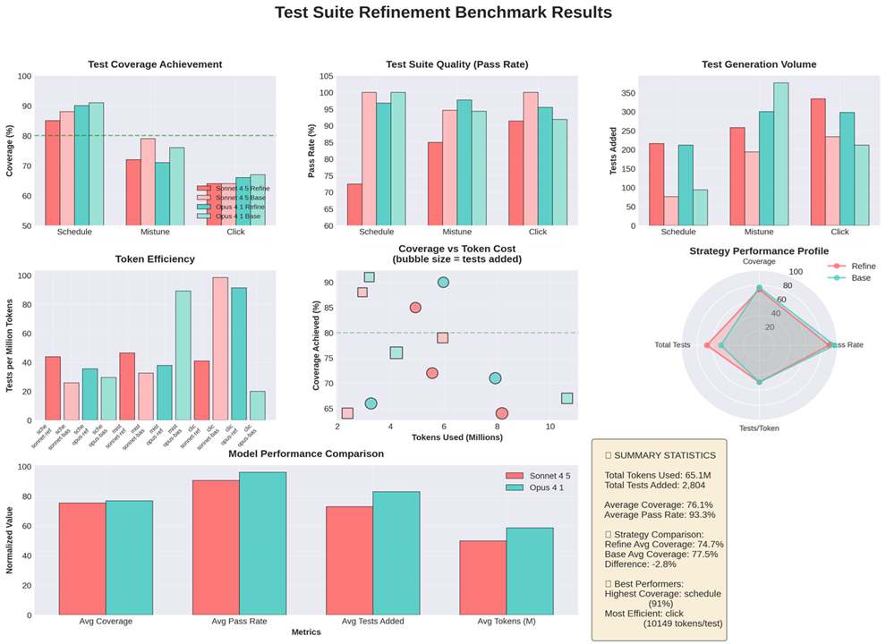


Preliminary
Results
Negative result!
Base model does better!
Refinement command not effective as written.
Sonnet - Refine
Sonnet - Base
Opus - Refine
Opus - Base
Notes:
Okay, and as you can see, unfortunately, so far, my result is a negative one. So the base model actually does better. The refinement command is not effective as written. It exceeds the performance of the base models a little bit in some cases. You can see the refined models are these darker colors. The red and blue. The lighter red and lighter blue are the two base models. And you can see there really isn't a consistent pattern as to one doing better than the other. You can see in Mistune, it actually looks like we had the reverse. The base was significantly better than refined. In Schedule, we actually see the same thing. In Qlik, it looks like base and refined for Sonnet did about as well in terms of final test coverage. There's, of course, the test suite quality. The total number of tests generated, of course, was more for the refined model, but fewer of them passed. So you can see the test per token is about on par. So we really didn't do much better than just feeding a very basic prompt. However, we did set up an extensive testing framework, so future things will be easier to test.

Slide 6
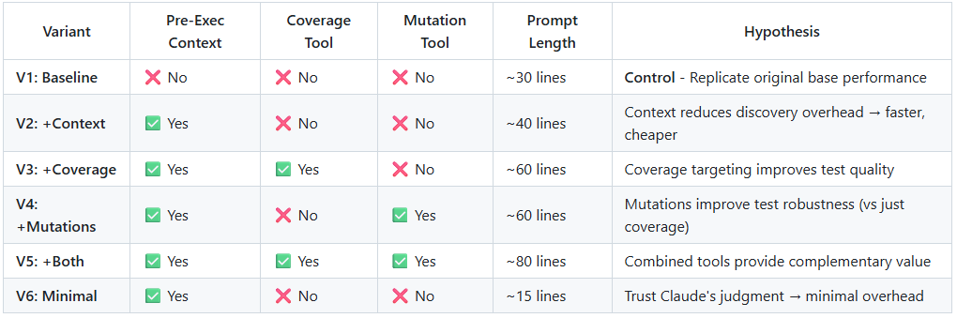
Refined variants (new since midterm)
Also:
  Sonnet 4.5 competitive in previous steps, cheaper: exclude Opus

Slide 7

Refined
Results
Sonnet 4.5 Only
Negative result!
Base model STILL does better!
Effects inconsistent

Slide 8
Refined
Results (II)
Sonnet 4.5 Only
Negative result!
Base model STILL does better!
Effects inconsistent

Slide 9

Exploratory
Results
(3 repos with low existing coverage)
Base model STILL competitive!
Directives and toolage are not the bottleneck

Slide 10
Exploratory
Results (II)
(3 repos with low existing coverage)
Base model STILL competitive!
Directives and toolage are not the bottleneck

Slide 11

Domain-specific
Results
(3 bioinformatics repos with low existing coverage)
Results inconsistent
Directives and specific toolage can hinder test suite refinement

Slide 12
Domain-specific
Results (II)
(3 bioinformatics repos with low existing coverage)
Results inconsistent
Directives and specific toolage can hinder test suite refinement

Slide 13
Complementary workflow:
AI-powered end-to-end webapp testing
Demo(s):
  Python library:
    rhowardstone/testScout: AI-driven Automatic End-to-End webapp testing
  Audit-1 (Wikipedia)
  Audit-2 (custom AI-career coach website I’m building for a friend)

