Slide 1
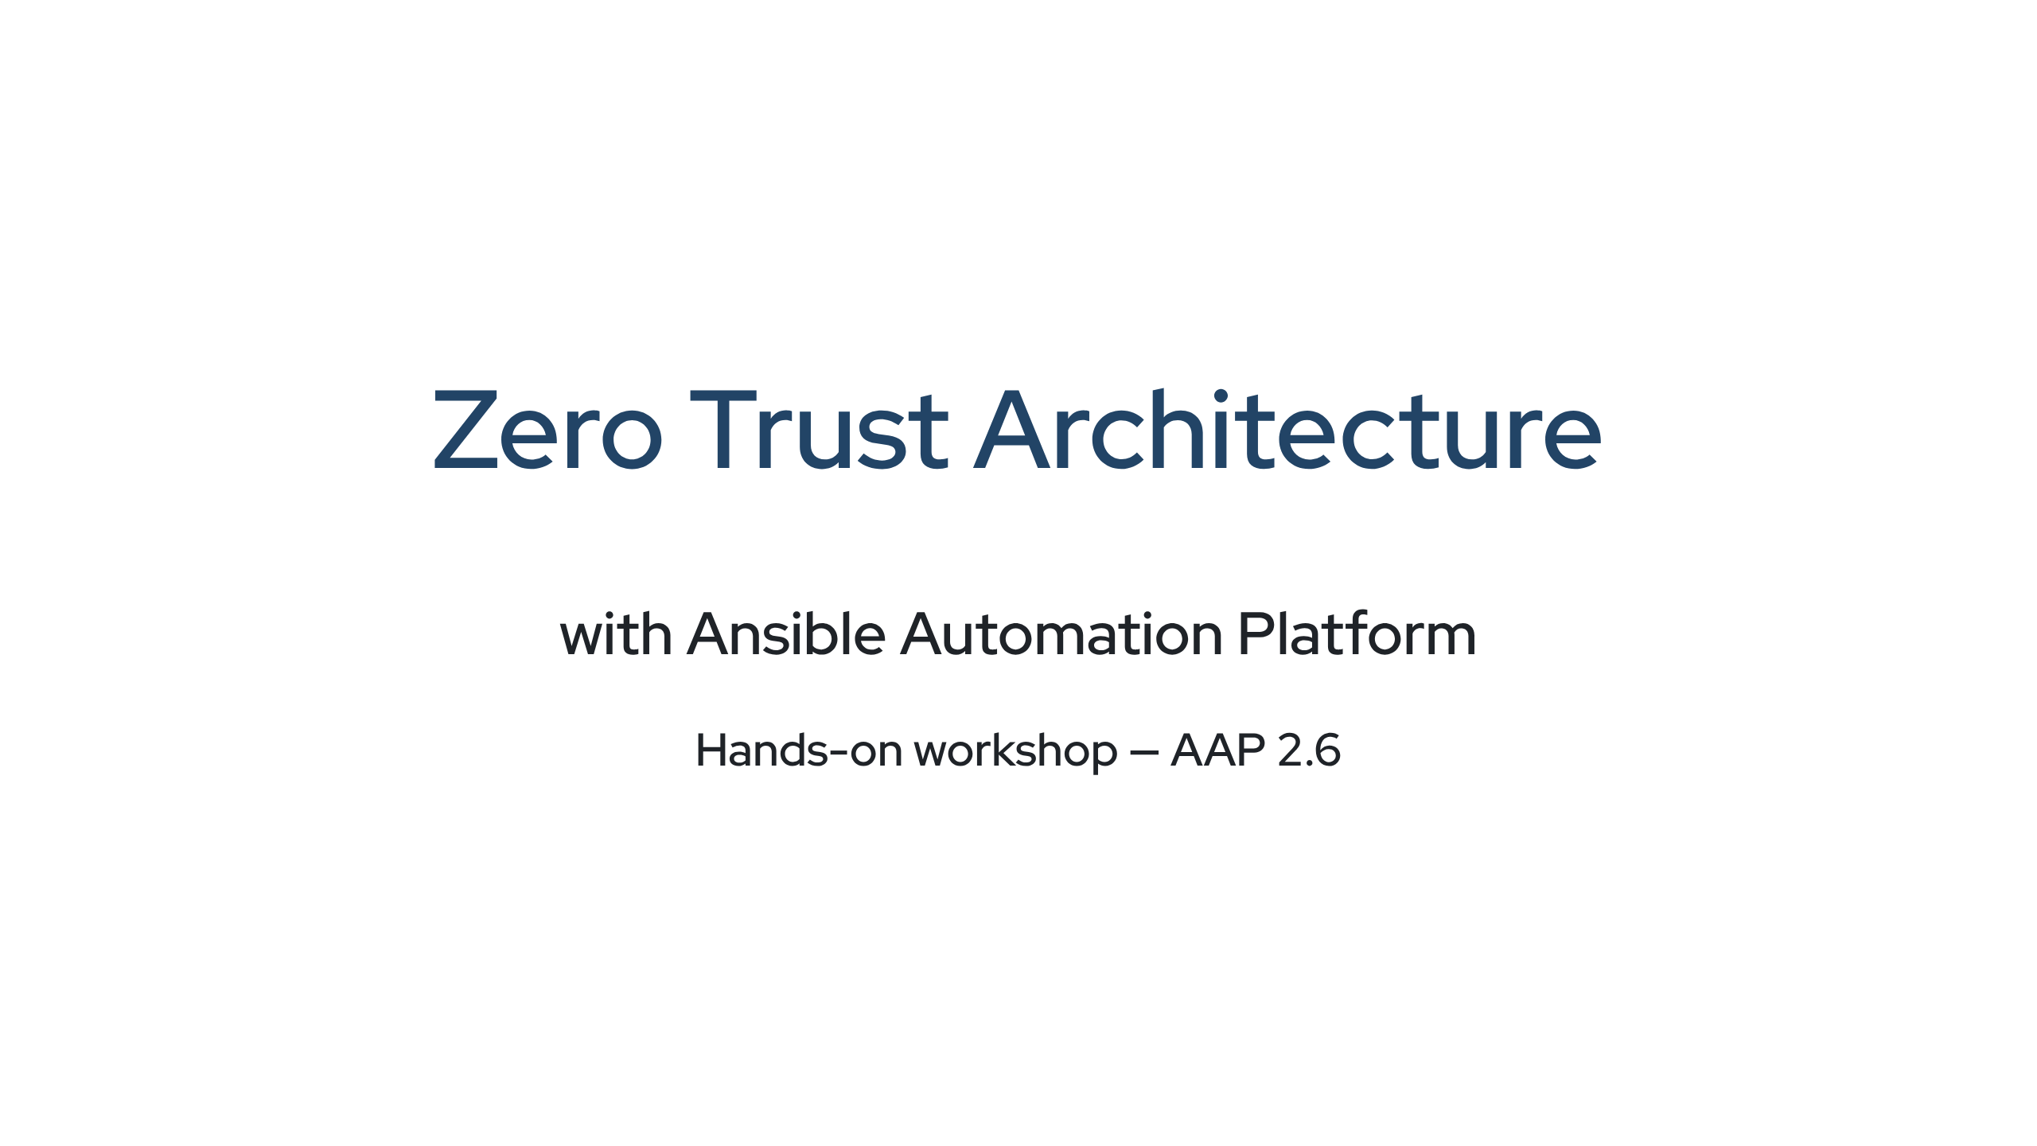

Slide 2
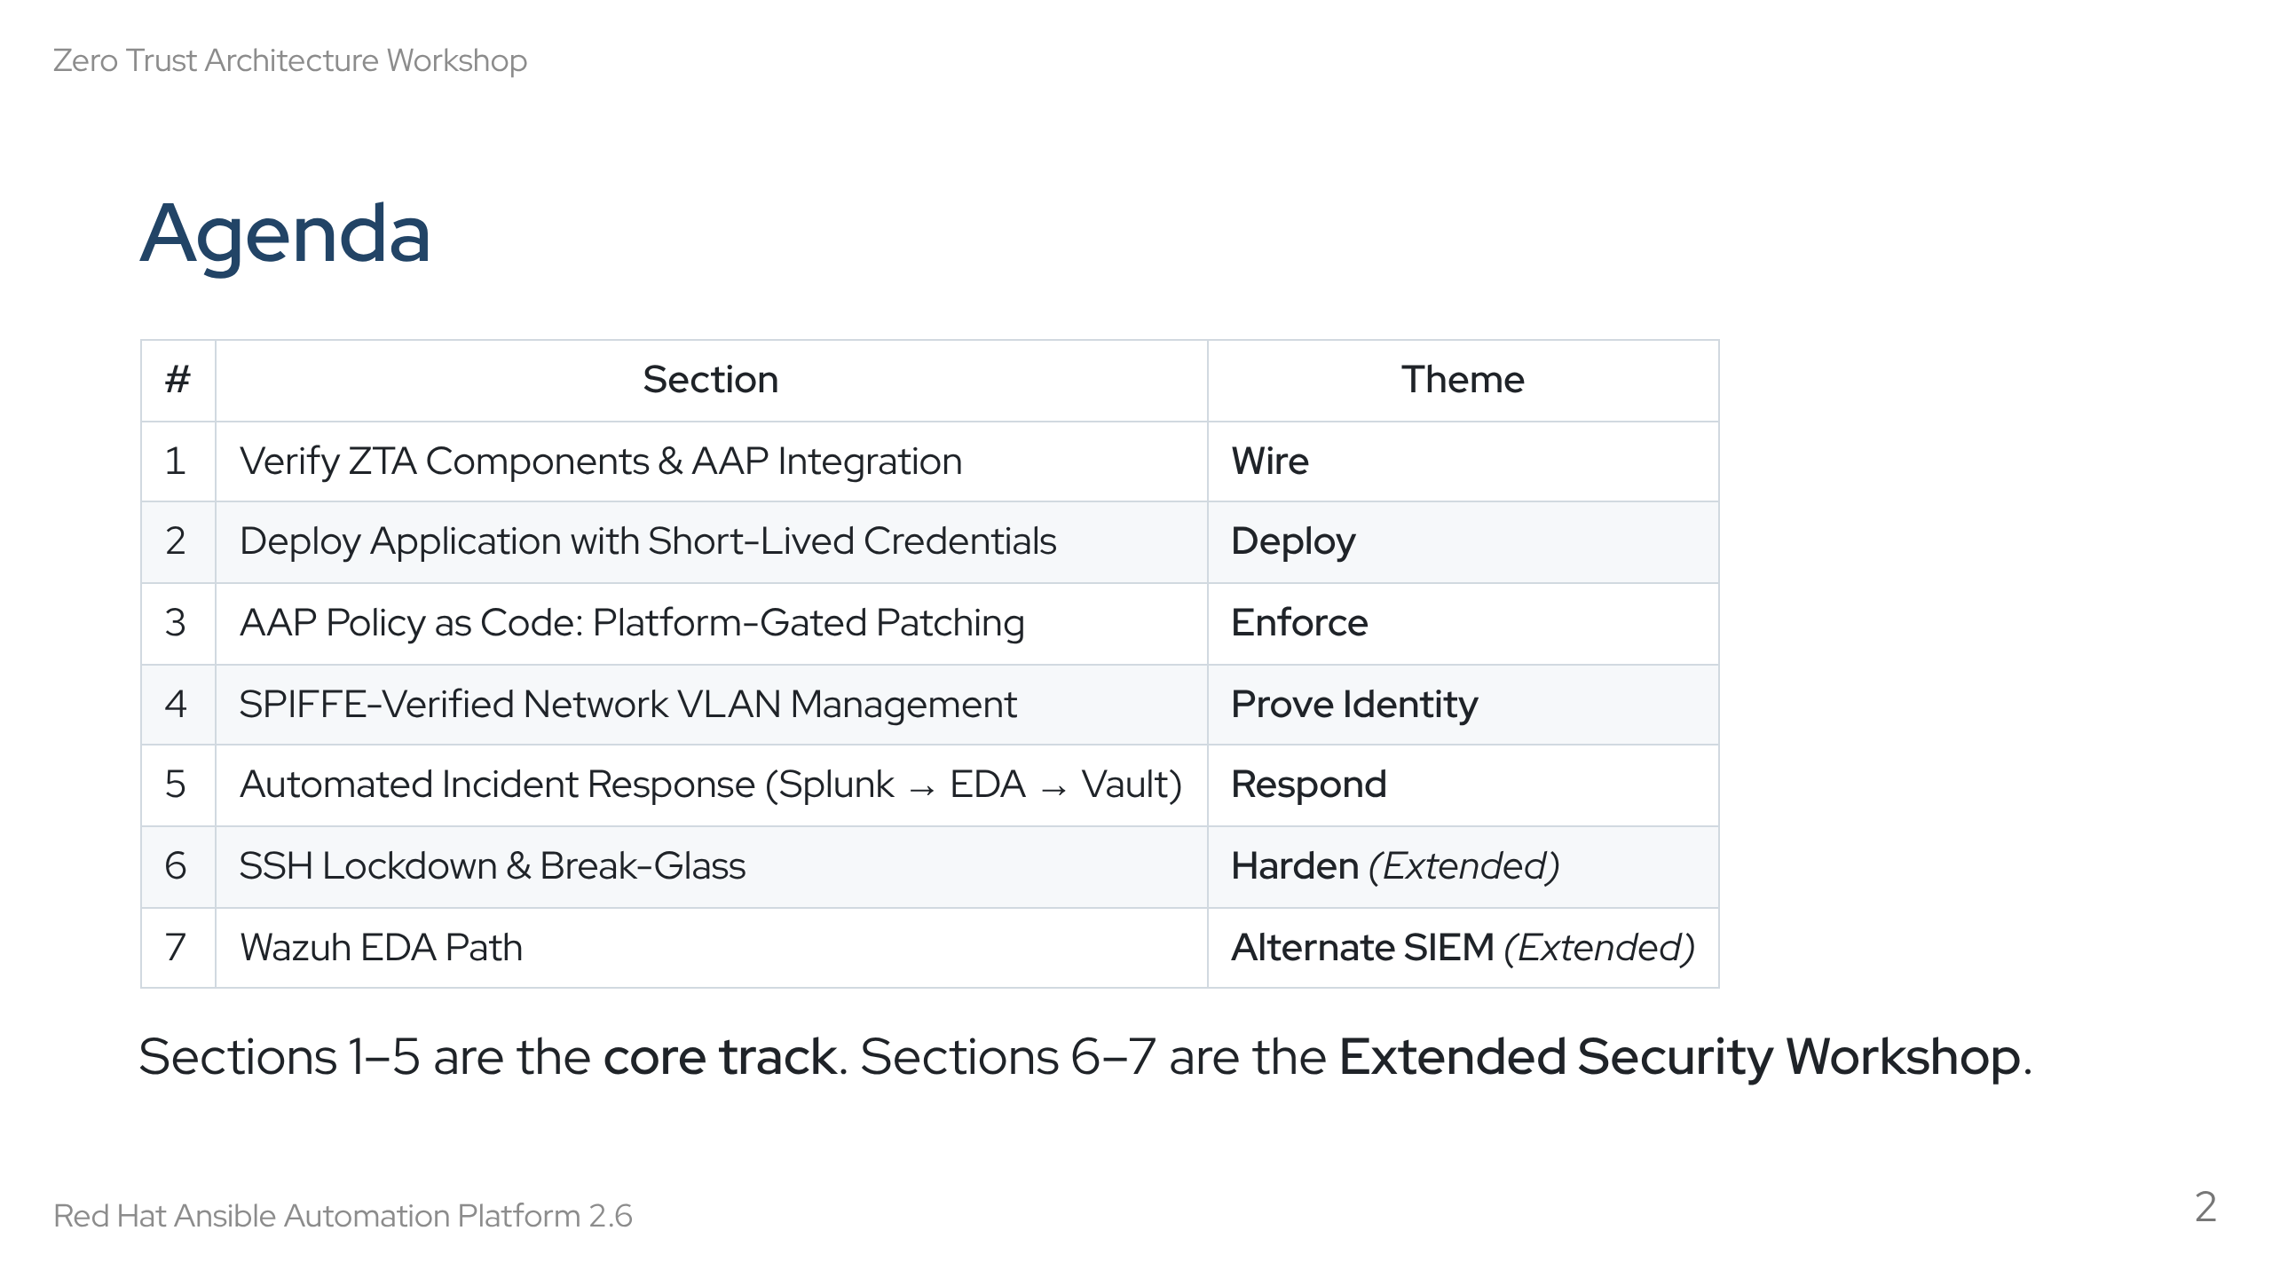
Notes:
Speaker notes: Walk through the agenda. Emphasise that sections build on each other — complete them in order. Sections 6 and 7 are optional and time-permitting. Check with your audience whether those are in scope.

Slide 3
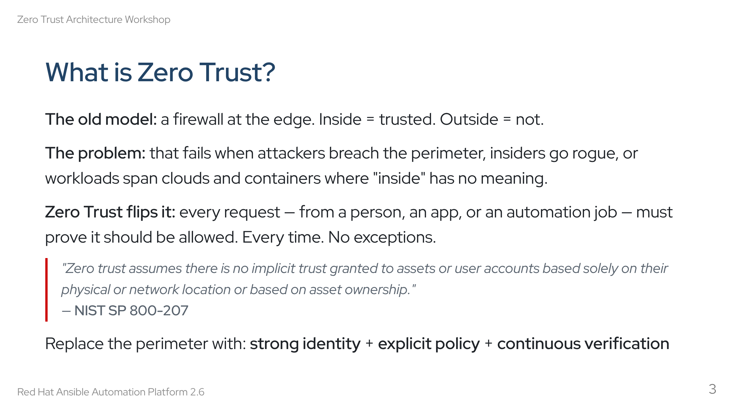
Notes:
Speaker notes: Start with the relatable scenario — most people's networks still look like the old model. The NIST quote grounds this in a standards body, not vendor marketing. The three replacement pillars (identity, policy, verification) will map directly to lab tools.

Slide 4
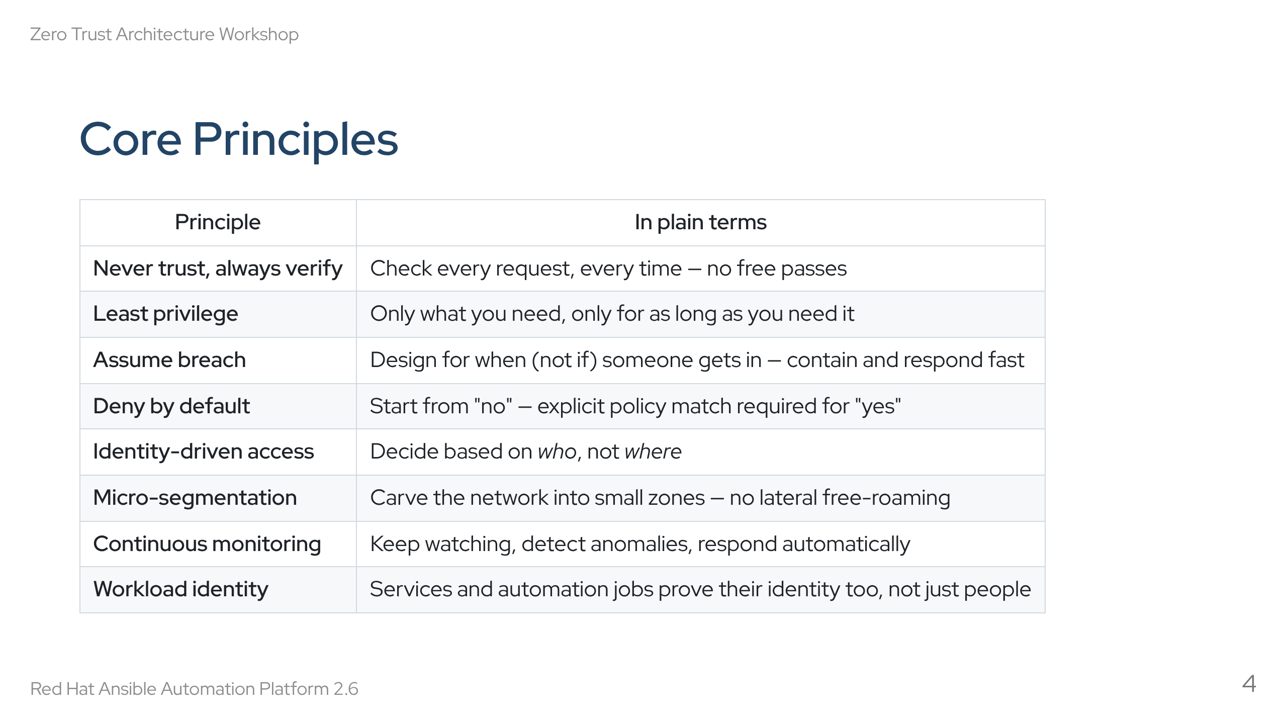
Notes:
Speaker notes: Don't read every row — highlight 3-4 that will surprise the audience. "Assume breach" and "workload identity" are often the ones that change how people think. Every principle maps to a specific exercise they'll do today.

Slide 5
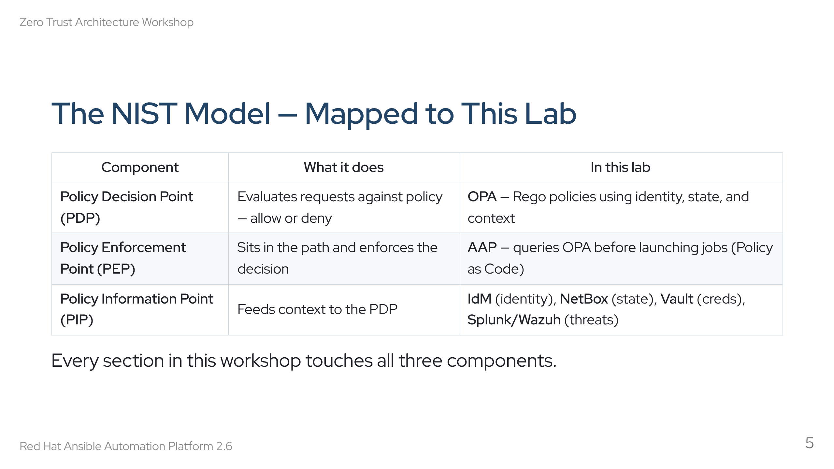
Notes:
Speaker notes: This is the NIST 800-207 framework. Three boxes — decision, enforcement, information. OPA is the brain (PDP), AAP is the muscle (PEP), and everything else feeds context (PIP). Students will see this pattern repeat in every exercise.

Slide 6
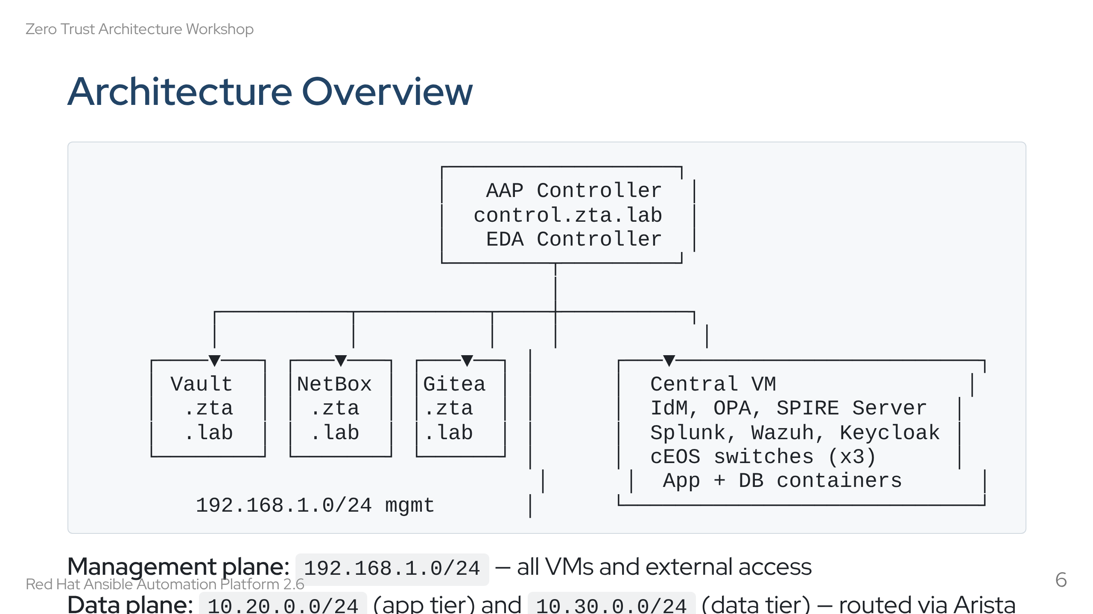
Notes:
Speaker notes: Point out the two networks. Management is how everything talks to each other. Data plane is internal — app and DB containers behind a three-switch cEOS fabric. Students will configure ACLs on the switches to control cross-tier traffic.

Slide 7
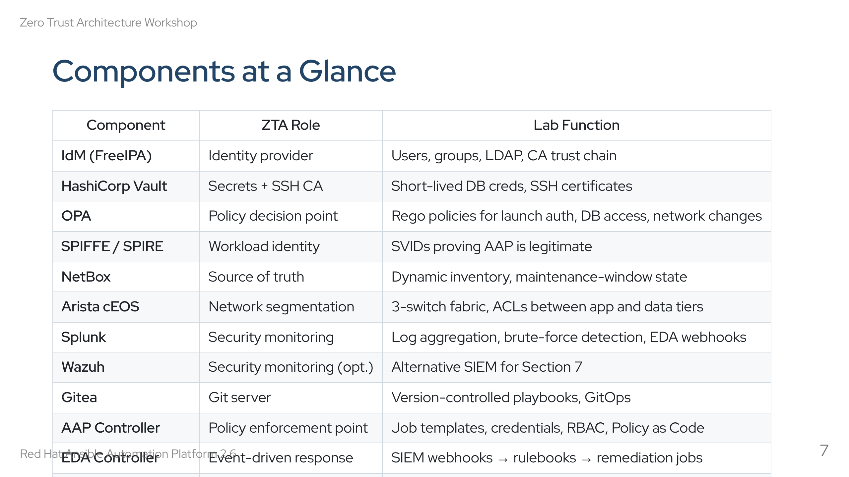
Notes:
Speaker notes: Don't read every row. Highlight that this is a real, integrated stack — not isolated demos. Every tool has a specific ZTA role. By the end, students will have touched all of them.

Slide 8
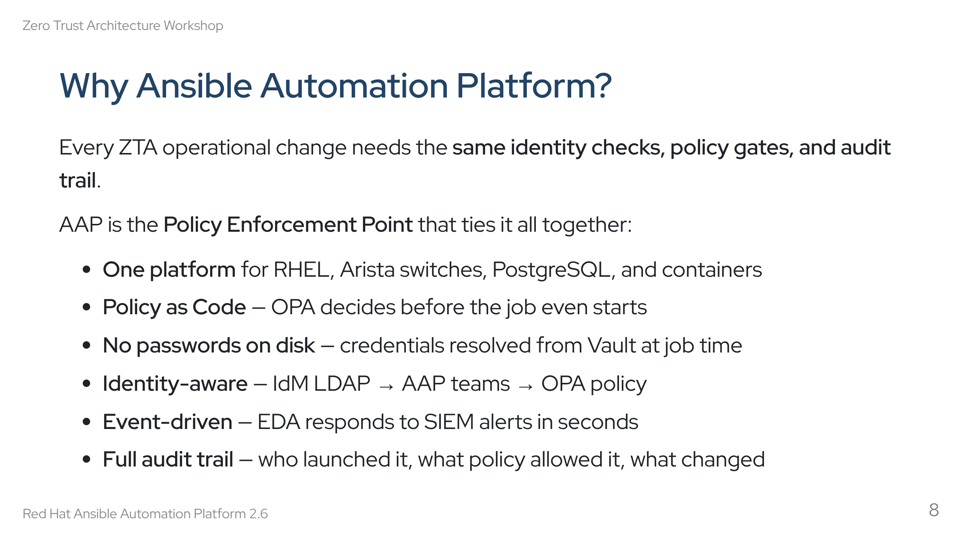
Notes:
Speaker notes: This is the "why are we using AAP for this" slide. The short answer: it's the only platform that manages RHEL, network, databases, and containers from one place — all under policy control. Without AAP, you'd need separate integrations for every tool in the ZTA stack.

Slide 9
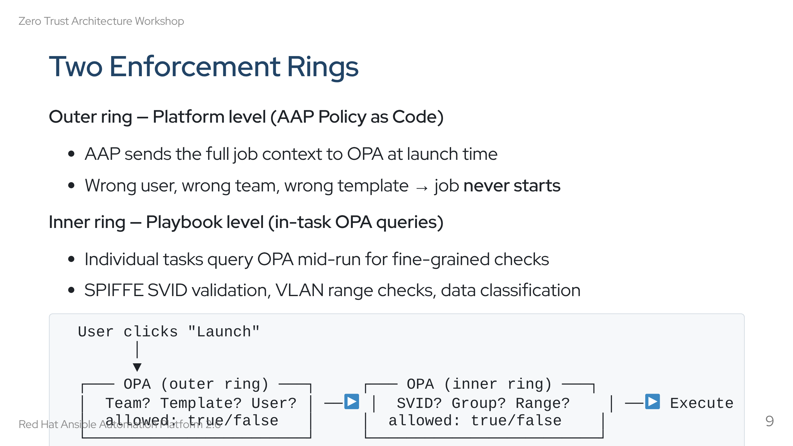
Notes:
Speaker notes: This is the key architectural concept. Two policy checkpoints, not one. The outer ring catches the obvious violations (wrong person for this job). The inner ring catches the subtle ones (right person, but invalid VLAN ID or missing workload identity). Sections 3 and 4 will exercise both rings explicitly.

Slide 10
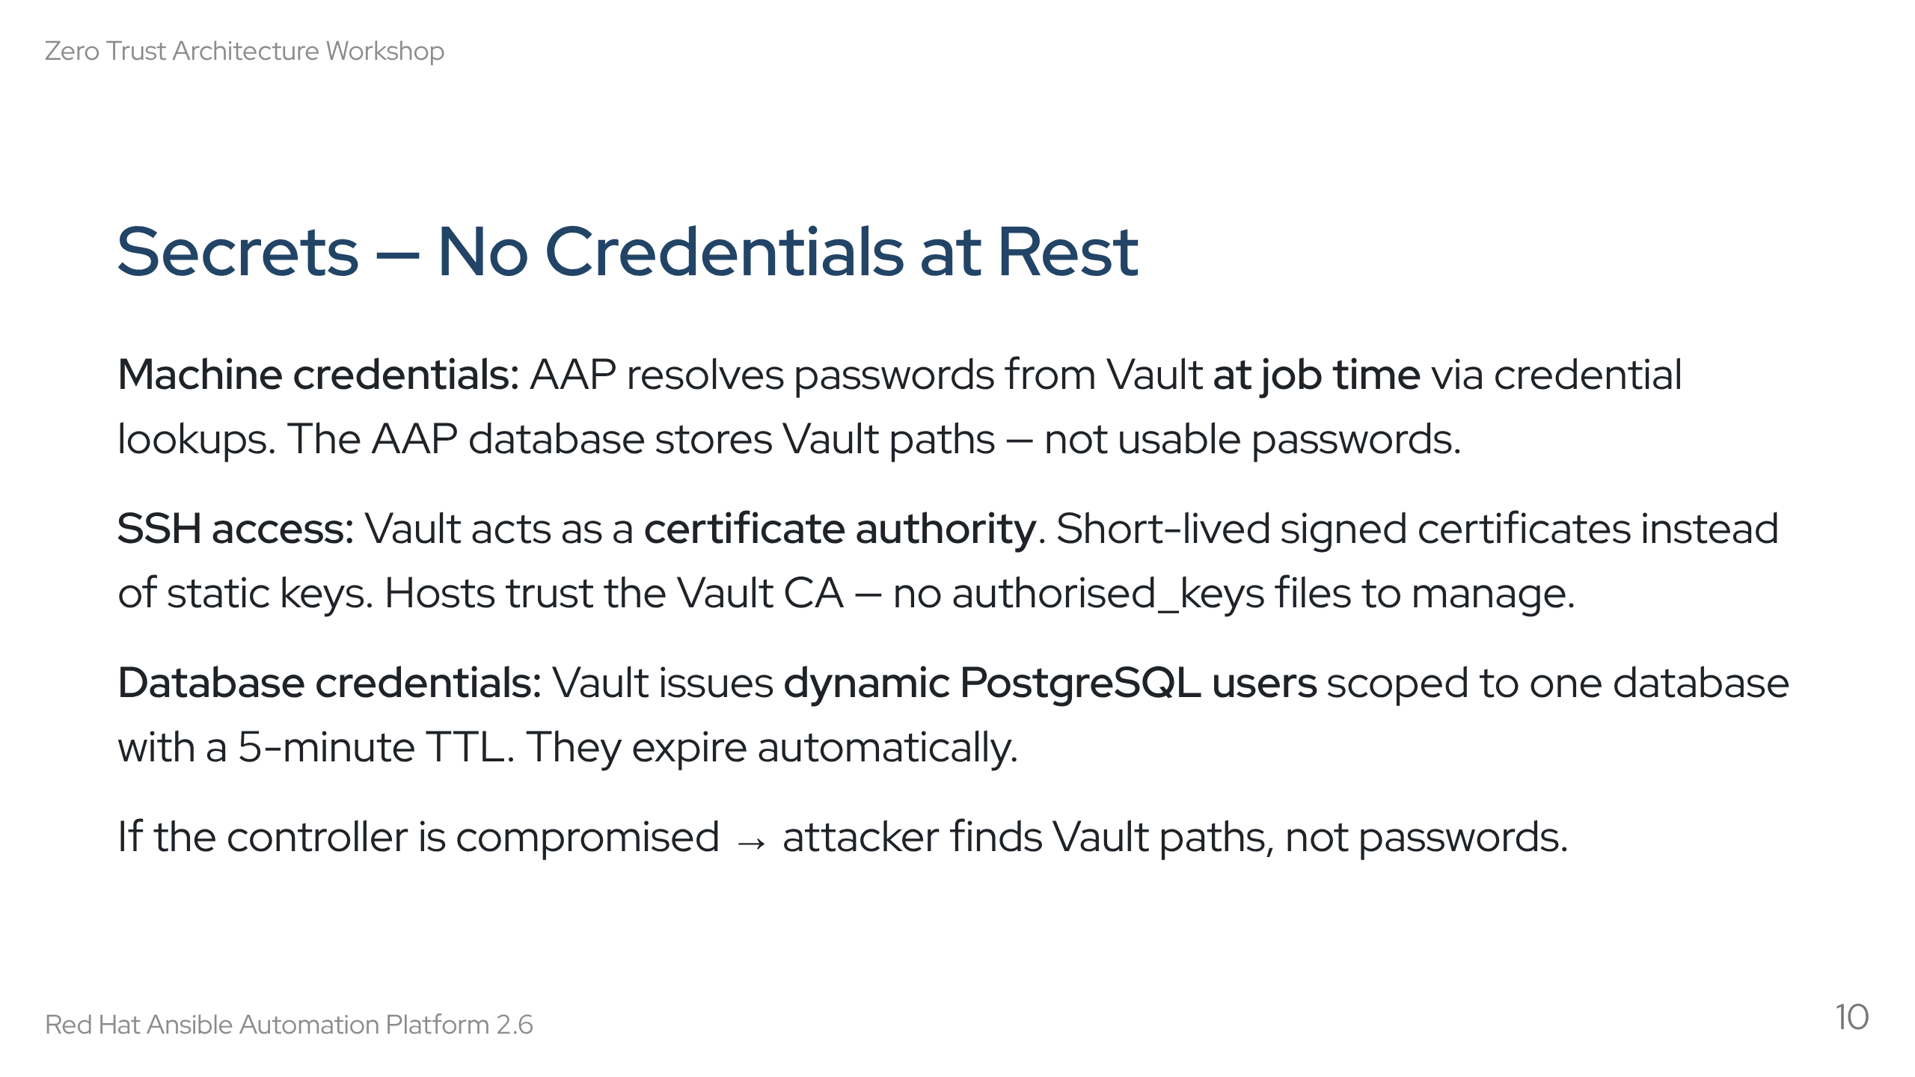
Notes:
Speaker notes: This is one of the biggest mindset shifts for ops teams. No more password vaults exported as CSVs. No more SSH keys that sit on disk for years. Everything is dynamic, short-lived, and automatically revoked. Section 2 will make this very concrete when DB creds expire mid-exercise.

Slide 11
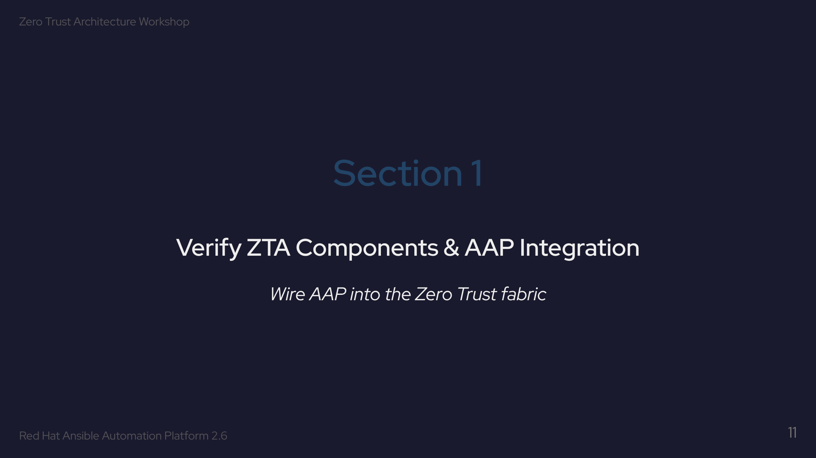

Slide 12
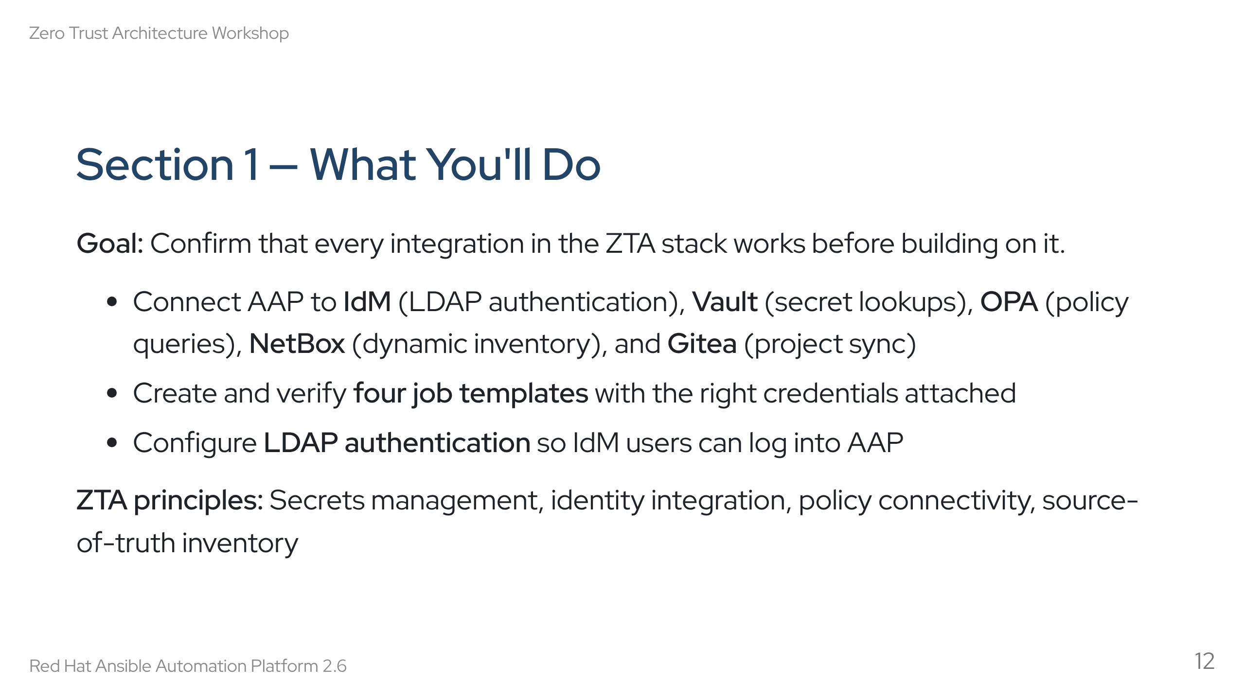
Notes:
Speaker notes: This is the foundation. Nothing in sections 2-7 works if these integrations aren't solid. The four verification templates are: Verify ZTA Services, Test Vault Integration, Test Vault SSH Certificates, Test OPA Policy. LDAP config is done manually in the AAP UI — it's an Exercise 1.2 hands-on step.

Slide 13
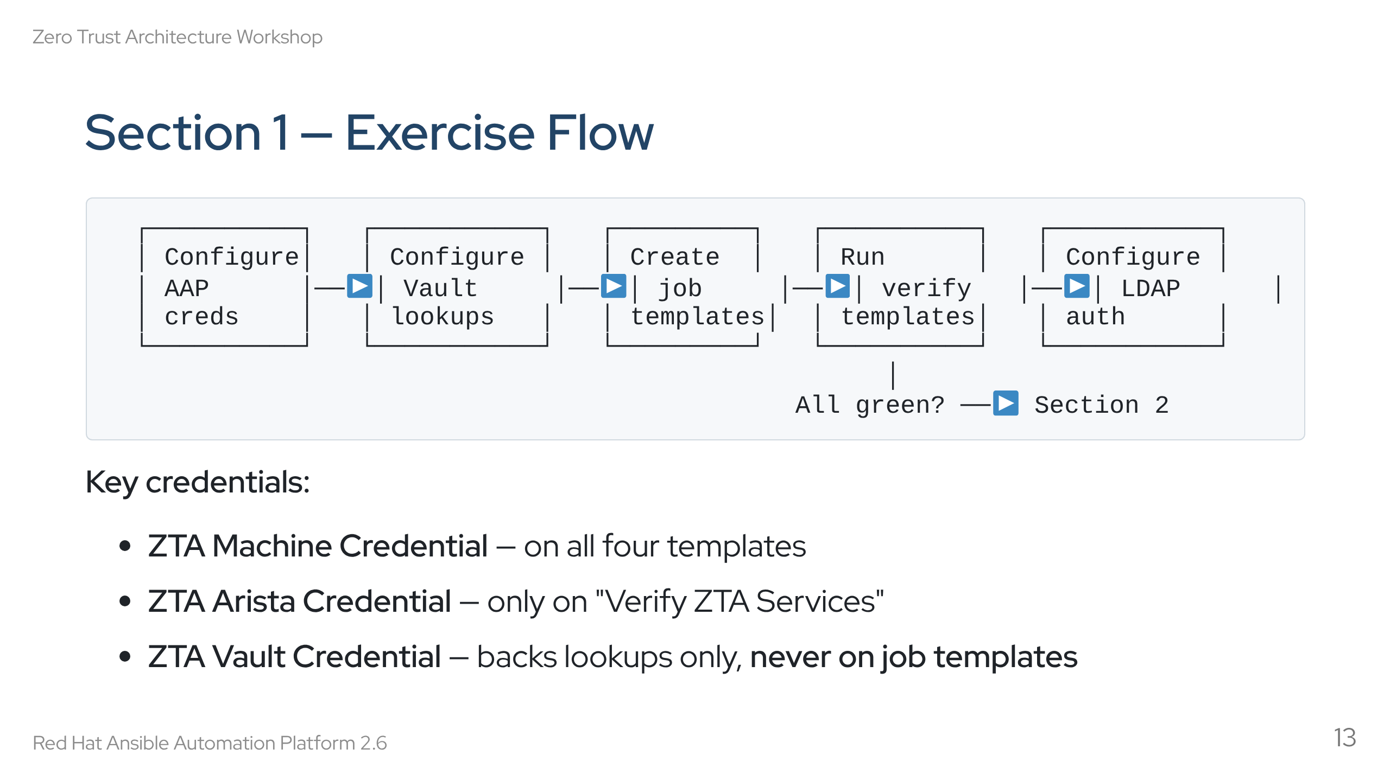
Notes:
Speaker notes: Walk through the flow left to right. Credential setup comes first because everything else depends on it. Emphasise the Vault credential rule: it's a lookup source, never attached directly to a job. If Verify ZTA Services runs green, the stack is healthy.

Slide 14
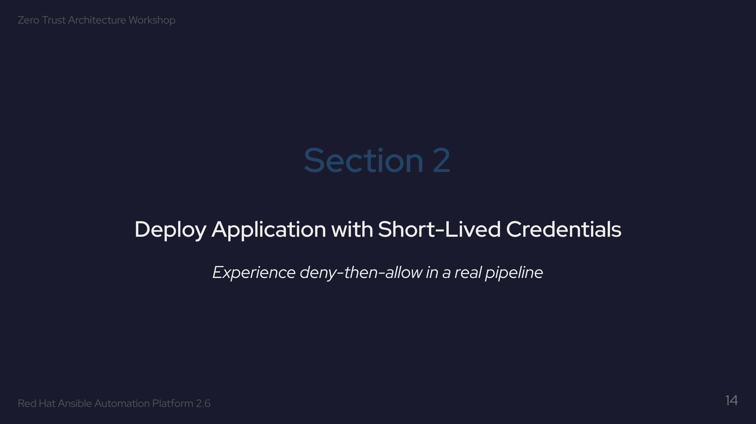

Slide 15
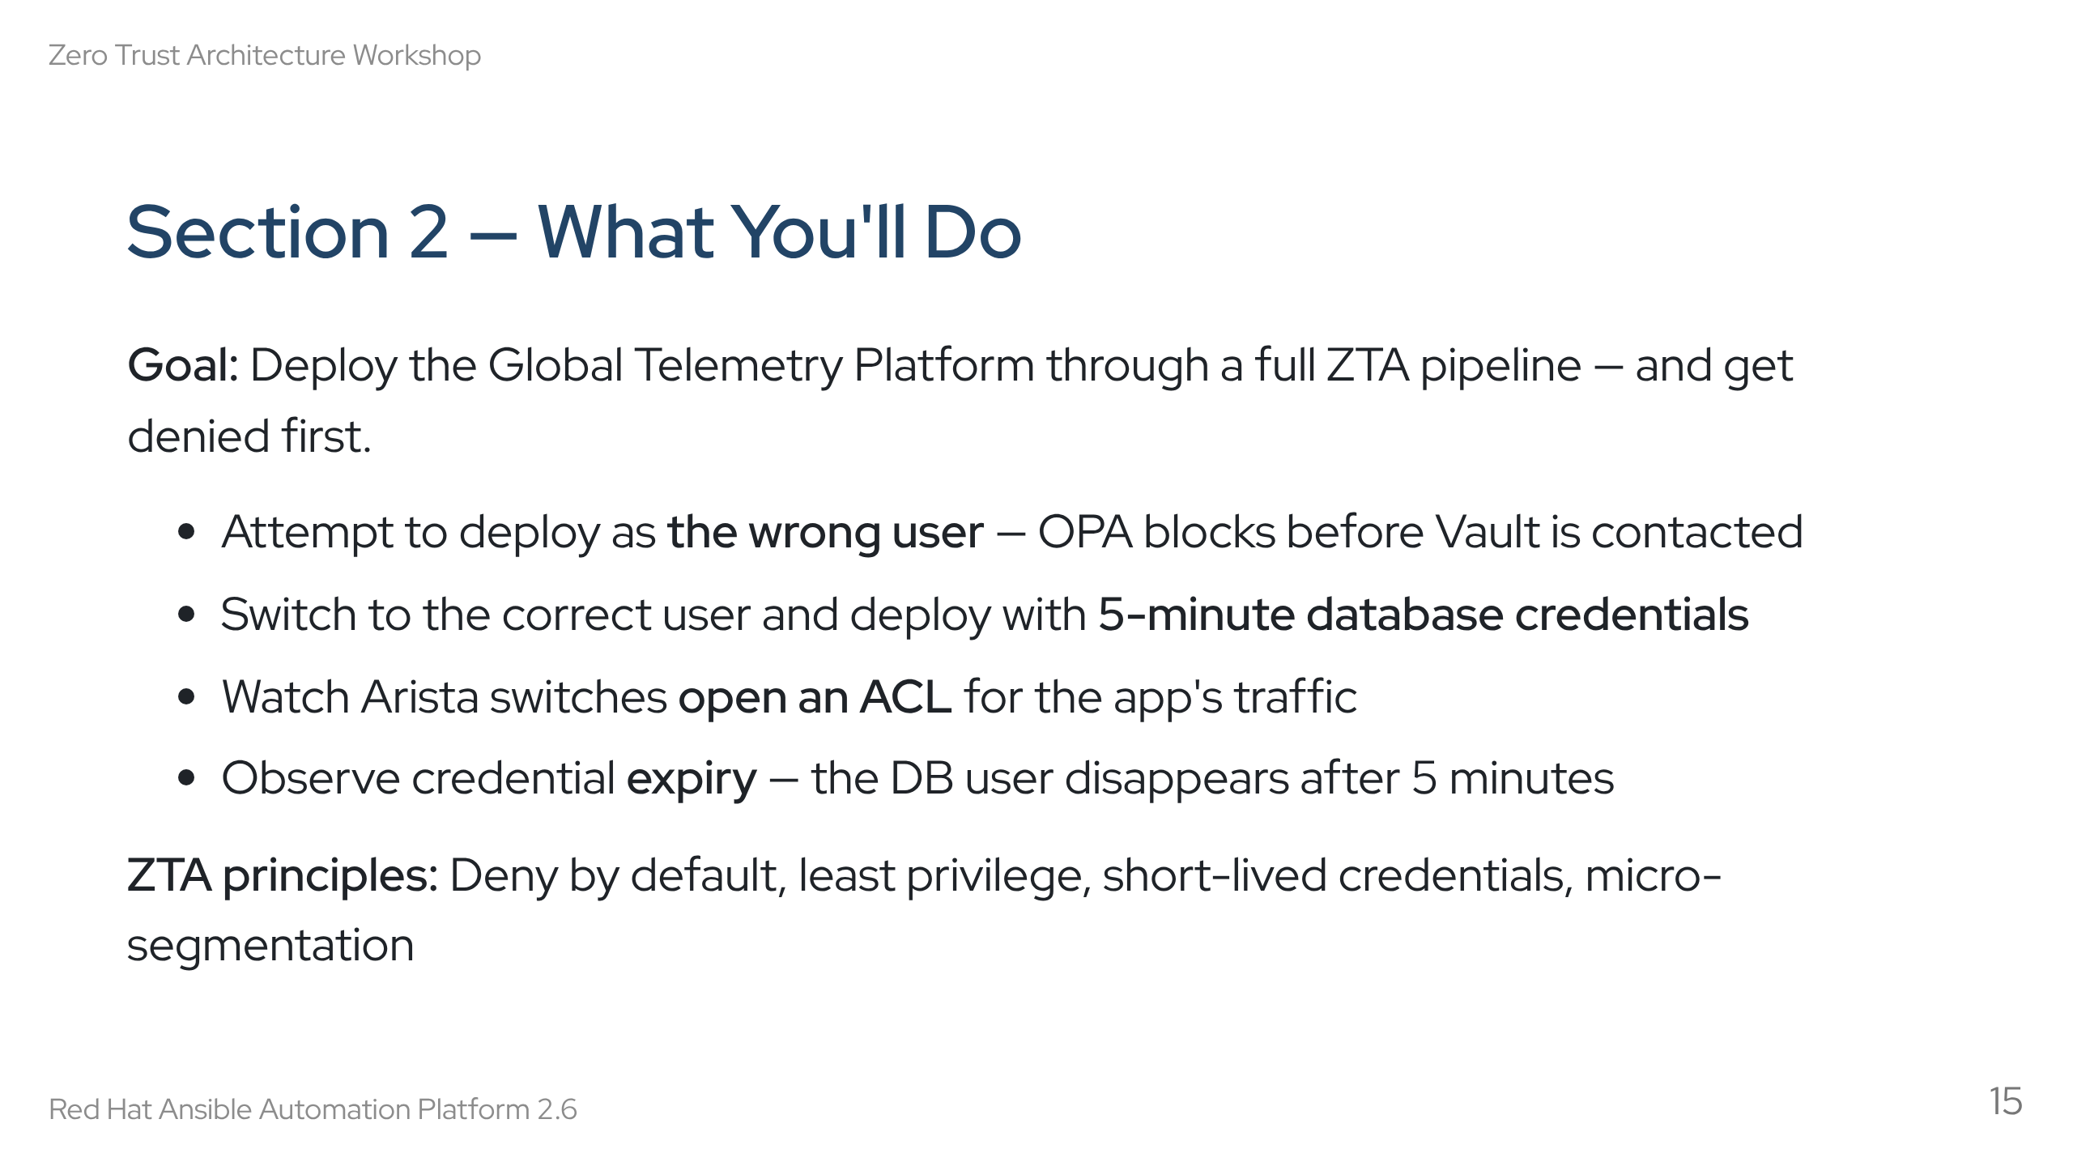
Notes:
Speaker notes: This is where it gets real. The "wrong user" step is intentional — students experience the deny path first. The 5-minute TTL is aggressive on purpose. If the workflow takes too long, creds expire mid-deploy. That forces the habit of running the full workflow every time, not reusing stale creds.

Slide 16
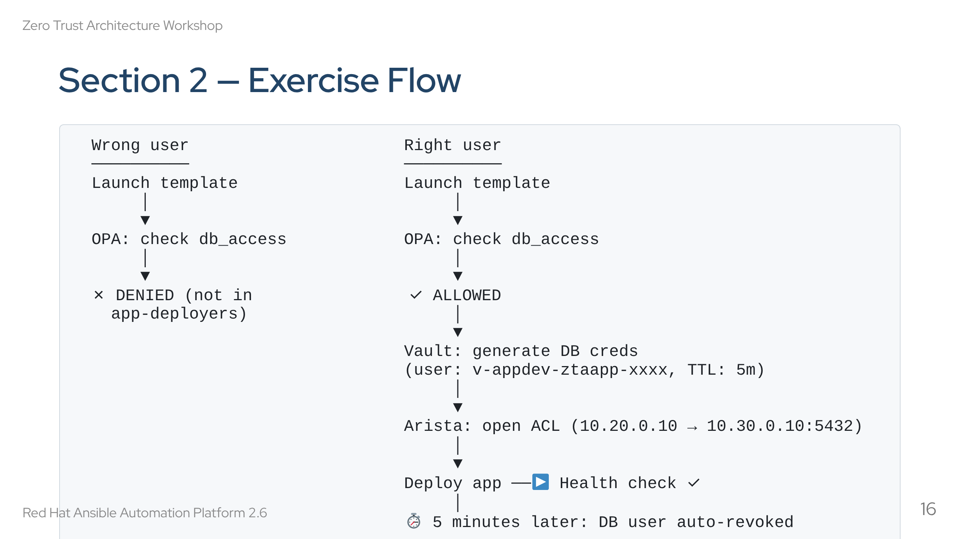
Notes:
Speaker notes: Draw attention to the left path — the denial happens BEFORE Vault is even contacted. OPA is the gatekeeper; Vault never wastes a credential on an unauthorised user. The ACL step shows micro-segmentation — even with creds, you need a network path. The 5-minute expiry at the bottom is the "least privilege" principle in action.

Slide 17
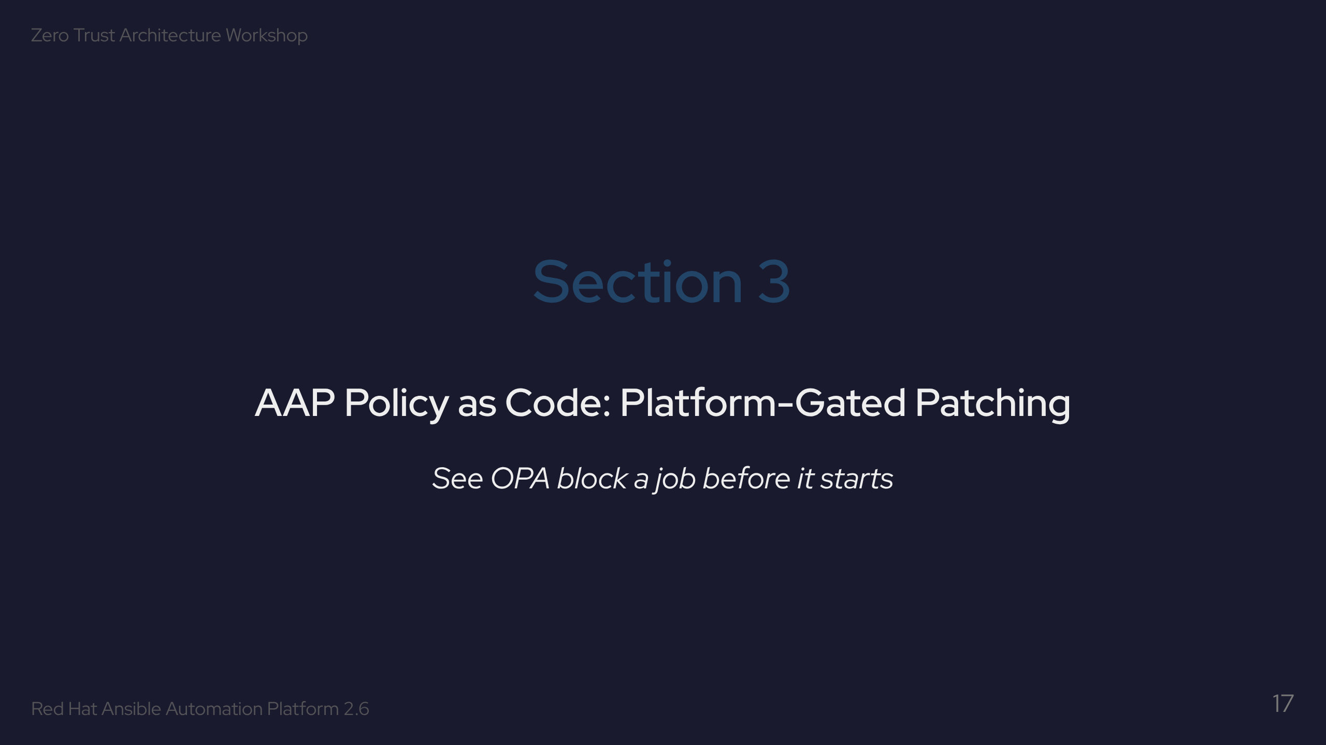

Slide 18
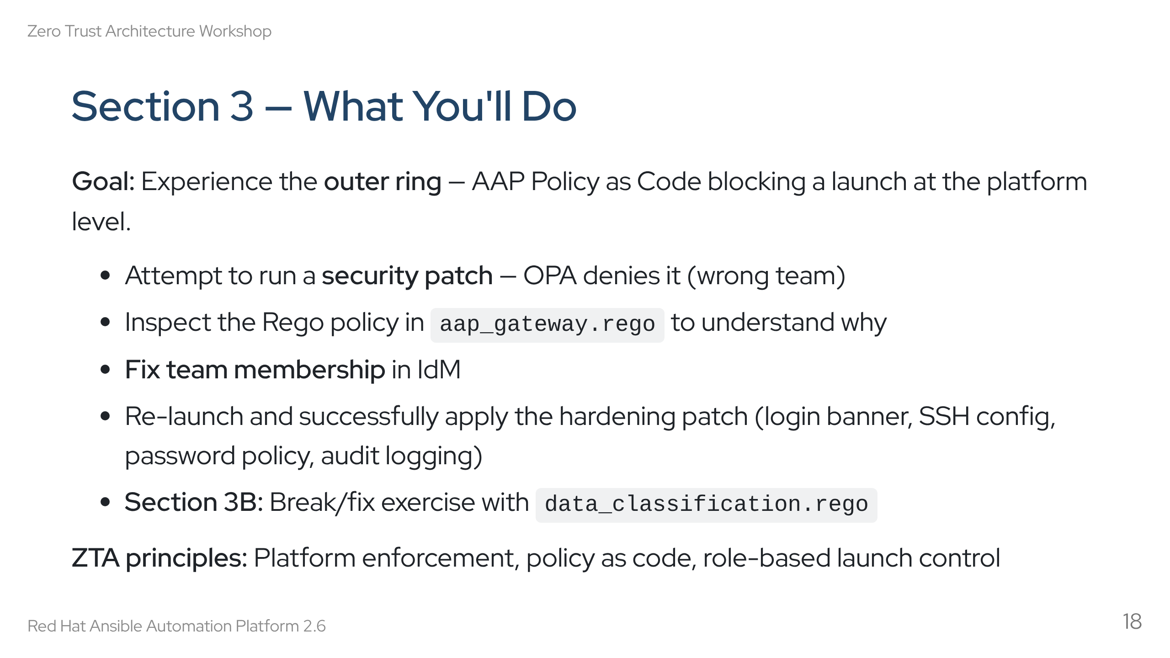
Notes:
Speaker notes: This is where Policy as Code clicks for students. The key insight: the job didn't fail partway through — it never started at all. AAP sent the context to OPA, OPA said no, and that was it. Section 3B is a bonus Rego exercise — students edit policy and see the impact immediately.

Slide 19
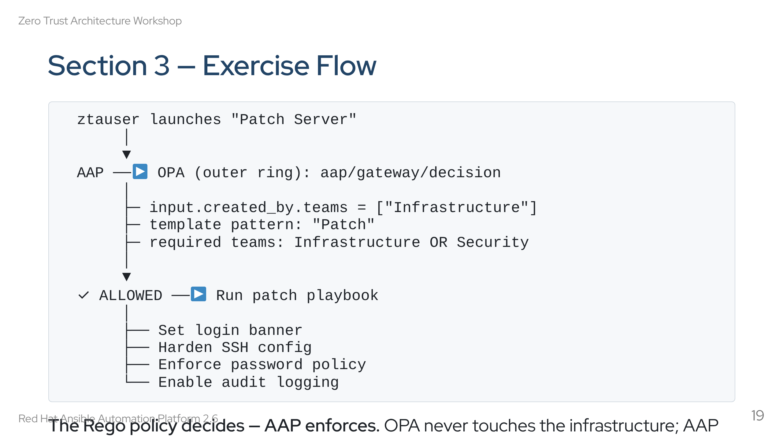
Notes:
Speaker notes: Show the clean separation: OPA is the brain, AAP is the muscle. The template pattern matching in the Rego policy maps template names to required teams. If you're not in Infrastructure or Security, you can't patch. Period. The actual patch tasks are standard Ansible — the ZTA magic is in the launch gate.

Slide 20
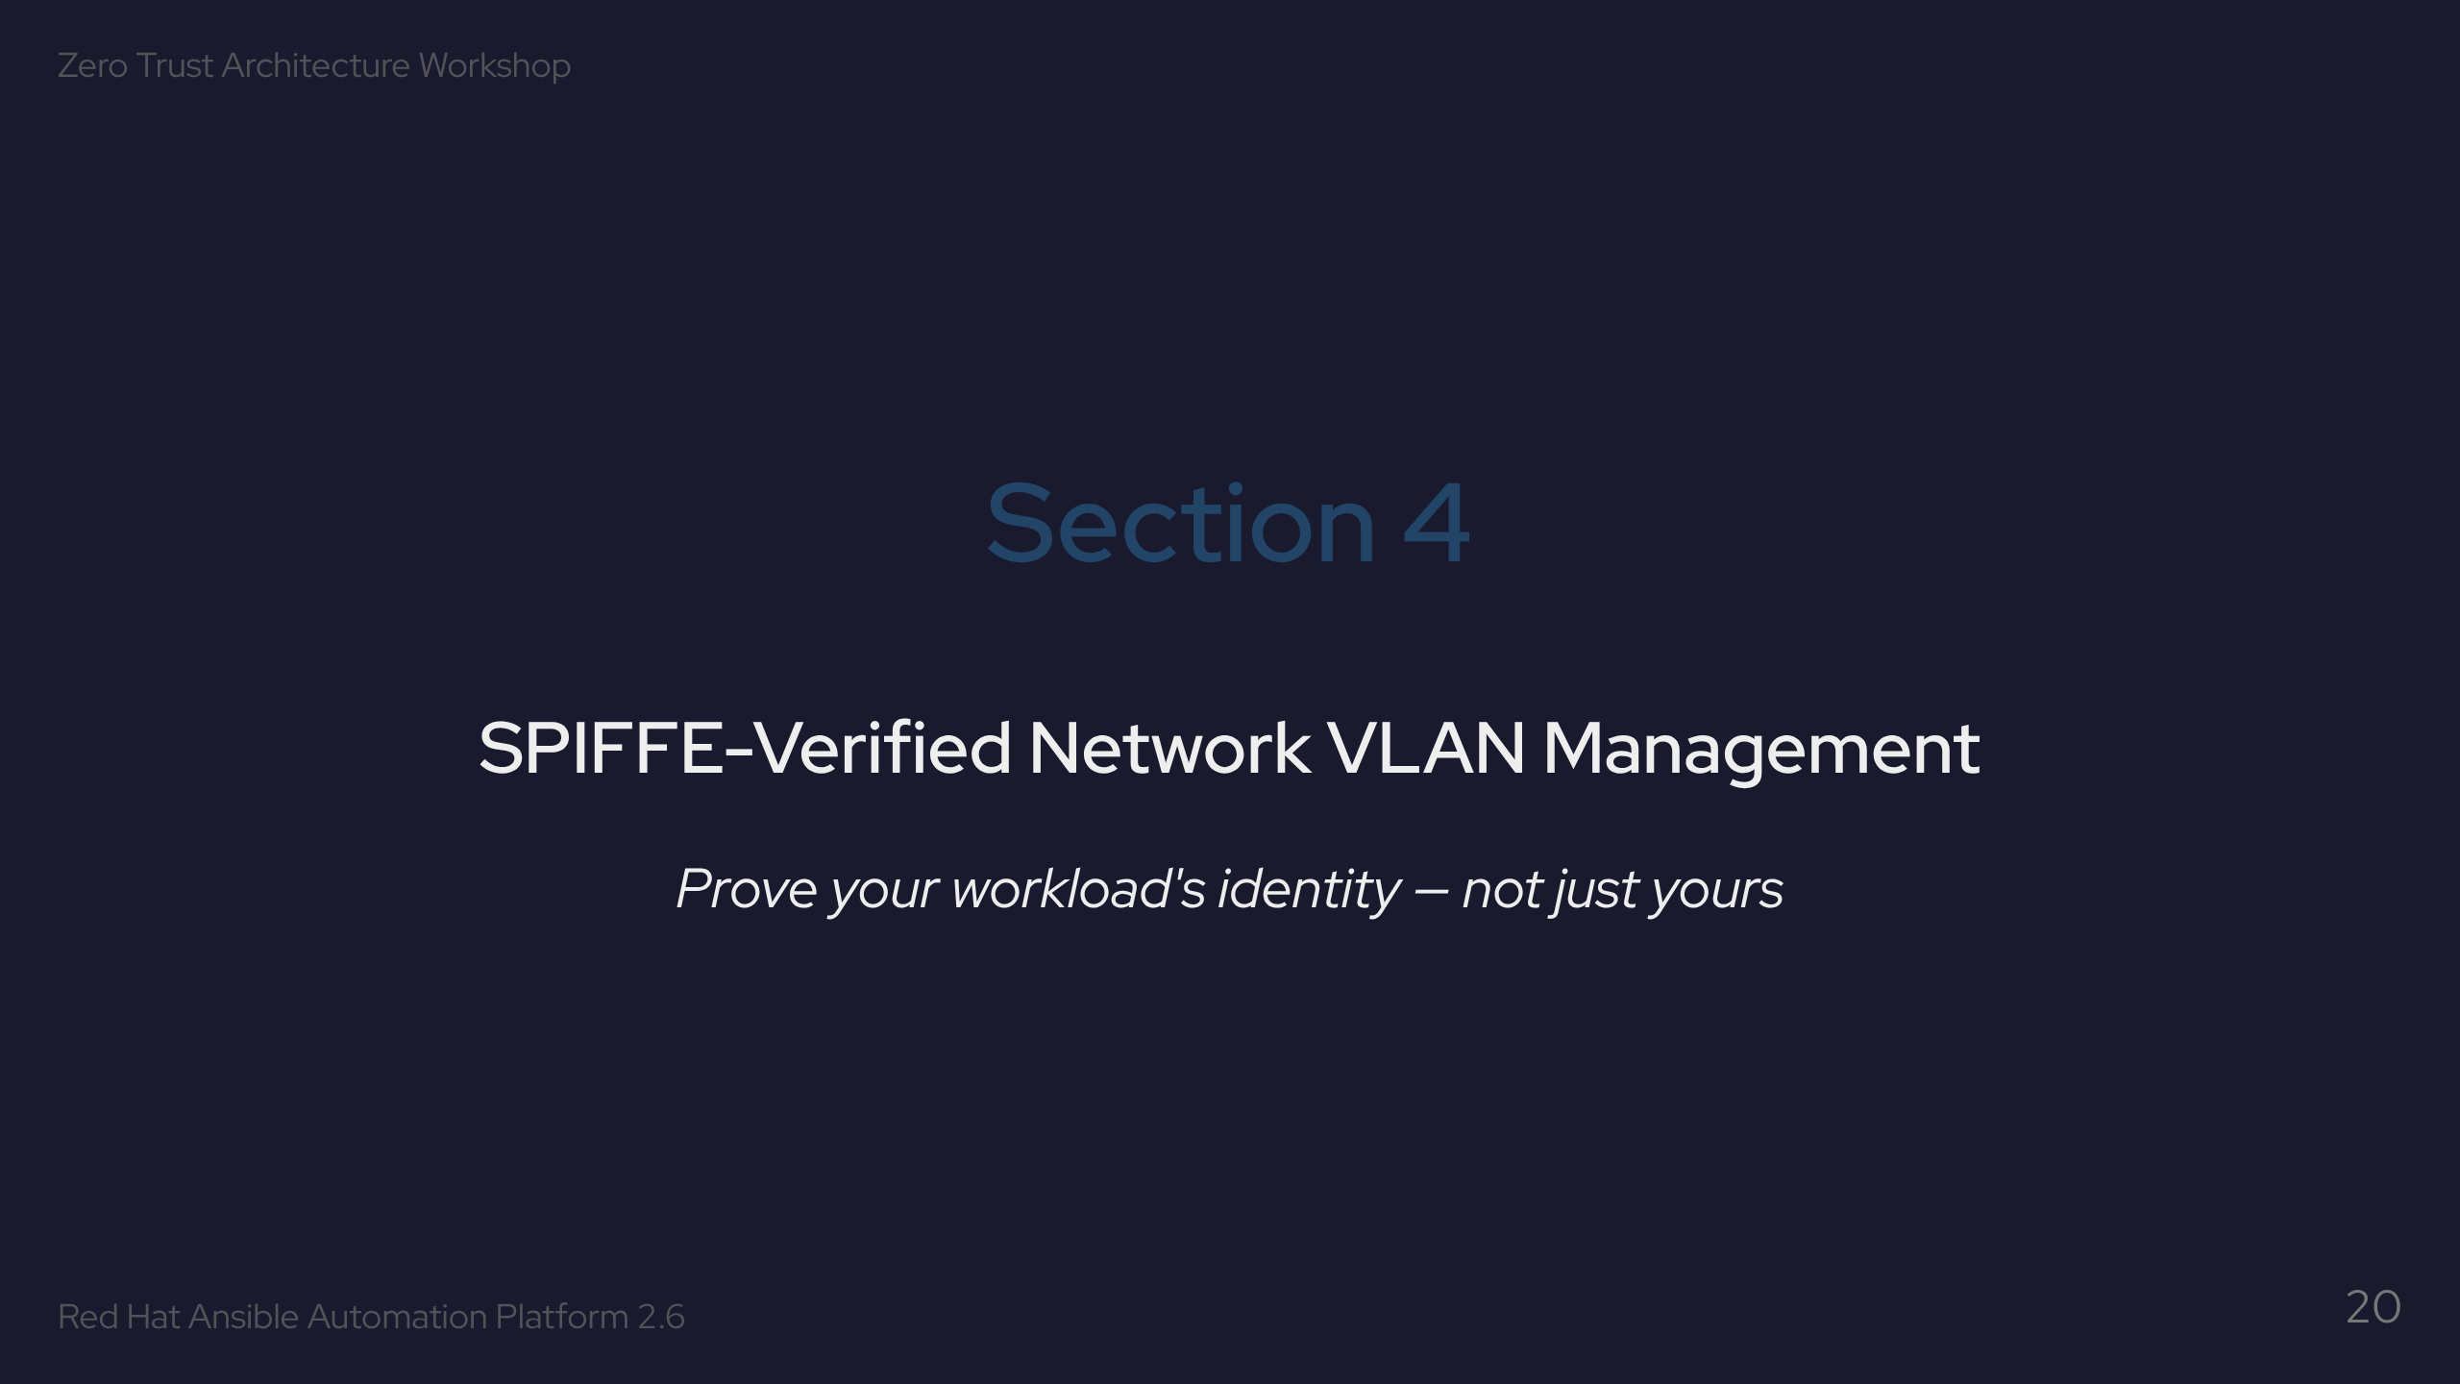

Slide 21
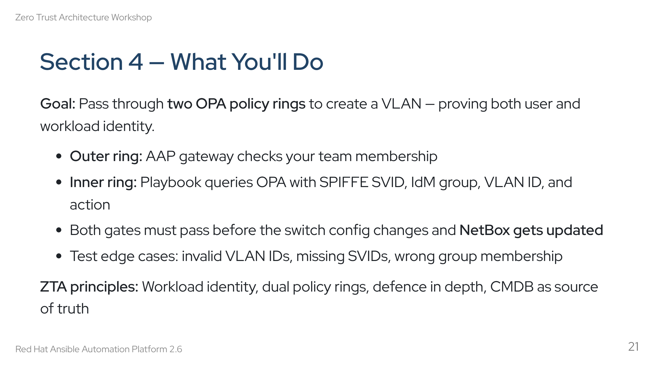
Notes:
Speaker notes: This is the most layered exercise. Two OPA checks, not one. The SPIFFE SVID proves that the *automation platform itself* is legitimate — not just the user. An attacker who somehow fakes a user login would still fail the workload identity check. The NetBox update at the end means the CMDB is always in sync with reality.

Slide 22
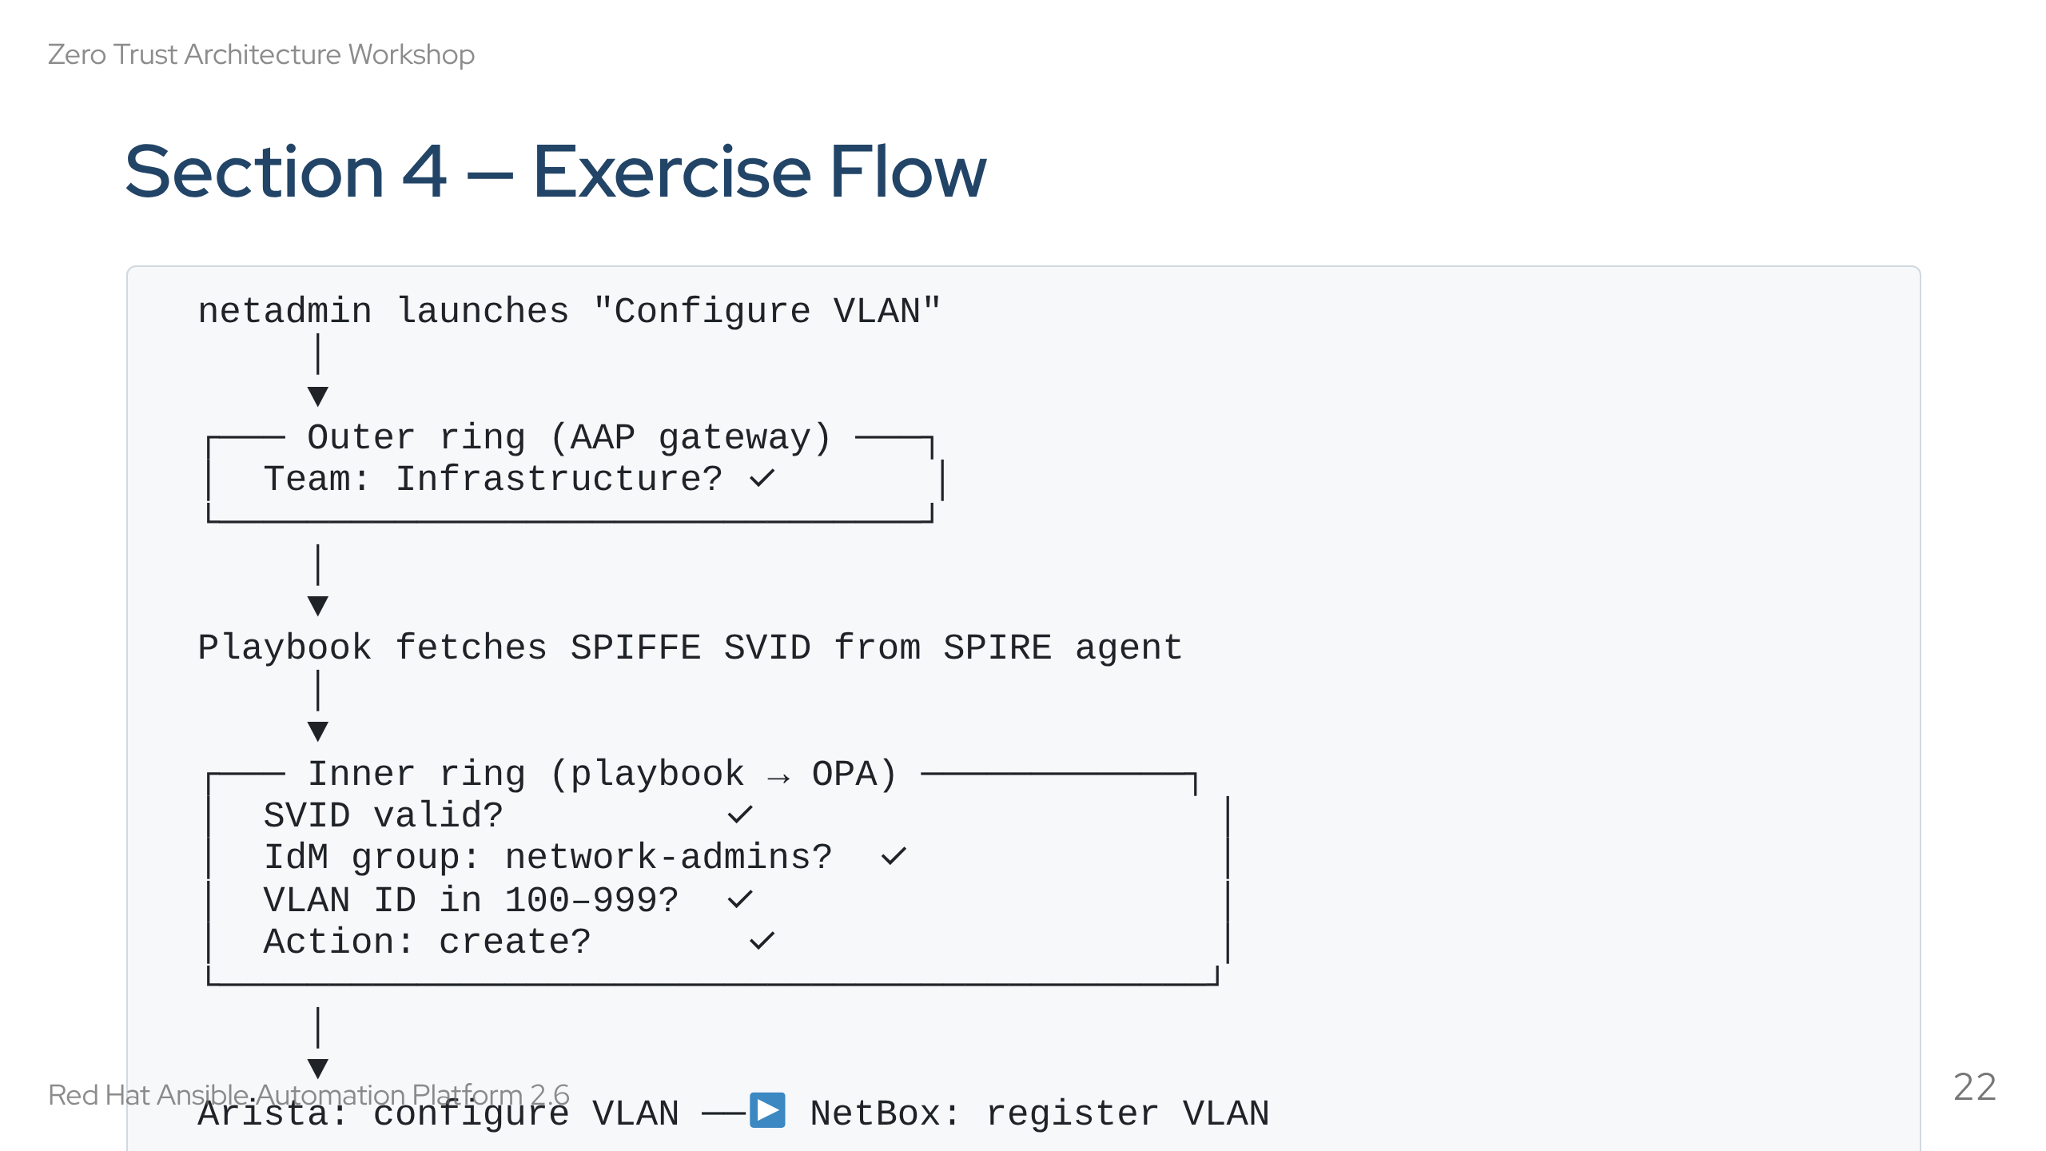
Notes:
Speaker notes: Walk through both rings. Outer ring is the same OPA gateway as Section 3. Inner ring is different — it's a playbook task that calls OPA with a richer input (SVID, group, VLAN ID). The VLAN range check (100-999) is enforced by OPA, not by Ansible. Students will test invalid values. NetBox update at the end ensures the CMDB stays in sync with the actual switch config.

Slide 23
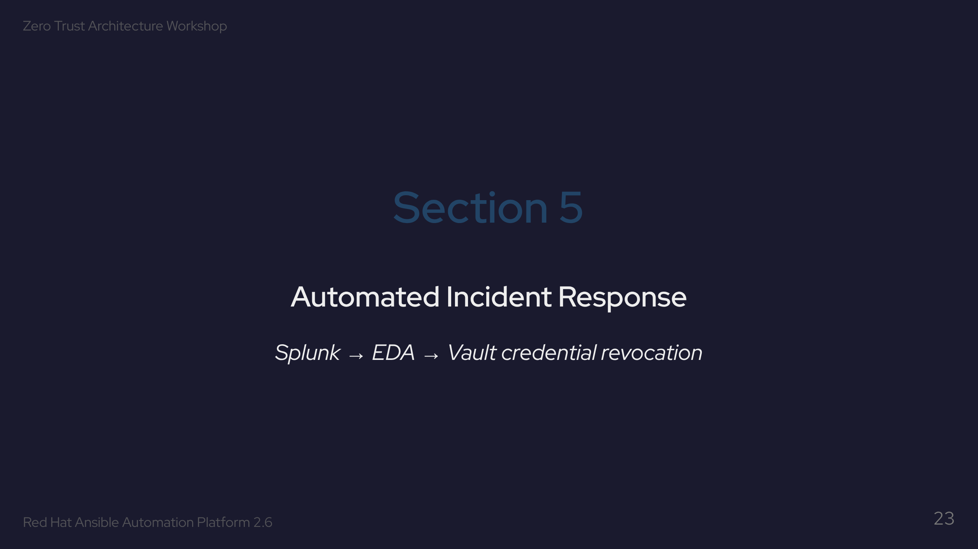

Slide 24
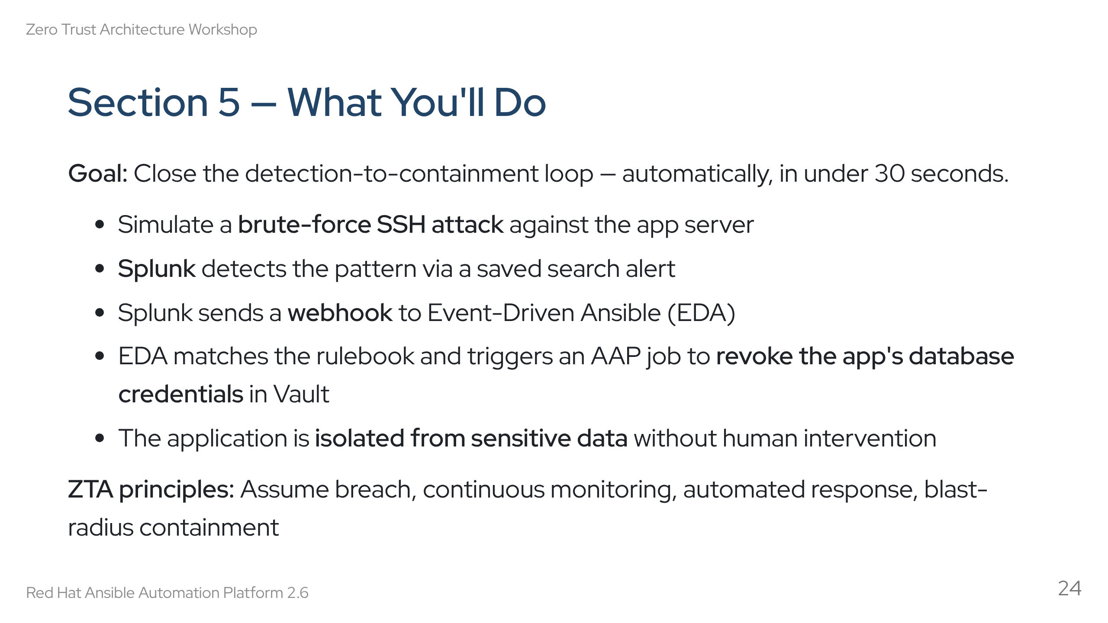
Notes:
Speaker notes: This is the "assume breach" exercise. The attack succeeds (SSH brute force) but the response is automated. Credential revocation happens in Vault — the app loses its DB connection immediately. The key metric: time from detection to containment. Target is under 30 seconds. Requires Section 2 to be complete (app must be deployed with active DB credentials to revoke).

Slide 25
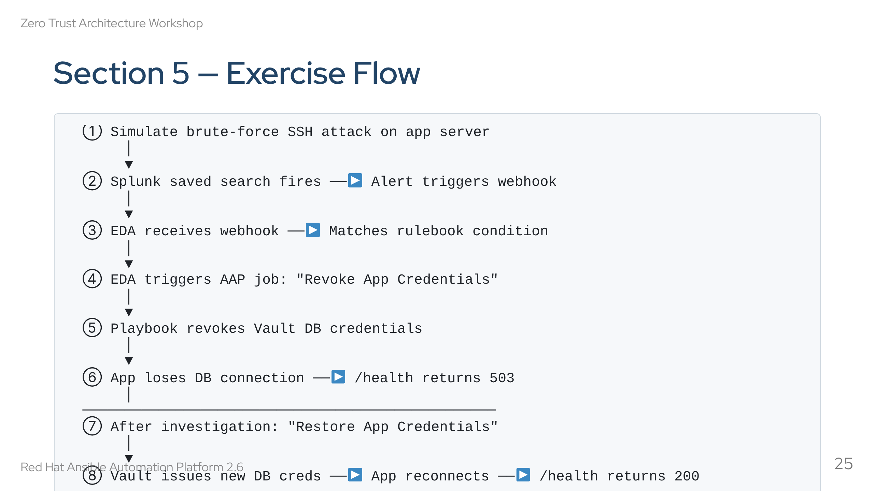
Notes:
Speaker notes: Walk through the numbered steps. Steps 1-6 happen automatically. The restore step (7-8) is manual and deliberate — you investigate first, then restore. The EDA rulebook is in extensions/eda/rulebooks/splunk-credential-revoke.yml. The webhook token is stored in Vault and attached to the EDA event stream credential.

Slide 26
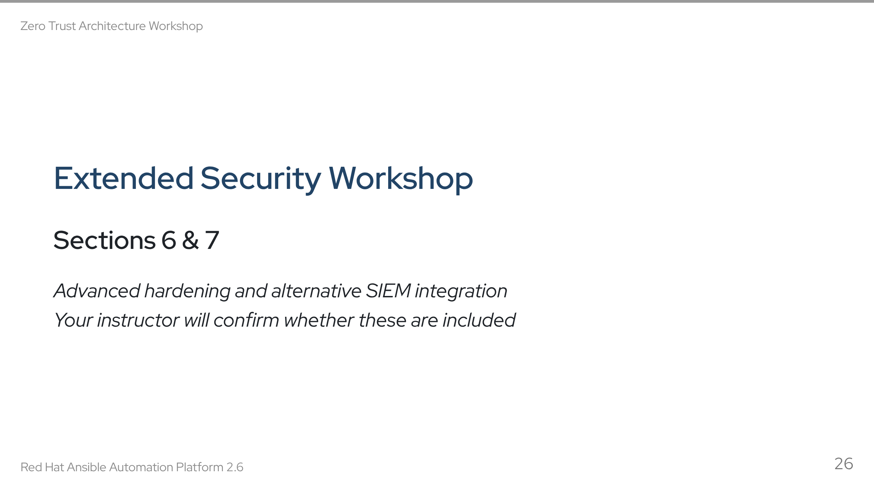

Slide 27
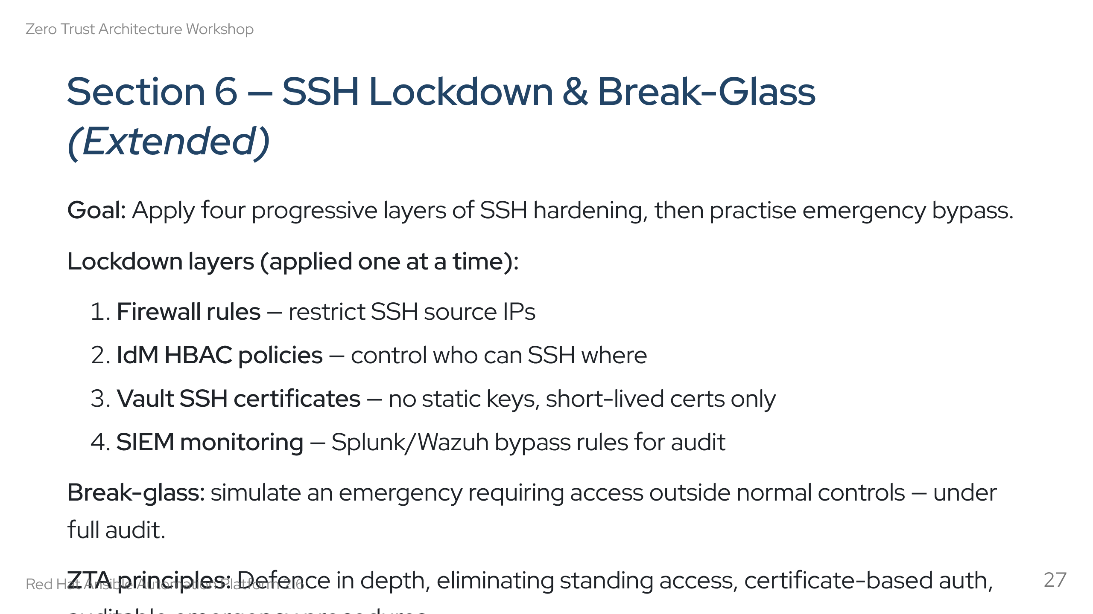
Notes:
Speaker notes: Each layer is a separate playbook in setup/ssh_lockdown/. The point is defence in depth — if one layer fails, the others still hold. The break-glass scenario is important: Zero Trust doesn't mean "no access ever" — it means "access under strict conditions with full audit trail."

Slide 28
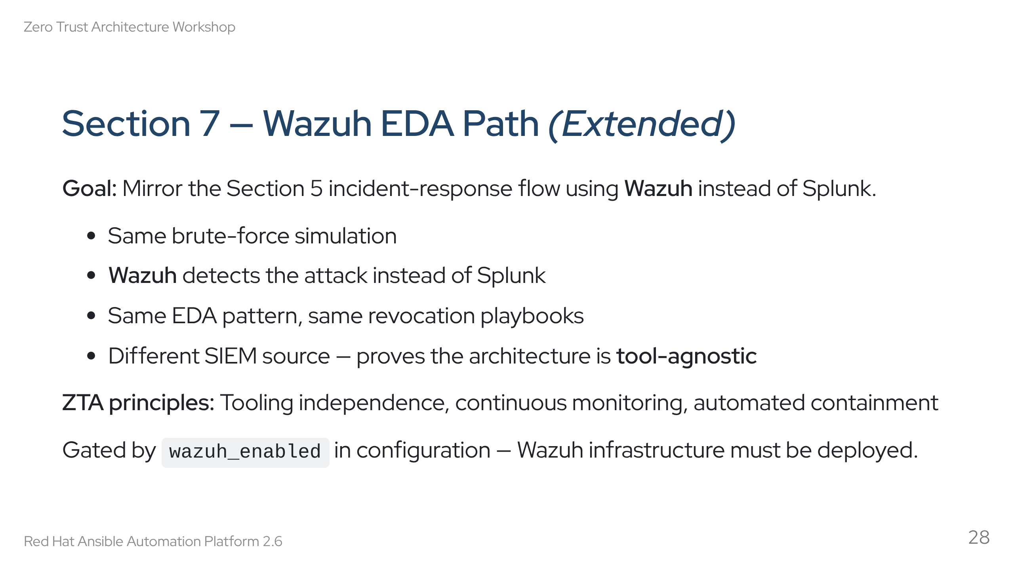
Notes:
Speaker notes: This demonstrates that the ZTA architecture isn't locked to a specific SIEM. Swap Splunk for Wazuh — the EDA pattern and revocation playbooks are the same. The only difference is the detection source and the webhook format. This is important for organisations evaluating different SIEM platforms.

Slide 29
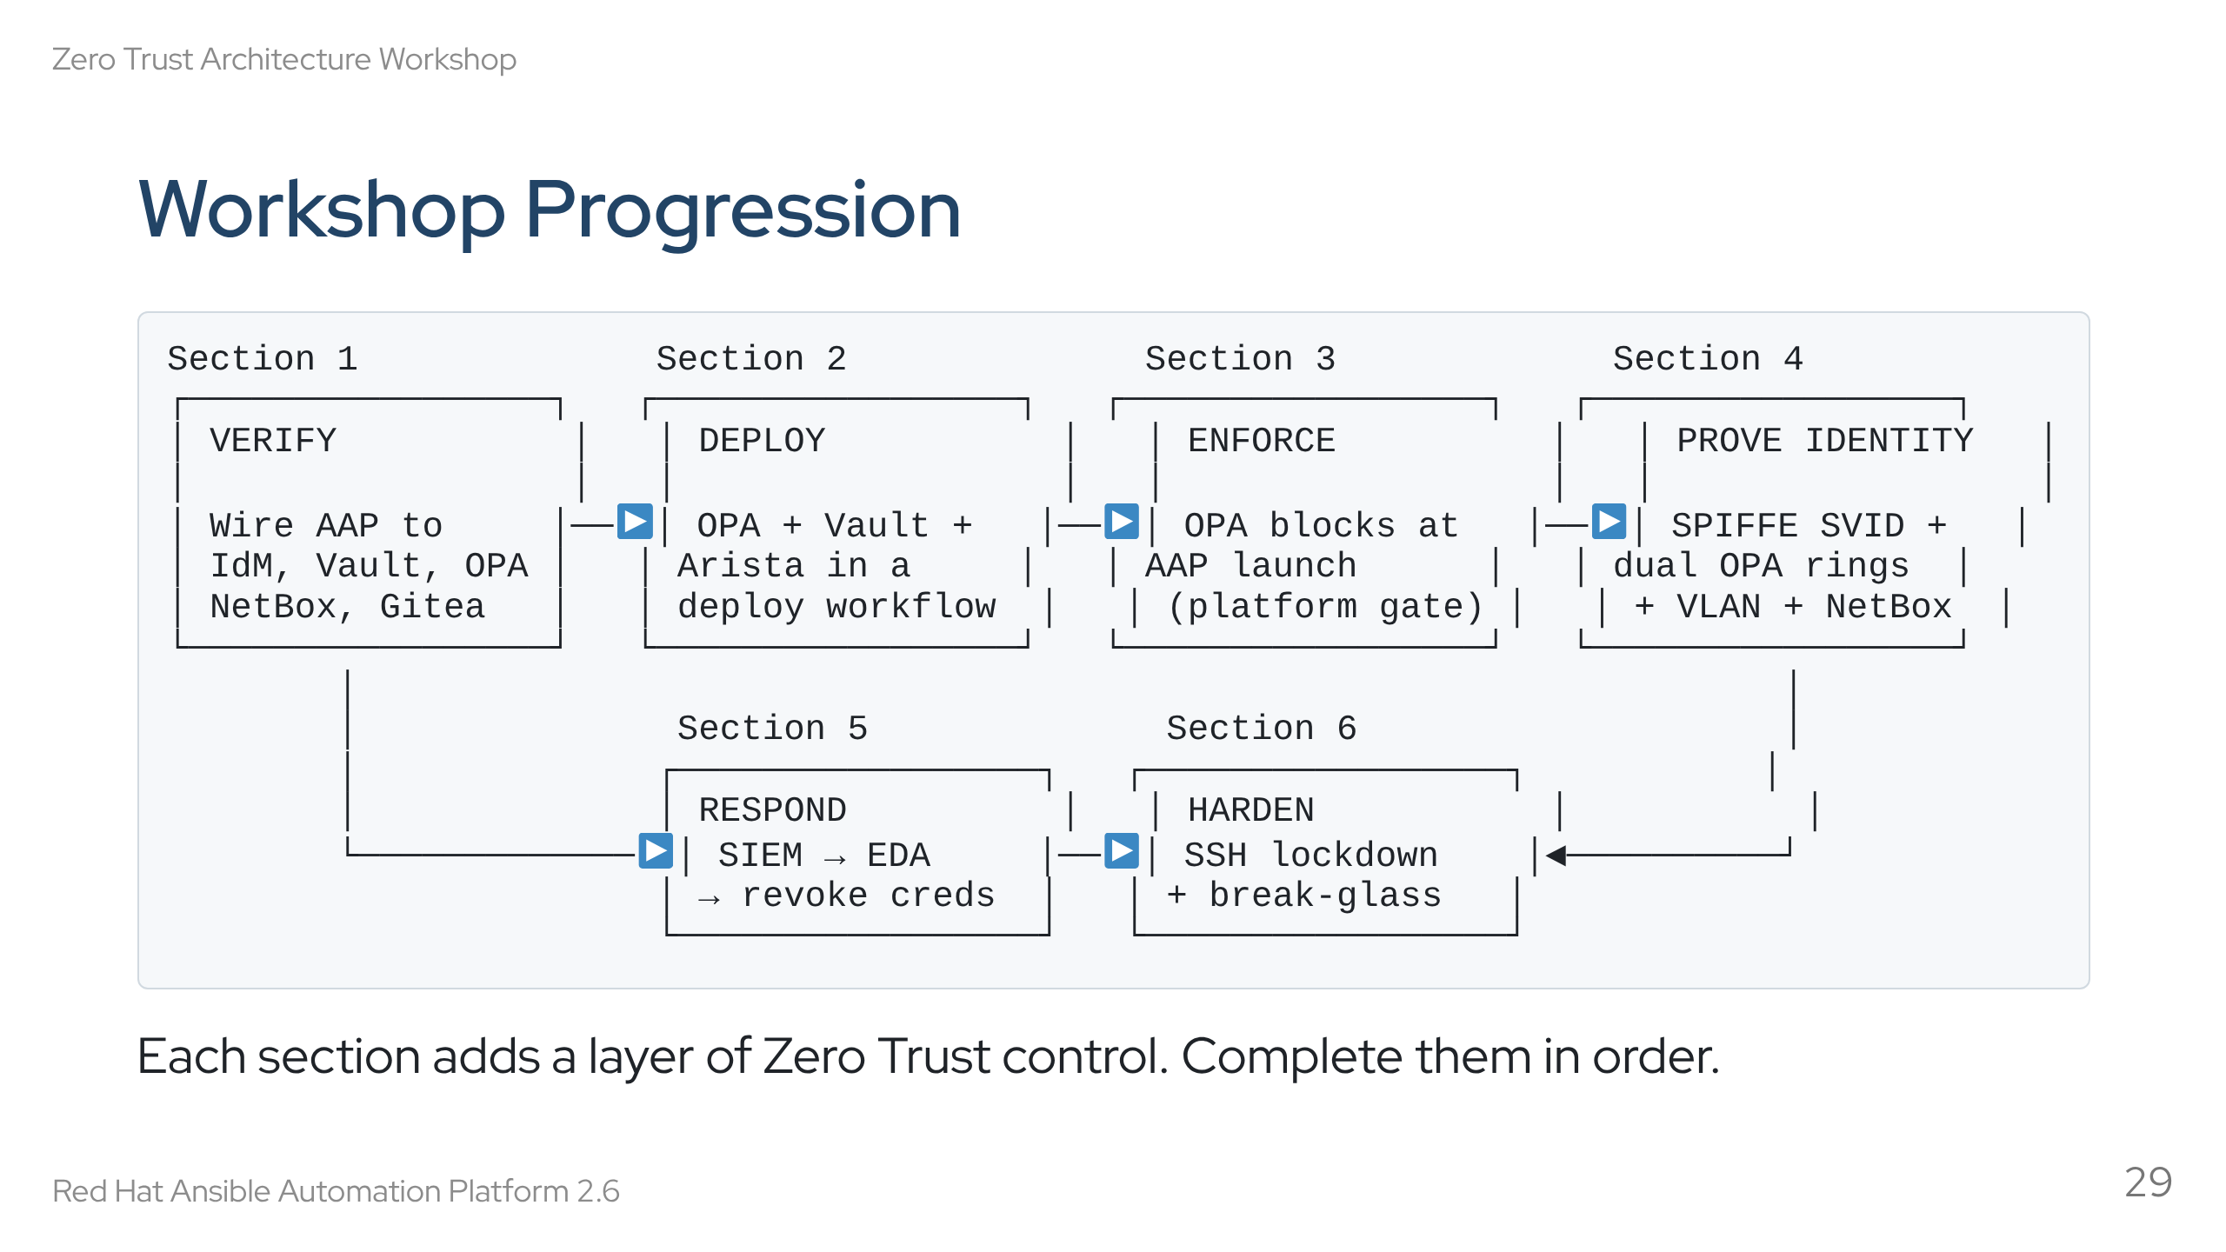
Notes:
Speaker notes: Use this as a map. Two tracks from Section 1: the main track (1→2→3→4→6) and the incident response track (1→5→6). Both converge at Section 6 (hardening). Emphasise the progressive layering — by Section 5 you have the full detection-to-response loop.

Slide 30
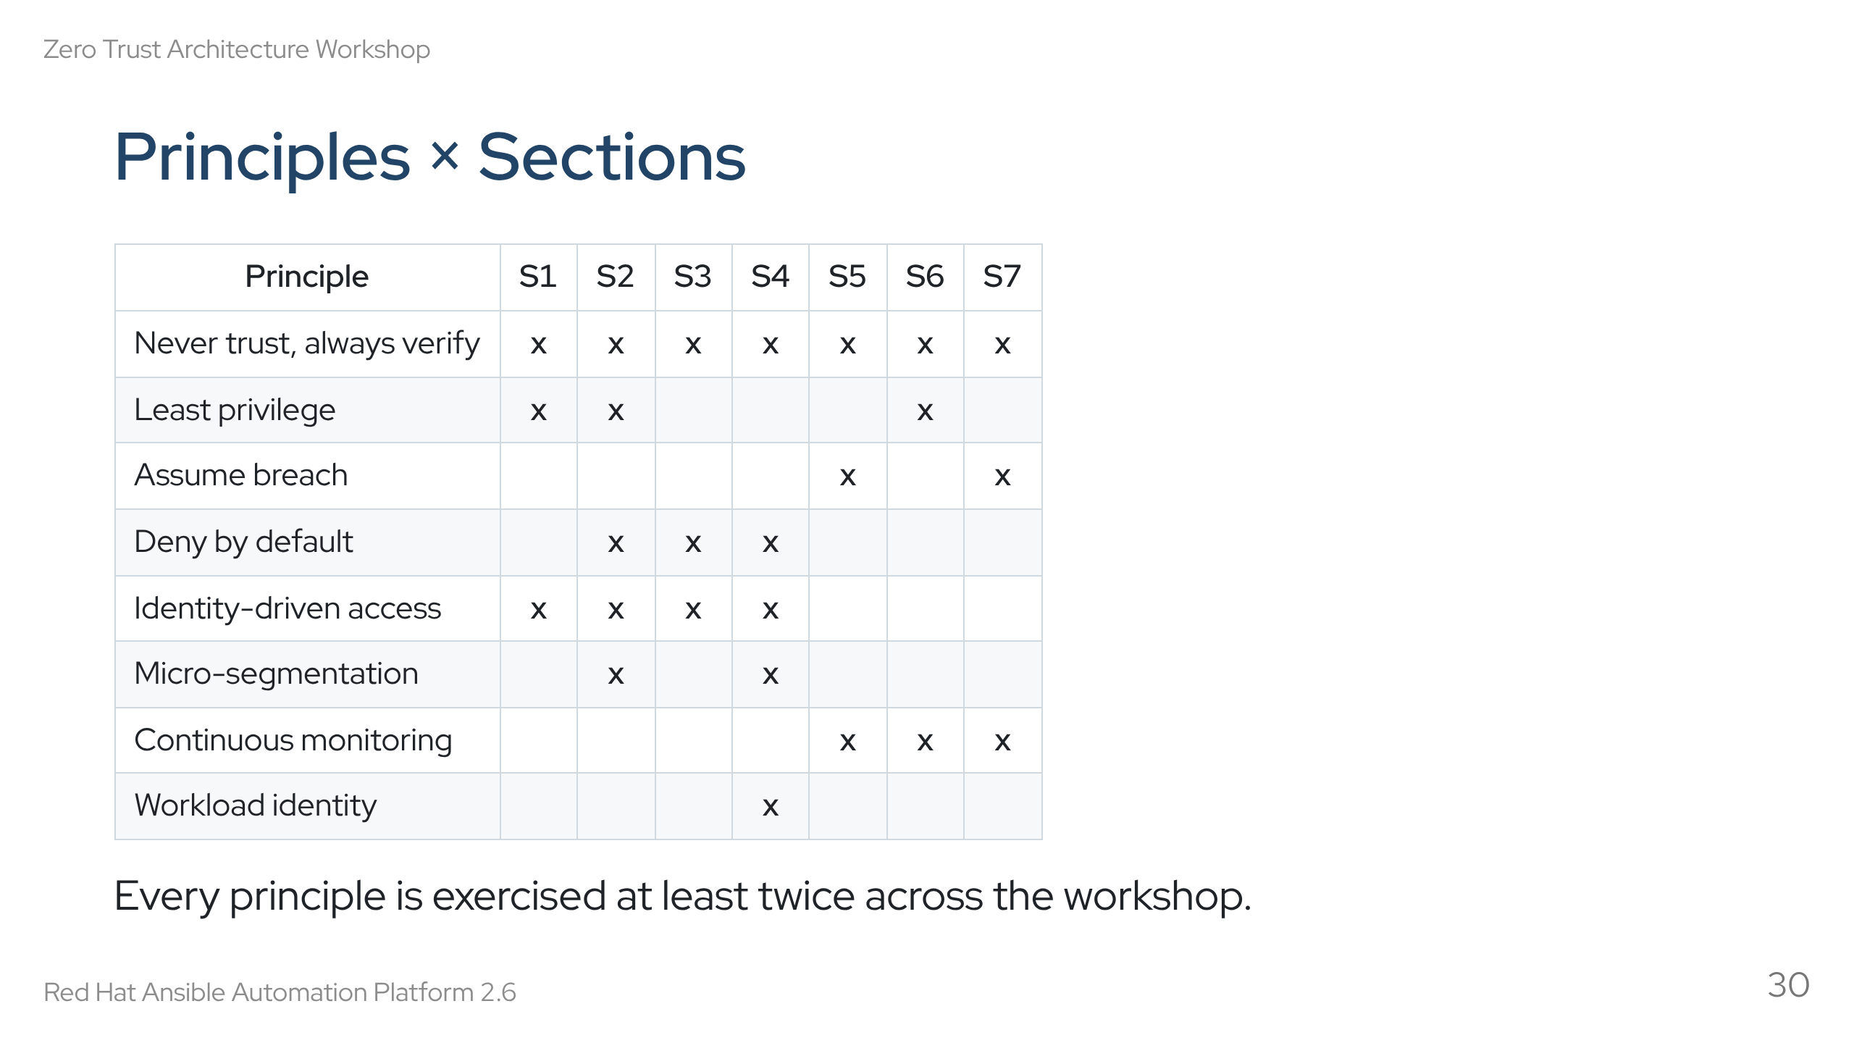
Notes:
Speaker notes: Use this as a recap. Walk across the columns, not down the rows. Highlight that "never trust, always verify" appears in every section — it's the foundation. "Workload identity" is concentrated in Section 4 because SPIFFE is introduced there. This matrix can help justify which sections to include in a time-limited session.

Slide 31
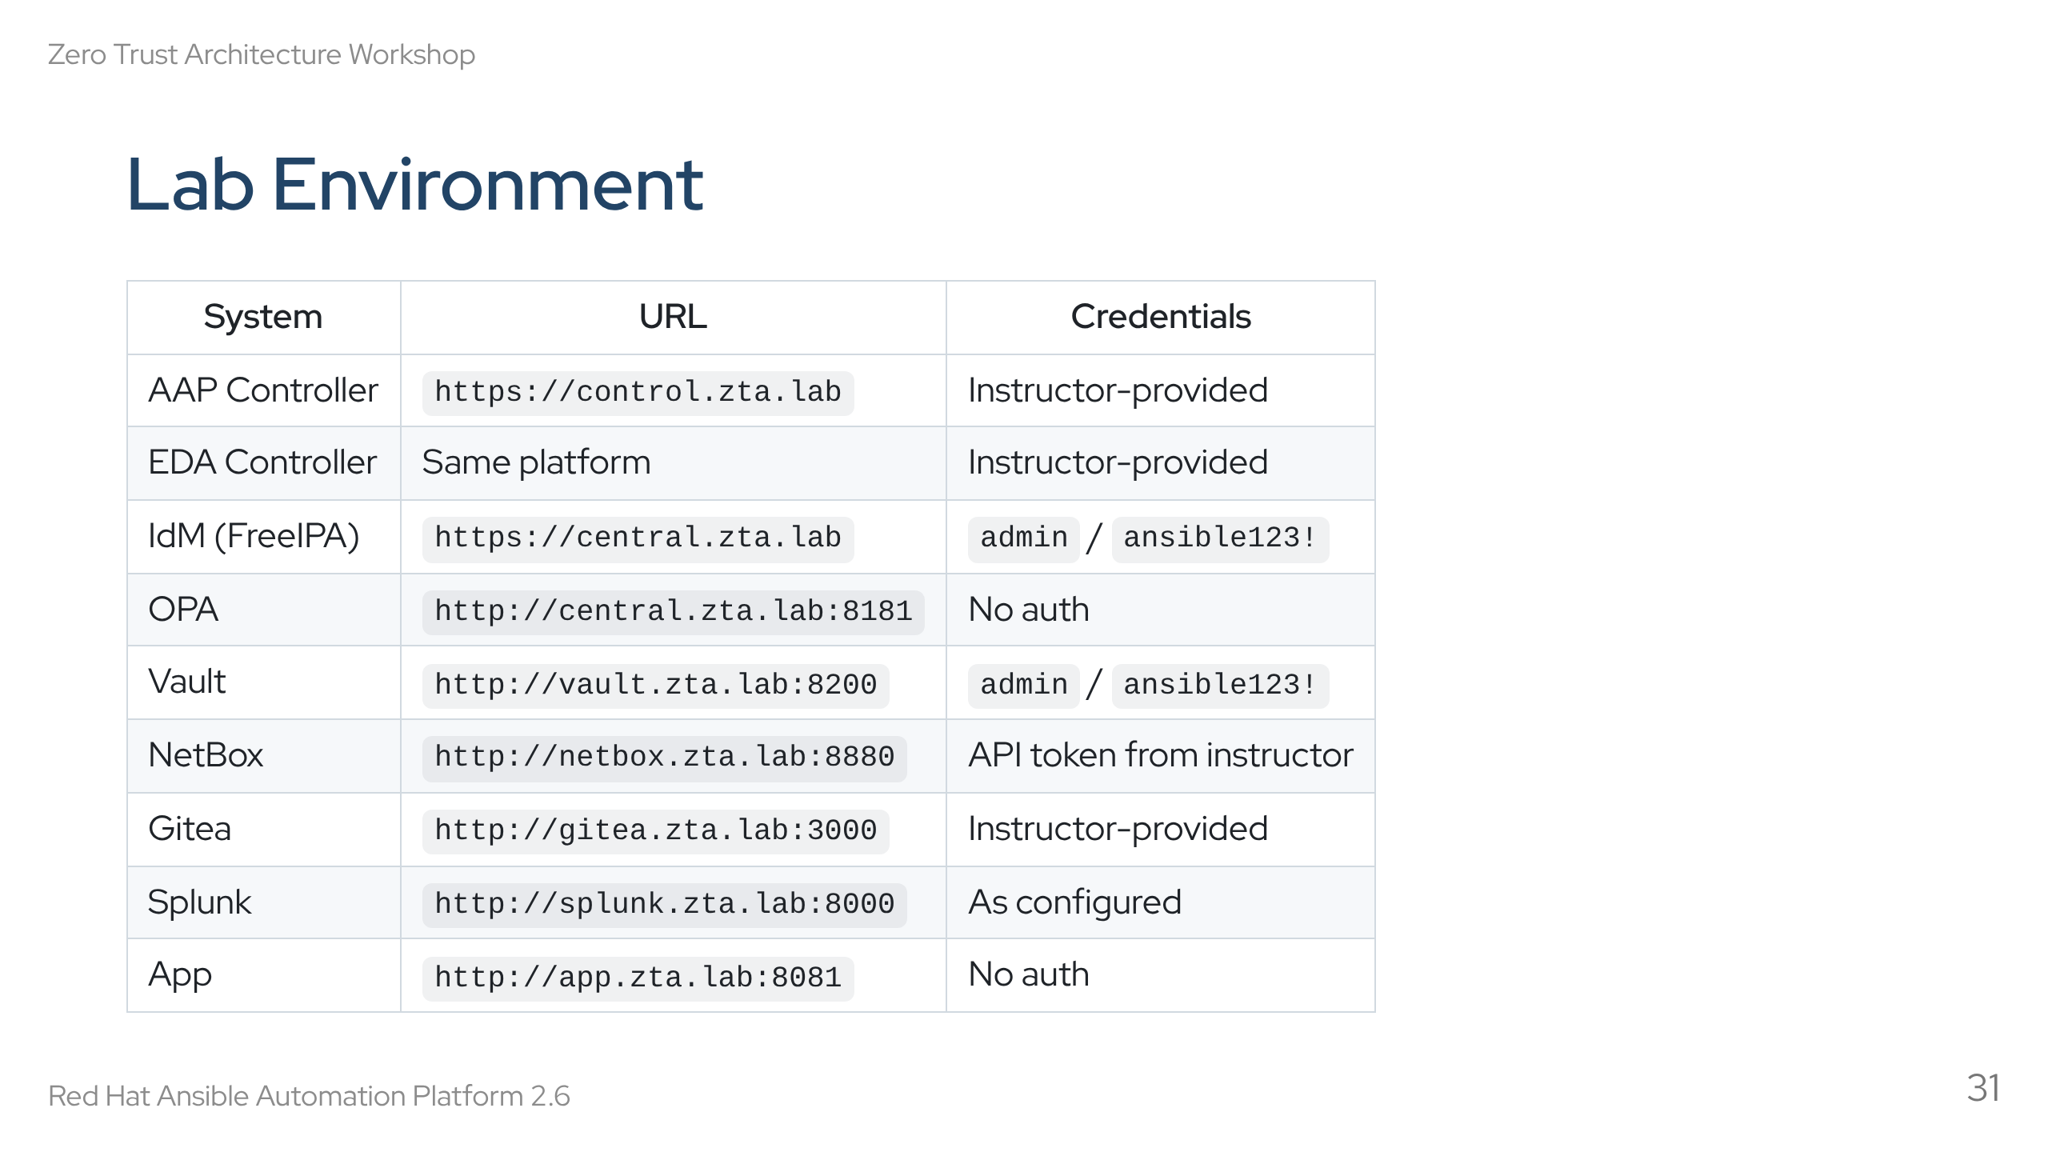
Notes:
Speaker notes: Review the access info. Students should confirm they can reach the AAP controller first. All IdM user passwords are ansible123! — this is a disposable lab, not production. Vault is HTTP (not HTTPS) in the lab for simplicity.

Slide 32
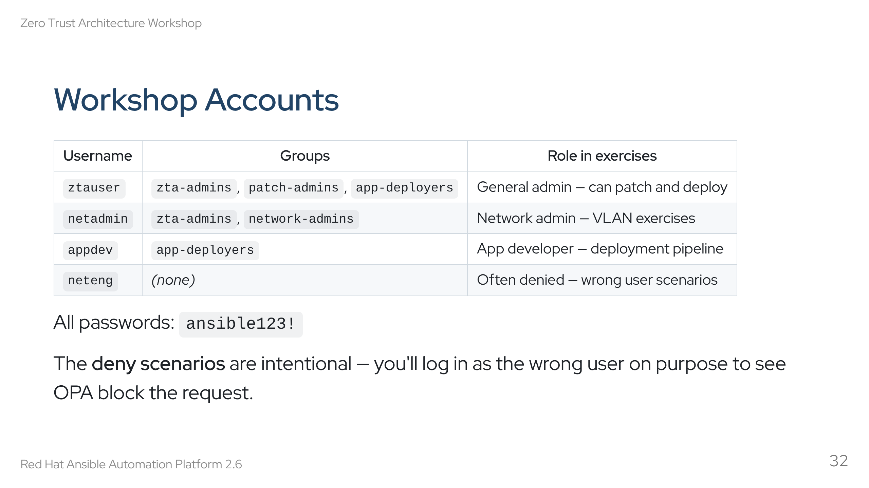
Notes:
Speaker notes: ztauser is the "happy path" account — can do most things. neteng is the "unhappy path" — used to show what happens when policy denies access. appdev is scoped to deployments only — can't patch or manage VLANs. netadmin is for Section 4 VLAN exercises. Students will switch between accounts to experience both allowed and denied paths.

Slide 33
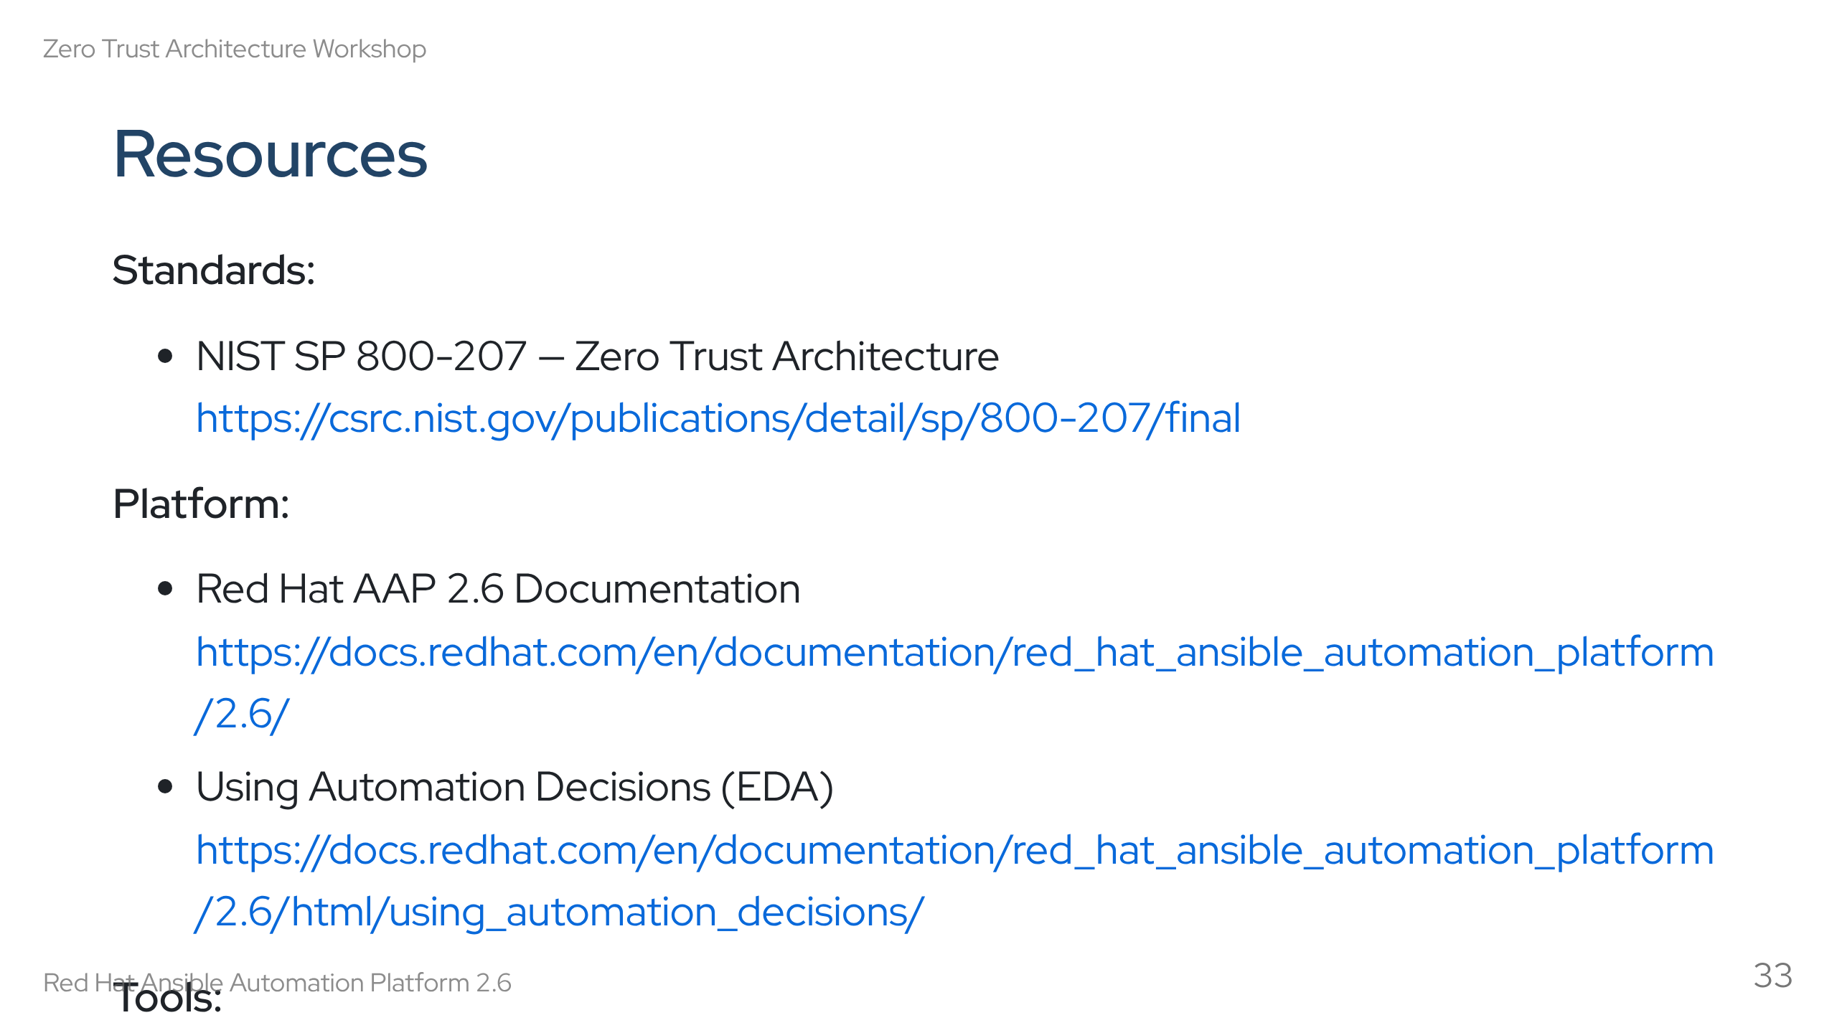
Notes:
Speaker notes: These are reference links for after the workshop. The AAP 2.6 docs are particularly important — Policy as Code is Chapter 7.4 of "Configuring automation execution". NIST 800-207 is a readable 50-page PDF — recommend it for anyone building a ZTA business case.

Slide 34
