Slide 1



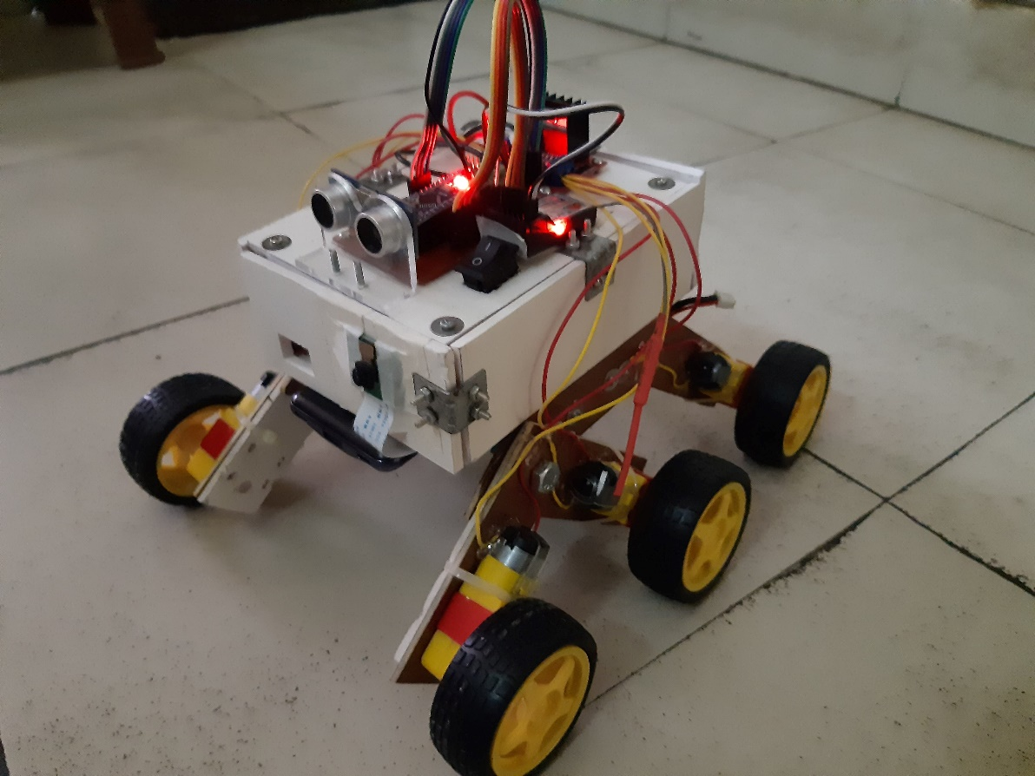
TEAM INFORMATION
Md. Saif Ahammod Khan
1721779642
Nasim Mahmud Mishu
1721387042
Ridwanul Haque 1721144042
Course: Cse323
Project Name: Disaster Bot
Submitted to: Dr. Nova Ahmed
DEX_BOT

Slide 2
Disaster Strucked Environment Condition Analysis
Motivation:
The main purpose to develop Dex-Bot is, it can respond quickly and effectively. Also can explore collapsed building or affected area and locate victims in there, and can analyze the condition of the environment of the affected area.
Introduction:
We introduce Dex-Bot as Disaster Exploring Robot. The robot is designed to explore collapsed building or any affected area where any victim is stuck and initially a rescue team cannot rescue or send help without locating the victim, there our Dex-Bot start its work. Here,
Arduino Nano is working as the main control unit of Dex-Bot.
Live stream using Raspberry Pi to know the surrounding and locate victim in affected area
Differential Wheel to run on rough terrain.
Two way Control system, Autonomous and Manual Control.
Node MCU to store sensor values in Real Time DataBase.
FireBase to main DataBase.
Android App to show Real time location and Environment Condition analysis by showing different sensor value.
Dex-Bot C-Section:
We have mainly divide Dex-Bot in 5 different sections to do the work done.
1. Design 2.Control 3.Sensor handle using Node MCU 4.Database and Android App 5.Live stream using Raspberry pi

Slide 3
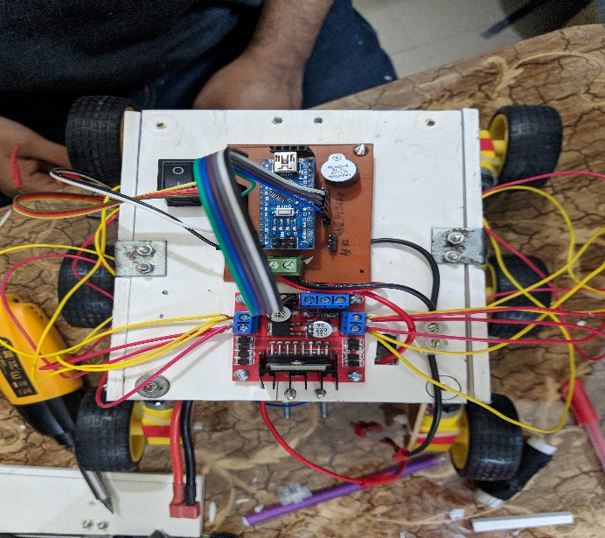
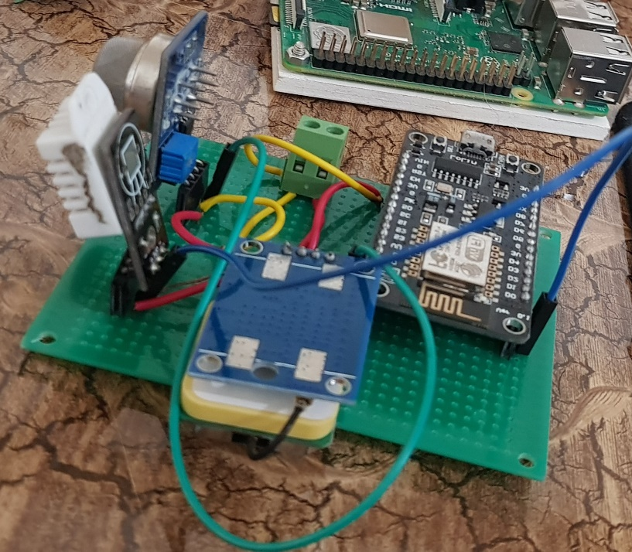
Design:
We have used Differential Wheel system to run the Dex-Bot in rough terrain.
We have PCB to make the Bot compact.
It will have a buzzer if the bot got disconnected we can rescue the bot by the alarm or we can get near to the victim by following the alarm.
Sensor handle using Node MCU:
Sensor used:
Temperature
Gas and
GPS
Node MCU is main board in Dex-Bot operating sensors. Instead using Arduino we are using Node MCU to analysis the disaster environment as in the same we are pushing the sensors data and location to our Real Time Database.

Slide 4

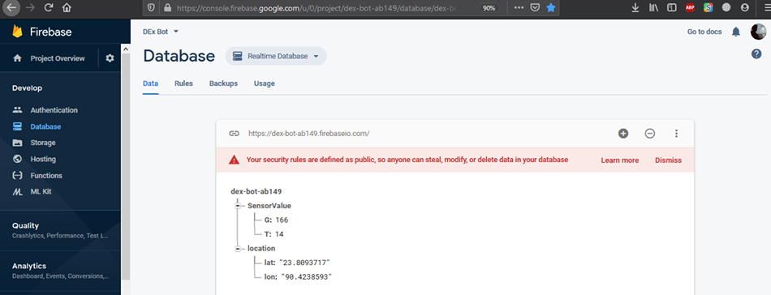
Control:
We used Arduino Nano as main control board and L298 motor driver to pass the voltage to the motor.
We devided main control system in 2 ways.
Autonomous : Using Ultrasonic sonar sensor by avoiding obstacle we make the bot autonomous with Arduino programe.
Maual control: Using FlySky FS-CT6B 2.4GHz 6 Channel Transmitter and Receiver Radio System we can control the Bot manually with Arduino programe if needed.
Database and Android App:
Firebase: we have used firebase to store all our sensor value to our Realtime database.

Slide 5
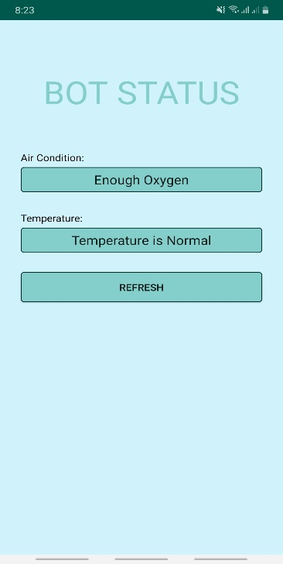
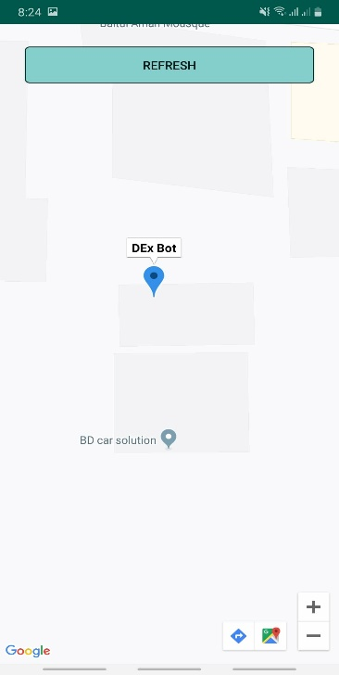
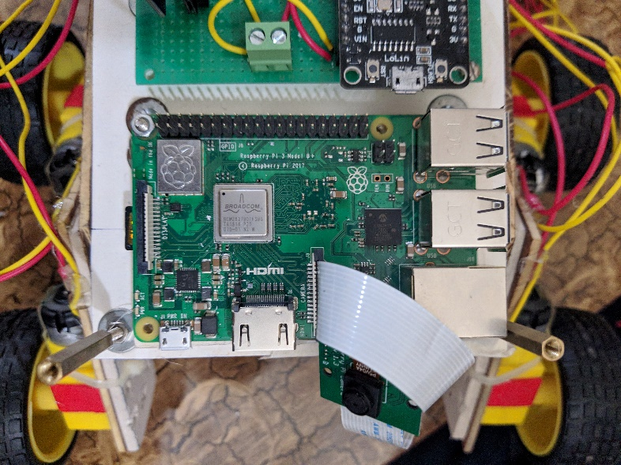
Android: We have build an android app to have Real time location of our robot. And using the data stored in Firebase we show them in the app to analysis the victim condition or environment.
Live stream using Raspberry pi:
VNC viewer we have used to stream live video using Raspberry pi Camera with Raspberry pi if we need to see the disaster area or to find victims.
VLC media player to watch the live stream.

