Slide 1

Spatio-temporal dynamics of regional mortality in EU Member States between 2002 and 2016
Rok Hrzic¹, Tobias Vogt², Helmut Brand¹
1. Maastricht University, Department of International Health, Care and Public Health Research Institute (CAPHRI)
2. University of Groningen, Population Research Centre
30 November 2018

Slide 2
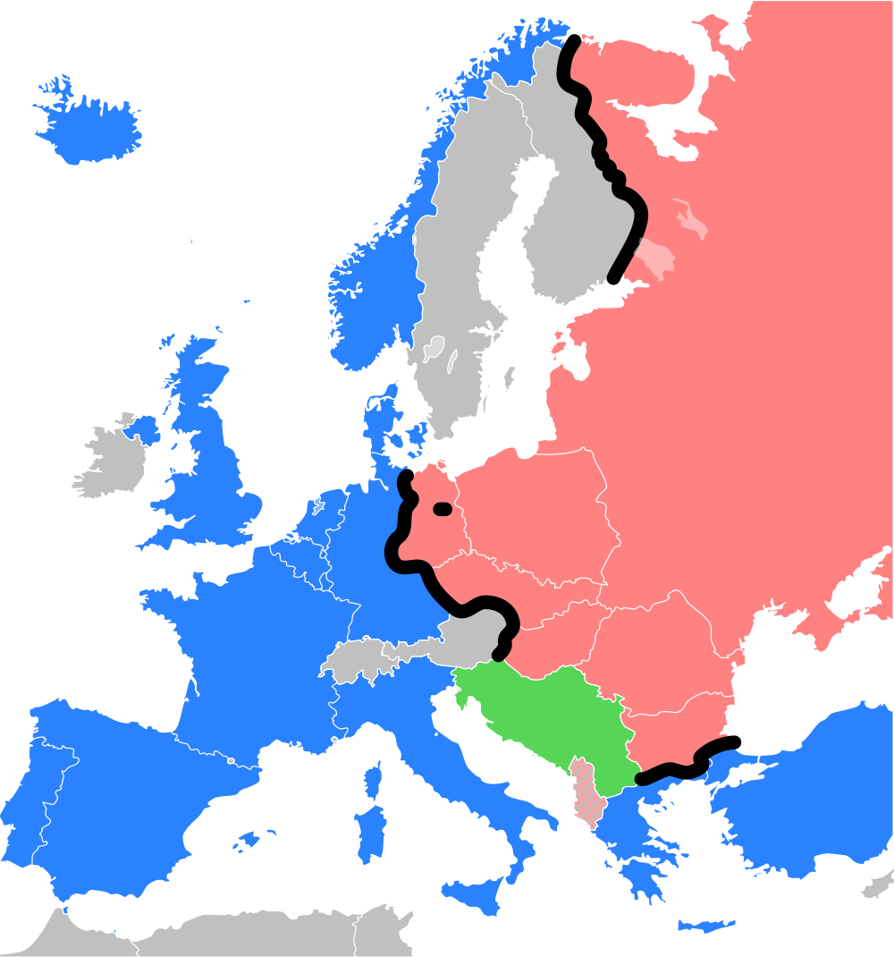
Background
Low mortality in middle and old age
High mortality in middle and old age

Slide 3
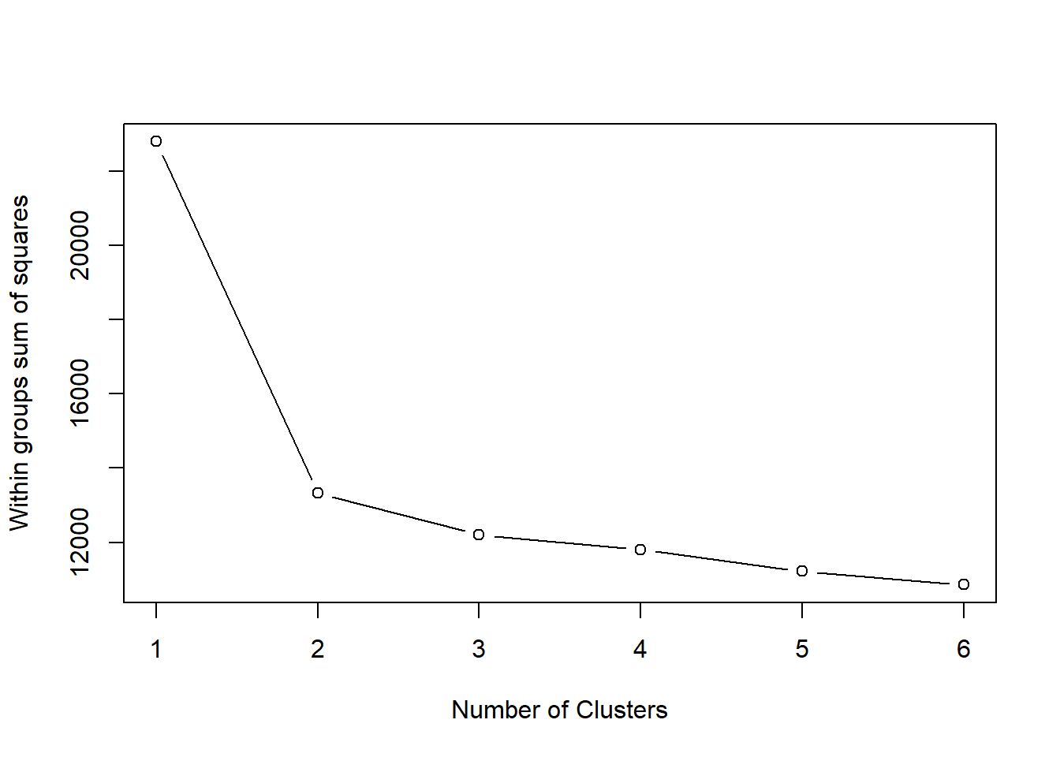
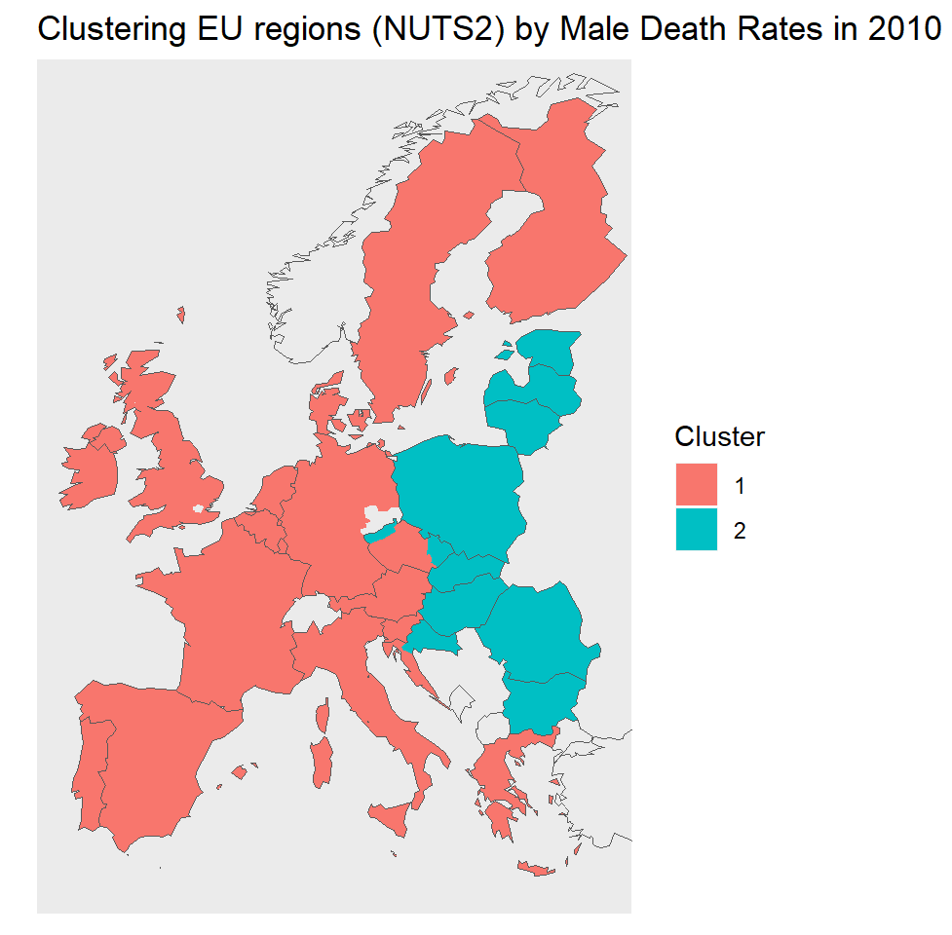
Methods
Elbow plots
were used to determine
optimal cluster number
Eurostat
regional male mortality
K-means clustering algorithm
aims to group observations (regions) into clusters in which each observation belongs to the cluster with the nearest mean.
Region
Years
Age
Eurostat
regional female mortality
Region
Years
Age
Choropleths
were examined to determine the
position of the east-west border

Slide 4
Results

Slide 5
Key messages
We examined the borders of the east-west EU mortality gap using K-means clustering of regional data
We found a persistent, yet changing low regional mortality border that does not precisely reflect political borders between western and CEE Member States

