Slide 1
CSE 115 Programming Language I
Instructor: Rummana Rahman
Sr. Lecturer
North South University

Slide 2
Lecture 12 Special String Functions (Requiring <string.h> )

Slide 3
strlen() example
#include <stdio.h>
#include <string.h>
int main()
{ char someStr[100] = "I love Bangladesh";
int n;
n = strlen(someStr);
printf("Length of %s = %d\n",someStr, n);
gets(someStr);
n = strlen(someStr);
printf("Length of %s = %d\n",someStr, n);
n = strlen("Hello world");
printf("Length of Hello world = %d\n",n);
return 0;
}

Slide 4
String Assignment
Strings can not be assigned using the assignment operator ‘=’.
char str[20]= “Test String”; valid
But,
char str[20];
str = “Test String”; not valid.
String copy
strcpy(destination, source)

Slide 5
Function strcpy()
Function strcpy copies source string into the destination string.
char dest[15];
The null character is appended at the end automatically.
If source string is longer than the destination string, the overflow characters may occupy the memory space used by other variables.
dest
0 | 1 | 2 | 3 | 4 | 5 | 6 | 7 | 8 | 9 | 10 | 11 | 12 | 13 | 14

Slide 6
Function strcpy()
Function strcpy copies source string into the destination string.
char dest[15];
strcpy(dest, “test string”);
The null character is appended at the end automatically.
If source string is longer than the destination string, the overflow characters may occupy the memory space used by other variables.
0 | 1 | 2 | 3 | 4 | 5 | 6 | 7 | 8 | 9 | 10 | 11 | 12 | 13 | 14
t | e | s | t |  | s | t | r | i | n | g | \0 | \0 | \0 | \0
dest

Slide 7
Function strncpy()
Function strncpy copies source string into the destination string by specifying the number of characters to copy.
char dest[15];
-If source string is longer than the destination string, the overflow characters are discarded automatically.
dest
0 | 1 | 2 | 3 | 4 | 5 | 6 | 7 | 8 | 9 | 10 | 11 | 12 | 13 | 14

Slide 8
Function strncpy()
Function strncpy copies source string into the destination string by specifying the number of characters to copy.
char dest[15];
strncpy(dest, “test string”, 6);
If source string is longer than the destination string, the overflow characters are discarded automatically.
0 | 1 | 2 | 3 | 4 | 5 | 6 | 7 | 8 | 9 | 10 | 11 | 12 | 13 | 14
t | e | s | t |  | s
dest

Slide 9
Function strncpy()
Function strncpy copies source string into the destination string by specifying the number of characters to copy.
char dest[15];
strncpy(dest, “test string”, 6);
dest[6] = ‘\0’;
You have to place the null character manually.
If source string is longer than the destination string, the overflow characters are discarded automatically.
0 | 1 | 2 | 3 | 4 | 5 | 6 | 7 | 8 | 9 | 10 | 11 | 12 | 13 | 14
t | e | s | t |  | s | \0
dest

Slide 10
strcpy and strncpy example
#include <stdio.h>
#include <string.h>
int main( )
{
char source[ ] = "fresh2refresh";
char target[20]= "";
printf("source = %s\n", source);
printf("target = %s\n", target);
strcpy(target, source);
printf("target after 1st strcpy( ) = %s\n", target);
strcpy(target, "***************");
printf("target after 2st strcpy( ) = %s\n", target);
strncpy(target, source, 6);
printf("target after strncpy( ) = %s\n", target);
target[6] = '\0';
printf("target after target[6] = '\\0' = %s\n", target);
return 0;
}

Slide 11
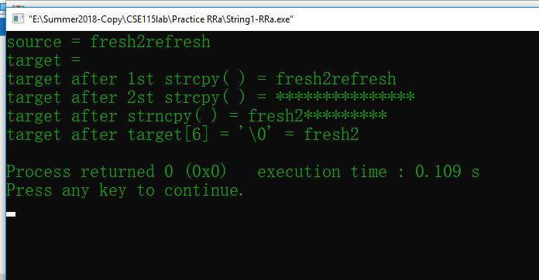
Result

Slide 12
String Appending
Strings can not be appended using the addition operator ‘+’.
str = “Test” + “String”; not valid.
String concatenation
strcat(destination, source)

Slide 13
Function strcat()
Function strcat concatenates the destination string with the source string.
char dest[15] = “Yin”;
dest
0 | 1 | 2 | 3 | 4 | 5 | 6 | 7 | 8 | 9 | 10 | 11 | 12 | 13 | 14
Y | I | N | \0 | \0 | \0 | … | … | … | … | … | … | … | … | \0

Slide 14
Function strcat()
Function strcat concatenates the destination string with the source string.
char dest[15] = “Yin”;
strcat(dest, “ Yang”);
0 | 1 | 2 | 3 | 4 | 5 | 6 | 7 | 8 | 9 | 10 | 11 | 12 | 13 | 14
Y | i | n |  | Y | a | n | g | \0
dest

Slide 15
Function strncat()
Function strncat concatenates the destination string with the source string. By the specified number of characters to append
char dest[15] = “quest”;
dest
0 | 1 | 2 | 3 | 4 | 5 | 6 | 7 | 8 | 9 | 10 | 11 | 12 | 13 | 14
q | u | e | s | t | \0

Slide 16
Function strncat()
Function strcat concatenates the destination string with the source string. By the specified number of characters to append
char dest[15] = “quest”;
strncat(dest, “ionized”, 3);
dest
0 | 1 | 2 | 3 | 4 | 5 | 6 | 7 | 8 | 9 | 10 | 11 | 12 | 13 | 14
q | u | e | s | t | i | o | n | \0

Slide 17
strcat and strncat example
#include <stdio.h>
#include <string.h>
int main ()
{ char str1[50] = "", str2[50];
strcpy (str2,“We");
strncat (str1, str2, 2);
strcpy(str2, “love");
strncat (str1, str2, 4);
strncat(str1, “C", 1);
strncat(str1, “Language", 8);
printf("%s", str1);
return 0;
}

Slide 18
String Comparison: strcmp()
The comparison between two strings is done by comparing each corresponding character in them (in terms of ASCII code).
“thrill” < “throw”
“joy” < joyous“
“Hi” < “hi”
Strings can not be compared using the relational operators like ‘<’ or ‘==’.
char str1[20]=“joy”, str2[20]=“joyous”;
if (str1 < str2) not valid.
String comparison
strcmp(string1, string2)

Slide 19
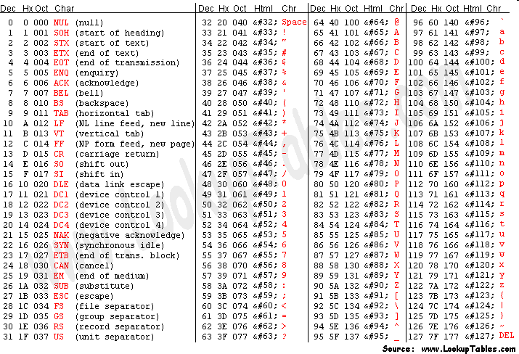
American Standard Code for Information Interchange (ASCII) Table

Slide 20
String Comparison
Relationship | Returned Value | Example
string1 < string2 | Negative | strcmp(“Hello”, “Hi”)
string1 = string2 | 0 | strcmp(“Hi”, “Hi”)
string1 > string2 | Positive | strcmp(“joyous”, “joy”)
If two strings are not equal,
strcmp() returns positive value if ASCII value of first mismatching element of first string is greater than that of second string and
negative value if ASCII value of first mismatching element of first string is less than that of second string.

Slide 21
strcmp Example
#include <stdio.h>
#include <string.h>
int main( )
{
char str1[20] = "fresh“, str2[20] = "refresh";
int result;
result = strcmp(str1, "fresh");
printf("%s and fresh: %d\n", str1, result);
result = strcmp(str1, "Fresh");
printf("%s and Fresh: %d\n", str1, result);
result = strcmp(str1, str2);
printf("%s and %s: %d\n", str1, str2, result);
result = strcmp(str1, "f");
printf("%s and f: %d\n", str1, result);
gets(str1); gets(str2);
if(strcmp(str1, str2) == 0)
printf("%s == %s", str1, str2);
else if(strcmp(str1, str2) < 0)
printf("%s < %s", str1, str2);
else printf("%s > %s", str1, str2);
return 0;
}

Slide 22
strncmp Example
#include <stdio.h>
#include <string.h>
int main ()
{
char str1[15];
char str2[15];
int ret;
strcpy(str1, "abcdef");
strcpy(str2, "ABCDEF");
ret = strncmp(str1, str2, 4);
if(ret < 0)
{
printf("str1 is less than str2");
}
else if(ret > 0)
{
printf("str2 is less than str1");
}
else
{
printf("str1 is equal to str2");
}
return 0;
}

Slide 23
C Program to mask password text with * : Using getch()
#include <stdio.h>
void main()
{
char pasword[10],usrname[10], ch;
int i;
printf("Enter User name: ");
gets(usrname);
printf("Enter the password <any 8 characters>: ");
for(i=0;i<8;i++)
{
ch = getch();
pasword[i] = ch;
ch = '*' ;
printf("%c", ch);
}
pasword[i] = '\0';
}

