Slide 1
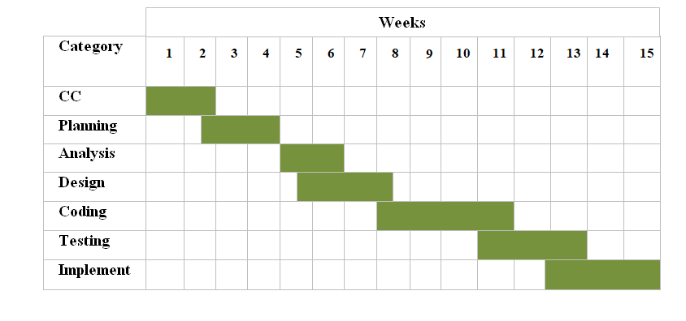
Project Scheduling Chart

