Slide 1
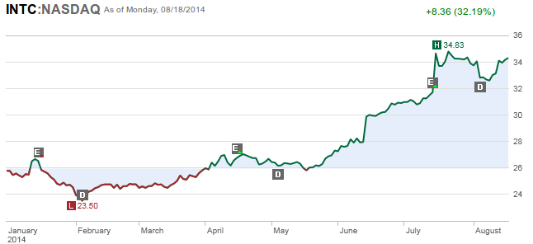
Ryan quits Intel

Slide 2
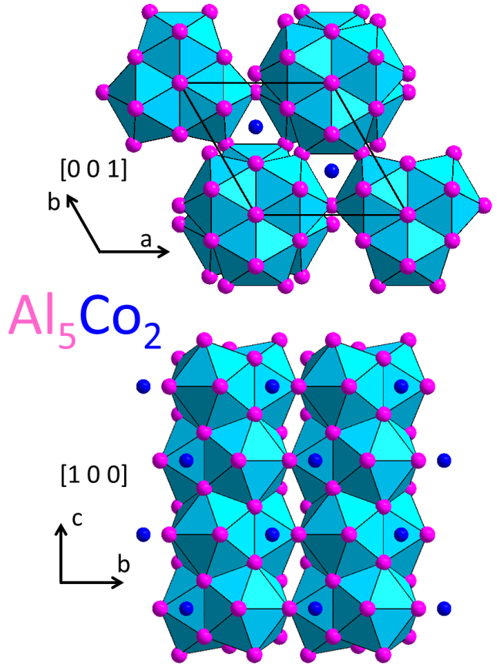
Crystal Structure Prediction with Random Forests
Al5Co2
?
~70% Al
~30% Co
Al radius
Co radius
Electronegativity difference
Radii difference
Electrons/atom
Etc.
Can we predict the atomic structure?
Ryan Henderson

Slide 3
Don't try to predict structure directly!
Point Group Symmetry
Volume per Site
c/a ratio
Coordination number for each element
Al5Co2
~70% Al
~30% Co
Al radius
Co radius
Electronegativity difference
Radii difference
Electrons/atom
Etc.
This is like guessing the country from information about the populations: language, GDP/capita, major religions – inexact, but narrows it down to a few possibilities

Slide 4
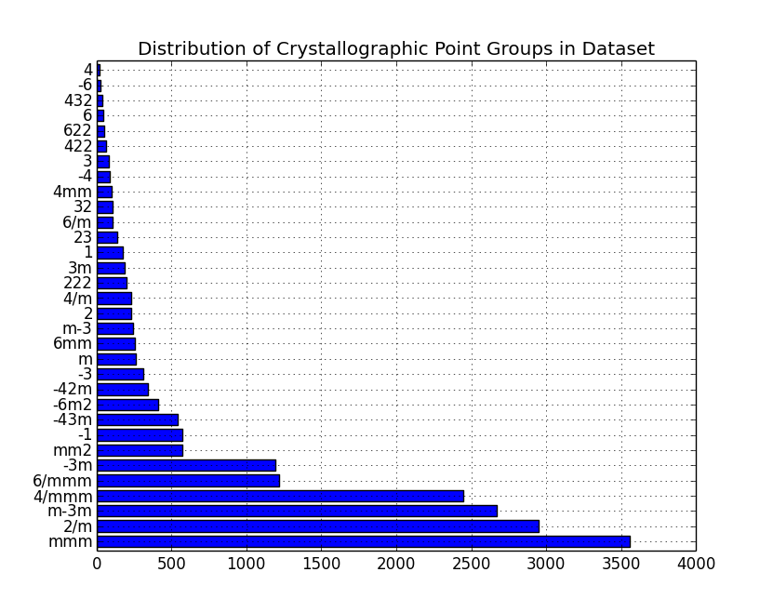
Our data set: materialsproject.org
19,428 structures:
all 32 crystallographic point groups represented

Slide 5
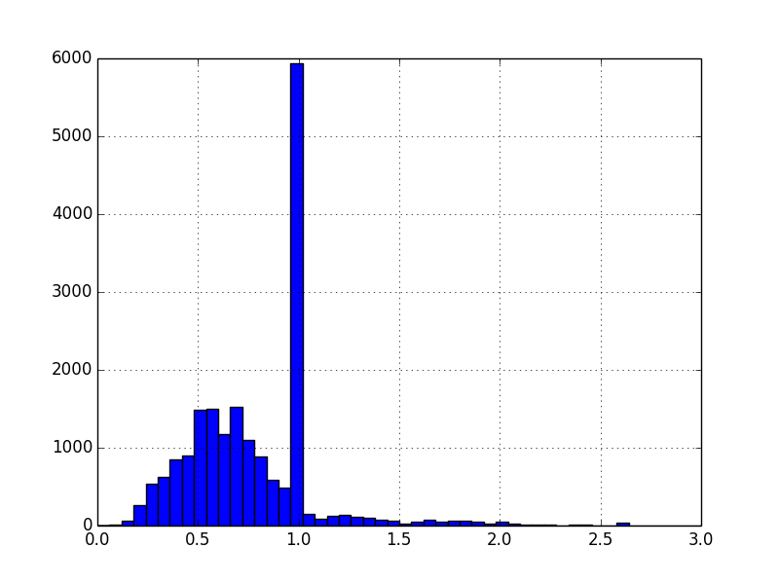
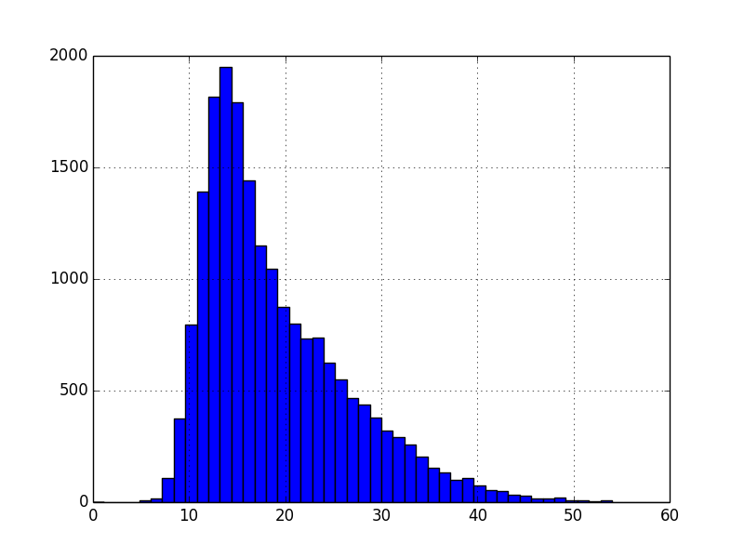
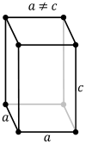
Our data set: materialsproject.org
Distribution of c/a
Distribution of volume/site (Å³)
Number of Structures
Why the huge peak at c/a=1.0?

Slide 6
Random Forest Classification:
Point Groups
Overall Accuracy (32 classes): 47%
Within crystal class accuracy much higher!
True Class
True Class
Important Features:
Hexagonal Accuracy (6 classes): 88%!!

Slide 7
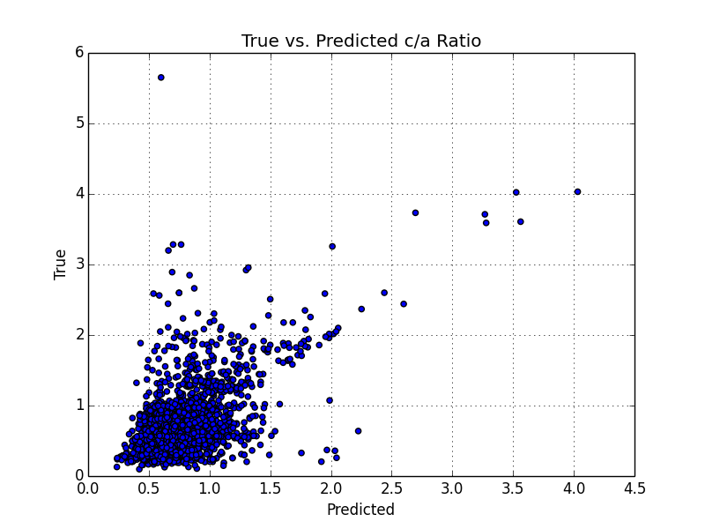
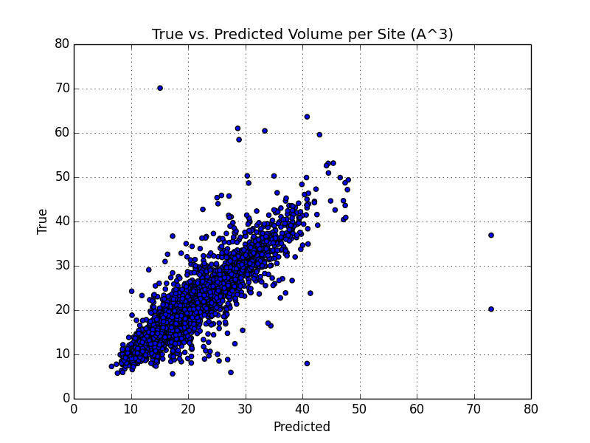
Random Forest Regression: c/a and volume/site
MAE = 0.20
MAE = 1.86 Å³

Slide 8
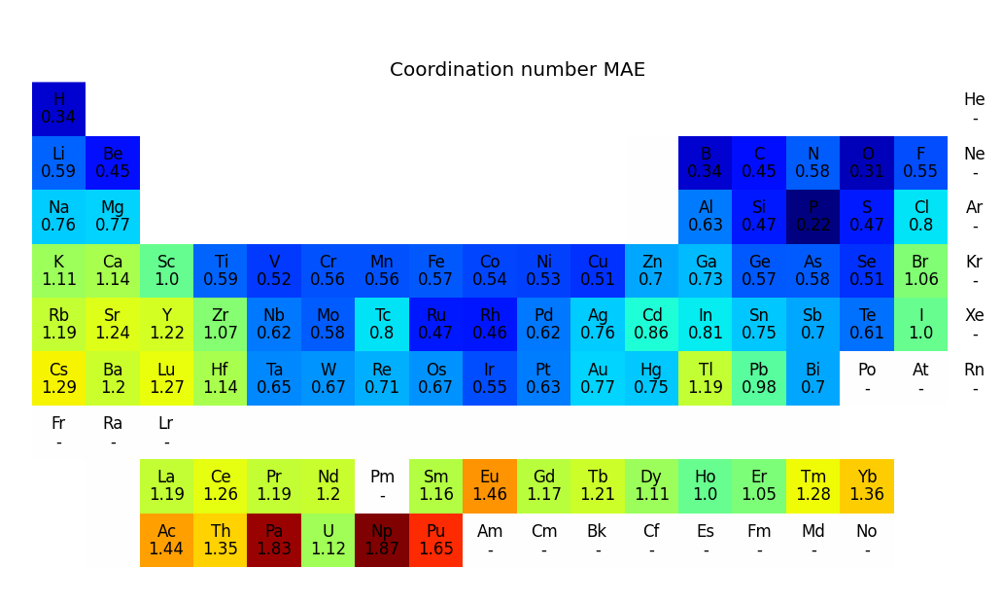
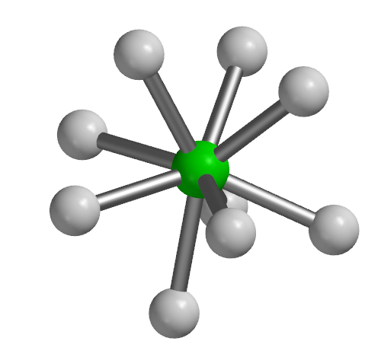
Random Forest Regression:
Coordination Number
Coordination numbers range from 1-12+
Feature importance varies by species

Slide 9
Conclusions
Random Forest methods can predict structural features from elemental composition reasonably well
With point group, c/a, volume, and coordination number for each site, a sensible structure could be constructed

Slide 10
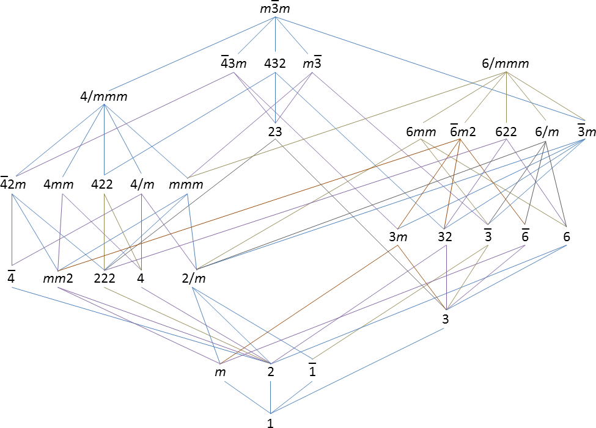
Improvements
Ex: exploit group-subgroup relationships for point groups in scoring

