Slide 1
Lab B Loop Reorder
110061575 RUI-HSUAN WANG

Slide 2
Matrix Multiplication
j
k
j
i
i
k
C
A
B
HLS Lab B
2022 / 03

Slide 3
Cache
A
B
Traversal order
*
Traversal order
= cache miss,
requested from main memory
= cache hit,
loaded as part of cache line
HLS Lab B
2022 / 03

Slide 4
Code
Change loop order to decrease the cache miss
lreorder1:
for (int i = 0; i < size; i++) {
lreorder2:
for (int j = 0; j < size; j++) {
lreorder3:
for (int k = 0; k < MAX_SIZE; k++) {
int result = (k == 0) ? 0 : temp_sum[j];
result += A[i][k] * B[k][j];
temp_sum[j] = result;
if (k== size -1) C[i][j] = result;
}
}
}
lreorder1:
for (int i = 0; i < size; i++) {
lreorder2:
for (int k = 0; k < size; k++) {
lreorder3:
for (int j = 0; j < MAX_SIZE; j++) {
int result = (k == 0) ? 0 : temp_sum[j];
result += A[i][k] * B[k][j];
temp_sum[j] = result;
if (k == size - 1) C[i][j] = result;
}
}
}
HLS Lab B
2022 / 03

Slide 5
Loop Reorder
j
k
j
i
i
k
C
A
B
HLS Lab B
2022 / 03

Slide 6
Cache
A
B
Traversal order
Traversal order
*
= cache miss,
requested from main memory
= cache hit,
loaded as part of cache line
HLS Lab B
2022 / 03

Slide 7
Flow Chart
Read A
mmult
Write C
Read B
HLS Lab B
2022 / 03

Slide 8
Case 1: II= 64
#pragma HLS LOOP_TRIPCOUNT: analysis only
Cycle 0 | Cycle 1 | Cycle 2 | Cycle 3 | Cycle 4 | Cycle 5 | Cycle 6 | Cycle 7 | Cycle 8
Result | R A[0, 0] | R B[0, 0] | * | W t[0]
 |  |  |  |  | R t[0] | R A[0, 1] | R B[1, 0]
Cache miss
Load 16 B
II = 16*4 = 64
lreorder1: for (int i = 0; i < size; i++) {
#pragma HLS LOOP_TRIPCOUNT min = c_size max = c_size
lreorder2: for (int j = 0; j < size; j++) {
#pragma HLS LOOP_TRIPCOUNT min = c_size max = c_size
lreorder3: for (int k = 0; k < MAX_SIZE; k++) {
int result = (k == 0) ? 0 : temp_sum[j];
result += A[i][k] * B[k][j];
temp_sum[j] = result;
if (k== size -1) C[i][j] = result;
}
}
}
HLS Lab B
2022 / 03

Slide 9
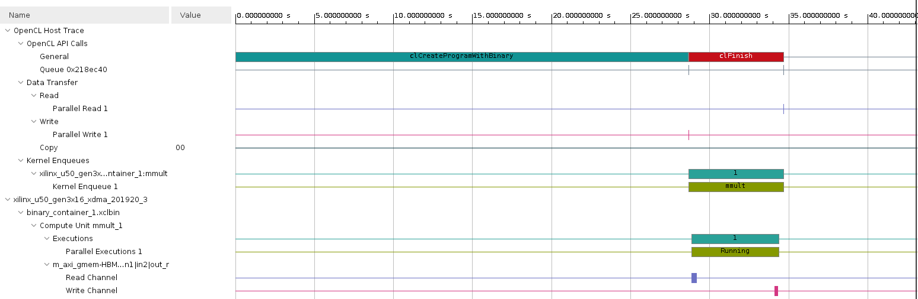
Case 1: II= 64 (HW Emu. Timeline)
HLS Lab B
2022 / 03

Slide 10
Case 2: II= 1
#pragma HLS LOOP_TRIPCOUNT: analysis only
Cache hit
II = 1
Cycle 0 | Cycle 1 | Cycle 2 | Cycle 3 | Cycle 4 | Cycle 5 | Cycle 6 | Cycle 7 | Cycle 8
Result | R A[0, 0] | R B[0, 0] | * | W t[0]
 | Result | R A[0, 0] | R B[0, 1] | * | W t[1]
lreorder1:
for (int i = 0; i < size; i++) {
#pragma HLS LOOP_TRIPCOUNT min = c_size max = c_size
lreorder2:
for (int k = 0; k < size; k++) {
#pragma HLS LOOP_TRIPCOUNT min = c_size max = c_size
lreorder3:
for (int j = 0; j < MAX_SIZE; j++) {
int result = (k == 0) ? 0 : temp_sum[j];
result += A[i][k] * B[k][j];
temp_sum[j] = result;
if (k == size - 1) C[i][j] = result;
}
}
}
HLS Lab B
2022 / 03

Slide 11
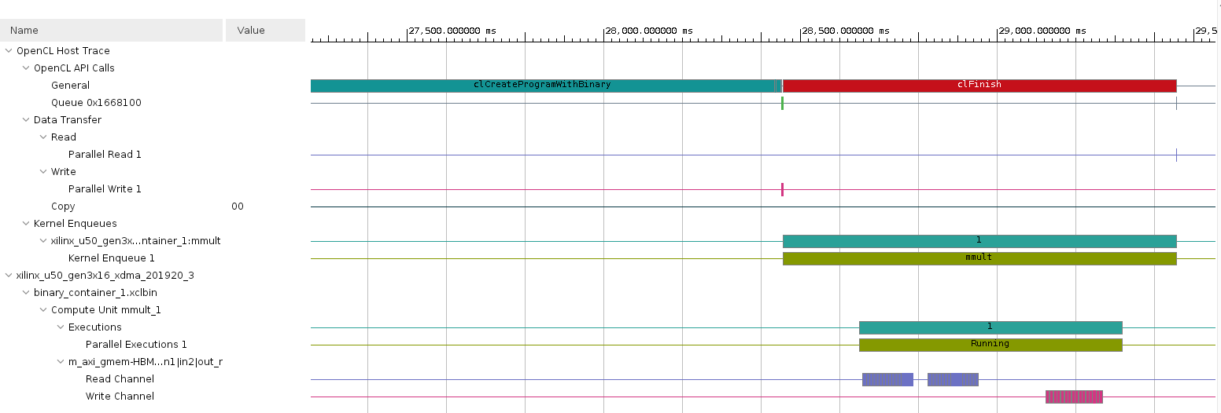
Case 2: II= 1 (HW Emu. Timeline)
HLS Lab B
2022 / 03

Slide 12
Case 3: II= 1 + UNROLL Loop
#pragma HLS LOOP_TRIPCOUNT: analysis only
#pragma HLS UNROLL: transforms loops by creating multiples copies of the loop body in the RTL design, which allows some or all loop iterations to occur in parallel.
lreorder1:
for (int i = 0; i < size; i++) {
#pragma HLS LOOP_TRIPCOUNT min = c_size max = c_size
lreorder2:
for (int k = 0; k < size; k++) {
#pragma HLS LOOP_TRIPCOUNT min = c_size max = c_size
lreorder3:
#pragma HLS UNROLL
for (int j = 0; j < MAX_SIZE; j++) {
int result = (k == 0) ? 0 : temp_sum[j];
result += A[i][k] * B[k][j];
temp_sum[j] = result;
if (k == size - 1) C[i][j] = result;
}
}
}
# j=0
int result = (k == 0) ? 0 : temp_sum[0];
result += A[i][k] * B[k][0];
temp_sum[0] = result;
if (k == size - 1) C[i][0] = result;
# j=1
int result = (k == 0) ? 0 : temp_sum[1];
result += A[i][k] * B[k][1];
temp_sum[0] = result;
if (k == size - 1) C[i][1] = result;
# j=2
int result = (k == 0) ? 0 : temp_sum[2];
result += A[i][k] * B[k][2];
temp_sum[0] = result;
if (k == size - 1) C[i][2] = result;
HLS Lab B
2022 / 03

Slide 13
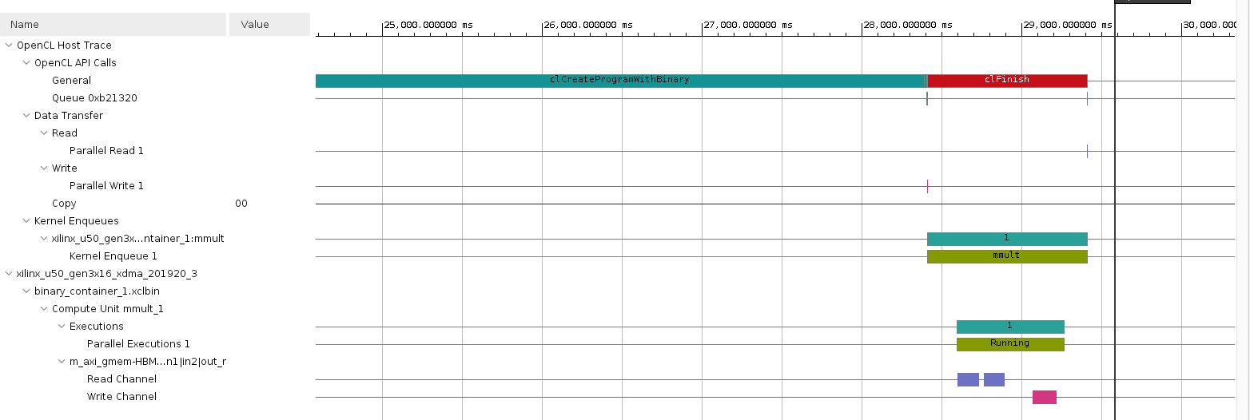
Case 3: II= 1 + UNROLL Loop (HW Emu. Timeline)
HLS Lab B
2022 / 03

Slide 14
Case 4: II= 1 + UNROLL Data (Read)
#pragma HLS ARRAY_PARTITION: increases the amount of read and write ports for the storage
#pragma HLS UNROLL: transforms loops by creating multiples copies of the loop body in the RTL design, which allows some or all loop iterations to occur in parallel.
#pragma HLS ARRAY_PARTITION variable = B dim = 2 complete
readA:
#pragma HLS UNROLL
for (int itr = 0, i = 0, j = 0; itr < size * size; itr++, j++) {
#pragma HLS LOOP_TRIPCOUNT min = c_size* c_size max = c_size * c_size
if (j == size) {
j = 0;
i++;
}
A[i][j] = in1[itr];
}
readB:
#pragma HLS UNROLL
for (int itr = 0, i = 0, j = 0; itr < size * size; itr++, j++) {
#pragma HLS LOOP_TRIPCOUNT min = c_size* c_size max = c_size * c_size
if (j == size) {
j = 0;
i++;
}
B[i][j] = in2[itr];
}
HLS Lab B
2022 / 03

Slide 15
Case 4: II= 1 + UNROLL Data (Write)
#pragma HLS ARRAY_PARTITION: increases the amount of read and write ports for the storage
#pragma HLS UNROLL: transforms loops by creating multiples copies of the loop body in the RTL design, which allows some or all loop iterations to occur in parallel.
writeC:
#pragma HLS UNROLL
for (int itr = 0, i = 0, j = 0; itr < size * size; itr++, j++) {
#pragma HLS LOOP_TRIPCOUNT min = c_size* c_size max = c_size * c_size
if (j == size) {
j = 0;
i++;
}
out_r[itr] = C[i][j];
}
#pragma HLS ARRAY_PARTITION variable = C dim = 2 complete
HLS Lab B
2022 / 03

Slide 16
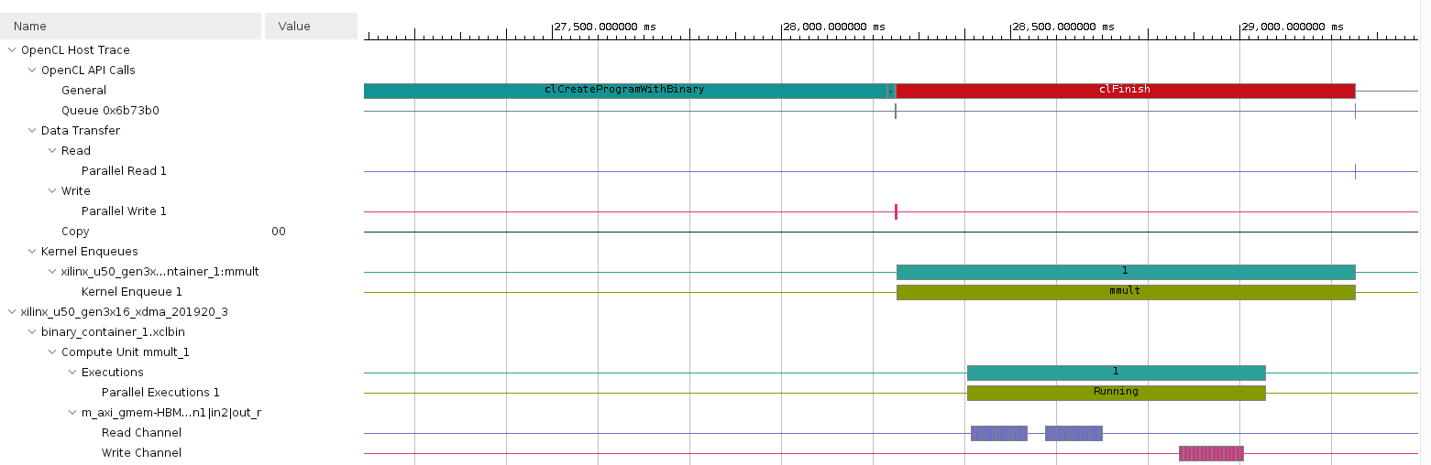
Case 4: II= 1 + UNROLL Data (HW Emu. Timeline)
HLS Lab B
2022 / 03

Slide 17
SW Emulation
SW Emulation | Total application runtime (ms) | Kernel total time (ms) | Compute Unit total time (ms) | Compute Unit Utilization
II= 64 | 77.8372 | 0.611 | 0.501 | 81.988
II= 1 | 62.346 | 0.549 | 0.462 | 84.257
II= 1 + unroll loop | 75.2701 | 0.592 | 0.496 | 83.91
II= 1 + unroll data | 66.2336 | 0.482 | 0.393 | 81.435
HLS Lab B
2022 / 03

Slide 18
HW Emulation
HW Emulation | Total application runtime (ms) | Kernel total time (ms) | Compute Unit total time (ms) | Compute Unit Utilization
II= 64 | 43106.8984 | 0.035 | 0.031 | 90.368
II= 1 | 42709.6992 | 0.007 | 0.004 | 67.764
II= 1 + unroll loop | 42657.1992 | 0.007 | 0.004 | 65.874
II= 1 + unroll data | 42562.6992 | 0.007 | 0.004 | 66.253
HLS Lab B
2022 / 03

Slide 19
Hardware
Hardware | Total application runtime (ms) | Kernel total time (ms) | Top Memory Writing Rate (MB/s) | Top Memory Reading Rate (MB/s)
II = 1 | 5633.4902 | 0.229 | 0.134 | 0.048
II= 1 + unroll loop | 4591.9902 | 0.283 | 0.141 | 0.032
II=1 + unroll data | 4933.8799 | 0.343 | 0.148 | 0.054
HLS Lab B
2022 / 03

Slide 20
Summary
Loop Reorder algorithm
Pragma Optimization
HLS Lab B
2022 / 03

Slide 21
Question
What if k is in the outer loop?
lreorder1:
for (int k = 0; k < size; k++) {
#pragma HLS LOOP_TRIPCOUNT min = c_size max = c_size
lreorder2:
for (int i = 0; i < size; i++) {
#pragma HLS LOOP_TRIPCOUNT min = c_size max = c_size
lreorder3:
for (int j = 0; j < MAX_SIZE; j++) {
int result = (k == 0) ? 0 : temp_sum[j];
result += A[i][k] * B[k][j];
temp_sum[j] = result;
if (k == size - 1) C[i][j] = result;
}
}
}
HLS Lab B
2022 / 03

Slide 22
Answer
A will have cache miss, result in worse performance.
j
k
j
i
i
k
C
A
B
HLS Lab B
2022 / 03

