Slide 1

QR Codes
The Brogrammers

Slide 2

Project Goal
To better his company Dr. Sears wants to…
Provide better service for his customers
Create a unique and exciting shopping experience
Provide his customers with more information about each product
Notes:
Dr. Sears mentioned when a customer comes in he receives the typical “I’m just looking response” from them. This immediately creates a disconnect between him and the customer, making it difficult for him to provide them with good service.
Dr. Sears wants each customers visit to be a unique and memorable one. This way the customer walks in excited to learn about his different products and increasing the chances of them finding that perfect item for themselves.
He has a lot of products that have interesting details that are not necessarily clear by simply browsing the store. So he wants to provide the customer with a means to get as much information about each product as they want.

Slide 3
Product features
Each product will have a QR code associated with it
A QR code will be on each product similar to a barcode
Dr. Sears will provide a customer with an iPod to scan any item they wish
After scanning the item, the iPod will go to a page displaying more information

Slide 4
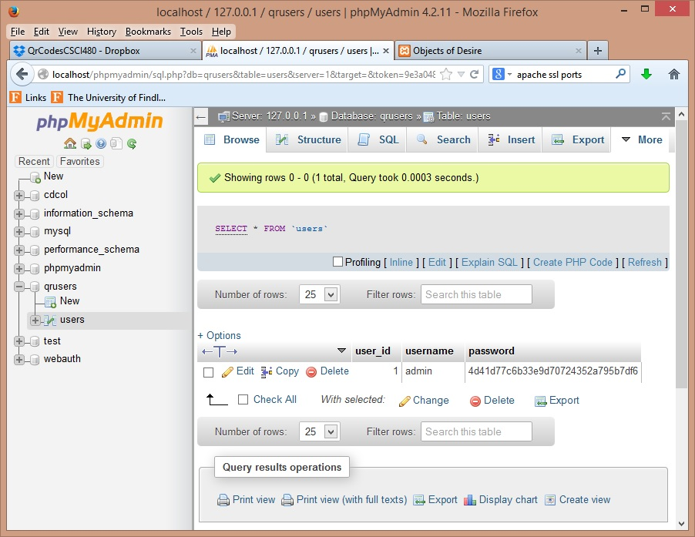
Database
We used phpadmin to create the database. This screenshot is of the table “users”, which is used to log into the application.

Slide 5
Info Displayed From QR Code
A picture of the item
The price of the item
A short description
An option to view a more detailed description
An option to select different sizes (if available)
Other related items
A button to easily return to the scanner

Slide 6
Other Features
A user will be able to access this information like any other website.
An admin will have a login account
An admin will be able to print off additional QR codes
An admin will be able to add new items
  Also print off a QR code for each new item

Slide 7
Other Features cont.
An admin will be able to update information about any item
An admin will be able to remove items

Slide 8
UPDATE II
THE BROGRAMMERS

Slide 9
Design Methods
We will be using Bootstrap to develop our webpage, this will allow us to format our webpage to be compatible with mobile devices.
We will be coding in HTML and PHP.

Slide 10
Project Updates
Ability to upload pictures via web app.
Ability to purchase items online.
Ability to print QR codes with title and description of item.
Notes:
Dr. Sears decided he would like to be able to use our app to upload pictures to his website, rather than email them to himself to upload them.
Talked about adding a purchase feature, where customers can go online and purchase products from his store.
Ability to print QR codes with title and description of item. Not sure what we will use to do the printing, and if different sizes will be an option, we will talk about that with him next meeting.

Slide 11
UPDATE III
THE BROGRAMMERS

Slide 12
Project updates
Completed tasks
Burndown chart
Hard coded Admin Login page, set up user database via phpmyadmin. Took 6 hours. (instead of 3 according to our tasks)
Next Steps: All group members install xAmpp.

Slide 13
UPDATE IV
THE BROGRAMMERS

Slide 14
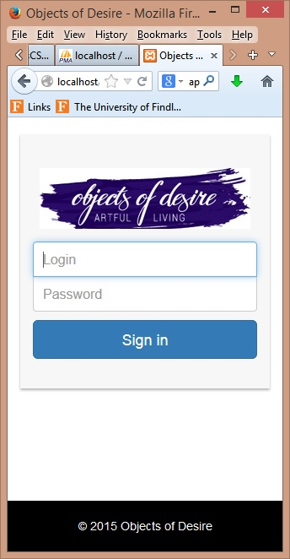
Login page
This page will be used by the admin to access the functions of the application.

Slide 15
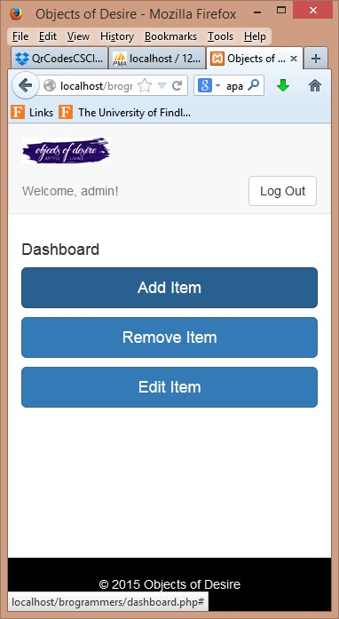
Dashboard
This page will provide the admin with the ability to add an item, remove an item, and edit an item within the database.

Slide 16
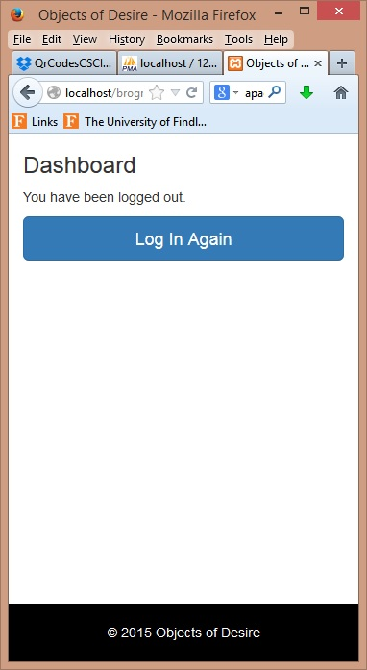
Log out
This is the screen displayed when the admin has logged out.

Slide 17
Database
We used phpadmin to create the database. This screenshot is of the table “users”, which is used to log into the application.

Slide 18
UPDATE V
THE BROGRAMMERS

Slide 19
Updates & Completed Task
Database structure has been updated to work better with the website
The form for the Add button has been completed
Most of the coding for the Add button is completed
Started working on displaying the products with pagination
Started making some progress on the Remove button as well

Slide 20
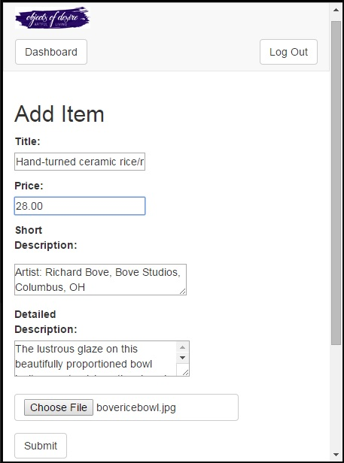
Add Item Form

Slide 21
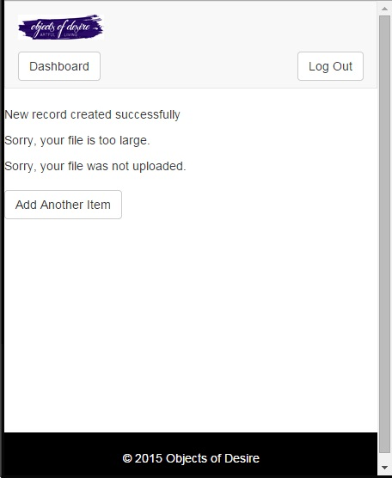
Add Item Form

Slide 22
Database Results
Items add successfully
Still need to stored the imagePath and qrCodePath

Slide 23
Up Next...
Finish the Add button screen
  It still needs to generate QR code
  Store product image path and QR code path
Display the products with pagination in a good format
  Used in edit button, remove button, and the main pages the customer will interact with
Complete coding on the Remove button
Implement the Edit button function

Slide 24
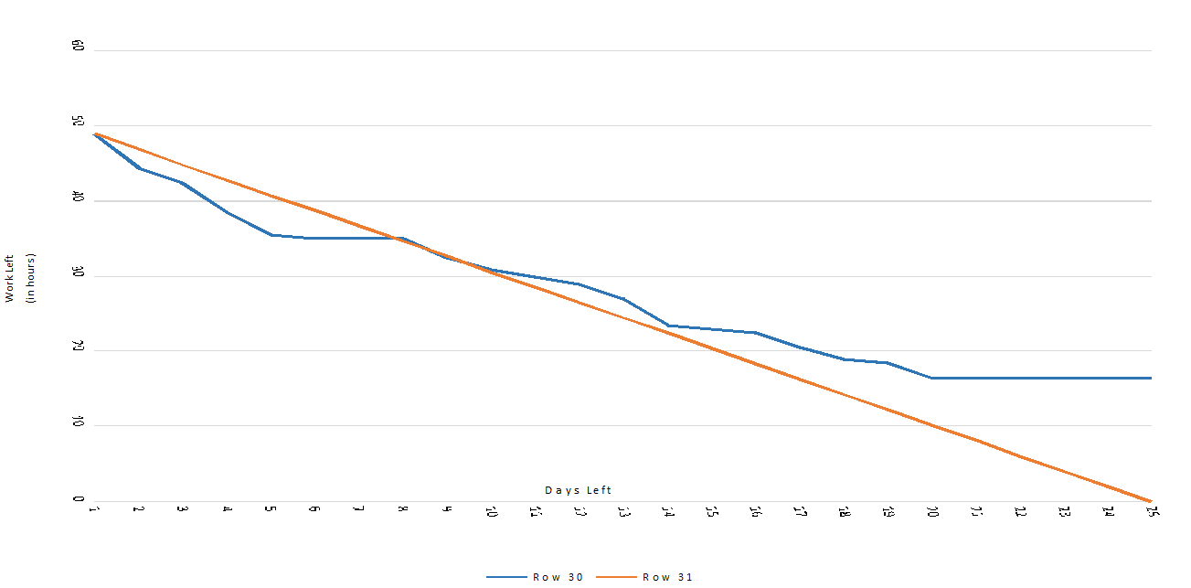
Productivity

