Slide 1
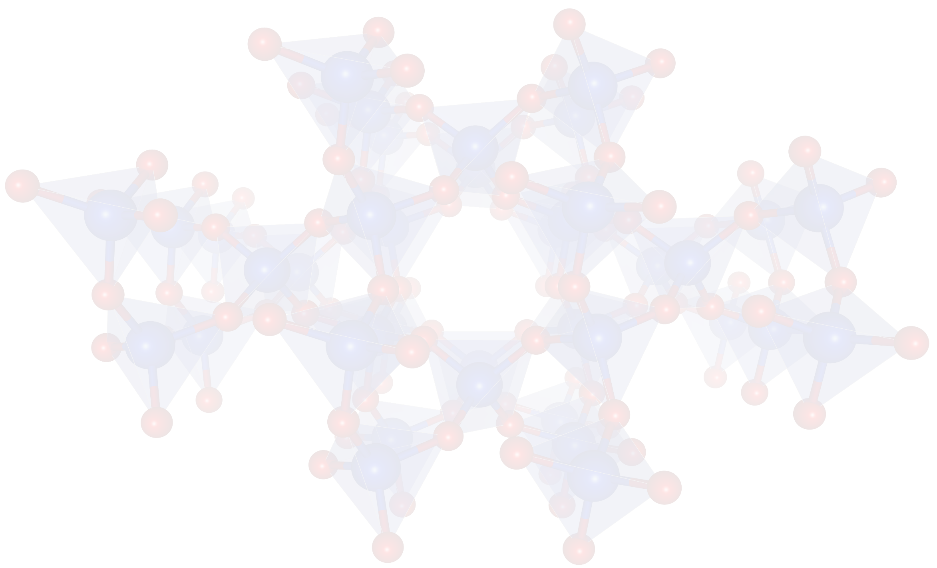
Diffusion quantum Monte Carlo studies of semiconducting energy gaps
R. J. Hunt, M. Szyniszewski, and N. D. Drummond
Department of Physics, Lancaster University
R. Maezono
Japan Advanced Institute of Science and Technology (JAIST)
Theory of finite-size
effects in gap
calculations
Excited-state QMC
best practices
Interesting
aspects
of this work
Ne: super-accurate
ionization potentials
Jahn-Teller distortion:
gaps in
small molecules.
First ab initio
biexciton binding
Various gaps and exciton binding energies for solids: diamond Si, cubic BN, α-quartz.

