Slide 1
Memory Dependence Prediction
(Sticky Bit Predictor, Store Sets)
ECE 721: Advanced Microarchitecture
Prof. Eric Rotenberg
Rhushikesh Prabhune
Ajinkya Tundurwar

Slide 2
Index
Key Ideas | 3
Outcomes | 4
Microarchitecture Description: Sticky Bit Predictor | 5
Performance comparison with no speculation, blind speculation, and oracle | 6
Performance Analysis(varying cyclic clear interval and number of entries in sticky bit predictor) | 8
Microarchitecture Description: Store Sets | 10
Store Set Implementation | 11
References | 12

Slide 3
Key Ideas
Exploration of the rich design space to increase the IPC by reducing memory order violations through constrained speculation.
Avoiding unnecessary stall of loads in presence of unknown older stores.
Investigate possible performance improvements by using 2-bit confidence counters with store sets.

Slide 4
Outcomes
Implementation of cyclic clear mechanism for sticky bit prediction.
Experimentation and analysis of IPC with sticky bit prediction, blind speculation, no speculation, and oracle disambiguation.
Implementation of Store Sets and augmentation of 2-bit confidence counter to the SSIT.

Slide 5
Microarchitecture Description:
Sticky Bit Predictor
One-bit confidence counter to check for load violation.
Set after load violation detected.
Reset periodically to avoid false dependencies.
Sticky bit algorithm:
if(sticky bit)
stall until all unknown store addr generated;
else
execute load;
if(load_instr == active_list.head)
if(load_viol)
set sticky bit for corresponding load;
recovery mechanism;
else
retire;

Slide 6
Cyclic clear periodically to avoid false dependencies.
Size of sticky bit predictor (indexing mechanism):
Load PC (difficult to implement in hardware)
Subset of Load PC
Load PC modulo table size (table size power of 2)

Slide 7
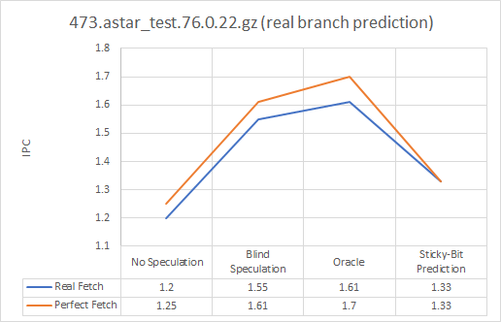
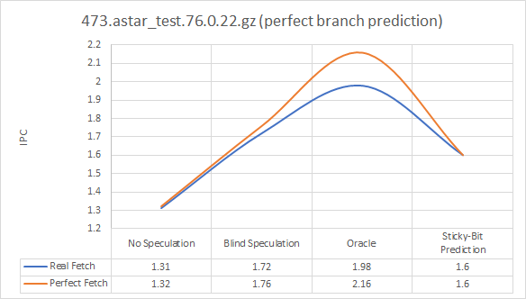
Performance comparison with no speculation, blind speculation, and oracle
#entries in sticky bit predictor: 512
cyclic clear interval: 1M instr
Lesser the cyclic clear interval, greater the IPC for 473.astar_test.76.0.22.gz

Slide 8
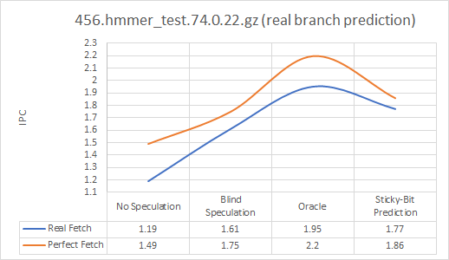
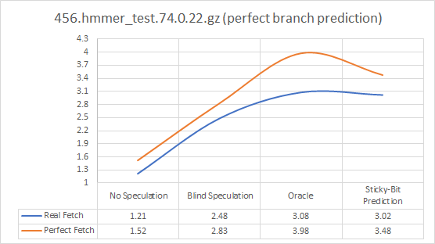
Performance comparison with no speculation, blind speculation, and oracle

Slide 9
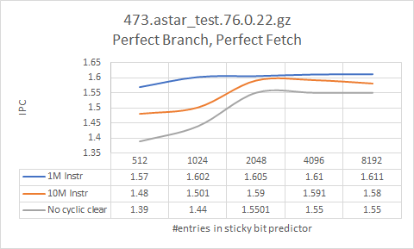
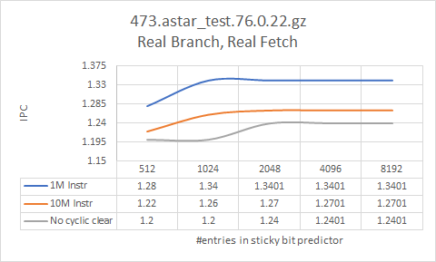
Performance Analysis by
varying cyclic clear interval and number of entries in sticky bit predictor

Slide 10
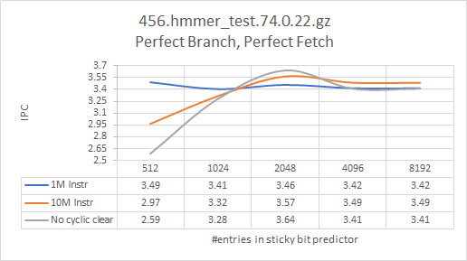
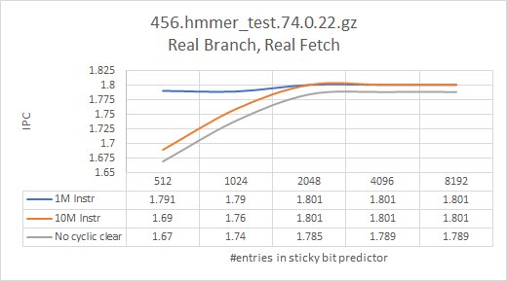
Performance Analysis by
varying cyclic clear interval and number of entries in sticky bit predictor

Slide 11
Microarchitecture Description:
Store Sets
Finds memory dependencies based on store sets for each load and store instruction.
Data Structures:
Store Set Identifier Table (SSIT): Maintains store sets by assigning unique common tag (SSID) for both violating load and store by using store set assignment rule.
Last Fetched Store Table (LFST): Maintains dynamic information (store inum) about the most recently fetched store for each store set.

Slide 12
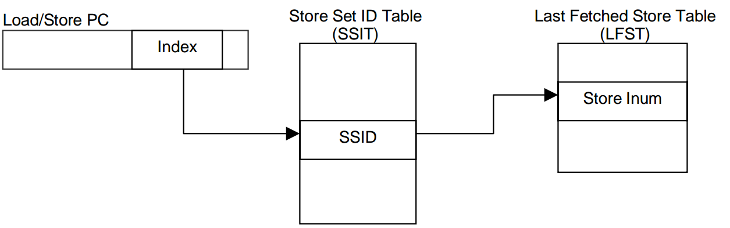
Store Set Implementation
The SSIT is indexed by the load/store PC to check for a valid SSID entry.
If there exists a valid SSID entry, then LFST is indexed by using same SSID to get store inum for predicting memory dependence.
Both SSIT and LFST are updated based on memory order violations and latest fetched store.

Slide 13
References
“Memory Dependence Prediction using Store Sets”, George Z. Chrysos and Joel S. Emer.
“Store Vectors for Scalable Memory Dependence Prediction and Scheduling”, Samantika Subramaniam Gabriel H. Loh Georgia Institute of Technology.
“ Memory Dependence Prediction”, by Andreas Ioannis Moshovos.
A. Yoaz, M. Erez, R. Ronen and S. Jourdan, “Speculation techniques for improving load related instruction scheduling”

Slide 14
Thank You

