Slide 1
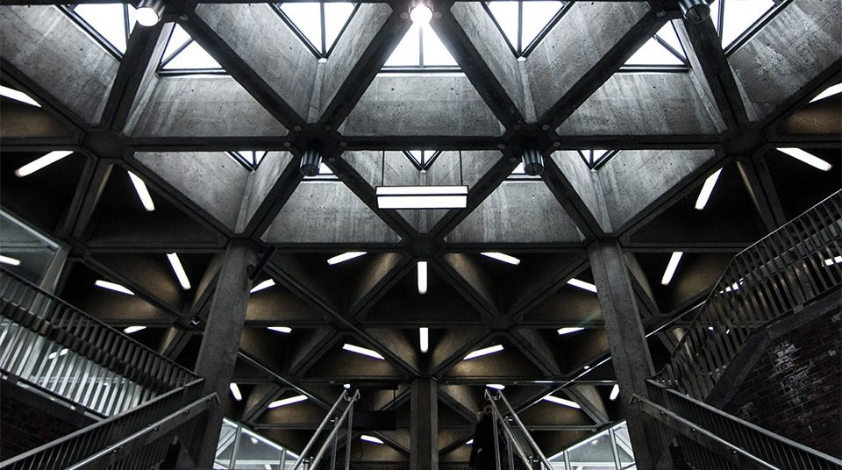
Galaxei
Shape the world

Slide 2
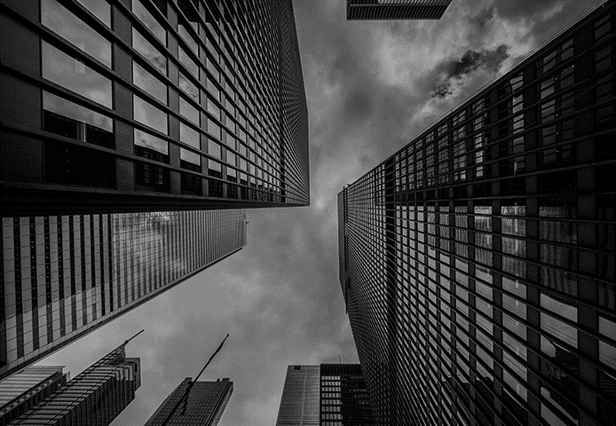

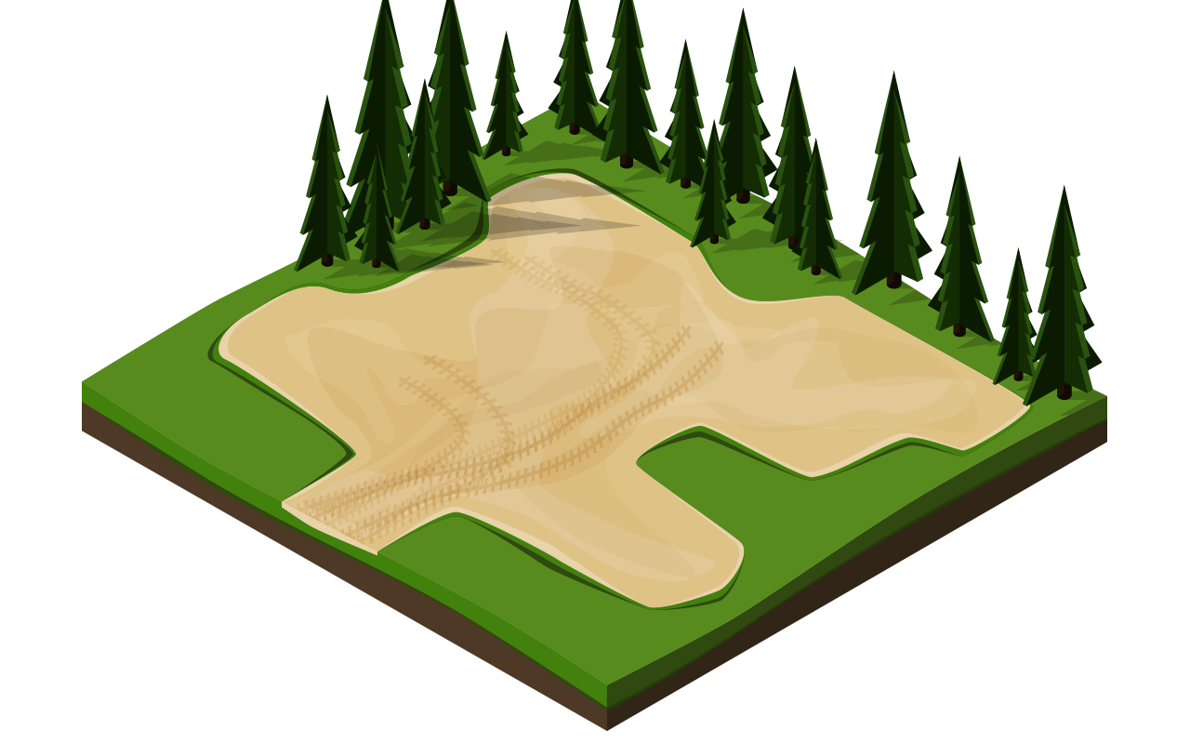
It begins with the basic unit
Start with a section of land, but choose strategically
Secure ownership

Slide 3
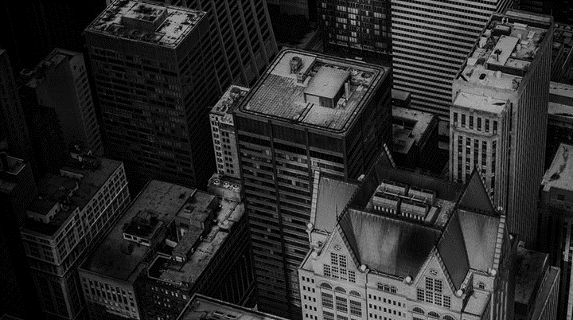


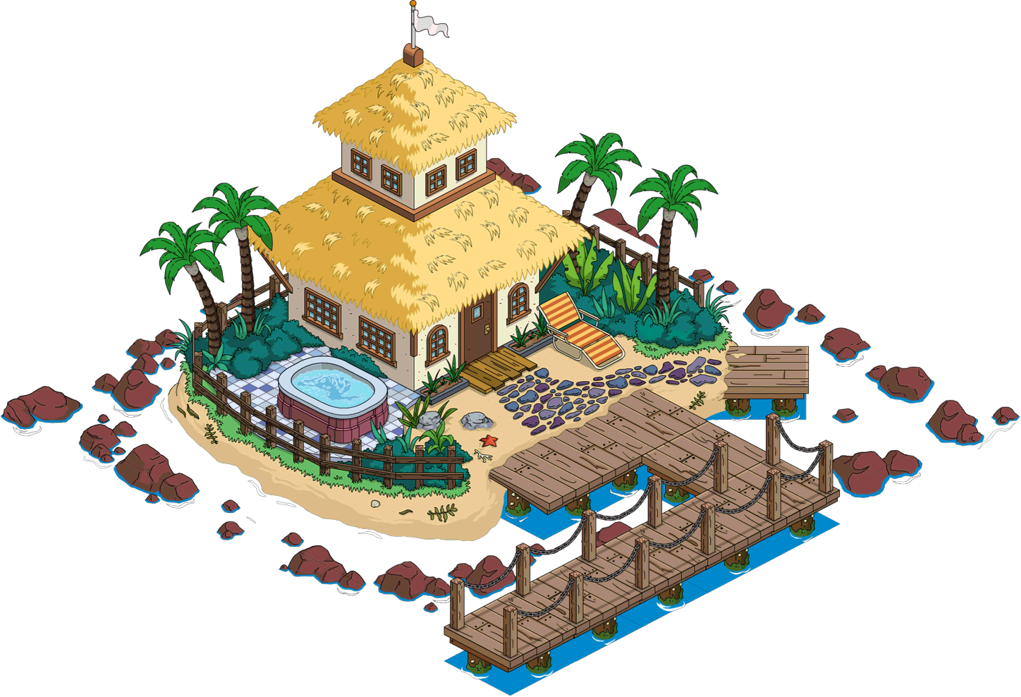
Grow your Land
Do as you wish, exchange freely, build your dreams.

Slide 4
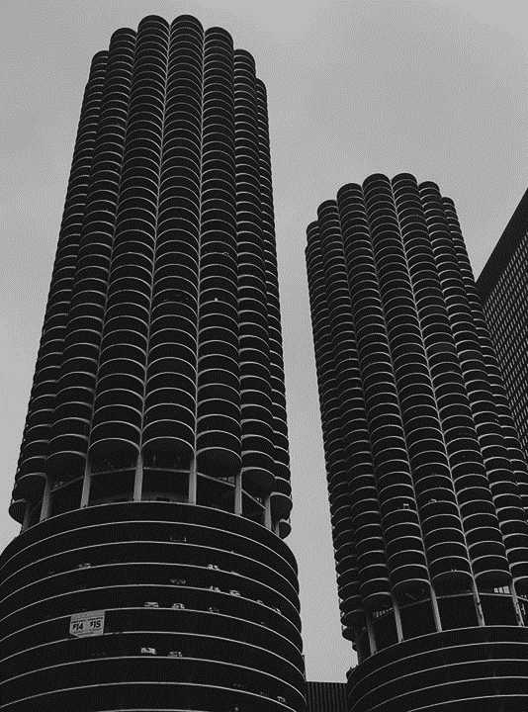

All secured as Private assets belonging to you on the blockchain with extremely fast Transactions

Slide 5
THANK YOU

