Slide 1




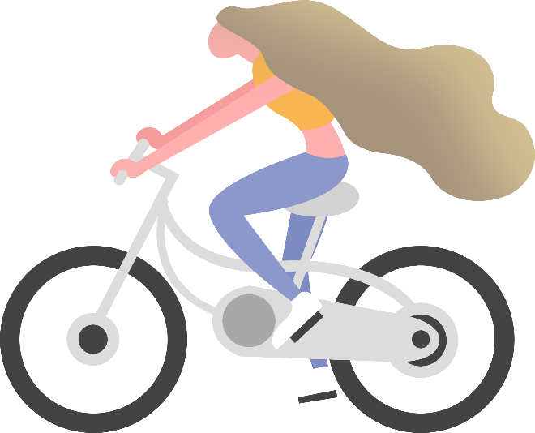

一般过去时

Slide 2
Period One

Slide 3
Simple Past Tense (一般过去时态)
一： 概念：
一般过去时表示过去某个时间发生的动作或存
在的状态。或表示过去经常或反复发生的动作
He was at home last weekend.
I got up at six thirty yesterday.
When I was a child, I often listened to music.

Slide 4
二：常用的表过去的时间状语
yesterday 昨天
yesterday morning / afternoon / evening
昨天上午、下午、晚上
the day before yesterday前天
last + 时间
last night / weekend / Monday / week / month / year
昨晚、上个周末、上周一、上周、上个月、去年
时间段+ ago: 多久以前
a week ago; three days ago, long long ago
4. just now 刚才， once 曾经， in 2020，…..

Slide 5
三: 含有be动词(was /were)的句子
am / is - was; are – were
was not – wasn’t are not – weren’t

Slide 6
I am at home now.
I was at home last weekend.
am ----- was
Jack is at school now.
Jack was at school last weekend.
is ------ was
My parents are at work now.
My parents were at work last weekend.
are ------ were

Slide 7
说一说在哪儿
I am …..now.
I was …..last weekend.
My friend … is …. now.
My friend …. was …. last weekend.
My parents are…. now.
My parents were ….. last weekend.

Slide 8
I am 50 this year.
I was 49 last year.
am ----- was
My friend Tony is 25 this year.
My friend Tony was 24 last year.
is ------ was
Jack and Tony are 13 this year.
Jack and Tony were 12 last year.
are ------ were

Slide 9
说一说年龄
I am … this year.
I was … last year.
My friend … is …. this year.
My friend … was … last year.
…and …. are … this year.
…and …. were … last year.

Slide 10
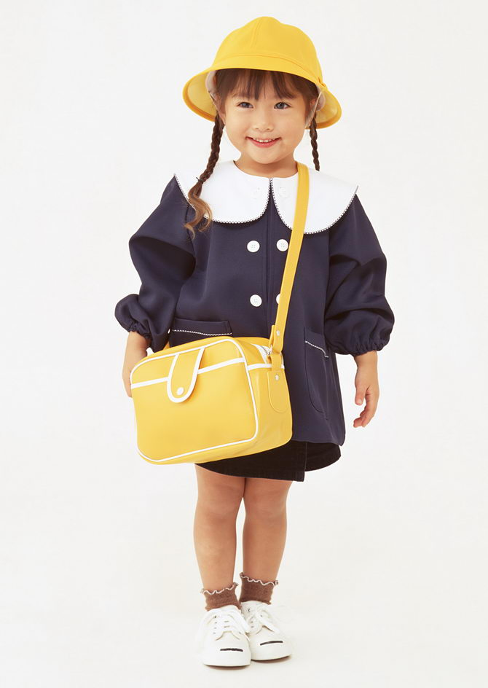
The girl is thin this year.
The girl was fat last year.
this year
last year

Slide 11
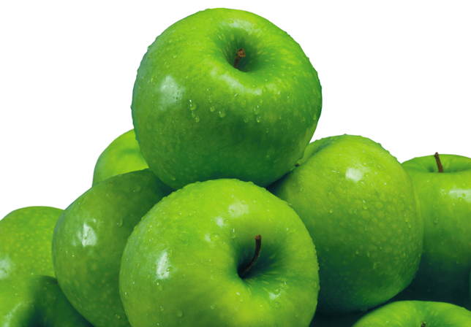
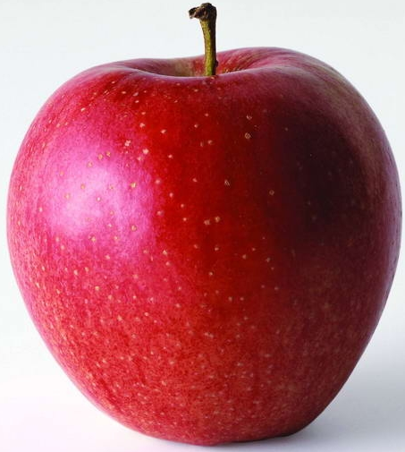
The apples were green last month.
last month
上个月
this month
这个月
The apples are red this month.

Slide 12
be 动词的过去时形式
am, is ---- was are ----were
用be的适当形式填空。
1. I ____ in a primary school last year .
2. They _____ happy today, but they _______ sad last week.
3. My brother _____ tall this year, but he ______ short two years ago.
was
are
were
is
was

Slide 13
Exercises:
I ____(am) in Beijing last week.
I ____(am) very happy yesterday.
I ____(am) in America 10 years ago.
He____(is) at the radio station the day before yesterday.
Carol ____(is) in the farm yesterday.
Jenny ____(is) was in primary school a year ago.
They _____(are) very good in the show.
Students_____(are) on the playground just now.
was
was
was
was
was
was
were
were

Slide 14
1: 肯定句： was / were +其他成分
我上个周末在家.
2. 昨天多云.
3. 去年他们十二岁.
I was at home last weekend .
It was cloudy yesterday.
They were twelve last year.

Slide 15
2.否定句：was / were not +其他成分
把下列句子改为否定句：
I was at home last weekend .
--- I wasn’t at home last weekend.
It was cloudy yesterday.
---It wasn’t cloudy yesterday.
They were twelve last year.
---They weren’t twelve last year.

Slide 16
3. 一般疑问句及回答：Was /Were + 主语 + 其他成分？Yes, ….was / were. No, … wasn’t / weren’t.
把下列句子改为一般疑问句并回答：
I was at home last weekend .
--- Were you at home last weekend?
Yes, I was. / No, I wasn’t.
It was cloudy yesterday.
--- Was it cloudy yesterday? Yes, it was. / No, it wasn’t.
They were twelve last year.
---Were they twelve last year?
Yes, they were. / No, they weren’t.

Slide 17
4. 特殊疑问句： 特殊疑问词 + was / were + 主语 + 其他成分？
对划线部分提问：
I was at home last weekend .
--- Where were you last weekend?
It was cloudy yesterday.
--- How was the weather yesterday?
They were twelve last year.
--- How old were they last year?

Slide 18
Exercises:汉译英： 1.昨天我妈妈很忙.
My mother was busy yesterday.
2.上周五是阴天，今天下雨。
It was cloudy last Friday and it is rainy today.
3. Tom的哥哥3年前在上海。
Tom’s brother was in Shanghai three years ago.
4. 昨天下午所有的学生都在教室里。
All the students were in the classroom yesterday afternoon.
5.去年这家公园里有很多树。
There were a lot of trees in the park last year.

Slide 19
Period Two

Slide 20
四: 含有行为动词（-ed）的句子

Slide 21
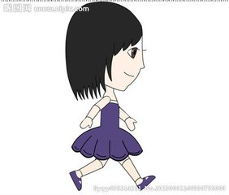
Weall changed a lot.
Last year, I went to school on foot.
Now I go to school by car.

Slide 22

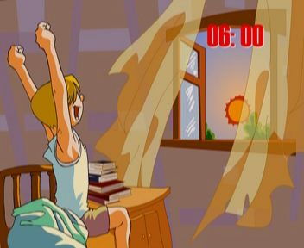
8:00
Last year Jim got up at 8:00.
6:00
Now Jim gets up at 6:00.

Slide 23
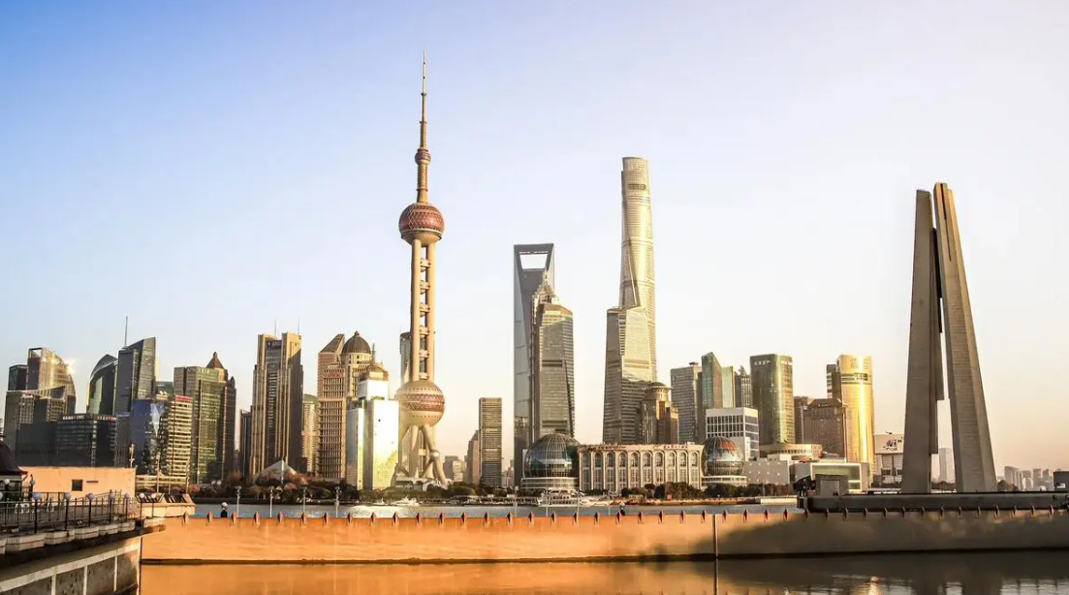
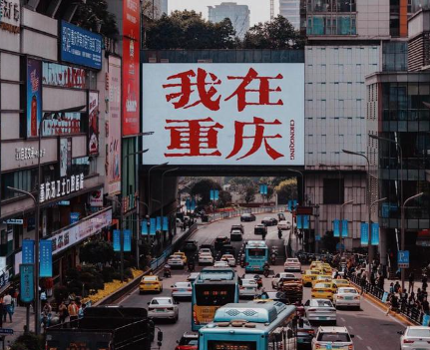
Last year they lived in Shanghai.
Now they live in Chongqing.

Slide 24
Now I go to school by car.
Last year, I went to school on foot.
2. Now Jim gets up at 6:00.
Last year Jim got up at 8:00.
3. Now they live in Chongqing.
Last year, they lived in Shanghai.

Slide 25
1.肯定句:
主语+ 行为动词(-ed) +其它成份.
1. I went to school on foot last year.
2. Jim got up at 8:00 last year.
3. They lived in Jiangbei last year.

Slide 26
2.否定句:
主语+didn’t +行为动词(原形) +其它成份.
I went to school on foot last year.
--- I didn’t go to school on foot last year.
2. Jim got up at 8:00 last year.
--- Jim didn’t get up at 8:00 last year.
3. They lived in Jiangbei last year.
--- They didn’t live in Jiangbei last year.

Slide 27
3.一般疑问句及回答.
Did +主语+行为动词(原形) +其它成份?
Yes, …did. / No, …didn’t.
1. I went to school on foot last year.
--- Did you go to school on foot last year?
--- Yes, I did. / No, I didn’t.
2. Jim got up at 8:00 last year.
---Did Jim get up at 8:00 last year?
---Yes, he did. / No, he didn’t.
3. They lived in Jiangbei last year.
---Did they live in Jiangbei last year?
---Yes, they did. / No, they didn’t.

Slide 28
4. 特殊疑问句.
特殊疑问词 +did +主语+行为动词(原形) +其它成份?
I went to school on foot last year.
--- How did you go to school last year?
2. Jim got up at 8:00 last year.
---What time did Jim get up last year?
3. They lived in Jiangbei last year.
---Where did they live last year?

Slide 29
五：规则动词的过去式的构成
work —
play--
enjoy--
start--
worked
played
enjoyed
started
1.一般加ed
2.以e结尾加d
live —
arrive--
like--
hope--
move--
practice--
lived
arrived
liked
hoped
moved
practiced

Slide 30
3.末尾只有一个辅音字母的重读闭音节词，先双写这个辅音字母，再加ed .
stop —
stopped
shop —
shopped
4.以辅音字母加y结尾的词,先改 y为i, 再加ed
study —
worry--
carry--
studied
worried
carried
5.不规则变化.(见不规则动词表P141)

Slide 31
规则动词过去式-ed的发音
1.在以清辅音结尾的规则动词后,
-ed读作/ t /
work
/w3:k/
ed
t/
2.在以浊辅音或元音结尾的规则动词后,
-ed读作/d /
play
/pleI /
live
/lIv /
d
ed
d/
d/

Slide 32
3.在以/t/或/d/结尾的规则动词后,
-ed读作/Id /
ed
visit
/’vIzIt /
Id/

Slide 33
一般现在时 VS 一般过去时
他们今天在中国。
are
They ____ in China today.
他们昨天在日本。
They ____ in Japan yesterday.
were
am/ is
was
are
were

Slide 34
每天，早餐我吃鸡蛋和牛奶。
have
I ____ eggs and milk for breakfast every morning.
昨天，早餐我吃面条。
had
I ____ noodles for breakfast yesterday morning.
他每天都吃水果。
has
He _____ fruit every day.
昨天他吃了3个苹果。
He _____ 3 apples yesterday.
had
have/ has
had

Slide 35
I get up at 6:30 every morning.
I ___ up at 9:00 last Sunday.
got
He plays football every afternoon.
He _____ basketball yesterday afternoon.
played
He does his homework every evening.
He ____ some reading last night.
did
动词原形、第三人称单数
动词过去式

Slide 36
They don’t watch TV in the evening.
They _________ TV last night.
didn’t watch
She doesn’t play basketball after school.
She _________ basketball after school yesterday.
didn’t play
Do you go to school on foot every day?
___ you __ to school on foot yesterday.
Did
go
Does he go to school by bus every day?
___ he ___to school by bus yesterday?
Did
go
don’t/ doesn’t
didn’t
did
do/ does

Slide 37
Fill in the blanks
went
1.Last summer my family and I ________（go）to the beach. 2. When it _________（rain）, I stayed at home and watched TV. 3.What time _____you ______(get) to school this morning? 4.They_______（be）always late for class last year.
5.What day_____（be）it yesterday?
rained
did get
were
was

Slide 38
1、Lucy listened to music at home.（改否定句）
Lucy _______ _______ to music at home.
2、His father worked all day last Monday.（改一般疑问句）
______his father ________ all day last Monday?
3、 I was very busy last week. （改否定句和一般疑问句）
I ________ very busy last week.
_____ you very busy last week?
4、There was some orange in the cup.（变一般疑问句)
_____ there _____ orange in the cup?
didn’t listen
Did work
wasn’t
Were
Was
any

Slide 39
Mike is from Canada. He’s an English teacher. He (live) in Shanghai. He usually (get) up at 7:00 and (go) to work by car.
He (speak) Chinese very well. The students (like) him very much.
Yesterday they (go) to the Changfeng Park. They (take) the bus to (get) there. They (have) a picnic and (sing) together. They were very happy.
lives
goes
gets
speaks
like
went
took
get
had
sang

