Slide 1
Book Your Bar / BYB
Wozniak
A BOOKING WEB-APP

Slide 2
Wozniak
So, what’s our pitch?
Why is this webapp useful?

Slide 3
Concept
Wozniak
Description
A web-app that allows users to quickly book a bar/lounge with a highly popular/busy location where booking in advance is almost always necessary.
Motivation for development?
Yelp and other websites like Yelp are wonderful, however sometimes the choices / filters are overwhelming when one may just want to simply find the “best of the best” and just book your bar quickly.

Slide 4
Concept Phase
Wozniak

Slide 5
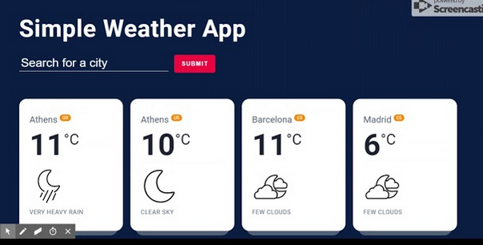
Weather app UI + booking app
Wozniak

Slide 6
User Story
As an interested person, I want to quickly locate top rated bars/lounges near me, so that I can reserve a table for my company and I.
Given: I search using a city in the united states.
When: I search using a location.
Then: A list of top rated bars/lounges populate for my selection.
When: I select/book the bar I want to visit,
Then: An option is shown with available time/date to reserve a table.
When: I view confirmation page for my reservation,
Then: A map is given with exact location and address of establishment.

Slide 7
Mockups
Wozniak

Slide 8
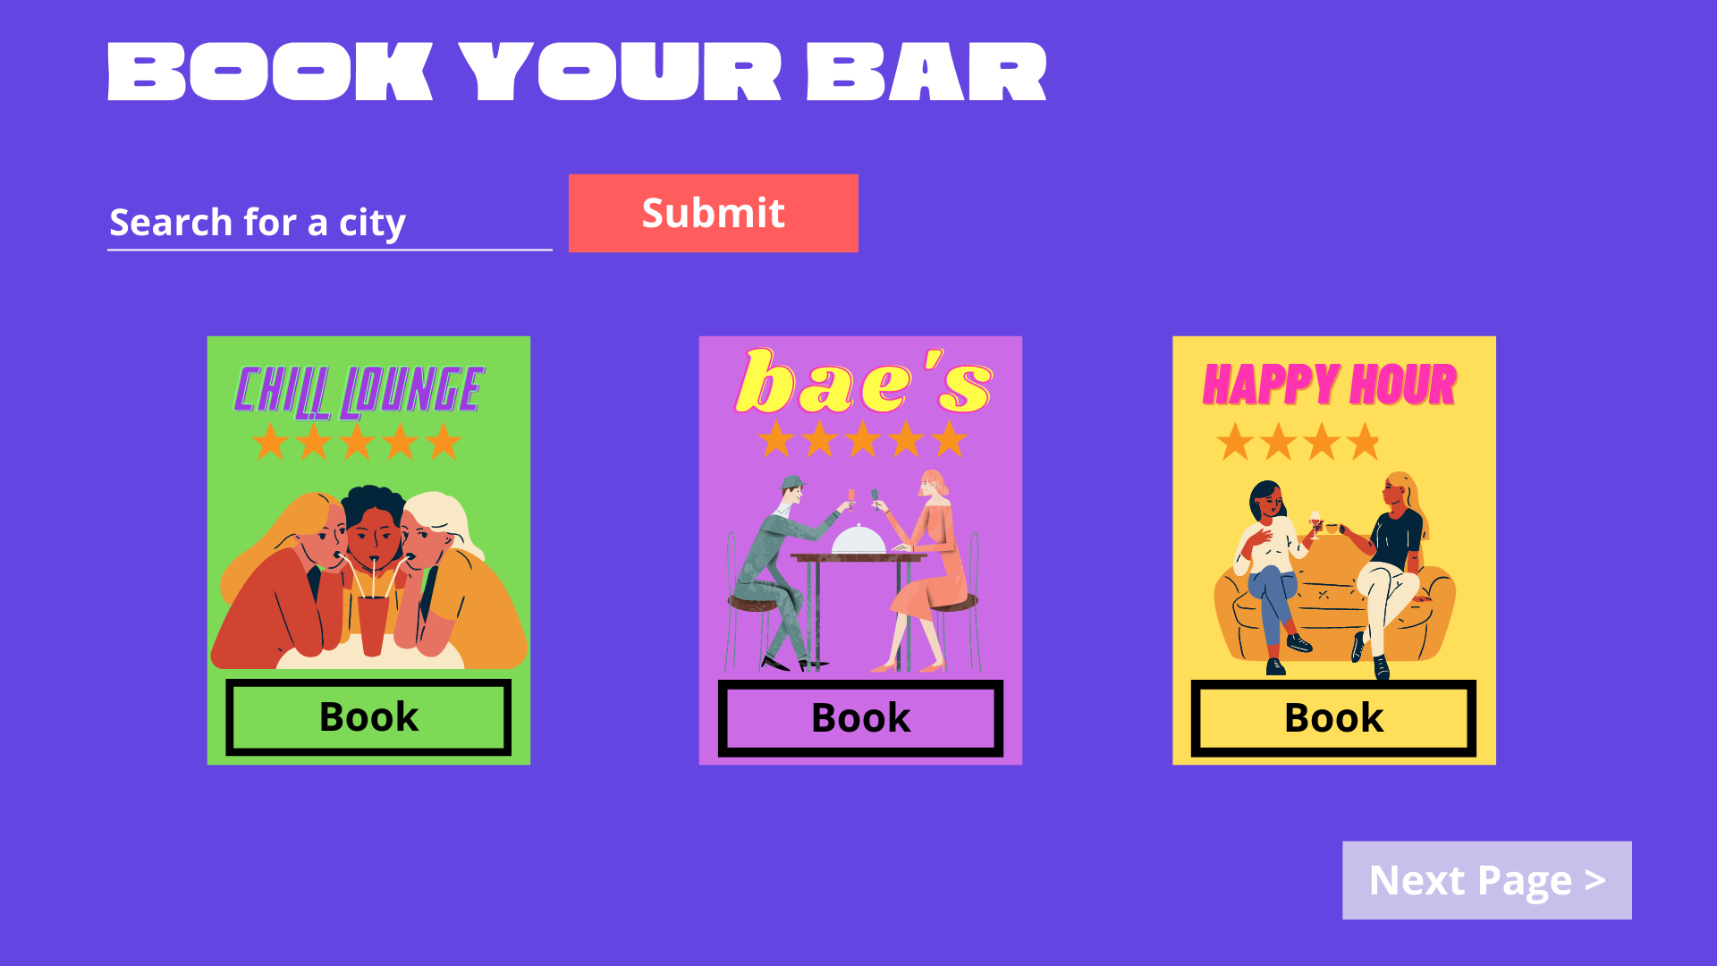
Mockup index.html
Wozniak

Slide 9
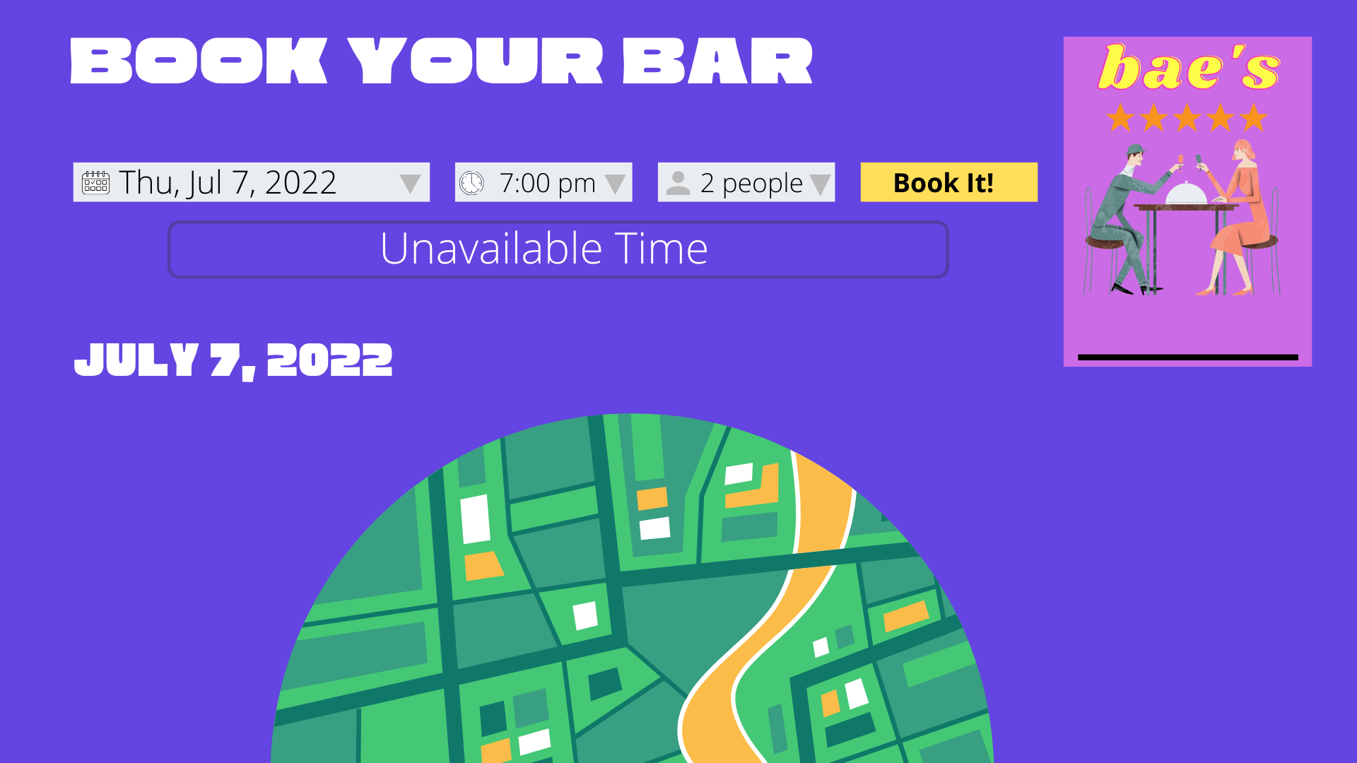
Mockup booking.html
Wozniak

Slide 10
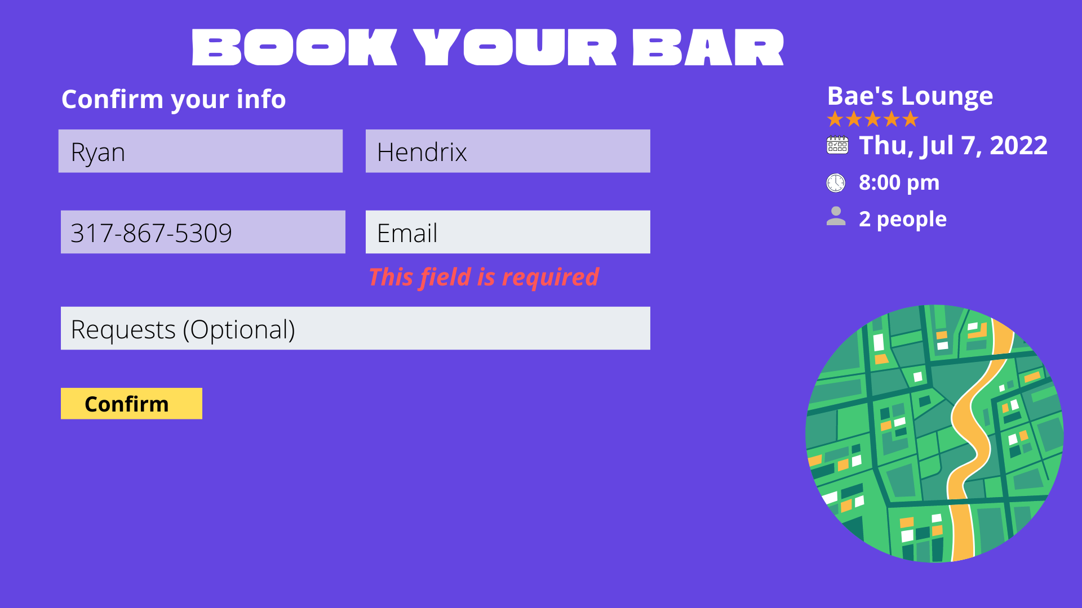
Mockup confirm.html
Wozniak

Slide 11
Process
Wozniak
Technologies used
html css tailwindcss and bootstrap for UI
JS / Jquery for web app functionality
Node and express for local server (for yelp api, they don’t sup. Client side requests)
Breakdown of tasks and roles
Challenges
Team got split up after the first week of project
Yelp access to their api
Outside the scope of the modules we have already learned
Successes

Slide 12
Demo
Wozniak

Slide 13
Directions for Future Development
Wozniak
Adding map
A web-app that allows users to quickly book a bar/lounge with a highly popular location where booking in advance is necessary.
Changing ‘bar’ pictures with different API (Trip Advisor’s API)
Yelp usually only shows food pictures, but we would rather it show the bar/lounge itself

Slide 14
Links
Wozniak
Deployed - https://book-your-bar.netlify.app/public/
GitHub repo - https://github.com/rhx1138/Book-Your-Bar

