Slide 1
Introduction
Convolutional Neural Networks (CNNs) are a specialised type of deep learning algorithm that have transformed computer vision and pattern recognition.
CNNs are widely used iv various practical applications such as autonomous vehicles and security systems
Optical Neural Networks (ONNs) represent the next hardware evolution for AI efficiency implementing optical components into Artificial Neural Networks (ANNs).

Slide 2
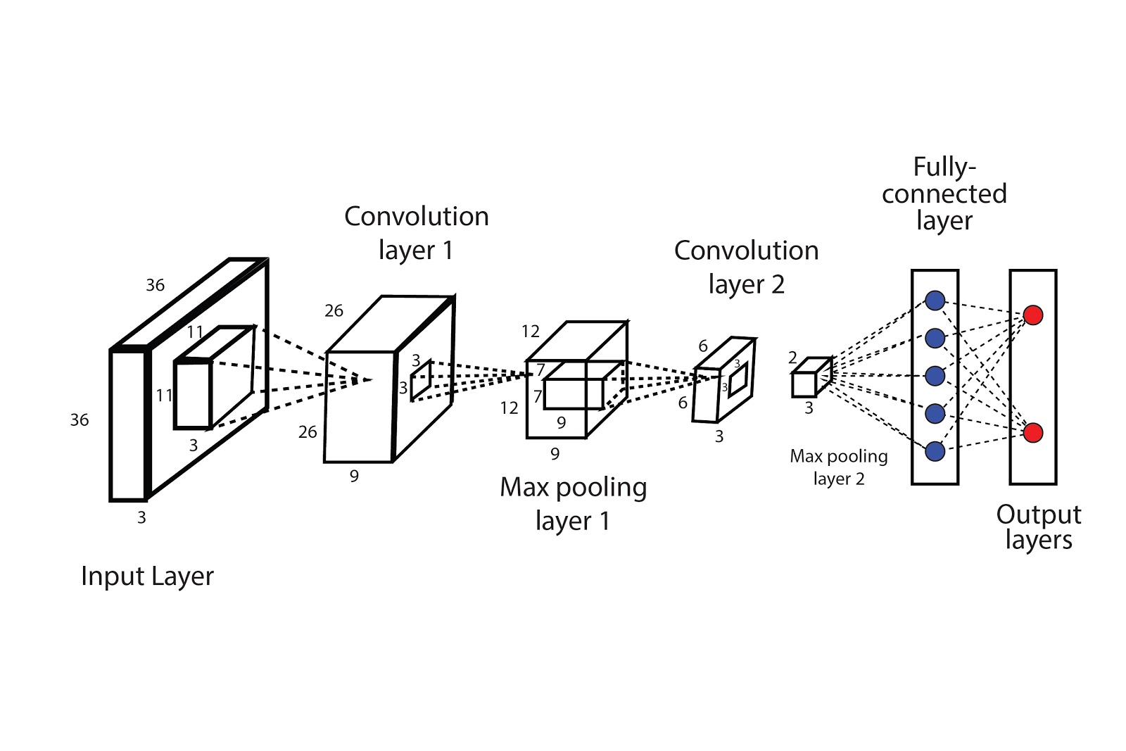
How DO CNNs work?
CNNs are made up of multiple key layers that an image must pass through.
The first layer is the Input Layer: The image is inserted into the network - you can imagine the image as a cuboid structure with a height, length and width.
The image is passed onto the Convolution Layer: Applies filters called kernels which “slide” along the image to extract key features, producing what is known as an Activation Map.
Pooling Layer: These layers reduce the spatial size of the Activation Maps, decreasing the number of parameters, thus reducing the computations required for training.
Fully Connected Layer: Flattens the data from the last convolutional layer into a 1-dimensional vector which can then be used to perform classification or regression tasks.
Activation Function: Enables the neural network to capture non-linear relationships in data.

Slide 3
Historical Development
CNNs have been theorised and developed for decades listed below are some of the key points of development for CNNs.
1989: LeNet-5 (LeCun) — digit recognition.
2012: AlexNet — deep CNNs outperform traditional methods.
2014: VGGNet — uniform architecture, small filters.
2015: ResNet — introduced residual connections for very deep networks.

Slide 4
Applications of CNNs in Research and Industry
Image classification (ImageNet, CIFAR-10).
Object detection (YOLO, Faster R-CNN).
Medical imaging (tumor and retinal scan analysis).
Autonomous systems (perception in self-driving cars).
Natural language processing (character-level CNNs).

Slide 5
Case Study - amazon
Amazon is one of many companies that utilise CNNs, specifically they use them to train their forecasting models enhancing their speed and accuracy.
The CNN algorithm compared to their original forecast algorithm can more accurately detect key indicators of demand, such as pre-order information, product page visits, promotional spikes, etc. allowing for more accurate forecasts.
Not only does this maximise the sales Amazon can make daily this algorithm is also openly available to all businesses through Amazon’s API which requires a fee to use.

Slide 6
Case Study — Tesla Autopilot
Uses CNNs for real-time visual perception from multiple cameras, allowing the recognition of objects such as vehicles, road lanes and pedestrians.
Once again these systems are trained on vast amounts of data and simulations to ensure that the cameras and sensors can accurately identify what objects are nearby.
The information gathered by the sensors are processed by the NVIDIA Drive AGX Pegasus AI computer (another company which is deeply involved with CNNs) constantly updating Tesla’s autopilot software.

Slide 7
Case Study — Hyperverge
HyperVerge is a security company which uses deep learning algorithms to analyse images of identity documents.
They are also one of the forerunners in facial recognition software and liveness detection, preventing identity fraud and deepfakes.
This process begins with the algorithm isolating human faces in images or videos, once faces are detected key features are extracted and mapped into mathematical representations known as feature vectors.
This is then compared to a database of known faces until a match is found.
Due to the accuracy of this system, it is used in many high-security environments such as Banks, Airports and government buildings.

Slide 8
Case Study — Viz.ai
Viz.ai is a startup which is now one of the leading AI in healthcare companies in the world, specialising in the analysis of medical imaging and clinical data.
Viz.ai addresses key problems in the healthcare industry such as delayed diagnoses and lack of staff.
Following the same process as the previous case studies, Viz.ai is trained off of a large dataset of medical images which have known and labelled features. From this training Viz.ai is now able to automatically detect any abnormalities in a range of medical imaging such as CT scans and MRIs.
What began as a startup now has 12 FDA-approved algorithms, and agreements with more than 1,500 US hospitals.

Slide 9
Limitations of CNNs
Computationally intensive: millions of parameters, require significant resources for training.
Data Dependency: CNNs require large amounts of labelled data for accurate training which can be difficult to obtain.
Interpretability: It can sometimes be difficult to understand why a particular decision was made by the CNN.

Slide 10
What are Optical Neural Networks (ONNs)
ONNs are physical implementations of an ANN which explore the use of photonics (manipulation of photons) instead of electronics.
Photonic solutions are able to significantly reduce the power consumption of data operations and increase the speed.
Linear mathematical operations are able to be performed at the speed of light with the use of ONNs.

Slide 11

Activity Lets get into the thick of it
https://github.com/rhyanb01/BOTSQUAD

Slide 12
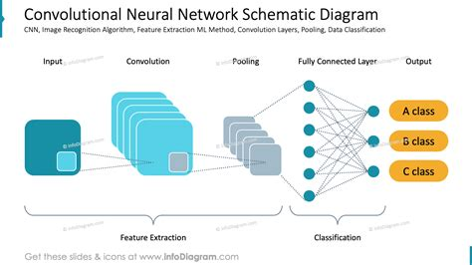
Introduction to CNN Preprocessing
CNN preprocessing transforms raw images into structured data that neural networks can understand. The process involves reducing noise, enhancing important visual features, and highlighting key edges or shapes. Each step from grayscale conversion to pooling simplifies the data while keeping important information intact for the CNN’s learning phase.

Slide 13
Step 1: Grayscale Kernel Conversion
The grayscale kernel step reduces image channels from three (RGB) to one, removing color while keeping brightness and contrast information. This simplifies computations and ensures that subsequent filters operate on uniform intensity data. Grayscale images help CNNs focus on edges, patterns, and structures rather than color variations.

Slide 14
Step 2: Gaussian Blur Filtering
Gaussian blur smooths the image, reducing noise and small variations that could distract the CNN. This step uses a mathematical kernel that assigns more weight to central pixels, producing soft transitions. By blurring the image slightly, edges become cleaner, making future feature extraction (like Sobel) more stable and consistent.

Slide 15
Step 3: Sobel Edge Detection
The Sobel kernel detects edges by calculating intensity gradients in both horizontal and vertical directions. It highlights regions with strong pixel transitions—key indicators of shapes or boundaries. This process creates an edge map, showing where significant visual features exist, which later CNN layers can use for pattern recognition.

Slide 16
Pooling and Downsampling
Pooling reduces the spatial size of feature maps, summarizing regions by their strongest activations. Max pooling, for example, retains only the most significant pixel values, ensuring essential features remain while lowering data complexity. Pooling also improves translation invariance, so the CNN recognizes patterns regardless of their position in the image.

Slide 17
Step 5: Sharpening Filter Application
Sharpening enhances image contrast by emphasizing edges and details that may have been softened by blurring. It works by subtracting a blurred version of the image from the original, intensifying transitions. In CNN preprocessing, sharpening ensures the network can distinguish between boundaries and subtle textural features during training.

Slide 18
Step 6: ReLU Activation & 2x2 Pooling to 64x64
After sharpening, the ReLU activation function removes negative values, keeping only strong feature responses. This introduces non-linearity, allowing CNNs to learn complex patterns. The 2×2 pooling step further compresses the data to 64×64, preserving the most meaningful activations and preparing the image for classification layers efficiently.

Slide 19
Full Preprocessing Pipeline Overview
Combining all preprocessing stages creates a clean, efficient input pipeline for CNNs. Starting from color images, the sequence of grayscale, blur, Sobel, sharpening, and pooling ensures robust feature extraction. Each layer transforms the image data, reducing noise while enhancing the shapes and textures critical for accurate classification.

Slide 20
Why Preprocessing Matters in CNNs
Effective preprocessing boosts CNN accuracy, stability, and training efficiency. By standardizing inputs and emphasizing relevant features, it reduces overfitting and noise sensitivity. Each preprocessing filter plays a specific role enhancing edges, removing redundancy, and simplifying patterns resulting in clearer, more meaningful representations for deep learning models.

Slide 21
Conclusion
CNNs revolutionized machine perception through hierarchical feature learning.
ONNs represent a future shift in hardware for AI.
Research continues toward faster, greener, and more interpretable models.

Slide 22
Thank You
Questions and Discussion

