Slide 1
Sign In
Username
jod1
Password
***********
Remember Me
Login
Forgot Password?
Login (Fail)

Slide 2




Logged in as John (Logout)
Dashboard
General Tools
Manage Hauliers
View All Journeys
Log a Journey

Slide 3




Logged in as John (Logout)
Haulier Manager
Back to Dashboard
New Haulier
Search…
B&W Haul
View Journeys
View Account
Generic Haul
View Journeys
Trucking inc.
View Account
View Journeys
PTP Trucks
View Account
View Journeys
Kiain Shaw Logistics
View Account
View Journeys
Foo Inc
View Account
View Account
View Journeys
Blah Deliveries
View Account
View Account
View Journeys
Bar Trucking
View Account
View Account
View Journeys

Slide 4

Logged in as John (Logout)
Haulier Manager
Back to Dashboard
New Haulier
Search…
B&W Haul
View Journeys
View Account
Generic Haul
View Journeys
Create a New Haulier
Trucking inc.
View Account
View Journeys
Name
Bell Haulage Inc
PTP Trucks
View Account
View Journeys
Kiain Shaw Logistics
View Account
View Journeys
Create
Discard
Foo Inc
View Account
View Account
View Journeys
Blah Deliveries
View Account
View Account
View Journeys
Bar Trucking
View Account
View Account
View Journeys

Slide 5

Logged in as John (Logout)
Haulier Manager
Back to Dashboard
New Haulier
Search…
B&W Haul
View Journeys
Remove Haulier?
View Account
Generic Haul
View Journeys
Trucking inc.
View Account
Yes
No
View Journeys
PTP Trucks
View Account
View Journeys
Kiain Shaw Logistics
View Account
View Journeys
Foo Inc
View Account
View Account
View Journeys
Blah Deliveries
View Account
View Account
View Journeys
Bar Trucking
View Account
View Account
View Journeys

Slide 6



Logged in as John (Logout)
View All Journeys
Back to Dashboard
Search…
Haulier Name
Source
Destination
Date / Time
B&W Haul
18/05/2018 – 15:00
SY23
LL12
Generic Haul
28/03/2018 – 12:30
LL57
SY23
Trucking inc.
LL57
LB23
18/05/2018 – 15:00
PTP Trucks
28/03/2018 – 12:30
SY23
LL57
Kiain Shaw
LL57
LL12
18/05/2018 – 15:00
SY23
28/03/2018 – 12:30
B&W Haul
LB23
Generic Haul
LB23
LL12
18/05/2018 – 15:00
1
2
3
4

Slide 7
Logged in as John (Logout)
View All Journeys
Back to Dashboard
Edit Journey
Source Post Code
LL57
Search…
Destination Post Code
SY23
Haulier Name
Source
Destination
Date / Time
Haulier Name
Generic Trucks
18/05/2018 – 15:00
B&W Haul
SY23
LL12
Generic Haul
(HTML Date Picker)
28/03/2018 – 12:30
Date of Departure
LL57
SY23
Time of Departure
Trucking inc.
(HTML Time Picker)
LB23
LL57
18/05/2018 – 15:00
PTP Trucks
Delete Journey
28/03/2018 – 12:30
SY23
LL57
Kiain Shaw
LL57
LL12
18/05/2018 – 15:00
Edit
Cancel
SY23
28/03/2018 – 12:30
B&W Haul
LB23
Generic Haul
LB23
LL12
18/05/2018 – 15:00
1
2
3
4

Slide 8
Logged in as John (Logout)
Log a Journey
Back to Dashboard
Source Post Code
LL57
Destination Post Code
SY23
Haulier Name
Generic Trucks
Date of Departure
(HTML Date Picker)
Time of Departure
(HTML Time Picker)
Create
Discard

Slide 9
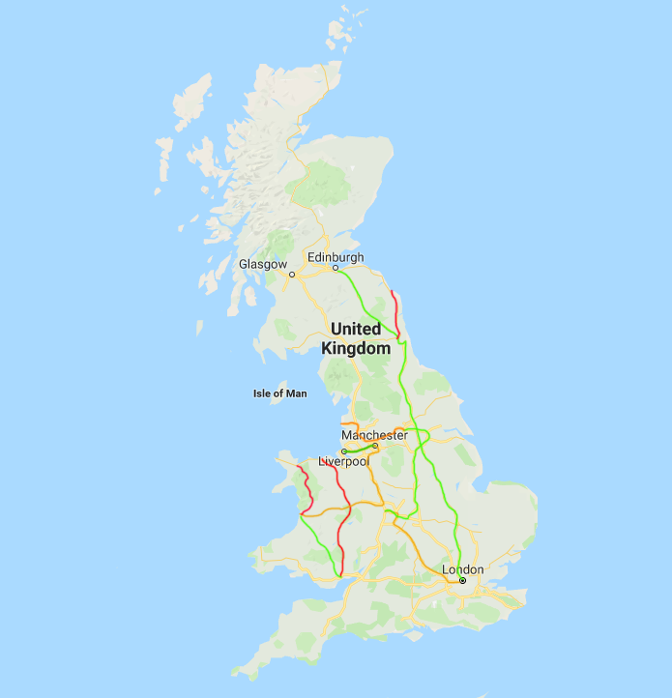
Logged in as John (Logout)
Generic Trucking’s Journeys
Back to Dashboard
Source
Destination
Source → Destination
Average Freq /day
Average Freq /week
SY23 → LL57
7
1
4
28
LB12 → LL57
SY53 → CF67
14
2
1
7
M1 → L1
5
35
LL34 → CF67
1
7
L1 → CF67
L1 → SY23
21
3
1
7
LL57 → M1
Low
High

