Slide 1
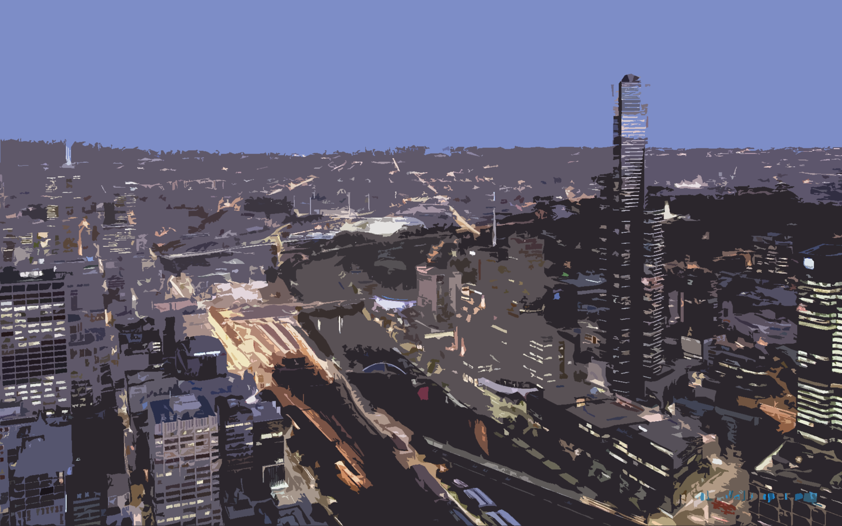
TRANSFORMATION
The Future of Autonomous Transportation

Slide 2
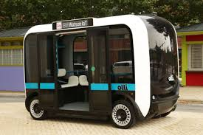
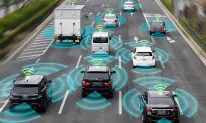
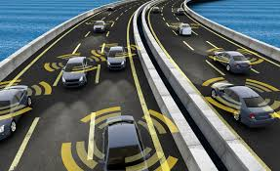
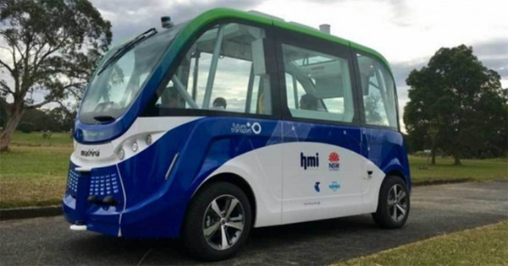
Western Transformations
Staff:
Tuan Luong
Daniel Lay
Jayden Barber
Rhys Burns
Melissa Eder
Nickolai Sokuluk (did not contribute)

Slide 3
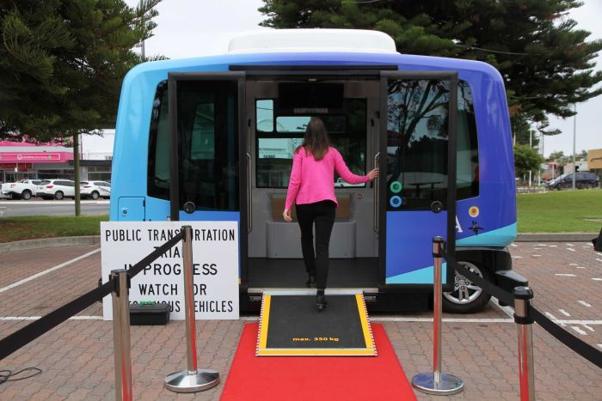
So…What Is TRANSFORMATION? What Does It Mean?
Transport – Our targeted industry is an Autonomous Community Bus Service
Forward – Imagine the Future, it means having self driving vehicles
AutoMation – The moving parts of this technology. The mechatronics.

Slide 4
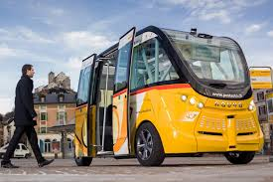
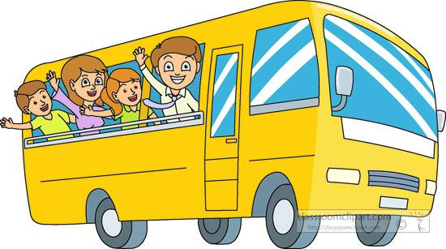
Transformation…Who Would Use It? Who Is it For?
Children
People with disabilities
Parents
Students
Elderly
Everyone!

Slide 5
How Does Trabsformations Work?
Transformation is an self driving totally autonomous vehicle.
Transformations uses state of the art technologies, such as GPS, Sensors, Cameras, Artifical Intelligence, Mechatronics, Communications, Computer Software, Electronics, The Internet Of Things, hardware to provide a range of vehicles that do not need human intervention.
Transformations will have a central Control System and an Intelligent Transport System to have human oversight, but will not need human oversight to function and drive itself around the community.

Slide 6
Transformations in More Detail
Transformations is working with VicRoads, the National Transportation Committee and other organizations to retrofit roads in our community to ensure they have sensors and markers and include good signals so that our autonomous vehicles ca use these to navigate around our community.
Trnasformations will also have top cyber security to ensure our vehicles can not be hacked or have viruses or malware downloaded on them.
Our vehicles will use a mixture of mobile phone apps, PC apps, a website and so on to enable people to make booking for our vehicles. into more detail about our service, we are working with VicRoads and The National Transportation Committee to

Slide 7
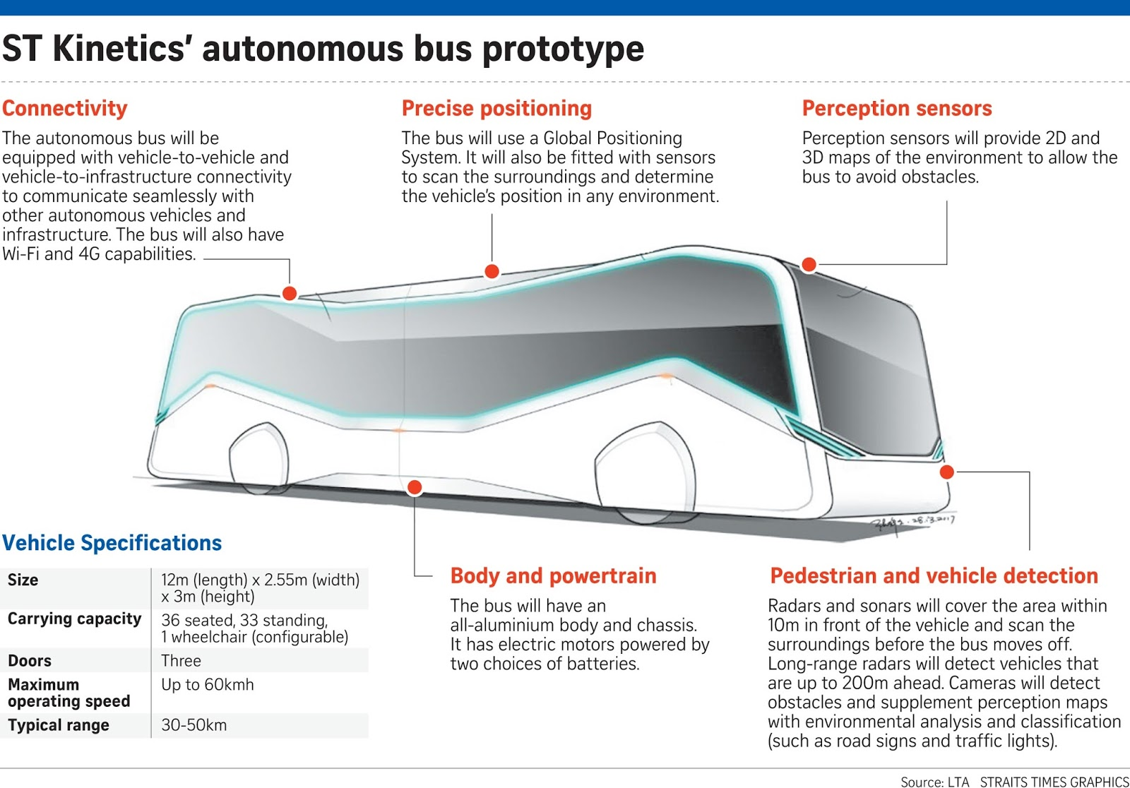
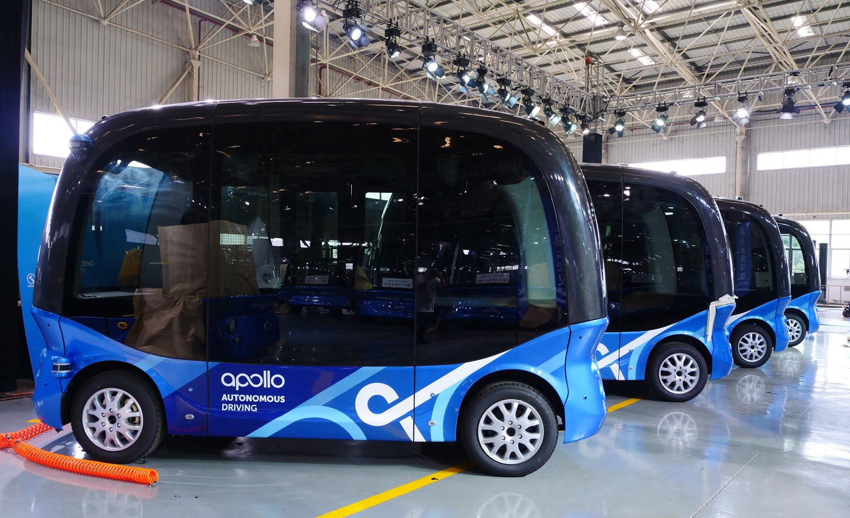
Design of Autonomous Vehicles Please See some Design ideas below

Slide 8
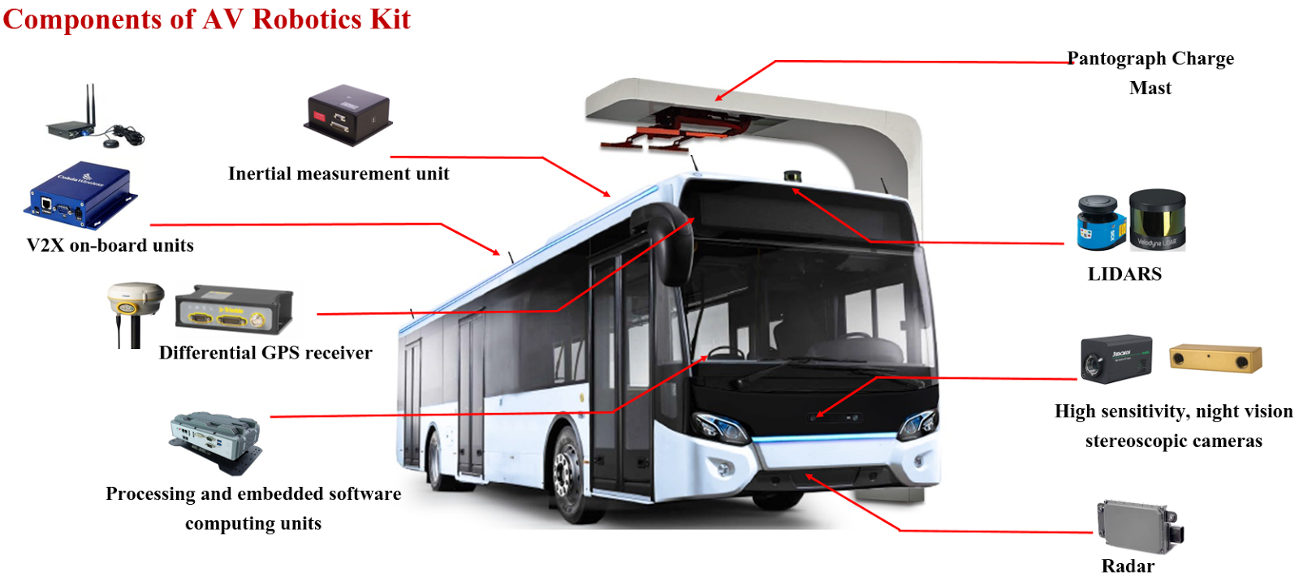
More On Bus Design
From the previous pictures, we are building buses with a range of equipment, such as sensors, cameras, GPS to make the vehicles capable of being self driven.
In addition, we are using state of the art mechatronics, mechanical engineering and electronics, to control the buses supenstion, turning of its wheels, and other features.

Slide 9
Where the Project is Currently
A few Victorian Organizations, such as Monash University, have already successfully tested autonomous vehicles of different types.
We already have roads that are being retro-fitted to ensure autonomous vehicles can operate on them safely.
Plans are already in place to start contructing 3 buses to then have a 3 motn test period.
The buses are alerady in the building phase and are awaiting testing then rollout.

Slide 10
Implementation
The final 3 buses need to finished for testing around St Albans to occur.
We are very confident of this sucess and want to start building, designing and testing further autonomus vehicles for use in our community.
We want to see other communities, especially remote communities benefitting from a range of autonomous vehicles to provide transportation solutions.

Slide 11
What Is Next for Transformations
To have a fleet of autonomud vehicles, such as buses, cars, trucks, motorized trikes, even potentially have flying autonomus vehicles to provide future transport solutions.
To explore other areas where autonomus vehicles, such as planes and so on might be able to provide better, safer and more cosy effective transportation
To fund research into new technologies and areas t push Austalia into the forefront of engineering, Information Technology and Science.

Slide 12
So what are you waiting for?
Dare to Dream
Dare to be different
Jump on board and prepare for the future of public transport and automation!
Thankyou

