Slide 1
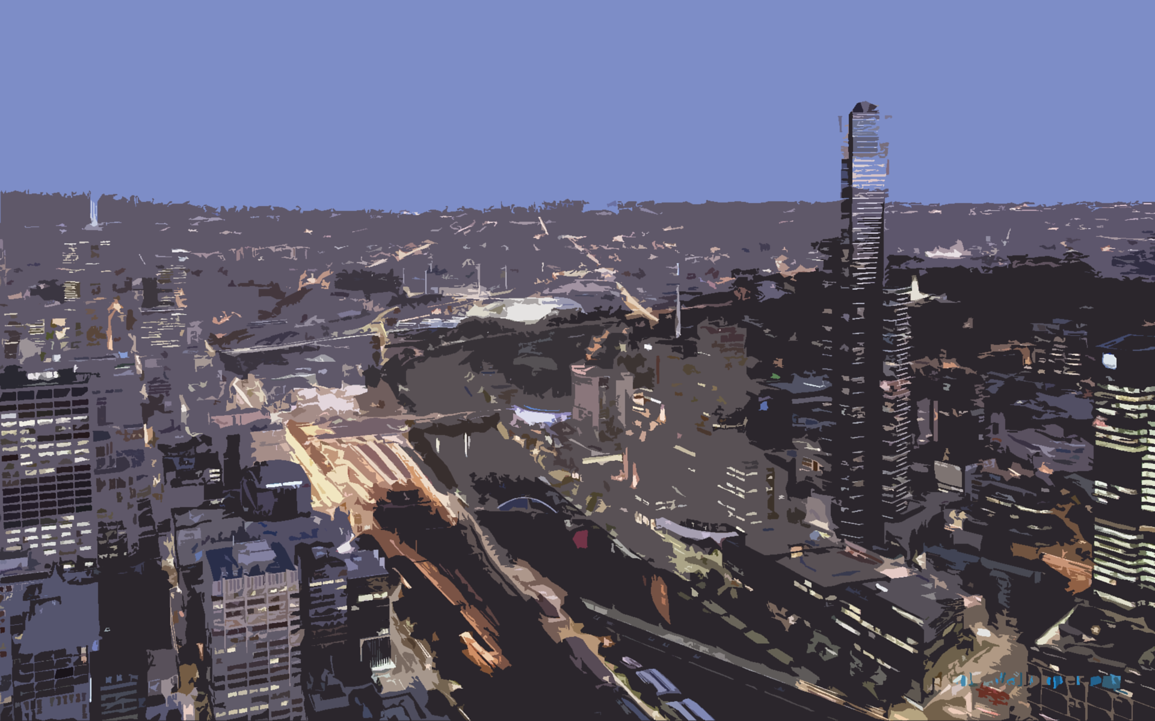
TRANSFORMATION
The Future of Autonomous Transportation

Slide 2
So…What Is It?
Transport – Our targeted industry
Forward – Think the future
AutoMation – The moving parts of this technology

Slide 3
And…Who Would Use It?
Children
Parents
Students
Elderly
Everyone!

Slide 4
How Does It Work?
Insert text on how it works

Slide 5
Concept Design
Insert pictures of a few concept buses, and talk about the features of the current fleet

Slide 6
Implementation
What stage is the technology at today
Where is it being tested or deployed

Slide 7
What Is Next?
Discuss future plans for TransForMation
Discuss what is in development

Slide 8
So what are you waiting for?
Jump on board and prepare for the future of public transport and automation!

