Slide 1
Vegan Restaurants in London
Coursera Project – Applied Data Science Capstone
By Rhys Davies
August 2019

Slide 2

Motivation
This presentation is prepared for the Vegan Society
This is intended to investigate if there is a relationship between wealth and veganism. It is also hoped that this presentation can provide information that may be userful to the Society and the general public.
Ref (1). https://www.vegansociety.com/

Slide 3
The Spark
Dr Marco Springmann of the Oxford Martin Programme on the Future of Food led an powerful and widely discussed study [Ref (2)].
Amongst the imlications, is one powerful point:
“If the world went vegan, it could save 8 million human lives by 2050, reduce greenhouse gas emissions by two thirds and lead to healthcare- related savings and avoided climate damages of $1.5 trillion.”
Ref (2). https://www.oxfordmartin.ox.ac.uk/news/201603-plant-based-diets/

Slide 4
Background i)
The trend of increasing veganism supported by qualitative evidence of more vegan based foods both in supermarkets and also restaurants.
We wish to explore if there is a relationship between veganism and wealth. To begin this enquiry we will consider property price as a proxy for wealth. Although this assumption is qualitative, it remains reasonable, at least for the purposes of this exploratory project. The basis for this assumption is that people tend to purchase more expensive properties as their wealth increases. The rate of this change is not constant and indeed complex, but for our purposes it is enough to acknowledge a positive correlation.¶

Slide 5
Background ii)
The data available for London is available, internally consistent and of sufficient quantity to enable a meaningful analysis to be undertaken and offers the opportunity for a reliable conclusion.
London is widely considered to be amongst the leading cities in the world and consistently scores in the top 10 cities offering the best alternatives for vegans.
The London property market is one of the most studied and invested in the world. This offers an opportunity to identify any possible early trends as well as to offer useful information to people who may find the abundance and proximity of vegan restaurants a factor in their home buying decisions.¶

Slide 6
Background iii)
The relative cost of living a vegan lifestyle is complex. The costs of the raw materials are generally cheaper, although anecdotal evidence suggests that vegan products and vegan restaurants can and do charge a premium. However this is a crude generalization. There are multi-factors from fashion to the available economies of scale at play and this subject is itself a rabbit-hole of possibility and intrigue.

Slide 7
Data Considerations (House Prices)
House price data can be obtained from UK Government website sourcing HM Land Registry data [Ref (3)].
This contains HM Land Registry data under the Crown copyright and database right 2019. This data is also licensed under the Open Government Licence v3.0.
Since house prices are not liquid, they are measured only occasionally when a transaction is made, then we do need to choose our method of measuring house price. General indices were considered, but for this analysis we consider the last paid price which represent the actual price paid for a unit within a particular postcode. This does mean however that the time of the transaction is not snapped at the same time and some transactions go back over the previous year. It also means that we are considering different unit sizes. Given our goal is to estimate the average in a region in order to rank by region, these effects will average themselves out.
Ref (3). https://www.gov.uk/government/statistical-data-sets/price-paid-data-downloads

Slide 8
Data Considerations (Vegan Restaurants)
Information pertaining to vegan restaurants will be obtained from Foursquare and their Products database. This will follow the requirements set out in the Developer section [Ref (4)]:
This data is of high quality, and particularly so for London for which there is a deep data set. We know from experience that Foursquare data is sound and under constant scrutiny by the vast network of developers, users and contributors. It is this community to which we are happily rely for the quality of our data.
The two data sets will be imported into a Python notebook and incorporated into a consistent dataframe where the data will be joined using postcode. This will then provide the ability to consider sold prices by postcode and also to consider the vegan restaurants per postcode. Given that many residential areas do not have high-streets or an abundance of commercial activity, we can ignore the postcodes which contain little or no commercial activity. Our goal is to consider the areas for which we do have an abundance of vegan restaurants and to view the house prices of these areas to the average.
Ref (4). https://developer.foursquare.com/

Slide 9
Methodology
The Foursquare will be centred on a central London coordinate (51.50795322377849, -0.12432828429154276) and include a search radius of 5KM utilizing the ‘%vegan% search query in the venue/search URL.
Restaurants with missing post code data will be removed if postcode cannot be found by manual search.
The data will be grouped by the first three characters of the postal code. This reflects that there is not a large number of vegan restaurants and we need to expand the grouped area in order to create meaningful clusters.

Slide 10
Results i)
Following importing the data and cleaning of the data, the data sets were merged as shown below.
The most immediate point to note is that only a small set of vegan restaurants were found. The total number of vegan restaurants, sourced from the Foursquare database was 25. Note that 7 were eliminated since they had incomplete data or were dubious existence.
This small number of results has been checked and it does remain the case that there appears to be a very small number of restaurants spread across London.

Slide 11
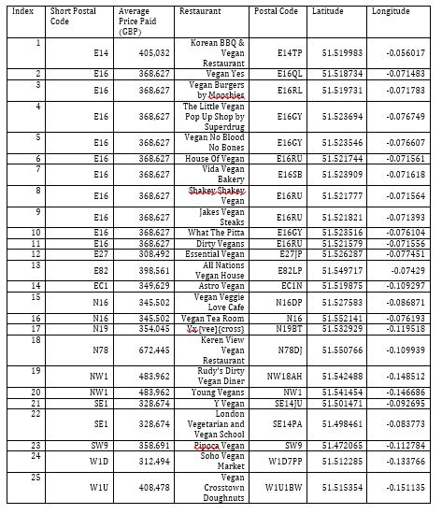
Results ii)
The full list of these are shown in the table alongside their coordinates and the average house price within their respective shortened postcode.

Slide 12
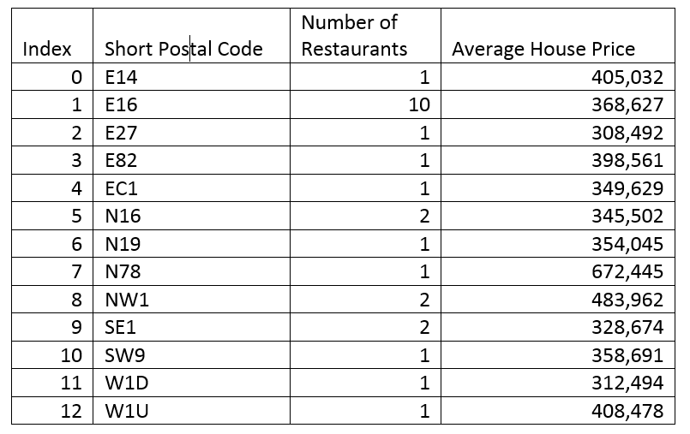
Results iii)
The number of restaurants per Short Postal Code were grouped together and the number of vegan restaurants counted as shown in the table below.

Slide 13
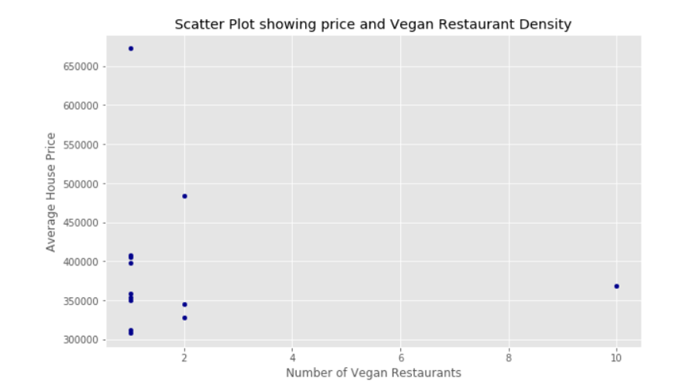
Results iv)
The scatter plot shows the average house prices against the number of vegan restaurants in the vicinity.

Slide 14
Results v)
The graph shows that only in one area is there a significant clustering of vegan restaurants. Other vicinities have only a single vegan restaurant and the average house prices in these areas cover a wide range. A number of regions have 2 vegan restaurants and the average prices in these vicinities again looks widely dispersed. The single outlier (representing short postal code E16) has 10 vegan restaurants.
Given this clustering, our analysis has calculated the mean position, given by the mean latitude and the mean longitude. This sits within the scatter of the restaurants and can be imagined as a centre of gravity type calculation.

Slide 15
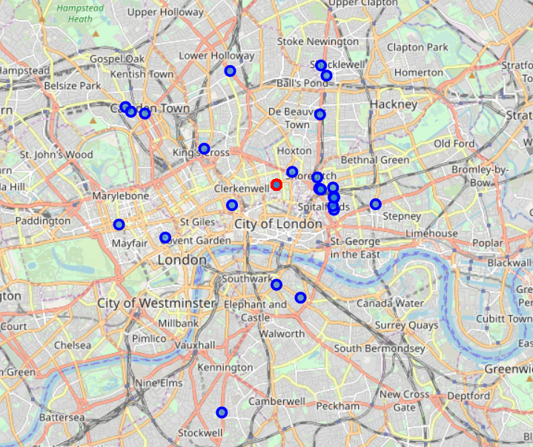
Results vi)
Map showing the location of the vegan restaurants (blue) shown below and the centre of gravity (shown in red) illustrated.

Slide 16
Discussion i)
Our original question on a link between wealth and veganism has not resulted in a clear answer. The proxy by comparing to house prices has led to the suggestion that veganism is not directly linked to house prices.
The number of vegan restaurants found within Foursquare was far less than originally supposed. This perhaps is an interesting conclusion in itself. It suggests one or more of the following:
Foursquare does not list many vegan restaurants
There are not many vegan restaurants
Restaurants serving vegan food are not uniquely vegan
Vegan restaurants have not identified themselves as vegan for the purposes of Foursquare rankings.

Slide 17
Discussion ii)
The results have however produced the unexpected result of the E16 cluster. Restaurant density and genre density is known to cluster, however the large cluster of 10 within E16 was surprising and hugely significant. This is a thread which if pulled and investigated could lead to some new insight and discovery. Why exactly is E16 such a hot-spot for vegan establishments? This is potentially of greater interest to The Vegan Society since identifies a geographical area in which there is clearly a significant interest in vegan dining.
The identification of this vegan hot-spot presents not only a research opportunity for The Vegan Society but also a marketing one too. Having such a focal area offers opportunities for news stories, promotional events (being a central point to attract others from the surrounding areas) as well as providing a competitive environment to nurture a high standard of products and cuisine.

Slide 18
Conclusion
The initial aim of this project was to investigate if wealth (proxied via house prices) was an indicator of veganism (proxied via the incidence of vegan restaurants). The analysis here has not found a direct relation between the two and finds no evidence to suggest a direct link between veganism and wealth.
However our analysis has identified a region with a significant density of vegan restaurants. This region is close to a ‘centre-of-gravity’ of the vegan restaurants in London. This region offers several interesting opportunities for The Vegan Society. These include an area offering research potential into vegan trends and dining, the opportunity for PR and marking, an epicentre with perhaps a critical mass of people to create innovation for the nascent vegan industry.

