Slide 1
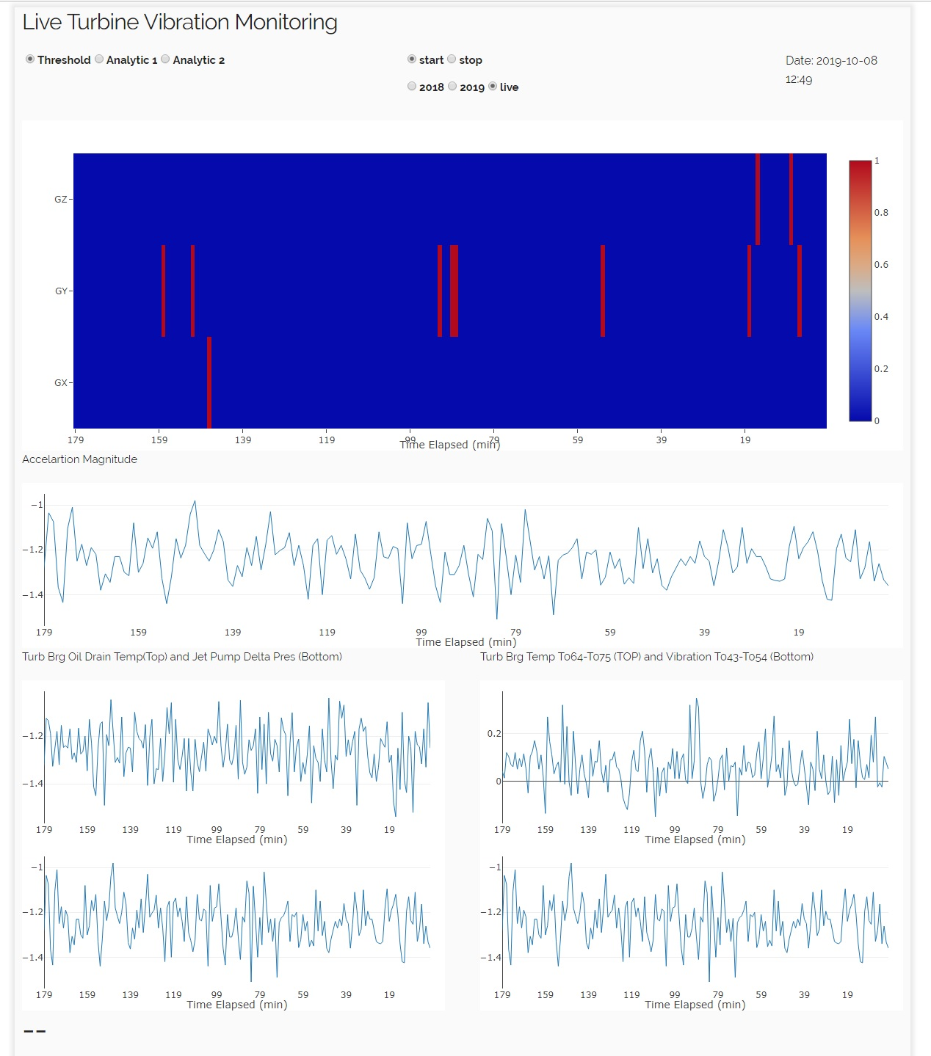
Stop/start streaming
Analytic Selection:
Enables selecting different analytics
Type of stream:
Live or Historical
Date-time
Z
Heatmap chart
X: is time; 0 time is the time of last data point which is shown in the Date-Time in the top-right corner and 179 is 3 hrs ago
Y: 3-D accelerometer
Z: binary values (0-1); red means out of thresholds range and blue is in the range
Y
X
You may Show results of your anomaly detection here.
Currently showing one of accelerations
Show details which helps field engineers, e.g. magnitude of acceleration, different phases or raw sensor readings

