Slide 1


Serverless Real-Time Data Pipeline on GCP
A fully serverless, end-to-end solution for processing real-time data using Google Cloud Platform's tools.
Presented By :
Ashish Kumar (M23AID069)
Ankita Agarwal (M23AID021)
Zarrish Iqrar (M23AID048)
Sachin Gupta (M23AID057)
Rhythem Sharma (M23AID023)

Slide 2
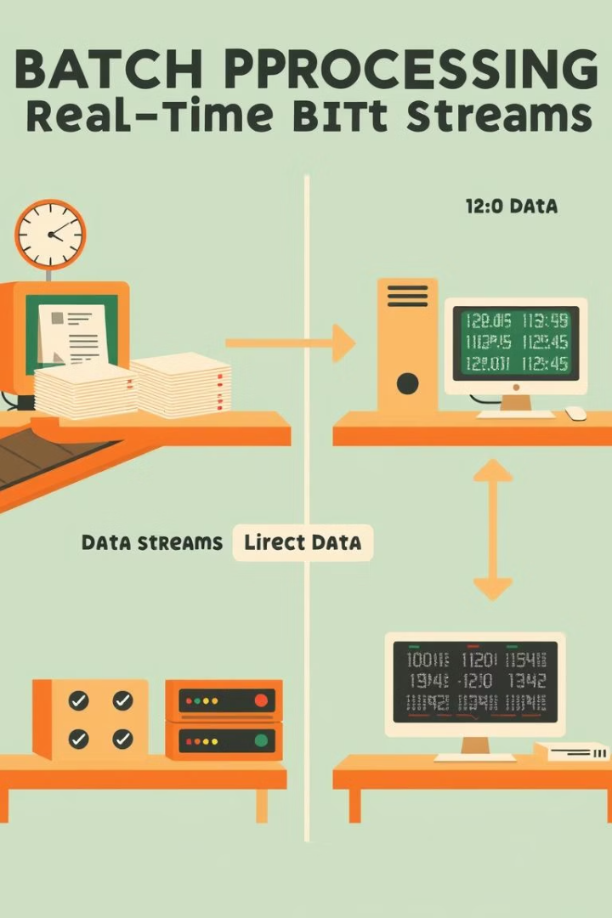
From Batch to Real-Time
Batch Processing Limitations
Real-Time Necessity
Finance, healthcare, retail need immediate insights
Data collected over time, processed all at once
Serverless Advantage
Focus on logic while cloud handles infrastructure

Slide 3








Project Objective
Real-Time Pipeline
Process streaming data efficiently
Scalable Architecture
Handle varying data volumes
Cost-Effective
Pay only for what we use
Low-Latency
Near-instant data availability

Slide 4
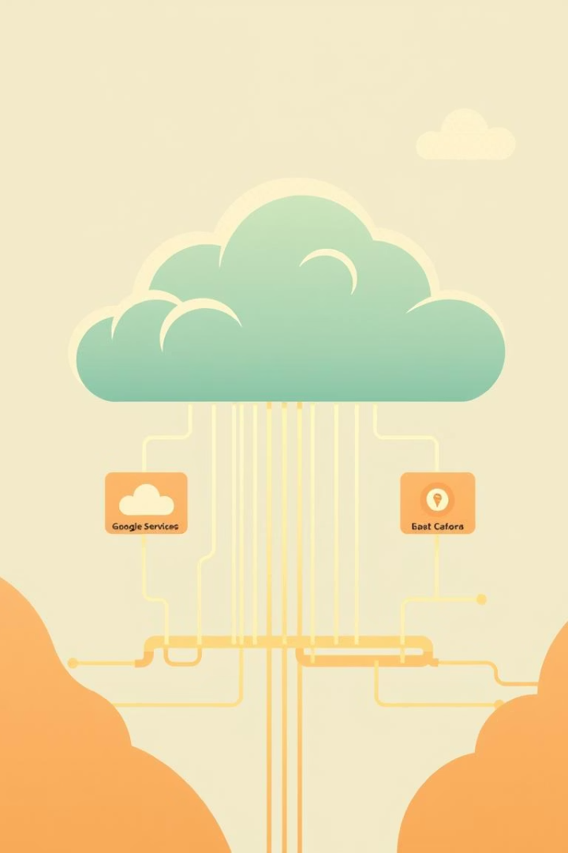
Cloud Computing Relevance
On-Demand Infrastructure
Serverless Simplicity
No server management complexity
Scalable resources ideal for data processing
GCP Ecosystem
Integrated tools working seamlessly together

Slide 5
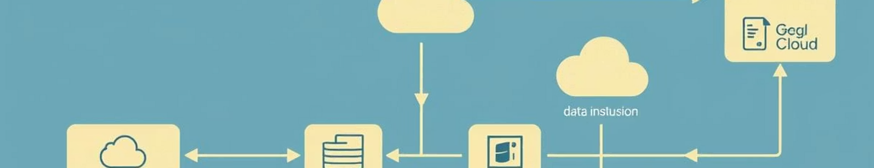




High-Level Architecture
Cloud Pub/Sub
Cloud Dataflow
BigQuery
Looker Studio
Ingests data streams
Processes data in real-time
Stores structured data
Visualizes processed data

Slide 6
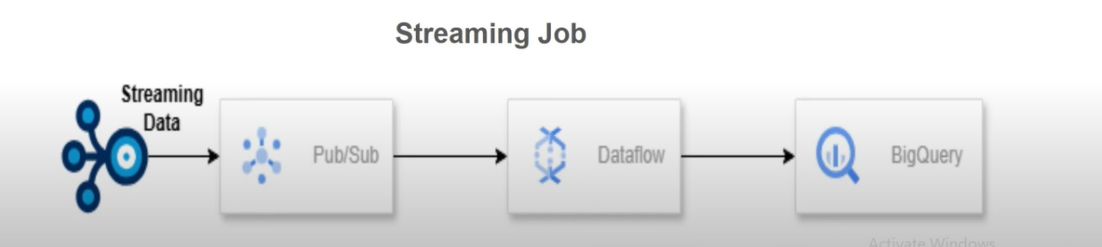

Slide 7
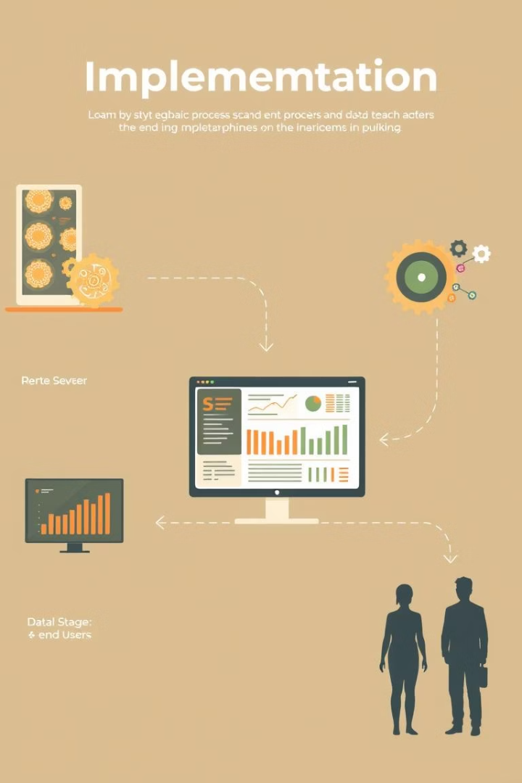




Implementation Steps
Data Ingestion
CSV data published to Pub/Sub
Data Processing
Dataflow cleans and transforms
Data Storage
BigQuery for queries, Storage for raw files
Data Analytics
Live dashboards with Looker Studio

Slide 8
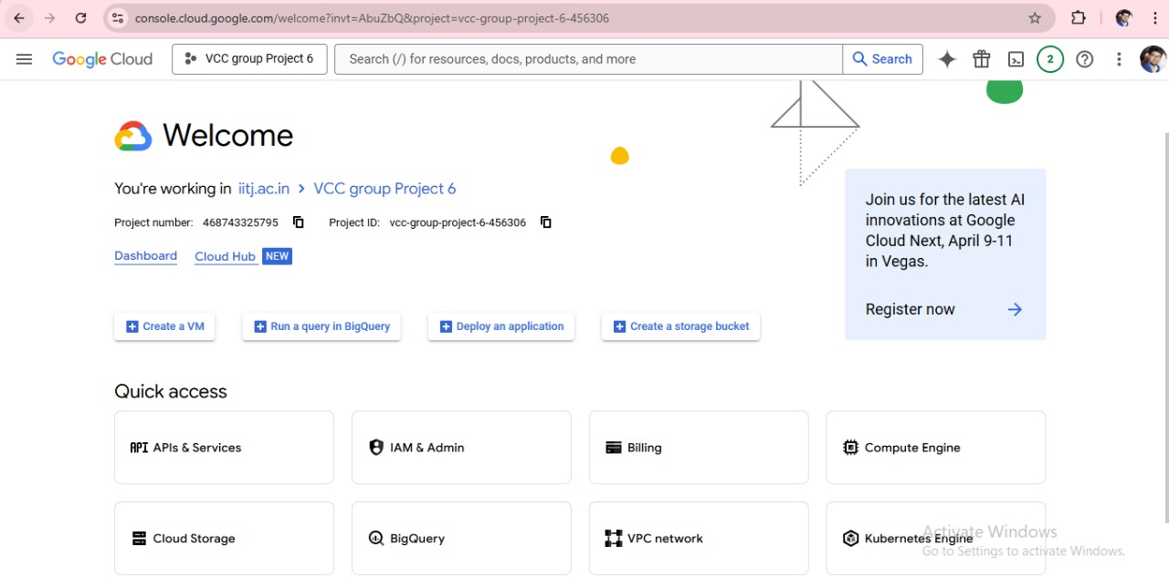
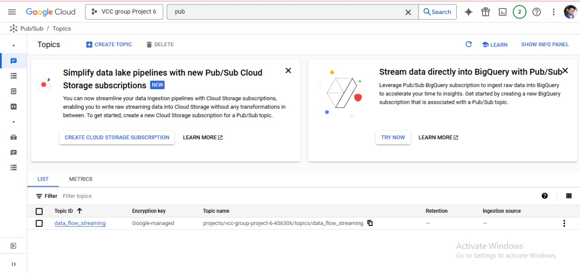
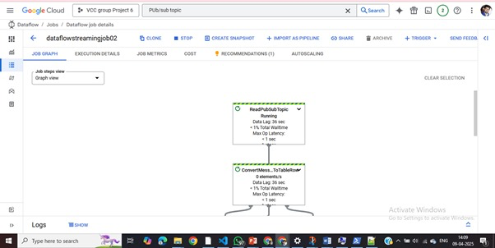
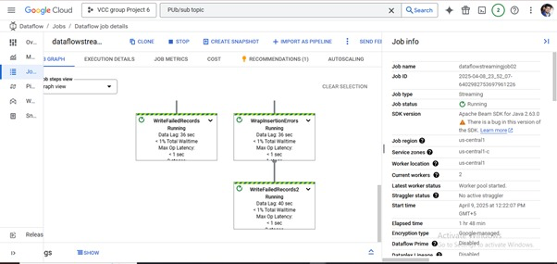


Slide 9
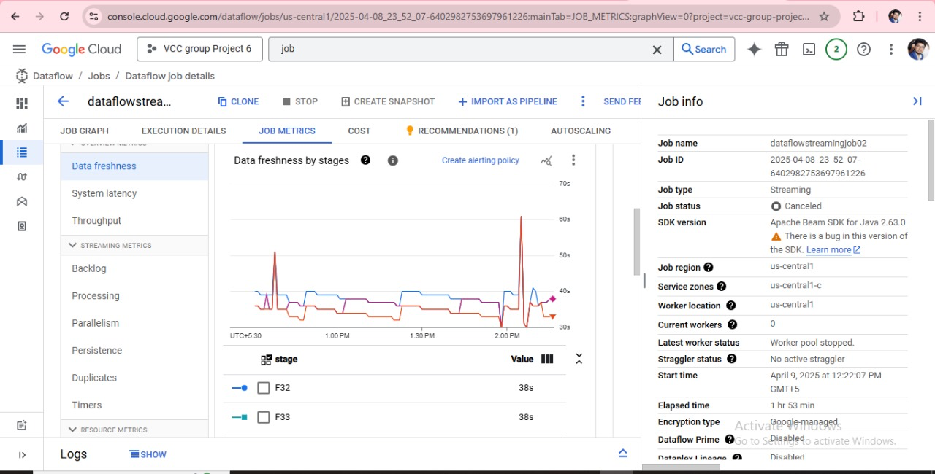
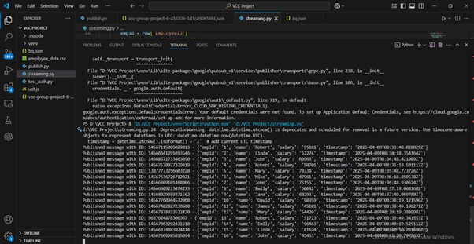

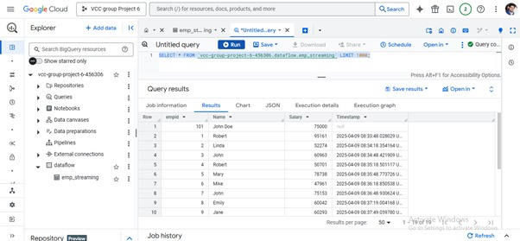
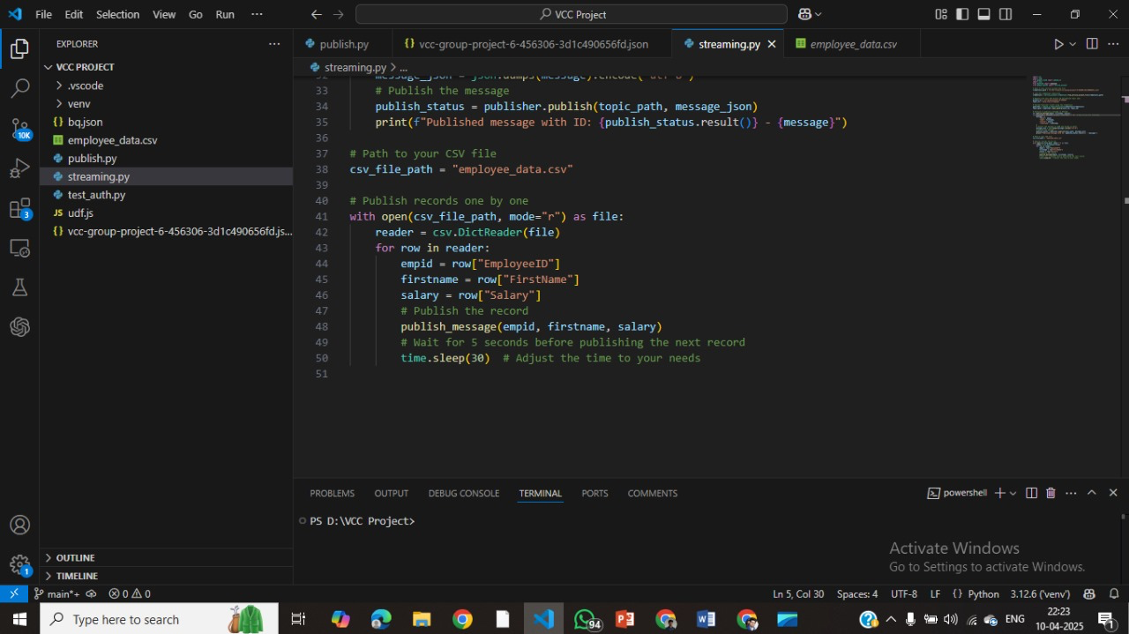

Slide 10





Tools and Technologies
Pub/Sub
Dataflow
BigQuery
Real-time message streaming
Stream processing with Apache Beam
Fast, scalable storage and analysis
Cloud Functions
Event-based automation

Slide 11
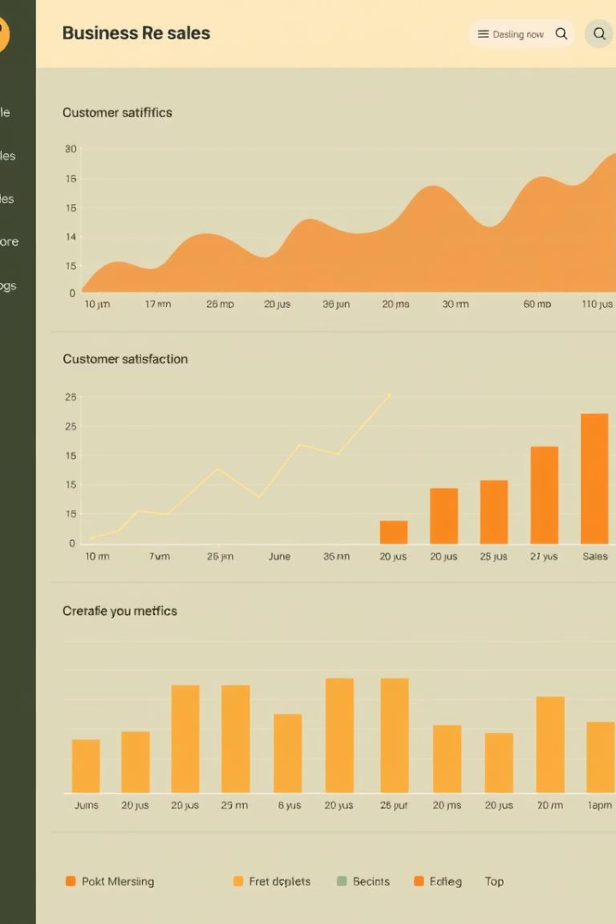
Key Outcomes
100ms
30%
Processing Latency
Cost Savings
Ultra-fast data processing
Compared to traditional setups
99.99%
Uptime
High availability maintained

Slide 12
Traditional vs Serverless
Traditional
Serverless
~200ms latency
~100ms latency
$0.80/GB cost
$0.50/GB cost
Manual scaling
Auto-scaling
High maintenance
Plug-and-play

Slide 13






Future Enhancements
Multi-cloud Integration
Improved resilience, reduced lock-in
ML-based Detection
AI to flag unusual patterns
Advanced Automation
Complex business logic triggers

