Slide 1
Paper discussion: Steffi, Sasha, Rhythima
25 Nov 2022

Slide 2
Agenda
Paper
Model & Results

Slide 3
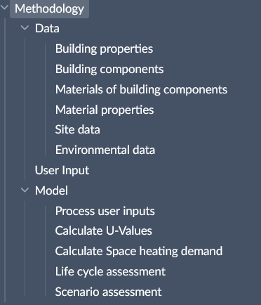
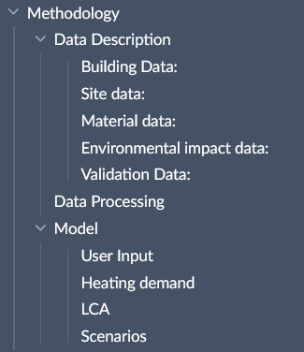
Paper – Methodology structure

Slide 4
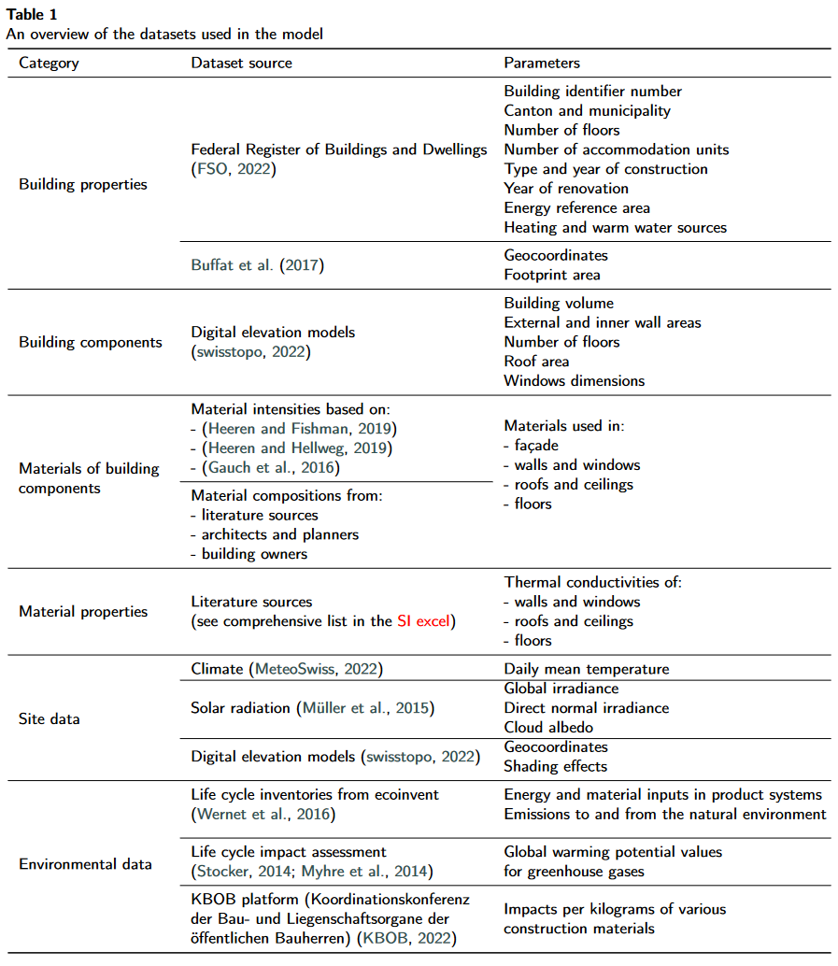
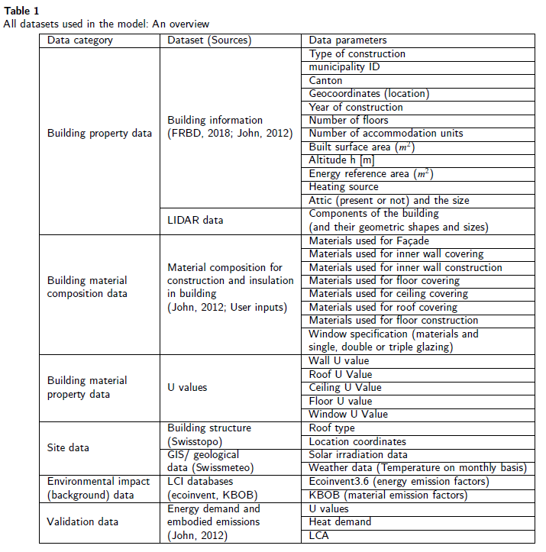
Paper – Data description (table)

Slide 5
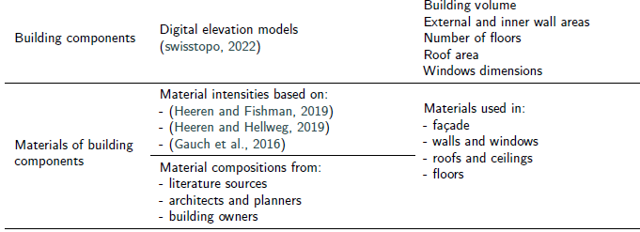
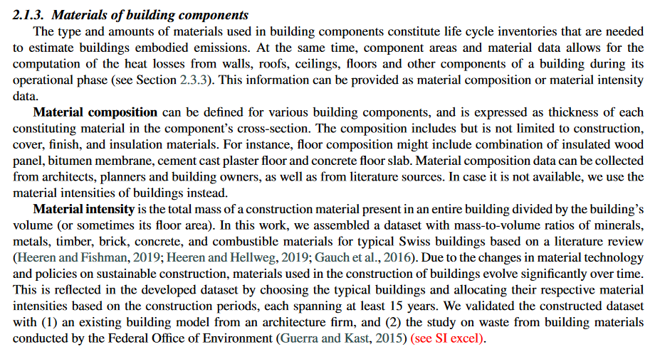
Paper – Data description (writing)

Slide 6
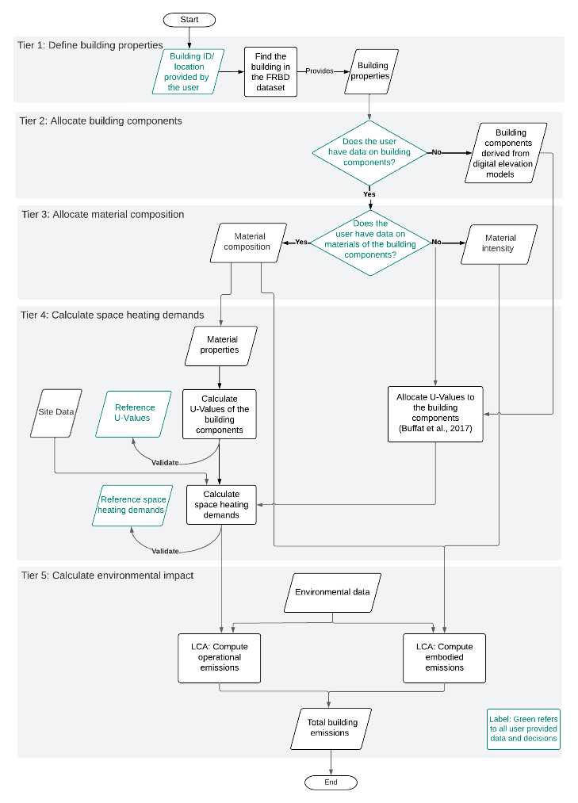
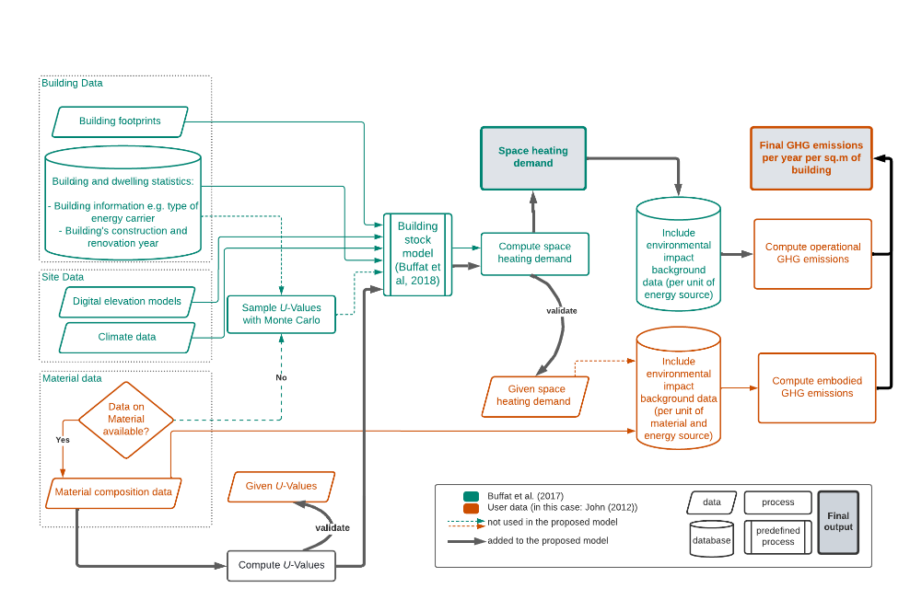
Paper – Method structure (diagram)

Slide 7


Slide 10
Model / Results - edits
Heat demand
Fixed the views on the server database and dependencies
Ventilation effects and window configurations discussed
LCA
Introduced embodied and operational

