Slide 1
Paper discussion: Steffi, Sasha, Rhythima
25 Nov 2022

Slide 2
Timeline
Dates | Work task | Overall Deadlines/ Review
25 Nov | Model: no error in beef model (all views have all parameters allocated) | Discussion (SSR): Section 2.1 + Figure 1 + Table 1
26 Nov | Move SI to excel (re) Write Section 2.2. User input (and Table 2) Write Section 2.3. Model (Explain Figure 1) (re) Write Section 2.3.1 Process User Inputs Fix Table 3
28 Nov | Write Section 2.3.2. Calculate U Values Check, maybe remove Table 4 Check figure 2 Write Section 2.3.3. Calculate Space heating | Sasha checks Writings on Section 2.2, Section 2.3, 2.3.1.
29 Nov | Model: Ventilation parameters fix Figure 1 + new: Ventilation flow chart concept Model: Check new results Finish Section 2.3.3 Space heating demand | Sasha checks 2.3.2 + 2.3.3 and discuss model ( u value, heat demand)
30 Nov | Buffer for heating demands calculations check figure 3, table 6 Check LCA calculations (KBOB sources) and adapt section 2.3.4 writing (if needed) Check Figure 4 | Sasha checks and discuss 2.3.4 (LCA)

Slide 3
Timeline
Dates | Work task | Overall Deadlines
1 Dec | Write Section 2.3.5. Scenario assessment Check Table 5 Check Figure 5 Check model scenario setup | Sasha checks 2.3.5
2 Dec | Buffer for scenario model Write Section 2 Methodology intro Complete Section check | Work and review together
3 Dec | BUFFER | Send the draft to Steffi on Section 2
5 Dec |  | Discussion (SSR): Section 2
6 Dec
7 Dec
8 Dec
9 Dec
10 Dec

Slide 4
Agenda
Old plan till 24 Nov
Paper
Model & Results

Slide 5
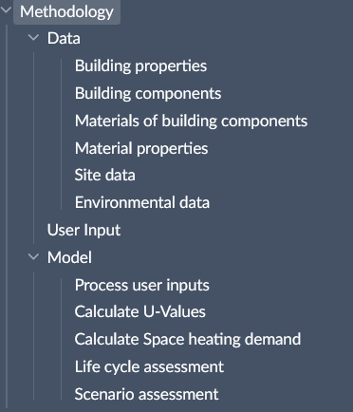
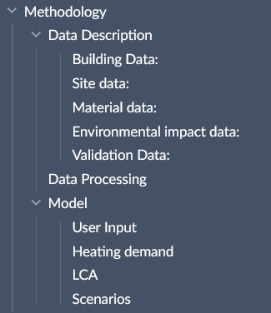
Paper – Methodology structure

Slide 6
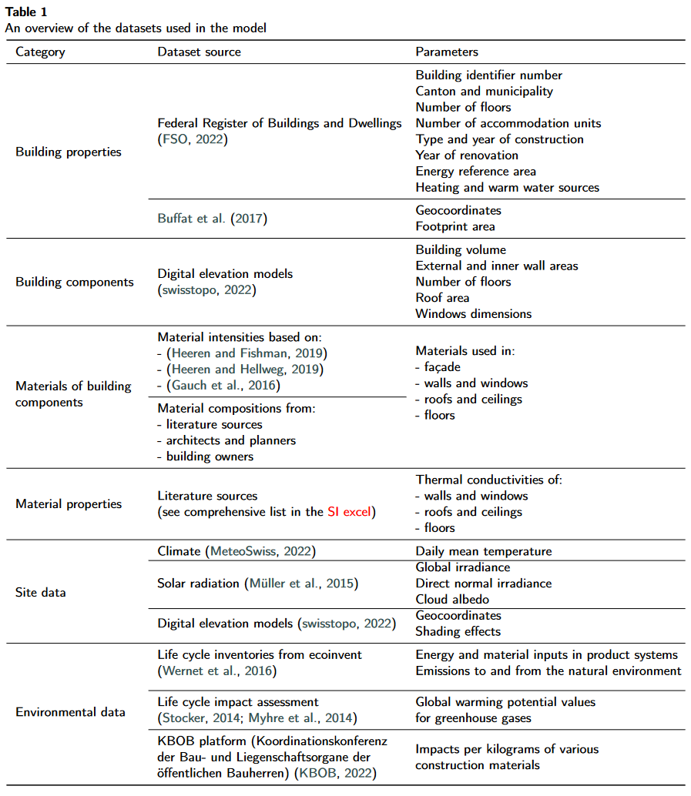
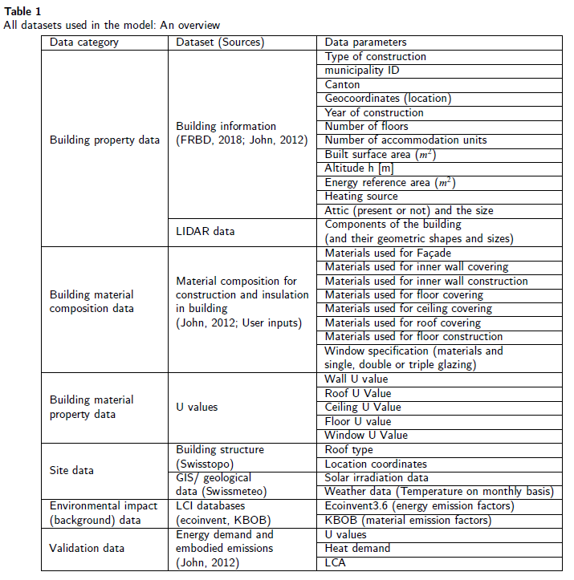
Paper – Data description (table)

Slide 7
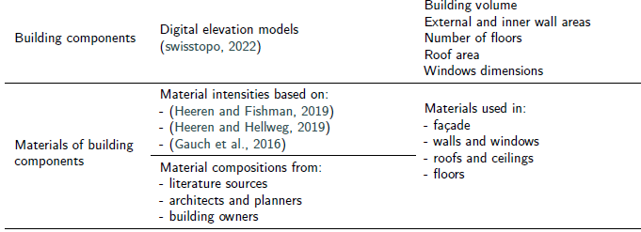
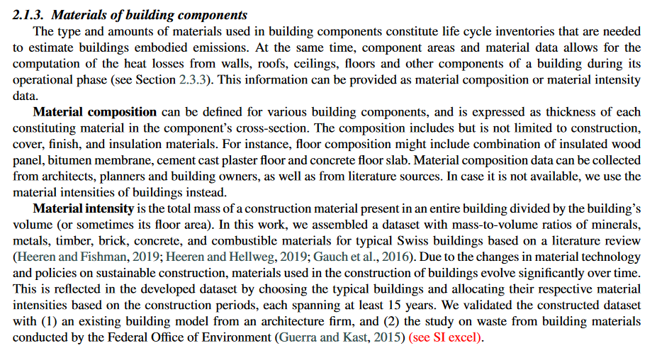
Paper – Data description (writing)

Slide 8
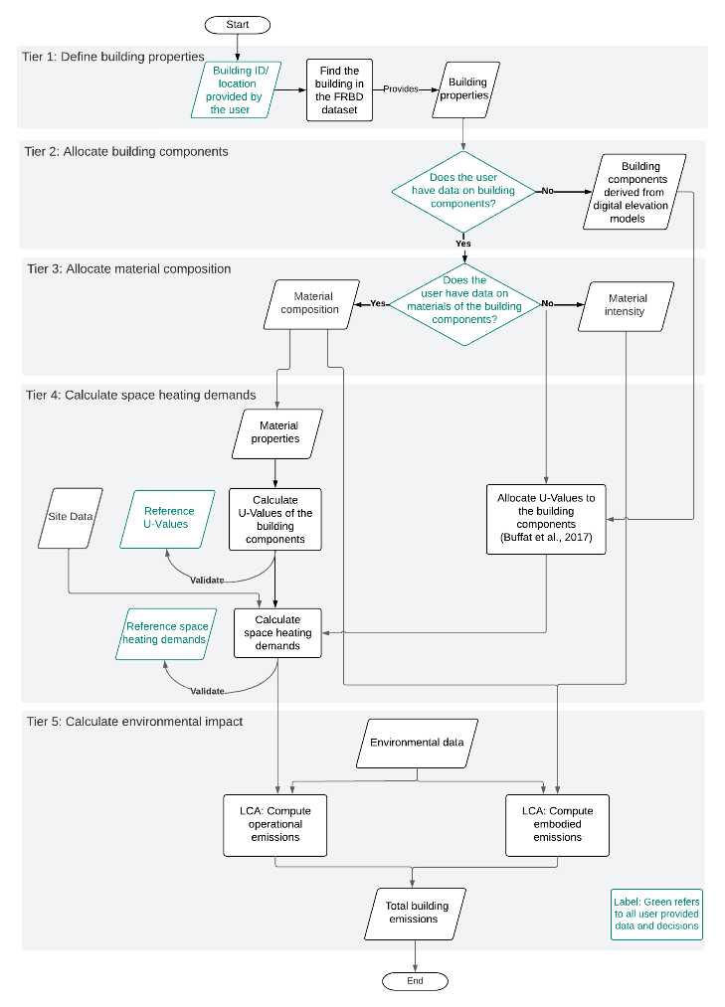
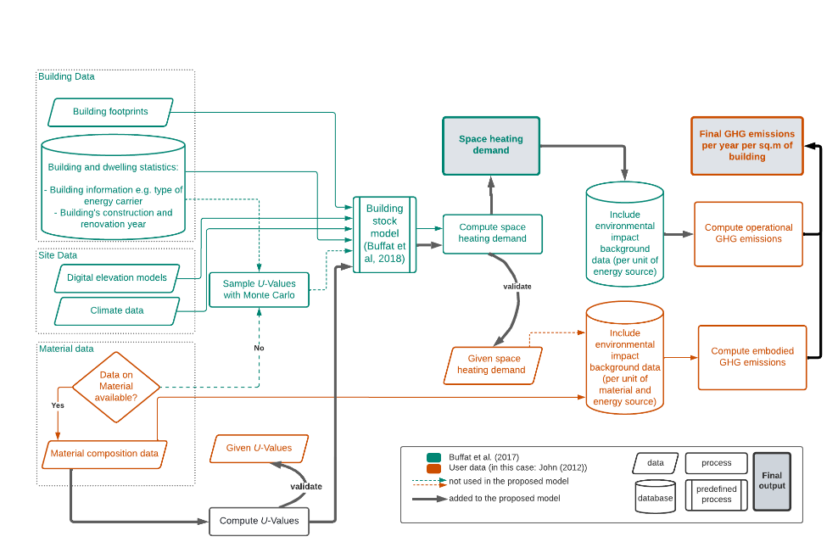
Paper – Method structure (diagram)

Slide 9


Slide 12
Model / Results - edits
Heat demand
Fixed the views on the server database and dependencies
Ventilation effects and window configurations discussed
LCA
Introduced embodied and operational

