Slide 1
Paper discussion: Steffi, Sasha, Rhythima
25 Nov 2022

Slide 2
Timeline
Dates | Work task | Overall Deadlines/ Review
25 Nov | Model: all views have all parameters allocated Model: environments reactivated | Discussion (SSR): Section 2.1 + Figure 1 + Table 1
27 Nov | Work on the model: string to integer table fix columns Writing: Write Section 2.2. Model (Explain Figure 1) (re) Write Section 2.2.1 Process User Inputs Fix Table 2 Check figure 2 and add all available buildings Check, maybe remove Table 3
28 Nov (+backlog 27) | Meeting Rene (discuss final results) Writing: Write Section 2.2. Model (Explain Figure 1) (re) Write Section 2.2.1 Process User Inputs Fix Table 2 | Sasha checks Writings on Section 2.2, Section 2.2.1
29 Nov (+ backlog 28) | Write Section 2.2.2. Calculate U Values Write Section 2.2.3. Calculate Space heating Move SI to excel | Sasha checks, 2.2.2 2.2.3
30 Nov | Model: Ventilation parameters fix Figure 1 + new: Ventilation flow chart concept Model: Check new results Finish Section 2.2.3 Space heating demand check figure 3, table 6

Slide 3
Timeline
Dates | Work task | Overall Deadlines
1 Dec | Check LCA calculations (KBOB sources) and adapt section 2.2.4 writing (if needed) Check Figure 4 and add operational and embodied emissions | Sasha discuss model ( u value, heat demand
2 Dec | Write Section 2.2.5. Scenario assessment Check Table 4 Check Figure 5 Check model scenario setup | Sasha checks and discuss 2.2.4 (LCA) Sasha checks 2.2.5
3 Dec | (re) Write Section 2.3. Case study (and Table 5) Write Section 2 Methodology intro | Sasha checks 2.3. + Section 2 intro Work and review together
4 Dec | Complete Section check | Send the draft to Steffi on Section 2
5 Dec |  | Discussion (SSR): Section 2
6 Dec
7 Dec
8 Dec
9 Dec
10 Dec

Slide 5
Agenda
Old plan till 24 Nov
Paper
Model & Results

Slide 6
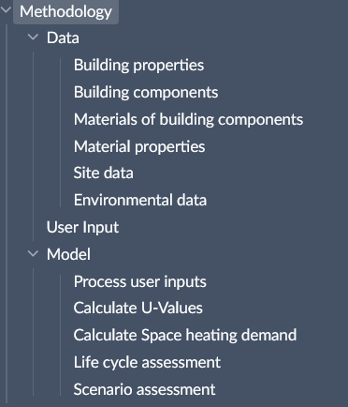
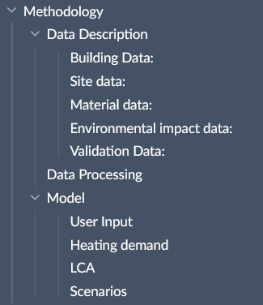
Paper – Methodology structure

Slide 7
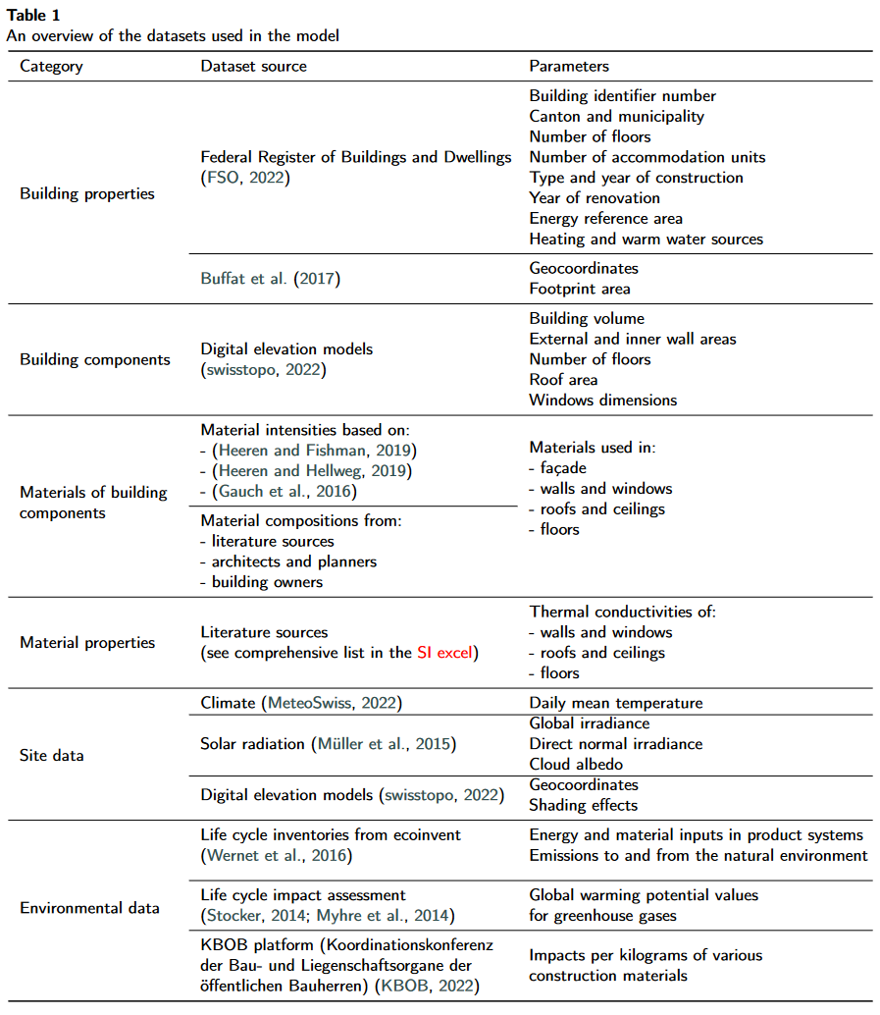
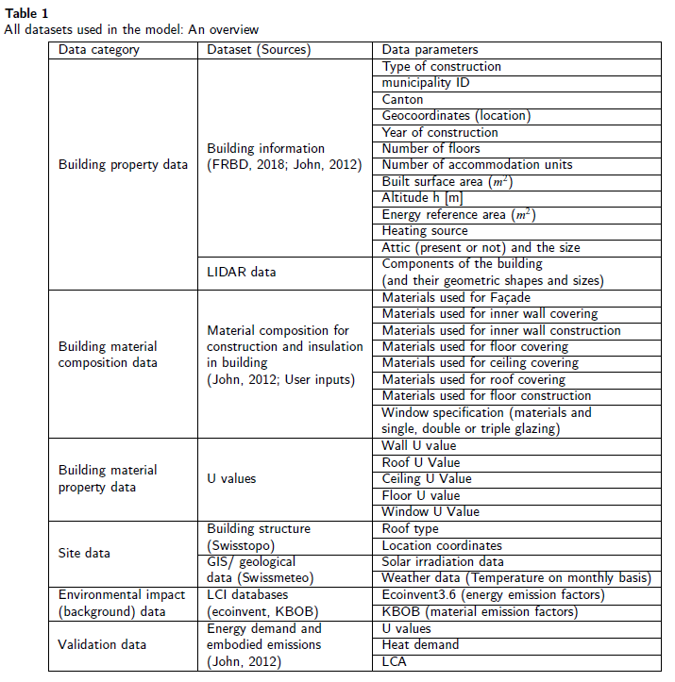
Paper – Data description (table)

Slide 8
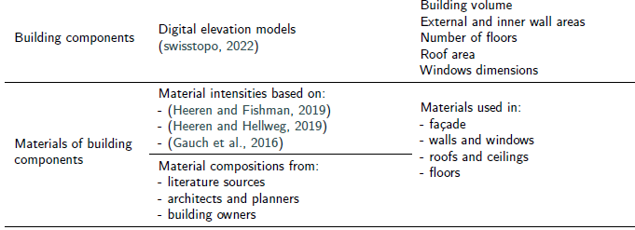
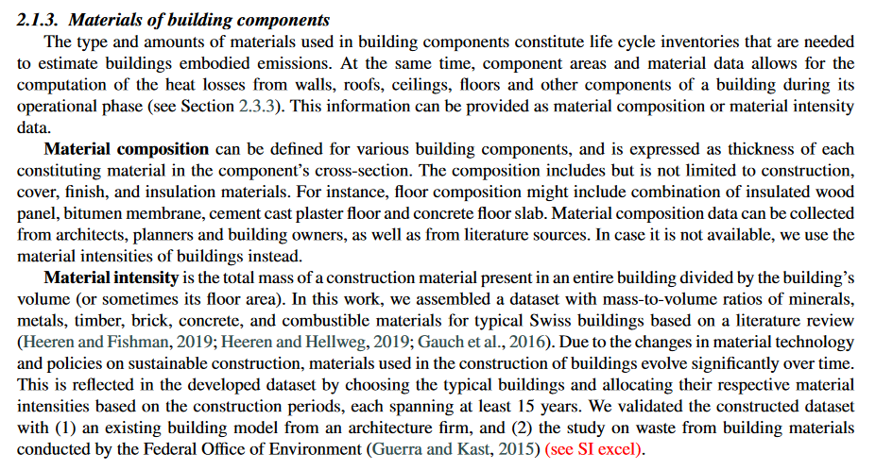
Paper – Data description (writing)

Slide 9
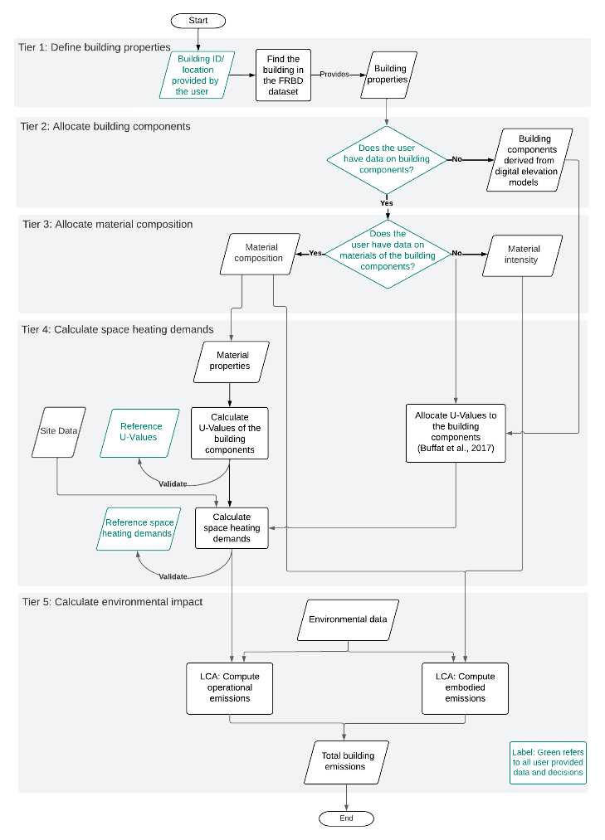
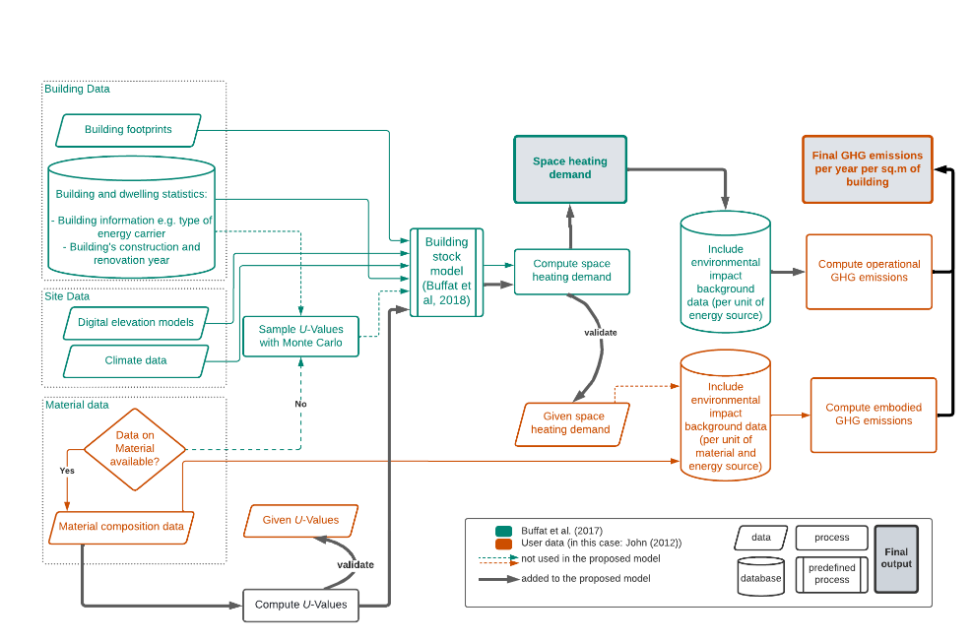
Paper – Method structure (diagram)

Slide 10


Slide 13
Model / Results - edits
Heat demand
Fixed the views on the server database and dependencies
Ventilation effects and window configurations discussed
LCA
Introduced embodied and operational

