Slide 1
Paper discussion: Steffi, Sasha, Rhythima
25 Nov 2022

Slide 2
Timeline - Method
Dates | Work task | Overall Deadlines/ Review
25 Nov | Model: all views have all parameters allocated Model: environments reactivated | Discussion (SSR): Section 2.1 + Figure 1 + Table 1
27 – 28 Nov | Work on the model: string to integer table fix columns
28 Nov | Writing: Check figure 2 and add all available buildings Check, maybe remove Table 3
29 Nov | Meeting Rene (discuss final results) Work on the model Writing: Write Section 2.2. Model (Explain Figure 1) Fix Table 2 (move to SI) , Move SI to excel | Sasha checks Writings on Section 2.2,
30 Nov | (re) Write Section 2.2.1 Process User Inputs Write Section 2.2.2. Calculate U Values
1 Dec | Model locate how to ventilation parameters fix (for writing) Figure 1 + new: Ventilation flow chart concept Finish Section 2.2.3 Space heating demand -------------------------------------------------------------------------------------- (re) Write Section 2.3. Case study (and Table 3) Write Section 2.3.2. Scenario assessment , Section 2.3.1 | Sasha checks writing Check LCA calculations (KBOB sources) and adapt writing 2.2.3
2 Dec | Write Section 2 Methodology intro Improve Section 2.3
4 Dec | Proofreading | Send the draft to Steffi on Section 2

Slide 3
Timeline – Results
Dates | Work task | Overall Deadlines
5-6 Dec | Fix timeline Comments on the paper writing | Discussion (SSR): Section 2
7-8 Dec | Leave
9 Dec | Writing results structure/ format Model: Convert string and integers PGadmin
12-14 Dec | Model: Fix postgres issues Check and fix U Values – figure 2 | Check paper comments section 2-4 Figure 1, table 1, alignment of tables/figs in the doc, final comment check Discuss the results writing format
15 Dec | Section 5.1 U values writing
16 Dec | Section 5.2 Heating demand writing Section 5.3 LCA
17 Dec | Section 5.4 Scenarios

Slide 4
Timeline – Results
Dates | Work task | Overall Deadlines
4 Jan | Postgres checks
5 Jan | Check calculations on heating demands With ventilation effects (direct calculations updates!)
6 Jan | Section 5.2 Heating demand writing Check / edit figure 3, table 5
7-8 Jan | LCA reading and updates
9 Jan | LCA updates
10 Jan | Code alignment/ reproducibility
11 Jan | Section 5.3 LCA writing
12 Jan | Section 5.4 Scenarios updates and writing Check model scenario setup: Figure 5 , table 2
13 Jan | Discussions SI check | Conclusion Abstract

Slide 5
Comments Section 2-4
Figure 1 + Table 1
Dimensions of building components
Ventilation data and updates

Slide 6
U values results
Internal walls removed
U Values rechecked
Some large values for buildings estimated with high space heating demands
Rechecked for the given values vs calculated – which one to use?
U Values windows updates

Slide 7
U Values writings
All results presented
Significant p values shown for given
Same p values against buffat

Slide 8
Heat demand results

Slide 9
Heat demand writings

Slide 10
LCA results

Slide 11
LCA writings

Slide 12
Title of the paper
Keywords
LCA of buildings
User tool
Material data integration
--------------------
New
Integration of materials in operational and embodied building impacts: tool for future renovation scenarios
Integration of materials in life cycle assessment (LCA) of buildings: tool for future renovation scenarios
------------------------
Old: Combined material-energy building environmental footprint model: assessment of future renovation scenarios

Slide 13
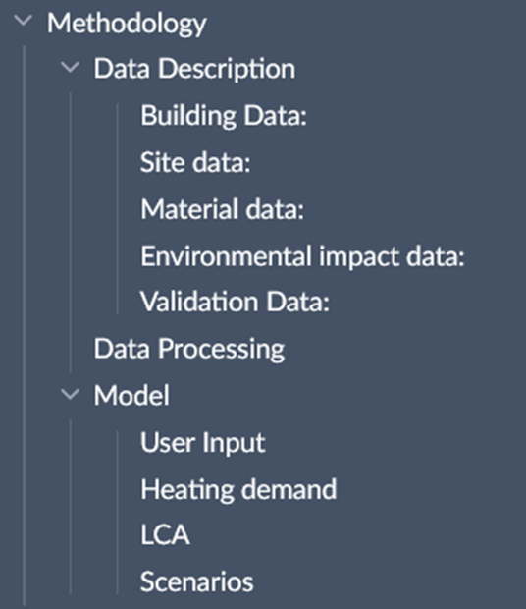
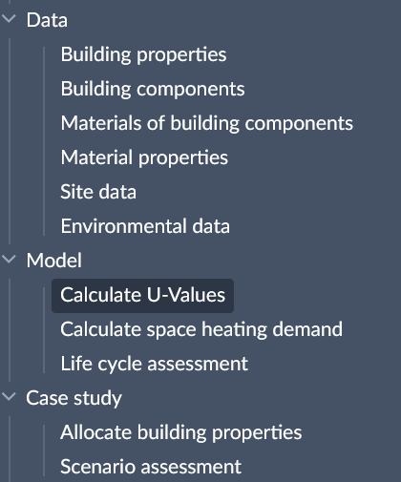
Paper – Methodology structure

Slide 14
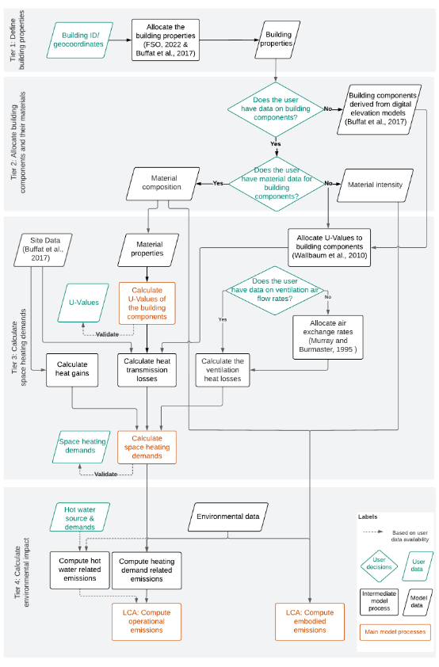
Paper – Method structure (diagram)

Slide 15
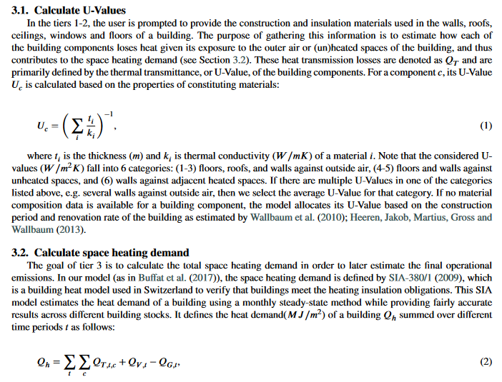
Paper – Model (writing)

Slide 16
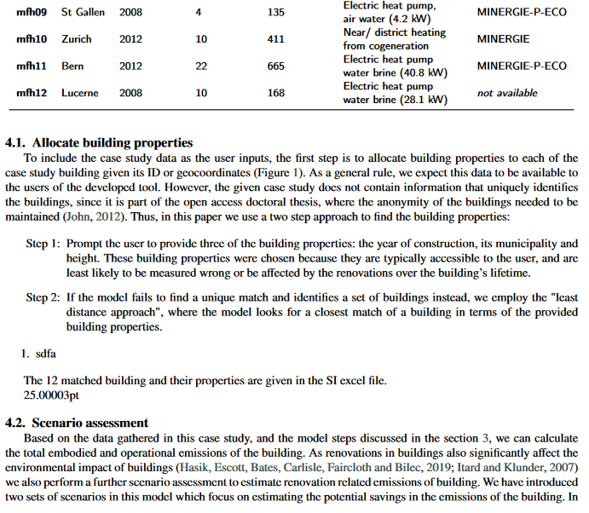
Paper – Case study (writing)

Slide 17
Agenda
Old plan till 24 Nov
Paper
Model & Results

Slide 18
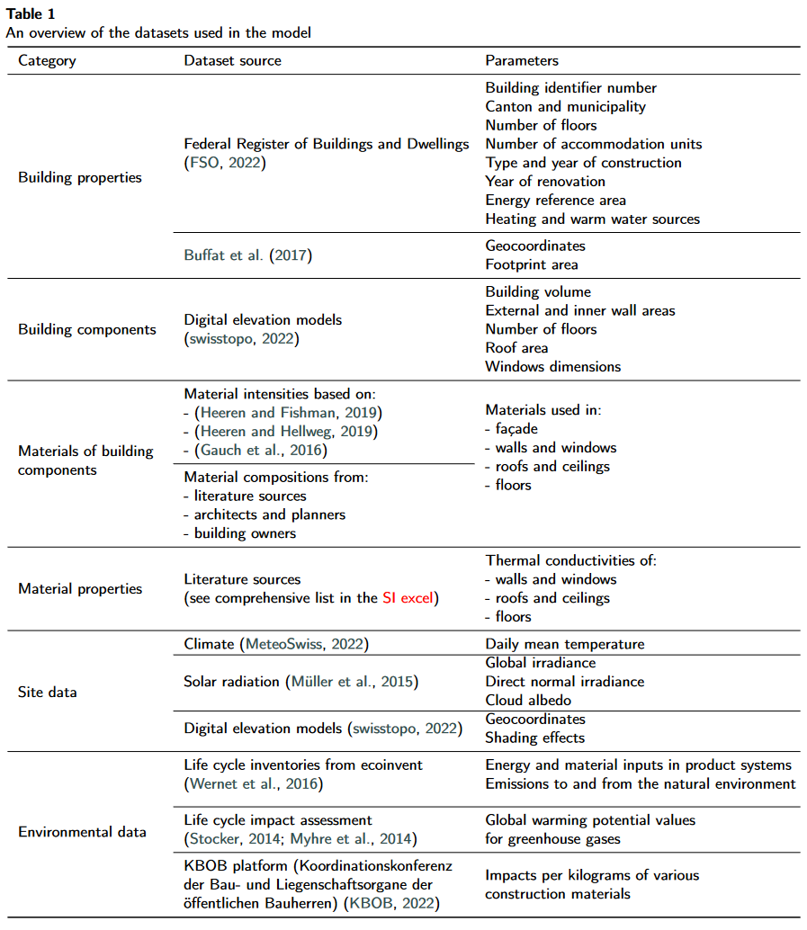
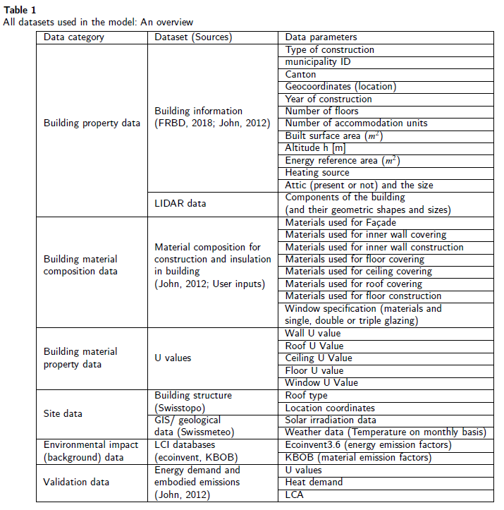
Paper – Data description (table)

Slide 19
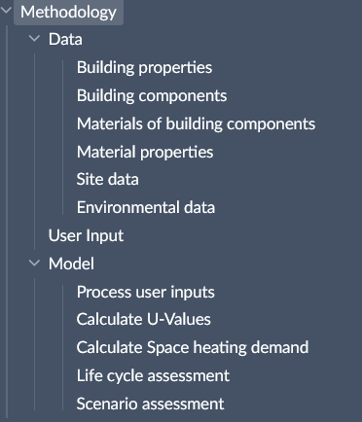
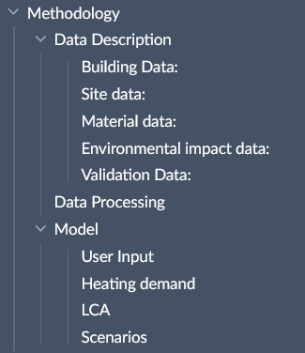
Paper – Methodology structure

Slide 20
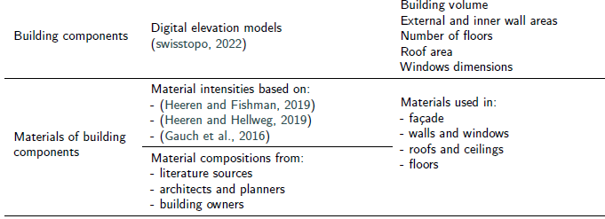
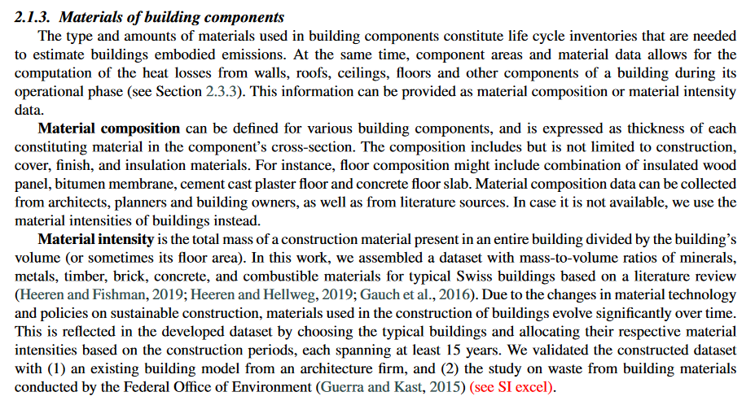
Paper – Data description (writing)

Slide 21
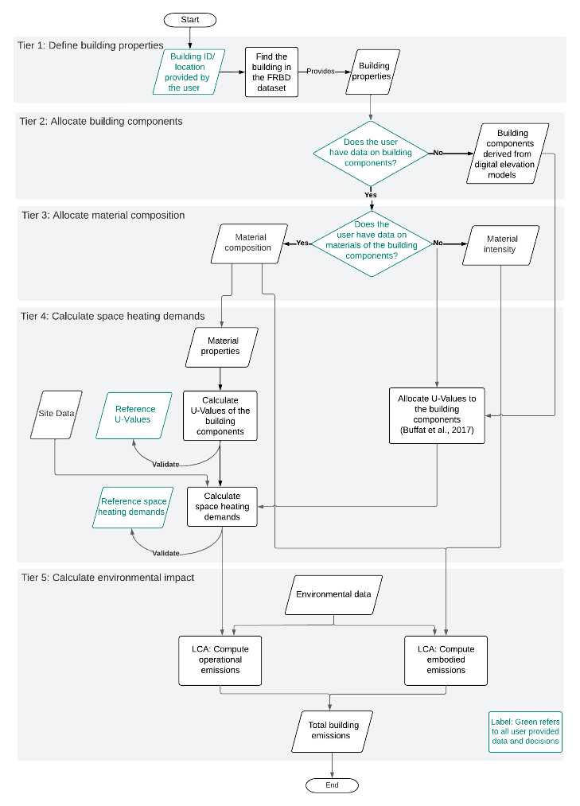
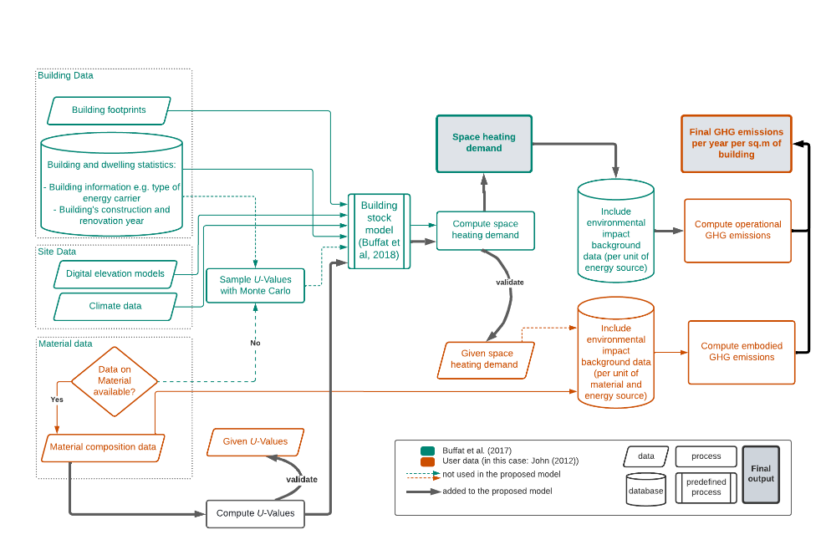
Paper – Method structure (diagram)

Slide 22


Slide 25
Model / Results - edits
Heat demand
Fixed the views on the server database and dependencies
Ventilation effects and window configurations discussed
LCA
Introduced embodied and operational

