Slide 1
Paper discussion: Steffi, Sasha, Rhythima
25 Nov 2022

Slide 2
Timeline - Method
Dates | Work task | Overall Deadlines/ Review
25 Nov | Model: all views have all parameters allocated Model: environments reactivated | Discussion (SSR): Section 2.1 + Figure 1 + Table 1
27 – 28 Nov | Work on the model: string to integer table fix columns
28 Nov | Writing: Check figure 2 and add all available buildings Check, maybe remove Table 3
29 Nov | Meeting Rene (discuss final results) Work on the model Writing: Write Section 2.2. Model (Explain Figure 1) Fix Table 2 (move to SI) , Move SI to excel | Sasha checks Writings on Section 2.2,
30 Nov | (re) Write Section 2.2.1 Process User Inputs Write Section 2.2.2. Calculate U Values
1 Dec | Model locate how to ventilation parameters fix (for writing) Figure 1 + new: Ventilation flow chart concept Finish Section 2.2.3 Space heating demand -------------------------------------------------------------------------------------- (re) Write Section 2.3. Case study (and Table 3) Write Section 2.3.2. Scenario assessment , Section 2.3.1 | Sasha checks writing Check LCA calculations (KBOB sources) and adapt writing 2.2.3
2 Dec | Write Section 2 Methodology intro Improve Section 2.3
4 Dec | Proofreading | Send the draft to Steffi on Section 2

Slide 3
Timeline – Results
Dates | Work task | Overall Deadlines
5-6 Dec | Fix timeline Comments on the paper writing | Discussion (SSR): Section 2
7-8 Dec | Leave
9 Dec | Writing results structure/ format Model: Convert string and integers PGadmin
12-14 Dec | Model: Fix postgres issues Check and fix U Values – figure 2 | Check paper comments section 2-4 Figure 1, table 1, alignment of tables/figs in the doc, final comment check Discuss the results writing format
15 Dec | Section 5.1 U values writing
16 Dec | Section 5.2 Heating demand writing Section 5.3 LCA
17 Dec | Section 5.4 Scenarios

Slide 4
Timeline – Results
Dates | Work task | Overall Deadlines
4 Jan | Postgres checks
5 Jan | Check calculations on heating demands With ventilation effects (direct calculations updates!)
6 Jan | Section 5.2 Heating demand writing Check / edit figure 3, table 5
7-8 Jan | LCA reading and updates
9 Jan | LCA updates
10 Jan | LCA reproducibility
11 Jan | LCA mfh02 results Section 5.3 LCA writing outline | Section 5.2 Heating demand writing check Section 5.3 LCA writing check
12 Jan | Planning | Meeting and discussions

Slide 5
Timeline – Results
Dates | Work task | Overall Deadlines
16 Jan | LCA all results , setup pipeline one building
17 Jan |  | LCA all results extension for all buildings
18 Jan | Off
19 Jan | EPL meetings and paper 3 plan
20-22 Jan | LCA results with U Values checks

Slide 6
Timeline – Writing
Dates | Work task | Overall Deadlines
23 Jan | LCA results verified and figures
24 Jan | U Values and heat demand results verified
25 Jan | Write Section 5.1. U Values, 5.2. Space heating | Review sections 5.1-5.3
26 Jan | Write Section 5.3. LCA | Review section 5.4 + Discussion pointers
27 Jan | Scenarios results + Write Section 5.4 Scenarios | Discussion review + Send draft Steffi
28-29 Jan | Discussion points / writing
30 Jan | Conclusion + Abstract
31 Jan | Letter to editor + SI check Paper overall read (consistency – next slide) | Final review send Steffi
1-2 Feb | Code check + data push Github
3 Feb | Check the journal guidelines completely Submit paper

Slide 7
Checks for consistency of the paper
12 buildings -> 10 buildings
Comments on the paper

Slide 8
U Values

Slide 9
Results
Overall LCA
Embodied emissions
Components of the building
Operational emissions
Space heating
Ventilation

Slide 10
LCA extensions
Overall LCA
Embodied emissions
Components of the building
+ Transportation
as assumed by Viola - lorry transportation of local and not local material till the building site)
Operational emissions
Space heating
Ventilation
+ Hot water
directly associated to the reported values of hot water usage)
+ Electricity
as assumed by viola based on occupancy)

Slide 11
1. Overall LCA - Embodied and operational (Example building)
Results on paper will show all buildings
Notes:
Climate data – how it changed over years
Indoor temperature assumptions by Viola and Rene (reasons for differences)
Heat exchangers (assumptions to mention from Rene)

Slide 12
2. Embodied : components (Example building)

Slide 13
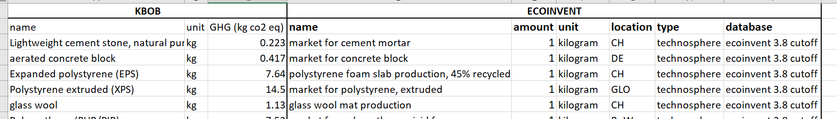
2. Embodied emissions: methodology
Material inventory database
KBOB <-> Ecoinvent mapping

Slide 14
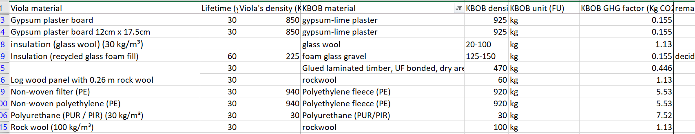
2. Embodied emissions: methodology
Material inventory database
KBOB <-> Viola’s material mapping

Slide 15
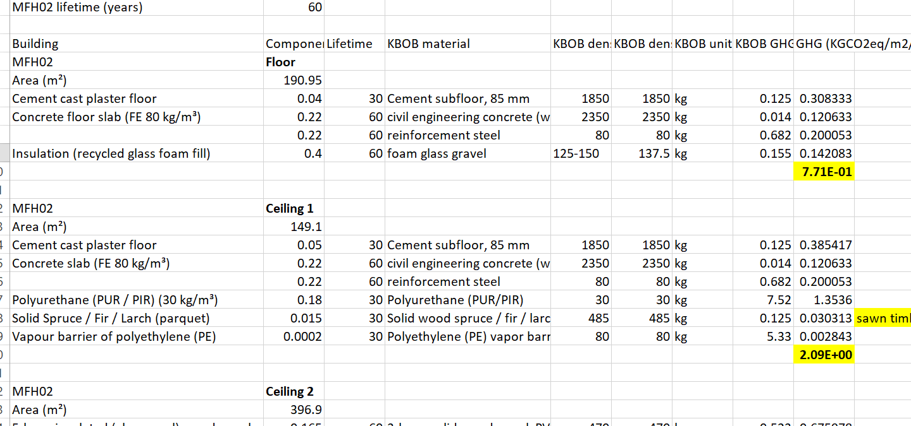
2. Embodied emissions: methodology
Pipeline for each building + each component + each material

Slide 16
3. Operational emissions : space heating + ventilation + hot water

Slide 17
3. Operational : all components (example building)

Slide 18
Comments Section 2-4
Figure 1 + Table 1
Dimensions of building components
Ventilation data and updates

Slide 19
U values results
Internal walls removed
U Values rechecked
Some large values for buildings estimated with high space heating demands
Rechecked for the given values vs calculated – which one to use?
U Values windows updates

Slide 20
U Values writings
All results presented
Significant p values shown for given
Same p values against buffat

Slide 21
Heat demand results

Slide 22
Heat demand writings

Slide 23
LCA results

Slide 24
LCA writings

Slide 25
Title of the paper
Keywords
LCA of buildings
User tool
Material data integration
--------------------
New
Integration of materials in operational and embodied building impacts: tool for future renovation scenarios
Integration of materials in life cycle assessment (LCA) of buildings: tool for future renovation scenarios
------------------------
Old: Combined material-energy building environmental footprint model: assessment of future renovation scenarios

Slide 26
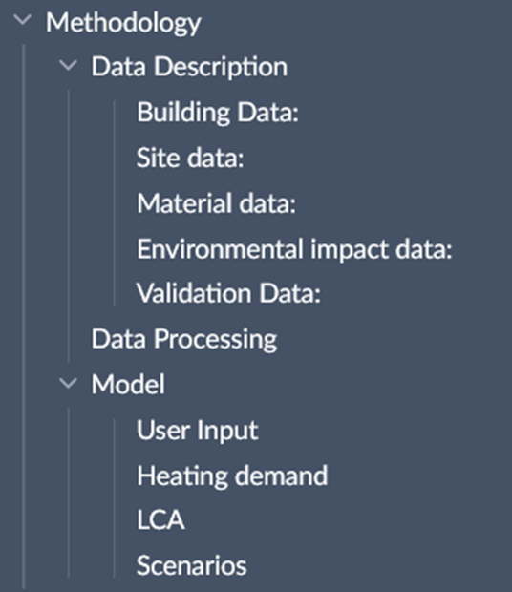
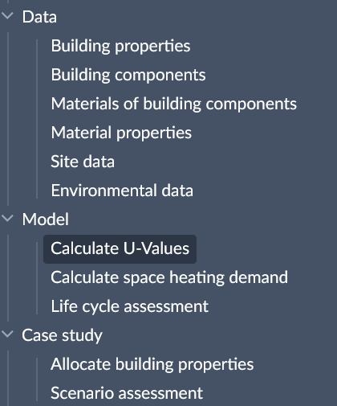
Paper – Methodology structure

Slide 27
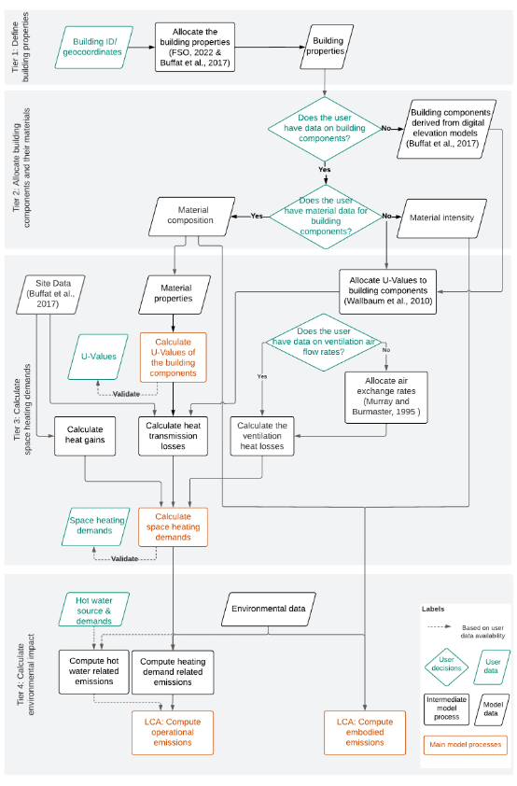
Paper – Method structure (diagram)

Slide 28
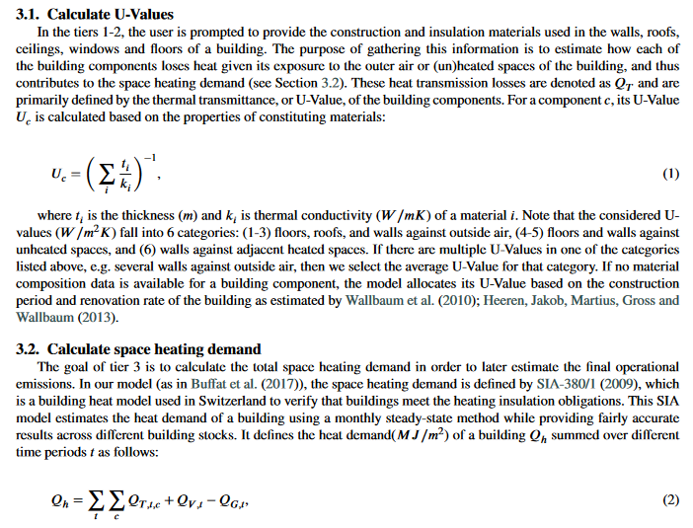
Paper – Model (writing)

Slide 29
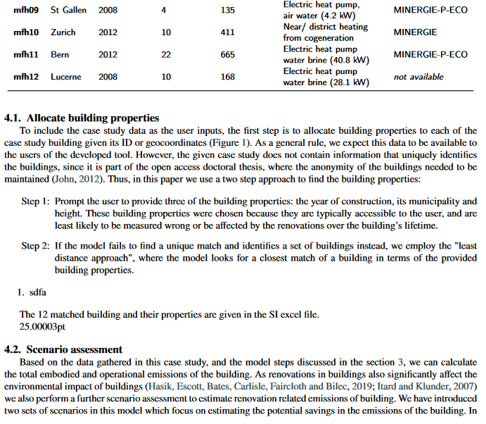
Paper – Case study (writing)

Slide 30
Agenda
Old plan till 24 Nov
Paper
Model & Results

Slide 31
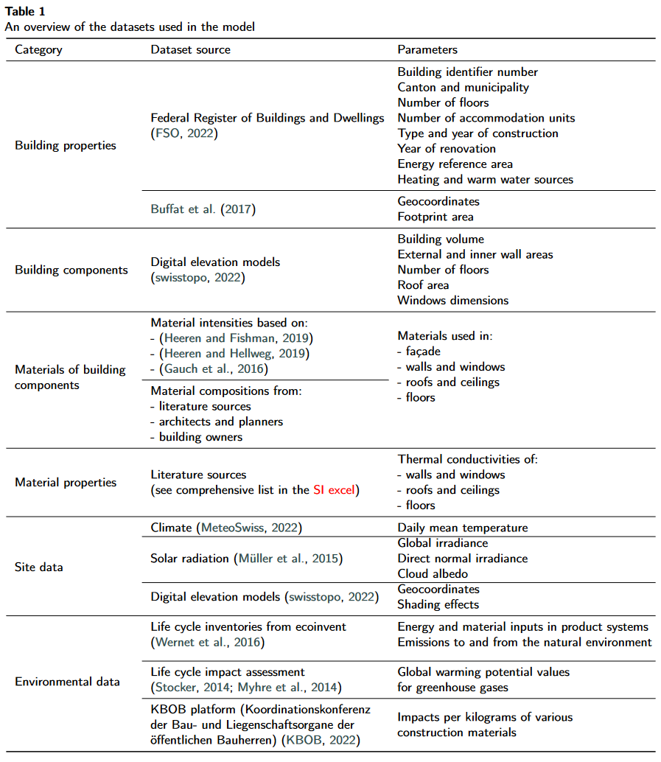
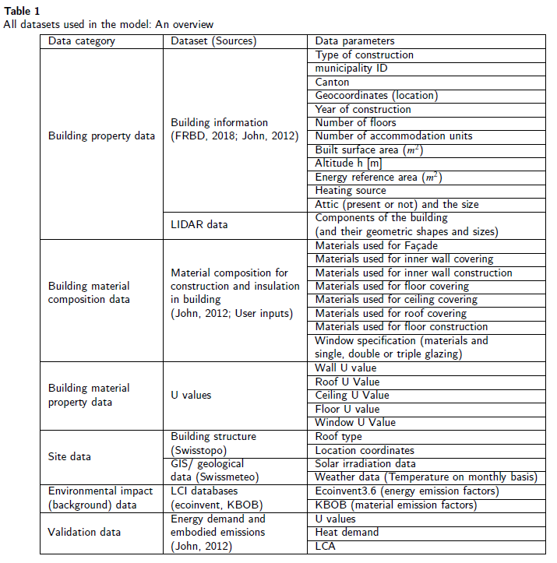
Paper – Data description (table)

Slide 32
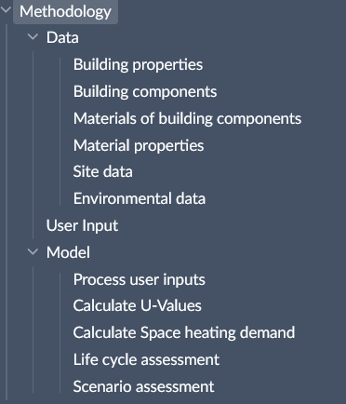
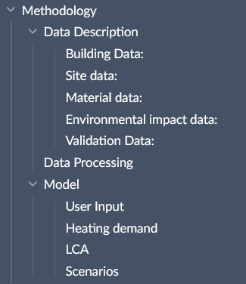
Paper – Methodology structure

Slide 33
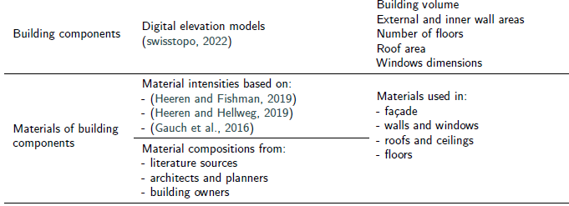
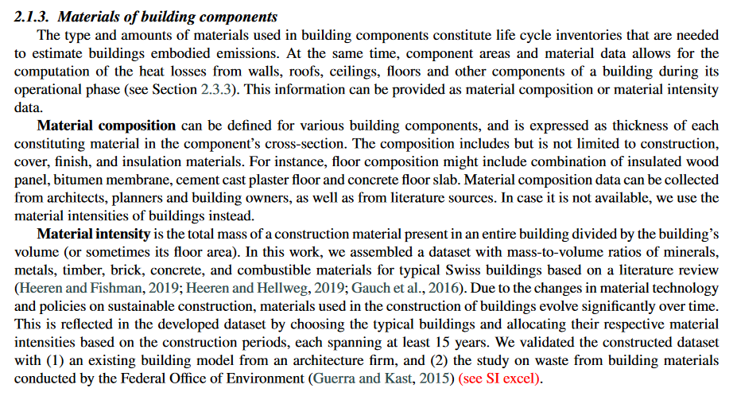
Paper – Data description (writing)

Slide 34
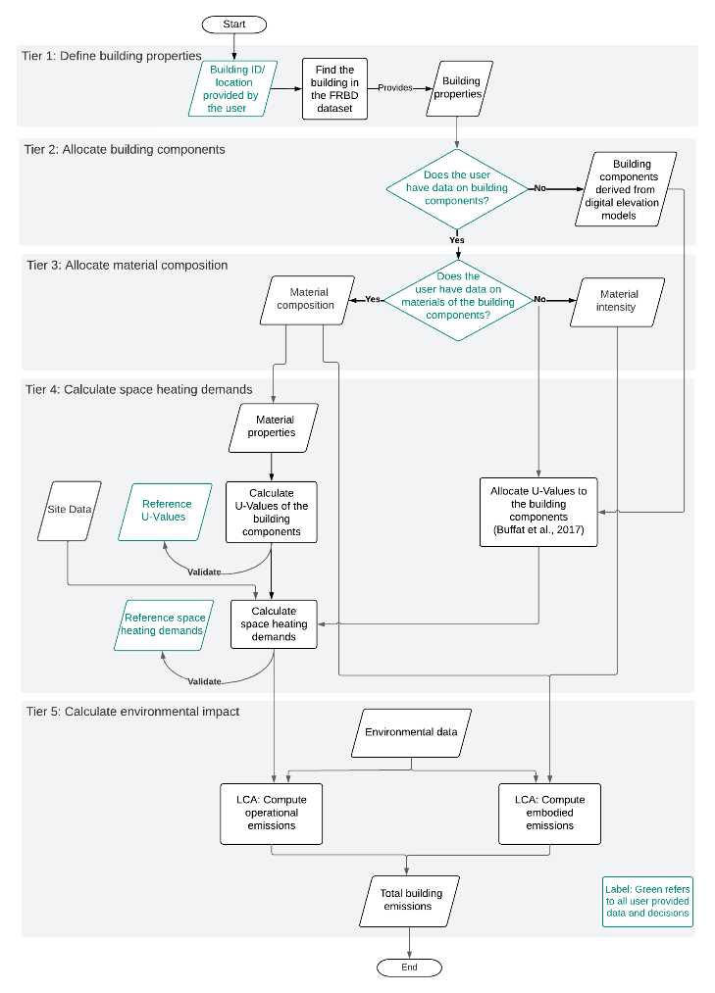
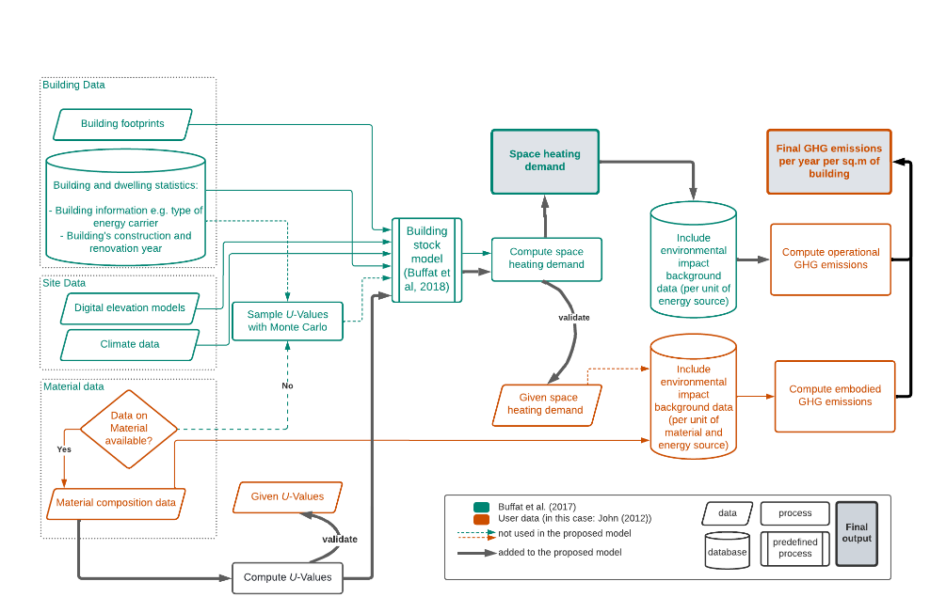
Paper – Method structure (diagram)

Slide 35


Slide 38
Model / Results - edits
Heat demand
Fixed the views on the server database and dependencies
Ventilation effects and window configurations discussed
LCA
Introduced embodied and operational

