Slide 1
Paper discussion: Steffi, Sasha, Rhythima
25 Nov 2022

Slide 2
Timeline - Method
Dates | Work task | Overall Deadlines/ Review
25 Nov | Model: all views have all parameters allocated Model: environments reactivated | Discussion (SSR): Section 2.1 + Figure 1 + Table 1
27 – 28 Nov | Work on the model: string to integer table fix columns
28 Nov | Writing: Check figure 2 and add all available buildings Check, maybe remove Table 3
29 Nov | Meeting Rene (discuss final results) Work on the model Writing: Write Section 2.2. Model (Explain Figure 1) Fix Table 2 (move to SI) , Move SI to excel | Sasha checks Writings on Section 2.2,
30 Nov | (re) Write Section 2.2.1 Process User Inputs Write Section 2.2.2. Calculate U Values
1 Dec | Model locate how to ventilation parameters fix (for writing) Figure 1 + new: Ventilation flow chart concept Finish Section 2.2.3 Space heating demand -------------------------------------------------------------------------------------- (re) Write Section 2.3. Case study (and Table 3) Write Section 2.3.2. Scenario assessment , Section 2.3.1 | Sasha checks writing Check LCA calculations (KBOB sources) and adapt writing 2.2.3
2 Dec | Write Section 2 Methodology intro Improve Section 2.3
4 Dec | Proofreading | Send the draft to Steffi on Section 2

Slide 3
Timeline – Results
Dates | Work task | Overall Deadlines
5-6 Dec | Fix timeline Comments on the paper writing | Discussion (SSR): Section 2
7-8 Dec | Leave
9 Dec | Writing results structure/ format Model: Convert string and integers PGadmin
12-14 Dec | Model: Fix postgres issues Check and fix U Values – figure 2 | Check paper comments section 2-4 Figure 1, table 1, alignment of tables/figs in the doc, final comment check Discuss the results writing format
15 Dec | Section 5.1 U values writing
16 Dec | Section 5.2 Heating demand writing Section 5.3 LCA
17 Dec | Section 5.4 Scenarios

Slide 4
Timeline – Results
Dates | Work task | Overall Deadlines
4 Jan | Postgres checks
5 Jan | Check calculations on heating demands With ventilation effects (direct calculations updates!)
6 Jan | Section 5.2 Heating demand writing Check / edit figure 3, table 5
7-8 Jan | LCA reading and updates
9 Jan | LCA updates
10 Jan | Code alignment/ reproducibility
11 Jan | Section 5.3 LCA writing
12 Jan | Section 5.4 Scenarios updates and writing Check model scenario setup: Figure 5 , table 2
13 Jan | Discussions SI check | Conclusion Abstract

Slide 5
U Values

Slide 6
Space heating demands

Slide 8
Comments Section 2-4
Figure 1 + Table 1
Dimensions of building components
Ventilation data and updates

Slide 9
U values results
Internal walls removed
U Values rechecked
Some large values for buildings estimated with high space heating demands
Rechecked for the given values vs calculated – which one to use?
U Values windows updates

Slide 10
U Values writings
All results presented
Significant p values shown for given
Same p values against buffat

Slide 11
Heat demand results

Slide 12
Heat demand writings

Slide 13
LCA results

Slide 14
LCA writings

Slide 15
Title of the paper
Keywords
LCA of buildings
User tool
Material data integration
--------------------
New
Integration of materials in operational and embodied building impacts: tool for future renovation scenarios
Integration of materials in life cycle assessment (LCA) of buildings: tool for future renovation scenarios
------------------------
Old: Combined material-energy building environmental footprint model: assessment of future renovation scenarios

Slide 16
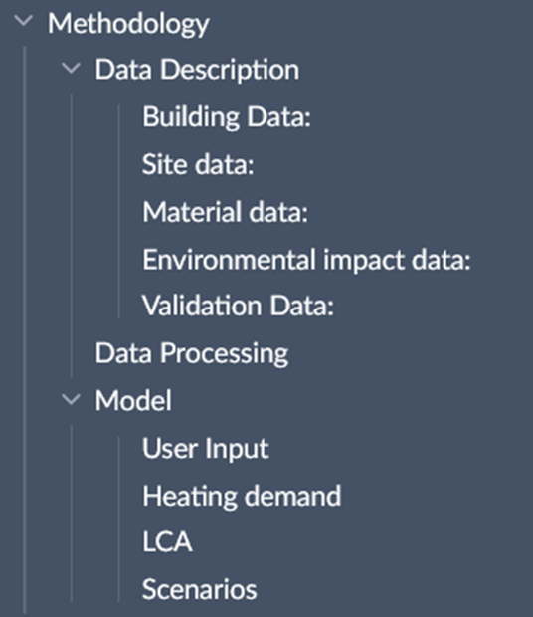
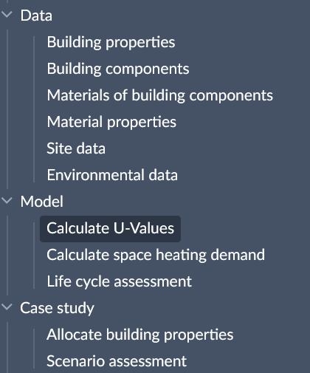
Paper – Methodology structure

Slide 17
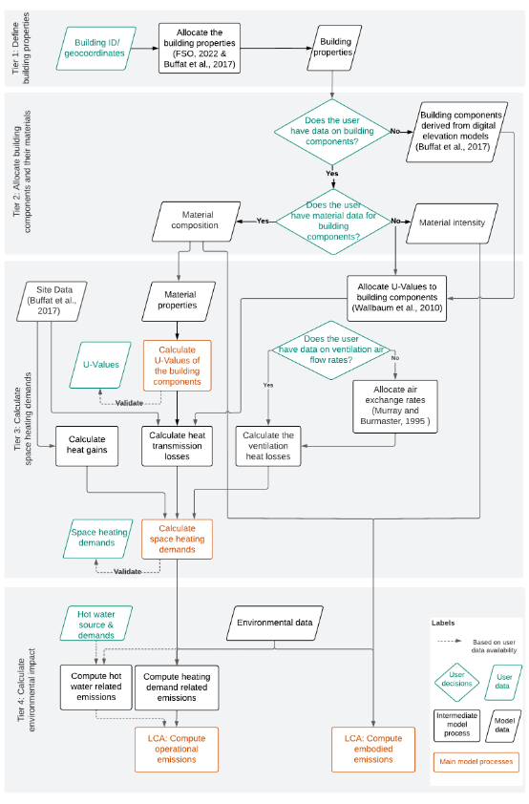
Paper – Method structure (diagram)

Slide 18
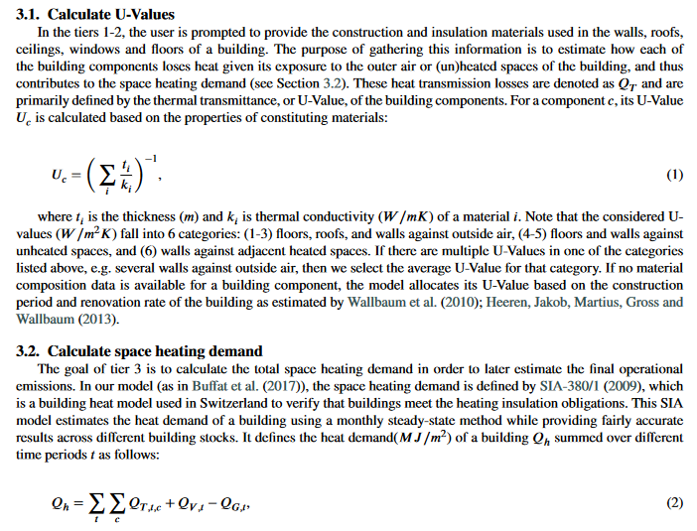
Paper – Model (writing)

Slide 19
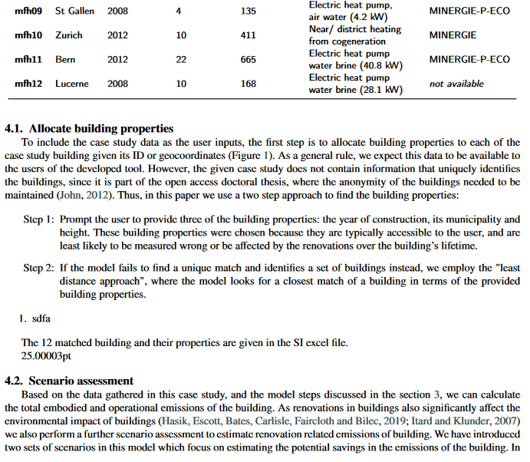
Paper – Case study (writing)

Slide 20
Agenda
Old plan till 24 Nov
Paper
Model & Results

Slide 21
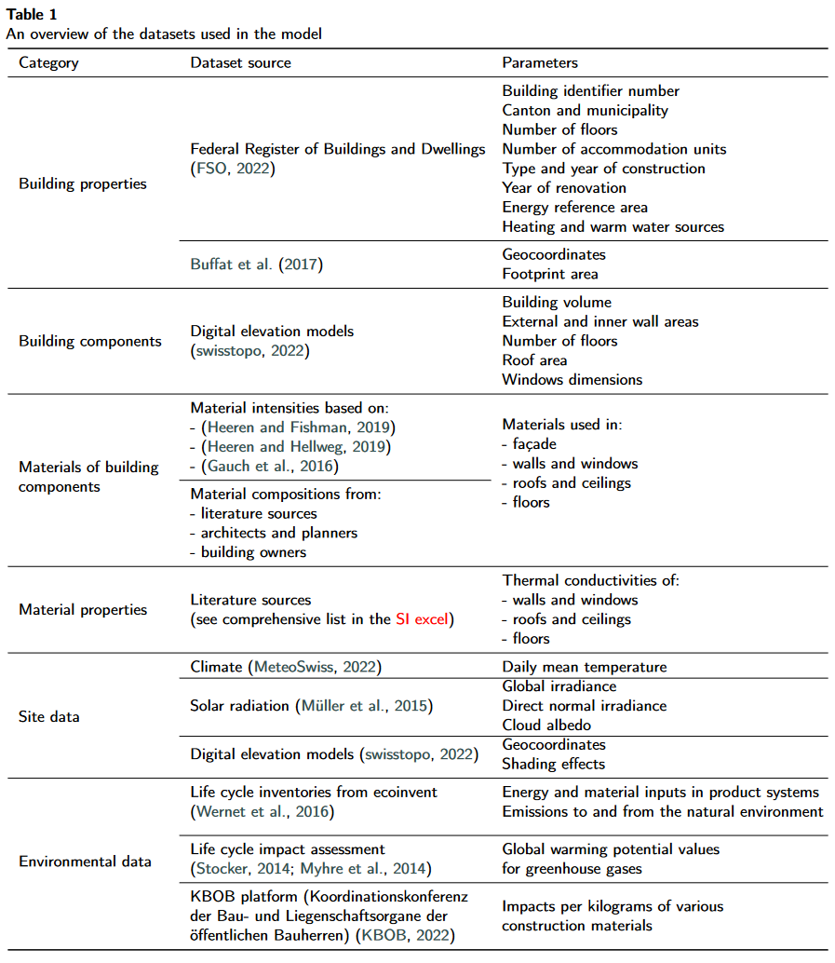
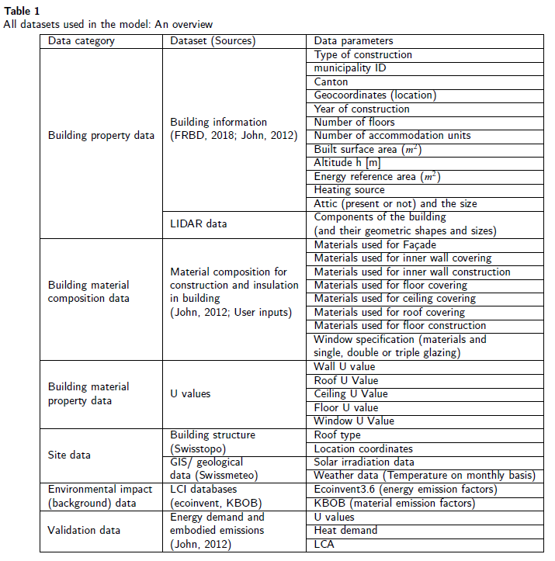
Paper – Data description (table)

Slide 22
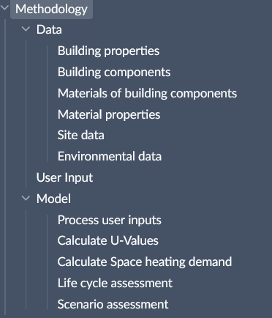
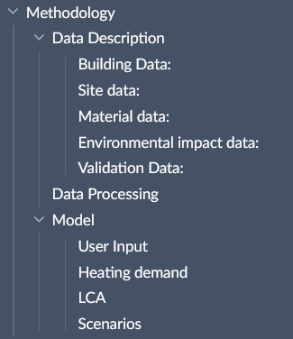
Paper – Methodology structure

Slide 23
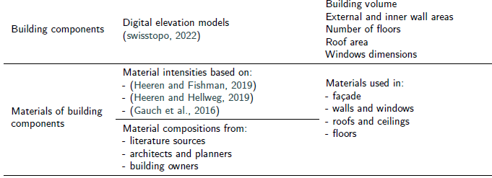
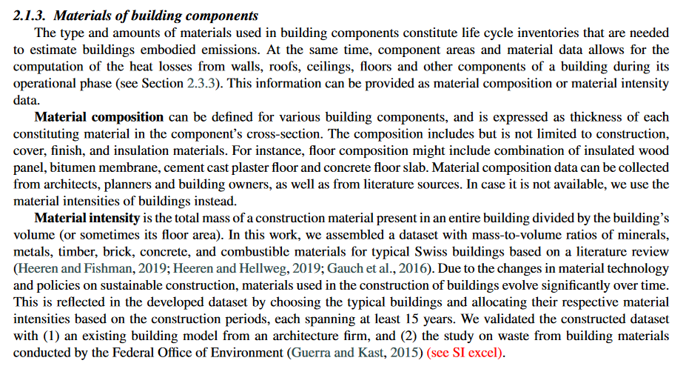
Paper – Data description (writing)

Slide 24
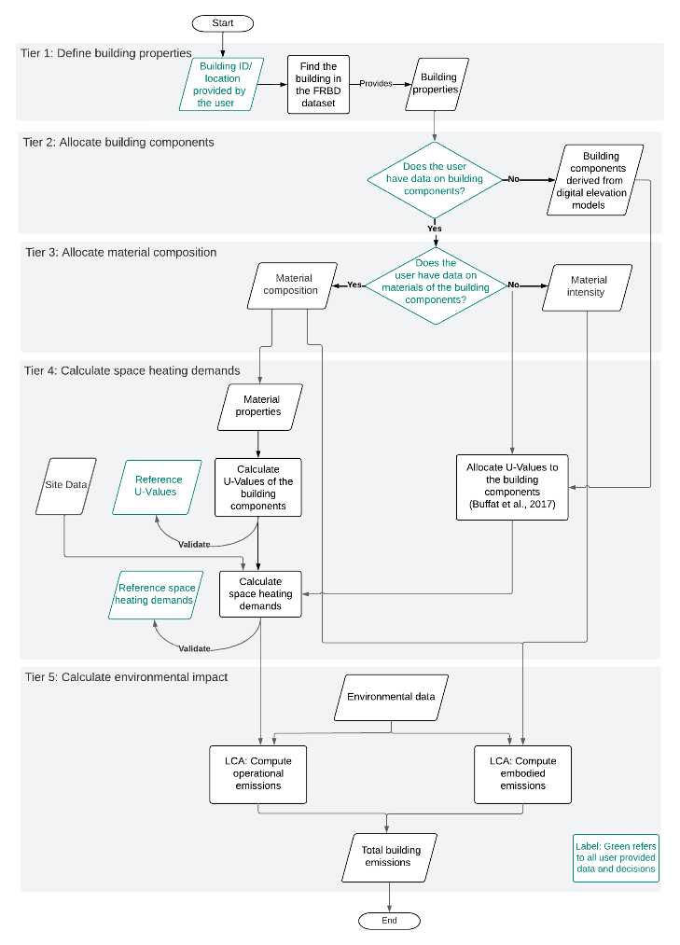
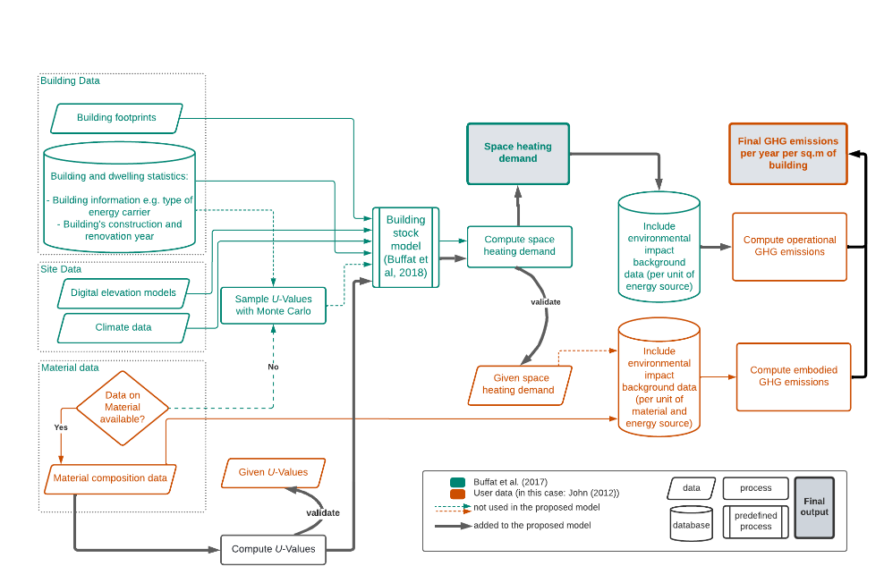
Paper – Method structure (diagram)

Slide 25


Slide 28
Model / Results - edits
Heat demand
Fixed the views on the server database and dependencies
Ventilation effects and window configurations discussed
LCA
Introduced embodied and operational

